Slide 2
An Introduction to the
NAVAL
POSTGRADUATE SCHOOL

Slide 3
The Naval Postgraduate School mission: educating students
NPS MISSION – OPNAVINST 5450.210D
Programs: “Provide relevant and unique advanced education and research programs to increase the combat effectiveness of commissioned officers of the naval service to enhance the security of the United States.”
Research and Faculty: “In support of the foregoing, and to sustain academic excellence, foster and encourage a program of relevant and meritorious research which both supports the needs of the Navy and Department of Defense (DOD) while building the intellectual capital of NPS faculty.”

Slide 4
NPS fulfills the graduate education needs of the Department of the Navy, DOD, and U.S. Government.
In-residence and Distance Learning (DL)
Master’s, Ph.D., Engineer, MBA, EMBA, more
Biennial program reviews by flag-level sponsors
Subspecialty and professional education
Professional certifications
Joint Professional Military Education
Civilian Instruction (CIVINS)

Slide 5
NPS provides graduate-level research opportunities, applying academic rigor to a defined niche.
Responds to joint, interagency, emerging needs and coalition requirements of the Departments of Navy, Defense, Homeland Security and more
Largest sponsor is the U.S. Navy
Fosters a multi-service, interagency, coalition learning environment
Prepares the joint intellectual leaders for tomorrow's joint forces

Slide 6
NPS’ location creates advantages and synergies for a dynamic learning and research environment.
Area academic/research institutions (Stanford University, UC Berkeley, UCSC, SJSU, Fleet Numerical Meteorology and Oceanography, Naval Research Laboratory, Defense Language Institute)
Open ocean ranges (Monterey Bay) and uncontrolled airspace (Camp Roberts)
Silicon Valley’s powerful technological epicenter

Slide 7
NPS has a long, rich history in the pursuit of innovative education in support of national security.
1909 – Founded at the U.S. Naval Academy
1951 – Moved to Monterey
1951 – Operations Research department
1956 – Systems Management department
1972 – National Security Affairs department and
Warfighting curricula (anti-submarine warfare)
1996 – Information Warfare curriculum
1999 – Joint Professional Military Education campus
2003 – Homeland Security curriculum
2004 – Information Operations curriculum
2011 – Cyber Systems and Operations curriculum
2012 – Energy Specializations

Slide 8
NPS was recently awarded a 10-year reaccreditation, the longest term achievable.
WASC Western Association of Schools and Colleges
ABET Accreditation Board for Engineering and Technology
AACSB Association to Advance Collegiate Schools of Business
NASPAA National Association of Schools of Public Affairs and Administration

Slide 9
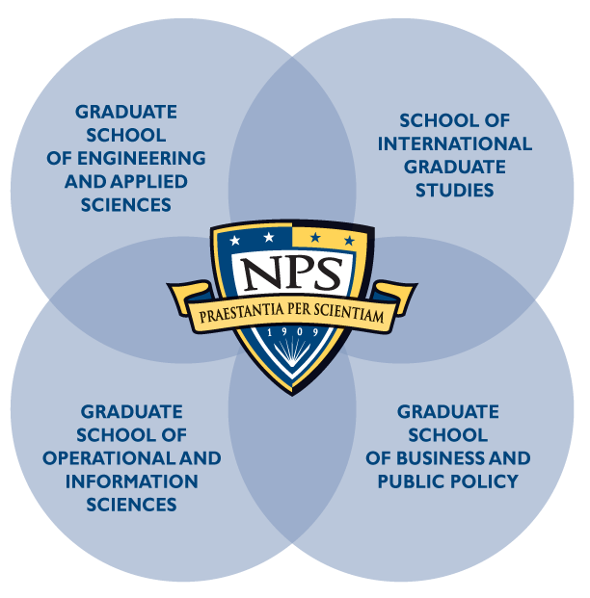
NPS is relevance delivered.
Student focused
Four dynamic graduate schools
Interdisciplinary academic groups combine expertise from across campus
Unique, relevant curricula

Slide 10
The Graduate School of Engineering and Applied Sciences (GSEAS) develops leading-edge technological advancements focused on DOD’s needs.
Applied Mathematics
Combat Systems Science and Technology
Electronic Systems Engineering (resident and DL)
Mechanical and Aerospace Engineering
Mechanical Engineering for Nuclear Trained Officers (DL)
Meteorology
Oceanography
Reactors/Mechanical Engineering
Space Systems Engineering
Space Systems Operations (resident and DL)
Systems Engineering (resident & DL)
Systems Engineering Management (DL)
Undersea Warfare
Underwater Acoustic Systems (DL)

Slide 11
The Graduate School of Operational and Information Sciences (GSOIS) meets warfighter requirements, today and tomorrow.
Computer Science (Res & DL)
Computer Technology (DL)
Cost Estimating & Analysis (DL)
Cyber Systems and Operations
Electronic Warfare Systems
Human Systems Integration
Identity Management and Cyber Security (Resident & DL)
Information Sciences
Information Systems and Operations
Information Systems and Technology
Information Warfare
Joint C4I Systems
Joint Information Operations
Joint Operational Logistics
Modeling, Virtual Environments, and Simulation
Operations Analysis
Remote Sensing
Software Engineering (Resident & DL)
Special Operations
Systems Analysis (DL)

Slide 12
The Graduate School of Business and Public Policy (GSBPP) provides unique education and research in the business of defense management.
Resident Programs MBA Degrees
Acquisition and Contract Management
Defense Business Management
Financial Management
Information Systems Management
Material Logistics Support
MSM Degrees
Defense Systems Analysis
Manpower Systems Analysis
Non-Resident Programs
Contract Management
Program Management
Executive MBA
Professional Development Programs
Advanced Acquisition Program
Cost Management Certificate
Practical Comptrollership
Human Resources
Conrad Scholar Program

Slide 13
The School of International Graduate Studies (SIGS) provides an education for today’s global challenges.
Security Studies
Strategy/Strategic Studies
Civil-Military Relations
Stabilization and Reconstruction
Combating Terrorism: Policy and Strategy
Homeland Defense and Security (Military and Civilian)
Regional Studies
Middle East, South Asia and Sub-Saharan Africa
Europe and Eurasia
Far East, Pacific, Southeast Asia
Western Hemisphere

Slide 14
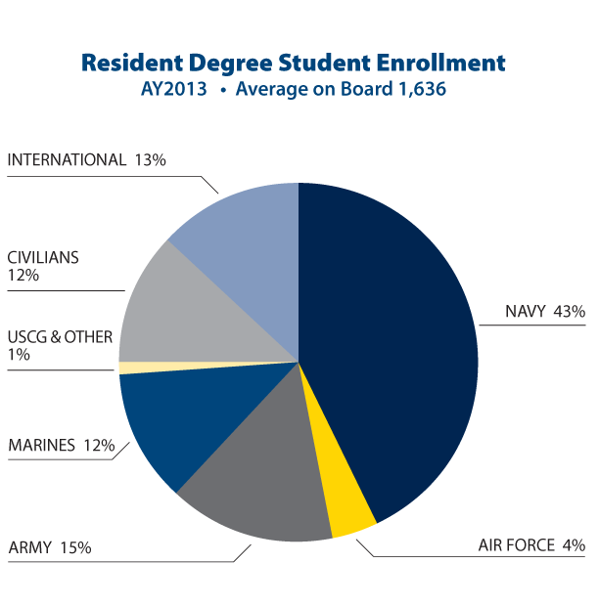
Resident Degree Students
Average on Board AY 2013
Total Resident: 1,636
75% U.S. uniformed services
13% International
12% Government Civilian

Slide 15
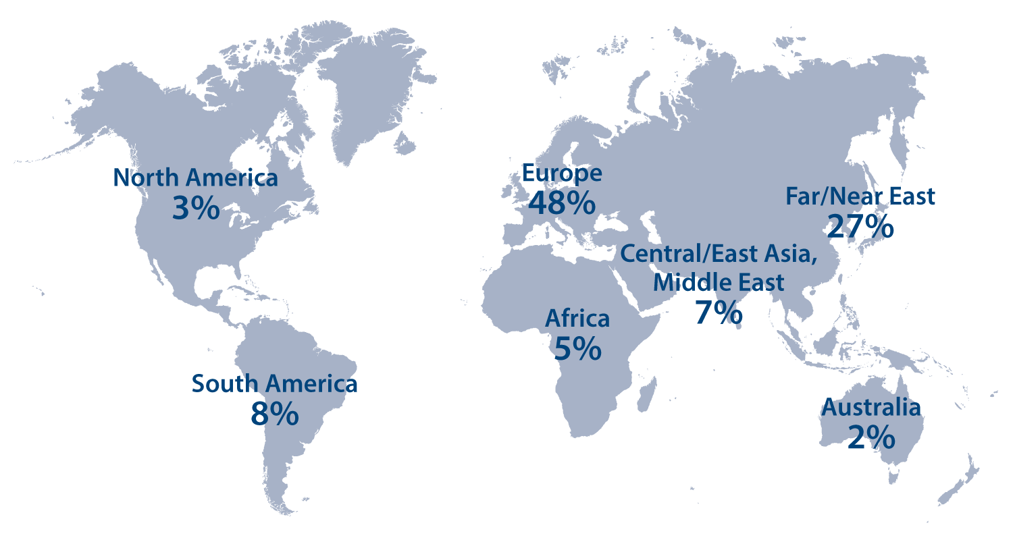
International Resident Students by Region

Slide 16
The world comes to our door…
219 Students
46 Countries
AY2013/QTR4
Europe
Albania
Netherlands
Bulgaria
Norway
Denmark
Estonia
Portugal
Georgia
Romania
Germany
Slovakia
Greece
Sweden
Turkey
Hungary
Ukraine
Caribbean, Central and South America
Argentina
Brazil
Chile
Colombia
Peru
Africa
Egypt
Mauritius
Tanzania
Tunisia
Uganda
Australia
Far/Near East
Indonesia
Japan
Kazakhstan
Korea
Malaysia
Maldives
Mongolia
Nepal
Philippines
Singapore
Taiwan
Thailand
North America
Canada
Mexico
Central/East Asia and Middle East
Israel
Jordan
Pakistan
Saudi Arabia
Yemen

Slide 17
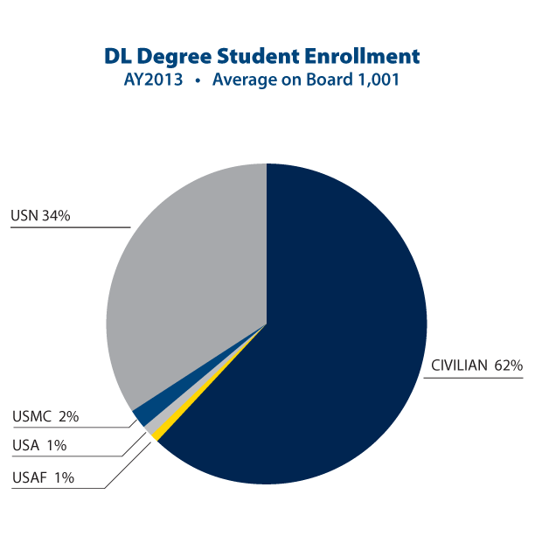
Distance Learning (DL) Degree Students
Average on Board AY 2013
Total DL Students: 1,001
62% Government Civilian
38% U.S. Uniformed Services (34% U.S. Navy)

Slide 18
We bring the best and brightest minds to teach the next generation of leaders.
FACULTY HIGHLIGHTS
719 CIVILIAN FACULTY
259 tenure or tenure-
track (100% with
doctorates)
460 non tenure-track
46 MILITARY FACULTY
Top Sources of Faculty Graduate Degrees
UC Berkeley 28
Stanford 30
MIT 23
USC 22
UCLA 12
Academic Leaders
278 NPS faculty
earned their highest
degree from one of
the nation’s top 50 universities.
Active recruiting from top Ph.D. programs
A robust mix of tenured faculty, lecturers, visiting professors, others
Includes 6% military personnel with strong academic credentials and recent operational expertise
Integrates teaching with research
No teaching assistants
Develops technologies eligible for patents
(AY2013/QTR 4)

Slide 19
Students bring real-world experience to explore complex national security issues, and find solutions.
Working shoulder to shoulder with world-class faculty creates a two-way learning environment
The perfect balance of academics and research enhances the graduate educational experience
Relevant education for today’s warfighter

Slide 20
At the cutting edge of cybersecurity research and education.
Multi-dimensional approach through research and dedicated curricula
SCIF and dedicated Cyber Battle Lab
Interdisciplinary core instruction from across campus
Degree programs for officers and senior enlisted cyber warriors

Slide 21
Leading the cultural change necessary to achieve energy independence.
Four specialized degree programs focused on energy science, technology, policy
Active, student-driven research in all aspects of energy, focused on warfighting first
Dedicated Energy Academic Group
Senior leader continuing education programs, campus lecture series, more

Slide 22
Advancing unmanned systems, from technical to tactical.
Consortium for Robotics and Unmanned Systems Education and Research (CRUSER)
SECNAV initiated / Chartered by former Under Secretary Robert O. Work
A cross-disciplinary community of experts in education and research across ALL areas of robotics and autonomous systems
From technical to ethical, concept generation to experimentation

Slide 23
An intellectual and experimental hub for the advancement of defense acquisition.
Multidisciplinary approach to all facets of cost, supply, performance mgmt. and more
Led the creation of a body of scholarly knowledge in defense acquisition unparalleled in government or academia
Consistent engagement from the Pentagon and fleet provides a continuous stream of relevant topics for research

Slide 24
Rapid deployment from field experimentation to fleet utilization.
Rapid technology integration from field to fleet and joint warfighter
Diverse applications —broad DOD impact, homeland security integration, civil crossover
Multi-disciplinary, campus-wide efforts
Multi-institutional partnerships — expanding list of military, homeland security, industry and academic organizations participating

Slide 25
A national Center of Excellence in adaptive optics education and research.
Three-Meter Segmented Mirror Telescope on campus
Prototype reconnaissance satellite on site (model)
Unique, experimental test-bed for dedicated faculty/student education and research
Research to advance capabilities in optics, vibration control, and operability

Slide 26
Playing a lead role in the evolution of securing our homeland.
Center for Homeland Defense and Security
The nation’s first graduate degree in homeland security
450+ graduates to date
Students come from Dept. Homeland Security, police, fire, EMS, military and several others at local, state, federal and tribal levels
Hybrid in-residence and web delivery, mobile education, executive leaders program, self-study
Executive education seminars for 16 governors in 13 states and territories

Slide 27
With over 50,000 graduates, alumni range from admirals to astronauts, service chiefs to chief executives.
Representing all U.S. military services, government agencies, defense industry leaders, and many more
More than 5,500 int’l officers from 100+ countries
16% of all U.S. Navy active-duty Flag Officers
About 28,300 resident and non-resident, non-degree participants annually
Notable alumni include:
Adm. Mark Ferguson, USN, Commander U.S. Naval Forces Europe- Africa
Adm. William McRaven, USN, Former Commander, U.S. Special Operations Command
Gen. Keith Alexander, USA, Former Director, National Security Agency
Adm. Mike Mullen, USN, Former Chairman, Joint Chiefs of Staff
Gen. Michael Hagee, USMC, Former Commandant

Slide 28
NPS is a world-class institution — a valued, strategic investment for the future of our nation.
Education is the ultimate provider of transformative thought leaders
Agile, unique programs focus on joint military applications like no other institution in the world
Relevant research responds to the immediate and future needs of the national security enterprise
Executive, distance and continuing education deliver programs regardless of when and where
Building international capacity, developing defense cooperation with partners across the globe

Slide 29
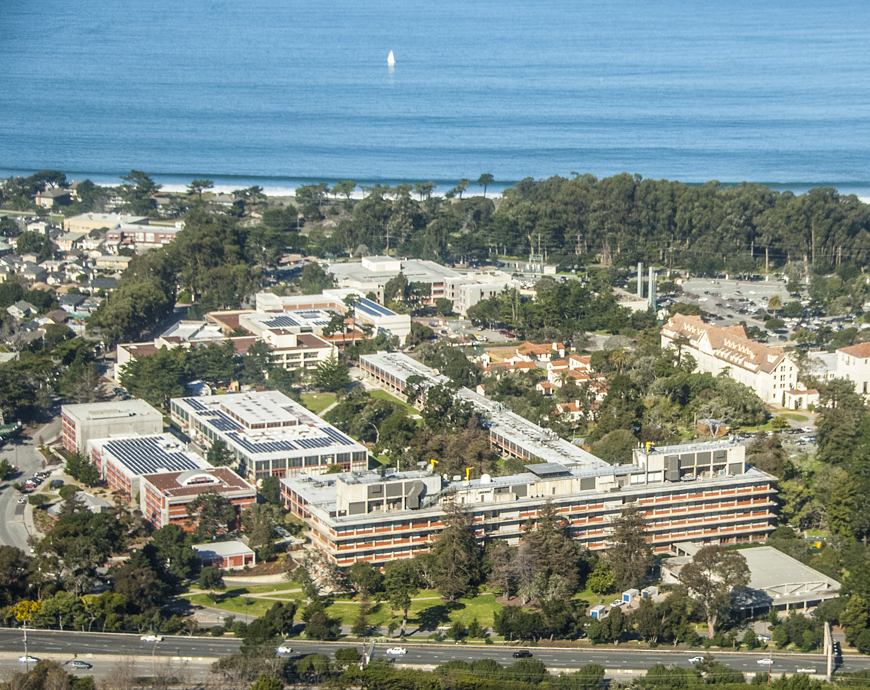
NAVAL POSTGRADUATE SCHOOL
1 University Circle • Monterey, CA 93943
(831) 656-1068 • www.nps.edu

