Slide 1
Introduction to Graduate School Writing and Research
Dr. Sandra Leavitt
Director, Graduate Writing Center and Thesis Processing Office
Chair, Generative AI Task Force
Spring 2024
Graduate Writing Center
Naval Postgraduate School
Notes:
There are generally two ways to approach the risk of plagiarism—1) with paralyzing fear and a stern warning not to do it, or 2) with confidence, gained by learning how HOW to use sources to look smart and be smart.
Indeed, incorporating source material into your own work is one of the best ways to look and be smart in academia. It is NOT something to fear.
It's not just smart, it’s an expectation.
If you master how to incorporate sources, then YOU will produce work that is
—easier to produce
—higher quality
—and looks better

Slide 2
Four Main Takeaways
New Expectations
Military vs. Academic Writing
The Research Process
Paradox: Quality Sources Produce Original Work

Slide 3
1. Expectations
“Do you agree?”
“Why or why not?”
We expect to hear you.
Learning and research are “organic.”
You need new relationships.
You will strengthen your intellectual skillset:
Mental agility • Reason • Perspective
Precision • Integrity • Communication

Slide 4
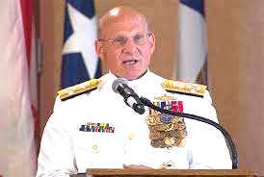
“Seek clarity and understanding. Trust and effective communications— absolute necessities in combat— must be developed and perfected in times of peace.”
CNO, Adm. Mike Gilday,
The Charge of Command, Jan. 2022

Slide 5
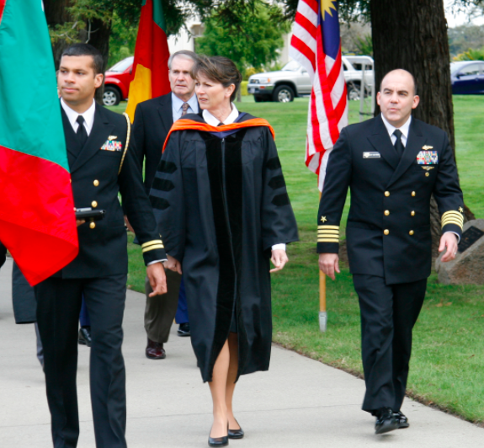
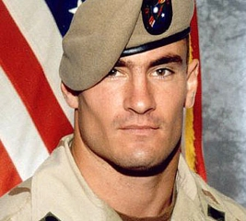
2. Military and Academic Writing Are Similar and Different
Purpose
Structure
Style

Slide 6
Military Writing
Similar
Different
Academic Writing
Share knowledge to… get aligned, make decisions
Describe
Convey orders, objectives, processes
Record discussions, data, decisions
Persuade with evidence, authority, ethos
Share knowledge to… educate, debate, discover
Explain
Explore how and why for new insights, inventions
Encourage thinking and experimentation
Persuade with evidence, logical argument, res. integrity
Purpose

Slide 7
Similar
Different
Military Writing
Academic Writing
Standard forms, sentences
“BLUF”
Topic, scope
Recommendations
Body
Relevant facts, known
Competing solutions
Hide “behind the scenes” methods and thinking
Standard sections
“BLUF”
Topic, scope
Findings
Body
Relevant facts + unknown
Competing explanations
Show and explain methods and thinking
Structure

Slide 8
Military Writing
Academic Writing
Accurate
Clear
Concise
Free of grammatical and mechanical errors
Accurate
Clear
Concise
Free of grammatical and mechanical errors
Style Similarities
Good writing is clear thinking made visible.
~Robert Wheeler

Slide 9
Military Writing
Academic Writing
Brevity
Overcapitalization
Mountains of acronyms
Institutional voice︎
Few sources
Even fewer citations
Thoroughness
Capitalization “proper”
Acronym light
Unique voice
✑ ✑ ✑ ✑ ✑
Many sources
Many citations
Style Differences

Slide 10
3. The 4-Phase Research Process
MORE SOURCES
SOME WRITING
MORE ORIGINALITY
MORE WRITING
Write up & Share
Analyze
Hunt & Gather
Research Question
Repeat

Slide 11
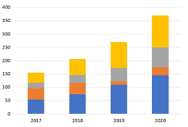
Look for or Create…
Write & Share
Outlines
Drafts
Finals
Analyze
Tables
Charts
Statistics
Process tracing
Hunt & Gather
Theories
Methods
Data
Tests
Explore Questions
Puzzles
Intros
Conclusions

Slide 12
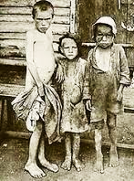
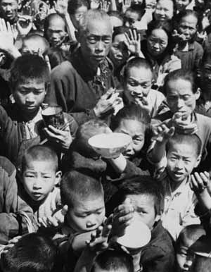
Famine: Weapon or Feature of Conflict?
Ukraine Famine 1932–33
Holodomor: Intentional “death by hunger”
4 million died
China
1958–62
Great Leap Forward
40–60 million died
Appling the Research Process
Nigeria Civil War
1967–69
Military blockage 100,000 combat deaths vs.
1.5 million starved to death
Yemen Civil War 2017–18 Military blockade
50,000 starved to death

Slide 13
Famine: Weapon or Feature of Conflict?
Res. Question
Hunt & Gather
Analyze
Why do famines happen?
What have others studied? How?
What happened, where and when?
By whom, to whom? How?
What context do we need?
How have others explained famines?
Theoretical explanations direct you to potential causes to study
Natural disasters
Poverty levels
Logistical issues
Int’l responses
Conflict strategy
Govt policies
What do your data tell you?
Can you explain your logic?
Where do your results fit with others’? Expand our knowledge?
Why do govts implement policies that cause famine?
Appling the Research Process
Write & Share

Slide 14
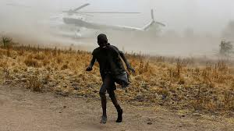
Why do governments implement policies that cause famine?
Possible Explanations
Intentional (Weapon)
Coercion, submission, capitulation
Punishment, retaliation, genocide
Military tactics
Sieges
Blockades
Unintentional (Feature)
Weak states
War disruptions
Blocked migration
Limited aid
Economic crises
No strategic interest
Appling the Research Process

Slide 15
4. How sources support your work
By consuming existing knowledge…
Save time
Discover additional sources
Increase accuracy, quality

Slide 16
To become a warrior-scholar…
Model academic norms (style, structure, purpose)
Show you know what they know
Transfer source reputations to yourself

Slide 17
For positive reputation transfer, seek
Established theories, concepts, and definitions
Transparency about methods and scope
Citations
Reputable organizations, publishers, speakers, and researchers
Seek peer-reviewed, academic presses, and other trusted institutions (.edu, .gov, .org, .mil)
Be alert to bias!
Think critically, check carefully

Slide 18
Today’s Key Take Aways
New Expectations
Similarities and Differences
Hear from YOU
The Research Process
Quality Sources

