Slide 1
Welcome to the TAC Outreach Call

Slide 2
TAC Outreach Call April 14, 2020
Manual Abandon Process and Look Ahead
Presenters: Jason Prado, Travel Assistance Center (TAC) Manager Dan Greene, TAC Outreach Call Coordinator

Slide 3
Agenda
Top Issues for March/April
Manual Abandon Process
Requirements
Process
Common Issues
DTS FY20 R2 Functional Release
Resources
Questions

Slide 4
Top Issues for March/April
Issue # | Summary | Workaround | Release
DTS-14360 | Document routes to CTO SUBMIT after the Trip Cancelled has been applied. Authorizations with the trip cancel applied will not update to CTO BOOKED. This is due to travelers canceling reservations prior to using the trip cancel. Canceling reservations manually is not necessary and will cause this issue. | Unfortunately, there is no workaround for this issue. Please submit a ticket to the TAC so we can have the document properly handled. | Ready for Assignment
DTS-10843 | The document is stuck at APPROVED. | Please submit a ticket to the TAC so we can have the issue properly documented. | Ready for Assignment
PPT | CBA invoices stopped processing at CERTIFIED. | Please submit a ticket to the TAC so we can have the issue properly documented.
DTS-16801 | MCTFS 824 Acknowledgements are not posting in DTS. | Please submit a ticket to the TAC so we can have the issue properly documented. | FY20-MR-3
DTS-17127 | Amended authorizations with two PNRs are calculating the flight Allowed cost to be higher than the Actual cost. This is causing an un-allocated expenses Pre-Audit, preventing routing, and causing errors adjusting LOAs and expenses. | Unfortunately, there is currently no workaround for this issue. If the travel is imminent, we recommend contacting the Travel Management Office (TMC) directly for assistance with ticketing outside of DTS. | FY20-MR-3

Slide 5
Manual Abandon Process
Documents that have system issues with no workaround that affect or prevent processing of the document may need to be manually abandoned.
If provided a workaround by the Travel Assistance Center (TAC), we always encourage you to ensure you try it before requesting the MANUAL ABANDON stamp be applied.
Once the TAC has notified you that the document will be escalated to be abandoned, you do not need to wait for the MANUAL ABANDON stamp.
Go ahead and create a new document immediately.

Slide 6
Manual Abandon Requirements
Given the current travel situation, the TAC has received a lot of requests to manually abandon older documents.
In order for a document to be stamped MANUAL ABANDON, there needs to be an existing issue with that document that would prevent normal processing.
Stamping a document MANUAL ABANDON for convenience is not permitted.

Slide 7
Manual Abandon Requirements
If a document meets one (or more) of the following criteria, instead of being locked and abandoned, it’s escalated to have a Permission Level 9 action performed:
Import/Export Authorization (documents imported from another system)
Approved Document with CBA as the method of reimbursement
Approved Document with Scheduled or Paid Advances
Approved Document with Scheduled or Paid Partial Payments
More information on the Manual Abandon and Lock Process can be found at http://www.defensetravel.dod.mil/Docs/Manual_Abandon_Stamp.pdf.

Slide 8
Manual Abandon – Common Issues
For certain issues, it’s a “given” that the document will not be able to be processed and instead will need to be manually abandoned.
The most common issues is having a document stuck at CTO SUBMIT for greater than 4 months.
After a certain amount of time the Passenger Name Record (PNR) is recycled by the Global Distribution System (GDS) and no longer belongs to the affected document.
Another common issue is trying to process documents that are very old.
Documents that have not processed with TANUMS beginning with a 0 or 1 fall under this category.

Slide 9
What does the MANUAL ABANDON stamp do?
The MANUAL ABANDON stamp is a permanent system stamp that will lock the document from further processing and remove it from the routing officials' queues.
Applying the MANUAL ABANDON stamp does not:
Remove the document from the traveler’s list of documents
Remove/cancel existing reservations
Perform a de-obligation in your official accounting system
Perform a de-obligation in your DTS Budget Module
Manual Abandon is not necessary to re-create a new document or perform a manual de-obligation.
If you’ve been informed that this must happen, it’s due to a local business rule and not a DTS requirement.

Slide 10
Manual Abandon Process – Reservations
If the document is for future travel and the traveler needs to book new reservations, please be sure to cancel all reservations in the Passenger Name Record (PNR) by having them contact their local Commercial Travel Office / Travel Management Company (CTO/TMC) outside of DTS before making any new reservations.
Ensure that they obtain a hotel cancellation confirmation number if their PNR contained a hotel reservation.
If this is for past dated travel:
Airfare can be added to the My Expenses screen in the "Other Expenses" section as a "Ticketed Expense".
Rental cars can be added as a "Transportation Expense".
As usual, lodging is claimed on the Per Diem Entitlements screen.

Slide 11
What happens when a Document is submitted for Manual Abandon?
The Travel Assistance Center does not have the ability to apply the MANUAL ABANDON stamp.
Documents must be escalated to DTS Operations to apply the MANUAL ABANDON stamp.
The TAC escalates the ticket to DTS Operations in batches after verifying the information is accurate and the system issue or problem is properly documented.
All of the information in the ticket needs to exactly match what is in DTS.

Slide 12
What happens when a Document is submitted for Manual Abandon?
DTS Operations receives the tickets from the TAC and runs a batch of them at a time depending on the workload.
It typically takes about 3 weeks for the document to be stamped MANUAL ABANDON after being escalated.
Lately, DTS Operations has been stamping documents MANUAL ABANDON within 1-2 weeks.
The time it could take could be longer or shorter.

Slide 13
Where Manual Abandon can go wrong…
The ticket must match DTS exactly in order for the document to be successfully abandoned.
We recommend copy/pasting from DTS.
Issues can occur if…
The document name is incorrect
The document has been amended
The traveler’s name is incorrect
The SSN in the ticket is incorrect
The document type is incorrect
The traveler has been deleted
There are two travelers with the same name and the same last four

Slide 14
If the Document Name is incorrect…
If the original version of the document is listed instead of an amendment, it will fail or the wrong version maybe locked.
Some reports show the original version of the document rather than the current version
For example, FLTDYLOC01012020_A01 vice FLTDYLOC01012020_A01-01.
The document name from the traveler’s list of documents must be in the ticket and not the document from the report.
Instead of the original, the current version (FLTDYLOC01012020_A01-01) should be in the ticket otherwise it will not be abandoned.
Be sure to copy/paste.
Many failures are due to the document name being typed incorrectly.

Slide 15
Amending the Document after it’s been escalated…
Documents are amended after being escalated to be abandoned can cause failures.
If the document name changes due to an amendment, or a voucher is removed, then the document in the ticket will fail to be abandoned.
We recommend not making any changes once the TAC has informed you that the document will be escalated to be abandoned.
At that point, you should create a new document.

Slide 16
If the Traveler’s Name is incorrect…
The most common issues we see with incorrect names are:
Missing the suffix (like JR, II, III, etc.) from the Last Name field.
Having a comma (,) in the Last Name field.
First and Last names are transposed (SMITH for First and JOHN for Last).
Names not copied/pasted from DTS.
People with names that can have different spellings are the most common we see with that issue (Jeffrey vice Jeffery, etc.)
As usual, we recommend copying/pasting the names from DTS rather than attempting to type them out.

Slide 17
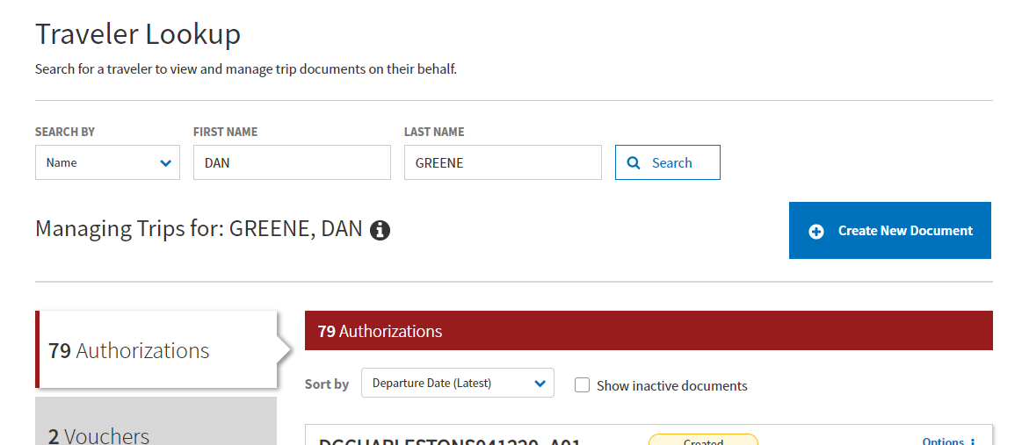
If the Traveler’s SSN is incorrect…
The traveler’s last four can be found in DTS by poking them in the “i”.
If there’s a special character in the last 4, that needs to be included in the Last Four SSN ticket field.

Slide 18
If the Traveler is deleted…
If a traveler is deleted, their documents vanish from visibility under Traveler Look-Up.
These documents are still out there, but cannot be seen unless the traveler is received back into the organization or created using the same SSN.
All documents will be restored/visible once either of these actions has been performed.
If a traveler has been deleted, the manual abandon process will fail until that traveler is restored.

Slide 19
There are two travelers with the same name and the same last four….
Sometimes a profile can be created with an incorrect SSN.
If the numbers in the incorrect SSN are not the last four (first 5 numbers), the traveler will appear to have two profiles in the system with the same last four.
Example: SWAN, WILL ###-##-1234 SWAN, WILL ###-##-1234
If a profile was created with the wrong SSN, the DTA can change the last name to include ‘Wrong SSN’ or ‘Bad Profile’ so the last name does not match.
Example: SWAN WRONG SSN, WILL ###-##-1234 SWAN, WILL ###-##-1234

Slide 20
Alternatives to stamping a document MANUAL ABANDON
The MANUAL ABANDON stamp does not perform a de-obligation, so if possible, we recommend cancelling the document or filing a zero dollar voucher.
Canceling an authorization will send a de-obligation to the accounting system when the document is stamped CANCELLED.
A zero dollar voucher will send an updated obligation (for zero dollars) to the accounting system upon voucher approval, so that will de-obligate the funding in the accounting system.

Slide 21
Reminders with Manual Abandons
Ensure the Ticket Information is up to date and accurate.
Copy/Paste Information from DTS.
Once the TAC has informed you that the document will be stamped MANUAL ABANDON, don’t touch it.
Start a new document.
Avoid amending the affected document.
The process can take greater than 3 weeks, so we appreciate your patience.
Avoid Client Updating your ticket.
Always attempt workarounds that the TAC provides to avoid system issues.
If the document can be processed, it’s better to do that than to stamp the document MANUAL ABANDON.

Slide 22
DTS FY20 R2 Functional Release
DTS FY20 R2 Functional Release scheduled for April 2020 focuses on the DTS Expenses module and document attachment functionality.
This software version reshapes the Add expenses and upload supporting documents design, displays recorded expenses in a single running list, incorporates quick access to per diem under Enter Expenses, and launches a What’s New feature.
This DTS edition also retires fax capability.
This is scheduled for the following dates:
April 13, 2020 – EWTS
More Info Next Slide – DTS

Slide 23
DTS FY20 R2 Functional Release
This release is being scheduled to be implemented in a phased approach across DoD organizations.
On April 17, 2020, the release will be implemented for randomly selected DoD organizations to allow software engineers to assess system performance.
If your organization is part of the pilot, users will see an on screen banner once logged into DTS.
Following a successful verification, the release will be implemented across all remaining DoD organizations, which is tentatively scheduled for April 28, 2020.
Please continue to monitor the DTS homepage for any updates to the release schedule.

Slide 24
Upcoming Changes – What’s New Pop-Up
A new feature that will be deployed is the “What’s New Pop-Up”.
Whenever there is a system change, the user will be presented with a What’s New Pop-Up describing the changes on that particular part of DTS.
The system will look at the traveler’s login information and will only present the traveler with this one time.

Slide 25
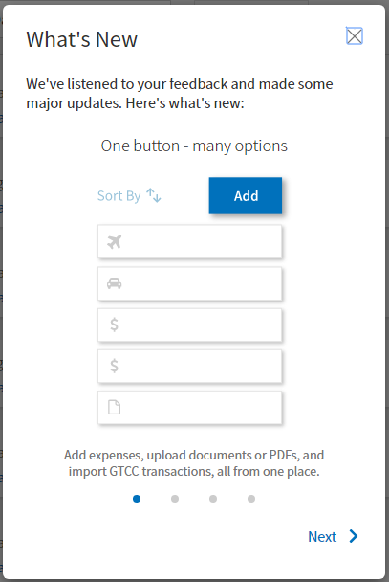
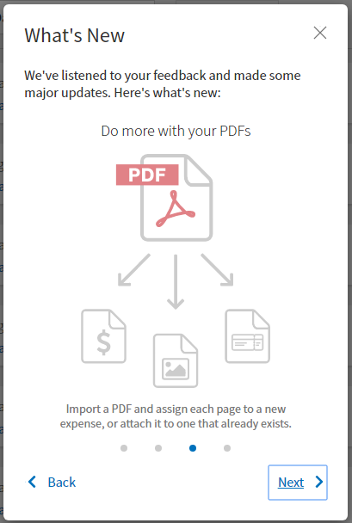
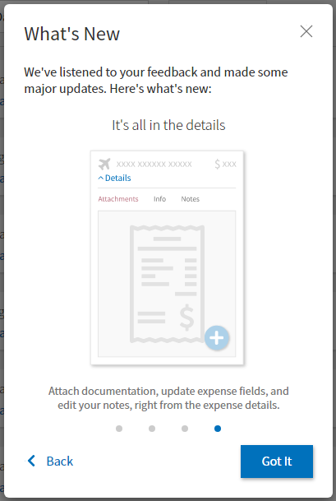
Upcoming Changes – What’s New Pop-Up

Slide 26
Upcoming Changes – New Expenses Screen
Trip Workbook, Reservation Expenses, Other Expenses, and Substantiating Documents will be combined into one Expenses page with new intuitive features.

Slide 27
Upcoming Changes – New Expenses Screen
All expenses will be collapsed and displayed in a default order, that can be modified by selecting the Sort By feature at the top.

Slide 28
Upcoming Changes – Download All Button
A new button will be added to allow routing officials to download all receipts at one time as a .zip file.

Slide 29
Upcoming Changes – Add Button
The “Add” button will now have the ability to add expenses, upload documents or pdfs, and import Government Charge Card Transactions (GTCCs) (on vouchers).

Slide 30
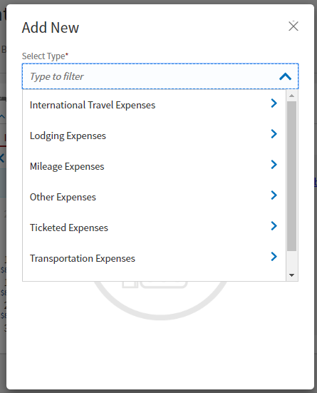
Upcoming Changes – Add Button
After selecting “Add New”, users can choose the type of expense to add using existing functionality.
Users can also attach receipts and leave notes when creating expenses.

Slide 31
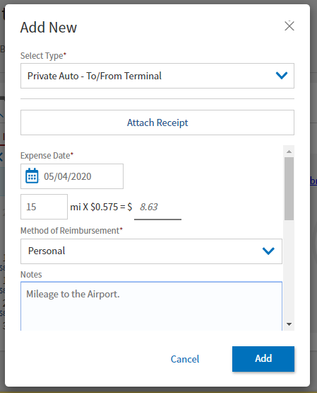
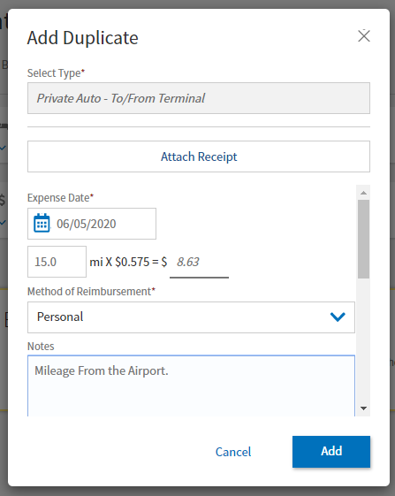
Upcoming Changes – Duplicate Expense
A new feature will be added to Duplicate Expense.

Slide 32
Upcoming Changes – Expanding Expenses
Information about each expense can be displayed by pressing the arrow button to expand.

Slide 33
Upcoming Changes – Expanding Expenses
Each expense will also have a “Notes” section to allow the traveler to enter any comments about the expense.

Slide 34
Upcoming Changes – Lodging Expenses
The Lodging will not be editable on this screen, but it will be visible and pulled from the Per Diem page.

Slide 35
Upcoming Changes – Adding Expenses, Documents, GTCC Transactions
The “Add” button will now have the ability to add expenses, upload documents or pdfs, and import Government Charge Card Transactions (GTCCs) (on vouchers).

Slide 36
Upcoming Changes – Attaching Documents
Selecting “Documents” will give the user the ability to upload the Constructed Travel Worksheet (CTW), Travel Authorization (Form 1610), Memos, Travel Orders, and Other types of documents.

Slide 37
Upcoming Changes – Attaching Documents
When documents will be uploaded, they will be automatically converted to a .png file, which will allow users to view it in DTS without having to download the file.
For documents that must retain their .pdf integrity, such as digitally signed documents, the “Attach as PDF” box can be checked.

Slide 38
Upcoming Changes – Attaching Receipts
When selecting an expense type to add, users will have the ability to attach a receipt at the same time.

Slide 39
Upcoming Changes – Attaching Receipts
When attaching a document or receipt, the workbook functions (zooming, rotating, moving) will be available prior to attaching.

Slide 40
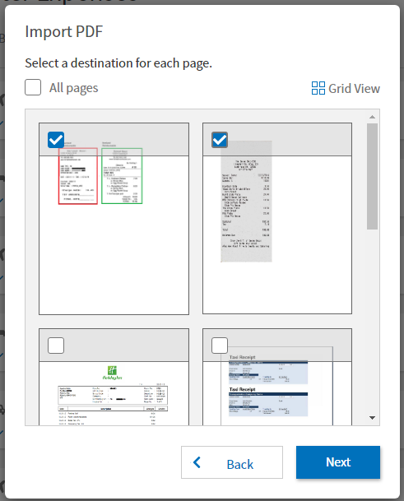
Upcoming Changes – Attaching Receipts

Slide 41
Upcoming Changes – Import PDF Button
A new button will be added to import PDFs.

Slide 42
Upcoming Changes – Import PDF
When importing a receipt or pdf, the user will be able to associate that pdf directly to an expense or create a new one.

Slide 43
Upcoming Changes – Import PDF
When importing a receipt or pdf, the user will be able to associate that pdf directly to an expense or create a new one.

Slide 44
Upcoming Changes – Attachments
After a receipt/document/pdf has been attached, it can be viewed by expanding the expense.

Slide 45
Upcoming Changes – Attachments
After a receipt/document/pdf has been attached, it can be viewed by expanding the expense.

Slide 46
Upcoming Changes – Currency Converter
For expenses that are in foreign currency, the Currency Converter will automatically convert based on the real-market currency rate.

Slide 47
Resources
Manual Abandon Process:
http://www.defensetravel.dod.mil/Docs/Manual_Abandon_Stamp.pdf
DTS FY20 R2 Functional Release
https://www.defensetravel.dod.mil/Docs/Look_Ahead_IP_14.pdf
You can contact the Travel Assistance Center (TAC) via:
Phone 888-Help1Go (888-435-7146)
Web (https://www.defensetravel.dod.mil/passport/)

Slide 48
Questions
Questions are taken via Telephone by Site Name in alphabetical order
A – E (Example – Dyess Air Force Base)
F – L (Example – Fort Huachuca)
M – S (Example – Redstone Arsenal)
T – Z (Example – Yuma Proving Ground)
You can press #6 to unmute your phone’s line to ask a question.
Please be considerate and mute your phone if you are not talking by pressing *6.

