Slide 1
Transonic Compressor

Slide 2
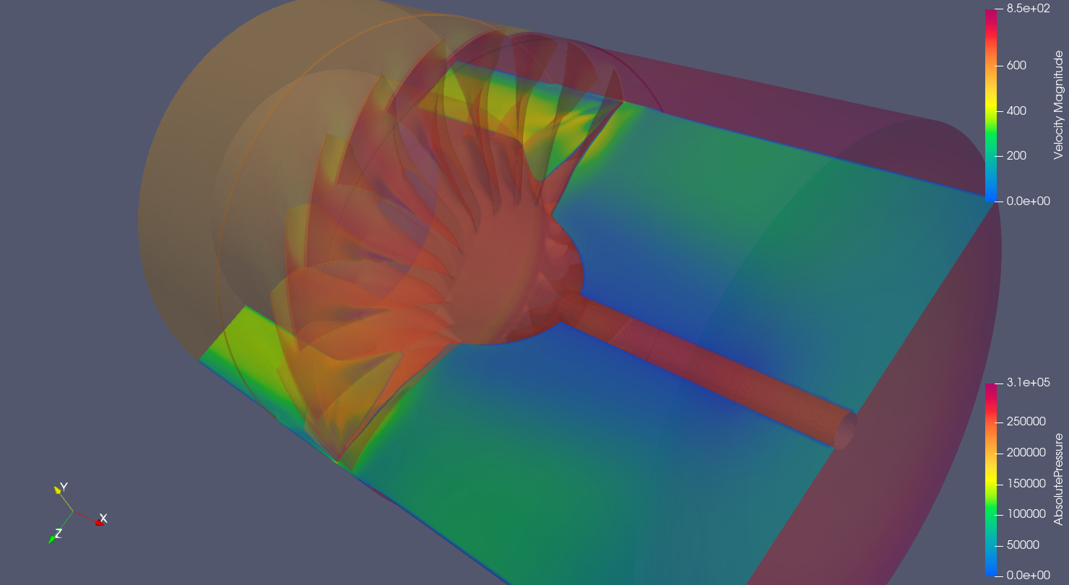
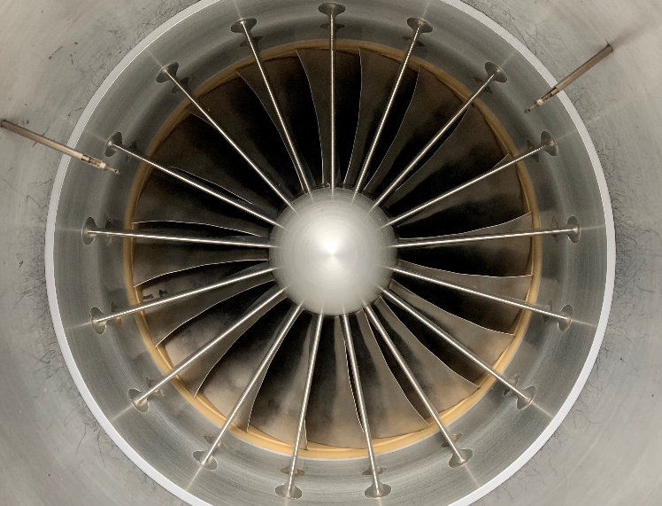
Computational Fluid Dynamics for Axial Compressor Stall Prediction (Funded)
Objectives:
  Validate performance/stall data for Transonic Compressor Rig (TCR)
    Tight Tip Gap
    Large Tip Gap
    1 Casing Treatment
  Determine effect on stall point prediction based on percent of full rotor modelled (single/multiple blade passages -> Full Rotor)
  Perform LES/iDDES simulation for a single configuration (single/multiple blade passages -> Full rotor) to compare stall prediction.
Walter C. Smith, PhD / walter.smith@nps.edu / 831.656.2593

Slide 3
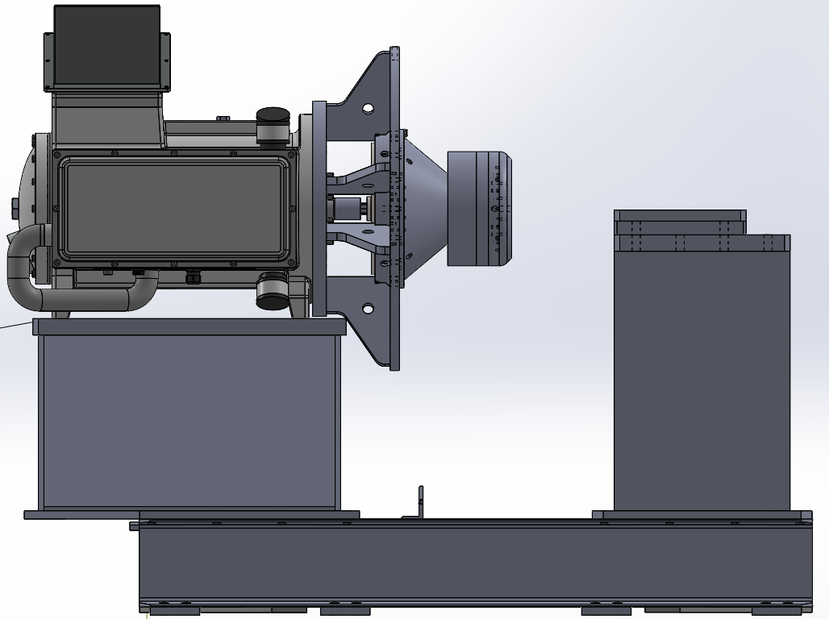
Design of TCR2
Setup and control of New 21000 rpm electric motor
Modification of current Rotor
  Structural/vibration analysis
Design of Casing and flow path
Operational checkout of available parts
Walter C. Smith, PhD / walter.smith@nps.edu / 831.656.2593

Slide 4
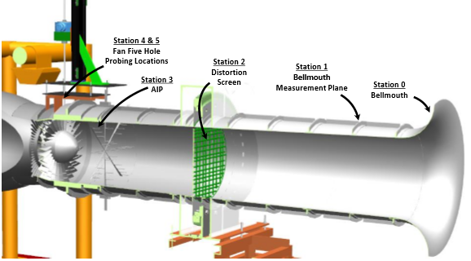
CFD/ Design of Transonic Compressor Inlet Distortion Screen
Development of Inlet Distortion Screen to increase Tip Sensitivity of NPS Military Fan
Computational Simulation and Analysis of Screen
Manufacture an Installation
Measurement of performance in baseline configuration
Measurement of performance with casing treatment to recover stall margin
Image Source: Bailey, Justin Mark. "Full Scale Experimental Transonic Fan Interaction with a Boundary Layer Ingesting Total Pressure Distortion." PhD diss., Virginia Tech, 2017.
Walter C. Smith, PhD / walter.smith@nps.edu / 831.656.2593

Slide 5
Automated design of casing treatments
Use Solidworks to generate different casing slot/grooves to increase stall margin in gas turbines for ships and aircraft.
Use simulation to find best one and test this on a real compressor.
Hah, ASME GT2018-75040
Walter C. Smith, PhD / walter.smith@nps.edu / 831.656.2593

Slide 6
Automated design of Transonic compressors/optimization
Show video of geometry being generated
https://nps01-my.sharepoint.com/:v:/g/personal/ajgannon_nps_edu/EQ3HQuCW8OBCmmY2yXLiSckBwnbMIU8GOSFNFkejsSRpYQ?e=ACH6ZS
Walter C. Smith, PhD / walter.smith@nps.edu / 831.656.2593

Slide 7
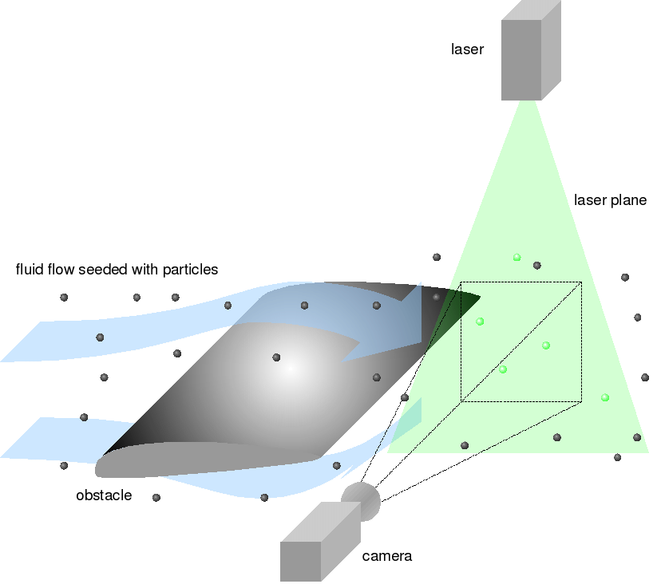
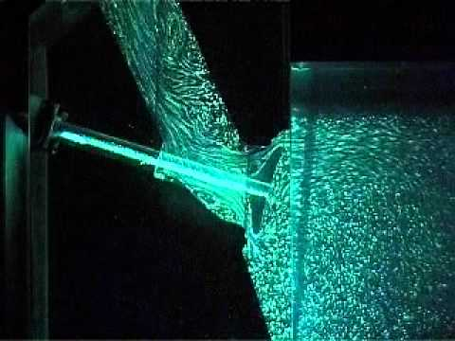
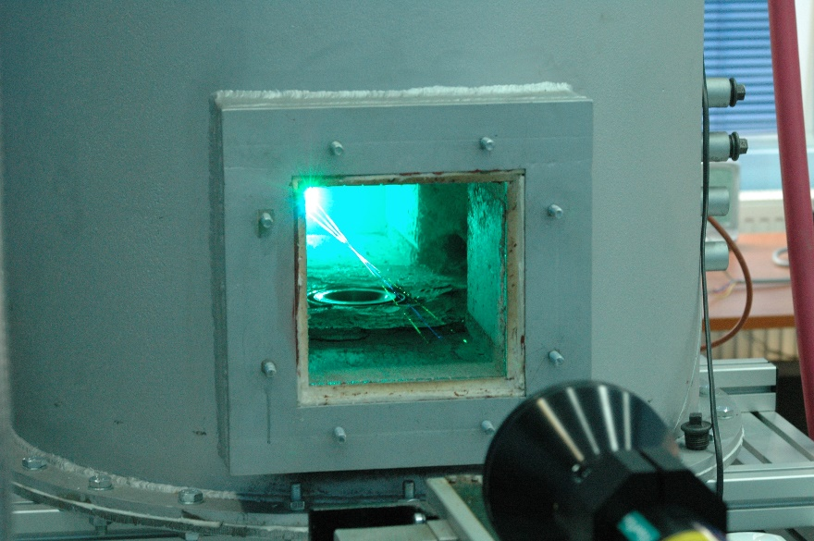
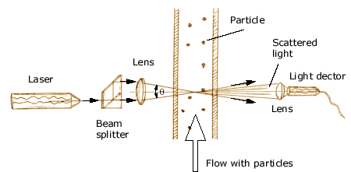
Optical Measurements in TCR/Cascade
Objectives:
  Design waveguide fixturing
  Implement PIV / LDV system in Linear Cascade
  Develop methodology for implementation in TCR
Hurdles
  Laser Safety timelines
Walter C. Smith, PhD / walter.smith@nps.edu / 831.656.2593

Slide 8
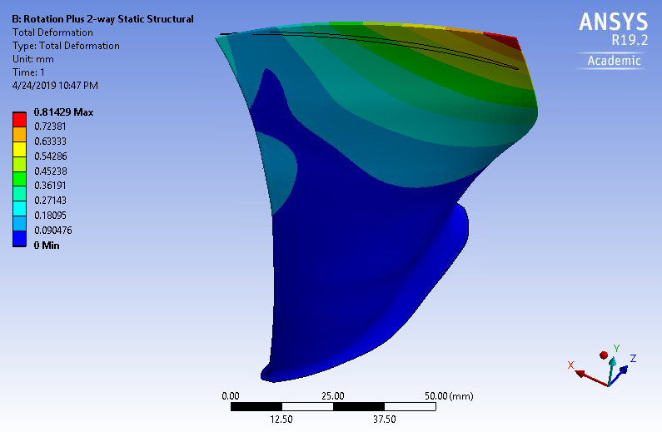
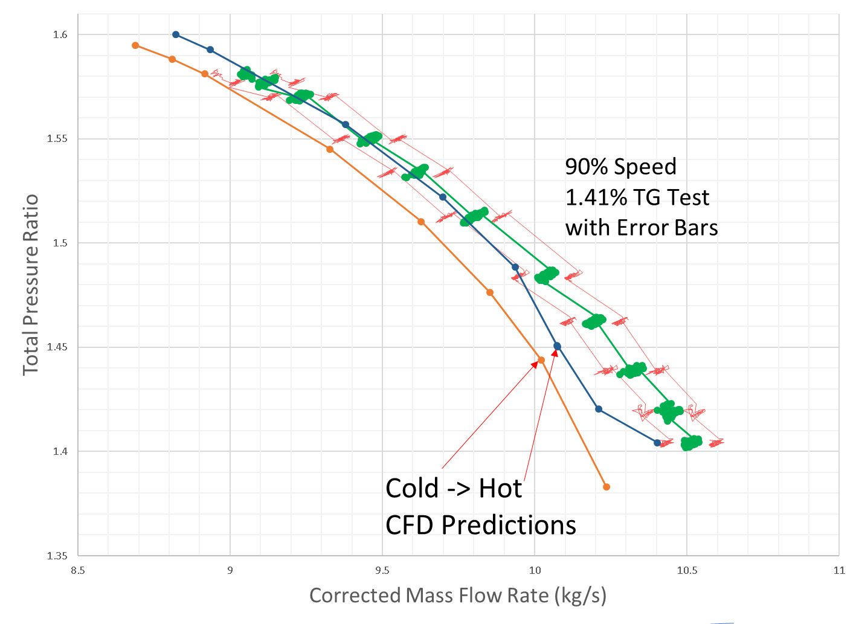
Rotor / casing treatment Computational Fluid Dynamics V&V Study
Model Fluid Structure interactions of Transonic Rotor
Include casing treatment analysis sensitivity study
Potential overlap with stall prediction effort
Walter C. Smith, PhD / walter.smith@nps.edu / 831.656.2593

Slide 9
Develop New Downstream Transonic Instrumentation / Implement Upstream Probes
Design new downstream instrumentation rakes for
  Pressure
  Kulite (High Speed Pressure)
  Temperature
Use additive manufacturing techniques to facilitate previously impractical designs
Baseline measurements in free-jet
Install and measure in transonic compressor
Data analysis and numerical integration (Baseline and Casing Treatment)
Walter C. Smith, PhD / walter.smith@nps.edu / 831.656.2593

Slide 10
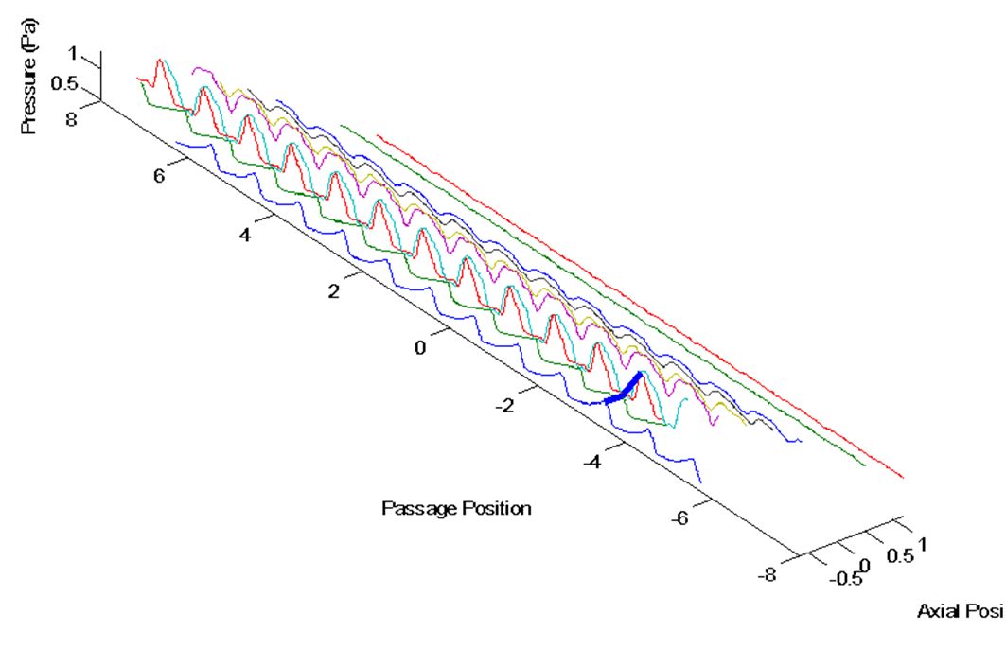
Casing High Speed
Pressure Measurements
Re-implement high speed casing pressure measurements on the NPS Military Fan
Make measurements of shock structure with/without Casing treatments
Walter C. Smith, PhD / walter.smith@nps.edu / 831.656.2593

Slide 11
Small Scale loop design
Design and specification of small scale transonic compressor test facility
Technical specification of components
Power, performance, fluid and heat transfer analysis
Walter C. Smith, PhD / walter.smith@nps.edu / 831.656.2593

Slide 12
Energy Resilience

Slide 13
H2 system automation gas turbine modification
https://nps01-my.sharepoint.com/:v:/g/personal/csclay_nps_edu/EWdJJP5vwddDhVuDcnI29K4BZZY-PRNVE033djj_zrBJQQ?e=YkSdY3

Slide 14

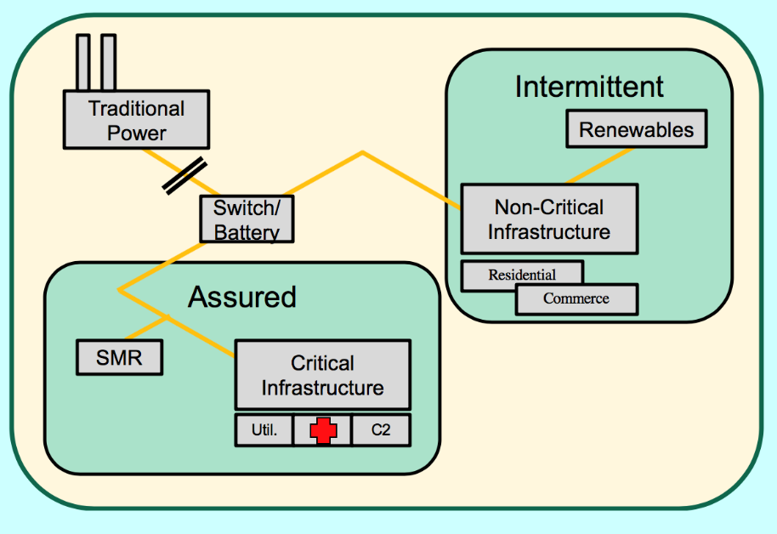
Research Opportunities in Combined Source
Microgrids with Energy Storage
PI: Craig Smith
Physics
cfsmith@nps.edu
Project Partners:
Westinghouse
European Commission
  Joint Research Center - Petten
An ongoing project is investigating Small Modular Reactors (SMRs) in Regional Energy Markets
Project is now moving toward considering the integration SMRs with renewable energy sources in independent grids
SMR Autonomous Load Following has been a focus of previous research but alternative means of achieving the same end are a new thrust
Load following - matching output to demand – is an especially important consideration when integrating energy sources that have their own intermittency (e.g., wind and solar) in conjunction with demand variability
Research opportunities include:
Comprehensive technology survey and evaluations to identify and characterize energy storage options most suitable for such applications
Modeling of reference energy source mixes to determine energy storage capacity needed
Experimental evaluation of performance of integrated supply with energy storage to meet variable demand scenarios
Walter C. Smith, PhD / walter.smith@nps.edu / 831.656.2593

Slide 15
Misc.

Slide 16
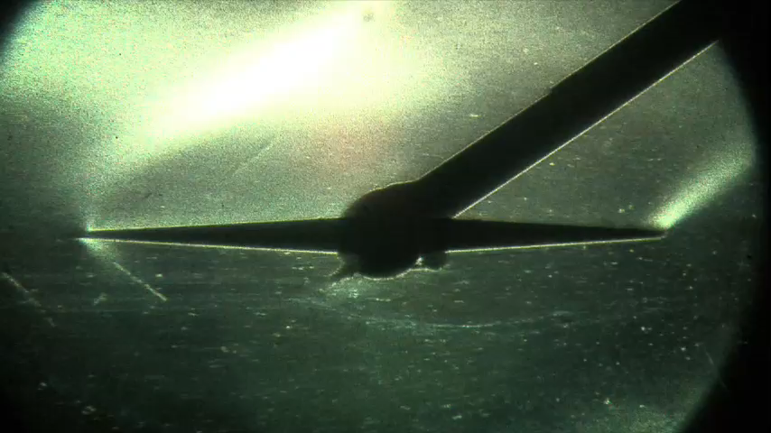
Supersonic wind tunnel upgrade – Mach 4+
Calculate new throat shape
Computational Fluid Dynamics Analysis
Design hardware
Have hardware built
Test in wind tunnel
Walter C. Smith, PhD / walter.smith@nps.edu / 831.656.2593

Slide 17
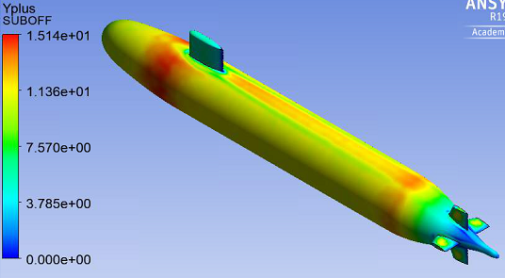
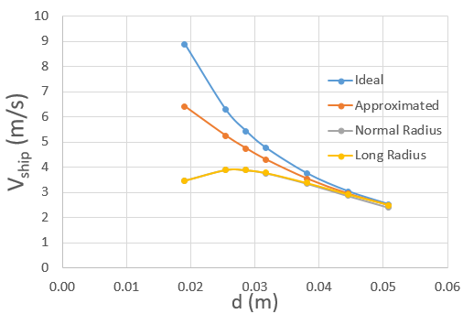
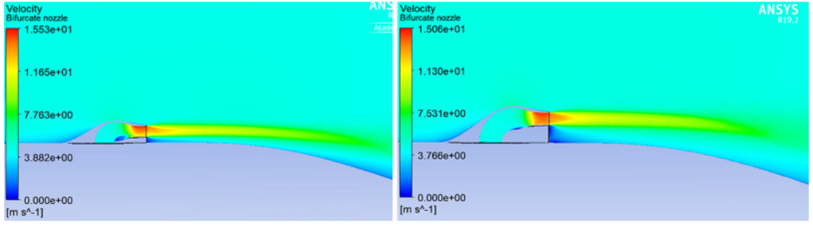
CFD Validation Experiment for Novel Auxiliary Propulsion System
Walter C. Smith, PhD / walter.smith@nps.edu / 831.656.2593

Slide 18
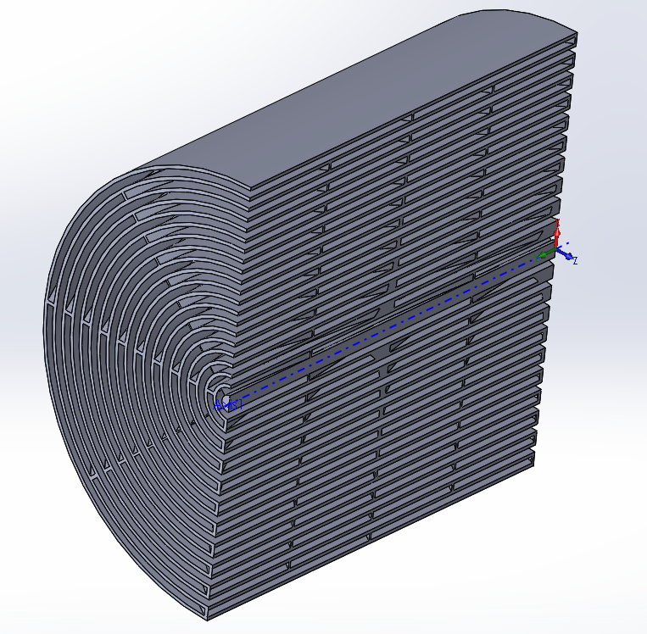
Optimal Low Vibration, low unsteadiness Flow Restriction Geometries (Pseudo-Funded)
Objectives:
  Characterize/Model flow “classical” flow restrictor geometries for hydraulic performance, turbulence, flow instability
  Model flow through AM enabled geometries to find performance (flow instability, turbulence, performace) benefits
  Re-purpose previously developed optimization scheme for use in automated design and analysis of candidate geometries.
  Develop test platform, AM build reference and candidate geometries, test.
Potential Collaborators:
  Naval Surface Warfare Center – Philadelphia Division (NSWCPD)
  Naval Reactors (NAVSEA 08E)
Walter C. Smith, PhD / walter.smith@nps.edu / 831.656.2593

Slide 19
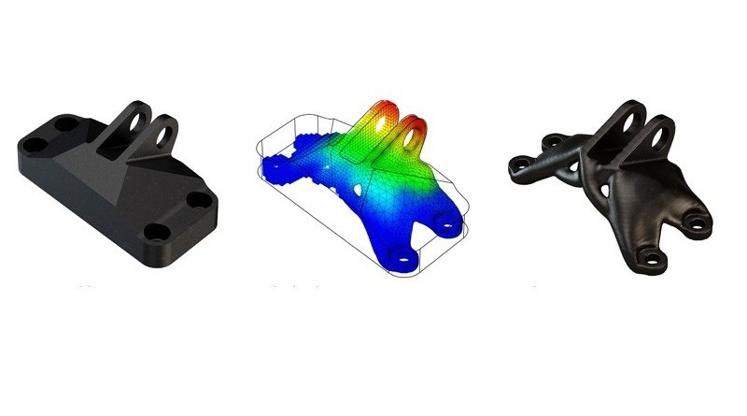
Topology Optimization of AM built parts for Mechanical Design (Un-Funded)
Objectives
  Re-purpose previously developed optimization scheme for use with mechanical parts
  Integrate geometry modification/subtraction
  Build parts
  Test parts
Walter C. Smith, PhD / walter.smith@nps.edu / 831.656.2593

Slide 20
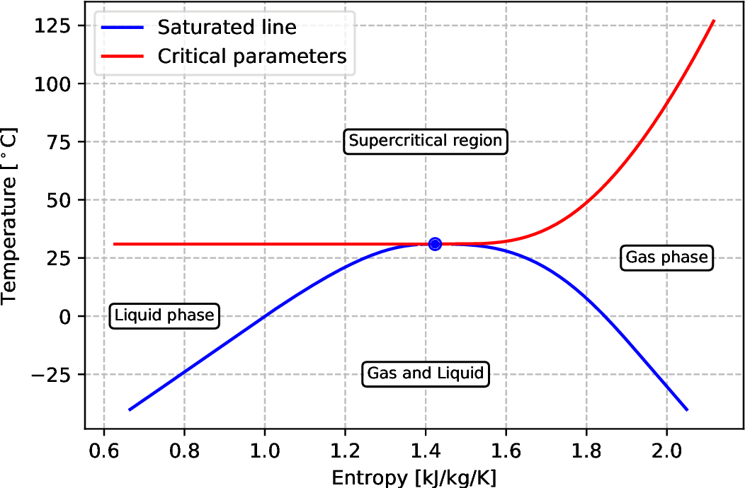
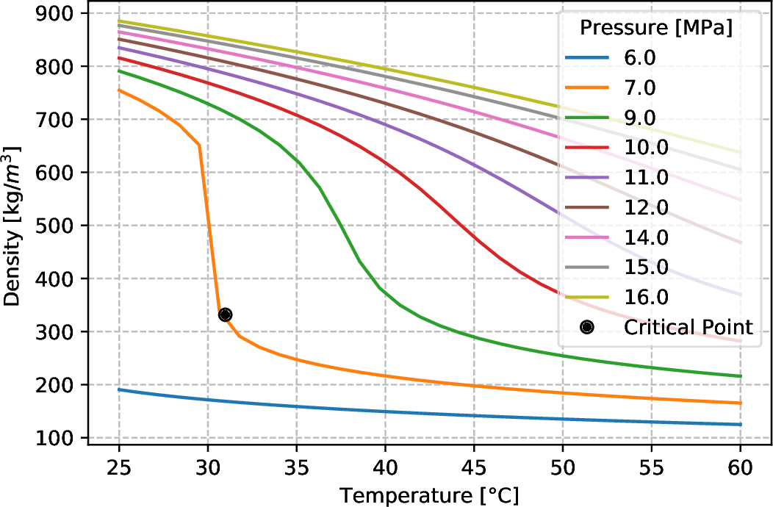
Analysis of Supercritical Pressure Fluid Use for Power Generation (Pseudo-Funded)
Objectives:
  Develop model of HX system for Waste Heat Recovery System
  Validate Numerical analysis for air as working fluid vs. measurement
  Implement appropriate SCO2 properties into Solver (CFX)
  Assess Heat transfer and system stability with SCO2 as working fluid
  Model buoyancy driven system to determine system stability boundary.
Walter C. Smith, PhD / walter.smith@nps.edu / 831.656.2593

Slide 21
Transonic compressor (rotating equp)
McFarland works
ESTEP (h2 and waste heat)
AM
SSWT

Slide 22
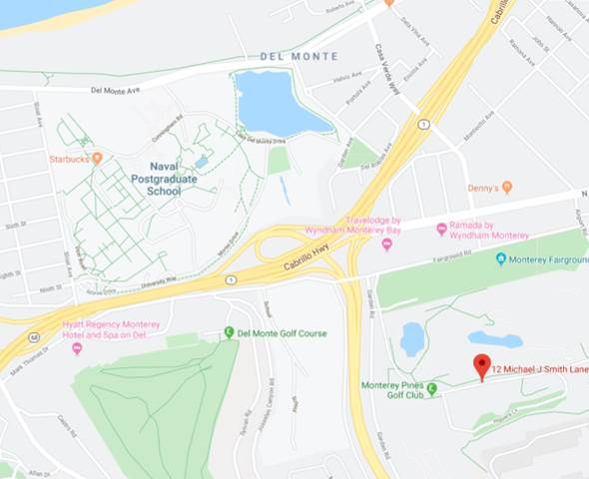
Large Experimental Annex
Located off campus
Other Faculty at the LEA/TPL:
Prof. Hobson
Prof. Gannon
Walter C. Smith, PhD / walter.smith@nps.edu / 831.656.2593

