Slide 1
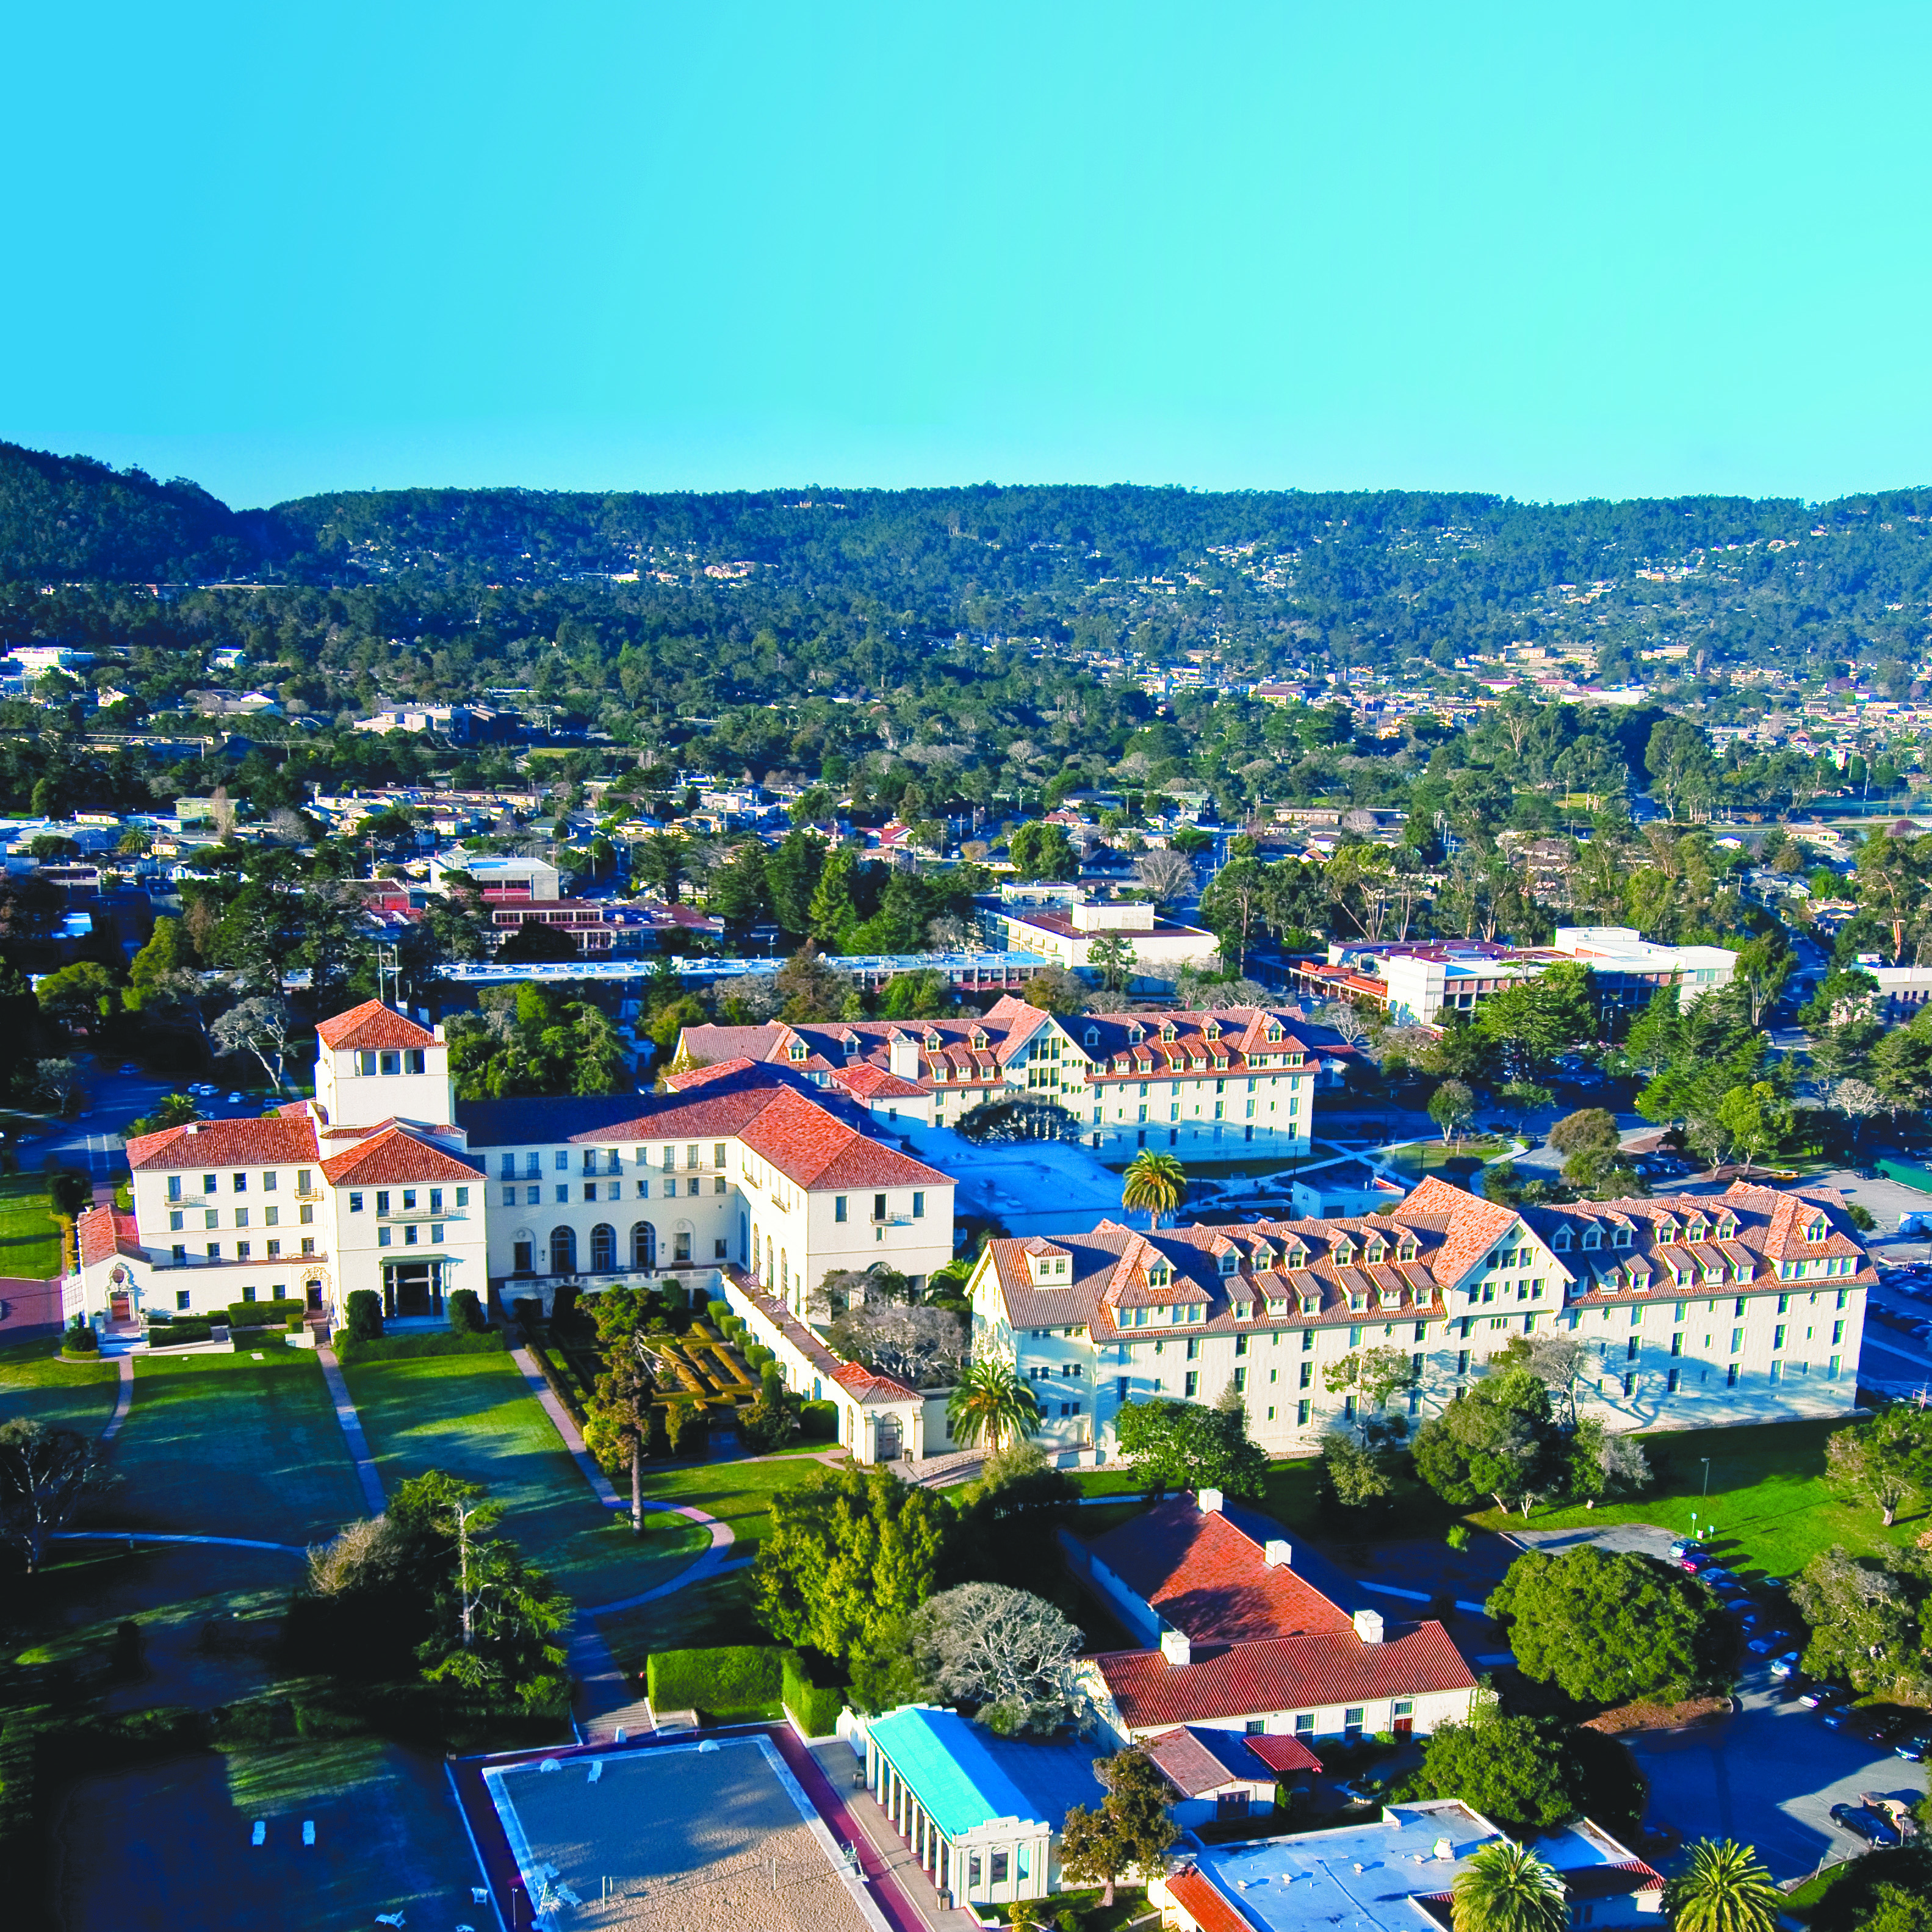

NAVAL POSTGRADUATE SCHOOL
1 University Circle, Monterey, CA
www.nps.edu

Slide 2
Graduate Certificate in
Robotics Engineering
Department of Mechanical and Aerospace Engineering

Slide 3
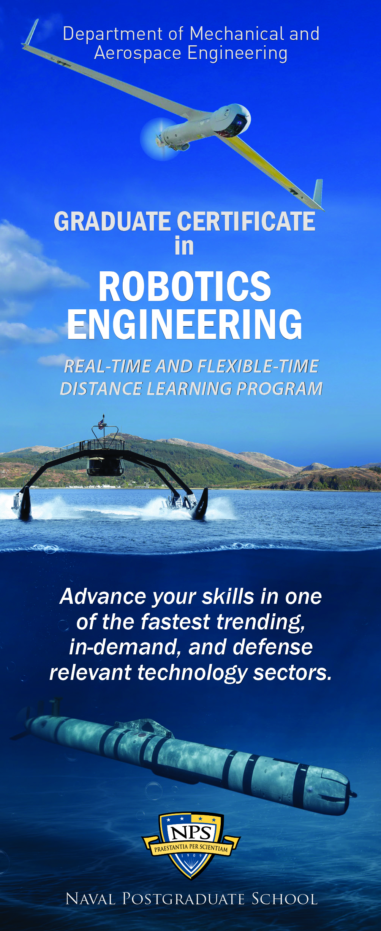
Overview
Graduate certificate
Focus on NR&DE relevant
topics in Unmanned Systems
Four technical courses,
nominally one year
Hybrid delivery:
  Remote classroom/assignments
  Two, one-week lab residencies
  (Currently Suspended)
Summer/ winter quarter entries -
late Sept/ March application deadlines

Slide 4
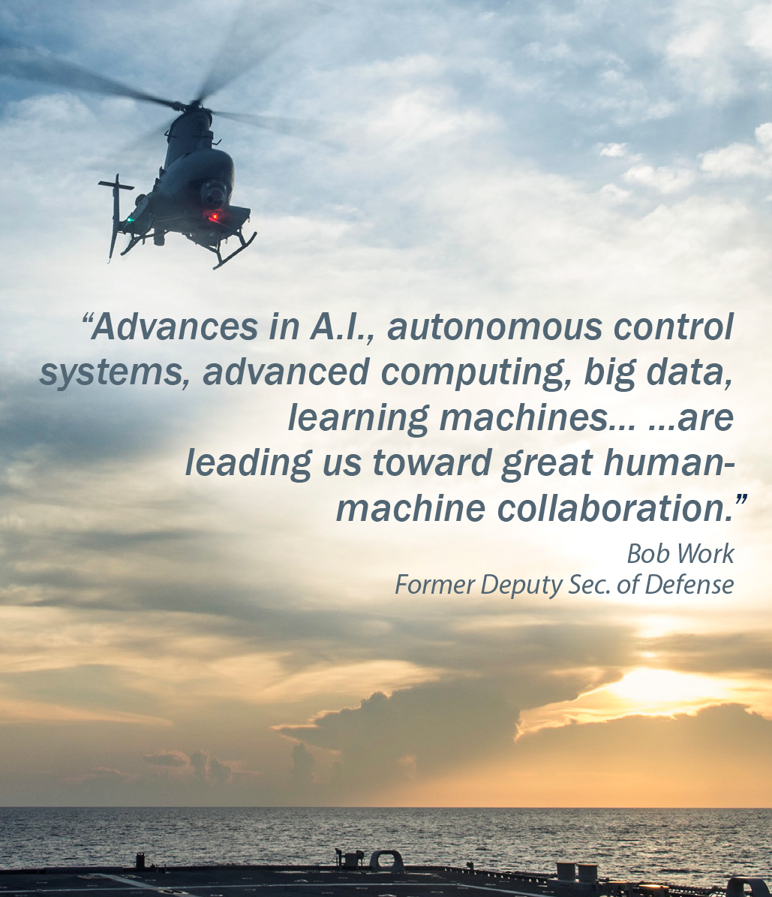
Robotics Engineering Certificate Four Graduate Courses
Foundations
  ME3420 Computational Foundations
  for Robotics (MATLAB)
  EC4310 Fundamentals of Robotics
Applications / Electives
  ME4822 Guidance, Navigation, and Control of Marine Systems –or– ME4828 Fundamental GNC Algorithms of Autonomous Robotics
  AE4820 Robotic Multibody Systems –or–
  ME4800 Machine Learning for Autonomous Operations
A variety of other courses across campus may be substituted for the “Applications” courses based on teaching schedules and customer demand. E.g., ME4823: Multiple Robot Cooperative Control.

Slide 5
Educational Objectives
Designed for a practicing engineers with a STEM undergraduate degree
Provide foundational knowledge to begin working on NR&DE topics in robotics and autonomous systems
Uniquely relevant defense (NAVSEA/NAVAIR) examples and applications:
  Sensor integration
  Mission-centric
Combine NPS expertise in
distance learning and
hands-on education
Foster collaboration and
alignment across NR&DE

Slide 6

Stackable
Options to “stack” certificate programs, e.g.,
  Robotics + Applied Trajectory Optimization + Thesis
  = Aeronautical Engineering MS
  Robotics + 4 ME courses + Thesis
  = Mechanical Engineering MS
  Robotics + 4 ECE courses (+ Thesis)
  = Electrical and Computer Engineering Meng (MS)
CAVEAT: This route benefits from prior planning!

Slide 7
Instruction
Faculty-led instruction
Typically one course per quarter
Online delivery in two modes
  Synchronous: Parallel with resident course via VTC
  Asynchronous: Self-paced online material
  Both modes provide schedule flexibility
One-week NPS residencies
  Hands-on labs
  Leverage NPS facilities
  Collaboration between NR&DE engineers

Slide 8
Details
Cost
  $3,500 / course
  Minimal textbook costs. Software licenses provided.
Eligibility
  STEM undergraduate degree
  Command participation agreement
Application
  Online application: See NPS calendar for deadlines
  No GRE

Slide 9
Details
Class Size
  Minimum of 10 students.
  Maximum 30 per section.
Programming Languages
  Emphasis on language-independent computational concepts
  Currently programming in MATLAB
  with exposure to ROS, OpenCV, simulation, etc.

Slide 10
Summary
Four course, one-year graduate
certificate in Robotics Engineering
DL format with synchronous and asynchronous activities
Cohorts starting in Winter / Summer quarters
Apply online:
  https://nps.edu/Admissions/AMS/
Contact
  robotics.certificate@nps.edu
  www.nps.edu/web/mae/robotics

