Slide 1
Seed Project Presentation Outline
This presentation outline/example is meant to follow the project plan format and hopefully falls out of that easily.
This is meant as a guide for the typical questions / answers required. Your plan may vary and not all questions raised in this outline are appropriate to your project.
Goal:
Get through presentation in 6-10 minutes leaving 20 minutes for real discussion with the group.
USE US!! Think of the Funding Committee as on your team so ask us anything! The presentation to the Funding Committee is a good trial for donors in the end. We are here to help you make a big impact, get funding and make a difference at NPS and in the world!
Use your Steward(s) from the Funding committee to review drafts, ask questions of etc.!
Suggestions and Tips
Minimize text on slides.
Reading slides is not engaging. These donors have their hearts in the right place and are looking for an engagement with their funds that can follow. Their personal interaction with you has an impact. They want to support people that are doing great work and that they like interacting with. Showing your personality is great!
Team … focus on how the different people cover different aspects of the project per the example TEAM slide below.
You have automatic credibility! We work with the donors to explain how wonderful you are and the significance of your background so that you automatically have credibility when you walk into the room. This is our work on your behalf. Therefore, in the presentation, you can go ‘lightly’ here to express your strength/experience as pertinent, but all of the awards and qualifications will have been dealt with before hand!
Bullet lists for key points.
Photos better than words where applicable.
Demo/video even better than photos… where applicable.
Backup Slides…
If you have greater detail, long quotes, etc., feel free to put them in backup slides that you can pull up if questioned and that can be read in advance.
Background / Reading Material:
Feel free to provide any of this that you have. The funding committee AND donors do their homework and read in advance. This allows the presentation to go more quickly because there is already an understanding and more time for discussion and interactions!

Slide 2
Operating in Infrastructure-Less Environments
Title Slide… Example
Gurminder Singh, Ph.D.
Professor, Computer Science
Director, Center for Mobile Devices and Communications

Slide 3
The Problem / Opportunity
What problem are you trying to solve? Issue being addressed?
Or… what is the opportunity created by your project.
The following is a good problem slide! Few words but you quickly get the idea.
The second slide talks to the opportunity… what software can be standardized and used…

Slide 4
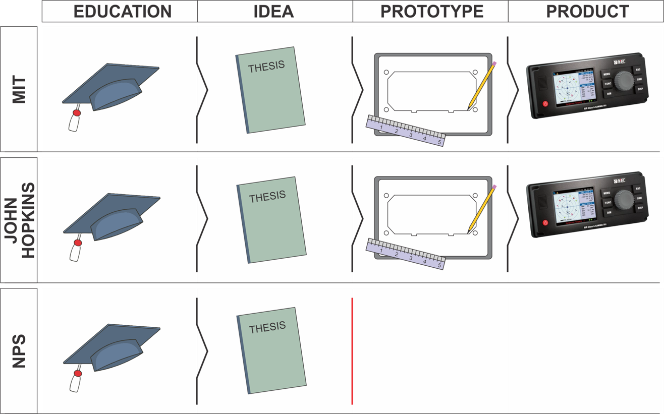

Slide 5
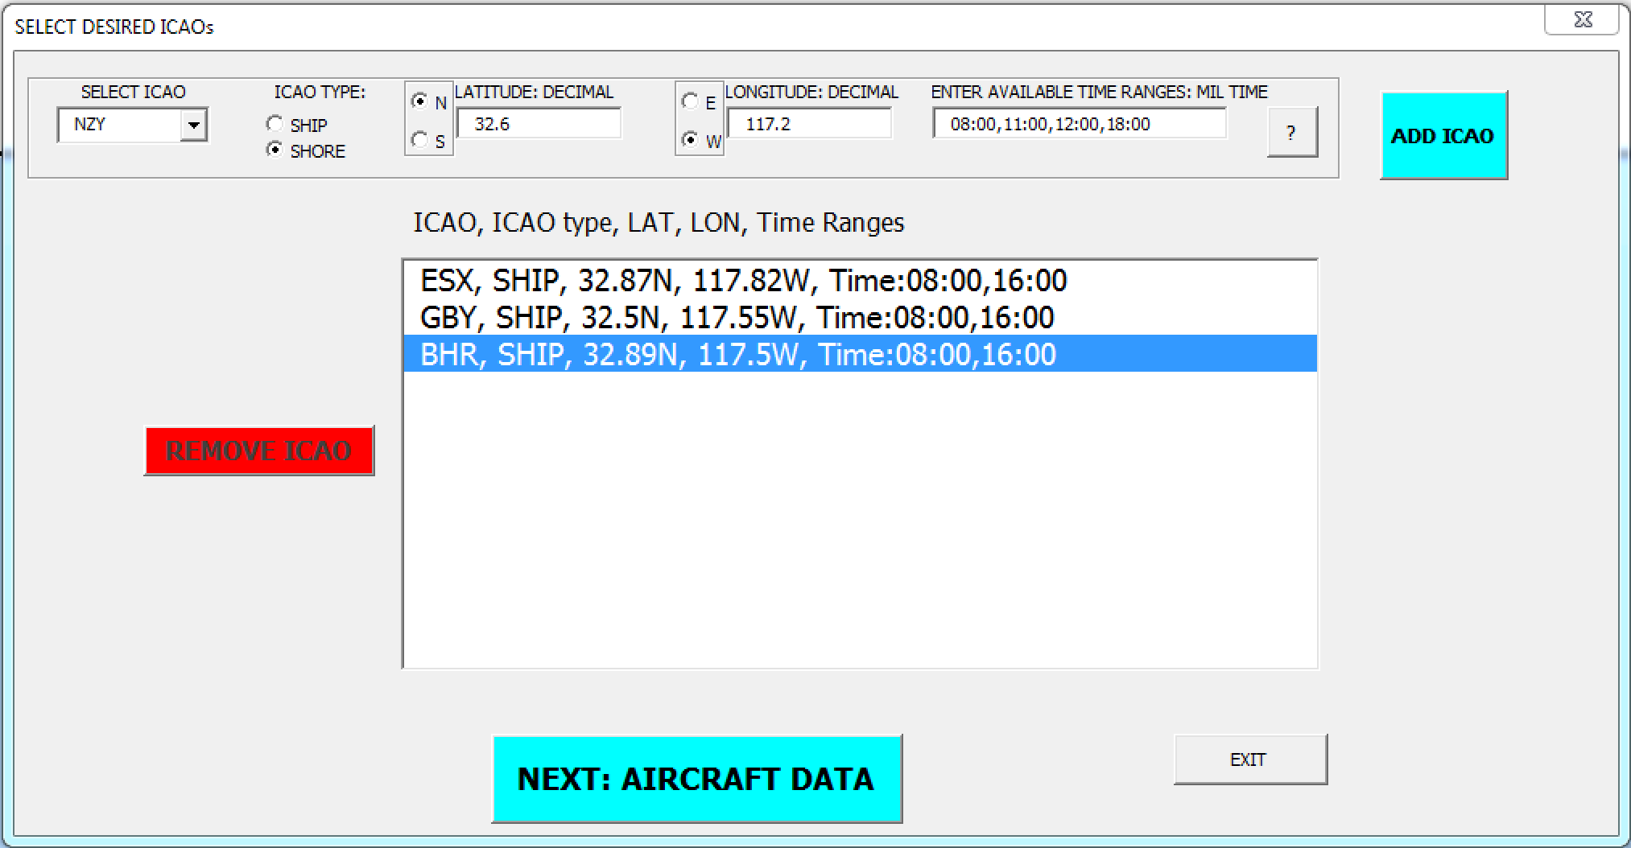
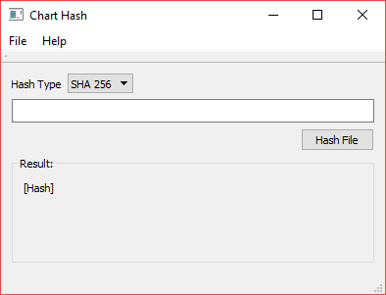
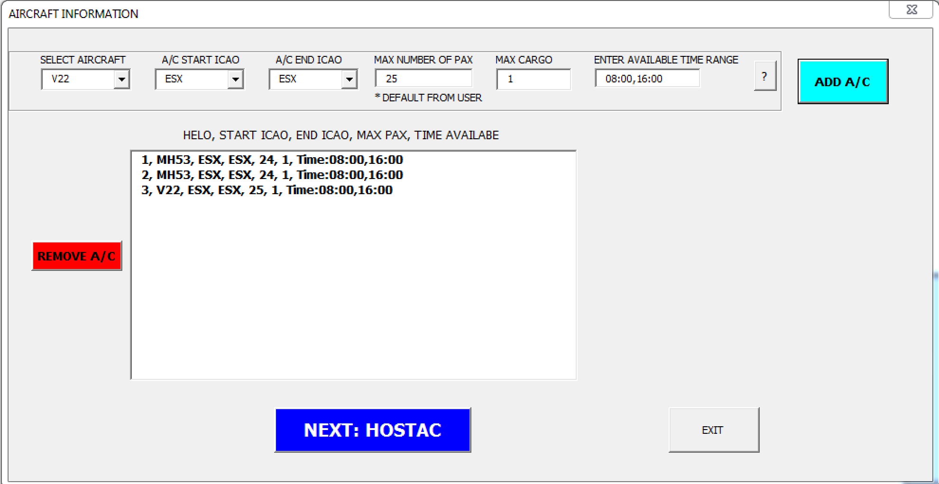
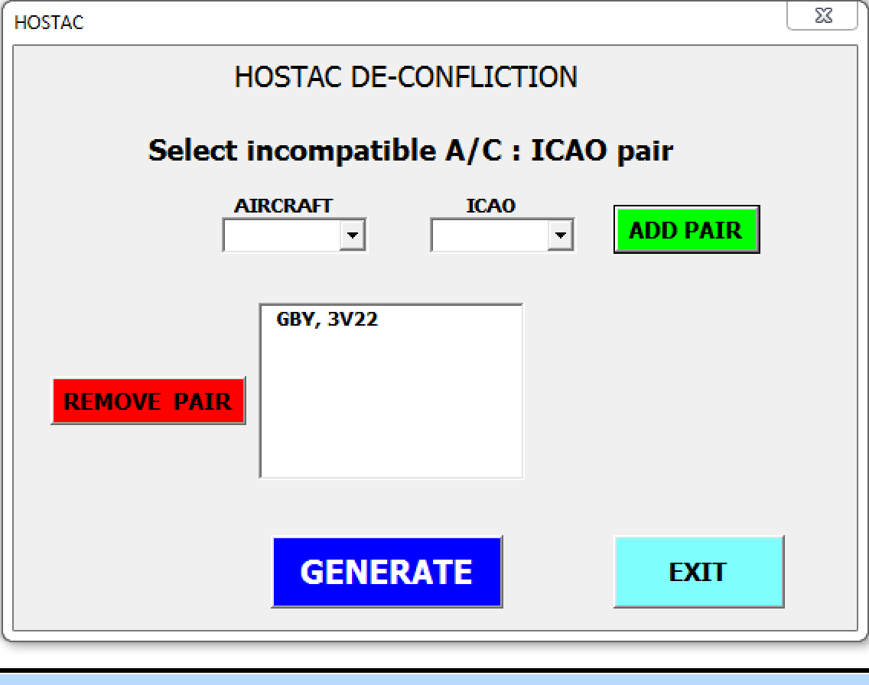
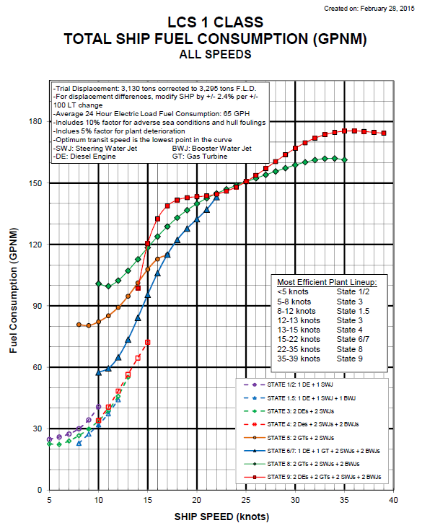
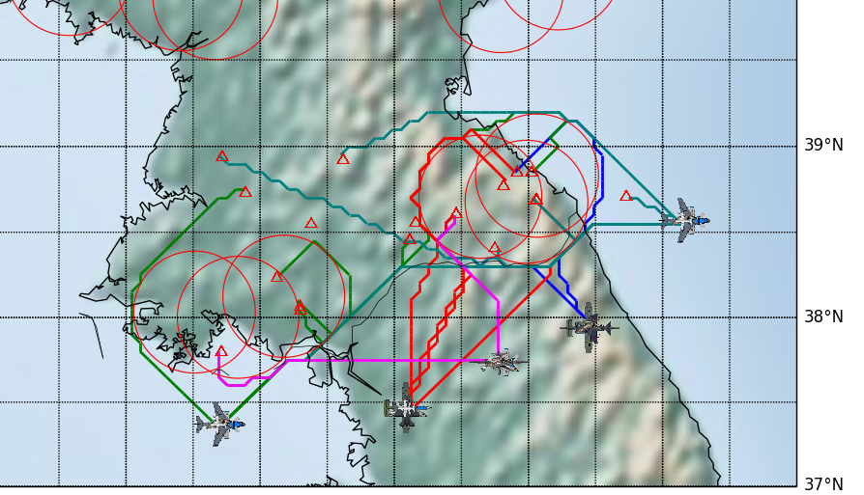
Ideas ready for transition
Amphibious route planning
Electronic chart security
Fuel conservation
Airborne battle management
Notes:
This is the main idea behind both TFP and OTTER
This is an example of how we minimize fuel usage using linear optimization.
Consider LCS1 on a 48 hour transit with a 19 kt PIM.
Traditionally, we would consider the best transit speed to be a constant, average speed.
Linear optimization tells us to use 2 speeds to average out the same but will burn less because of efficient points of interest.
Knowing these points of interest are a key to efficient ship driving.
This example shows a savings of 432 gph which over a 48 hour transit = 113 hours on station
This is a huge XX% savings
***This is compared to a ship maintaining average speed for the entire transit****
We all know that COs love drills and evolutions and typically stay at the front of the PIM window instead exactly in the middle.
So maintaining a constant speed is not a realistic comparison.
If we model in the actual behavior and compare the savings, it is significantly better for all ships.
Here is the formulation – Minimize total fuel burned, Arrive(1), on time (2).

Slide 6
The Solution
What you plan to do to solve the problem.
The less text and the more diagrams, schematics and photos the better. If you have a prototype or demo, this is the time to transition to it!
A picture is worth 1000 words and a prototype is worth 10,000 slides!

Slide 7
Value Proposition
Explain the value of the elimination of the problem…
… And / Or the value of the solution you provide.
Why is this so critical to NPS/DoN/DoD or…
Why is this approach novel?
What critical gap will this project fill?

Slide 8
Competitive Analysis (Why this approach/solution is not and can not be done by others in the world!)
Explain the current state of the art as you know it.
Provide limitations of other work being done in this area and why your approach is better.
Why hasn’t this been done elsewhere? Why hasn’t someone else identified this problem?
Why should/can this be done at NPS versus another leading research institution?
Everyone already understands:
The students are different…
Classified research is hard to do elsewhere…
Go beyond these generalities and make it more specific to your project.

Slide 9
Success & Metrics
What is success to you and how will it be measured?
What are the key metrics you plan to achieve.
What will you measure and how?

Slide 10
Impact Plan
What are your deliverables?
Who is your target customer with these deliverables?
Explain how your are going to reach your target customer so that this technology / research has an impact!
How is this research transitioned to the real world?

Slide 11
Current Status / Accomplishments To Date
If applicable…
Could be work already accomplished that will feed into this project or work in progress…

Slide 12
The Team
Big picture of the solution areas to show you have the bases covered as well as the expertise in that area.
Diagrams with names are often most effective here.
Made up Example: Budget Based Planning
The Combined Solution
Database of Solutions / Parts
Karen…: Owns company with all the models for every electric vehicle in the world.
Already vetted and used in other projects.
Simulation Engine
Dick…: Award winning,… tested in this way and that. Can be easily extended to include financial variables.
Wargaming Expertise
Andy…: Participates in x,y,z today and can easily get this to be a part of those.
Congress Connection = How we make an impact and influence the influencers.
Susan…: In Congress on the budget planning committee and looking for a new tool to take there.

Slide 13
Timeline and Use of Funds
Next Slide one example.

Slide 14
Example: Proposal
3 year effort, split into yearly phases
Phase 1 - $150K - Overall architecture development
Phase 2 - $200K - Detailed algorithms for security and control mechanisms
Phase 3 - $100K - Field testing and applications
Use of funds
85-90% - Faculty and research staff labor
5-10% - Equipment
5-10% - Travel for field experiments and conferences

Slide 15
In Summary: The Impact Statement
Reaffirm / summarize what impact this project will have.
This is your last and lasting impression! Make your case as compelling and simple as possible to sum it up!
This should be the lines you would want to hear people saying about your project over and over behind your back!

