Slide 1
Researcher(s): Title\Mil Rank, Name, Department, Center and/or Institute e.g., Dr. Ana Lytical, Physics; CAPT Perry Scope USN Ret., Operations Research; Ms. Ima Sage, SEED Center; Dr. Aldus Lamp COL USA Ret., MOVES Institute
Topic Sponsor: Lead (TRB) Organization Full Name e.g. N7 - Warfighting Development
NRP Project ID: NPS-XX-XXXX-X
e.g. NPS-21-N500-B
Technical Report: Calhoun Handle
Thesis: Calhoun Handle

Slide 2
Researcher(s): Title\Mil Rank, Name, Department, Center and/or Institute e.g., Dr. Ana Lytical, Physics; CAPT Perry Scope USN Ret., Operations Research; Ms. Ima Sage, SEED Center; Dr. Aldus Lamp COL USA Ret., MOVES Institute

Slide 3
submissions must be print/publish ready,
Department / organization names etc., should be spelled out, as this is a formal publication;
you are welcome to change the poster body layout. Do not change the header or footer format. Do not change the font. Minimum ½ inch margin on all sides;
if you do not have an NRP Project ID (required for all NRP projects) or Calhoun Identifier Number, etc., remove those fields. Do not leave blank information;
all submissions must be "Approved for public release; distribution is unlimited." and include this distro statement (if submitting NRP deliverable for restricted research a poster with appropriate markings must still be produced);
slide size must be 24x36 (template default);
it is recommended that you use high quality vector images;
prior to sending your poster slide to the NRP, ensure that you review your poster slide at "100% Zoom" (default view is 25% zoom) to verify the image print quality;
posters will also be uploaded to Calhoun and may be used for NRP marketing.
Questions? Contact: nrp@nps.edu or visit our portal at: https://nps.edu/nrp/

Slide 5
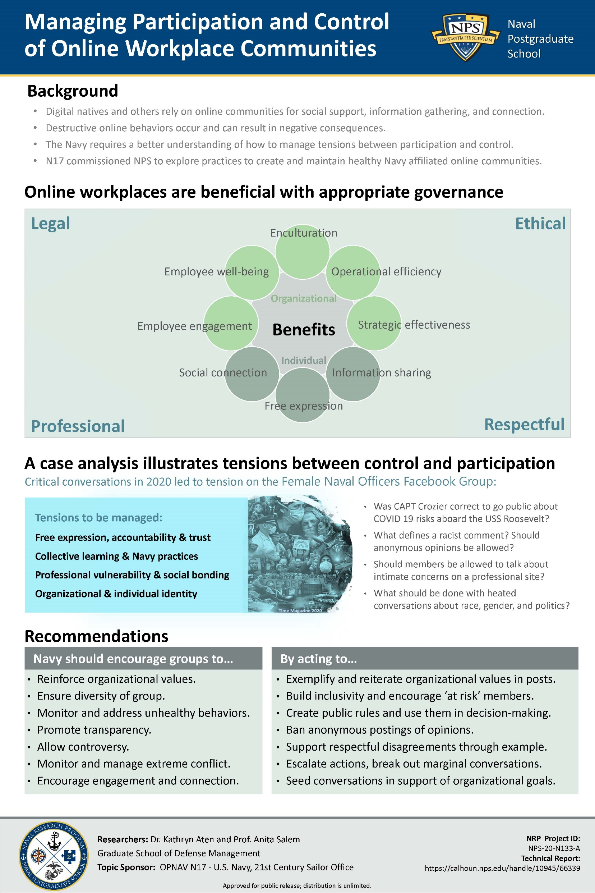

Slide 13
