Slide 1
How to Solder
Captain Matt Audette
Jan 2017
mraudett@nps.edu
404-304-9903

Slide 2
Topics Covered
Overview
Minimal Tools
Nice to Haves
Safety
How to Solder
Best Practices
Prac App

Slide 3
Overview
Different than welding
More like brazing
Solder: conducts, low melting temperature
Iron: heats up, melts solder
Joins wires, PCBs, electronic components
Quickly: Soldering in the Dojo

Slide 4
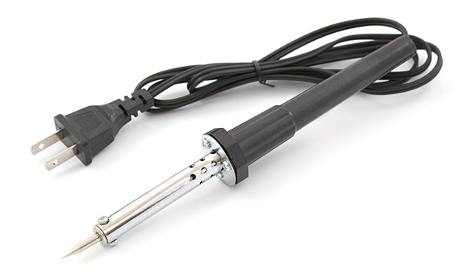
Soldering Irons
Gets hot
Like really hot
Gets components hot!
Will get you hot!
Parts
Tip types/sizes, changeability
Soldering Station
Unregulated heat

Slide 5
Solder
Alloy
Pb, Tin
Conducts electricity
Spools, tubes
Different gauges
2 types: leaded and Lead Free

Slide 6
Types of Solder
Leaded
Unleaded
Pb, Tin
Lower melting temperature
Sticks to itself
Does contain lead.
EU banned, CA Hard to find
Tin, copper, silver
No lead = higher melting temperature
Station
More difficult to use
“rosin core” / flux
Fumes

Slide 7
Minimal Tools
Iron
Solder
Knife/wire strippers
Tape/heat shrink
Wire cutters/pliers

Slide 8
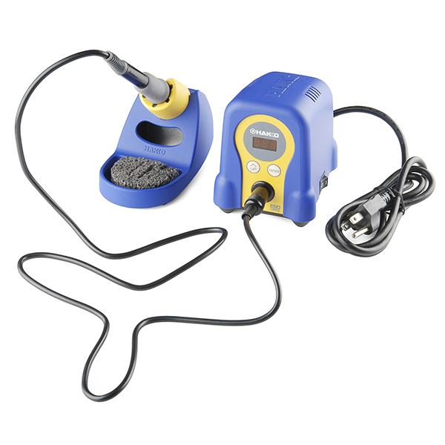
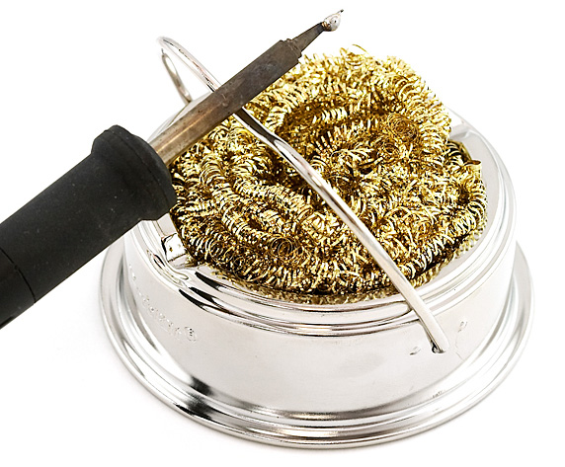
Nice to Haves:
Helping hands
Flux
Sponge/brass sponge
Cradle
Station
Solder pump/vacuum/wick
Ventilator
PCB Vice
Adam Savage’s Rule of Tool Buying

Slide 9
https://i.imgur.com/IGW8DcX.gifv

Slide 10
Soldering Stations
Regulates heat of the iron
w/o, get hotter and hotter
Varying levels
Cost vs niceness
Tailor to your level!
Plugs

Slide 11
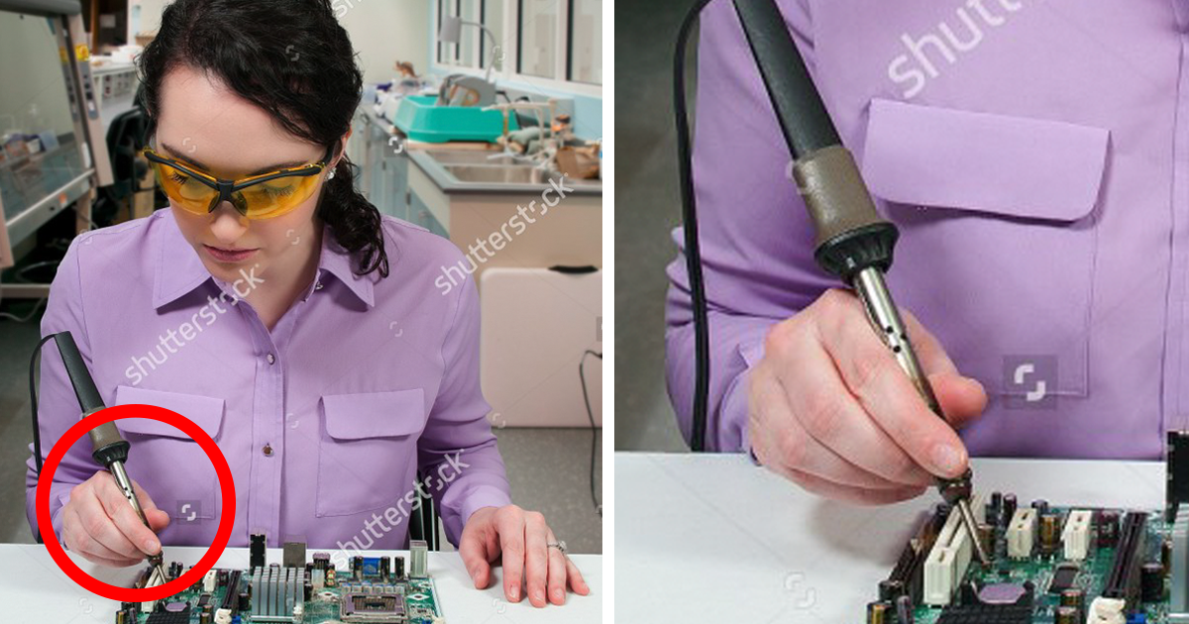
Safety
It gets hot
Fumes
Ventilated room
Ventilator
Leaded solder
NEVER SOLDER BATTERIES

Slide 12
Soldering
Good solder joint
“inside” wires
Strip wires
Join wires –
Apply flux
Apply iron
1 second count
Apply solder
Wait
Remove solder
Remove iron
Heat both ends to be soldered evenly
Both wires
Wire and the PCB
Heat your components, THEN add the solder
Side of the iron, NOT the tip
“Sweet spot”

Slide 13
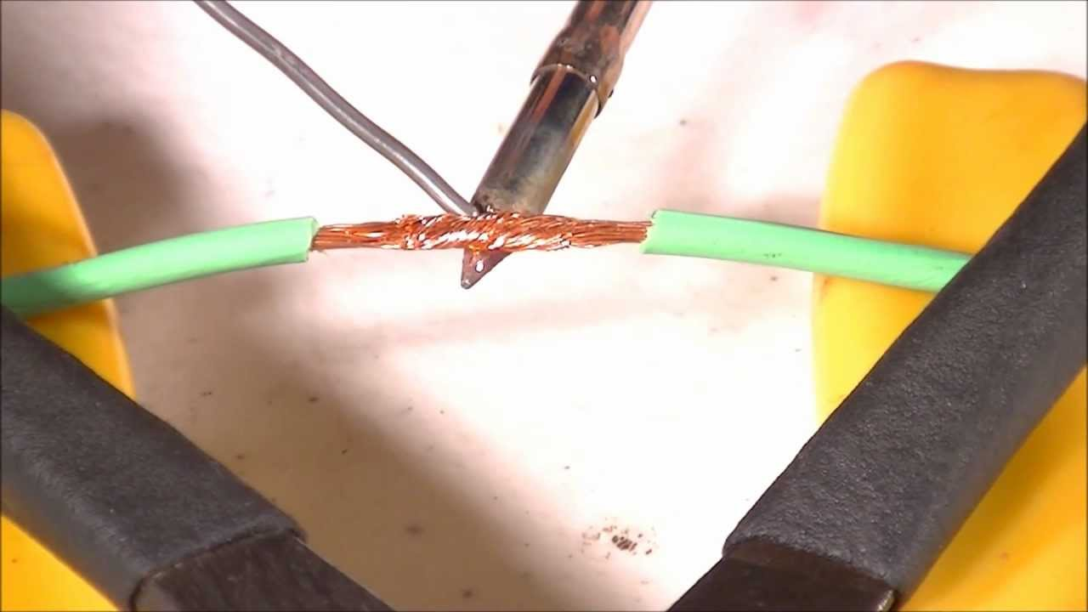

Slide 14
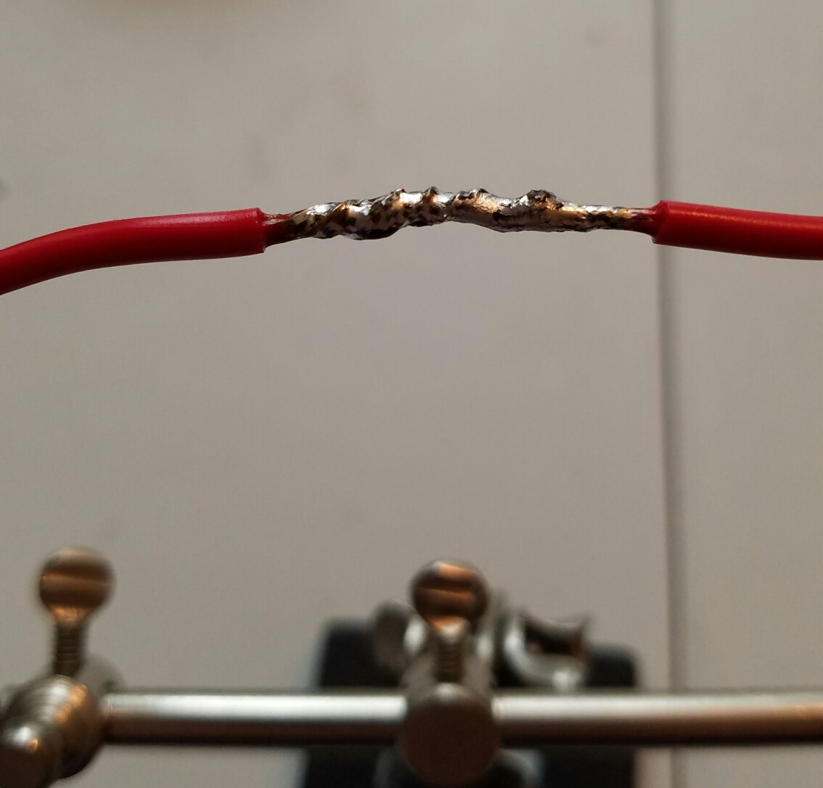

Slide 15
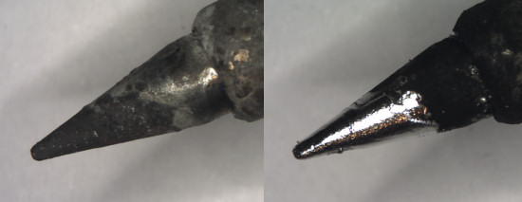
Tinning the Iron’s Tip
Hot tips oxidize
Tinned tips are easier to use
Brass sponge/damp sponge
“Buttering bread” motion
Place solder on tip, let it melt
Coat the tip in solder, let sit
Brush off extra solder

Slide 16
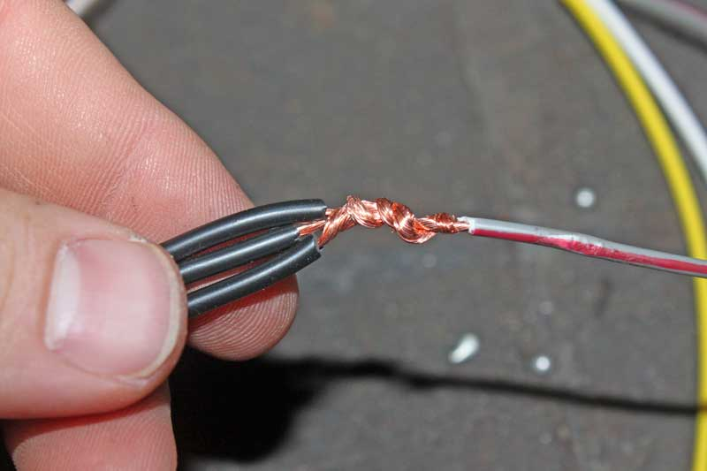
Joining Wires
Laying on top
“Mash up”
Twist
Western Union Pigtail
Best- NASA
“Wrong” is doesn’t conduct
Bulky is inconvenient

Slide 17
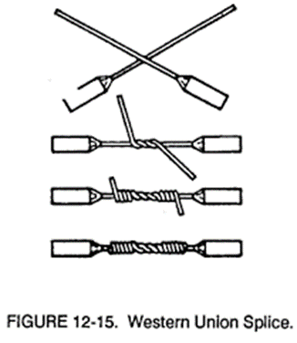
Western Union Pig Tail

Slide 18
Practice!

Slide 19
Soldering onto PCBs

Slide 20
Best Practices/Pro Tips
“Sweet spot”
Pull the iron away quickly
Flush cut cutters

Slide 21
Further Reading/Watching
https://learn.sparkfun.com/tutorials/how-to-solder---through-hole-soldering/soldering-irons

Slide 22
Further Reading/Watching

Slide 23
References

Slide 24
References: Videos
https://www.youtube.com/watch?v=f95i88OSWB4
https://learn.adafruit.com/minty-boost/solder-it

