Slide 1
How to Navigate TWMS and NKO

Slide 2
Overview
TWMS-
Every DON employee (active duty/reservist/civilian) has a TWMS account
Some TWMS courses take you to NKO
NKO – Slide 10

Slide 3
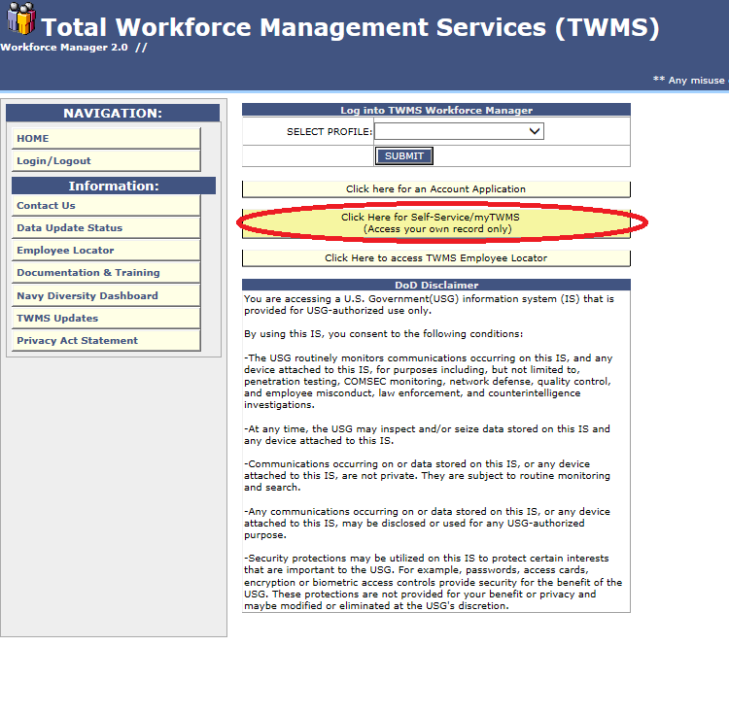
TWMS
https://mytwms.navy.mil/
Click for Self-Service

Slide 4
TWMS
Click continue

Slide 5
TWMS
Pop up appears and takes you to your outstanding training
No pop-up go to next slide

Slide 6
TWMS
If you do not get the pop-up from the previous page:
Select Online Training and Notices
Once on the page, this option will disappear from you menu on the left.

Slide 7
TWMS
Click on your desired requirement

Slide 8
TWMS

Slide 9
TWMS
If course is on TWMS it will pop up. If it is located on NKO it will redirect you to the NKO homepage

Slide 10
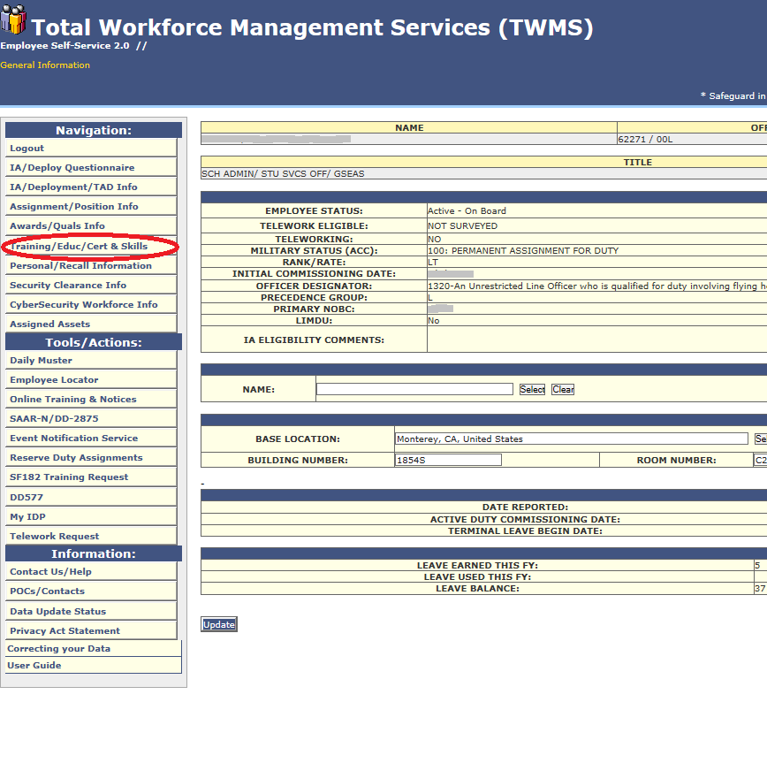
TWMS
Track your training
Click “Training/Educ/Cert &Skills”

Slide 11
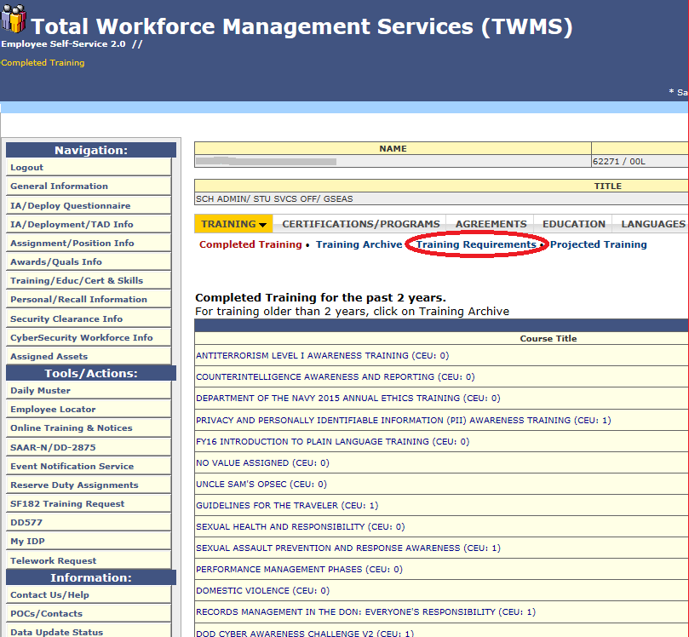
TWMS
Click “Training Requirements”

Slide 12
TWMS
The below list will show all of your requirements, their due dates and whether or not you have complete it. Due to training being on multiple sites, the completion column may take several days to reflect the completed training.

Slide 13
NKO
https://www.aas.prod.nel.training.navy.mil
CAC required
Click “I agree” and on next page “Login With CAC Card”

Slide 14
NKO
Course Catalog

Slide 15
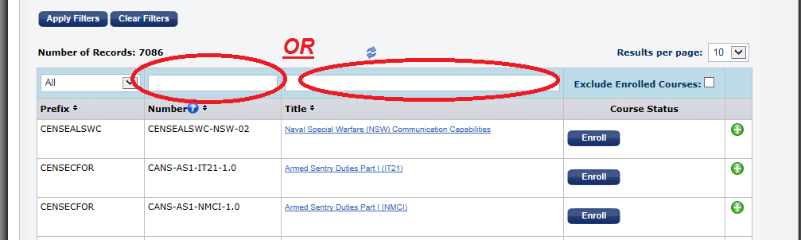
NKO
Type in the course code in the “Number” section
Ex: DOD-IAA-V13.0 for DOD Cyber Awareness
Type in the title or key word in the “Title” Section
Ex: Cyber Awareness or DOD Cyber Awareness Challenge V3

Slide 16
NKO
Click enroll for all applicable courses
Click “OK”

Slide 17
NKO
Go back to “My Learning” Tab

Slide 18
NKO
Launch Course!

Slide 19
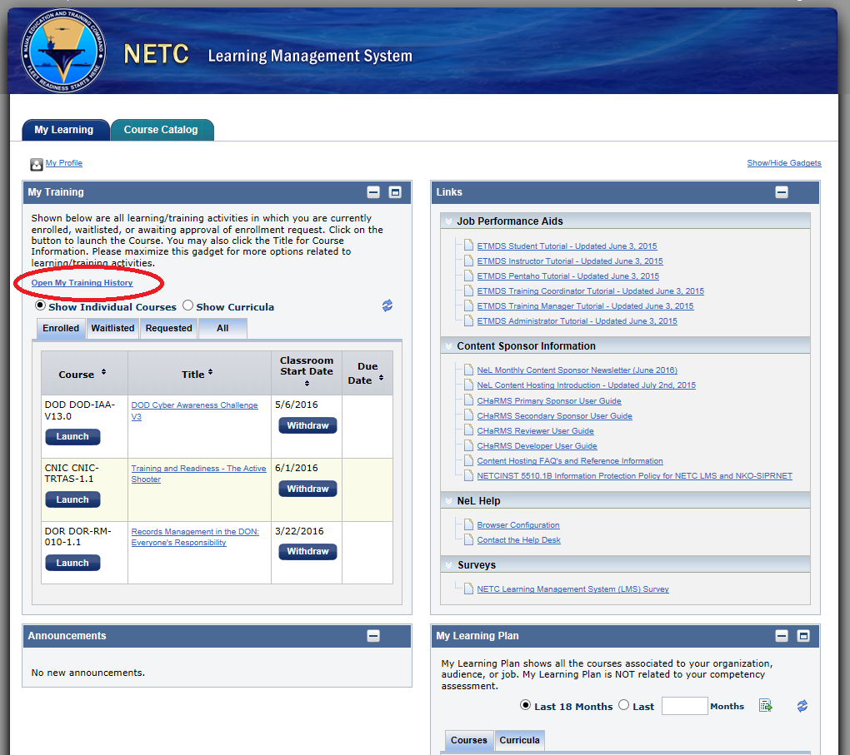
NKO
Find your Certificate after completion under My Learning click on “Open My Training History”

Slide 20
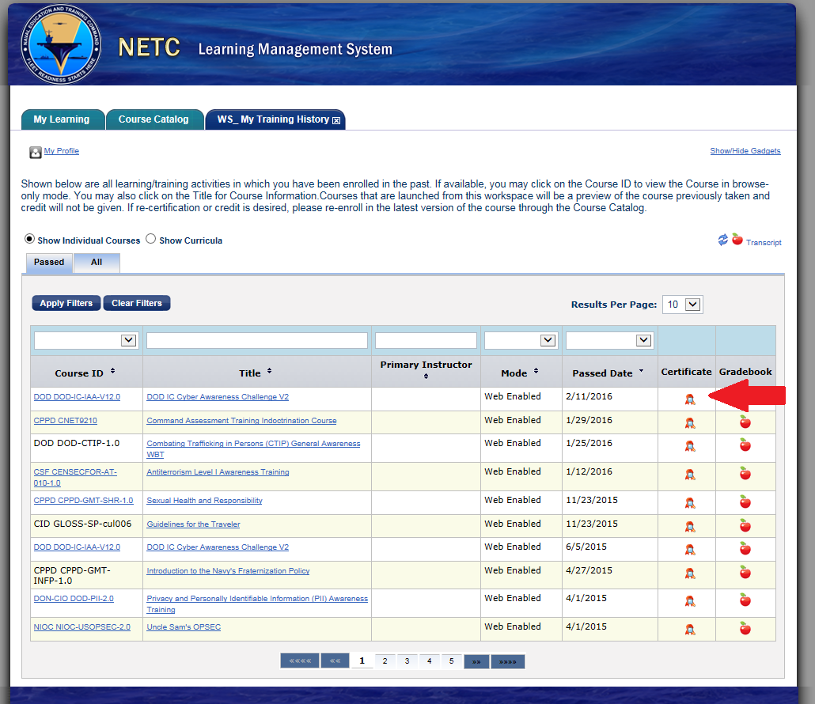
NKO
Find your training and click on the certificate

Slide 21
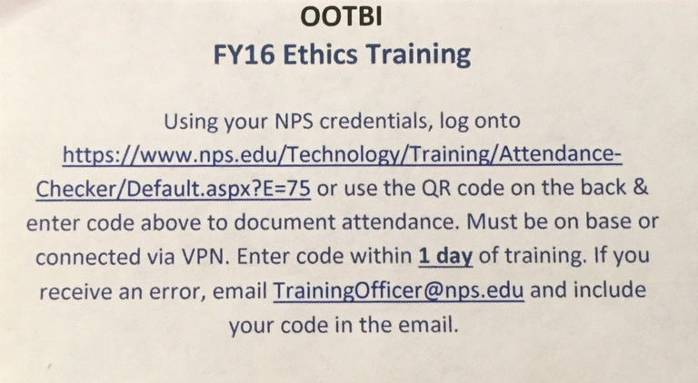
Muster Codes
Must be exact URL & connected via VPN

Slide 22
Questions?
Contact the Civilian Training Officer
George Martinez
TrainingOfficer@nps.edu
gcmartin@nps.edu
X-1187

