Slide 1
RoboData Project
IS-3201 - Group 13
Laura Dippold LCDR Lisa Gebreamlak Cpt. Huseyin Karaarslan
15 September 2016

Slide 2
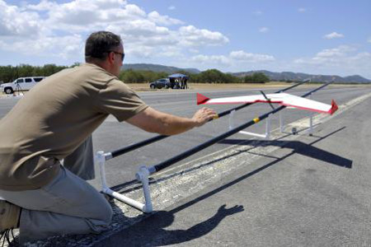
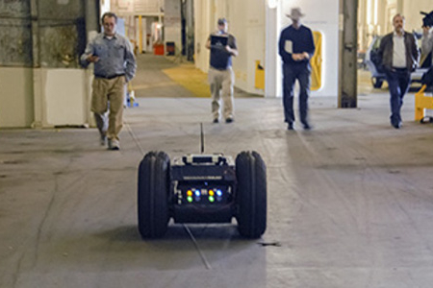
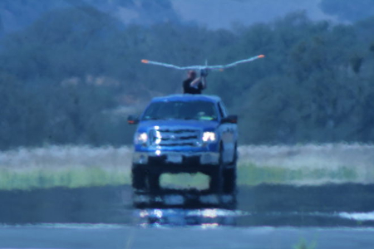
Agenda
Introduction
Purpose
Model
Demonstration
https://my.nps.edu/web/fx

Slide 3
Introduction
JIFX/CRUSER campaigns
Collaborative testing environment
Multiple vehicles/devices participate
STOQS @ MBARI
(Spatial Temporal Oceanographic Query System)
Query-able visual oceanographic database
https://my.nps.edu/web/cruser

Slide 4
Purpose
This database collects data from multiple sources
Key experiment parameters from STOQS
JIFX team registrations, including project descriptions
(possibly) NRP project summaries and other databases
Goals, results and references
Produce initial template and data schema for an eventual institutional robodata database
Show data extraction, usability, functionality

Slide 5
Model and Demo
Demo time!

Slide 6
Next Steps and Future Development
Refine the model
Additional entities may be needed as more data points are identified
Implementation and testing
Buy in from participants and stakeholders
Advisory Board creation to help guide the project

