Slide 1







Introduction to the DoD Performance Management and Appraisal Program (DPMAP)
DPMAP Rev. 2
July 2016

Slide 2

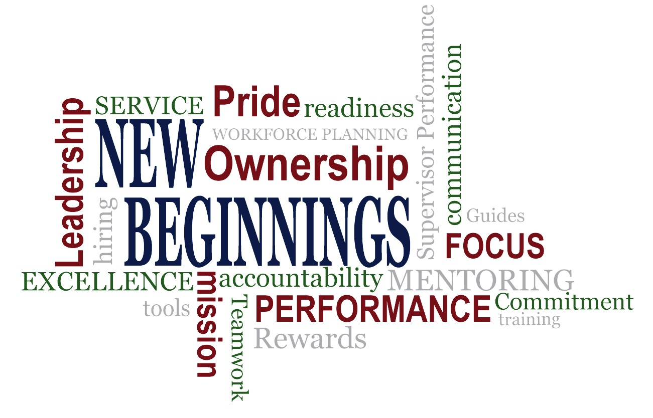
Fair – Credible – Transparent
DPMAP Rev. 2
Ju 16
(2)
ly 20

Slide 3
Course Information
Lesson 1: Performance Management Overview
Fair – Credible – Transparent
DPMAP Rev. 2
Ju 16
(3)
ly 20

Slide 4
Introductions
Please share your:
  Name
  Current position
  Location
  Experience in performance management
  Burning questions
Fair – Credible – Transparent
DPMAP Rev. 2
Ju 16
(4)
ly 20

Slide 5

Administrative Information
Start and end times for the class
Timing of breaks
Timing of lunch
Smoking area
Location of bathrooms
Location of emergency exits
Mobile devices
Parking Lot
Fair – Credible – Transparent
DPMAP Rev. 2
Ju 16
(5)
ly 20

Slide 6

Ground Rules
Participate
Share experiences
Respect divergent opinions
Ask questions
Avoid private side conversations
Honor time commitments
Fair – Credible – Transparent
DPMAP Rev. 2
Ju 16
(6)
ly 20

Slide 7
DPMAP Training Agenda
2 - day course
7 Lessons
Lesson 1 Performance Management Overview
Lesson 2 Engaged Employees
Lesson 3 Planning Performance
Lesson 4 Continuous Feedback
Lesson 5 Monitoring Performance
Lesson 6 Evaluating Performance
Lesson 7 Recognizing and Rewarding Performance
Fair – Credible – Transparent
DPMAP Rev. 2
Ju 16
(7)
ly 20
Notes:
Note: This training is not designed to teach you how to use the My Performance Tool.

Slide 8
Learning Objectives
Upon completion of this lesson, you will be able to:
Describe the relationship between performance management and the Department of Defense (DoD) mission and core values
Identify key performance management roles and responsibilities
Recognize significant performance management features
Characterize the DoD performance management model
Fair – Credible – Transparent
DPMAP Rev. 2
Ju 16
(8)
ly 20

Slide 9

What Do You Know About Performance Management?
What You
THINK
You Know
PERFORMANCE
MANAGEMENT
What You KNOW
You Know
What You ACTUALLY
Know
Fair – Credible – Transparent
DPMAP Rev. 2
Ju 16
(9)
ly 20
Notes:
Slide Hidden

Slide 10



Performance Management and DoD Strategic Mission/Goals
DoD Strategic Mission/Goals
Team/Individual
Organizational Goals
Component/Command/Activity Goals
Fair – Credible – Transparent
DPMAP Rev. 2
Ju
(10)
ly 2016

Slide 11
Pre-Decisional Involvement (PDI) of Labor Representatives and Program Development
DoD engaged with labor representatives through the DoD Roundtable
– Unions holding National Consultation Rights (NCR) under the Labor Relations Statute participated in the development of the DoD Performance Management and Appraisal Program with senior DoD leadership
Nothing in DPMAP changes the rights of employees, unions, or management
How the program is implemented may be guided by the collective bargaining
agreement (CBA)
– Depending on the procedures contained in the CBA, bargaining may be required prior to local implementation of the program
Consult your local Human Resources (HR) Labor & Employee Relations office for collective bargaining guidance
Fair – Credible – Transparent
DPMAP Rev. 2
Ju
(11)
ly 2016

Slide 12
DoD Performance Management Process
Performance Management is the systematic process by which an Agency involves its employees, as individuals and members of a group, in improving organizational effectiveness in the accomplishment of Agency mission and goals. (5 CFR §430.102)
Performance management is:
  Planning work and setting expectations
  Monitoring performance continually
  Evaluating performance in a summary fashion
  Recognizing and rewarding good performance
Fair – Credible – Transparent
DPMAP Rev. 2
Ju
(12)
ly 2016

Slide 13
DoD Core Values
Duty
Loyalty
Courage
TECHNICAL KNOWLEDGE
PROFESSIONALISM LEADERSHIP
Integrity
Honor
Ethics
Fair – Credible – Transparent
DPMAP Rev. 2
Ju
(13)
ly 2016

Slide 14

High-Performing Organizations
Continuous Learning and Improvement
Diversity
Integrity
Communication
High- Performing Organization
Accountability
Respect
Fair – Credible – Transparent
DPMAP Rev. 2
Ju
(14)
ly 2016

Slide 15

Key Performance Management Levels
DoD
Mission
Supervisors and
Employees
Organization
Component/Command/Activity
Fair – Credible – Transparent
DPMAP Rev. 2
Ju
(15)
ly 2016

Slide 16

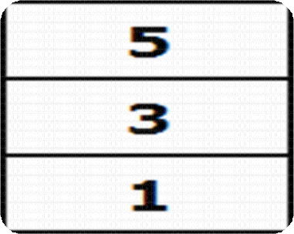

Key Performance Management Features
Minimum of THREE
Performance Discussions are
Required
BUT MORE
RECOMMENDED
Three-Level
Rating Pattern
Outstanding (5)
Fully Successful (3)
Unacceptable (1)
Performance
Appraisal Cycle
1 Oct. through 30 Sept.
Fair – Credible – Transparent
Notes:
NPS is working under a special dispensation authorizing a unique performance cycle in order to account for academic year.

Slide 17



Key Performance Management Features
Continuous Recognition and Rewards
Fosters Cultural and Attitudinal Change
Automated Performance Appraisal Tool
(Training to Follow)
Fair – Credible – Transparent

Slide 18
DoD Performance Management Model
PLANNING
MONITORING
EVALUATING
Fair – Credible – Transparent
DPMAP Rev. 2
Ju
(18)
ly 2016

Slide 19
Learning Objectives Review
You should now be able to:
Describe the relationship between performance management and the Department of Defense (DoD) mission and core values
Identify key performance management roles and
responsibilities
Recognize significant performance management features
Characterize the DoD performance management model
Fair – Credible – Transparent
DPMAP Rev. 2
Ju
(19)
ly 2016

Slide 20

Questions
Are there any questions?
Fair – Credible – Transparent
DPMAP Rev. 2
Ju
(20)
ly 2016

Slide 21
Additional Resources
National Defense Authorization Act for Fiscal Year 2010, Section 1113(d) DODI 1400.25, Volume 410, DoD Civilian Personnel Management System: Training, Education, and Professional Development.
DODI 1400.25, Volume 431, DoD Civilian Personnel Management System: Performance Management and Appraisal Program.
DODI 1400.25, Volume 451, DoD Civilian Personnel Management System: Awards.
DCPAS Resources and References web site:
https://www.cpms.osd.mil/Subpage/NewBeginnings/ResourcesReferences/
DCPAS HR Toolkit:
https://dodhrinfo.cpms.osd.mil/Directorates/HROPS/Labor-and-Employee- Relations/Performance- Management/Pages/PM-Guides-TipSheets-Checklists.aspx
DCPAS LERD web site
https://dodhrinfo.cpms.osd.mil/Directorates/HROPS/Labor-and-Employee-Relations/Pages/Home1.aspx
Corporate Leadership Council. Building the High-Performance Workforce: A Quantitative Analysis of the Effectiveness of Performance Management Strategies (Washington D.C.: Corporate Executive Board, 2002)
DPMAP Rev. 2
Fair – Credible – Transparent
July 2016
(21)

