Slide 1



Lesson 2: Engaged Employees
DPMAP Rev.2
July 2016

Slide 2
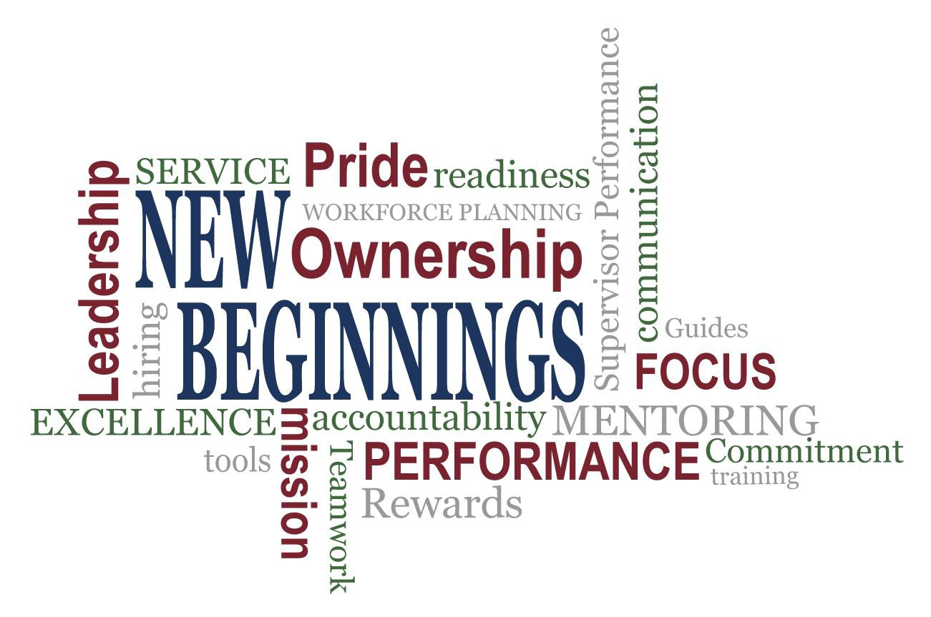

Slide 3

Learning Objectives
Upon completion of this lesson, you will be able to:
Define the relationship between organizational effectiveness and performance management
Define employee engagement’s connection to the
DoD culture of high performance
Identify activities that can improve supervisor- employee relationship
Identify strategies to enhance employee engagement

Slide 4
Organizational Effectiveness and Performance Management
Performance management is the integrated process by which an agency involves its employees in improving organizational effectiveness in the accomplishment of agency mission and strategic goals
Organizational effectiveness is defined as how well an organization is able to meet its goals
Credibility, transparency, equity, and accountability enhance organizational effectiveness
Effective performance management can significantly improve
organizational success

Slide 5



Employee Engagement and High-Performance Environments
COLLABORATIVE
DIRECTIVE
Top-down thinking
Supervisors provide instruction, employees carry out the task
Two-way
Supervisors provide instruction, but employees are encouraged to provide feedback
Upward feedback
HIGH-
PERFORMANCE
ENVIRONMENT

Slide 6

Video – Greatness

Slide 7





What Is Employee Engagement?
U.S. Merit System Protection Board research identified six themes important to Federal employees. They are:
1. Pride in one’s work or workplace
1. Pride in one’s work or workplace
4. Satisfaction with leadership
A heightened connection among employees, their work, their organizations, and the people with whom they work, including supervisors
2. Opportunity to perform well at
work
5. Satisfaction with the recognition
received
3. Prospect for future personal and professional
growth
6. A positive work environment with
a focus on teamwork
MSPB Source: The Power of Federal Employee Engagement by the U.S. Merit Systems Protection Board http://www.mspb.gov/netsearch/viewdocs.aspx?docnumber=379024&version=379721&application=ACROB
DPMAP Re^{AT}v.2
July 2016
(7)

Slide 8
Supervisor-Employee Engagement
DoD core values
Supervisors and employees should MEET FREQUENTLY
Organizational goals
Work assignments and accountability
Time, resources, and changing mission requirements
Career goals and interests
to discuss:
Focus on performance planning
Skill development and learning opportunities

Slide 9
Supervisor-Employee Roles and Responsibilities
Supervisors and employees, when effectively collaborating, can greatly impact organizational effectiveness
Open communication is beneficial to building employee
engagement
Three keys roles for employees to help their supervisors:
Team Empowerment | Upward Coaching | Upward Feedback
Maintain team cohesion Understand what others on the team do Share their sense of the team’s strengths and areas for improvement Share their understanding of the team’s biggest challenges | Understand both the team’s and their responsibilities Share the best informal ways of getting things done Share the team’s long-term work goals Teach their supervisors a new skill, concept, process, or procedure | Give their supervisors constructive feedback Give feedback on their supervisors’ ideas Sharing their understanding of the supervisors’ strengths and areas for improvement

Slide 10
Group Activity: Employee Engagement Scenarios
As a class discuss the following three scenarios:
Employee Engagement Scenario #1
Employee Engagement Scenario #2
Employee Engagement Scenario #3
DPMAP Rev.2
July 2016
(10)

Slide 11
Employee Engagement Scenario #1
Betty is a supervisor who loves her job and is very passionate about what she does and how she does it. She takes advantage of opportunities to learn more about her field, attending an annual conference and signing up for seminars when they are offered. Her personal values align well with those of the agency, and she emphasizes the importance of their mission to her employees. She ensures that her team is prepared to take advantage of developmental opportunities. Her employees always know her expectations for their work because she meets with them regularly to discuss their work.
Her employees always give her their best and follow her lead in looking for opportunities to grow professionally. They take great pains with their work to ensure it’s the best they can do. They often collaborate with each other, reaching out to help each other achieve their goals.
Betty has never thought to nominate her team for the agency’s annual Outstanding Department of the Year award for exceptional performance, even though supervisors often tell her how much they enjoy working with her team. They often praise the team’s professionalism and say that the team’s work is first-rate. Betty takes great pride in receiving these compliments and believes it is because of the high standards she has instilled in the team.

Slide 12



Employee Engagement Scenario #1 Debrief
On a scale of 1 to 5, where 1 is being disengaged and 5 is being highly engaged, how engaged do you think Betty is? Why?
What are some of the positive results of Betty's level of employee engagement in her job?
How would your employees respond to Betty's style and level of employee engagement? Why?

Slide 13
Employee Engagement Scenario #2
Sam was promoted to supervisor almost a year ago, partly because of his strong technical skills, but also because he so clearly loved what he was doing. His values closely matched the mission of the organization, which made him work harder than many of his counterparts. He is highly competent in his team’s technical area, and often prefers to solve problems himself rather than delegating appropriately to his employees or ask their opinions on how to proceed.
Although Sam is courteous and respectful to his employees, he does not spend much time talking with them to find out about their career goals or professional interests. He is very reserved and his team seems to be reluctant to initiate conversations with him about topics such as his expectations for their performance, opportunities for growth, or offering to take more responsibility for decision making.
Sam received feedback during his performance review that suggested he should focus on his interpersonal skills as a way to help his employees become more engaged with their work and the agency. Since he received this feedback, Sam has become less enthusiastic and involved in his work. He often leaves work early and avoids having one-on-one conversations with his team. He knows that this is having a negative effect on his team’s engagement and motivation, but he does not know what to do.

Slide 14



Employee Engagement Scenario #2 Debrief
Sam was highly engaged at the time of his promotion, but the performance elements of his job that require supervision and one-on-one interaction with employees make him uncomfortable. As a result, he is becoming less engaged. What effect will this have on his team's level of engagement?
If you were Sam's supervisor and you noticed this change in behavior, what would you do?
If Sam really wants to change things and get his team engaged in their work, what could he do?

Slide 15
Employee Engagement Scenario #3
Francine is an experienced supervisor who absolutely loves her job. She enjoys both the technical work and, particularly, being in a position to assist and influence others in their career development. She feels that working with her team is one of the most important things she does, and looks forward to opportunities to mentor them and share her knowledge. Francine also acts as a conduit for information from other parts of the organization. Last month, her supervisor told her that several budget-cutting actions were coming within the next two months. These included cutting training classes and cuts in awards programs for the rest of the fiscal year. Depending on how much money is saved through these cuts, leadership is considering reorganizing some departments to improve efficiency.
Her employees seemed to appreciate her interest and they came to her for advice and, following her example, they worked very collaboratively. After she told her team about the upcoming budget cutting measures, she has noticed that they seem to be working more on their own rather than seeking out others to share ideas or discuss problems. In addition, they are not communicating with her in person, often choosing to email her rather than call or come to her office. So far, performance has not decreased, but Francine is concerned that the cuts are causing her team to feel less engaged with the agency.

Slide 16



Employee Engagement Scenario #3 Debrief
What are some potential causes for
the change within the team?
What can Francine do to help improve the team’s engagement level?
What effect might her employees’ lower level of employee engagement have on Francine’s own attitude and engagement?
What could the team do to help her?
What could she do to re-energize herself?
What could her supervisor do to help her?

Slide 17
Employee Engagement Scenarios Exercise
What are some strategies that supervisors can implement to
enhance employee engagement?
  Record 3 ideas that would work in your workplace and submit them to your teaching team as lessons-learned

Slide 18
Additional Employee Engagement Strategies
Fostering culture of continuous feedback
Encourage employees to find a mentor
Sharing time with employees
Employee Engagement
Encourage and promote professional growth and learning
Give employees opportunity to provide input
Take opportunities to provide positive feedback
Encourage and model work-life balance

Slide 19

Wrap-up Discussion:
Engaging and Disengaging Behaviors In Your Workplace
What have you seen in your own workplace that...
Engages people?
Disengages people?

Slide 20
Learning Objectives
You should now be able to:
Define the relationship between organizational effectiveness and performance management
Define employee engagement’s connection to the
DoD culture of high performance
Identify activities that can improve supervisor- employee relationship
Identify strategies to enhance employee engagement
DPMAP Rev.2
July 2016
(20)

Slide 21
Questions
Are there any questions?
DPMAP Rev.2
July 2016
(21)

Slide 22
Additional Resources
DODI 1400.25, Volume 431, DoD Civilian Personnel Management System: Performance Management and Appraisal Program.
DODI 1400.25, Volume 451, DoD Civilian Personnel Management System: Awards.
U.S. Department of Defense, Report of the New Beginnings Design Teams: Proposals and Recommendations for the Design of Personnel Authorities in Section 1113(d) of the National Defense Authorization Act for Fiscal Year 2010 (Washington D.C.: November 2011)
U.S. Government Accountability Office, Additional Analysis and Sharing of Promising Practices Could Improve Employee Engagement and Performance GAO-15-585 (Washington D.C.: Government Printing Office, 2015).
U.S. Merit Systems Protection Board, Managing for Engagement – Communication, Connection,
and Courage (Washington D.C: Government Printing Office, 2009).
U.S. Merit Systems Protection Board, The Power of Federal Employee Engagement (Washington D.C: Government Printing Office, 2008).
DCPAS Resources and References web site: https://www.cpms.osd.mil/Subpage/NewBeginnings/ResourcesReferences/
DCPAS HR Toolkit:
https://dodhrinfo.cpms.osd.mil/Directorates/HROPS/Labor-and-Employee- Relations/Performance- Management/Pages/PM-Guides-TipSheets-Checklists.aspx
DCPAS LERD web site https://dodhrinfo.cpms.osd.mil/Directorates/HROPS/Labor-and-Employee- Relations/Pages/Home1.aspx
Performance Management is a COLLABORATIVE EFFORT between Supervisors and Employees
DPMAP Rev.2
July 2016
(22)

