Slide 1



Lesson 3 Planning Performance
DPMAP Rev.2
July 2016

Slide 2



Slide 3
Learning Objectives
Upon completion of this lesson, you will be able to:
  Explain the performance planning phase and its importance to the success of the performance management process.
  Explain how to link your work performance plan to your organization’s
mission and core values.
  Write performance standards for the performance plan using the SMART concept.
  Describe tools and techniques used to finalize the performance plan.

Slide 4
Performance Management
Ongoing
Supervisors and employees share responsibility
Consist of:
  Proactively planning work and setting expectations
  Continually monitoring
performance
  Evaluating performance in a summary fashion
  Recognizing and rewarding good performance
PLANNING
PERFORMANCE
MANAGEMENT
EVALUATING
MONITORING
RECOGNIZING AND REWARDING

Slide 5
The Importance of Planning
Plan work, set expectations for future results
Connect employee’s work to the DoD mission and how it cascades down to the employee
Increase awareness of expectations and results
Provide a sense of ownership in the plan
Create a better understanding of performance and evaluation standards

Slide 6




Planning Performance
Planning Phase
Effective performance planning is a result of employee and supervisor engagement that provides opportunity for employee input in establishing ongoing communication and establishment of a mutual understanding of performance expectations and organizational goals throughout the performance appraisal cycle

Slide 7


Planning Phase Roles and Responsibilities
Employees: Supervisors:
Identify achievable performance elements and standards for themselves
Provide input to supervisor regarding the performance plan
Ask questions to clarify the supervisor’s expectations of their performance
Compile list of tasks
Establish appropriate performance elements
Establish quantifiable and measureable standards
Communicate approved performance plan to employee and how performance expectations link to organizational goals
Encourage continuous, meaningful two-way communication
Proactively communicate the plan to the employee
Provide a copy of the approved performance plan
Conduct performance planning discussion s
Modify the performance plan, as needed

Slide 8
Performance Elements
Performance elements describe what work is to be performed
  Performance plans must have a minimum of one critical performance element, maximum of 10, and each performance element must have associated standards that define expectations
  The number of supervisory performance elements on performance plans for supervisors will equal or exceed the number of non- supervisory (technical) performance elements
  An organization may have standardized performance elements
DoD Instruction 1400.25, Vol. 431

Slide 9
Standards
Standards describe how the requirements and expectations provided in the performance elements are to be evaluated
  Should be written using SMART criteria
  Must be written at “Fully Successful” level for each performance element
  Avoid using absolute standards (e.g., 100 percent, always, or never)
unless critical to life and safety
DoD Instruction 1400.25, Vol. 431

Slide 10
Are the standards applicable?
Can the supervisor use the standards to appraise performance?
The standards should clearly describe the factors that the
supervisor would look for and how well those factors should be done.
Standards should specify:
Quality
Quantity
Timeliness
Cost-effectiveness
 | Can the supervisor effectively use the
 | data collected?
If monitoring performance on the performance element is too costly or time-consuming, the standard might need to be altered to include more manageable standards
DPMAP Rev.2
July 2016
(10

Slide 11
Are the standards achievable?
Are expectations reasonable?
Research has shown that setting expectations that are impossible or nearly impossible to achieve can actually cause performance levels to drop because employees tend to give up if they perceive the goal as impossible

Slide 12
Are the standards fair?
Are they comparable to expectations for other employees in
similar positions?
  Applying different standards to employees doing the same work does not appear on its face to be fair or valid
  Requiring higher-level management review of standards for similar
work across an organization may be one way of ensuring equity
Do the standards allow for some margin of error?
  Requiring perfection is not fair in most instances

Slide 13



Can the Fully-Successful be surpassed?
Is it possible for an employee's performance to
exceed the standard?
By including “Fully Successful” standards that cannot be surpassed, the performance plan effectively eliminates the opportunity for the employee to obtain a higher assessment

Slide 14
Are performance elements and standards adjustable?
Can they be adapted readily to changes in resources?
Performance elements and standards can be modified during the performance appraisal cycle to meet changing organizational goals and other situations
– As long as the employee works under the new standards for at least 90 days
This flexibility allows performance plans to be used as management tools to manage employee performance on a day-to-day and week-to-week basis

Slide 15



Writing SMART Standards
S
Specific
M Measurable
A R T
Achievable
Relevant Timely

Slide 16


Writing SMART Standards
S
Specific: stated as simply, concisely, and explicitly as possible.
Defined as specific behaviors, efficiencies, or results
Concrete and job-related
Stated in active voice with one action verb
Example: Type written communications for the division.

Slide 17



Writing SMART Standards
M
Measurable: Outcome-oriented, reflecting the most important aspects of performance
Should be able to
  Evaluate objectively
  Identify criteria for success and failure
  Provide a number or percent that can be tracked
Example: Type written communications for the division with
less than 3 errors per page.

Slide 18


Writing SMART Standards
A
Achievable: Can be accomplished with available resources
Should be:
  Realistic requirements
  Appropriate amount of work/responsibility
  Feasible according to the employee’s competencies and the organization’s resources
Example: Type written communications for the division according to the unit’s established guidelines with no more than than 3 errors per page.

Slide 19


Writing SMART Standards
R
Relevant: the standard is important to the employee and the
organization.
Should be:
  Consistent with the employee’s role in the workplace.
  Aligned with the employee’s skills, knowledge, and ability
needed to reach fully successful
  Made clear to employee that task is important to success of the organization

Slide 20


Writing SMART Standards
_{T} Timely: Change within acceptable timeframe
Should be:
  State when task should be completed.
  Express as a clear and unambiguous timeframe.
  Plausible according to average workload.
Example: Type written communications for the division according to the unit’s established guidelines, with no more than 3 errors per page and no less than 80% completed on time.
DPMAP Rev.2
July 2016
(20)

Slide 21

Small Group Exercise: SMART Standards
As a class follow the instructions on the SMART Standards Worksheet
Be prepared to share your work with the rest of the class
DPMAP Rev.2
July 2016
(21

Slide 22


Example 1: SMART Standards
Timely
1. Provide relevant, timely, all-source intelligence reporting
Complete analysis of effects of UN-imposed sanctions on Iraqi industrial sector and present results in appropriately coordinated intelligence report for release to policy-making
Specific
community by 31 August. Product will reflect engagement with other analysts and stakeholders, and incorporate their coordinated views. The completed product will make use of
Relevant
available intelligence from at least 90% of relevant sources as
dictated by ICD 203.2 and reflect engagement with other
stakeholders in the subject of the analysis.
Measurable/
Achievable

Slide 23
Example 2: SMART Standards
Timely
2. Provide accurate, timely customer service
Upon receipt of requests, provide accurate responses in the agreed-upon timeframes, as defined by ICD 24.8, using the appropriate format identified in SOP25 during the
Specific
Relevant
performance appraisal cycle ending March 31, 2017. This supports the organization’s commitment to be responsive to customers and clients. Meet suspenses 90% of the time.
Provide accurate responses with no more than 2 errors per
request.
Measurable/
Achievable

Slide 24

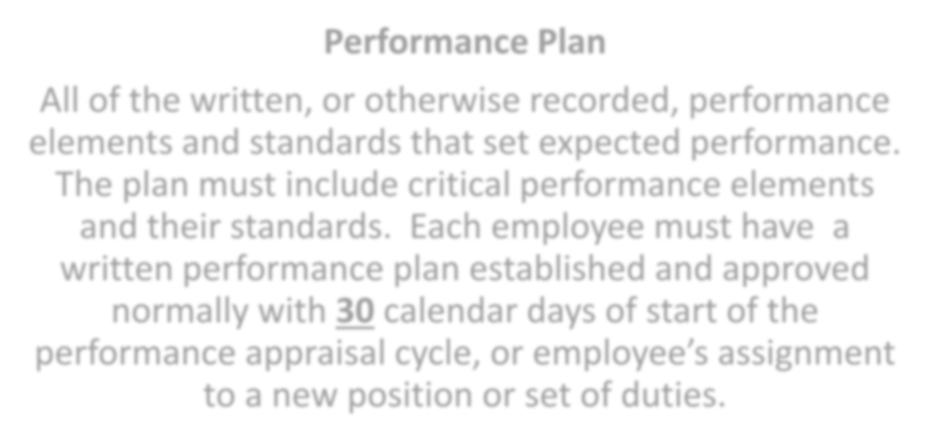
Performance Plans
Performance Plan
All of the written, or otherwise recorded, performance
elements and standards that set expected performance.
The plan must include critical performance elements and their standards. Each employee must have a written performance plan established and approved normally with 30 calendar days of start of the performance appraisal cycle, or employee’s assignment to a new position or set of duties.
DoD Instruction 1400.25, Vol. 431

Slide 25


Performance Plans (cont’d)
Organizational performance plan (e.g., Performance Assistance Plan)
Individual Development Plan (IDP)
Organizational document that focuses on providing the workforce the options for employee development
Records the learning and experience needed for short- and long-range career goals
PERFORMANCE
PLAN

Slide 26
Will employees understand what is required?
If the standards are generic, have they been supplemented with specific information so that employees know what they have to do to demonstrate “Fully Successful” performance?
Performance elements and their standards should be written
clearly and be specific to the job

Slide 27
Is the Fully Successful performance level clearly understood by the supervisor and employee?
Are the expectations established in the performance elements and standards quantifiable, observable, and/or verifiable?
Expectations that are specific and that clearly define what must be done and how well it must be done are more effective for managing and directing performance than vague or general expectations
Employees must know what they have to do and how well they have
to do it to perform at a Fully Successful level

Slide 28

Revising the Performance Plan
A change to the Performance Plan may be
needed if there:
Are there new organizational goals
✓Minimum 90 calendar days for:
Is a change in assignment(s), position, or duties
monitoring of approved performance plans
Are outside influences beyond an employee’s control that make the original performance elements unachievable
Is a change in assumptions about what can be reasonably achieved during the performance appraisal cycle
employee performance of new performance elements
Are new priorities
Are shifts or changes in mission
DoD Instruction 1400.25, Vol. 431

Slide 29

Finalize Performance Plan
After discussion(s), finalize a written performance plan
It’s important that both the supervisor and the employee
understand the performance plan, even if not in agreement
Plans must be clearly communicated to and acknowledged by employees

Slide 30





Performance Plan Checklist
When developing a performance plan, ask:
Is the Fully Successful performance level clearly understood by supervisor and employee
Are the standards achievable?
Are the standards fair?
Are the standards
applicable?
Will employees understand what is required?
Are the performance elements and standards adjustable?
Can the “Fully Successful” level be surpassed?
DPMAP Rev.2
July 2016
(30)
Notes:
Point out the fact that while the above slide does not look like a check list, it is!

Slide 31
Benefits of the Performance Plan Checklist
Using the performance plan checklist and involving
employees allows for:
A better understanding of what is expected
An understanding of the terminology used
An understanding of how performance will be measured
Acceptance and trust in the process

Slide 32

Exercise: Applying the Performance Plan Checklist
Use the checklist to review the performance elements and
standards
Pair up and have partners independently validate the SMART standards against the checklist
Be prepared to share your work with the rest of the class

Slide 33



Planning the Meeting With the Employee
Communicate how performance elements and standards relate back to organizational goals
performance elements
Organizational Goals
Ask for feedback on
the performance elements and standards
Standards
DPMAP Rev.2
July 2016
(33

Slide 34

Exercise: Performance Planning Discussion video

Slide 35
Learning Objectives Review
You should now be able to:
  Explain the performance planning phase and its importance to the
success of the performance management process.
  Explain how to link your work performance plan to your organization’s
mission and core values.
  Write performance standards for the performance plan using the SMART concept.
  Describe tools and techniques used to finalize the performance plan.

Slide 36
Questions?
Are there any questions?
Performance Management is a COLLABORATION between Supervisors and Employees
DPMAP Rev.2
July 2016
(36)

Slide 37
Additional Resources
DODI 1400.25, Volume 410, DoD Civilian Personnel Management System: Training, Education, and Professional Development.
DODI 1400.25, Volume 431, DoD Civilian Personnel Management System: Performance
Management and Appraisal Program.
DODI 1400.25, Volume 451, DoD Civilian Personnel Management System: Awards
A Handbook for Measuring Employee Performance: Aligning Employee Performance
Plans with Organizational Goals. Available at:
https://www.opm.gov/policy-data oversight/performance- management/measuring/employee_performance_handbook.pdf
DCPAS Resources and References web site includes: DCPAS HR Toolkit, Tip Sheets
and Checklist, MyPerformance Training Videos, and MyPerformance User Guides
https://www.cpms.osd.mil/Subpage/NewBeginnings/ResourcesReferences/
DCPAS LERD web site https://dodhrinfo.cpms.osd.mil/Directorates/HROPS/Labor-and-Employee- Relations/Pages/Home1.aspx
DPMAP Rev.2
July 2016
(37)

