Slide 1
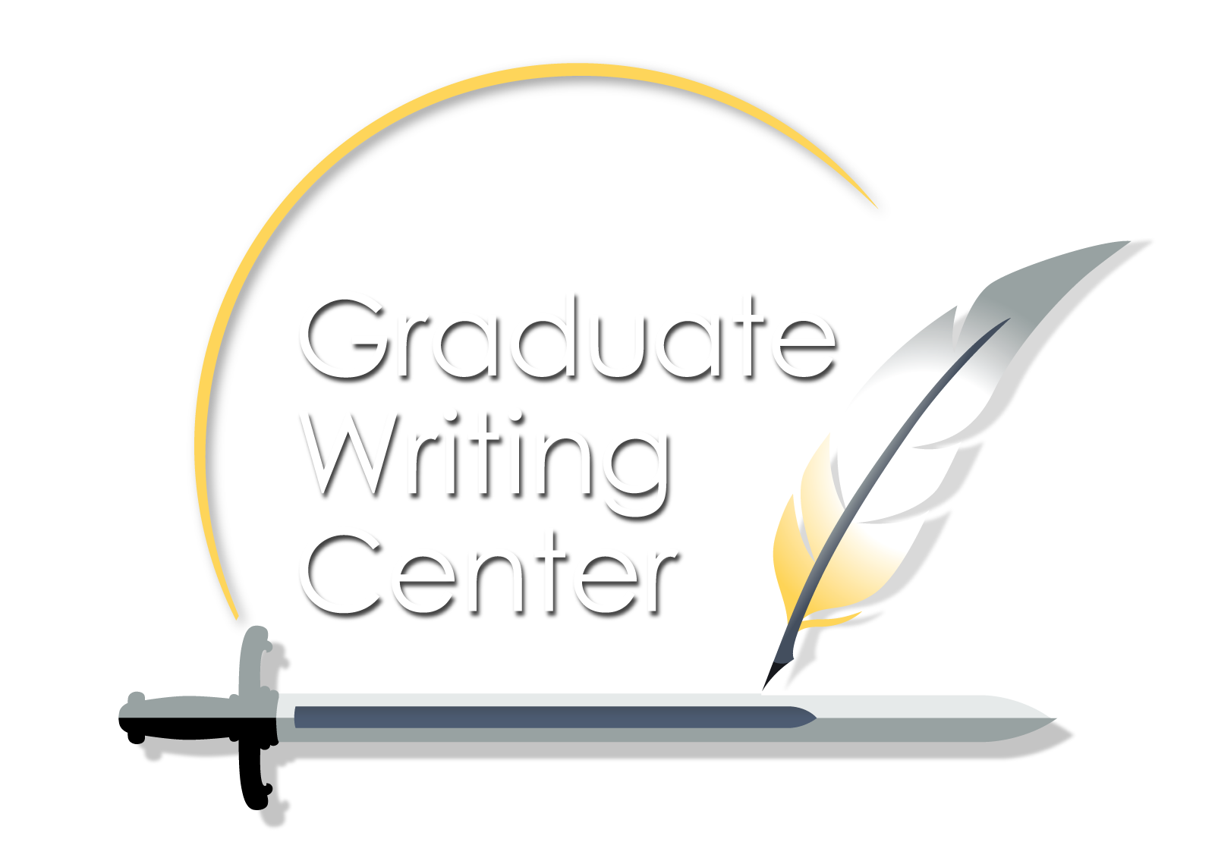
NPS is the place to create a complete thought, away from the tyranny of the urgent.
—Col Todd Lyons, USMC, July 2019
Foundations of Academic Writing
12 APR 2024
Graduate Writing Center
https://nps.edu/gwc

Slide 2
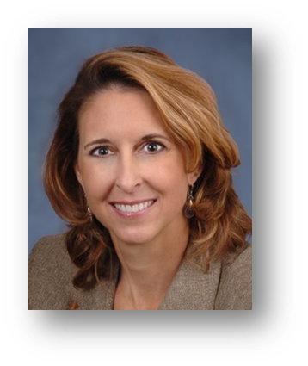
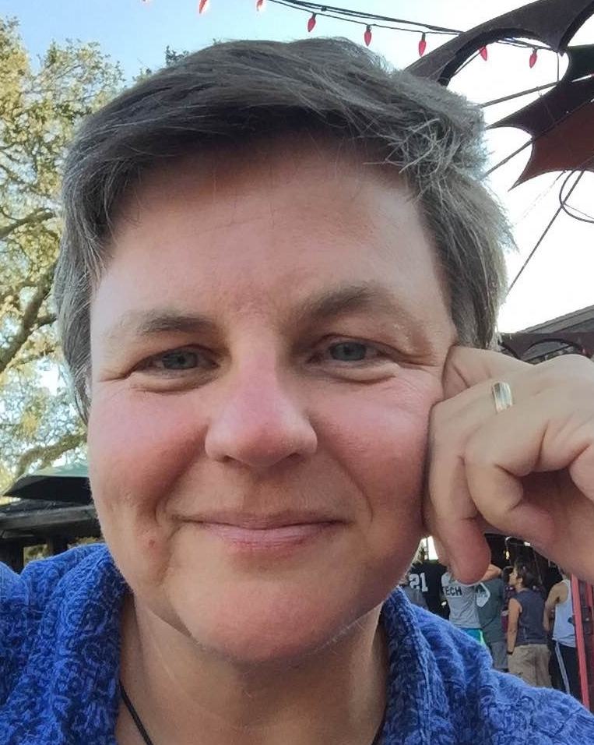
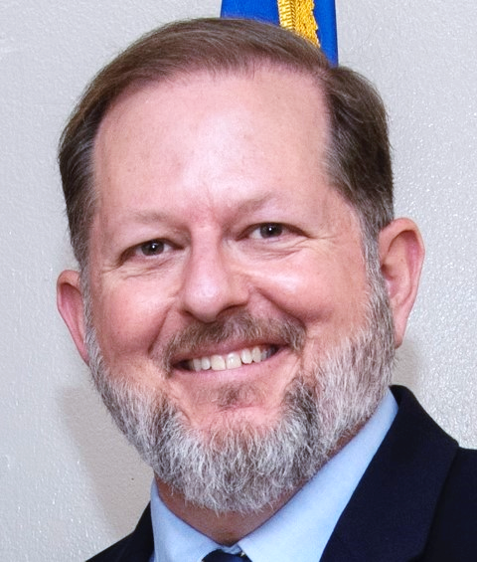
Introduction to Graduate School Research and Writing
Dr. Sandra Leavitt Director, Graduate Writing Center
Plagiarism Prevention Aileen Houston Deputy Director, Graduate Writing
The Writing Process
Dr. Kate Egerton Writing Coach (contractor), Graduate Writing Center
Going Straight to the Source: Using Human Subjects Data in Your Thesis, Capstone Report or Dissertation Bryan Hudgens Chair, Institutional Review Board

Slide 3
LECTURES

Slide 4
GWC Coaching
Live—1:1 in real time
Asynchronous—emailed feedback
Drop-in—quick questions; last minute
Write-ins—structured studying
Sign Up!

Slide 5
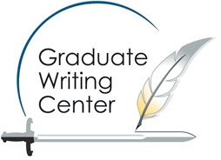
GWC and DKL Workshops
NOW!
Refresh academic fundamentals
Sharpen critical thinking skills
Learn academic norms
Strengthen writing mechanics
Library Quick Start
Thesis Quick Start
Citation Management with Zotero
SIGN UP: nps.edu/web/gwc/live-workshops

Slide 6
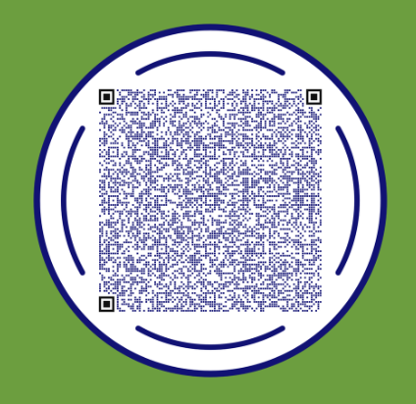
Please fill out our survey
Questions?
Meet us in the lobby or webinar chat.
https://nps.edu/gwc writingcenter@nps.edu

