Slide 1
FA57 Simulation Operations
Unclassified
Controlled by: AMSO-SP
CUI Category(ies): Unclassified
Limited Dissemination Control: FEDCON
POC: MAJ Jason Belinski, 703-785-0590
COL Randy Verde
randall.s.verde.mil@army.mil
(571) 332-7922
Unclassified

Slide 2
The U.S. Army Modeling and Simulation Office Mission and Vision
Mission: The Army Modeling Simulation Office serves as HQDA’s lead activity to:
Develops the strategy and policy for Army Modeling and Simulation Enterprise
Executes effective governance and resource management through leadership and synchronization
Leads coordination of the Army modeling and simulation enterprise and cross-community areas including Joint, Intergovernmental, Interagency, and Multinational environments
Trains, Educates and Manages the Army Analysis, Modeling & Simulation M&S Workforce (Military and Civilian)
Vision: An Army that effectively and efficiently employs modeling and simulation capabilities and tools, within and across all Army organizations, in support of both the Operating and Generating Forces.
Mission, Vision and Organization 2 of 5

Slide 3
Army Modeling & Simulation Office
UNCLASSIFIED
Army DCS G-8
HQDA
FOA
Director,
Center for Army Analysis and
Army Modeling and Simulation Office
Deputy Director
AMSO
Strategy and Resource Management Division
Simulation Proponent and Schools Division
Enterprise Integration
Value of M&S Analysis
Governance & Policy
M&S Standards
Education
& Training
Military
Programs
SIG/Futures
M&S Investments
M&S Futures Analysis
SR Key Tasks:
M&S policy development
M&S Enterprise Governance Management
M&S strategic planning
M&S Enterprise Resource Management
M&S Integration: capabilities, environment, enablers
Joint and U.S. Service Component engagement
NATO and multi-national engagement
M&S future concepts
Combined Key Tasks:
VMSO MDEP Manager
OneSAF, SIMCI, JEPAC & CSI POM Support
AMSO Programming, Budgeting & Execution
Liaison between AMSO, CAA & G-8
Contract Management (COR/ACOR)
Desktop IT Support (BLDG 805)
Security Management (BLDG 805)
Maintenance and Logistics (BLDG 805)
SP & AMSS Key Tasks:
Career management support
M&S workforce life cycle management
Education and training development
Career management and assignments
Acquisition and Sustainment
Structure and concepts
Workforce integration
Assessments
UNCLASSIFIED

Slide 4
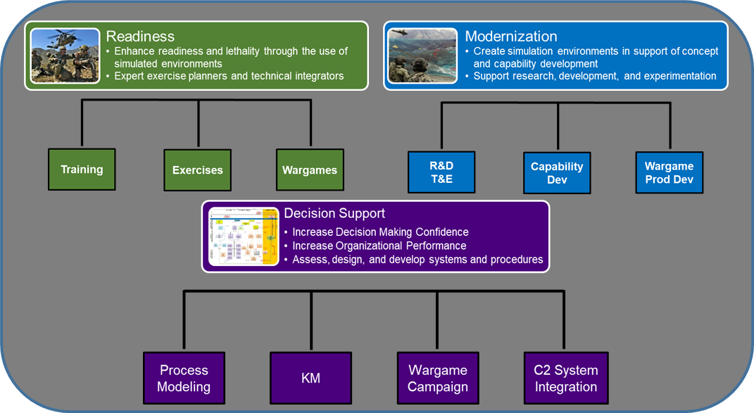
FA57 Overview
Unclassified
FA57 provides the Army with officers who specialize in creating realistic simulation environments where leaders plan, train, test, and experiment, in support of readiness, modernization, and enhanced decision support. FA57s are the Army’s experts at translating complex concepts into viable readiness and modernization solutions by leveraging new and emerging technologies
FA57 Core Competencies:
Readiness – Applying the Art and Science of modeling and simulation technologies in support of training, exercises, and wargaming.
Modernization– Applying the Art and Science of modeling and simulation technologies in support of concept development, research and analysis, and experimentation.
Decision Support – Assess, design, develop, and implement systems and procedures to improve efficiency, shared understanding, and data-driven decision-making.
MODERNIZATION
READINESS
FA57
ENHANCED DECISION SUPPORT
Unclassified

Slide 5
UNCLASSIFIED
USAREUR-AF (1 LTC, 1 MAJ)
7ATC (3 MAJ, 1 CPT)
JMRC
10th AAMDC
16th/21st SUS CMD
41 FAB
FA57 Active Duty Authorizations
GERMANY
I Corps
7th ID
17th FA BDE
16th AV BDE
593d ESC
189TH IN BDE MTC
MTC-JBLM (1 LTC)
EUCOM
AFRICOM
USARAF
JBLM
Italy
NATO M&S COE (1 LTC)
V CORPS
4TH CAV BDE
1st TSC
AWC (1 COL, 2 CPT)
USMA (1 MAJ, 3 MAJ)
US Army AK (1 MAJ)
Ft. Drum
174TH IN BDE
84th ATD
2nd ID
210 FA BDE
19th ESC
Eight Army
USFK (KBSC)
84th GLTD
181ST IN BDE
10TH MTN
CAA/AMSO (1 COL, 1 LTC)
ARCYBER (2 MAJ, 1 CPT)
Def Threat Reduc Agency ( 1 LTC)
HQDA G 3/5/7 (2 LTC)
1st Army HQ
Ft. McCoy
CAC (1 COL, 7 LTC, 2 MAJ)
MCTP
MXCOE CDID (1 LTC, 1MAJ)
Rock Island
AITF (1 LTC)
84th PTD
Pittsburgh
TRADOC G27 (1 LTC)
7th TRANS
ACT NATO (1 LTC, 1 MAJ)
AFC FCC (1 LTC)
STRACOM (1 MAJ)
84th PTD
Ft. Leavenworth
SCOE CDID (1 COL)
CASCOM
CAC (1 MAJ_
1 ID
157TH IN BDE
NCR
4 ID
Ft. Riley
Ft. Lee
Ft. Carson
Ft. Knox
Suffolk
Joint Staff/J7 (2 LTC, 1 MAJ)
Naval Post Grad School (1 LTC)
AFC Research CTR (1 MAJ)
FCOE CDID (1 LTC)
75th FA BDE
MSCOE CDID
(1 MAJ)
Ft. Campbell
FORSCOM
Bragg MTC (1 LTC)
XVIII ABN Corps
82nd ABN Div
3RD ESC
SATMO
USASOC
18th FA BDE
1ST SF GRP
101st
160th SOAR
Ft. Bragg
III Corps
Hood MTC
1 CAV
13 ESC
120 IN BDE
166 AV BDE
OTC
(1 LTC, 2 MAJ)
Ft. Sill
MCOE CDID
WHINSEC
MCoE
Shaw AFB
 | Masters | PhD
CPT | 4
MAJ | 26 | 3
LTC | 29 | 4
COL | 4
NTC (1 MAJ)
11th Armored CAV
Ft. Irwin
ICoE
177TH FA BDE
Ft. Benning
Ft. Huachuca
Cp. Shelby
Ft. Rucker
Ft. Gordon
Ft. Stewart
USARPAC
25th ID
94th AAMDC
8th TSC
INDOPACOM(1MAJ)
Ft. Bliss
Ft. Hood
AVCOE
(1 LTC, 1 MAJ)
ARCENT
LEGEND FA 57 LOCATION & DENSITY
3 OR LESS
4-10
10 OR MORE
San Antonio
Houston
Ft. Polk
USAE (1 LTC)
505th C2 (1 MAJ)
3rd ID
1 AD
5th AR BDE
JMC (1 LTC)
32nd AAMDC
CYBER CDID (1 MAJ)
ARCYBER
AUSTRALIA
JRTC
(1 MAJ)
Miami
ARNORTH
ARSOUTH
SOUTHCOM (1 LTC)
NATO JWC, Norway
NATO JFTC, Poland
NATO ARRC, UK
NATO NRDC, Spain
AER 96 (Masters)
STE CFT (1 MAJ, 1 LTC)
PEO-STRI (1 LTC)
AER 98 (PhD)
75th TNG CMD
Both 96 and 98
UNCLASSIFIED

Slide 6
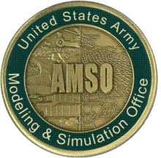
M&S Communities of Interest by Organization
Headquarters Department of the Army (HQDA)
G-3/5/7
U.S. Army Training and Doctrine Command
(TRADOC)
ONI
CAC
CIO/G-6
NGIC
TRADOC
G27
G-8
G-2
G-1
MSIC
G-3/5/7
Resourcing &
Programming
Intelligence
AFC
DOT&E
Training
USAF
CDID
DoD
AIMD
Battle Labs
DUSA-TE
Experimentation
CoE
DARPA
USN
Joint
USMC
AFC TRAC
Enablers
Analysis
AFC DAC
NGA
AGC
CAA
DISA
CYBER
Industry and Academia
NPS
Acquisition
Test & Evaluation
ODU
Army Test and Evaluation Command (ATEC)
UCF
FFRDC
Assistant Secretary of the Army for Acquisition, Logistics and Technology ASA(ALT)
Army Material Command (AMC)
CSU
PURDUE NW
AEC
I/ITSEC
PEO IEW&S
GMU
PEO AMMO
OTC
PEO JTRS
PEO C3T
PEO AVN
PEO STRI
JPEO CBD
Mission, Vision and Organization 4 of 5

Slide 7
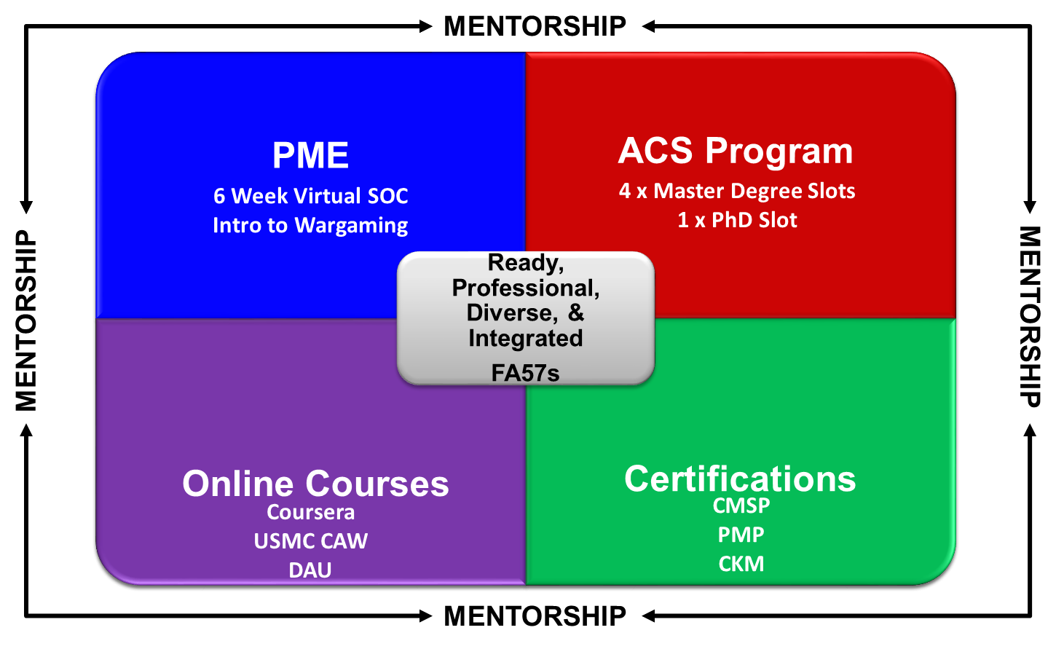
FA57 Development and Education
UNCLASSIFIED
Simulation Operations Course (SOC)
Intermediate SOC
Advanced Simulation Course
Monthly Seminar Series
Industry Certifications Opportunities
Army Credentialing Opportunities Online (COOL)
Certified Models and Simulations Professional (CMSP)
Advanced Civil Schooling
Training With Industry
On-Demand Learning
Wargaming Education
DAU
A ready, professional, diverse, and integrated FA57 understands the art and science of simulations in support of the Total Army and Joint Force.
UNCLASSIFIED

Slide 8
Closing Comments and Questions
UNCLASSIFIED
UNCLASSIFIED

