Slide 1


Dysruption Game to Study Surprise in Infrastructure Management
Daniel Eisenberg
Michelle L Hancock
Operations Research
Center for Infrastructure Defense
MOVES Institute Open House
23 MAY 2023
Notes:
Your briefing will not be longer than 30 minutes
Do not use font smaller than 18

Slide 2
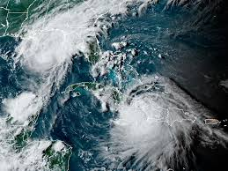
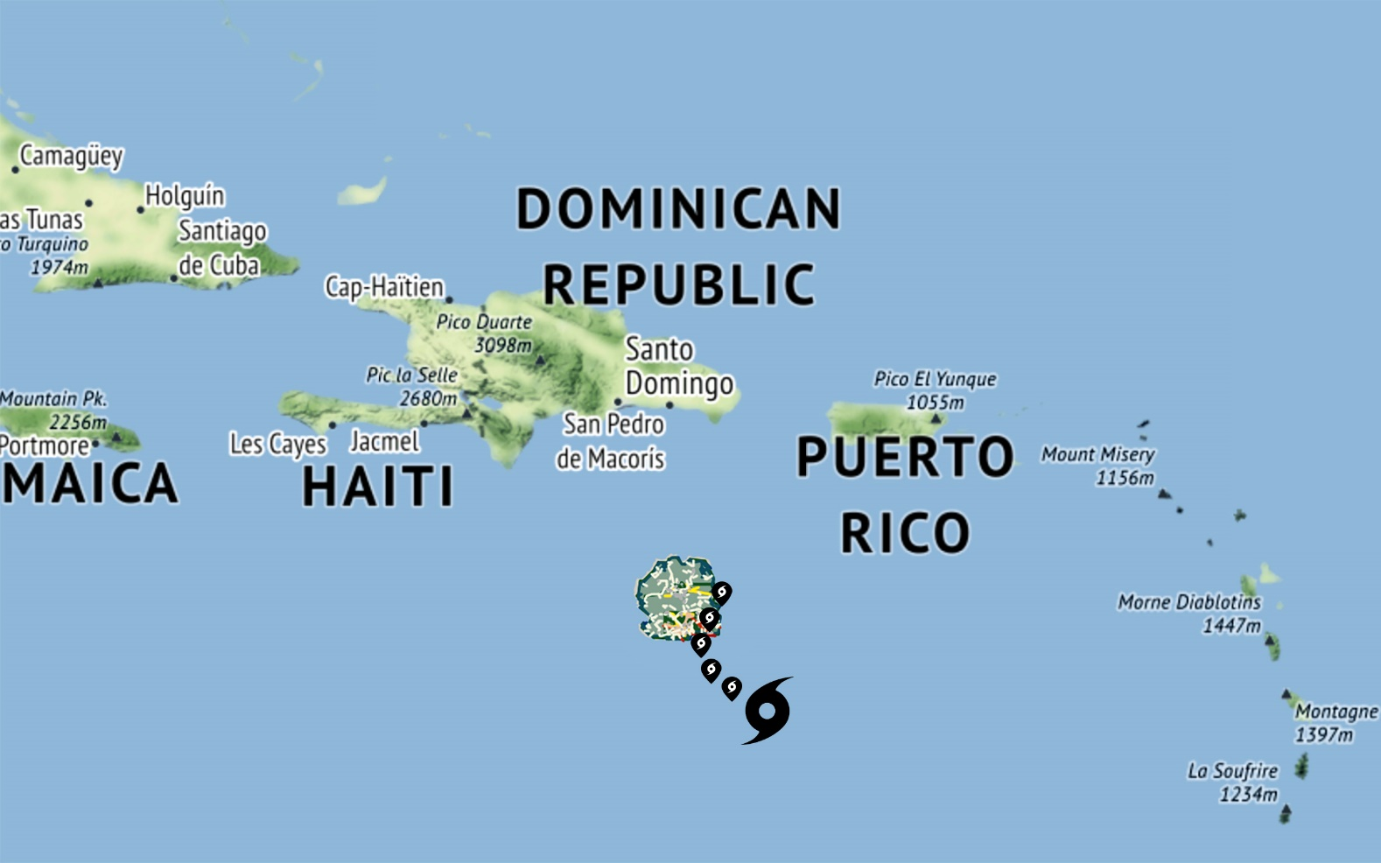
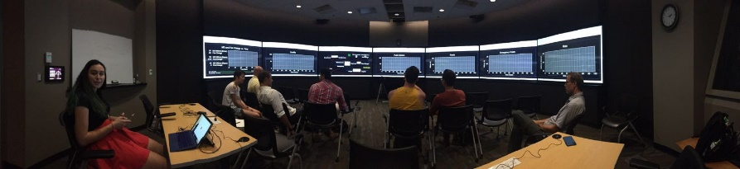
Project Objective
Develop theory, tools, case studies, and training exercises that assess and enhance the resilience of installation infrastructure systems by studying their capacity to adapt to surprising future events driven by climate extremes.
Identify the characteristics of resilient systems that successfully adapt.
Create associated measures and tools for the resilience of US military installations to natural disasters.
Develop novel tools to study and train installation mission owners and infrastructure operators how to prepare for and manage future surprises.
Climate-Driven Surprises
Realistic,Yet Fictitious Place
Novel Training Exercises
TS Marco
AUG
2020
TS Laura
Notes:
1. Limit to one slide only.
2. This section is meant to orient the review committee on the overall objectives of the research, regardless of what portion of the planned work was accomplished since project inception or the previous IPR, whichever is applicable.

Slide 3
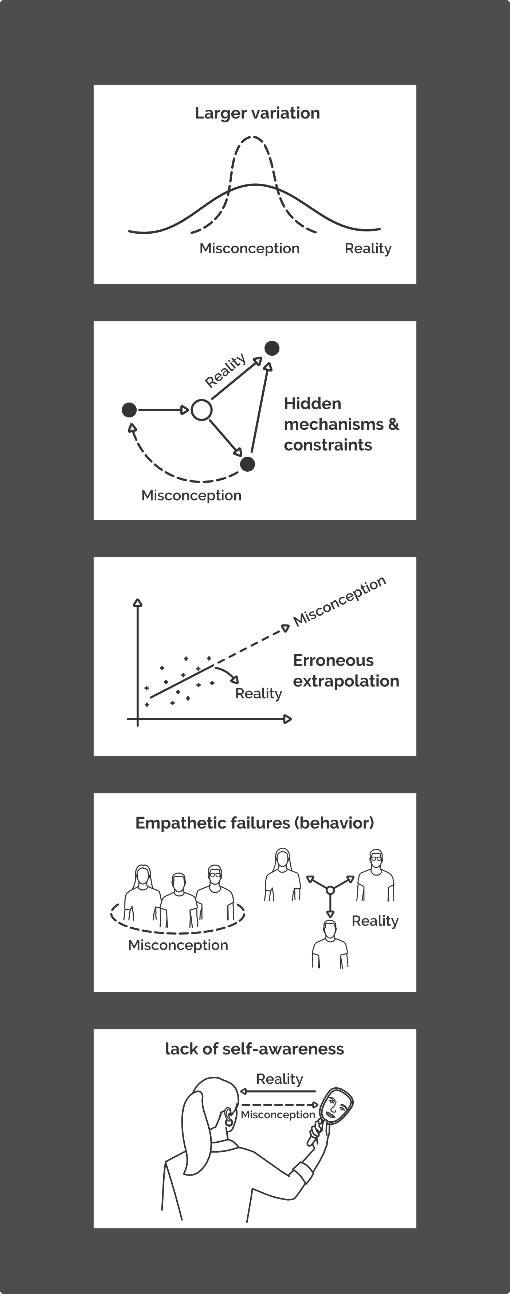
Background: Surprise & Gaming
“Surprise” is a process that has structure and responses that can be studied
  Sources of Surprise: A challenge-response relationship exists between any system and its operating environment.
  Surprise Process: System elements must extend capability in novel ways – this is adaptive capacity, or fail to – this is shock.
Notes:
Performance of every infrastructure system is limited by interactions within and across its technological and organizational systems
These dictate its operational boundary (design envelope)
Understanding the importance of surprise for installation resilience is tied to the challenge-response relationship that exists between any system and its operating environment.
Where does surprise occur?
Understanding of events that challenge the design boundary of our system
Understanding of our system, how it works, and its operational boundary

Slide 4
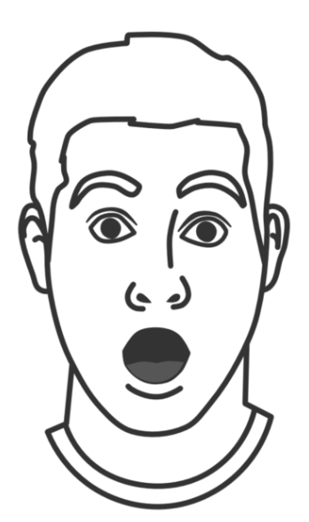
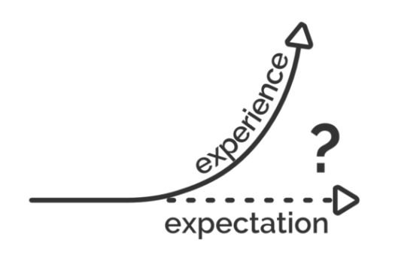
Background: Surprise & Gaming
“Surprise” is a process that has structure and responses that can be studied
  Sources of Surprise: A challenge-response relationship exists between any system and its operating environment.
  Surprise Process: System elements must extend capability in novel ways – this is adaptive capacity, or fail to – this is shock.
Autonomic
Arousal
Cognitive & Emotional Orientation
Reframing & Updating
Beliefs
Adaptive
Adaptive
Shock
Shock
Sensing
Anticipating
Learning
Notes:
Performance of every infrastructure system is limited by interactions within and across its technological and organizational systems
These dictate its operational boundary (design envelope)
Understanding the importance of surprise for installation resilience is tied to the challenge-response relationship that exists between any system and its operating environment.
Where does surprise occur?
Understanding of events that challenge the design boundary of our system
Understanding of our system, how it works, and its operational boundary

Slide 5
Background: Surprise & Gaming
“Surprise” is a process that has structure and responses that can be studied
  Sources of Surprise: A challenge-response relationship exists between any system and its operating environment.
  Surprise Process: System elements must extend capability in novel ways – this is adaptive capacity, or fail to – this is shock.
How to create controlled conditions of surprise?
Models and simulations require relatively little expense, but they are unable to explore much beyond the normal variation of events that have been conceived in the model.
Notes:
Performance of every infrastructure system is limited by interactions within and across its technological and organizational systems
These dictate its operational boundary (design envelope)
Understanding the importance of surprise for installation resilience is tied to the challenge-response relationship that exists between any system and its operating environment.
Where does surprise occur?
Understanding of events that challenge the design boundary of our system
Understanding of our system, how it works, and its operational boundary

Slide 6
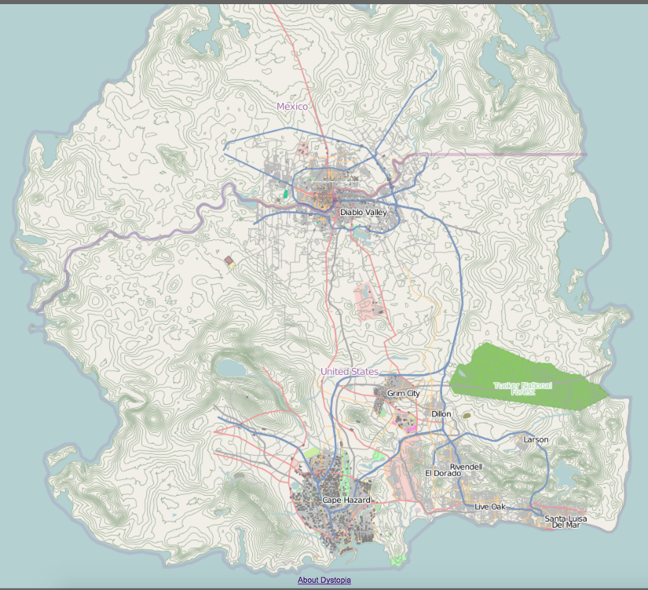
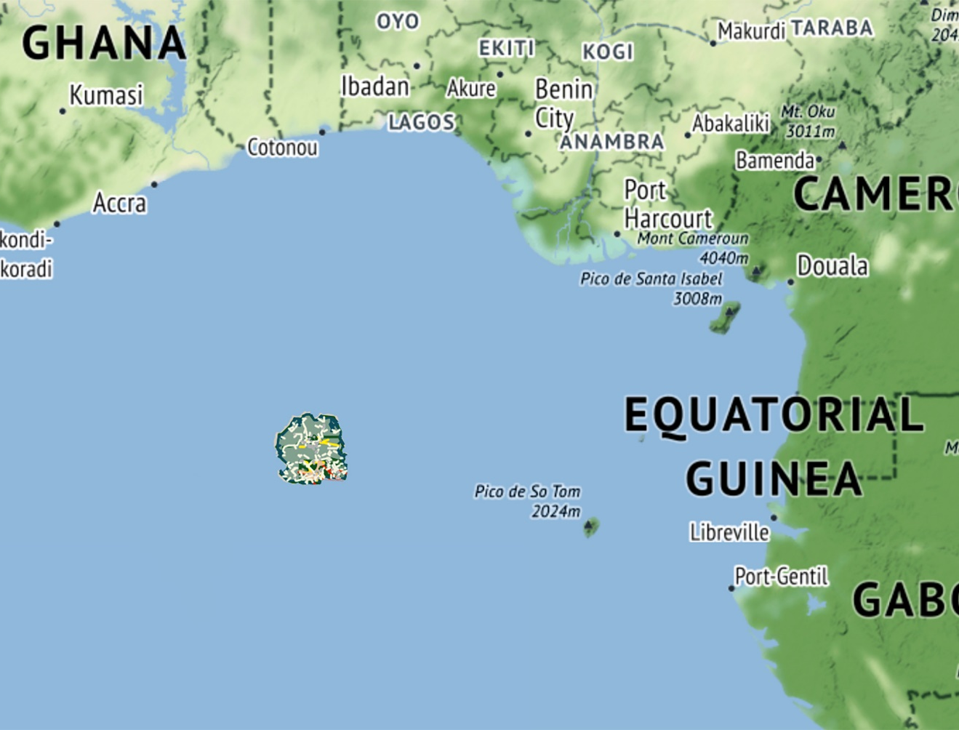
Background: Realistic Setting
The Dystopia Virtual World (simply “Dystopia”) was developed previously at the NPS Center for Homeland Defense and Security (CHDS) for tabletop exercises.
Combines geographic and functional realism
  assessing operational resilience requires infrastructure function
A collection of structured data—including geographically realistic terrain, maps, population demographics, and infrastructure systems
  military installations & communities
  can be relocated in any part of the world

Slide 7
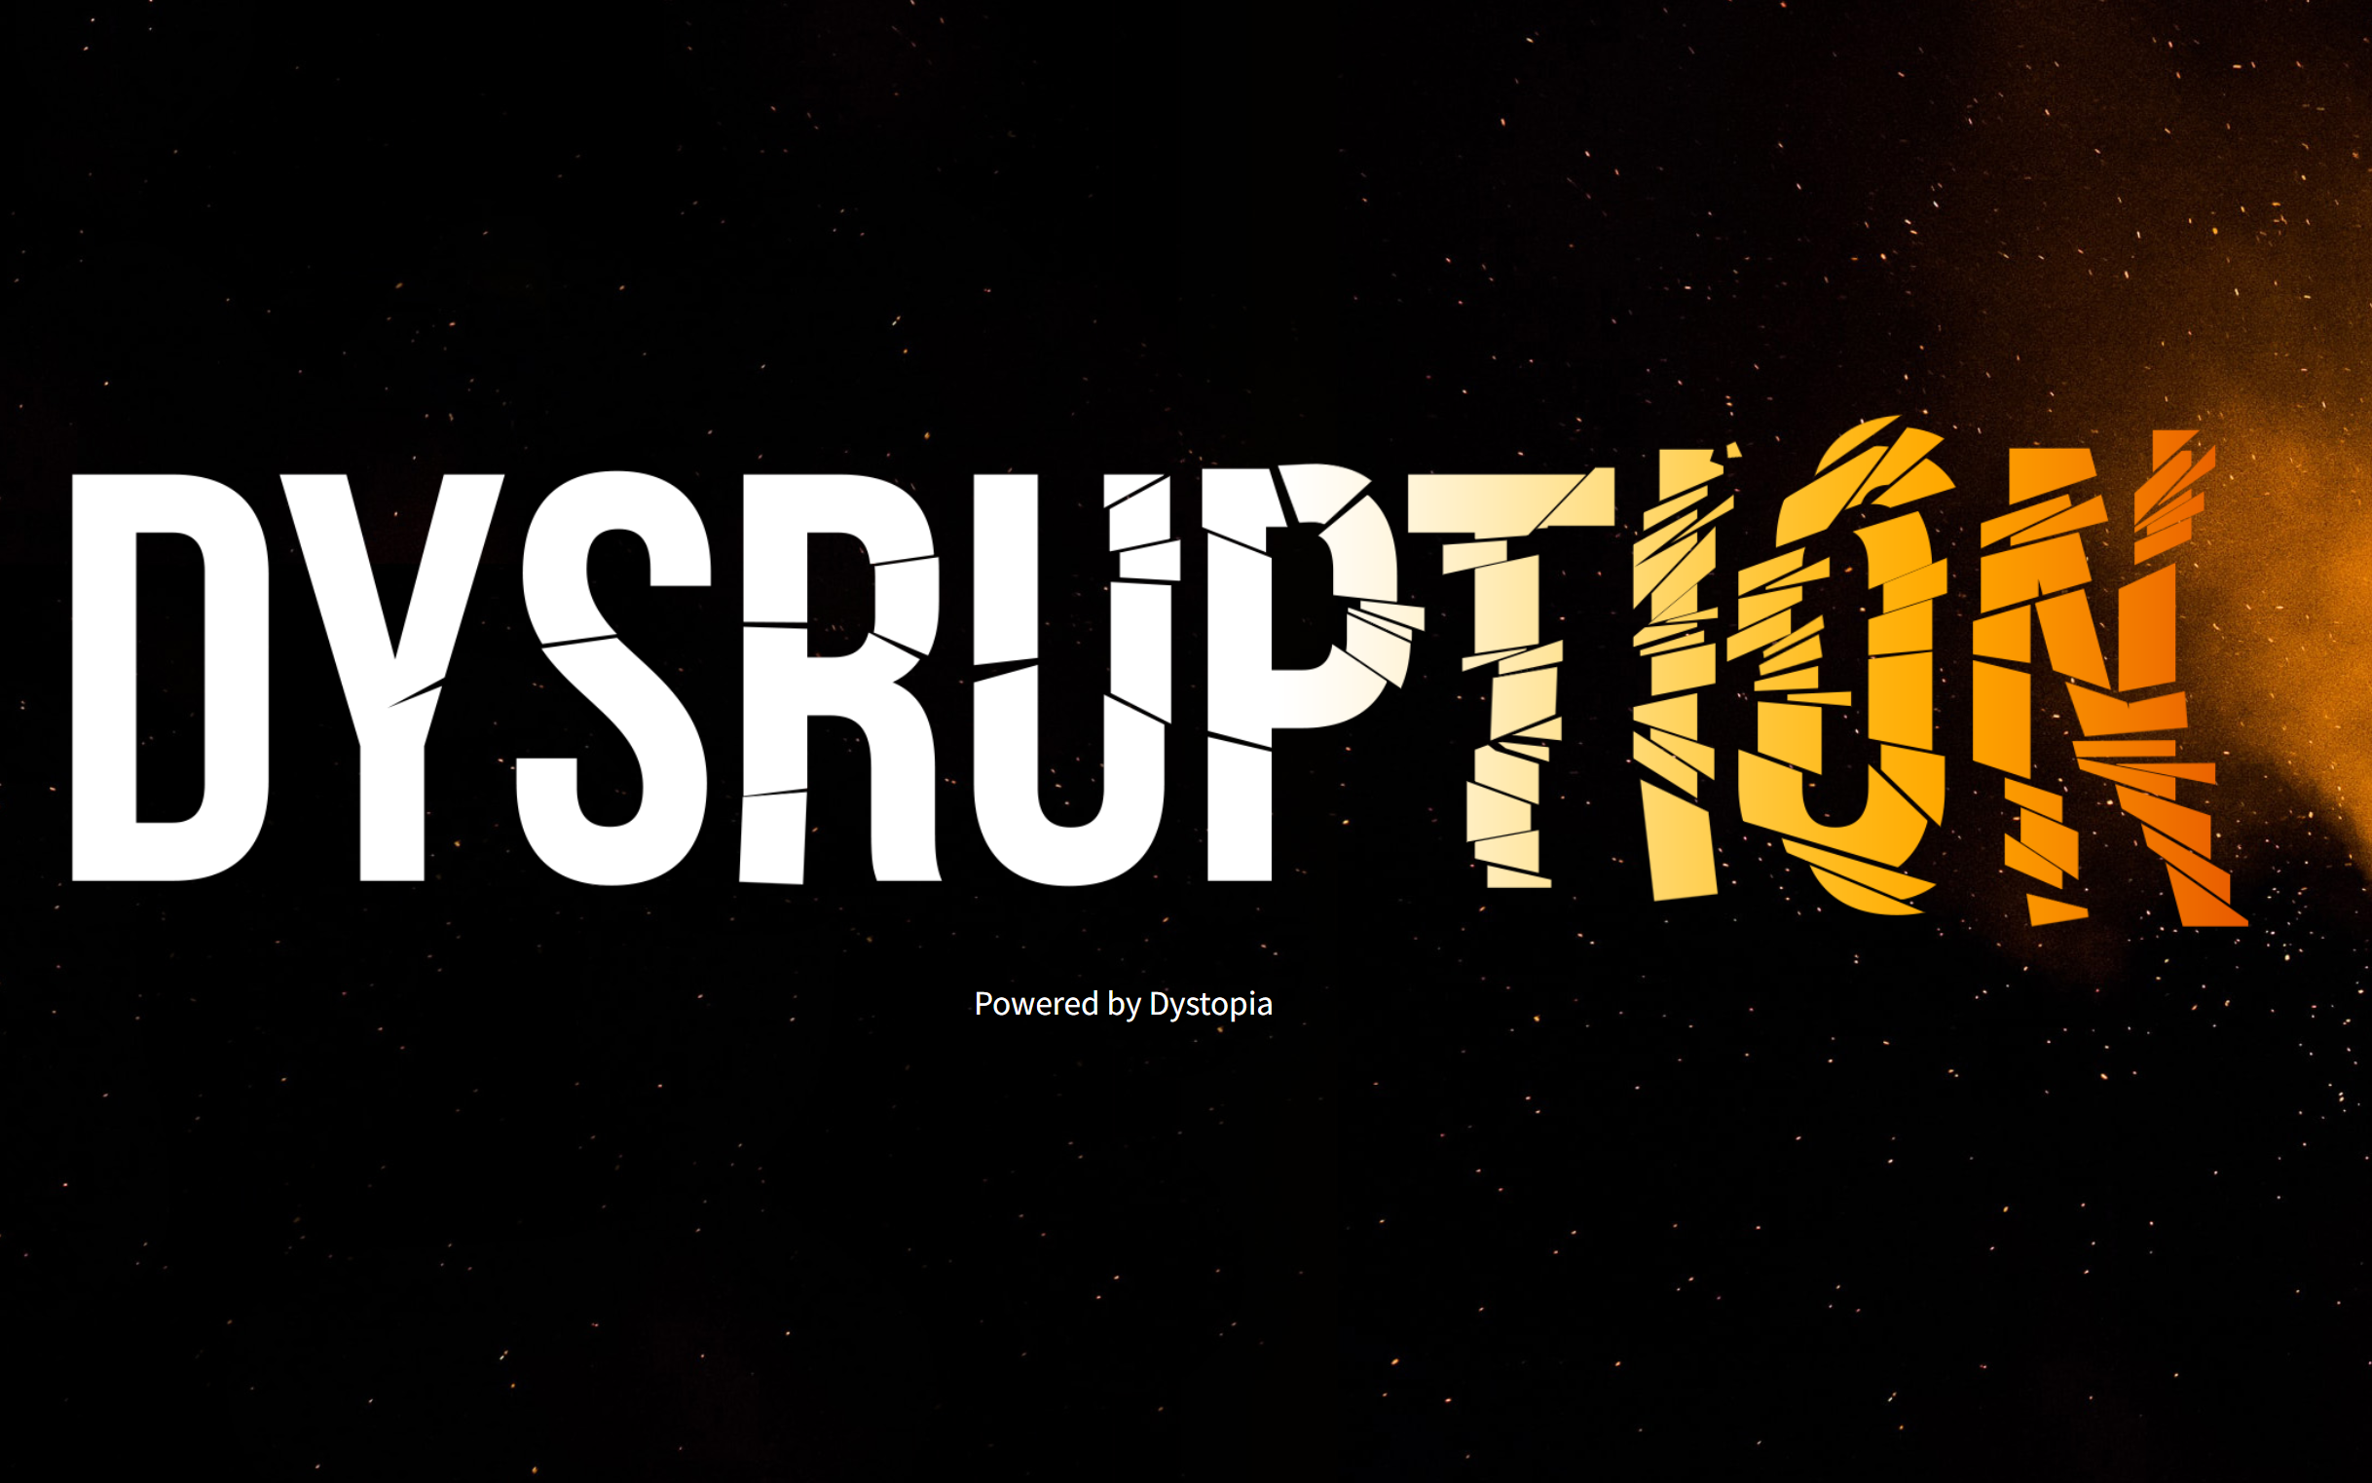
dysruption.net

Slide 8
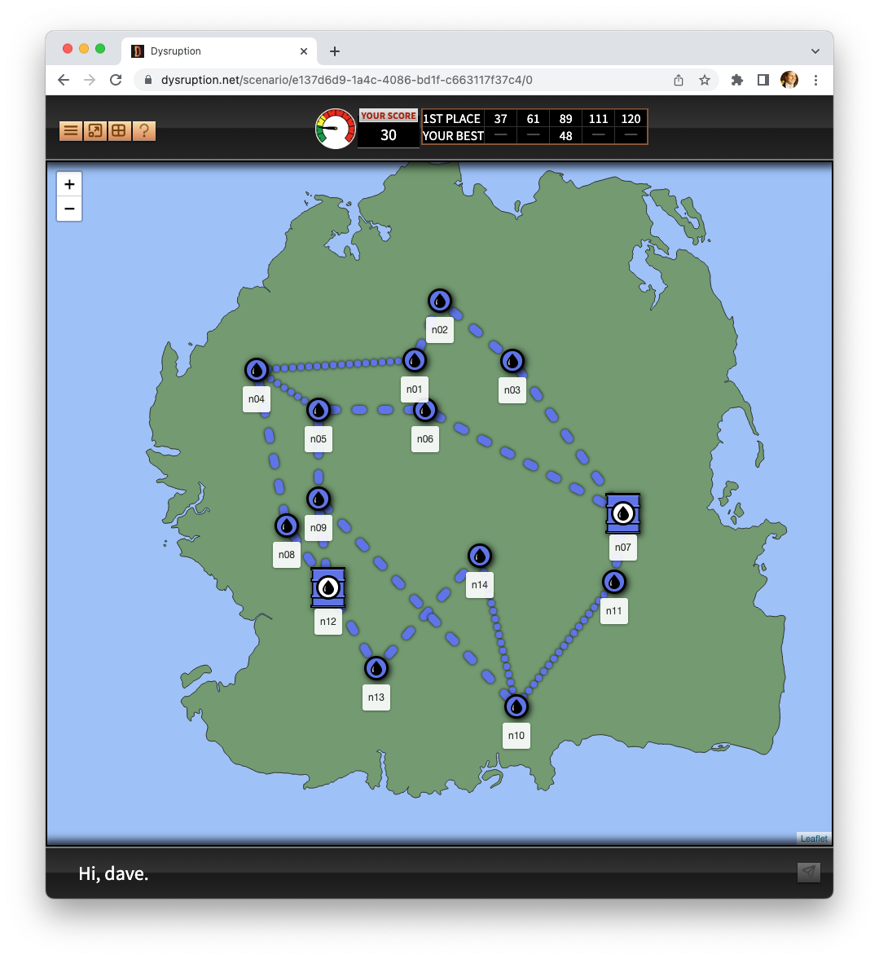
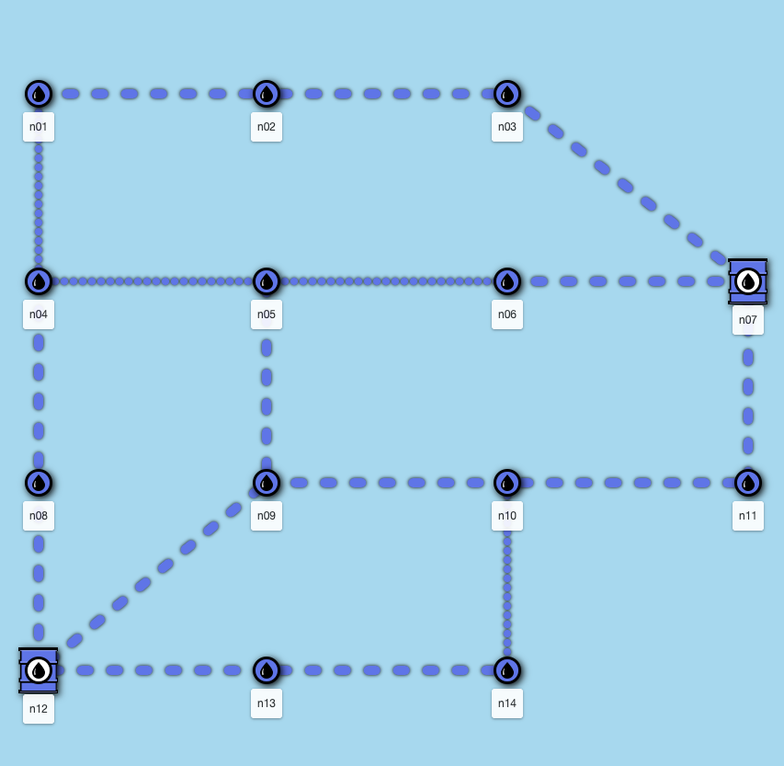
A notional fuel network on the island of Dystopia
Schematic View
Map View

Slide 9
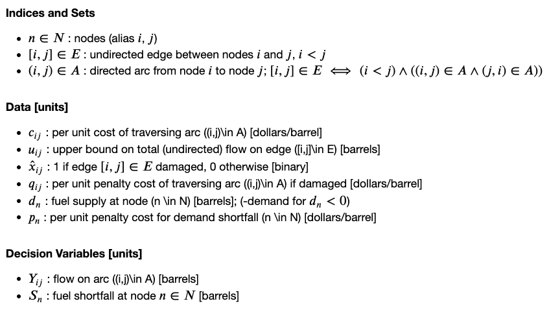
A Minimum-Cost Flow Network
Undirected Network
Per-Unit Flow Costs
Capacitated Edges
Cost-Based Interdiction
Penalties for Demand Shortfalls
Delivery Cost
Shortfall Penalty
Balance of Flow
Edge Capacities
Ref: Alderson, D.L., Brown, G., and Carlyle, W.M., 2015, "Operational Models of Infrastructure Resilience," Risk Analysis 35(4): 562-586

Slide 10
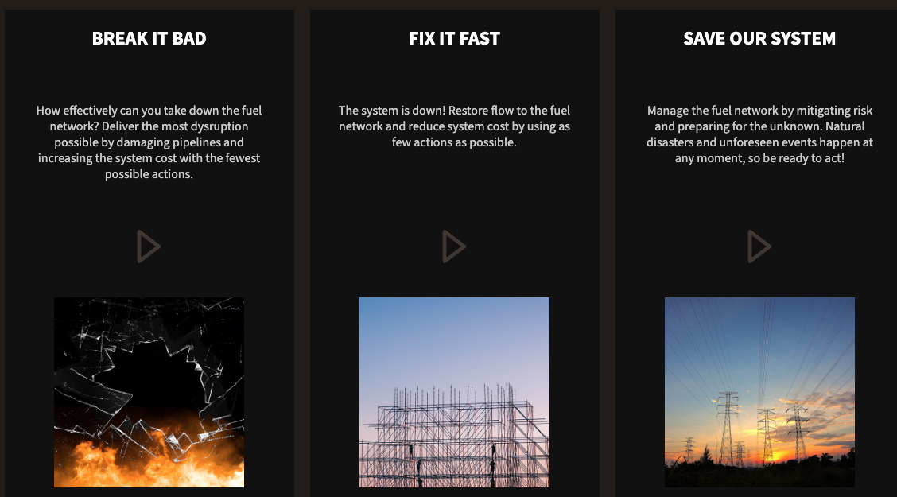
Dysruption currently features 3 games
Attack-based exploration of system dependence and vulnerability
Repair broken components to restore function under time pressure
Repair or replace to fix random failures under time and budget pressure

Slide 11
Game 1: Break It Bad
INSIGHTS
You are the “attacker” of the system
Your job is to increase the operating cost of the system
You break pipe segments to do this
  After each break, flows will be rerouted to in minimum cost manner
You will submit 5 different attack strategies
  If you could attack 1, 2, 3, 4, 5 link(s) in the original system, which one(s) would you choose?
Worst-Case Attack Strategies are not “nested”
Network vulnerabilities are often hidden in plain sight

Slide 12
Game 1: Break It Bad
INSIGHTS
You are the “attacker” of the system
Your job is to increase the operating cost of the system
You break pipe segments to do this
  After each break, flows will be rerouted to in minimum cost manner
You will submit 5 different attack strategies
  If you could attack 1, 2, 3, 4, 5 link(s) in the original system, which one(s) would you choose?
Worst-Case Attack Strategies are not “nested”
Network vulnerabilities are often hidden in plain sight
Game 2: Fix It Fast
You are the “operator” of the system trying to recover system function after a disruption
Your job is to decrease the operating cost of the system
You fix pipe segments to do this
  After each fix, flows will be rerouted to in minimum cost manner
You will submit 5 different repair strategies
  If you could repair k=1, 2, 3, 4, 5 links in the original system, which one would you choose?
You will have limited time to identify these repair strategies!
The best strategies for breaking and fixing are different!

Slide 13
Game 3: Save Our System
INSIGHTS
You are the “operator” of the system trying to manage system function over several rounds during which various pipes can break at random
You can either repair or replace a pipe segment
  Replacing a broken pipe increases FCI more, and costs more
  Repairing a broken pipe increases FCI less, and costs less
After each fix, flows in the network are rerouted
Worst-Case Attack Strategies are not “nested”
New components start at FCI=100.
The older the pipe segment, the lower the FCI.
The lower the FCI, the higher
the Prob(Failure)
Nominal aging
(normal wear and tear, preventive maintenance, normal environmental conditions, etc)
P(Fail | FCI=100) = 8.2%
P(Fail | FCI=97) = 8.8%
Accelerated aging (overuse, deferred maintenance,
unanticipated environmental exposure)
Facility Condition Index (FCI)
P(Fail | FCI=80) = 13.5%
Component Age (# turns)
Facility Condition Index (FCI)

Slide 14
Save Our System: A Progression of Scenarios
Scenario 1: You are the Public Works Officer (PWO) for a brand new system
  All components start brand new (FCI=100)
  You have a starting budget of $1000
  You receive an additional $300 per turn
Scenario 2: You are the PWO for an existing system
  One pipe segment is broken
  All components start with 95 ≤ FCI ≤ 100
  You have a starting budget of $1000
  You receive an additional $300 per turn
Scenario 3: Your system experienced a major disaster
  Many components broken
  All components start with 95 ≤ FCI ≤ 100
  Congress has given you 2.5x your normal budget (start = $2500)
  You receive an additional $300 per turn
INSIGHTS
Can perform poorly if bad luck or strategies
Possible to keep system running on repairs
Increased budget does not solve problems

Slide 15

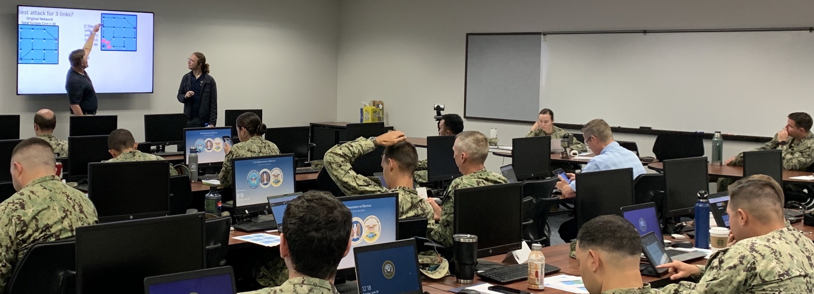


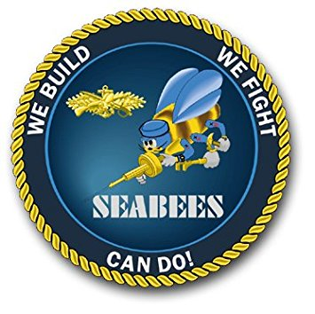

We have held 8 Dysruption training sessions to date
June 2022 (resident): Military Operations Research Society (MORS) Annual Symposium, Marine Corps University, Quantico, VA
participants: 18-20 (researchers, faculty, + grad students)
June 2022 (hybrid): NAVFAC Civil Engineering Corps Officer School (CECOS) Intermediate Public Works Department (PWD) Course
Naval Base Port Hueneme, CA
students: 20 resident, 12 online (rank O3-O4)
July 2022 (hybrid): NAVFAC CECOS Advanced PWD Course
Navy Yard, Washington DC
students: 12 resident, 8 online (rank O3-O5)
Sept 2022 (resident): NPS / CHDS Critical Infrastructure Course
Washington DC; students: 12 resident students
Oct 2022 (resident): NPS / CHDS Critical Infrastructure Course
Monterey, CA; students: 25 resident students

Slide 16
Results: Experience and Surprise
Experience with System Mgmt.
Near
Far
Sensing
CECOS
(n = 52)
CHDS
(n = 80)
ASU (n = 30)
MORS (n = 20)
Anticipating
Learning

Slide 17
Results: Experience and Surprise
Experience with System Mgmt.
Near
Far
Sensing
CECOS
(n = 52)
CHDS
(n = 80)
ASU (n = 30)
MORS (n = 20)
“…caught me off
my game”
Anticipating
“difficulties assigning priorities”
Learning
“need to adjust”

Slide 18
Results: Experience and Surprise
Experience with System Mgmt.
Near
Far
Sensing
CECOS
(n = 52)
CHDS
(n = 80)
ASU (n = 30)
MORS (n = 20)
More Experience = Higher Expectations
Anticipating
Delayed Reaction
Learning
Style Adjustment

Slide 19
Results: Experience and Surprise
Experience with System Mgmt.
Near
Far
Sensing
CECOS
(n = 52)
CHDS
(n = 80)
ASU (n = 30)
MORS (n = 20)
More Experience = Higher Expectations
Anticipating
Delayed Reaction
Learning
Style Adjustment

Slide 20
Results: Experience and Surprise
Experience with System Mgmt.
Near
Far
Sensing
CECOS
(n = 52)
CHDS
(n = 80)
ASU (n = 30)
MORS (n = 20)
More Experience = Higher Expectations
“the game was harder than it looks”
Anticipating
Delayed Reaction
“systems I thought I understood I did not”
Learning
Style Adjustment
“I don’t think I think the way most do”

Slide 21
Results: Experience and Surprise
Experience with System Mgmt.
Near
Far
Sensing
CECOS
(n = 52)
CHDS
(n = 80)
ASU (n = 30)
MORS (n = 20)
More Experience = Higher Expectations
Some Experience = “Harder than it Looks”
Anticipating
Delayed Reaction
Questions Knowledge
Learning
Style Adjustment
Needs Time to Think

Slide 22
Results: Experience and Surprise
Experience with System Mgmt.
Near
Far
Sensing
CECOS
(n = 52)
CHDS
(n = 80)
ASU (n = 30)
MORS (n = 20)
More Experience = Higher Expectations
Some Experience = “Harder than it Looks”
Anticipating
Delayed Reaction
Questions Knowledge
Learning
Style Adjustment
Needs Time to Think

Slide 23
Results: Experience and Surprise
Experience with System Mgmt.
Near
Far
Sensing
CECOS
(n = 52)
CHDS
(n = 80)
ASU (n = 30)
MORS (n = 20)
More Experience = Higher Expectations
Some Experience = “Harder than it Looks”
“I relied on trial
and error”
Anticipating
Delayed Reaction
Questions Knowledge
“opening up to strategize under pressure”
Learning
Style Adjustment
Needs Time to Think
“critical thinking takes more time”

Slide 24
Results: Experience and Surprise
Experience with System Mgmt.
Near
Far
Sensing
CECOS
(n = 52)
CHDS
(n = 80)
ASU (n = 30)
MORS (n = 20)
More Experience = Higher Expectations
Some Experience = “Harder than it Looks”
Less Experience = Lower Expectations
Anticipating
Delayed Reaction
Questions Knowledge
Room for Growth
Learning
Style Adjustment
Needs Time to Think
Lens Widens

Slide 25
Results: Experience and Surprise
Experience with System Mgmt.
Near
Far
Sensing
CECOS
(n = 52)
CHDS
(n = 80)
ASU (n = 30)
MORS (n = 20)
More Experience = Higher Expectations
Some Experience = “Harder than it Looks”
Less Experience = Lower Expectations
Anticipating
Delayed Reaction
Questions Knowledge
Room for Growth
Learning
Style Adjustment
Needs Time to Think
Lens Widens

Slide 26
Summary & Next Steps
Dysruption:
Game-based exercises offer a platform to study surprise
Quickly test and Train strategies for managing surprising failures.
Respondents:
Experience in infrastructure correlate to positive and negative differences in behavioral response to surprise.
Adaptive and shock response can occur during different surprise processes
Next Steps:
Student theses: Wildfire generation (Hardesty), Power systems (Oliveros)
Qualitative Research: Control groups + game experiences

Slide 27
Questions
Daniel Eisenberg
Assistant Professor | Operations Research
Deputy Director | Center for Infrastructure Defense
daniel.eisenberg@nps.edu
Michelle L. Hancock
Faculty Associate Research | Operations Research
Community Research Lead | Center for Infrastructure Defense
michelle.hancock@nps.edu

Slide 28
BACKUP MATERIAL

Slide 29
Acronyms and Symbols
ASU Arizona State University
CAP Climate Adaptation Plan (CAP)
CECOS Civil Engineering Corps Officer School
CHDS NPS Center for Homeland Defense and Security
ESWG Environmental Security Working Group
IJDRR International Journal of Disaster Risk Reduction
MORS Military Operations Research Society
NAVFAC Naval Facilities Command
NPS Naval Postgraduate School
ORISE Oak Ridge Institute for Science and Education
RECESS Resource Competition, Environmental Security, and Stability
Notes:
A symbol would be something like T_{s} standing for specimen temperature. Do not list common unit designations (e.g., mm, kW, lb) or elemental symbols from the periodic table.

