Slide 1
TRAC Monterey Overview
27 April 2023
Notes:
Bonjour. I’m pleased to be able to introduce our organization to you today. We’ll focus on how we work -

Slide 2
TRAC Monterey
Director
Military Backgrounds:
Aviation
Air Defense Artillery
Logistics
Intelligence
Academic Backgrounds:
Data Science & Analytics
Machine Learning
Systems & Operations Research
Computer Science
Electrical Engineering
Physics
Modeling & Simulation
Management Science
LTC James Jablonski
PhD, UVA
Deputy Director
Dr. Brian Wade
PhD, GT
Combat Analysts
LTC Matthew Smith
PhD, Stanford
MAJ Sean Eskew
MS, USC
MAJ Candice Farney
MS, UCF
MAJ Kurt Reynolds
MS, NPS
MAJ Daniel Ruiz
MS, UC Irvine
Support Staff
Admin Support
Ms. Sandra Lackey
Professionals
Leaders
Mentors
Scholars
Notes:
2

Slide 3

Charter
Mission: Conduct novel, relevant & credible applied research to advance military operations analysis.
  Key Tasks:
  Provide methods, models, tools, and analysis to TRAC. ​
  Identify mutually relevant research problems through DoD partnerships. ​
  Integrate with NPS, USMA, and other academic institutions to drive innovation.
Values: Innovation, Insight, Impact, and Integrity.
Vision: Inspire and enable innovative analytics across the Army.
Notes:
- Added 'novel' and 'applied' to more accurately describe our mission and capacity/abilties.
- Added key tasks to further focus our efforts. TRAC>mutually relevant>Integration
- Our values reflect a further focus on innovation, but a demand for integrity.

Slide 4

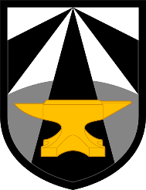




TRAC-MTRY and NPS Partnership
DoD and AFC Research Needs
Military / Government Students
World-Class Faculty
TRAC-MTRY
Naval Postgraduate School
Student and Faculty Research
TRAC-MTRY works with AFC, Army, and DoD sponsors to identify problems that require graduate-level research and performs that research with students and faculty at NPS and other schools.

Slide 5
2023 - Lines of Effort
Data Analytics, Visualization, & Engineering
,
Objective: Support & enhance current TRAC operations & DoD sponsors using OR, systems engineering, and visualization techniques.
Analysis of Alternatives Support, FARA, OMFV Tradespace.
Persistent Experimentation Capstone.
Army Continuum of Analysis.
End State: MTRY developed AoA visualization tools used in TRAC AoA or another TRAC study. MTRY enhances in-stride analysis for PC24.
Army Foundational Models - Language
Objective: Leverage recent advances in language models to provide TRAC and DoD Sponsors with tools to maintain data dominance.
Knowledge Discovery, PC/NTC Data, FCC Forge Database, CRC Data.
Operational Support (1SFC, CENTCOM, USARPAC).
Persistent Experimentation Capstone.
End State: MTRY fine-tuned language models used to support TRAC (study or processes) or by a DoD organization within their mission.
With NPS, USMA, & Academic Institutions
Across TRAC / AFC
Partnerships / Sponsored Projects
Advance Models & Simulations
Objective: Improve scalability and capability of simulations using reinforcement learning, cloud technologies, and other advanced methods.
HPC/Cloud execution and post-processing.
COMBAT XXI & CISCR.
Intelligent Agents in a wargame or simulation.
End State: RL Agents are incorporated into a TRAC simulation. Streamline HPC/cloud execution of combat simulations.
Notes:
- Focus on end-states for the year.
- Bread and butter remains DAVE.
- LM and Advanced models are the DAVE of tomorrow.

Slide 6
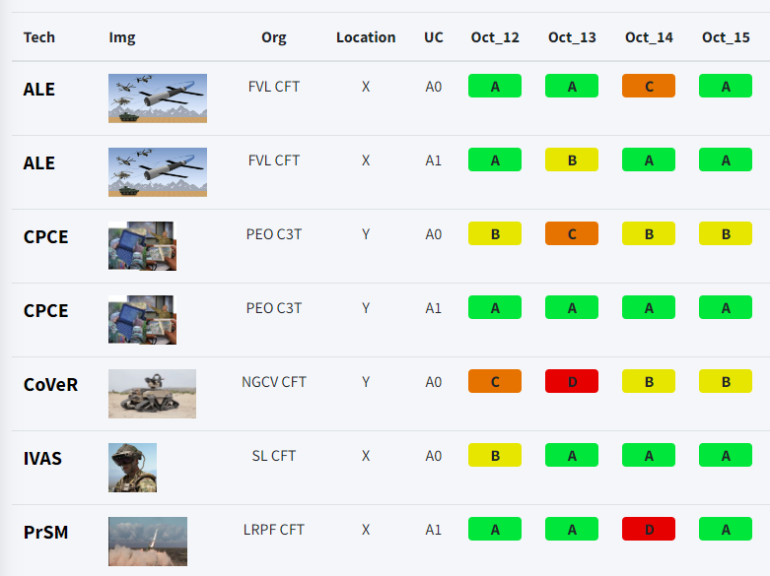
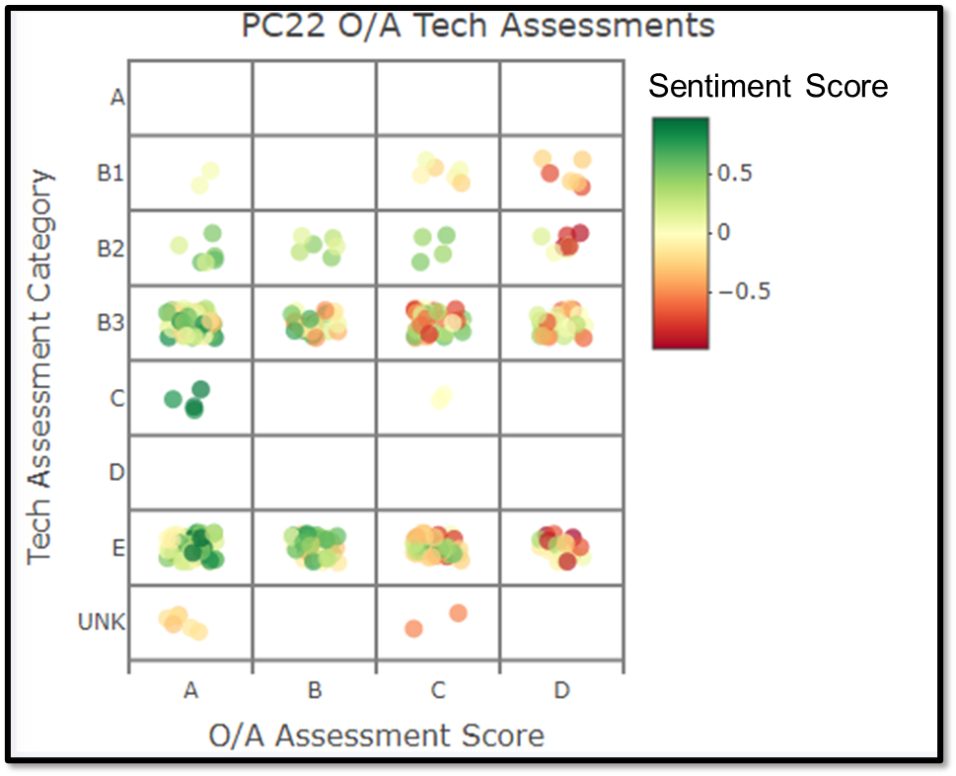
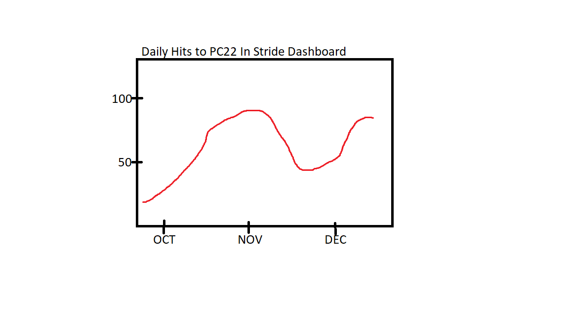
PC22 In Stride Analysis
TRAC MTRY filled key PC22 data analysis gap by providing near real time insights, often within hours of event execution.
Overview
Results
PC22 Challenges
Lack of precise Execution Checklist (ExCheck) timing data.
Increased reliance on O/A free-text comments.
More variability and free play than PC21.
In Stride Analysis Approach
Built and implemented state of the art natural language processing tools.
Coordinated with DAC, ATEC, and JMC to ensure digital collection of key execution data.
Developed and fielded new interactive web dashboard on SIPR MADE to share results.
Delivered novel insights into technology performance, critical task execution, experiment trends, and more.
Tech Performance Tracker
Sentiment Analysis
Over 1900 hits to In Stride Dashboard.
Scen.
A
Scen.
B
Reporting Phase

Slide 7
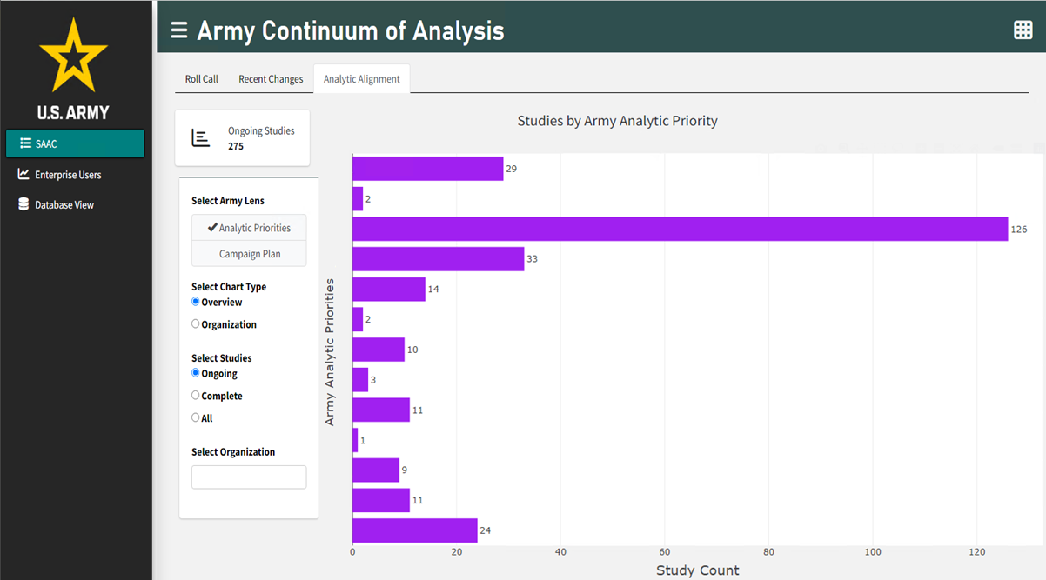
Army Continuum of Analysis Dashboard
The Army Continuum of Analysis is an effort across all the Army Analytic agencies to synchronize efforts for cross collaboration.
Goals
Dashboard Snapshot
Provides a real-time dashboard for both briefing and analytic coordination efforts
  Connected to a database hosted on Azure
Hosted on cArmy
Accessible to all DoD employees & contractors through government issued IDs
Dashboard creators (TRAC)
  Majors Sean Eskew & Candice Farney
Database creators (FCC)
  Majors Maxine Drake & Shane Hasbrouck
The ACA has a flexible tool to visualize and align efforts to Senior Leader Guidance across the analytic community.
Notes:
Cloud hosted
DoD accessible
Briefing and Coordination tool

Slide 8
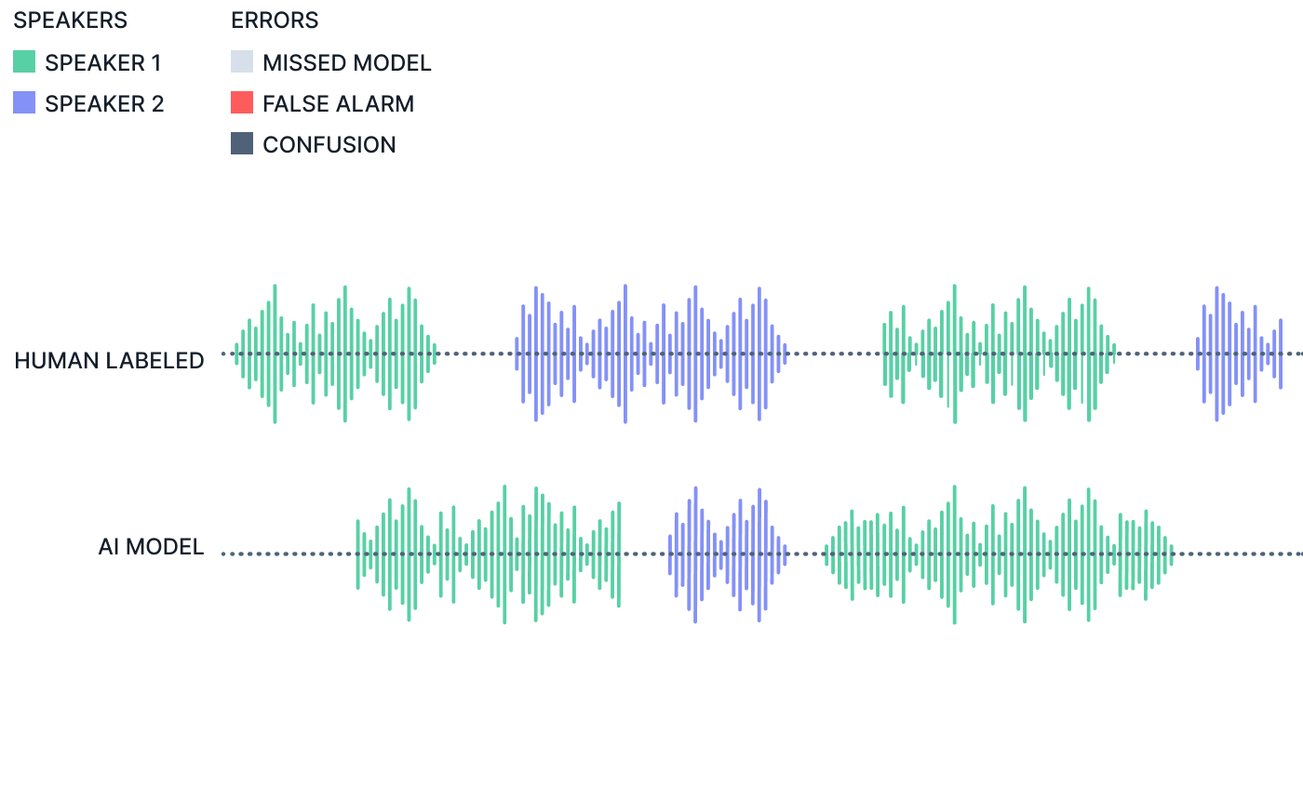
Multi-Speaker Aware Diarization
TRAC-Monterey is currently researching applications of speaker aware diarization during mission planning exercises.
Goals
Challenges
Capture discussions and their impacts on decisions in mission planning
Provide text summarizations of planning activities and semantic search in post event analysis
Hardware:
  Microphone set up
  Significant processing power required
  Operating on classified systems
Model Selection:
  Choosing the right model for the conditions
Conditions:
  Room size
  Small group work
  Personal/ unrelated conversations recorded
  Differing opinions expected in conversation
Source: Deepgram

Slide 9
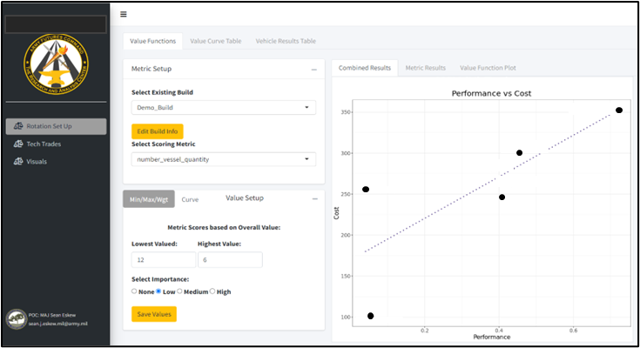
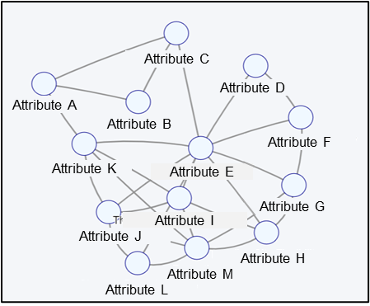
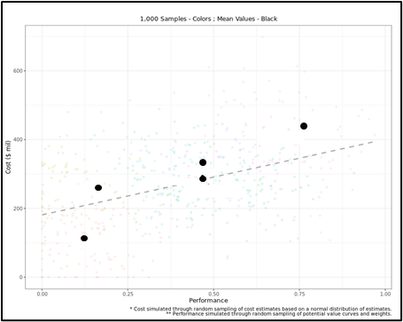
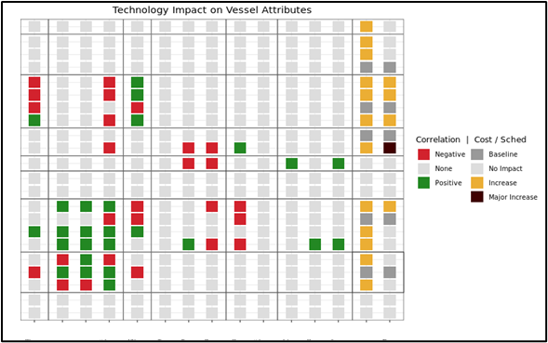
Tradespace Analysis
Study Teams require standardized means to explore and visualize tradespace analysis across Cost, Schedule, and Performance for Analysis of Alternatives to support consistent achievement of analytic sufficiency.
Objectives
Understand and evaluate trades within and between Cost, Schedule, and Performance.
Support Study Team Analysis and Senior Leader Decisions.
Provide a repeatable methods to help communicate the analytic sufficiency across multiple TRAC studies.
MTRY Analysts: MAJ Candice Farney​
MAJ Sean Eskew

Slide 10
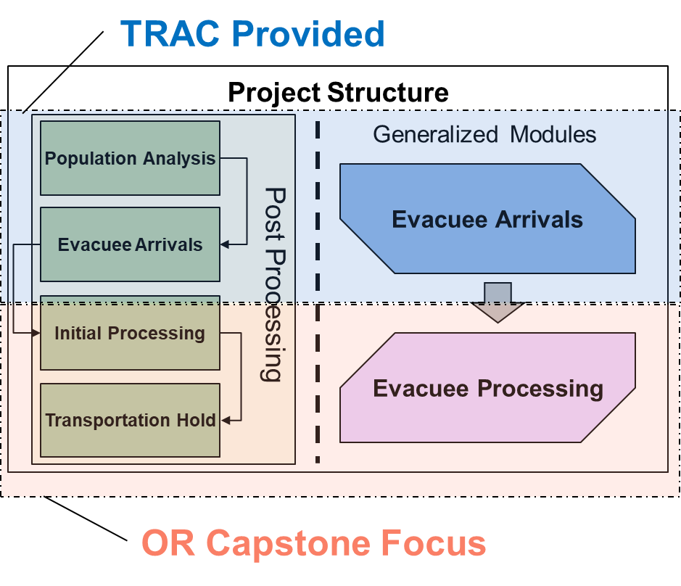
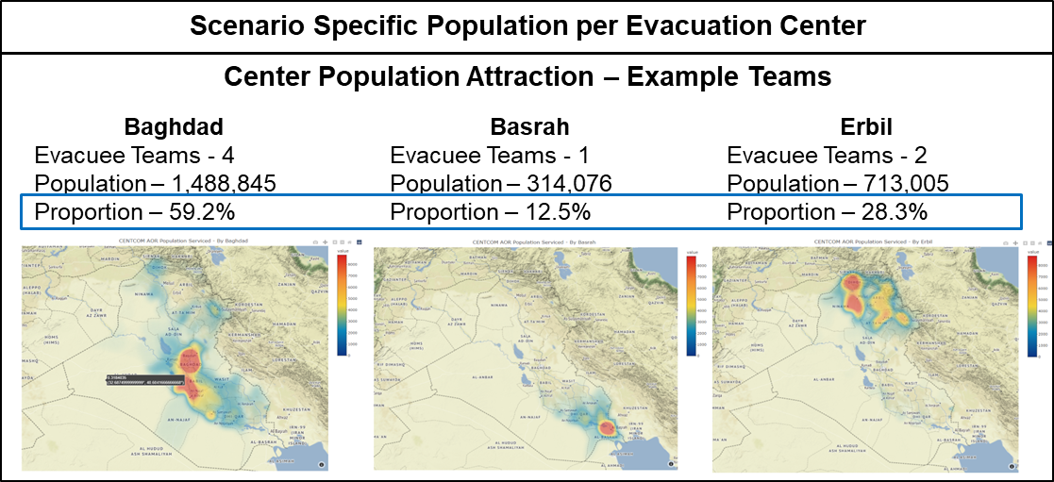
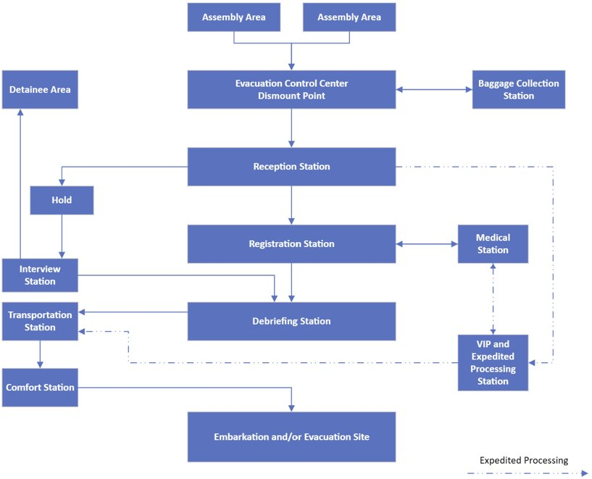
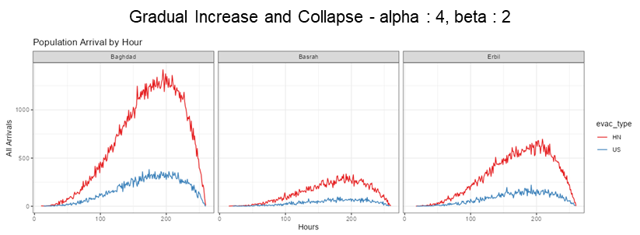
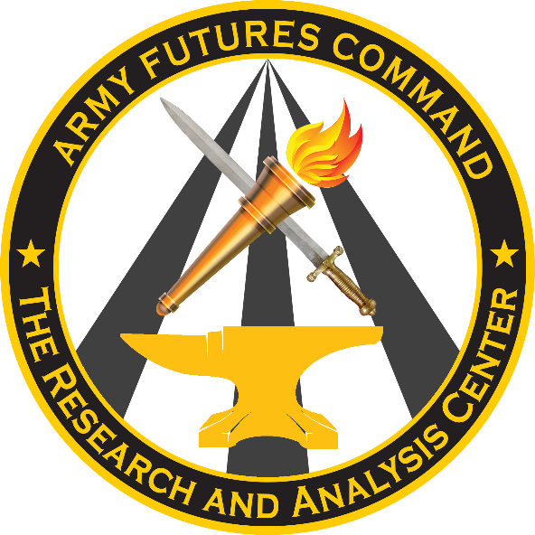


CENTCOM NEO Planning SIM
Develop a generalized simulation system for Non-Combatant Evacuation Operations (NEOs) for scenarios across the CENTCOM AoR.
Collaborators
MTRY Analysts
  LTC Matt Smith
  MAJ Kurt Reynolds
  MAJ Sean Eskew
NPS Capstone Team (5xStudents)

Slide 11







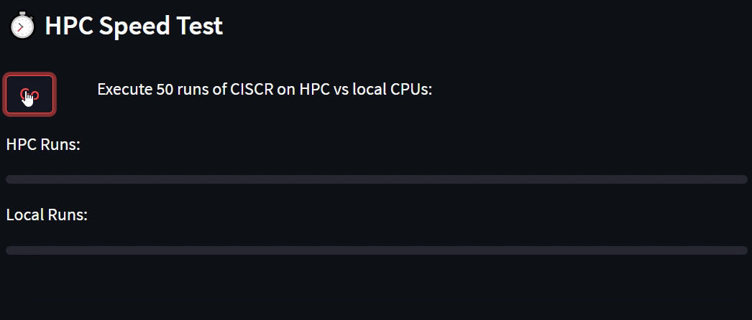
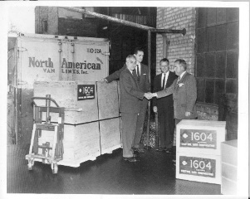
TRAC M&S Cloud Experimentation
What is the cost-benefit of different High-Performance Computing (HPC) platforms to support combat M&S experimentation and other use cases?
TRAC Local Compute Farms
Future Cloud and HPC Infrastructure
Azure - Modernization Application and Data Environment (MADE), cARMY.
Potential HPC Benefits
Greater compute capability.
Scalable network.
On-demand resources.
Lower long-term costs.
AWS - Army MI Cloud Computing Service Provider (AC2SP).
High Performance Computers (HPCs) – DoD owned multi-core supercomputers.
Locally managed server farm – 180 physical cores.
Configured to support TRAC.
TRAC must upkeep and maintain resources.
TRAC MTRY experimentation on NPS HPC Systems:
Shipment of first CRAY Model 1604 supercomputer to NPS (1960)
Notes:
TRAC: 180 cores, NPS 4200 cores
TRAC MTRY experimentation on NPS HPC assets to explore future M&S experimentation and eventual cloud transition.

Slide 12
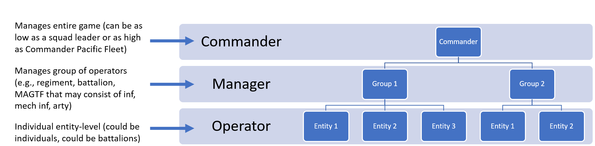
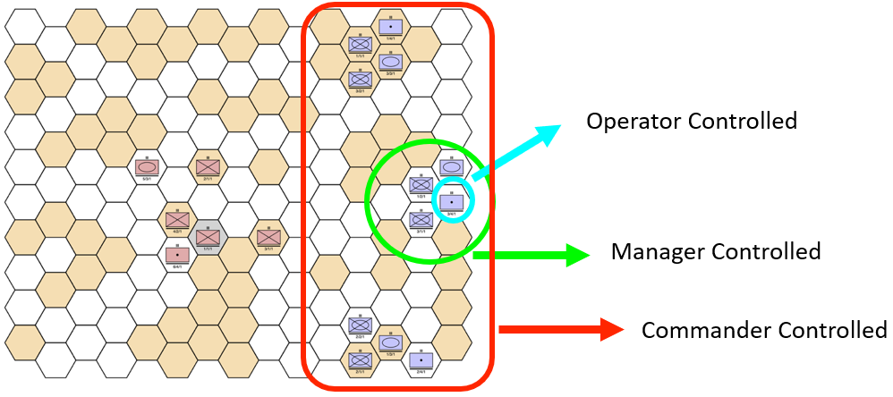
ATLATL/Wargaming
Employing hierarchical machine learning techniques builds accuracy, scalability, and interpretability in complex decision-making tasks.
Objectives
Apply Hierarchical Machine Learning (HML)/ Reinforcement Learning (RL) techniques using the MOVES Atlatl program to train agents that can operate at various echelons.
Develop methods to enable the decomposition of complex decision-making tasks into smaller tasks that can be processed by individual agents resulting in enhanced accuracy, scalability, and interpretability.
Estimated Completion Date TBD.
Collaborators
MTRY Analyst(s)
  MAJ Kurt Reynolds
  Dr. Brian Wade
NPS MOVES
  Advisor – Dr. Christian Darken
Student Support
  MOVES PhD Candidate – Lt Col Scotty Black
Concept for the application of HML:
Notes:
ATLATL/Wargaming – more fundamental research into HIERARCHICAL ML
Discuss wargame application and presentation (MORS)
Working with MOVES and student collaboration to explore techniques in ML that can apply to other simulations
Goal of having model that can help leaders make complex decisions, but we are not there yet. This research is a foundational step in that direction.
DARPA, Specter model are examples of efforts that try to do this.

Slide 13
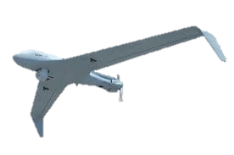
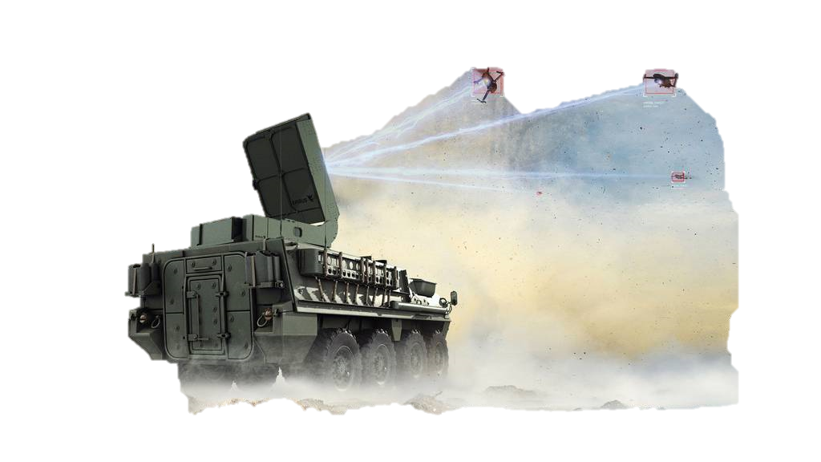
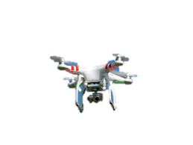
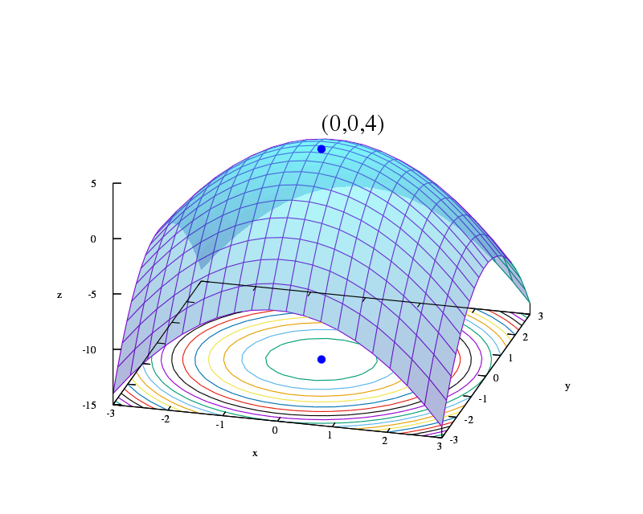
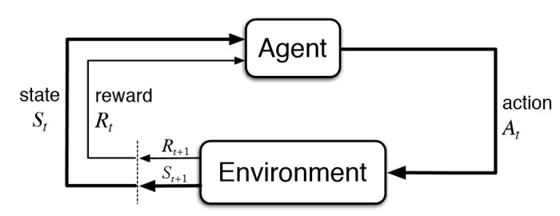
CISCR Optimization
Employing reinforcement learning and simulation optimization techniques to create a robust analysis of counter small unmanned aerial systems.
Objectives
Apply Reinforcement Learning (RL) to enhance red small unmanned aerial systems (sUAS) tactics and, simultaneously, apply simulation optimization methods to enhance blue counter sUAS (C-sUAS) systems and capabilities mix.
Optimizing the red UAS tactics enables a robust concept and system optimization for blue C-sUAS systems.
Estimated Completion Date TBD.
Collaborators
MTRY Analyst(s)
  MAJ Kurt Reynolds
  Dr. Brian Wade
  LTC Matt Smith
WSMR Analyst
  Dr. Michael Yereniuk
Dual Optimization Framework:
sUAS Tactics
C-sUAS Capabilities
Dual Competing Optimization
Optimize Red sUAS Tactics and Employment
Optimize Blue C-sUAS System Mix and Capabilities
Reinforcement Learning
Simulation Optimization
Optimization of sequential decision making.
Optimization of large input spaces for simulations.
CISCR – Counter Information Seeker Computational Research Model

Slide 14
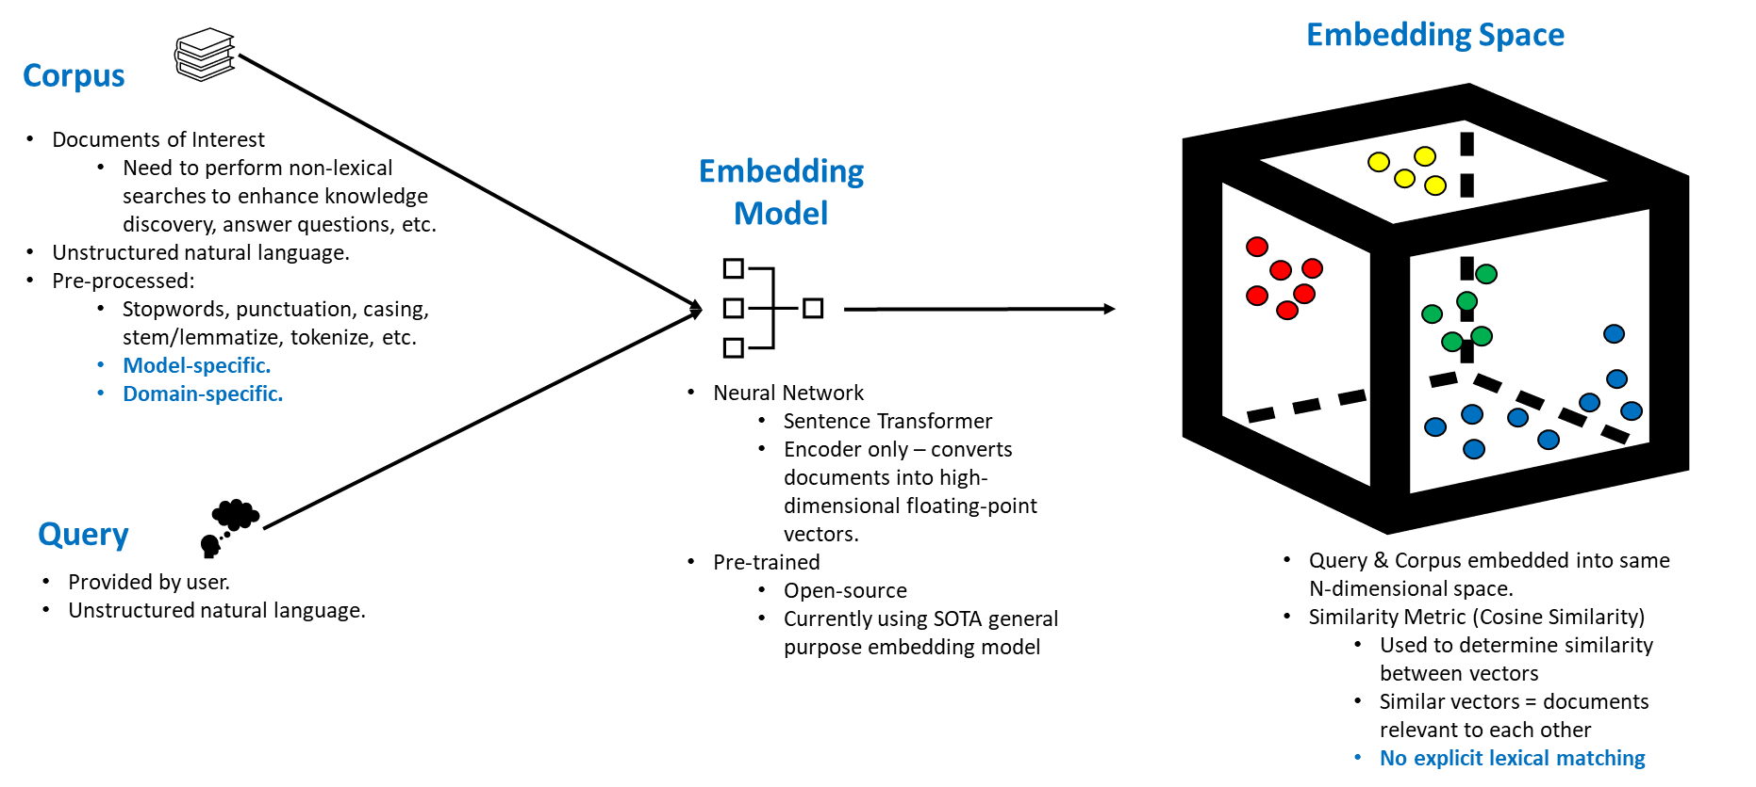
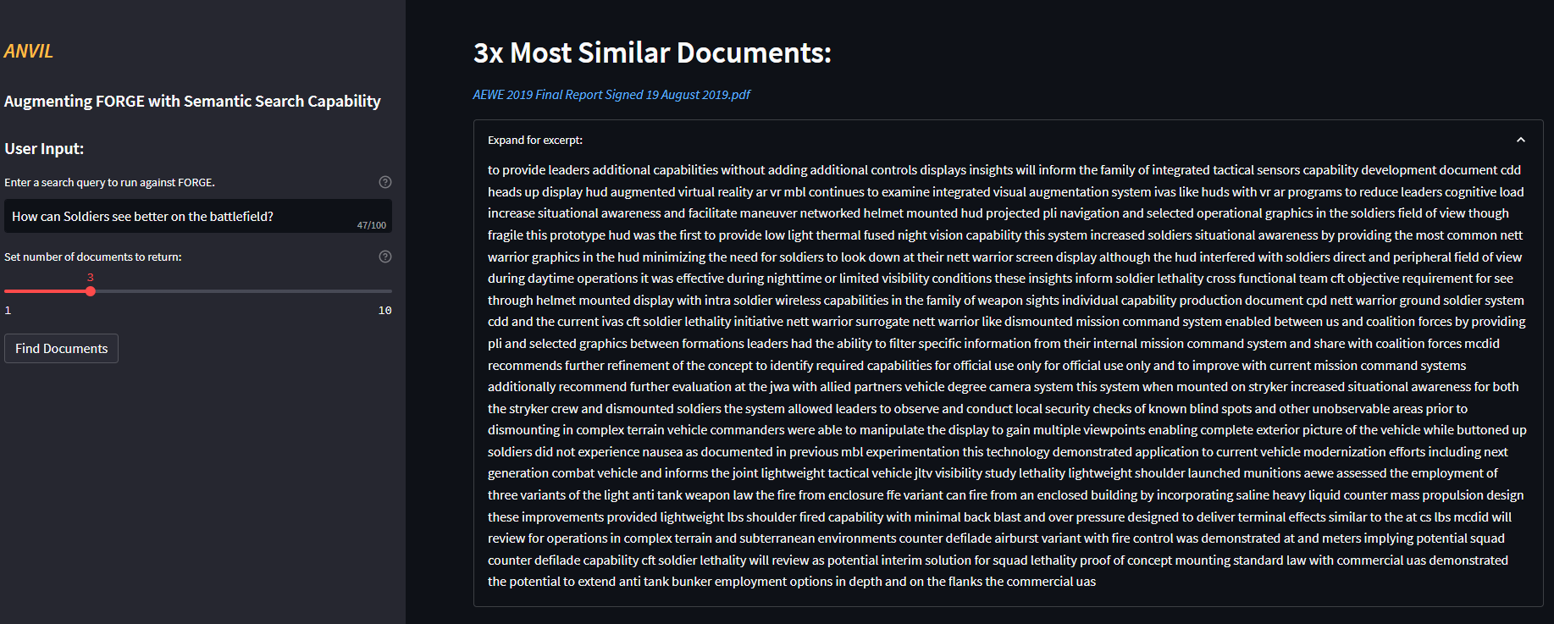
FORGE Advanced Search (ANVIL)
To move forward with plans for FORGE 2.0, FCC seeks to integrate knowledge discovery and information retrieval capabilities into existing processes & platforms.
Objectives
FCC requested TRAC-Monterey support.
TRAC-Monterey analysts provided ANVIL, a vision & prototype for semantic search capabilities.
  Utilized on-prem resources (BigRigs)
Broad approval from FCC; interested in further development / integration.
Impact to TRAC – potential for semantic search capabilities in other domains (studies, ACA, etc.)
Collaborators
MTRY Analysts
  MAJ Daniel Ruiz
  MAJ Sean Eskew
Coordination
  MAJ Shane Hasbrouck (FCC)
  MAJ Maxine Drake (FCC)
  CPT Bradley Warren (AI2C), pending
  Mr. Jeffery Moore (AI2C), pending

Slide 15
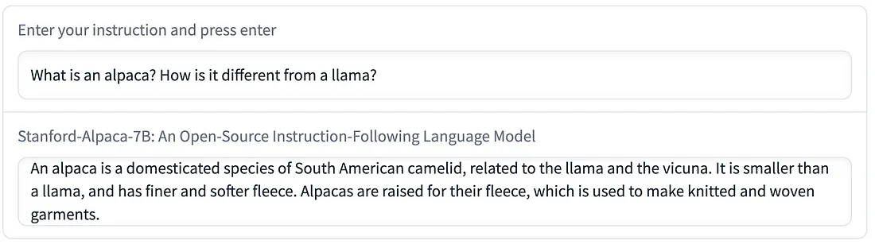
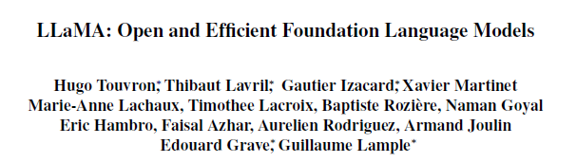

Training “AlTRACa” – From Llama to Alpaca
Open-Source LLM
(LLAMA 13B, etc.)
GPT-4 Outputs
Instruction-Tune
Deploy
TRAC Code & Documents
TRAC-GPT
AlTRACa
Fine-Tune
GPT-3.5 Cost > $40m & LLaMA > $20m
Alpaca - Cost ~$600
vs.
Inefficient / Cost-Prohibitive
Efficient & Effective

Slide 16
Questions and Contact
Contact us at:
Director
LTC James Jablonski
james.jablonski@nps.edu
(831) 656-3086
Principal Analyst
Dr. Brian Wade
Brian.wade@nps.edu
(831) 656-3087
Admin Support
Ms. Sandra Lackey
sdlackey@nps.edu
(831) 656-3086
Mil. Personnel S1
MAJ Candice Farney
Candice.Farney@nps.edu
(831) 656-7575

Slide 17
Backup

Slide 18
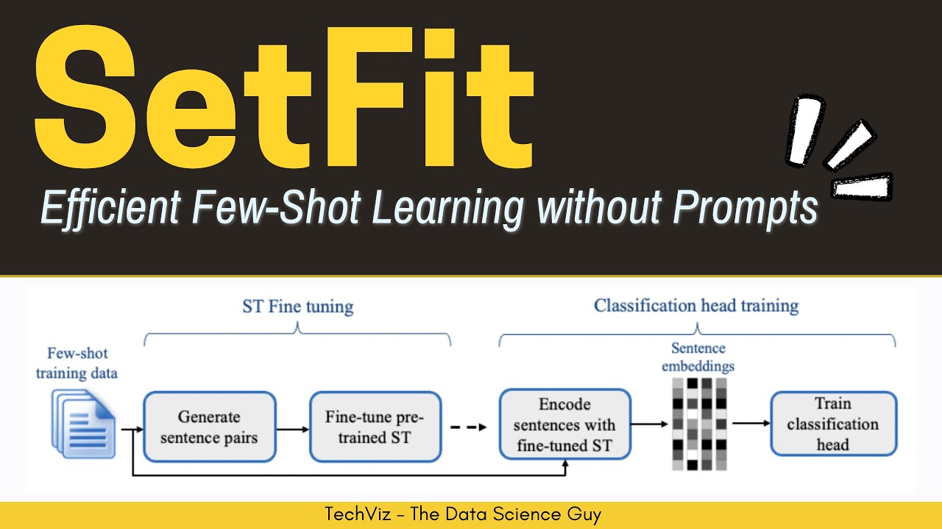
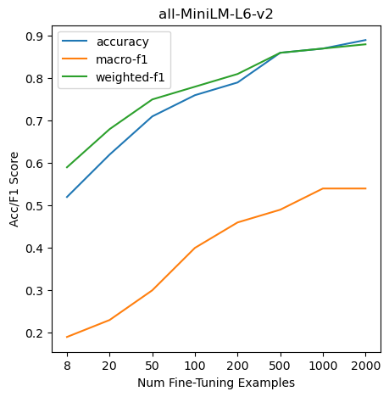
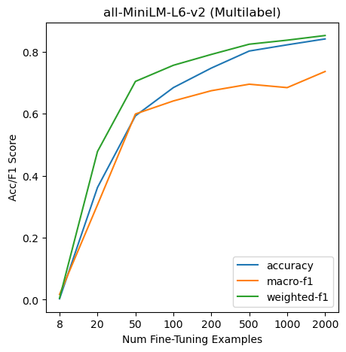
USA CRC Survey Classification
U.S. Army Combat Readiness Center (USACRC) seeks code review and technical advice to train classifiers for unstructured text from surveys.
Objectives
Given 8000+ data points, asked to evaluate and provide recommendations for further analysis.
Review of USACRC code - provided insights WRT data preprocessing & dataset imbalance.
Applied SetFit framework to create classification models that outperformed CRC models by significant margin.
Highlighted modern NLP technique & applicability to Army problems.
Collaborators
MTRY Analysts
  MAJ Daniel Ruiz
  MAJ Sean Eskew
Coordination
  Sarah Oldfield (USA CRC)
CRC Acc.
CRC Acc.

Slide 19
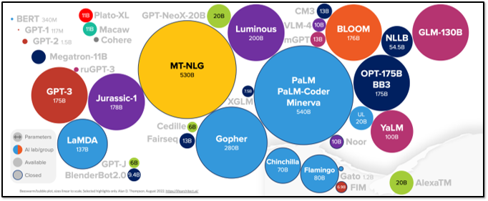
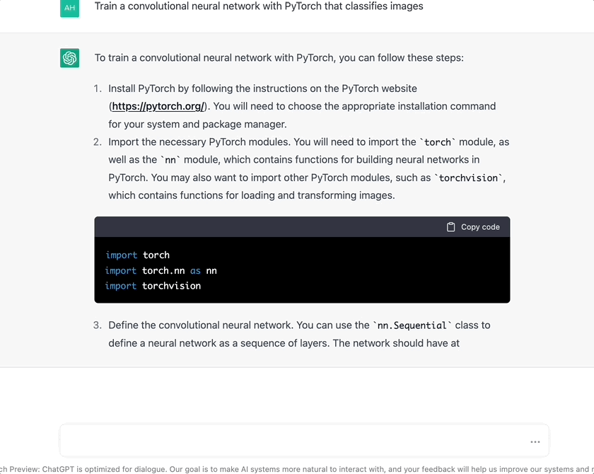
NLP & Language Models – More on LLMs
Large Language Models (LLMs) are emerging AI technologies with groundbreaking capabilities across a variety of use cases; unfortunately, LLMs are severely underutilized by the Army and DoD.
What are they?
  “Large” LMs are LMs with 1B+ trainable parameters.
  Generate text indistinguishable from human prose.
  Capable of zero-shot generalization.
  Recently went open-source.
What is the current state of the art?
  ChatGPT from OpenAI (see top right)
  Other competitors include models Google, Microsoft, and Meta.
Who else is using them?​
  Russia’s Internet Research Agency utilizes LLMs to augment ongoing disinformation campaigns.​
  The PRC has funded LLM development in the private and academic sectors.
  Chinese LLMs are the largest in the world (1T+ parameters), and public information about their usage or capabilities is nonexistent.

Slide 20
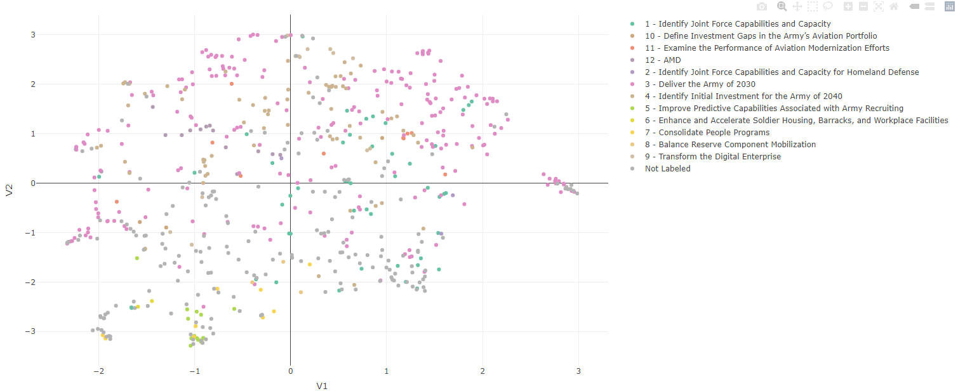
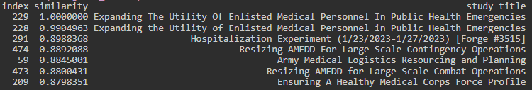
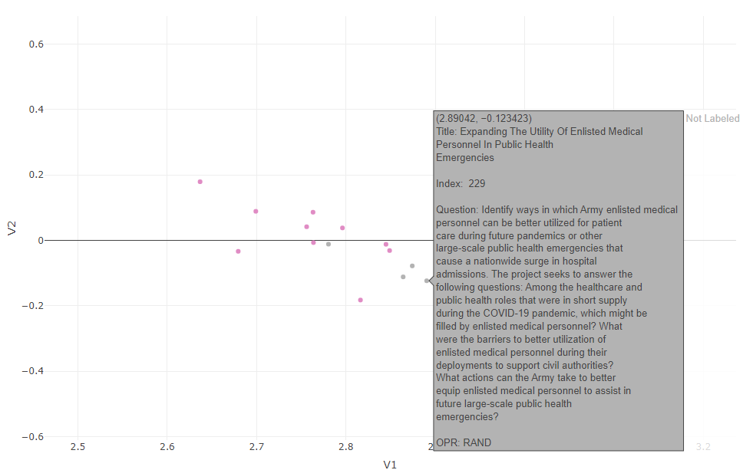
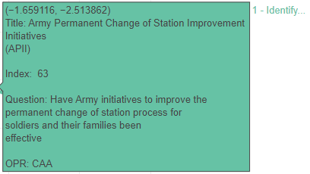
Additional Applications - ACA
The same methodology can be applied to the ACA database to support analyst understanding of similar efforts beyond their assigned study effort.
Study Similarity
Objectives
Apply Army Foundational Model learned methods, models, to existing problem sets.
Support the shared understanding and cross-coordination amongst the Army Analytic Community.
Medical Cluster
Possible Mis-Label

Slide 21
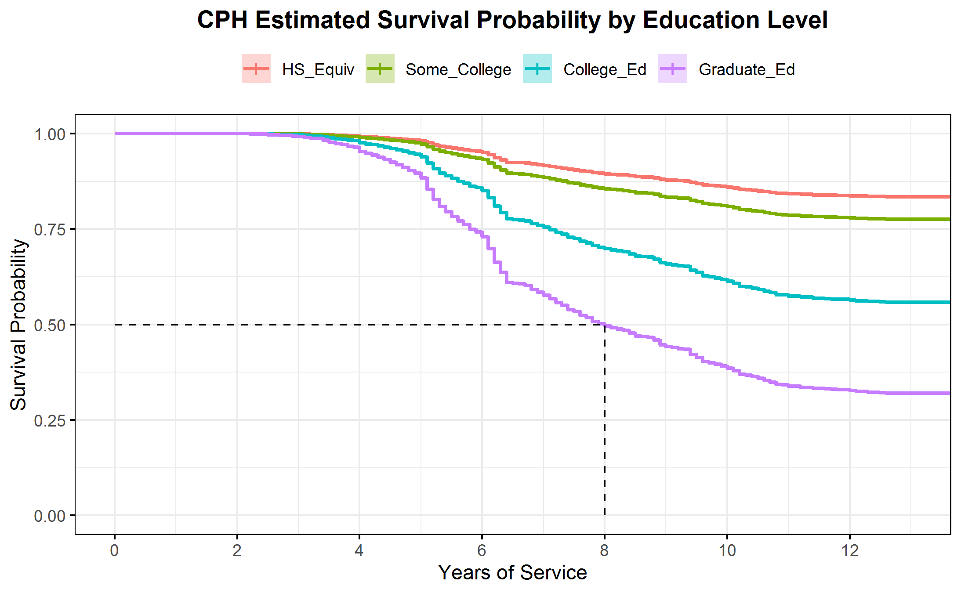
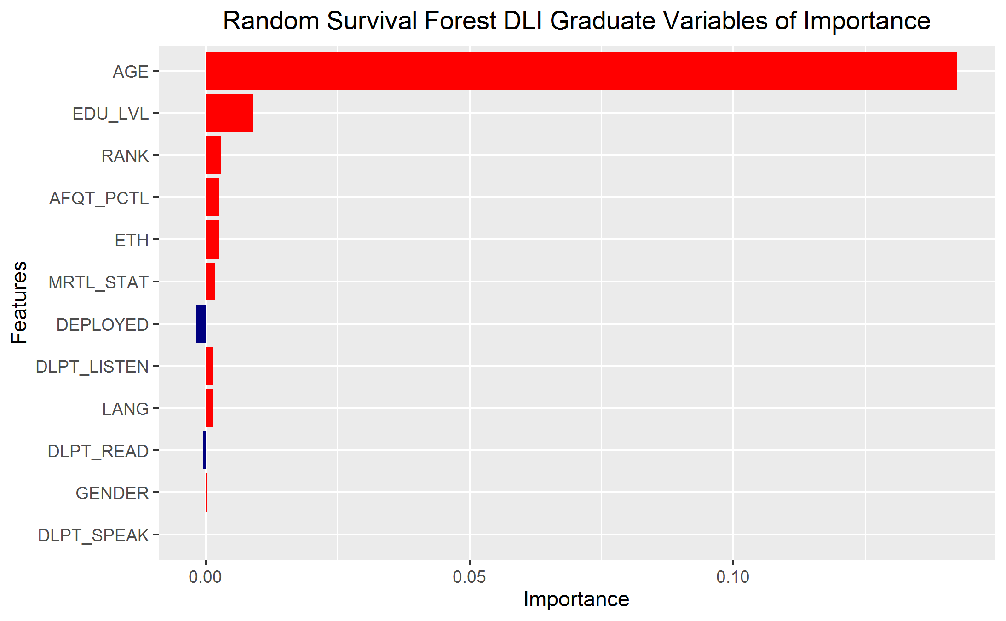
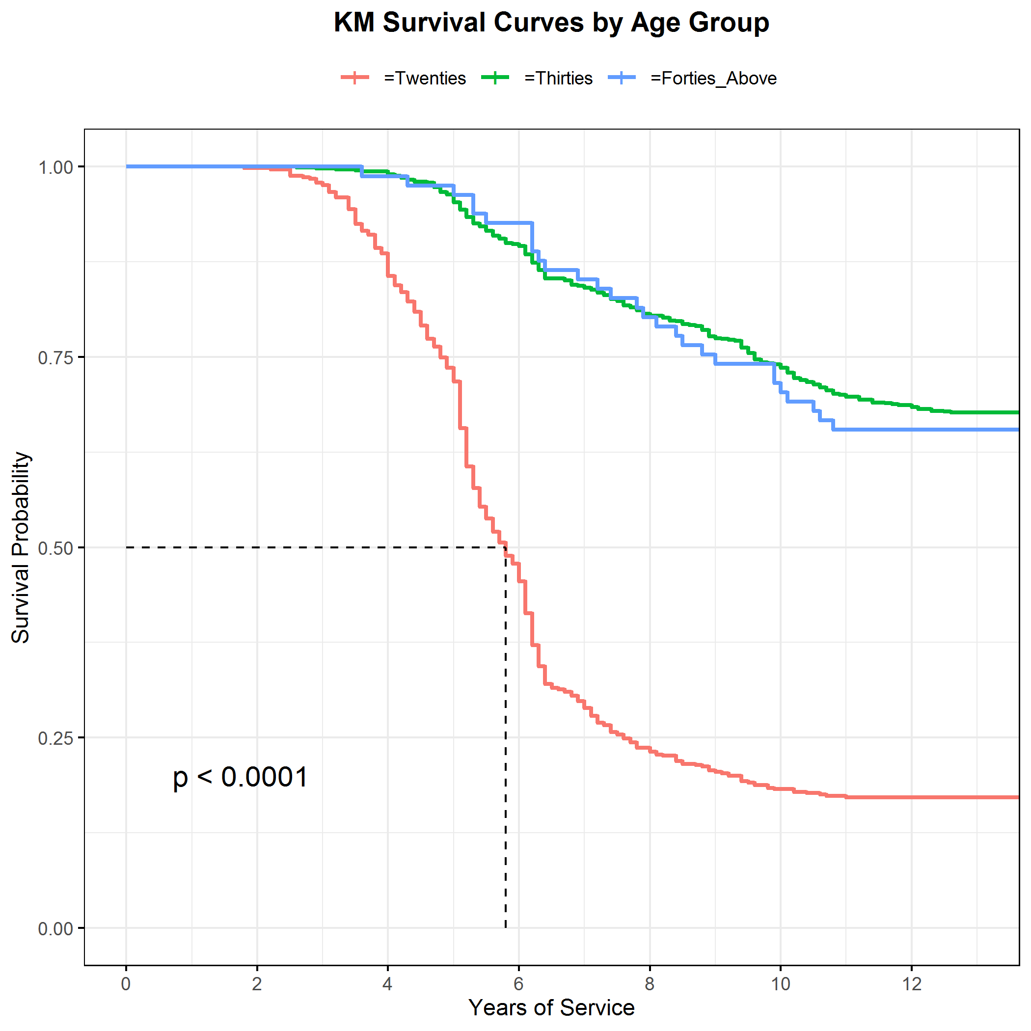
Person-Event Data Environment (PDE) & Retention
The Army Analytics Group (AAG) facilitates student research by giving them access to DoD data and computing resources for their thesis work.
PDE
Linguist Retention
Onboarding process does not fit student timelines.
TRAC-MTRY analysts accelerate the project.
  Make sequential efforts parallel.
AAG handles the funding with OPA.
Potential TRAC benefit: Opportunities to collaborate with OPA or other “People” based studies.
  HRC Innovation Cell: Building NLP Models to replace boards.
Current state: Two OR student theses on retention.
  Linguist Retention.
  Mid-Career Reservist Retention.
Used Kaplan Meier, Cox Proportional Hazard, and Random Survival Forest.
Notes:
Problem: On average, it costs $323,000 per student to attend DLIFLC. Some students are recycled, change languages, or need additional enhancement training, adding significant costs and time to their training pipeline. Young enlisted students on their initial service contract, account for the largest share of DLIFLC students. Attrition is a significant loss in DOD time, resources, and money. In an increasingly difficult recruiting environment, it has become vital to understand why and when attrition occurs
Analysis procedure for which the outcome variable is time until event occurs
Event: Separation from Army
Time: Years of Service until Separation
Survival function – probability that an observations survival time is greater than a specified time
Censored data: Some information is known about individual survival time, but exact time-to-event is unknown
Thesis data was right-censored, meaning time-to-event is greater than the observation time for some observations

