Slide 1




Model-based Assessment of Adaptive Automation’s Unintended Consequences
LTC Charles P. Rowan
24 May 2023
charles.rowan@nps.edu

Slide 2
Agenda
Background
Problem Statement
Approach
Results
Future Work
Discussion

Slide 3
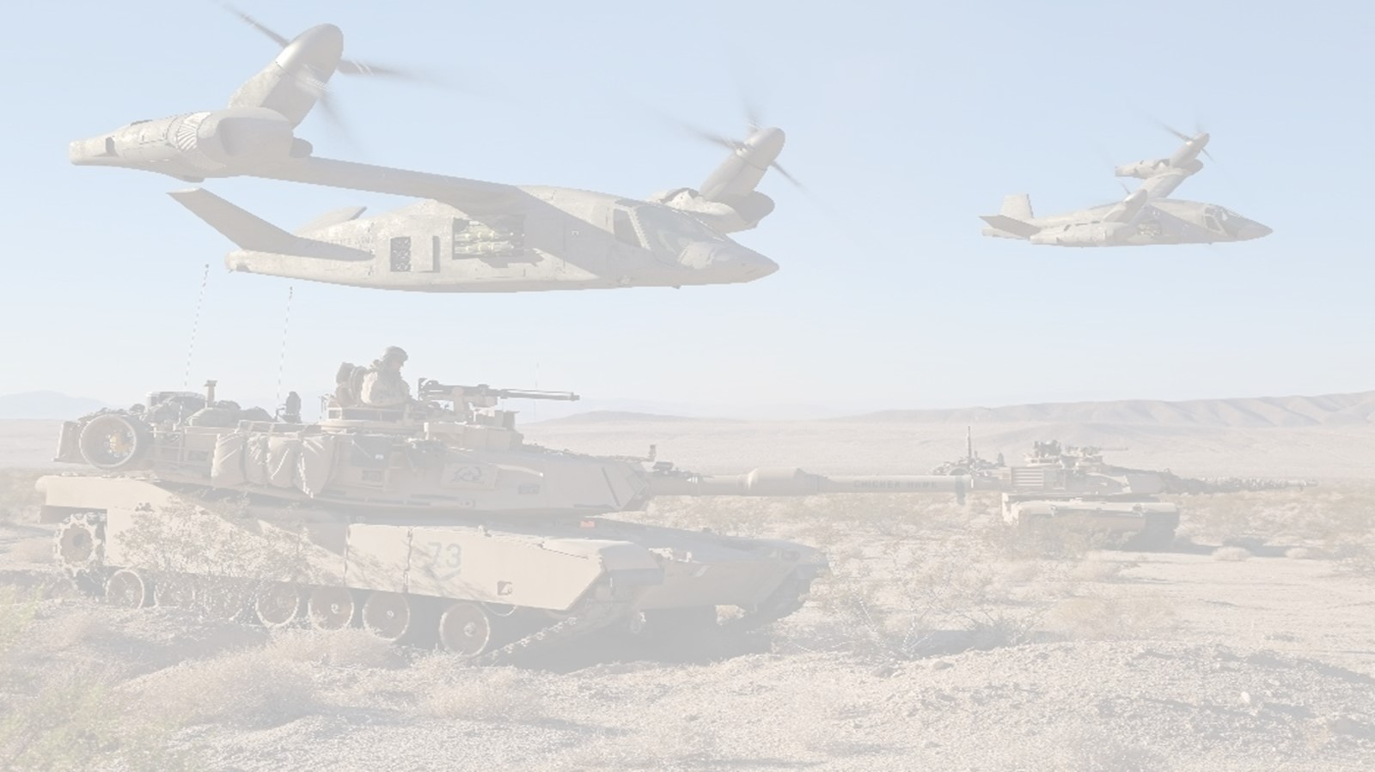


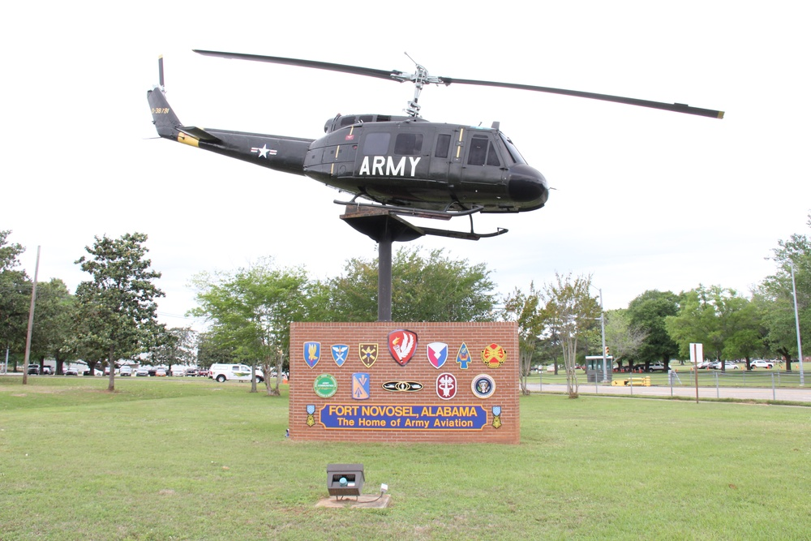














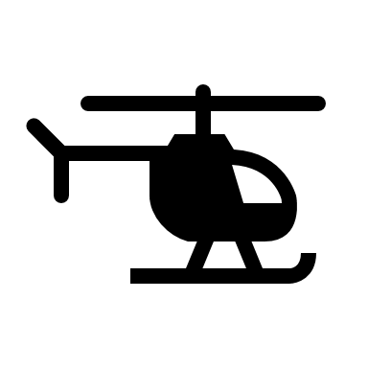





The Journey: By the Numbers
Foundational Work
Data Collection
Amplifying Information
133
500+
Items Reviewed
7
In-Person Participants Over
3
Studies
2
Site Visits
6
20
7
Memoranda of Agreement
4
General/Flag Officers Briefed
Synchronized
Data Streams
Collected Simultaneously
Hardware / Software Items
External
Presentations
25+
6
220+
45
17K
$20K
Collaborators across Organizations
Data Collection Hours
Data Collection Days
Miles traveled
Travel & Equipment
30+
Hours Using
2
4
2.1TB
7.5
1
UH-60A/L Sim Hours
IRB
Approvals
GWC Coach Hours
Data Collected
Pandemic

Slide 4
Background
The US Army’s Future Vertical Lift (FVL) Program includes the Holistic Situational Awareness and Decision Making (HSA-DM) effort to:
Identify drivers of cognitive workload.
Develop cognitive workload management capabilities.
An opportunity to address human operator cognitive workload considerations.
Cognitive workload: “represents the degree of activation of a finite pool of resources, limited in capacity, while cognitively processing a primary task over time, mediated by external stochastic environmental and situational factors, as well as affected by definite internal characteristics of a human operator, for coping with static task demands, by devoted effort and attention.” (Longo et al., 2022, p.18)

Slide 5
Problem Statement
Adaptive automation (AA) is one of the most important ideas in the history of human factors.
Adaptive automation specifically serves to assist in keeping humans in a band of optimal workload.
AA can improve performance, safety, and efficiency.
However, AA can introduce unintended negative consequences.
This dissertation leveraged a model-based approach to assess the unintended negative consequences of adaptive automation on cognitive workload.

Slide 6
Approach
Research Questions
RQ 1. Can cognitive workload modeling inform design decisions in AA systems?
RQ 1a. How do operator cognitive workload model predictions, physiological measures, and subjective workload measures associate in adaptive automation systems?
RQ 1b. What is the relationship between cognitive workload and situation awareness as AA’s unintended consequences emerge during a task?
RQ 2. Do cognitive workload predictions predict future performance in AA systems?
RQ 2a. Will unintended (or unanticipated) design consequences of AA systems emerge in the form of changes in performance?
Contributions
AA carries a transition cost that negatively impacts cognitive workload.
Approach and insights to investigating AA through cognitive workload modeling
Mode determination can be complicated with AA systems.
Cognitive workload management goals can be delayed.
Situation awareness and cognitive workload relationships in AA systems.
Support to real-time operator state monitoring.
RQ 1, 1a, 1b
RQ 1a, 1b, 2
RQ
1, 2, 2a

Slide 7
Approach

Slide 8
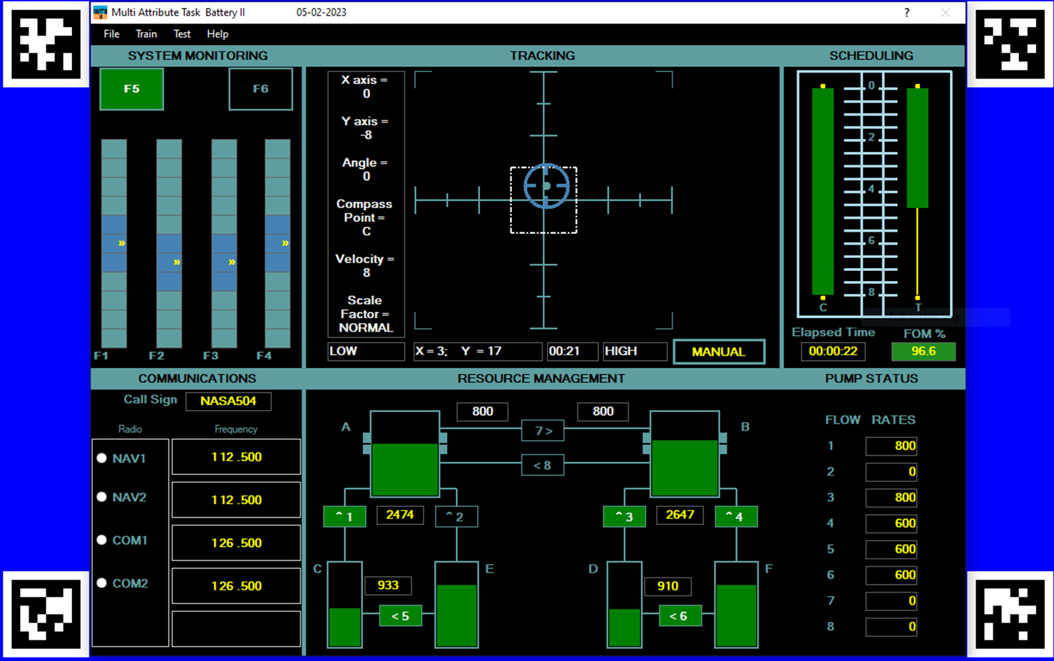
NASA’s Multi-Attribute Task Battery-II v.3.5

Slide 9
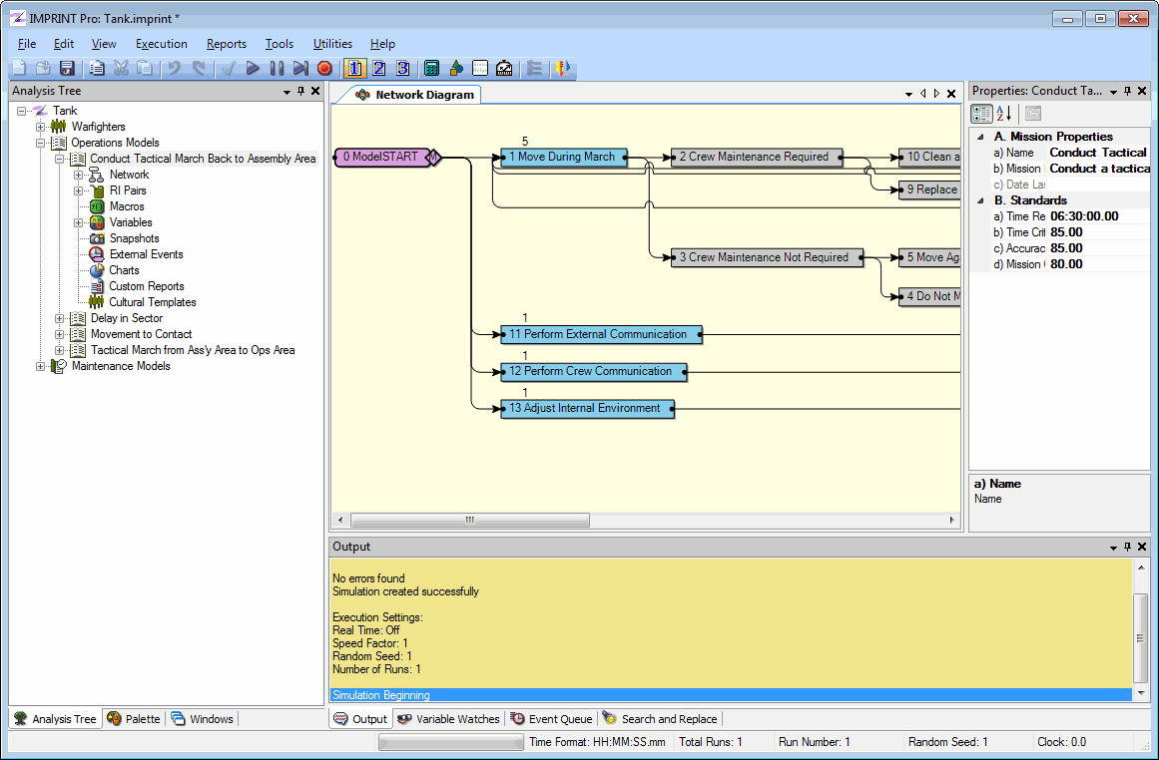
IMPRINT Modeling
Two sets of IMPRINT models developed for each MATB-II scenario.
  Researcher- and expert-derived IMPRINT models using default anchor values in IMPRINT.
Verification included support from IMPRINT developers.
Refined IMPRINT models developed as part of final analysis.

Slide 10
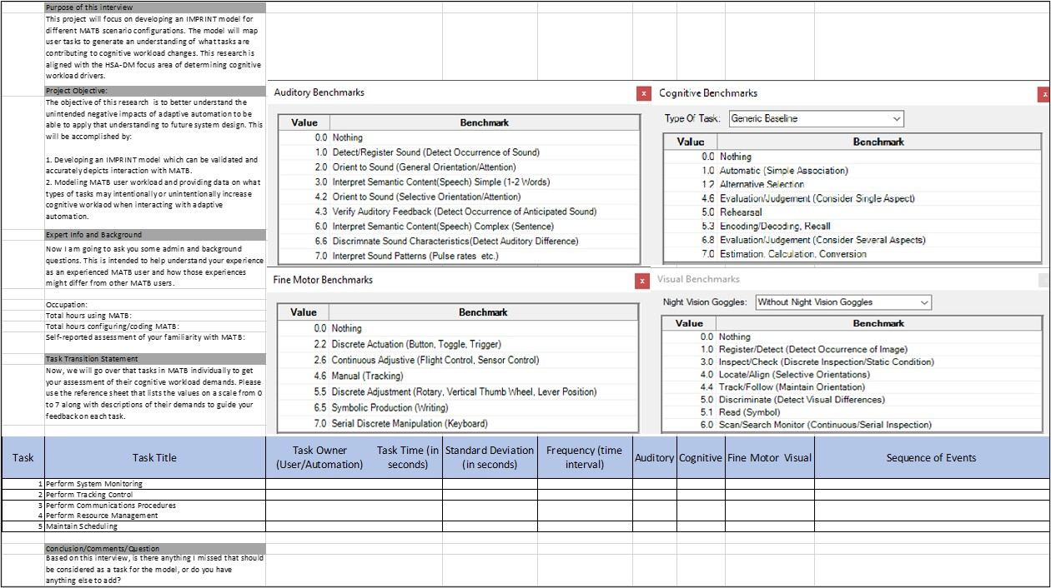
Cognitive Walk-through Questionnaire

Slide 11
Study 3 IMPRINT Model
Low Workload
(Manual Tracking)
Low Workload
(Auto Tracking)
High Workload
(Manual Tracking)
High Workload
(Auto Tracking)
Predicted average workload value = 38.48
Predicted average workload value = 11.65
Predicted average workload value = 41.05
Predicted average workload value = 19.20

Slide 12
Study 3
Number of Participants | Variables Manipulated | Data Collected | Tools
40 Experienced 20 Novice -29 Males -11 Females - Mean age: 34.18 | - Workload Levels - Tracking Control | HRV Eye Tracking fNIRS FOM NASA TLX SART | MATB-II
Group 1:
10 Experienced Participants
Practice
Low Workload
Low Workload
(Manual Tracking)
Low Workload
(Auto Tracking)
High Workload
(Manual Tracking)
High Workload
(Auto Tracking)
Group 2:
10 Experienced Participants
Practice
Low Workload
Low Workload
(Auto Tracking)
Low Workload
(Manual Tracking)
High Workload
(Auto Tracking)
High Workload
(Manual Tracking)
Group 3:
10 Experienced Participants
Practice
Low Workload
High Workload
(Manual Tracking)
High Workload
(Auto Tracking)
Low Workload
(Manual Tracking)
Low Workload
(Auto Tracking)
Group 4:
10 Experienced Participants
Practice
Low Workload
High Workload
(Auto Tracking)
High Workload
(Manual Tracking)
Low Workload
(Auto Tracking)
Low Workload
(Manual Tracking)
5 Minutes
Instrumentation
5 Minutes
5 Minutes
5 Minutes
5 Minutes

Slide 13
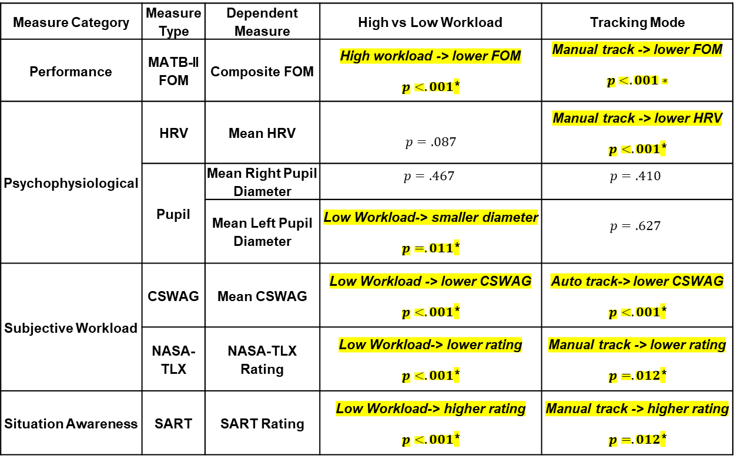
Study 3 Results
Study 3: Workload Forecasting Based on AA
Measure Category | Measure Type | Dependent Measure | High vs Low Workload | Tracking Mode
Performance | MATB-II FOM | Composite FOM | High workload -> lower FOM $p<.001$* | Manual track -> lower FOM $$p<.001∗$$
Psychophysiological | HRV | Mean HRV | $$p=.087$$ | Manual track -> lower HRV $p<.001$*
 | Pupil | Mean Right Pupil Diameter | $$p=.467$$ | $$p=.410$$
 |  | Mean Left Pupil Diameter | Low Workload-> smaller diameter $p=.011$* | $$p=.627$$
Subjective Workload | CSWAG | Mean CSWAG | Low Workload -> lower CSWAG $p<.001$* | Auto track-> lower CSWAG $p<.001$*
 | NASA-TLX | NASA-TLX Rating | Low Workload-> lower rating $p<.001$* | Manual track -> lower rating $p=.012$*
Situation Awareness | SART | SART Rating | Low Workload-> higher rating $p<.001$* | Manual track -> higher rating $p=.012$*

Slide 14
Study 3 Findings
Both pupils were significantly larger 10, 30, and 60 seconds around system state transitions.
Autonomic Nervous System
  Left pupil associated with sympathetic response, right with associated with parasympathetic response
  Differences 5-60 seconds in left pupil may indicate sympathetic activation
    Differences after in right pupil may indicate parasympathetic activation
Two-handed task impacts
  Larger right pupil diameter
Left eye
Right eye

Slide 15
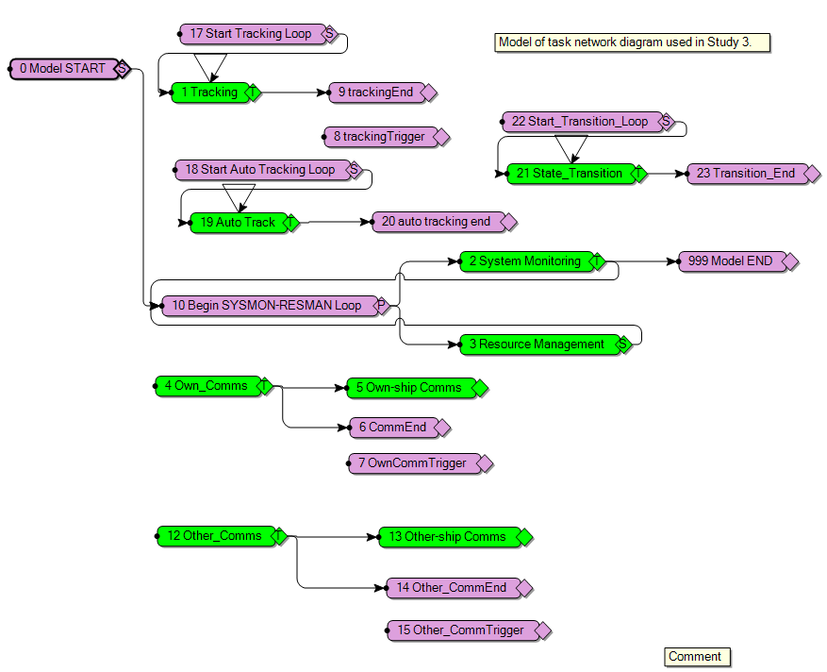
Results
Low Workload
(Manual)
Low Workload
(Auto)
High Workload
(Manual)
High Workload
(Auto)
Group | Low Manual | Low Auto | High Manual | High Auto | Total
1 | 40.02 (+0.02) | 13.69 (+0.80) | 42.70 (+1.12) | 28.15 (+4.36) | 31.00 (+2.28)
2 | 40.89 (+0.56) | 13.18 (-0.17) | 45.16 (+3.11) | 23.89 (+1.94) | 30.63 (+1.60)
3 | 41.35 (+1.32) | 16.40 (+2.99) | 42.49 (+0.11) | 24.13 (+1.27) | 30.81 (+1.79)
4 | 41.29 (+0.58) | 14.12 (-0.19) | 42.11 (+0.41) | 22.17 (+0.03) | 29.78 (+1.07)

Slide 16
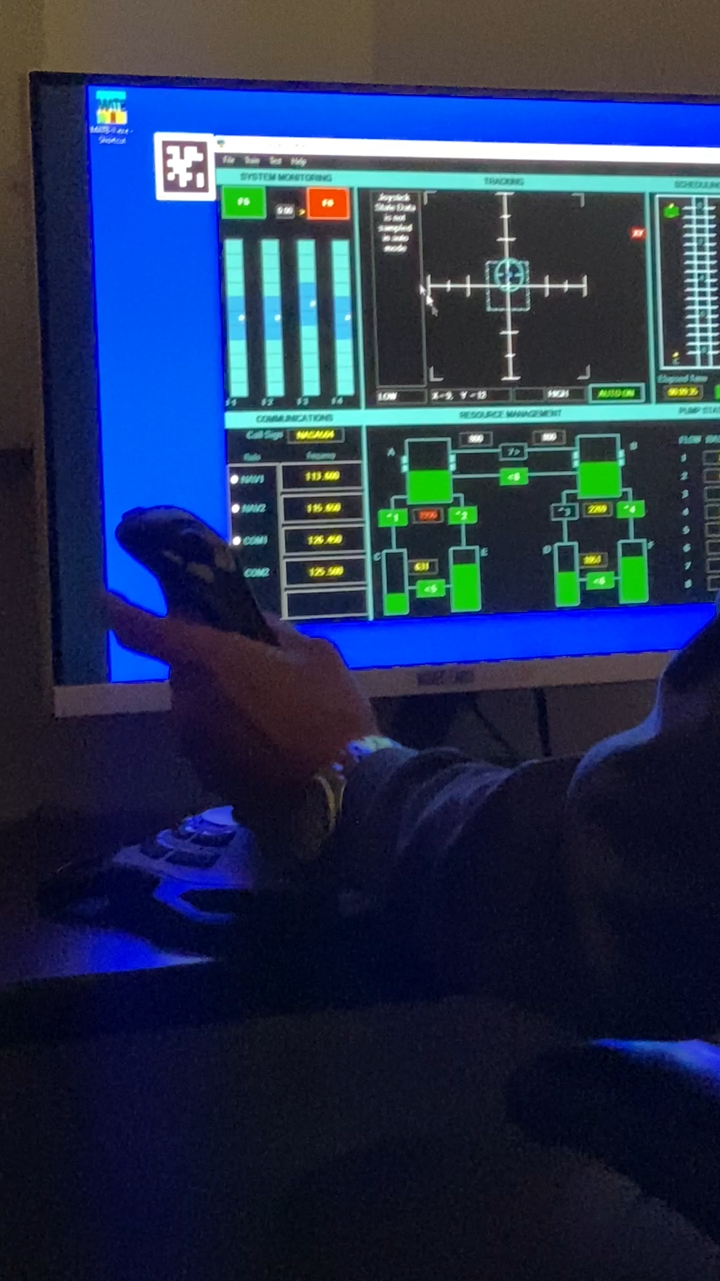
Contributions
Assessing the Unintended Consequences of AA
(-) AA transition cost.
(+/-) Delayed AA benefits.
(+/-) SA and cognitive workload relationship in AA.
(-) System salience indications and mode errors with AA.

Slide 17
Contributions
Cognitive Workload Modeling Considerations
  IMPRINT Model Utility
  AA Unintended Consequence Modeling and Measurement Process
  Future IMPRINT Considerations
Additional Contributions
  Towards real-time operator state monitoring.
  Training and human factors considerations.

Slide 18
Future Work
FVL Considerations
  Saccade and fixation analysis at system state transitions.
  Real-time inputs to IMPRINT to refine visual, auditory, cognitive, and psychomotoer (VACP) prediction values with task specificity.
  Capturing workload data to assess impacts over time, not just during a task or mission.
Research
  Linking HITL simulations to IMPRINT and cognitive architectures
    We do not have FVL systems yet, but we have M&S solutions.
  Further analysis of fNIRS as a surrogate measure of cognitive workload in fast changing tasks.
    Investigation of ANS and fNIRS levels to understand pupil differences in two-handed tasks.

Slide 19
Discussion
Model-based Assessment of Adaptive Automation’s Unintended Consequences

Slide 20
Backup Slides

