Slide 1

NWSI Wargaming Center
Overview Brief
Notes:
Lyla format edits

Slide 2
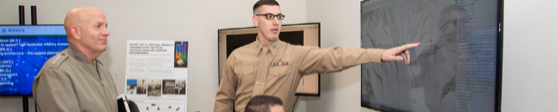
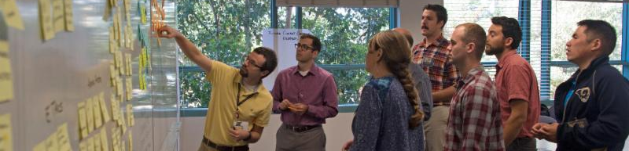
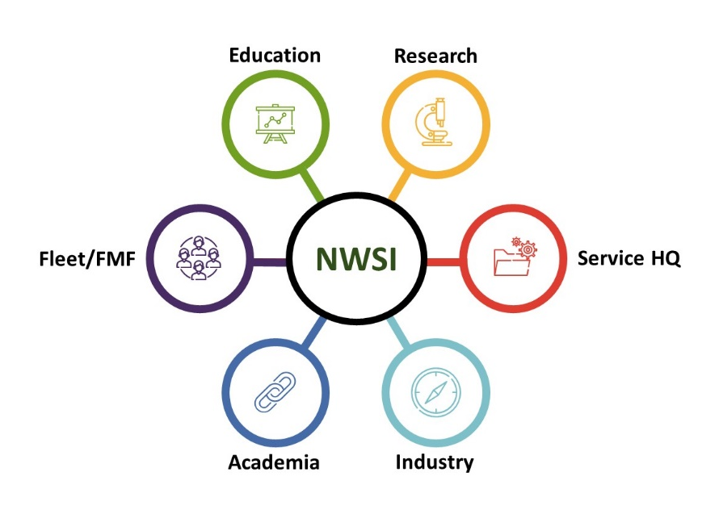
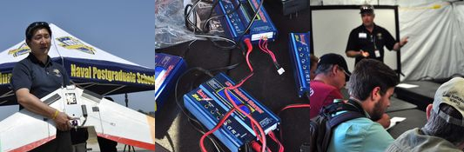
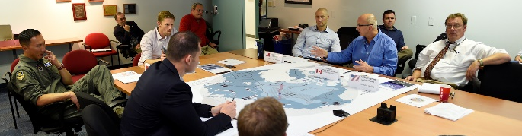
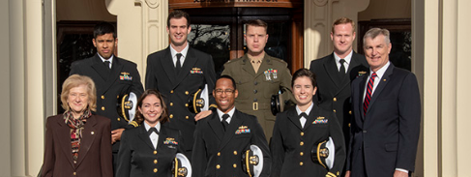
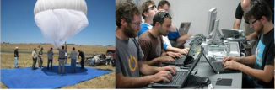
NWSI Mission
NWSI Mission: Coordinate NPS inter-disciplinary research and education to accelerate and enhance warfare concept and capability development while preparing our students for future conflict.
Translate – Integrate – Coordinate – Advocate – Communicate
MOVES Institute
Warfare Innovation Continuum
Industry Partnerships
Wargaming
Meyer Scholar Program & WTI Scholars
Experimentation (JIFX)

Slide 3
NWSI Wargaming Center
The Wargaming Center serves to coordinate wargaming activities across campus and with and external wargaming partners, incorporating a wide range of skilled practitioners from technologists and area specialists to warfighters.
Mission
Provide the Department of Defense, allies and defense partners access to the unique wargaming capabilities of the Naval Postgraduate School students and faculty.
Vision
Assist Defense leaders, through wargaming, in their mission to develop new strategies and concepts across all levels of warfare.
Support external DoD sponsors to help develop, plan and execute wargaming activities.
Serve as a focal point to facilitate coordination, collaboration and support across NPS’ wargaming expertise.
Provide a robust innovation and concepts analysis, wargaming and simulation environment to develop analytical and critical thinking skills in our students.
Develop an integrated wargaming program with a focus on the cycle of research complimenting ongoing field experimentation activities for the rapid exploration, testing and fielding of new technologies and operating concepts.
D

Slide 4
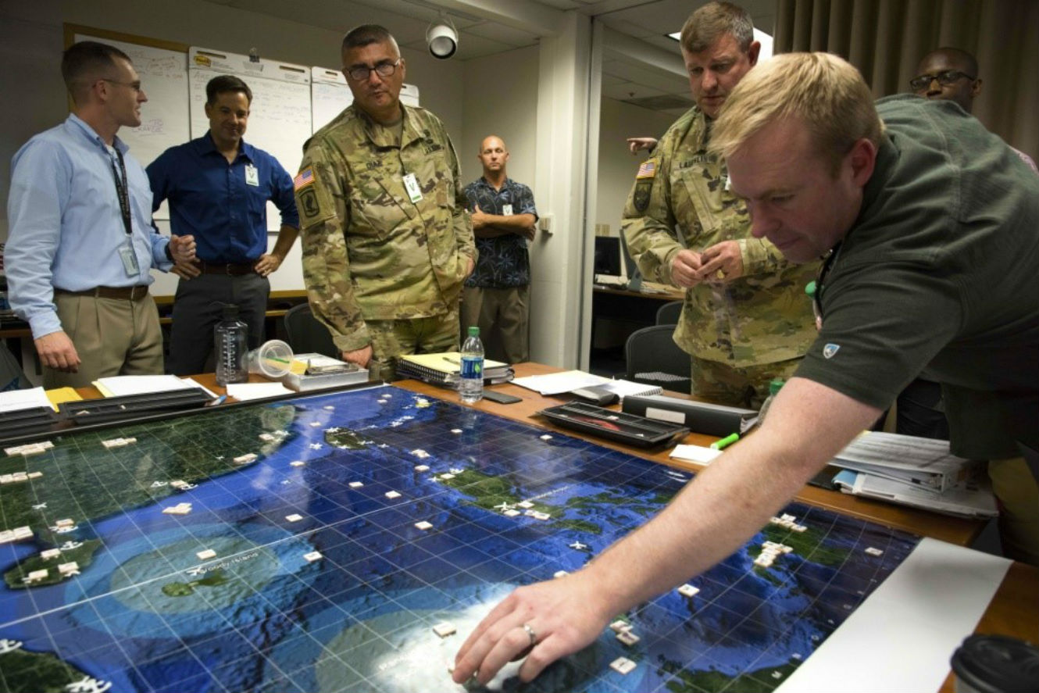
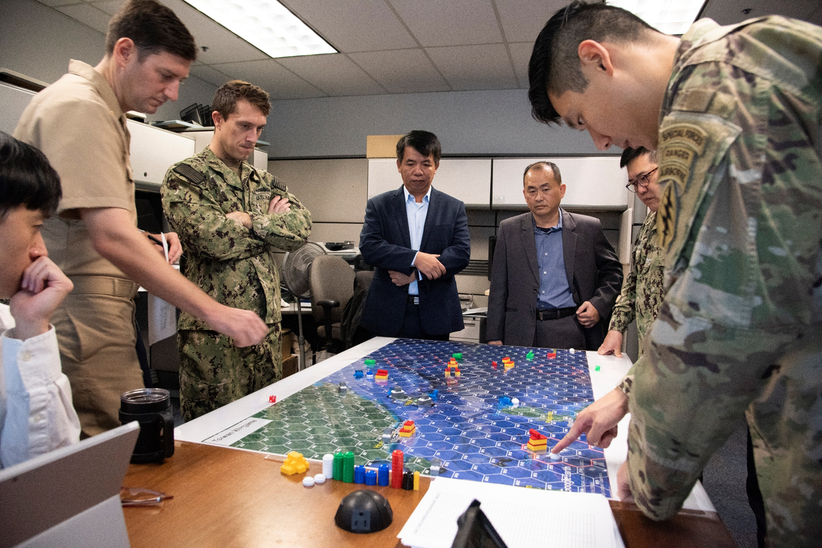
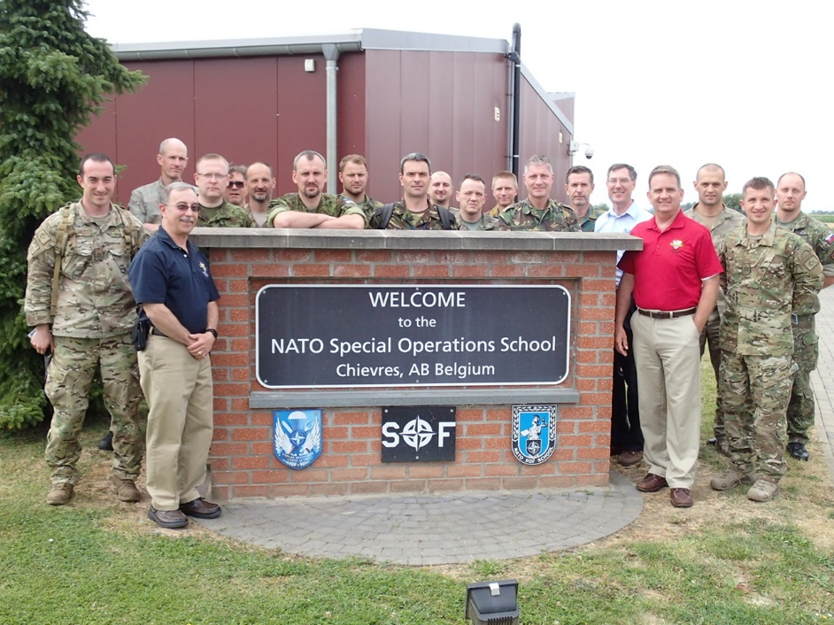
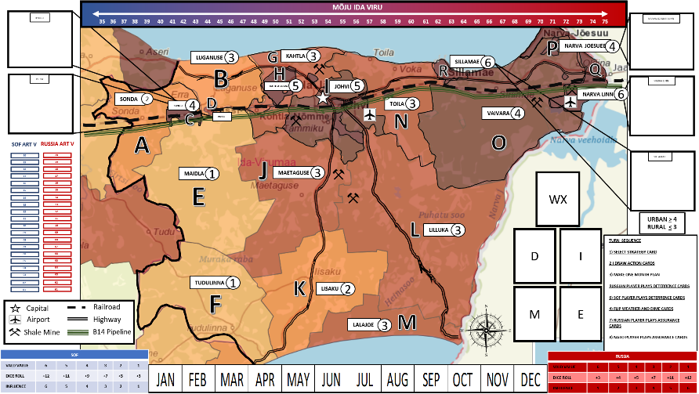
NWSI Wargaming Center
  Wargaming Education and Outreach
  Established in 2016 to provide the Department of Defense, allies and defense partners access to the unique wargaming capabilities of the NPS students and faculty.
Mobile Wargaming Education: NSHQ
Student Driven Analytical Wargaming
“Influence in IDA VIRU” Wargame

Slide 5
Role for NWSI Wargaming in Allied Cooperation
Sponsored Allied wargames explore cooperation in conflict
  RAN/USN Theater ASW Game (Fall 2016)
  ADF sponsored Full Spectrum ASW Game (Dec 2020)
Resident International student involvement in on-campus games
MTT/Short courses in country of interest
  Australian Defence Force – 2017- Present (next course Feb-Mar 2021)
  NATO (2019, Oct 2020)
  Taiwan
  Indonesia

Slide 6
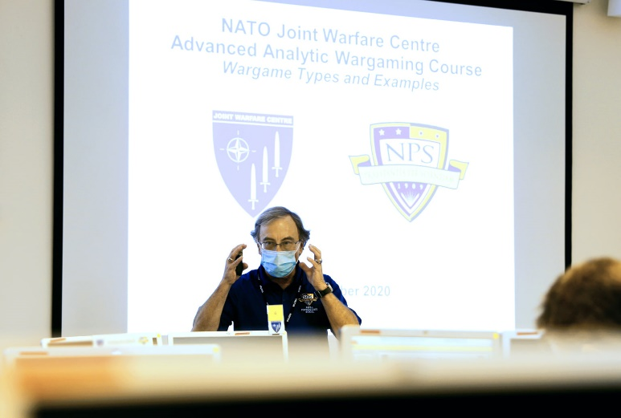
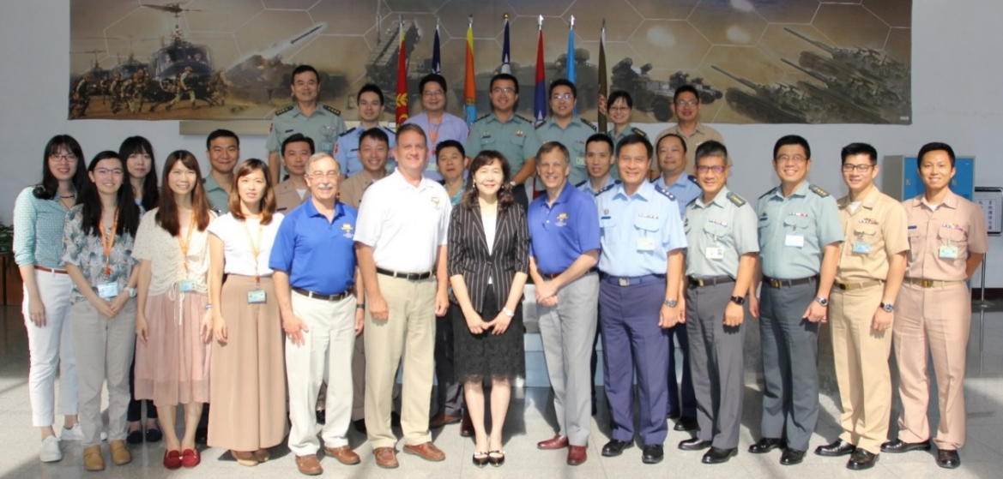
Mobile Education Team (MET)
Basic Analytic Wargaming Course
Building an organizational wargaming capability: The MET is designed to support building a cadre of personnel who can initiate, design, develop, conduct, and analyze a wargame.
Designing a wargame for your organization: Because the sponsoring organization chooses the wargaming topic used in the course’s practical exercises, the organization will have the framework of a wargame created by the course’s completion that it can flesh out and use to meet organizational wargaming requirements.
NATO - October 2019
Taiwan Armed Forces - August 2019

Slide 7

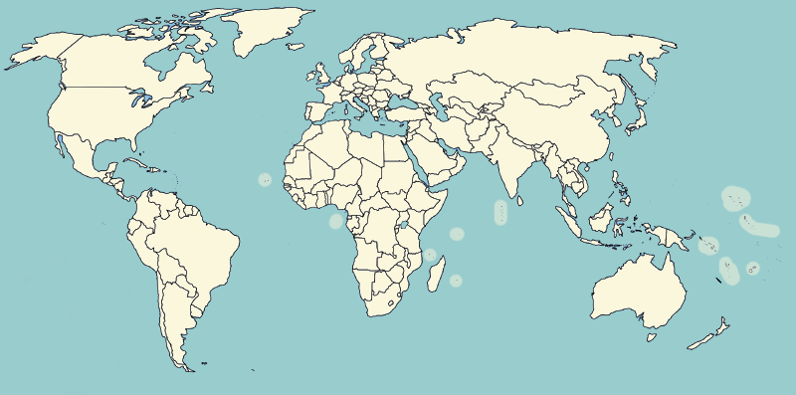
















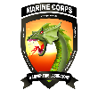



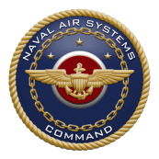





NPS Wargaming Mobile Education Team
Delivered and Projected (2021)
Swedish DRA
(Stockholm, 2018)
Europe and Central Asia
NATO JWC
(Stavanger, 2020)
North America
Hybrid Centre of Excellence
(Helsinki, 2021)
Royal Canadian AF
(Trenton, 2011)
Scandinavian
Tri-Lateral
(Olso, 2019)
USAREUR/NATO ARRC
(Wiesbaden, 2021)
STRATCOM
(Omaha, 2014)
NATO SOF
(Mons, 2019)
TRAC
(WSMR, 2018)
USA Futures Cmd
(Picatinny, 2021)
Kazakhstan Army
(Almaty, 2011)
Lockheed Martin
(Sunnyvale, 2012)
AFRICOM
(Stuttgart, 2018)
Tajikistan Gov’t
(Dushanbe, 2014)
DTRA
(Ft Belvoir, 2021)
Oceania and Southeast Asia
MCWL
(Quantico, 2018, 2019)
Taiwan
(Taipei, 2019)
ADF Joint Experimentation
(Canberra, 2021)
MCCDC
(Quantico, 2016,2021)
Indonesian Navy
(Surabaya, 2015)
NAVAIR
(China Lake, 2017)
ADF Joint Experimentation
(Canberra, 2017-2020)
NAVAIR
(China Lake, 2019)
CENTCOM
(Tampa, 2015, 2017[2])
NSMWDC
(San Diego, 2019)
DST-Group
(Adelaide, 2016)
MARFORPAC
(Camp Smith, 2019)
Basic Analytic Wargaming workshop
DTA
(Auckland, 2013)
Non-standard Wargaming workshop

Slide 8
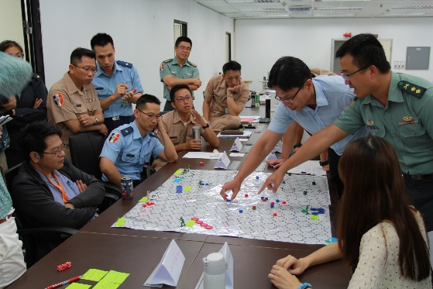
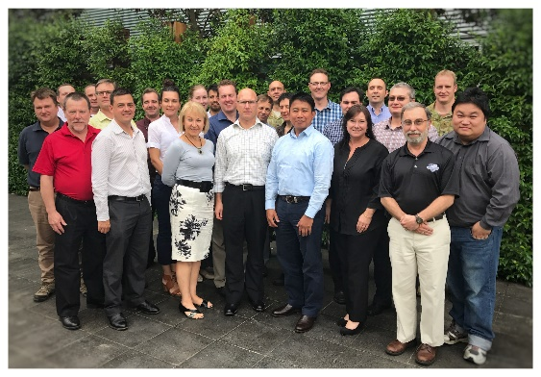
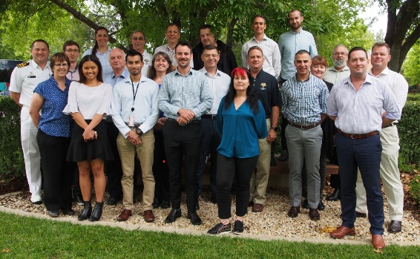
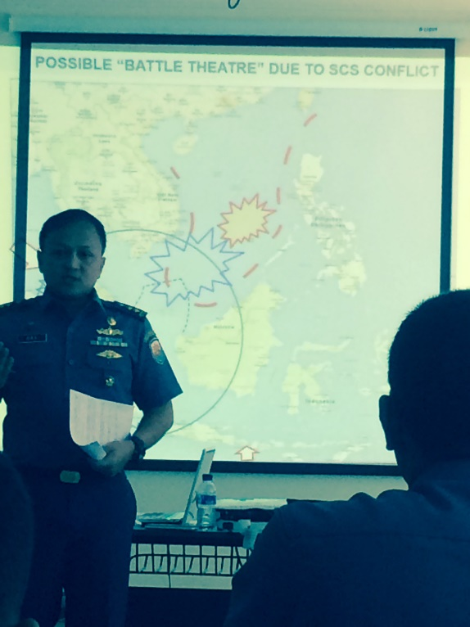
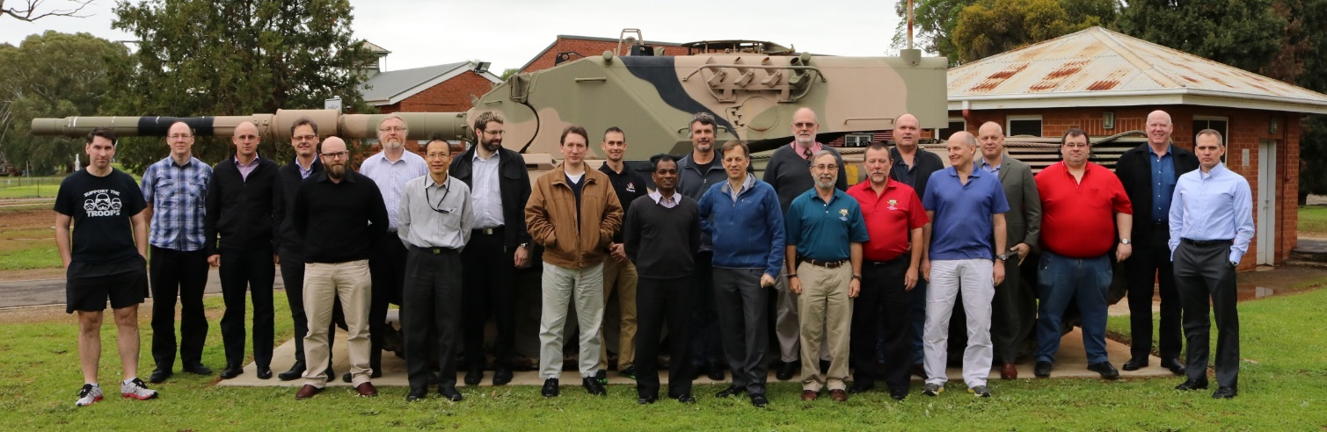
NPS Wargaming Mobile Education Team
Oceania and Southwest Asia
Taiwan
(Taipei, 2019)
ADF Joint Experimentation
(Canberra, 2021)
Indonesian Navy
(Surabaya, 2015)
ADF Joint Experimentation
(Canberra, 2017-2020)
DST-Group
(Adelaide, 2016)
DTA
(Auckland, 2013)

Slide 9
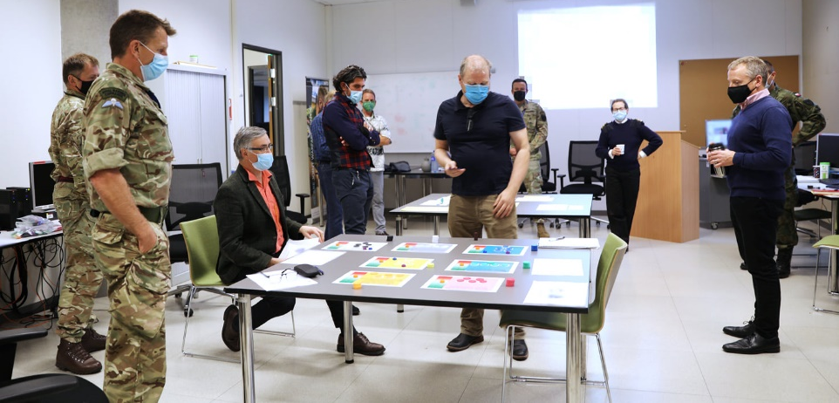
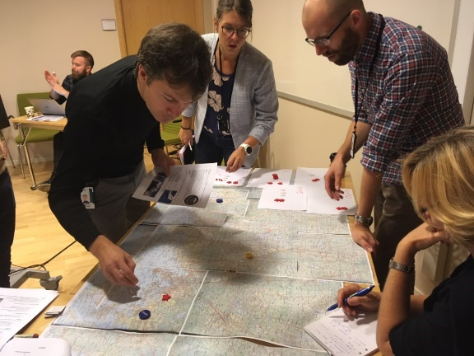
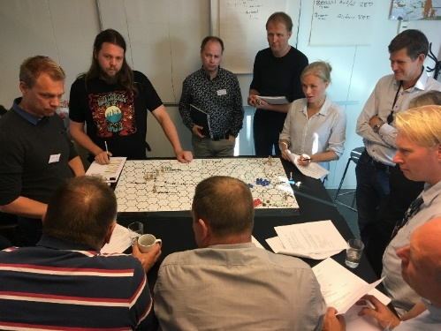

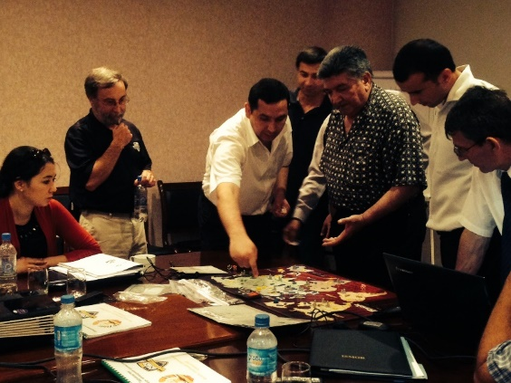
NPS Wargaming Mobile Education Team
Europe and Central Asia
Swedish DRA
(Stockholm, 2018)
NATO JWC
(Stavanger, 2020)
Hybrid Centre of Excellence
(Helsinki, 2021)
Scandinavian
Tri-Lateral
(Olso, 2019)
USAREUR/NATO ARRC
(Wiesbaden, 2021)
NATO SOF
(Mons, 2019)
Kazakhstan Army
(Almaty, 2011)
AFRICOM
(Stuttgart, 2018)
Tajikistan Gov’t
(Dushanbe, 2014)

Slide 10
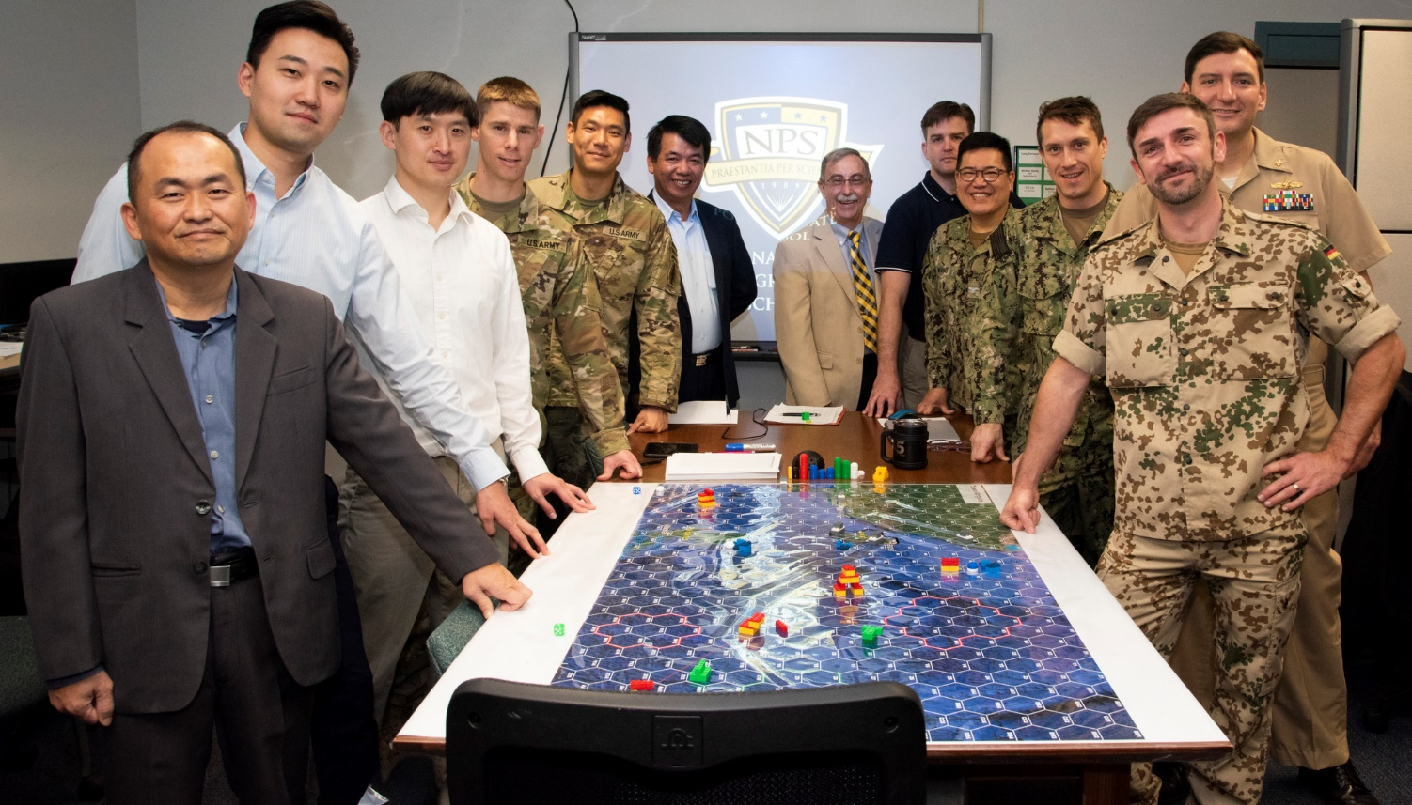
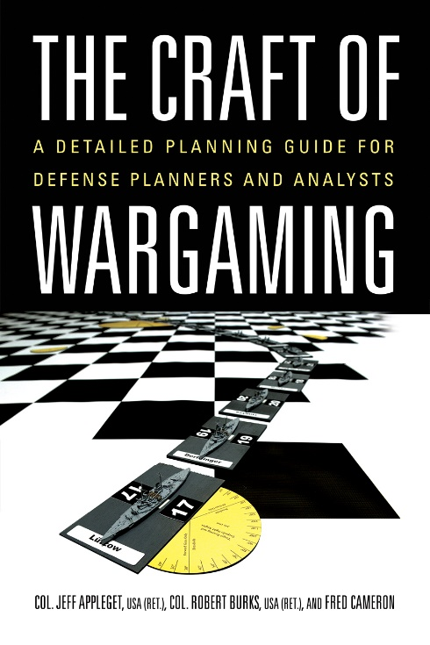
Resident Wargaming Course
Students spend over half of the course designing, developing, conducting and analyzing wargames for Navy, other DoD, or defense partner sponsors.
Taiwan Wargame - 2019
DoD Capstone Sponsors : 15 Navy, 7 Joint, 6 Int’l, 4 Army, 5 Marine Corps, 1 Industry.
Wargames (78 total): 27 Navy, 18 Marine Corps, 9 Joint, 13 Int’l, 9 Army, 2 Industry.
Notes:
The first half of the Wargaming Applications course teaches the fundamentals of wargaming using a mix of lectures and practical exercises. Concludes with the completion of the “Wargaming Apprentice Certification Exam.”
Wargaming Capstone Project: The second half of the course focuses on applying wargaming fundamentals to design, develop, conduct and analyze a wargame to answer an external (usually DoD) sponsor's actual requirement.

Slide 11


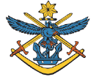
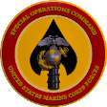
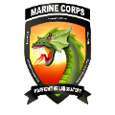


Wargaming Applications
Capstone Projects FY19
    Sponsor: NATO SOF
    Wargame: Near-Peer Competition (3 wargames)
    Sponsor: MARFORPAC*
    Wargame: Shaping Activities (contact and blunt layers)
    Sponsor: Australian Defence Force
    Wargame: USMC-ADF interoperability
    Sponsor: MARSOC*
    Wargame: Indirect and Partner Actions SCS (2 wargames)
    Sponsor: MCWL*
    Wargame: Sea control/sea denial
    Sponsor: USMC
    Wargame: Shore-based ASM
    Sponsor: NAVY
    Wargame: Small Combatants
* Funded through NPS Naval Research Program (NRP)

Slide 12
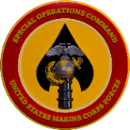
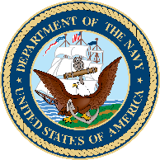

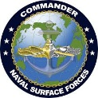

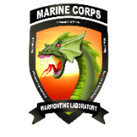
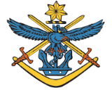
Wargaming Applications
Capstone Projects FY20
    Sponsor: NATO SOF
    Wargame: Near-Peer Competition (2 wargames)
    Sponsor: MARSOC*
    Wargame: Indirect and Partner Actions SCS (6 wargames)
    Sponsor: OPNAV N4*
    Wargame: Contested logistics—Weather
    Sponsor: Taiwan
    Wargame: Counter Blockade Ops
    Sponsor: SURFDEVRON ONE
    Wargame: Unmanned Surface Vehicle Operations
    Sponsor: MCLOG
    Wargame: Logistics Assessment
    Sponsor: MCWL*
    Wargame: Centralized versus Decentralized C2
    Sponsor: ADF
    Wargame: ADF & MRF-D Coalition Operations
* Funded through NPS Naval Research Program (NRP)

Slide 13
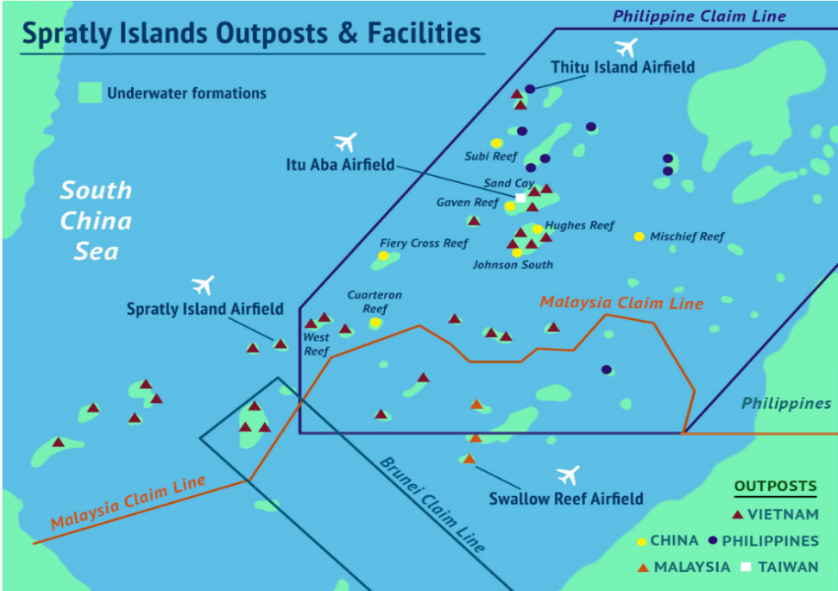
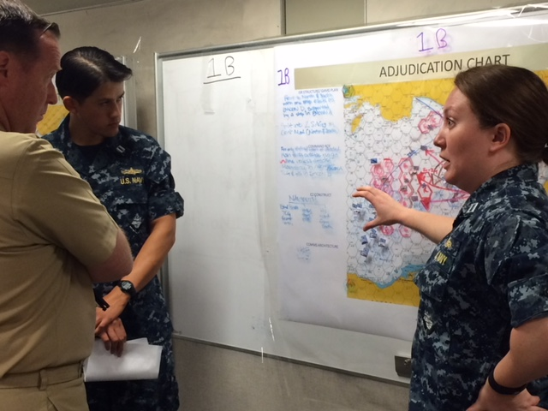
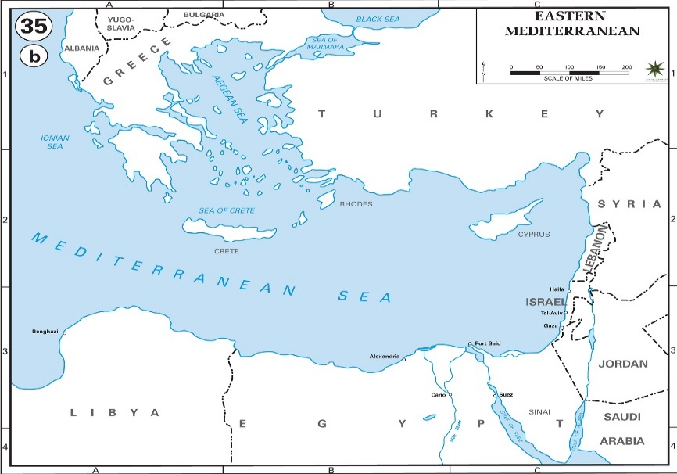
NAVY: Distributed Maritime
Operations Wargaming
The concept of Distributed Maritime Operations intends to enable a force that is capable of winning a fleet-on-fleet engagement through the integration of manned and unmanned systems, execution of deceptive tactics, and emboldening of units to conduct offensive strikes.
NPS conducted a series of wargames from 2015-2019 underpinning elements of the DMO concept in support of N96.

Slide 14
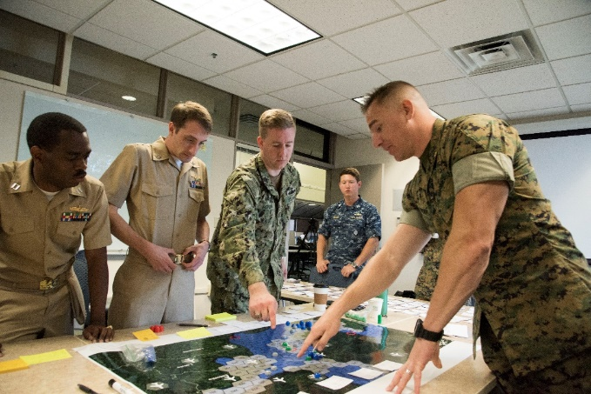
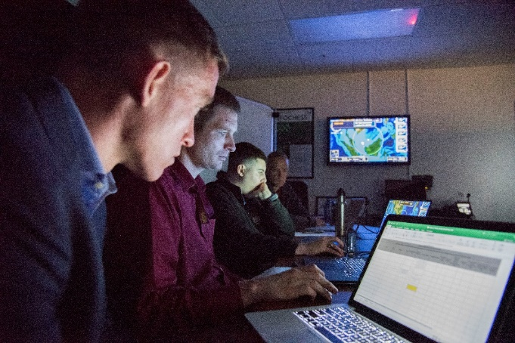
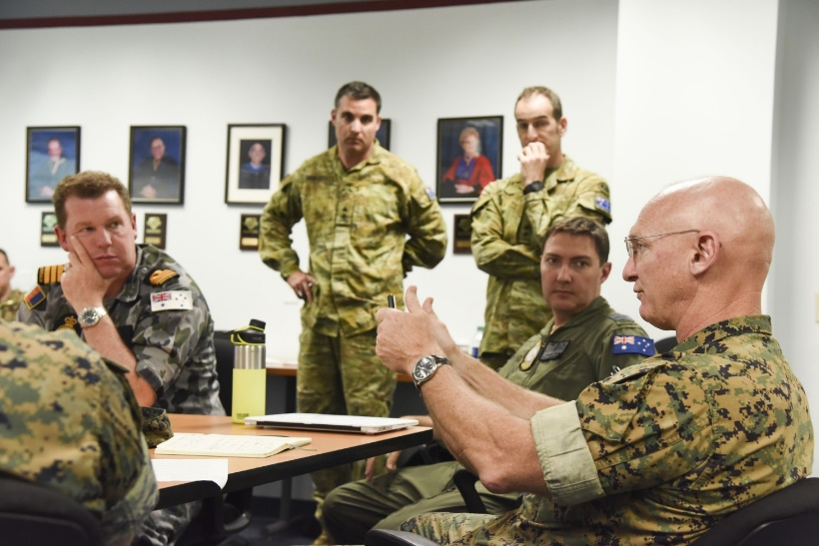
USMC: Expeditionary Advanced
Base Operations Wargaming
USMC-Australian Defence Force Interoperability
EABO in Baltic Sea
USMC Anti-ship Missiles for Sea Control/Sea Denial
EABO seek to further distribute lethality by providing land-based options for increasing the number of sensors and shooters beyond the upper limit imposed by the quantity of seagoing platforms available.
The EABO concept espouses employing mobile, relatively low-cost capabilities in austere, temporary locations forward as integral elements of fleet/JFMCC operations.
They may also control key maritime terrain to improve the security of sea lines of communications (SLOCs) and chokepoints or deny their use to the enemy, and exploit and enhance the natural barriers formed by island chains.

Slide 15
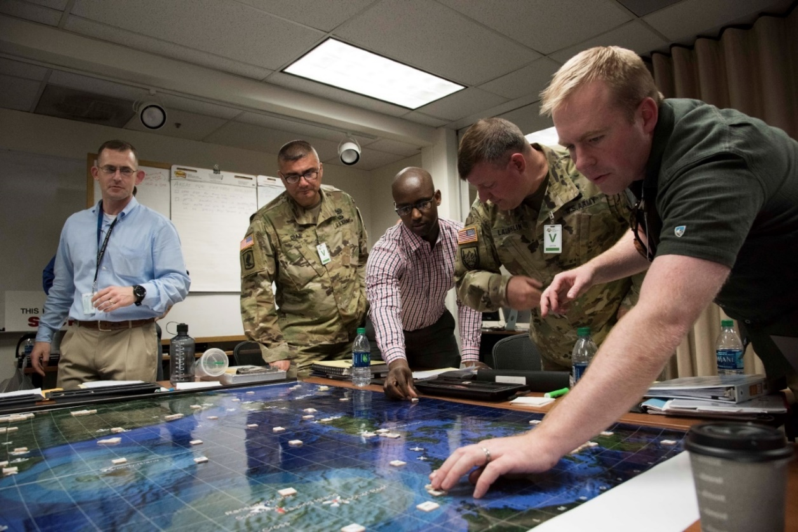
Army: Multi-Domain Operations
Wargaming
MDO provides commanders numerous options for executing simultaneous and sequential operations using surprise and the rapid and continuous integration of capabilities across all domains to present multiple dilemmas to an adversary in order to gain physical and psychological advantages and influence and control over the operational environment.

Slide 16
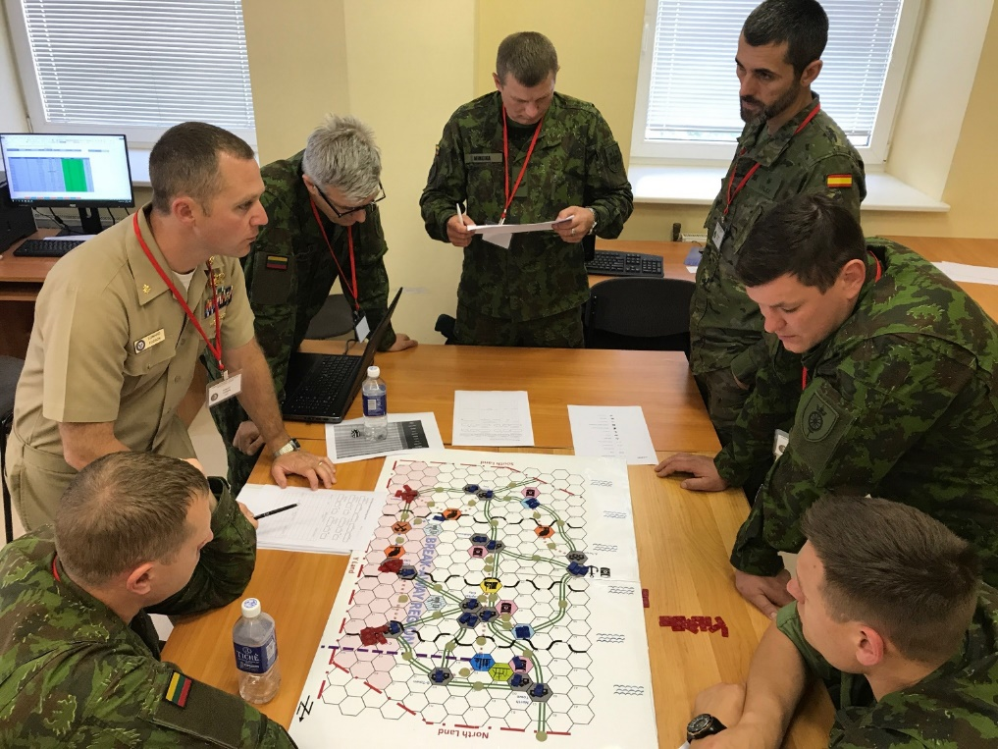
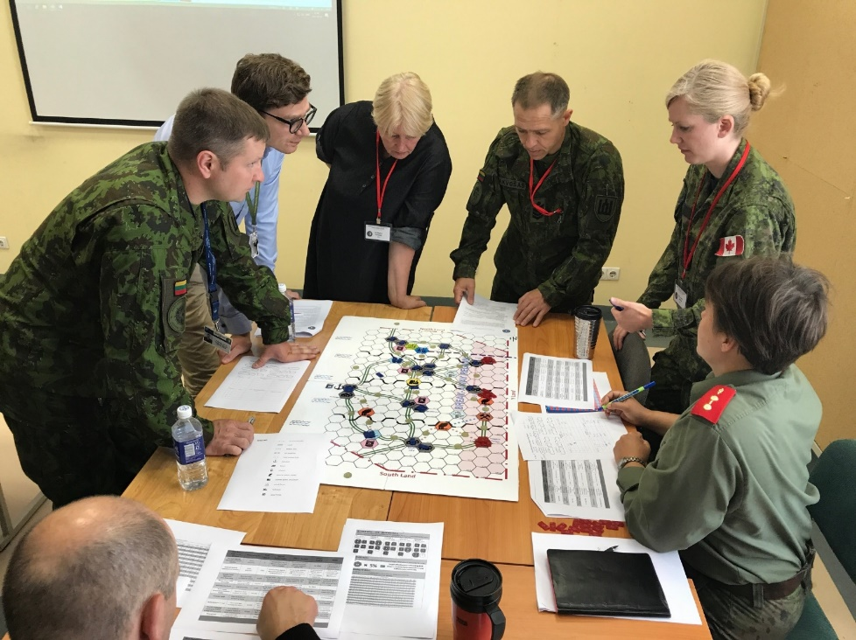
NATO: Operational Energy Wargaming
The Operational Energy game was developed at NPS and taken to Lithuania to support a NATO Operational Energy Course
Energy Wargame - 2017
The wargame develops NATO Officer and senior Enlisted students' understanding of Operational Energy and Energy Security concepts and how they affect mission execution. It will teach players the importance of incorporating energy resources and requirements into decision making during mission planning and execution.

Slide 17
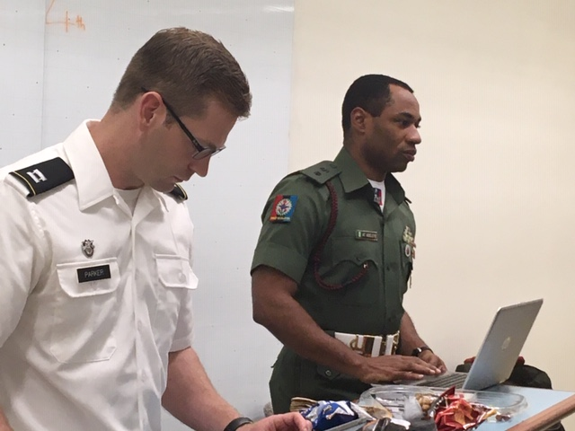
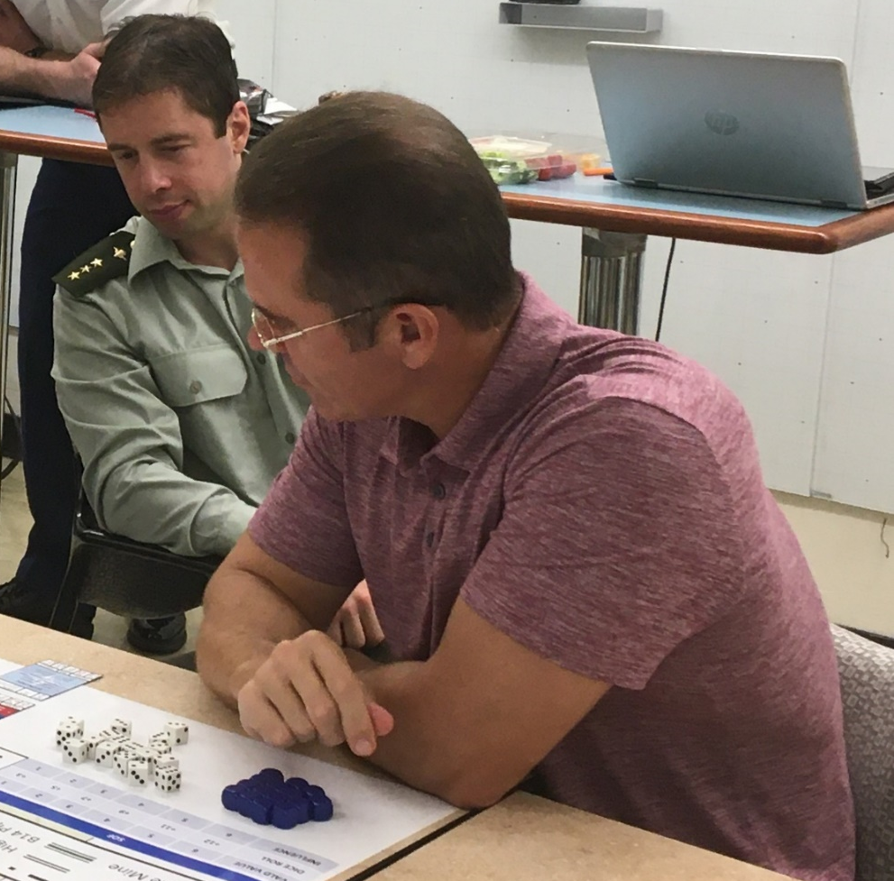
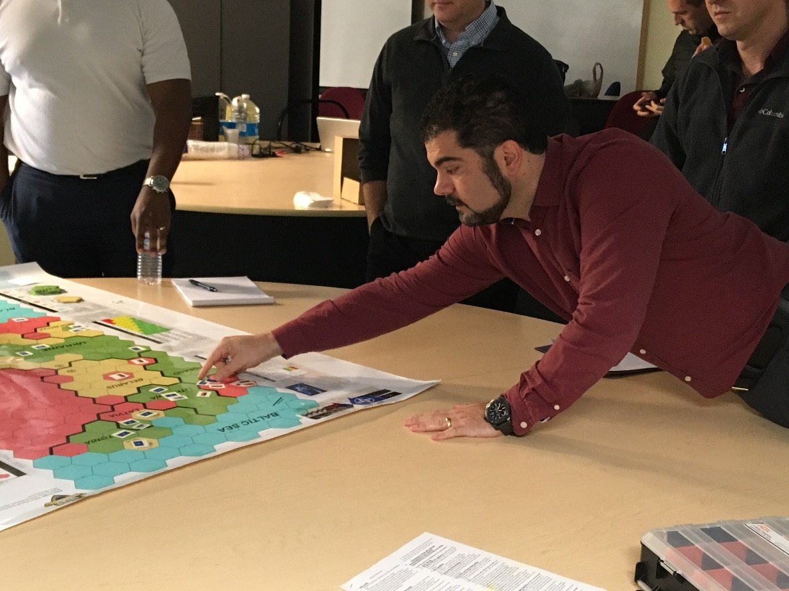
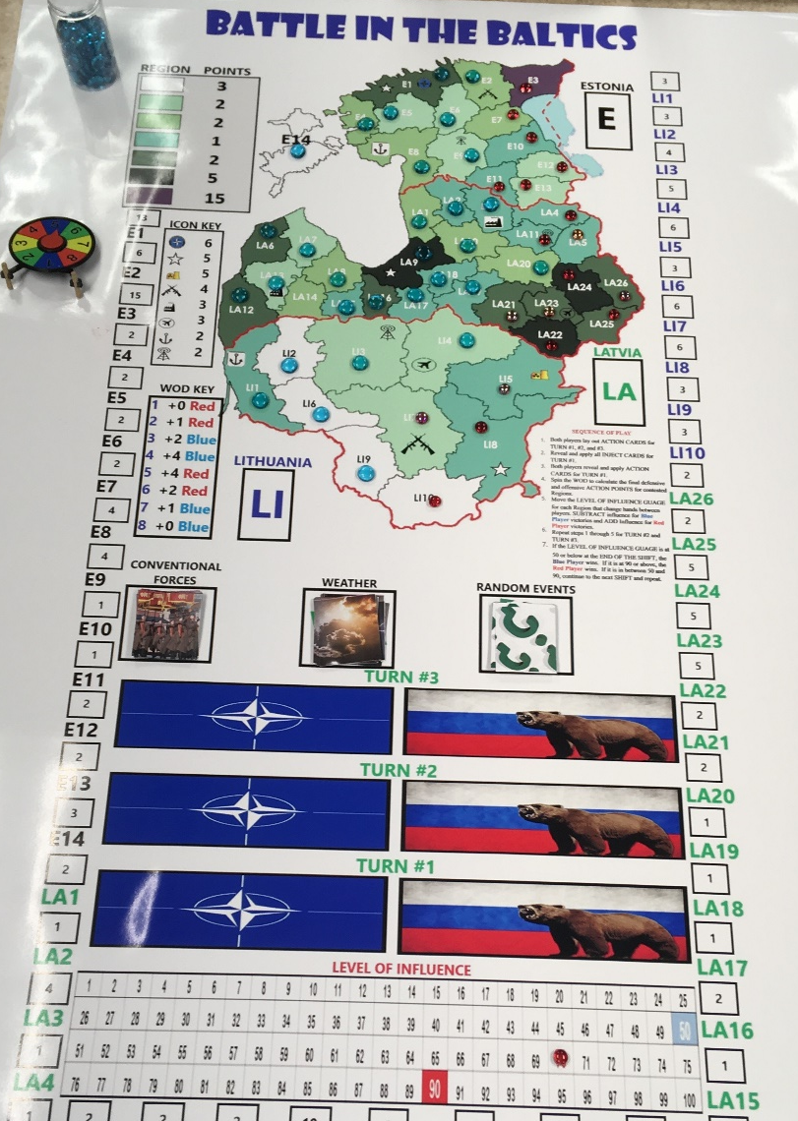
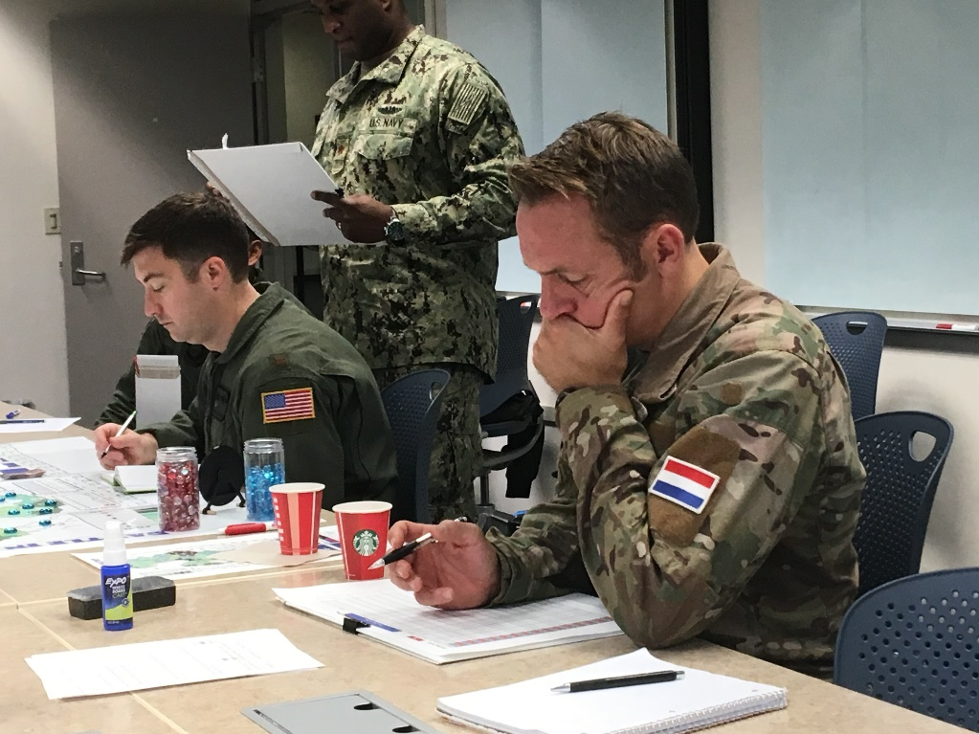
NATO SOF Wargames
(2018-19)
NPS has created and conducted 5 wargames for NATO SOF. NPS international students from Slovakia, Nigeria, Switzerland, Saudi Arabia, Guyana, Albania, Germany, and the Netherlands teamed with fellow U.S. students to execute these wargames.
How could/should NATO support deterrence and assurance to its allies under pressure short of an Article V declaration?

Slide 18
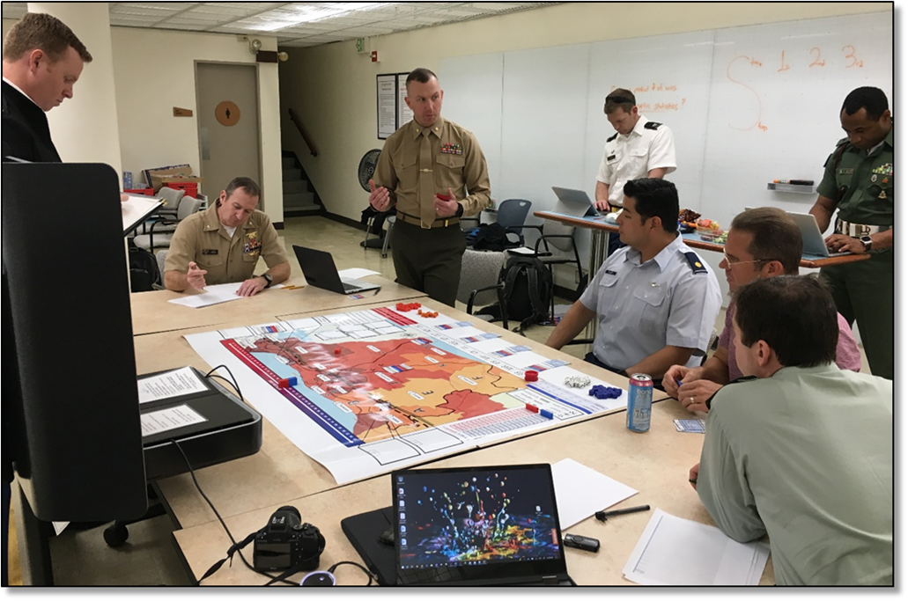

Estonia SOF Wargaming
Students took an additional elective to further enhance the wargame for play ISO Estonia SOF.
IDA - IRU Wargame - 2019
The Influence in IDA-VIRU Estonia game was developed at NPS to examine what actions might be taken to counter outside influences in a NATO nation.

Slide 19


Australian Defence Force – USMC Interoperability Wargaming
NPS has now done four interoperability wargames with the ADF and USMC.
ADF-USMC Interoperability Wargame - 2019
Assess the capabilities and limitations with regard to combined United States Marine Corps (USMC)/Australian Defence Force (ADF) command and control of fires ashore during amphibious operations

Slide 20



Taiwan Wargame
Taiwan - 2019
Explore the possible strategies the Taiwan Navy can use to maintain open sea lines of communication entering Taiwan while deterring or preventing Chinese invasion of the west side of Taiwan.
The two Taiwan Naval officer OR students completed theses that complemented the wargame.

Slide 21
Sponsored Thesis Supported Wargames
The Wargaming Center has established a robust ability to enable the student development of wargames in support of sponsored thesis efforts.
Recent Thesis efforts include:
  Unconventional Warfare Education and Training Reinforcement Wargame (MAJ Chad Klay, MAJ Jeremy Arias): Designed to reinforce UW doctrine and provide an engaging practical application of UW concepts that reinforce the theory and operational practices.
  Special Forces in High-end War (CPT Palmer, CPT Smith): Designed to gain insights into how US Army Special Forces will contribute to defeating a great power adversary in high-end war between 2030-2050.
  Interactive Wargaming: CYBERWAR 2025 (SFC David “Ty” Long, CPT Christopher Mulch): Designed to stimulate, build, and increase the players’ knowledge base while they gain experience in planning and practical application of cyberspace operations such as CISR, DCO.
  Determining Future Naval Special Warfare Requirements (LT Rob Birch, LT Bill Cicchillo): Designed to leverage Defense Analysis and Operations Research faculty and students, to gain insights into future challenges and opportunities for the Naval Special Warfare community in both conventional conflict and hybrid war situations considering available new technologies.
  Rebellion (MAJ Derek Hirtz, MAJ Richard Hill): Designed to reinforce the relationship and interaction between the insurgent and counterinsurgent in a two-sided competition for control and legitimacy of a nation.

Slide 22
Sponsored Wargames
Fall FY21
Sponsor: Australian Defence Force Joint Experimentation Directorate
Wargame (Wargame classified, topic unclassified): Assess concepts for the optimal employment of AUS, US and JPN ASW forces in the Full Spectrum ASW mission (previously TASW) Funded through FMS
Sponsor: Naval Information Warfighting Development Center
Wargame: Assess the ability of U.S. Navy CSGs to use cloud cover to prevent detection from adversary Electro-Optical/Infrared (EO/IR) capabilities
Sponsor: OPNAV N4
Wargame: Examine Command & Control (C2) with a combined USN/USMC staff in support of Distributed Maritime Operations (DMO) and Expeditionary Advanced Base Operations (EABO) within a Logistics Task Force Commander organization in a contested environment against a peer adversary. Funded through NRP
Spring 2021: 7-9 wargames, sponsors include OPNAV N4 & MCWL

Slide 23
Questions?

