Slide 1


Slide 2

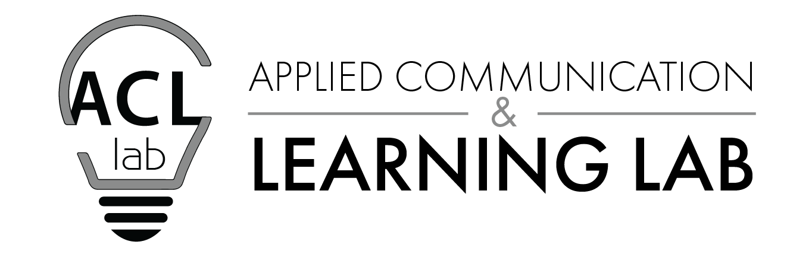
Our Own Worst Critic?
Challenges of & Strategies for peer & Self Critique
Dr. Abram Trosky
Professor of Communicative Arts
US Army War College
Notes:
The ACL Lab is a “bridges” insights on the science of teaching and learning and traditionally humanities-centric concerns of graduate liberal arts: the development and application of critical thinking and communication skills mentioned in our JLO, ILO, CLO KSA. Application and development include today’s topic, critique: seeking, giving, implementing feedback to help realize the stated goal of assessment informed, outcomes-based PME.

Slide 3
Workshop Outcomes
Identify the value of, and cognitive/cultural barriers to, effective self and peer critique
Introduce tools, techniques, and strategies for structuring discussions and assignments to overcome these barriers
Discuss experience and aspirations of adapting these or similar tools, exercises, and practices in PME environments
Notes:
Inspiration of the title and icon: Cognitive blind spots — SF museum of science exhibit demonstrating how one’s brain fills in and corrects missing or misspelled words.

Slide 4
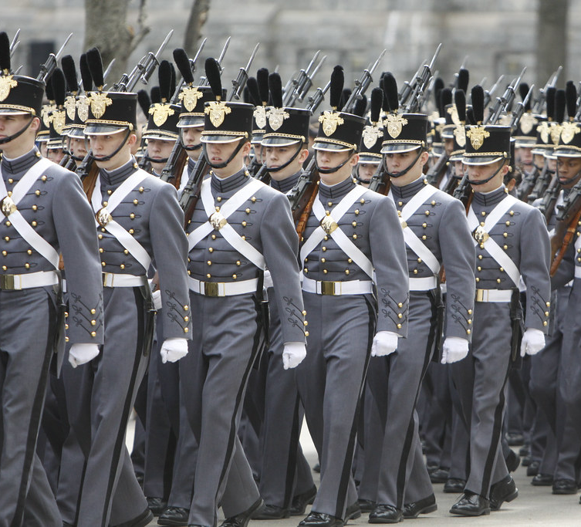
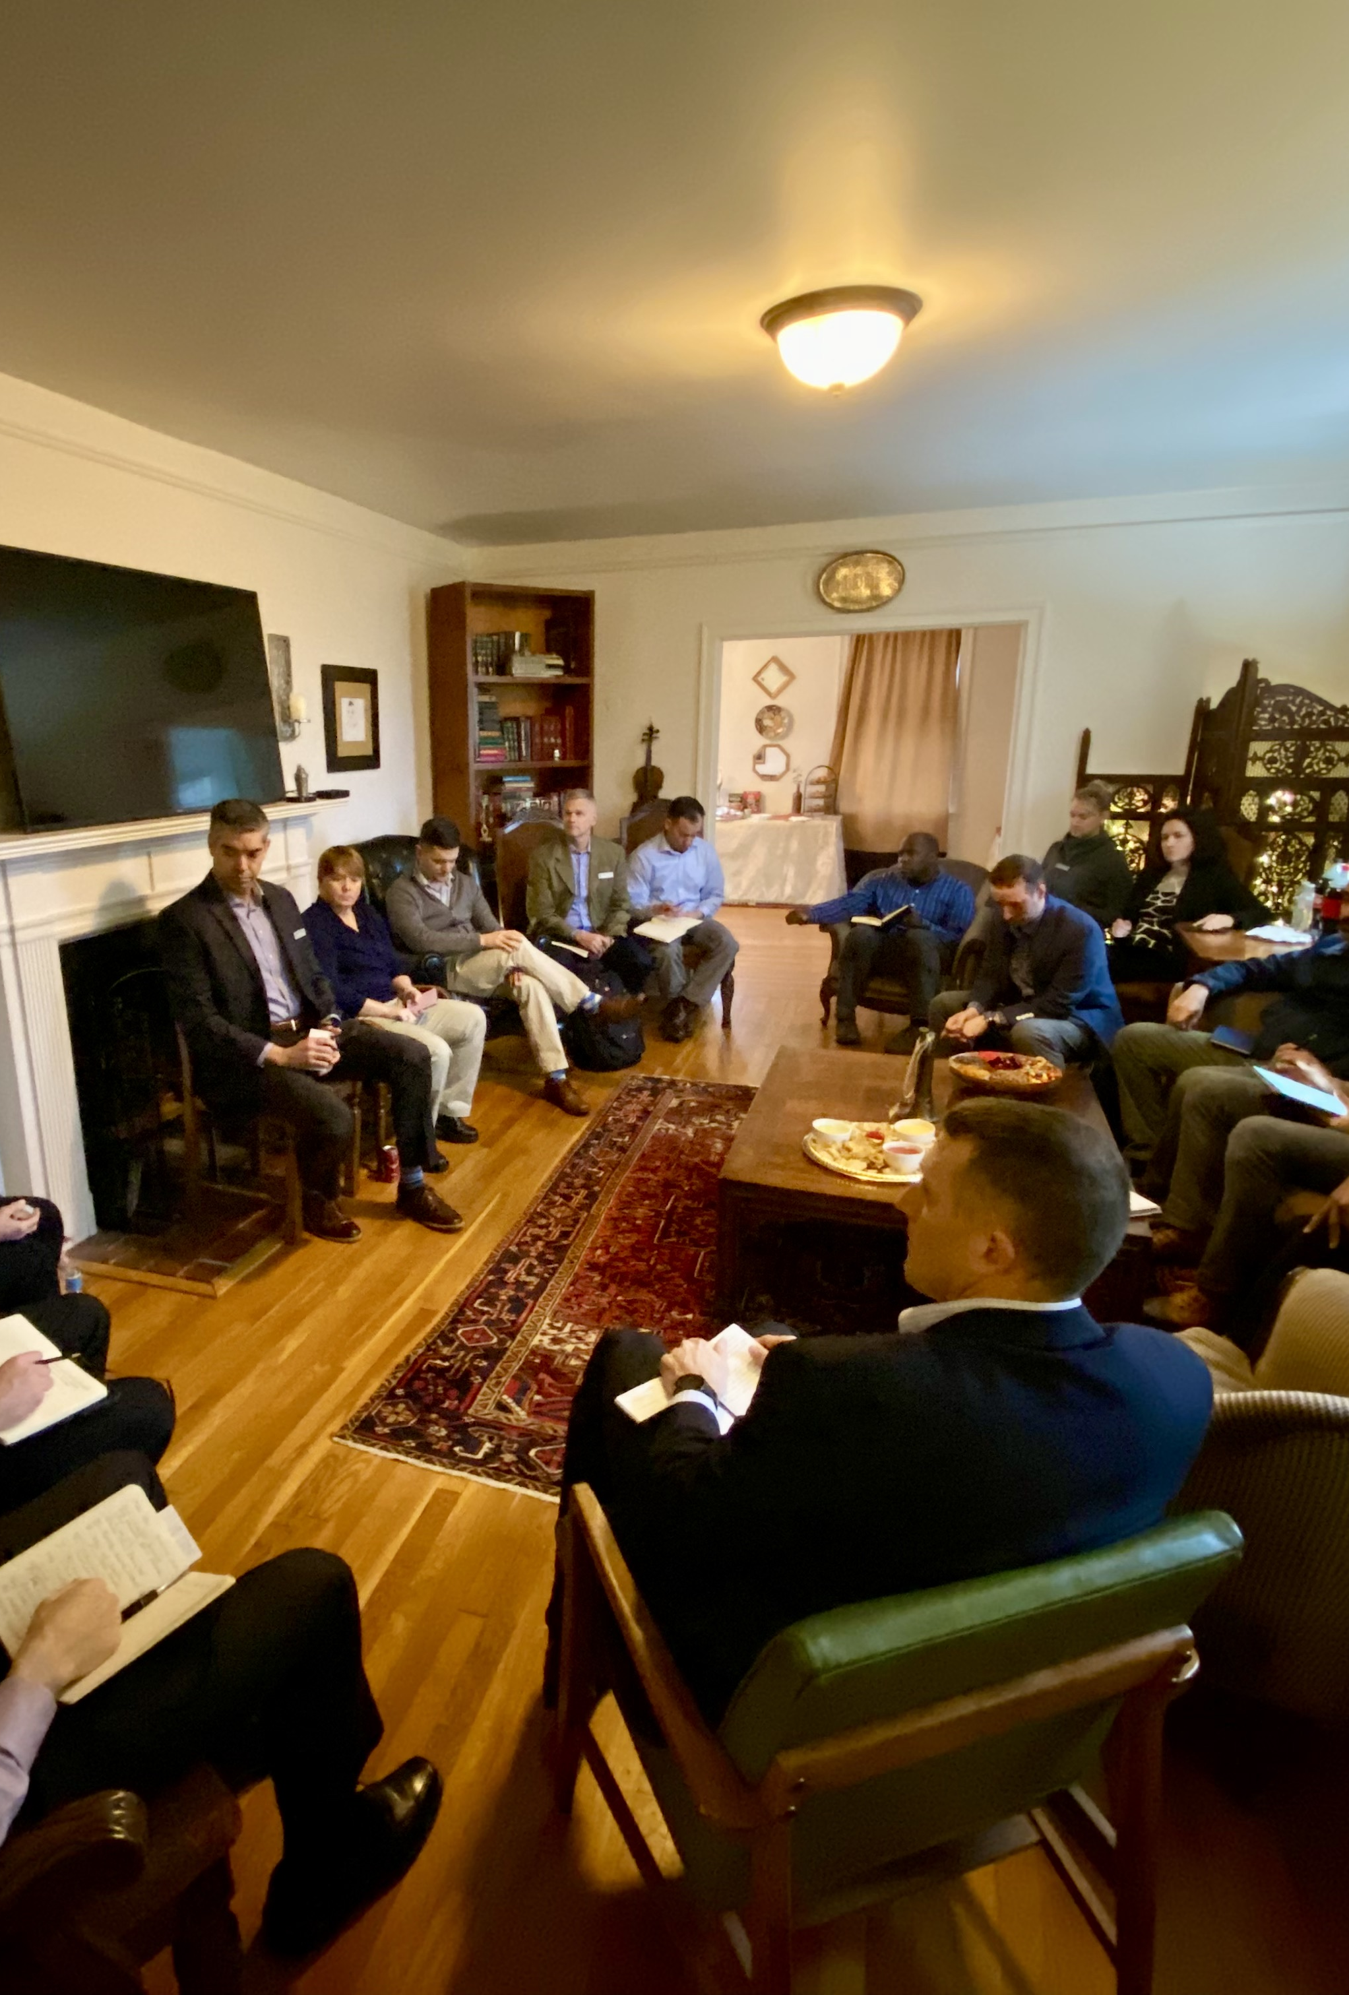
Military cultural and subcultural barriers
A tale of two service school experiences:
From the art of survival to the art of critique
Notes:
USCGA, USMA plebe experience: socialization into norms and practices that enhance group survival. Balanced by pressure to “figure it out,” be resourceful, not ask for help. “Outside” pressures to conform and not rock the boat, “critique” is seen as antithetical to the first-year team “bootcamp” ethos — can be seen as throwing a shipmate under the bus (er, sub).
The subcultural norm of individual self-sufficiency is reinforced in the field, where communal features of service life are balanced by the principle of ethical egoism: I help the group most by taking care of myself; I have your back, but I won’t ruck your pack, or as an officer of the same rank, tell you how to do things, or do things better
Compare this to the senior service college seminar experience of group learning, which is what “the Carlisle Experience” primarily conveys — 25 seminar groups of around 16 students who build the requisite trust to give and take critique

Slide 5
Seminar Norming: safe to vs. safe from critique
Day 1: Seminar Dialogue, Socratic Inquiry
Day 2: Historical-mindedness
Day 3: Critical Reading
Day 4: Writing Workshop
Reading, Writing, Reflection, Collaboration Day
Day 5: Argumentation
Day 6: Sources & Citation
Day 7: Paper Prompt + Rubric
Reading, Writing, Reflection, Collaboration Day
Notes:
The seminar is central to the Carlisle Experience, and the first weeks are foundational to seminar success.
Seminar formation involves developing a group identity around norms of respect and trust. In the best case, seminar groups transition from the competitive discussion-mode of communication decisionmaking, to dialogue, which is essentially co-operative.
More tolerant of ambiguity, dialogue focuses on understanding complexity and problem deconstruction, including exposing individual, cultural, national biases. The new norm at the strategic level is to encourage questioning, including others’ and one’s own assumptions, and to support their positions with the authority of evidence, not only the authority of rank.

Slide 6
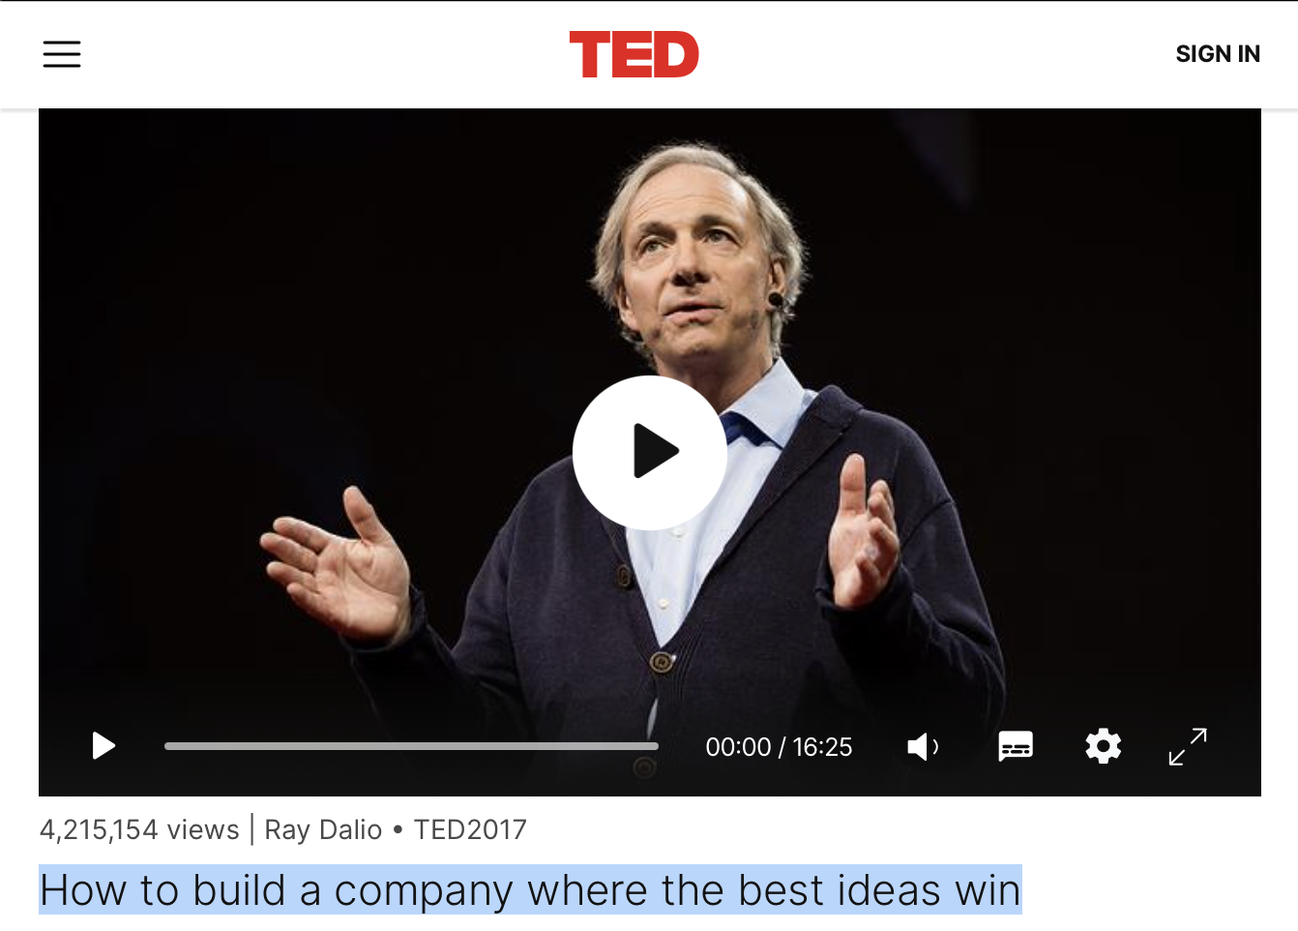
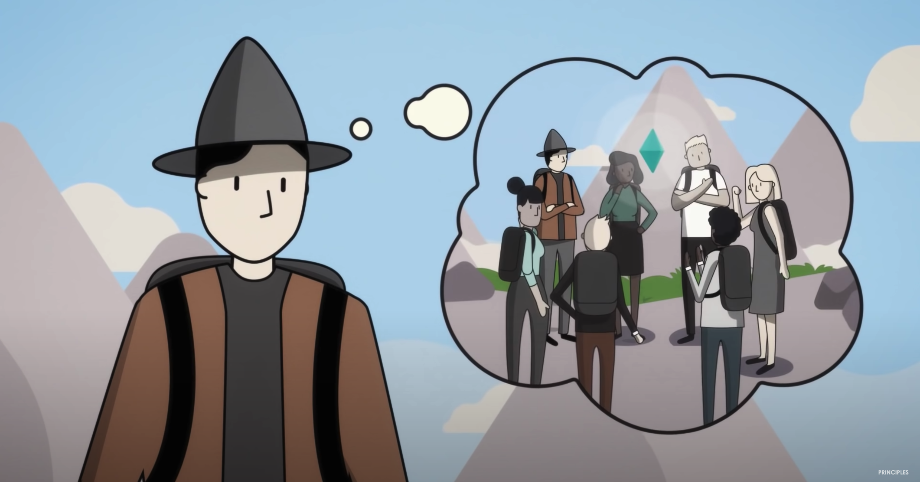
“The Art of critique”
Notes:
Outgoing USAWC CMDT MG John Kem called this approach of integrated skill training and collaborative problem solving, “the art of critique.” The aim is to recognize and retrain individual and organizational habits or defaults to normalize critique.
Think of the environment of radical truth telling, irrespective of rank that Bridgewater Associates CEO Ray Dalio promotes. The premise is that privileging data-driven, evidence-based argument over seniority, status, rhetorical prowess or other arbitrary factors allows an open marketplace of ideas in which the best/most accurate courses of action prevail.
Note two things: this process consciously accepts initial inefficiency of data collection, dialogue, and debate as a cost for longer term efficiency, namely accuracy, which in Bridgewater’s case, means profits (the most successful hedge fund). The stakes for military organizations are even higher, but the challenge of reorienting to this form of strategic thinking, is arguably even more difficult for a host of cognitive and cultural reasons.

Slide 7
Obstacles to seeking, Giving, & receiving critique
cultural Barriers
Cognitive barriers
American individualism, independence, and the self-made myth
“Face” and ego considerations for IFs
Positionality: those “down” may not know; those “up”/peers too busy
Identity (anti-Socratic ignorance)
Assumptions others know (imposter)
Ego protection (Dunning–Kruger)
Rule utilitarianism & reciprocity
More?
Notes:
Even if the goal is an “open” marketplace of ideas in which the best (supported) argument wins, the realities of power, culture, and limits of our own evolutionary psychology indicate that an “open” marketplace of ideas cannot mean “unregulated.”
To the contrary, the first step to mitigating individual and group propensities to bend arguments to suit their perceived interest is to identify these “macro” and “micro” factors that can distort analyses, conversations, and the decisionmaking processes. These include… (above)
The next step is introducing self- and other assessments early in the educational process that identify bias, increase self- and other awareness (also known as strategic empathy) and retrain habits of mind. Though we already teach self-awareness, open-mindedness, and critical thinking, the painful irony is that the professoriate doesn’t always demonstrate them. PME skews older and more conservative, a disposition more skeptical of the category of cognitive or implicit bias and more trusting of experience, instinct, intuition, personalism (Lakoff). Cf. General Officers survey on intuition

Slide 8

REGAN: 'Tis the infirmity of his age. Yet he hath ever but slenderly known himself.
GONERIL
The best and soundest of his time hath been but rash. Then must we look from his age to receive not alone the imperfections of long-engrafted condition…
Notes:
As King Lear shows, invisibility to oneself is more a matter of habit than age. If we work at it, we can gain greater perspective, but I argue that candid insight from peers, mentors, even children, do more than the implicit bias tests because they also provide a motivation and means to change.
If we don’t work at seeking self- and peer critique, we risk dissonance at best, perceived hypocrisy at worst among students who see us feebly fumbling with technology, pronunciation, and pronouns…as we criticize millennials for being fragile and maladaptive.

Slide 9
Workshop Outcomes
Identify the value of, and cognitive/cultural barriers to, effective self and peer critique
Introduce tools, techniques, and strategies for structuring discussions and assignments to overcome these barriers
Discuss experience and aspirations of adapting these or similar tools, exercises, and practices in PME environments
Notes:
SF museum of science exhibit demonstrating how one’s brain fills in and corrects missing or misspelled words.

Slide 10
Technique #1: Role modeling Socratic inquiry
Flushing” Questions force interlocutors from familiar forests to take and clarify a position:
1. Questions soliciting Judgment or Account
2. Questions of Definition, Clarification, Attribution
“Shotgun” Questions poke empirical or logical holes in interlocutors or authors’ assertions/arguments:
3. Questions probing Assumptions & Premises
4. Questions probing Reasons & Evidence
“Retrieval” Questions point interlocutors toward unconsidered perspectives, prospects, or analogies:
5. Questions pointing to Implications & Consequences
6. Perspective-taking Questions & Counterargument
Notes:
One way to soften critique is the Socratic method. As the name implies, the goal of Elenkhos is perplexity, that is, allowing interlocutors to come to an awareness of the insufficiency or incompleteness of their own initial, position, argument by asking questions that generate or highlight contradictions, costs, tradeoffs.
This approach not only makes for more interesting class discussions, it has two other distinct advantages: 1. learners who find their way to “better” are more likely to remember, repeat, and enact (retention, conviction, and application). Constructing or revising an argument is far “stickier,” in other words than than being told or controverted, or “thin” critique of did you like the article, or is the author, model, theory right or wrong (vice useful). 2. Delegation

Slide 11
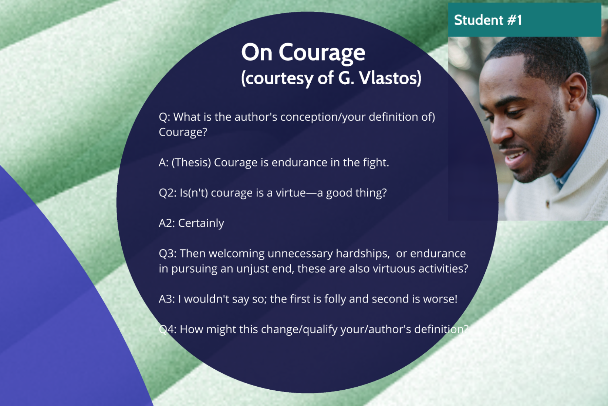
Notes:
Screen shot from NFD Prezi: Good questions lead students to critique themselves, which saves face and is more likely to be remembered/implemented in refining concepts and language (“learning”)

Slide 12
New, integrated Week One at USAWC
Day 1: Seminar Dialogue, Socratic Inquiry
Day 2: Historical-mindedness
Day 3: Critical Reading
Day 4: Writing Workshop
Reading, Writing, Reflection, Collaboration
Day 5: Argumentation
Day 6: Sources & Citation
Day 7: Paper Prompt + Rubric
Reading, Writing, Reflection, Collaboration

Slide 13

Reframing ”Critique” & “Feedback”
Word association: “Feedback”
What changes with the word “Loop”?
Continuous v. Sequential/unidirectional
  ~ Dialogue or conversation
Preventative vs. Curative
Proactive vs. Reactive
Notes:
Part of overcoming the cultural and cognitive obstacles to developing a culture of feedback is reframing what feedback, criticism, and assessment are.
Compare the “looped” conception with the “fire and forget” of non-integrated, unrelated assignments and curriculum. The connections between assignments aid in recall and retention of material and students, fighting attrition.
Observing early gains earns greater buy-in, promoting more gains: a virtuous cycle. What separates the longer term change of education versus short term modification of training.

Slide 14
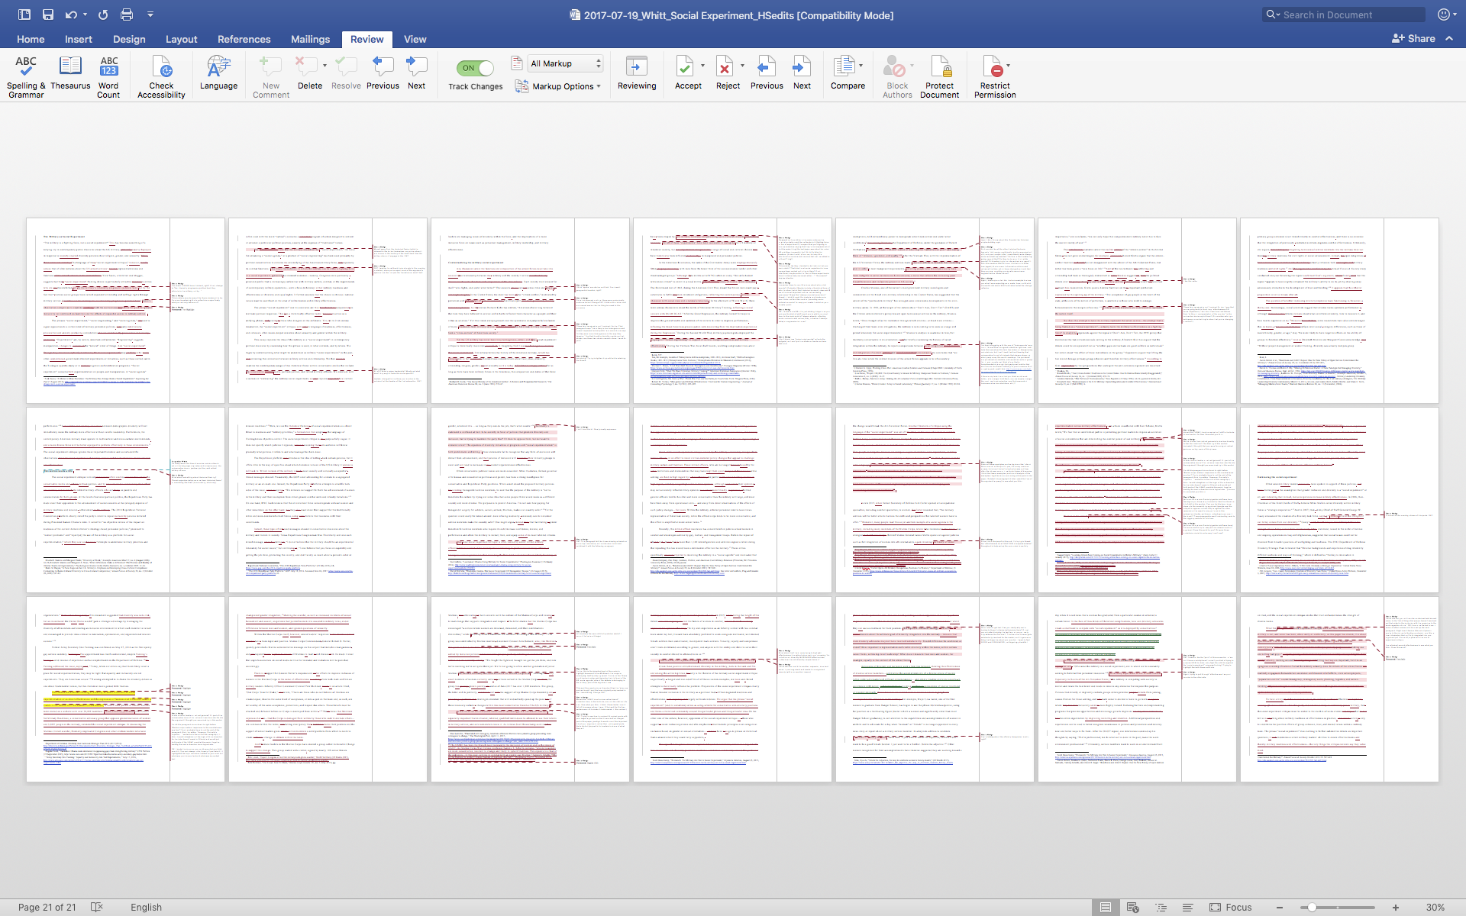
Strategy #1
Destigmatize & Decentralize feedback
Notes:
Traditional approaches underutilize feedback and deliver it in a way that engenders aversion. USAWC has been using a “shock and awe” approach of being greeted by a 50-item grammar and usage test, the GSD, before matriculation then triaging the bottom 10%. Now, we have 1-on-1 writing consultations for all who want it in REP, and now expanding to DEP.
There was a similar “shock and awe” approach by some to grading the first paper — what I call the “sea of red.” The idea was to normalize feedback, create a reference, and set a bar for improvement
Problems: Dunning–Kruger folks are definitionally immune to shock and awe, blaming the instructor or the test. More commonly, the shock of having one’s thoughts picked apart can backfire, conditioning learners to think of “feedback” as unpleasant and behave as “strategic learners” — look at the grade, ignore most markings (cognitive overload), and (continue to) write to pass.

Slide 15
Everyone Gets feedback!
“War is a continuation of politics with the admixture of other means.”
Notes:
See Vanya Eftimova Bellinger, Marie von Clausewitz, The Woman Behind the Making of On War (Oxford University Press, 2015).
* The idea for this slide courtesy of COL Eric Murphy, USAF.

Slide 16

The Stakes of good Feedback
Proactive, prioritized feedback from instructor and/or to and from classmates results in better draft products, improving student performance satisfaction (~ faculty performance).
Notes:
Sometimes the battle is with colleagues or leadership, vice students or co-instructors.
A question of style?: Precision in language affects (reception of) content, so is equally integral to effective communication. For example, the seemingly small matter of defining pronouns (who are the ”they’” and “we”?) and making passive voice active each clarify causal relationships by attributing, rather than obscuring, agency.
What if the stakes were higher? Imagine: ‘natural’ grade inflation in which the dependent variable is not “raw” quality of students or instructors but attention to process. Not only helping those most in need but allowing the good to get better by improving each other.

Slide 17
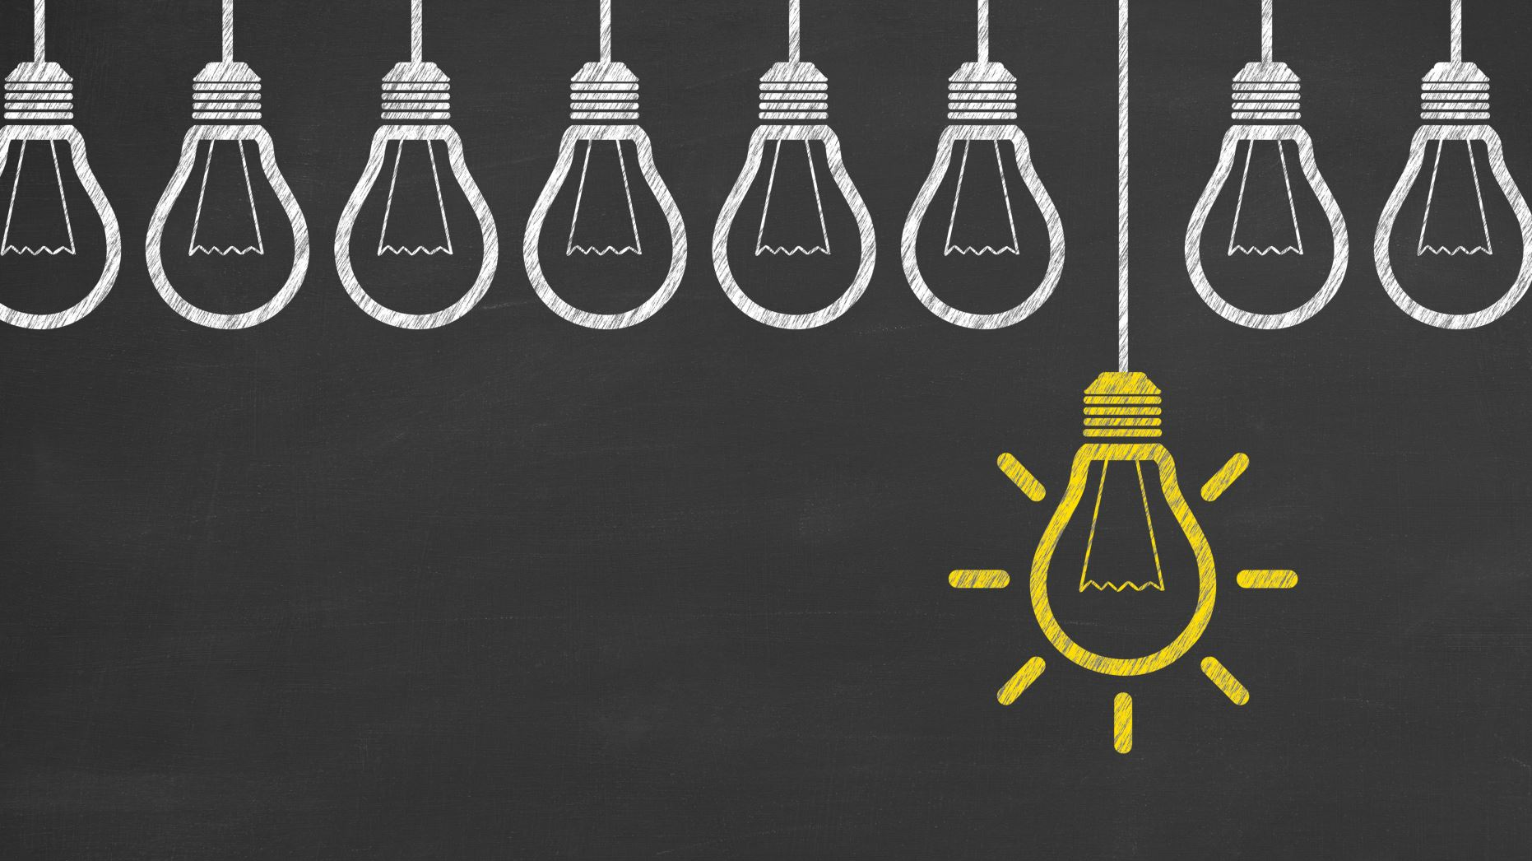
tools & Techniques for Proactive Feedback
Framing critical reading and class discussion (and notetaking on each) as thesis, argument, outline development
Early distribution of tailored rubric with a short prompt (and fielding questions thereon)
Peer &/or faculty review of thesis, introduction, &/or outline at least one week before due date (prewriting)
Requiring or incentivizing a draft process by providing time &/or credit for guided evaluation (e.g. with Peerceptiv)
Providing self–peer guide and checklist products to structure draft/editing processes
Notes:
To avoid dissonance, one might take an instrumental “good enough” approach to writing, thinking (wrongly) of grammar and style as subject. The reality is that as one rises, so do expectations related to clarity and cogence of written expression; rightly or wrongly, perceptions of writing facility inform perception of overall competence.
tailored instruction is a work in progress. Precision in language is not subjective: defining pronouns (who are the ”they’” and “we”?) and making passive voice active to attribute agency, causation
To avoid dissonance, one might take an instrumental “good enough” approach to writing, thinking (wrongly) of grammar and style as subject. The reality is that as one rises, so do expectations related to clarity and cogence of written expression; rightly or wrongly, perceptions of writing facility inform perception of overall competence.

Slide 18
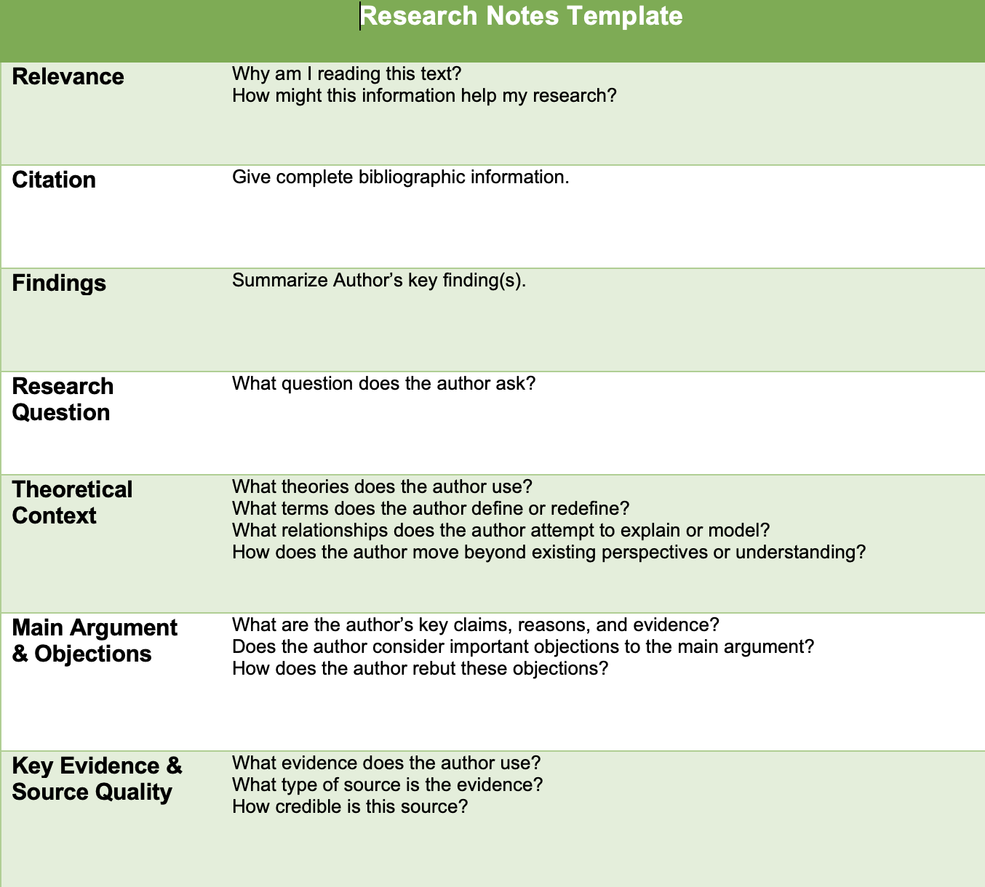
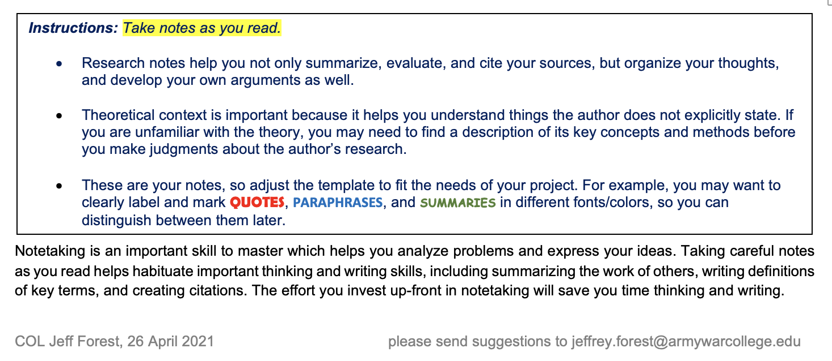

Notes:
Tool 1: Research Notes Template by COL (Ret.) Jeff Forest
Helps achieve first technique: Framing critical reading and class discussion (and notetaking on each) as thesis, argument, outline development

Slide 19
tools & Techniques for Proactive Feedback
Framing critical reading and class discussion (and notetaking on each) as thesis, argument, outline development
Early distribution of tailored rubric with a short prompt (and fielding questions thereon)
Peer &/or faculty review of thesis, introduction, &/or outline at least one week before due date (prewriting)
Requiring or incentivizing a draft process by providing time &/or credit for guided evaluation (e.g. with Peerceptiv)
Providing self–peer guide and checklist products to structure draft/editing processes

Slide 20
Strategy: “Alignment” Determines Lesson- & assignment learning outcomes
OPMEP OBME & JLO → ILO → PLO → CLO (via Dept. chairs & Course Directors) → Lesson/Assignment Outcomes
Translation: Outcomes provide the ‘what’ and ‘why’ of ‘graded requirements’; rubrics provide the ‘how’

Slide 21
AWC ILO
Think strategically and skillfully develop strategies to achieve national security objectives
Provide strategic context and perspective to inform and advise national-level leaders with sound, nuanced, and thoughtful military advice
Apply intellectual rigor and adaptive problem-solving to multi-domain, joint warfighting, and enterprise-level challenges
Lead teams with expert knowledge and collaborate with others to provide innovative solutions to complex, unstructured problems
Exercise moral judgment, and promote the values and ethics of the profession of arms
Convey complex information and communicate effectively and persuasively to any audience

Slide 22
Rubrics
Scaffolding
Standards
Learning Outcomes
Assessment
Standardization
Feedback
(Student &
Institution)

Slide 25
tools & Techniques for Proactive Feedback
Framing critical reading and class discussion (and notetaking on each) as thesis, argument, outline development
Early distribution of tailored rubric with a short prompt (and fielding questions thereon)
Peer &/or faculty review of thesis, introduction, &/or outline at least one week before due date (prewriting)
Requiring or incentivizing a draft process by providing time &/or credit for guided evaluation (e.g. with Peerceptiv)
Providing self–peer guide and checklist products to structure draft/editing processes

Slide 26
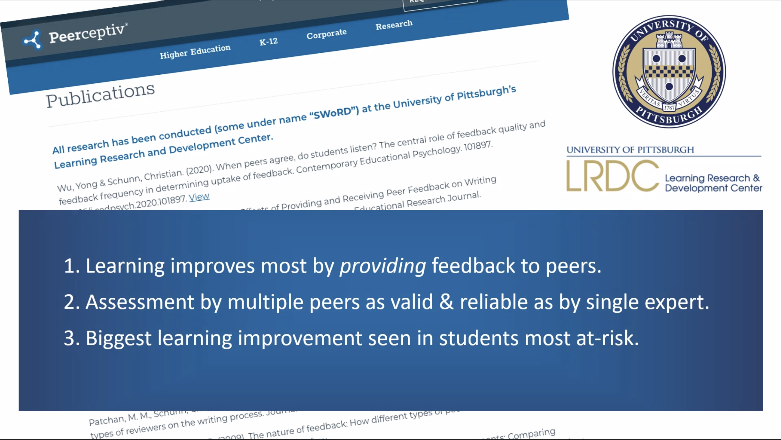
Notes:
Blind leading the blind? Hardly

Slide 27
tools & Techniques for Proactive Feedback
Framing critical reading and class discussion (and notetaking on each) as thesis, argument, outline development
Early distribution of tailored rubric with a short prompt (and fielding questions thereon)
Peer &/or faculty review of thesis, introduction, &/or outline at least one week before due date (prewriting)
Requiring or incentivizing a draft process by providing time &/or credit for guided evaluation (e.g. with Peerceptiv)
Providing self–peer guide and checklist products to structure draft/editing processes

Slide 29
Workshop Outcomes
Identify the value of, and cognitive/cultural barriers to, effective self and peer critique
Introduce tools, techniques, and strategies for structuring discussions and assignments to overcome these barriers
Discuss experience and aspirations of adapting these or similar tools, exercises, and practices in PME environments

Slide 30
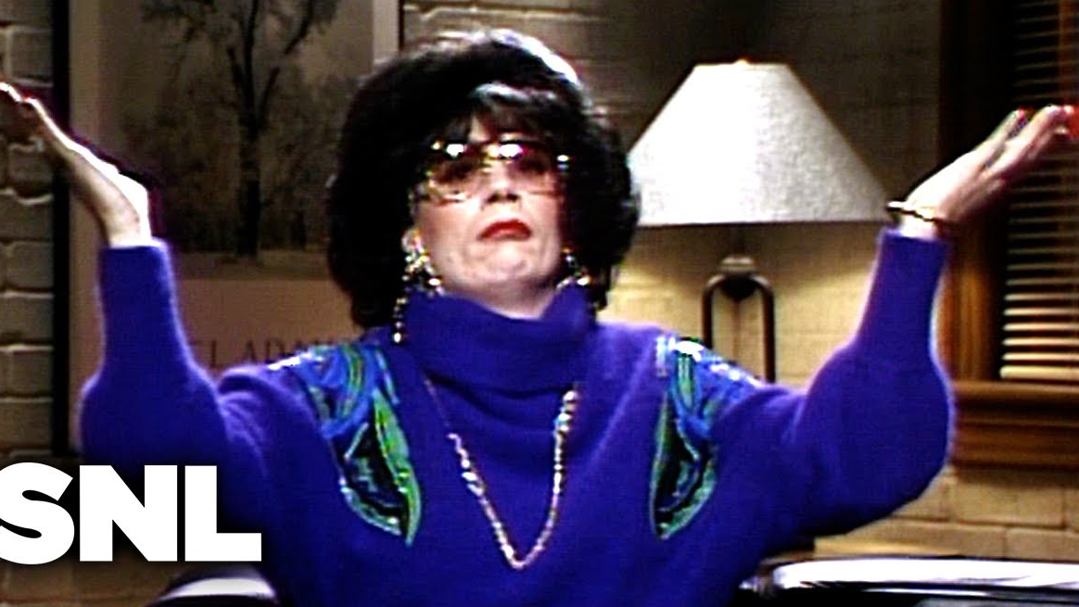
Discussion
What strategies, tools, techniques, &/or technologies can facilitate or have facilitated developing creativity, adaptive expertise, &/or a critical learning environment?

Slide 31
What is the status quo of critique & Feedback at your institution?
Willingness to challenge? In forums? In person?
Random/intentional partnering for thesis/draft check?
With open-ended prompts? Rubrics? Example drafts?
Does/could ChatGPT count as a “peer”?

Slide 32

Recommendation for integration + feedback
Focus the reading assignments, conversation, prompts, and rubrics on identifying, evaluating, and elaborating arguments, per taxonomies (Bloom’s [1956] and Anderson & Krathwohl’s 2001 update)
Notes:
Benjamin Bloom: educational psychologist who pioneered the classification system in 1956; passed away in 1999 and Lorin Anderson & David Krathwohl revised the system in 2001. The main differences are clear here– a transition from noun-driven verbiage to active language in verb form, as well as the still-contentious substitution of “synthesis” for “evaluating,” adding “creating” as the highest level of learning in the cognitive domain.
Remember: retrieving relevant knowledge from memory (recognizing, recalling)
Understand: determining the meaning of instructional messages (interpreting, exemplifying, classifying, summarizing, inferring, comparing, explaining)
Apply: carrying out or using a procedure in a given situation (executing, implementing)
Analyze: breaking material into its constituent parts and detecting how the parts relate to one another and to an overall structure or purpose (differentiating, organizing, attributing)
Evaluate: making judgments based on criteria and standards (checking, critiquing)
Create: putting elements together to form a novel, coherent whole or make an original product (generating, planning, producing)

Slide 33
More Alignment…
“Pre-writing” too often focuses on grammar, mechanics, citations — items which at bottom of Bloom’s Taxonmy…and rubrics → weighted less
Building from the top: Good assignment prompts correspond to the ‘what’ and ‘how’—thesis and content/organization (A-S-A)—which are also at the core of the rubric AND self–peer checklist and editing tools
In Bloom’s verbs, this usually involves applying one or more theory/framework, analyzing sources/evidence, and evaluating the fit/argument

