Slide 1


Slide 2
Boxed In
Identifying Attributes and Accounting for Process in Writing-Related Rubrics
Jeffrey Turner
Professor of Writing and Communication
Joint Forces Staff College, National Defense University
18 January 2023

Slide 3
Preface and Caveat Emptor
Rubric development takes quite a bit of iteration and subject matter expertise to develop well, align with the assignment, course and program outcomes, and implement in the classroom.
Please feel free to reach out with questions in the application of the information in the slides.
jeffrey.a.turner.civ@ndu.edu
Professor of Writing and Communication
JFSC/NDU

Slide 4
Workshop Objectives
To create opportunities for discussion and guided practice that enable attendees to revise existing or develop new writing-related rubrics.
Workshop Approach:
  We’ll discuss a topic, then you’ll apply it to your circumstance.
Topics/Organization:
  General Rubric: Setup, Types, Process
  Writing Related Rubric Challenges
  Writing Genres and Scaffolded and Sequenced Assignments
  Identifying Attributes to Establish the Ideal
  Clustering and Differentiation
  Scaling Down
  Develop a draft rubric over the course of the workshop

Slide 5
General Rubric: Purpose
To aid in the evaluation process by ensuring attributes align with
  the assignment
  learning objectives and outcomes
Identify and weight key attributes for evaluation
Establish the basis for interrater reliability and grade norming
Make evaluation more efficient (sometimes)

Slide 6
General Rubric: Types 1
There are several types of rubrics that serve different purposes
  Analytic or atomistic
  Holistic
  Developmental
  Single-Point
  Checklists

Slide 7
General Rubric: Types 2
Holistic
Analytic
Excellent
  The submitted paper includes a thesis statement, exemplary logic, and clarity of writing.
Meets Standard
  The submitted paper provides a thesis statement, is generally logical, and the writing is clear.
Does Not Meet Standard
  The submitted paper may or may not have a thesis statement, if so the thesis is weak. There is no discernible logic. The writing is hard to follow and unclear due to errors.
Logic of Analysis 20%
  Excellent: Balanced presentation of relevant and legitimate information that clearly supports a central purpose or argument and show a thoughtful, in-depth analysis of a significant topic. Student employs persuasive reasoning.
  Meets Standard: Information provides reasonable support for the thesis and displays evidence of a basic analysis of a significant topic. Reader gains some insights.
  Does Not Meet Standard: Information supports a central purpose or argument at times. Analysis is basic or general. Reader gains few insights. Or, logic supporting the thesis is not clearly identified. Analysis is vague or not evident. Reader is left confused or uncertain.
Thesis Statement 10%
  Excellent: Thesis is clear and well defined. It makes a significant and compelling position.
  Meets Standard: Thesis clearly states the position. Some terms may not have been defined.
  Does Not Meet Standard: Thesis states a general position but does not make a specific case. Or, thesis is vague or unclear. Key terms are not defined.
Which type of rubric is required for Outcomes Based Education? Why?

Slide 8
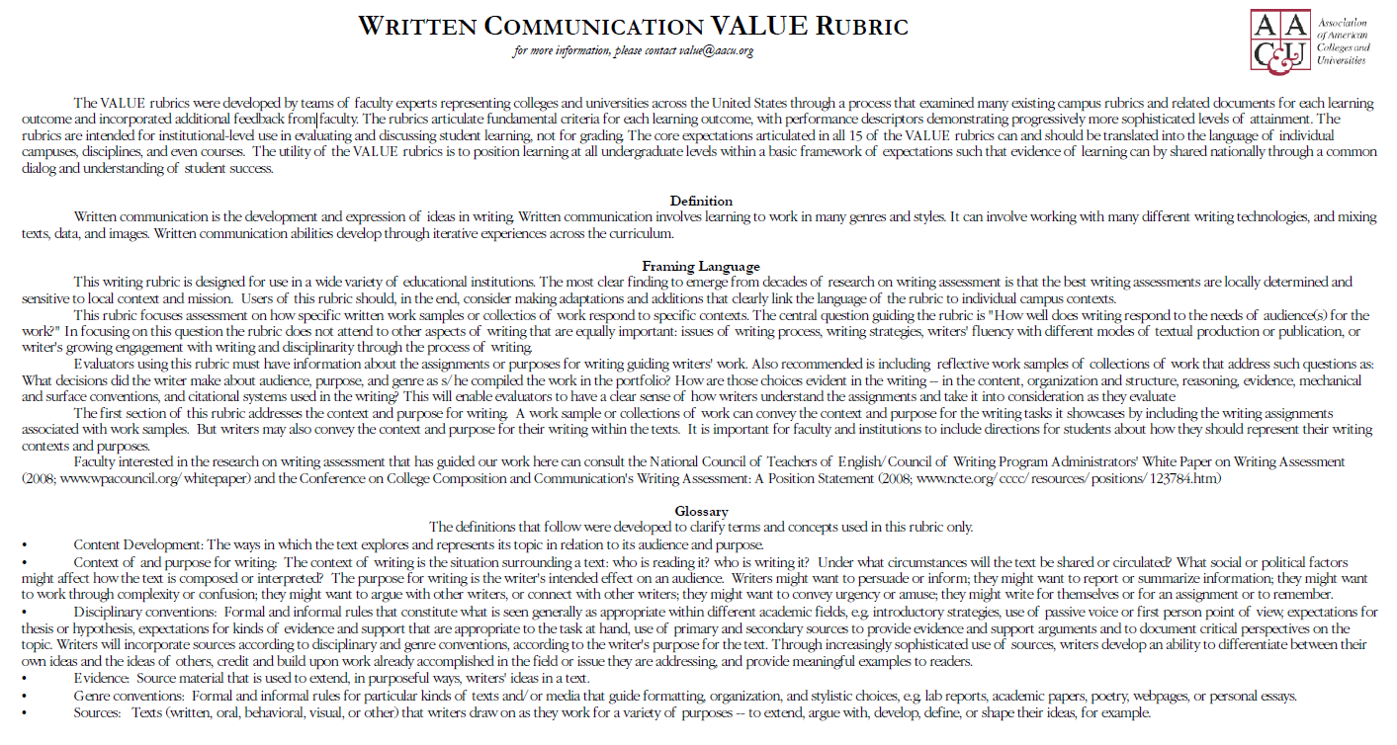
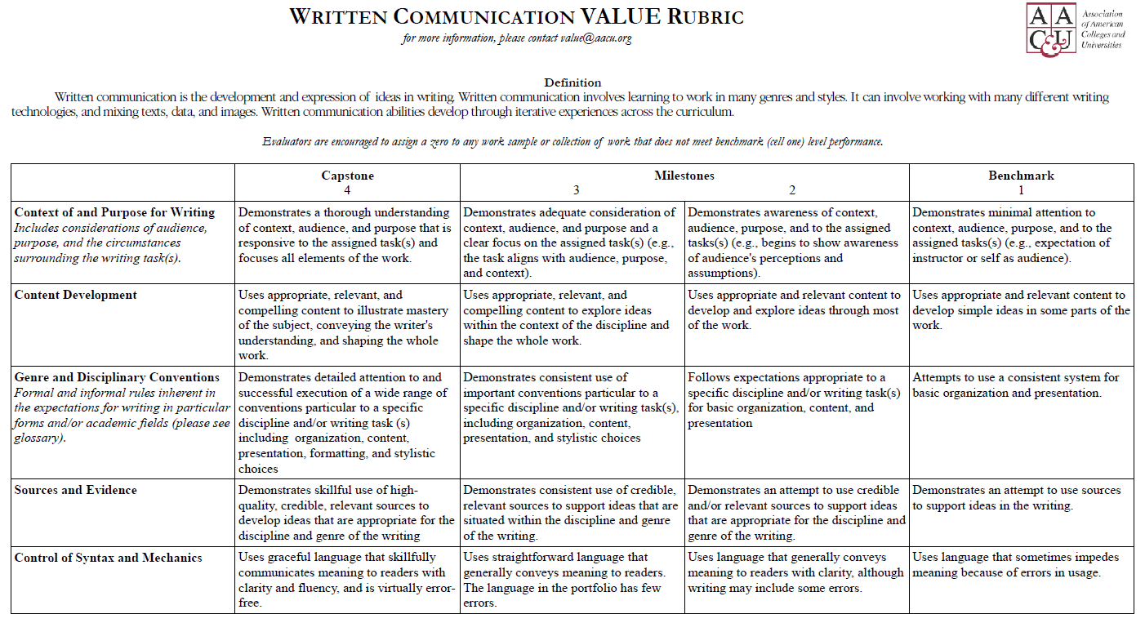
General Rubric: Pre-made Rubrics 1

Slide 9
General Rubric: Pre-made Rubrics 2

Slide 10
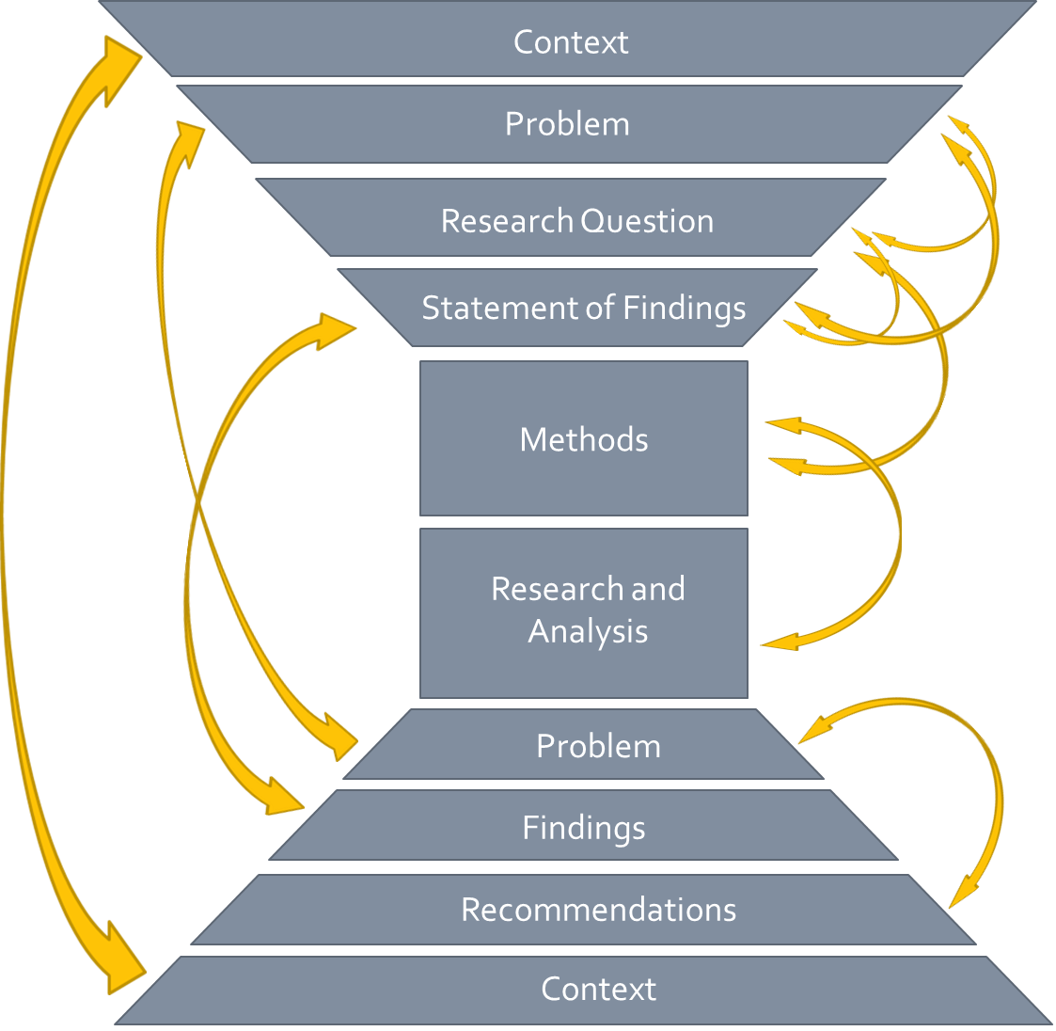
Writing-Related Rubrics: Challenges
Process and Genre
  Most graduate-level work employs assignments that are sequenced, scaffolded, or both
  Genres and genre sets are typified forms of written texts that conform to or meet the needs of activity systems.
Professional, aka multi-disciplinary, aka multi-content areas
  Cogency
Coherence
  Quantity of grading criteria
  Double-indemnity

Slide 11
Writing-Related Rubrics: Overview of Steps
Setup the rubric matrix
Identify the genre and defining genre attributes
Understand how the genre fits into the broader process, assignments, and milestones/deliverables
Use the defining genre attributes to describe the ideal submission
Scale downwards based on the ideal description for each attribute

Slide 12
Rubric Development: Setup
Attribute | Scale Range A+ 100-95 | Scale Range A-A- 94-90 | Scale Range B+-B 89-85 | Scale Range . . . | Percentage | Weighted Average
Thesis |  |  |  |  | 15
Organization |  |  |  |  | 20
Logic |  |  |  |  | 30
Uses of Sources |  |  |  |  | 20
Grammar |  |  |  |  | 15

Slide 13
Rubric Development: Writing Genres and Process 1
Understand the big picture, genres, progression/process
  What are the features/attributes of each genre document?
  What features/attributes are unique and which persist throughout the process?
    Sometimes it is easier to see the unique by comparing the preceding and following documents.
To answer those two questions, we need to understand professional writing circumstances and consider specific genre conventions

Slide 14
Rubric Development: Writing Genre and Process 2
White Papers
Master’s Thesis
Executive Summary
Purpose/Problem Statement
Methods (maybe)
Analysis
  Lesson
  Support/Evidence
  Value
Conclusion
Introduction
  Problem Statement
  Research Question
  Findings
Methods
Research/Analysis
Discussion
  Problem Statement
  Findings
  Synthesis
  Recommendation(s)
What genre are you building a rubric around today?
What are the key attributes of that genre?

Slide 15
Rubric Development: Writing Genres and Process 3
Papers
Position
Information
White
Executive Summary
Comment & Response
Event/Meeting
Read Aheads
Talking Points
Memorandums
Action
Decision
Information
Commander’s Guidance
Executive and Staff Writing Genres
Process of Development
Notice the importance of sequence

Slide 16
Proposal
Problem Statement
Literature Review
Key Research Areas
First Draft
Presentation
Final Draft
Research Question(s)
Anticipated Findings
Outline
Methods
Annotated Bibliography
Provenance
Value to/Application to Research Question/Methods
Introduction
Analysis
Sources
Findings
Introduction
Analysis
Sources
Findings
Methods
Methods
Projection
Tone
Question/Dialogue
Posture
Rubric Development: Writing Genres and Process 4
Master’s Thesis Research, Writing, and Analysis Process
Notice the scaffolding
How does your genre fit into broader genre processes,
aka What are the types of documents that precede it and follow it?

Slide 17
Rubric Development: Writing Genres and Process Exercise
Identify a writing assignment and answer these broad questions:
  What genre does the assignment require students to complete?
  What are the genre’s defining attributes?
  Does this assignment have subsequent or prior assignments it will build on or build from?
    Do the attributes persist, not persist, or transform, how so?

Slide 18
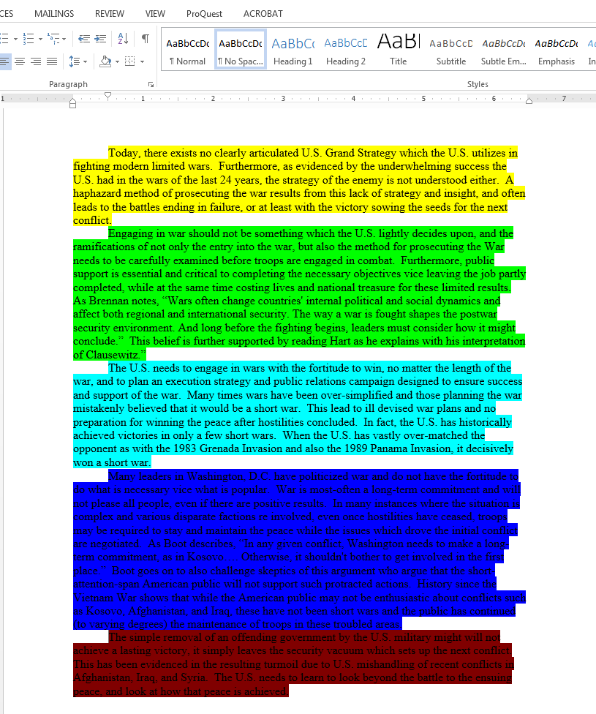
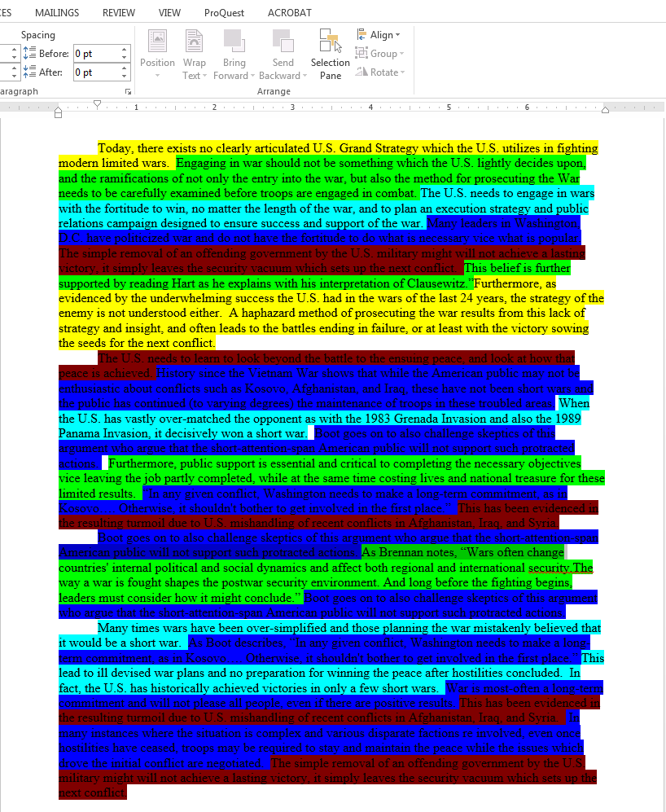
Rubric Development: Measurable and Observable Attributes, Literature Review
Serial Integration
Series Integration
Source A
Source B
Source C
Original
Topic X
What is the measurable and observable attribute of the “good” literature review on the right compared to the “weak” literature review on the left?

Slide 19
Rubric Development: Measurable and Observable Attributes, Clustering
Literature Review
  Organization and Development
    The contents of the literature review are organized to identify essential areas of disagreement, agreement, dissonance, contradiction, or other basis for the research that will enable the researcher to accurately frame context, provide background, and conduct deep and nuanced analysis.
  Citations and Source Quality
    Provides compelling, reliable, and accurate sources and information throughout the paper with high quality sources and significant depth, often using multiple sources, to overwhelmingly substantiate the research.
    Attribution is clear and objective.
  Writing
    The quality of the writing suggests a high level of immersion and familiarization with the features of the discourse community, posing few if any mechanical or grammatical errors that interrupted reading.
  Appropriateness to Problem and Research Questions (as outlined in the Proposal)
    Focus of the literature review elements have clear connection and further frame the research problem and provide foundational material for conducting analysis that will answer the research question.
How are the attributes clustered in this example?

Slide 20
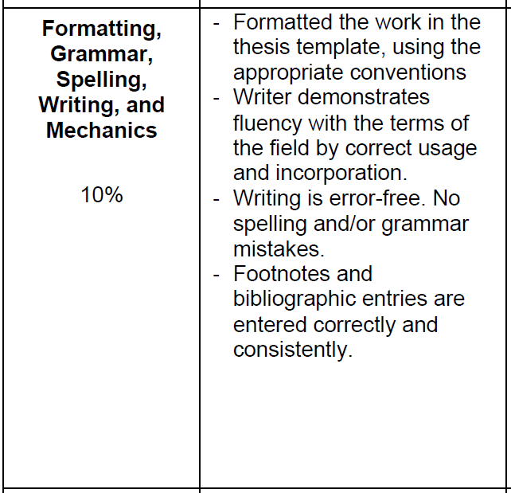
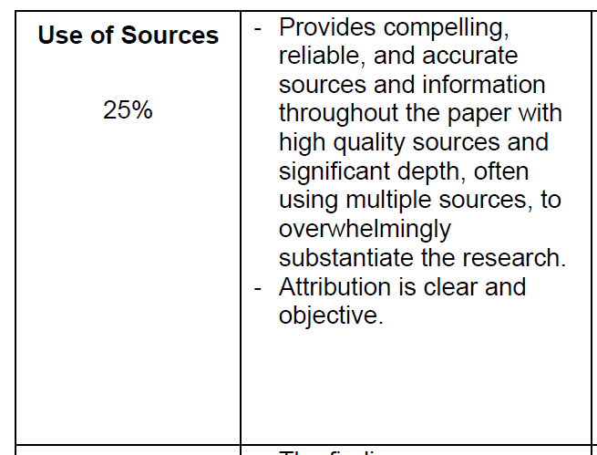
Rubric Development: Measurable and Observable Attributes, Differentiation
How does clustering lead to differentiation between attributes?

Slide 21
Rubric Development: Measurable and Observable Attributes, Exercise
Consider the defining attributes of the genre you identified in the previous exercise.
Develop descriptions for those attributes based on the ideal?
  What are the measurable and observable attributes of the ideal paper? Describe them.
Look at the attributes broadly, cluster and re-label where possible.
  Does the new cluster clearly differentiate observable and measurable attributes?
  Is their double-indemnity because of a lack of differentiation?

Slide 22
Rubric Development:
Scaling to Lower-levels of Achievement
Preparation
  Institutional Scale
    3 column, 4 column, 5 column?
    Ranges, e.g. 100-95, 94-90, 89-85, etc.?
Process for Scaling to Lower-levels of Achievement
  Work from the ideal example, the A+/99% work
  Go to the range below the ideal:
    What is not happening that prevented the work from being a great?
    The work tends to go from superlative to neutral to negative (missing attributes)
    The language is relative, so you may get one column done, then realize it needs to be changed after starting the column to the right of it
    Sometimes, the sub-attributes need to be broken, i.e. at one level one piece will be present, but at a lower-level a different piece will be missing or present

Slide 23
Rubric Development:
Scaling to Lower-levels of Achievement, Example
Exceeds Expectations (Ideal)
Meets Expectations
Below Expectations
  Organization and Development
    The contents of the literature review are organized to identify the essential areas of disagreement, agreement, dissonance, contradiction, or other basis for the research that will enable the researcher to conduct deep and nuanced analysis or provide deep background.
  Organization and Development
    The contents of the literature review are organized and most areas of disagreement, agreement, dissonance, contradiction, or other basis for the research that will enable the researcher to conduct nuanced analysis or provide background.
  Organization and Development
    The contents of the literature review are disorganized, making it difficult to identify areas of disagreement, agreement, dissonance, contradiction, or other basis which will make it difficult for the researcher to conduct sufficient analysis or provide sufficient background.
What differentiates each level of achievement within the scale?
How do the Meets and Below derive from the Exceeds?
How does the language account for process?

Slide 24
Rubric Development:
Scaling to Lower-levels of Achievement
Exercise
Work left to right, scale the attribute description from the ideal to the lower levels of achievement.

Slide 25
Closing Discussion and Questions
Jeffrey Turner
Professor of Writing and Communication
Joint Forces Staff College, National Defense University
jeffrey.a.turner.civ@ndu.edu

Slide 26
References
Association of American Colleges and Universities. “VALUE Rubrics.” https://www.aacu.org/initiatives/value-initiative/value-rubrics.
Behrens, Laurence and Leonard Rosen. “A Sequence for Academic Writing.”
Booth, Wayne, Gregory Colomb, Joseph Williams, Joseph Bizup, and William Fitzgerald. “The Craft of Research, Fourth Edition.”
Broad, Bob, Linda Adler-Kassner, Barry Alford, Jane Detweiler, Heidi Estrem, Susanmarie Harrington, Maureen McBride, Eric Stalions, Scott Weeden. “Organic Writing Assessment: Dynamic Criteria Mapping in Action.”
Cheng, An. “Genre and Graduate-Level Research Writing.”
Depaul University. “Types of Rubrics.” https://resources.depaul.edu/teaching-commons/teaching-guides/feedback-grading/rubrics/Pages/types-of-rubrics.aspx#checklists.
Gonzalez, Jennifer. “Know Your Terms: Holistic, Analytic, and Single-Point Rubrics.” https://www.cultofpedagogy.com/holistic-analytic-single-point-rubrics/.
Walvoord, Barbara and Virginia Anderson, “Effective Grading: A Tool for Learning and Assessment in College, Second Edition.”
White, Edward and Cassie Wright. “Assigning, Responding, and Evaluating: A Writing Teacher’s Guide, Fifth Edition.”

