Slide 2
Professional Executive Summaries
Colette O’Connor, MFA (contractor)
Writing Coach, Graduate Writing Center

Slide 3
Today’s Learning Outcomes
By the end of this workshop, you will better understand…
The Goals and Purpose of an Executive Summary
Essential Elements of an Executive Summary
How to Write and Revise an Executive Summary
Best Practices and Nifty Tips for a Clean, Clear, and Polished Finished Product

Slide 4
An executive summary is like a preface, providing a nice introduction to your work.
True or False
If your work is technical in nature, it’s helpful to include relevant equations or figures in your executive summary.
True or False
Don’t forget to include important acronyms and their definitions in your summary!
True or False
4. Remember, you are writing for an audience as savvy as you are about your topic, if not for your clued-in boss or superior.
True or False
It’s important that your executive summary’s language be specific to your field of study or activity.
True or False
It’s typically better to explain than summarize key concepts in your executive summary, just to be sure your work is fully understood.
True or False
ALL FALSE
7. An excellent executive summary is at least 4 pages.
True or False

Slide 5
It is not a preface
It is not an introduction
It is not an abstract
It is not a random collection of highlights
What an Executive Summary is Not

Slide 6
What an Executive Summary Is!
It is a highly condensed, stand-alone version of your research project that leaves the reader with a solid understanding of the project’s overall purpose, scope, method, findings, policy recommendations, and/or suggestions for further research.
It is a mini-me version of your entire project, written for a general audience – those who do not have the time or inclination to read your many-paged masterpiece.
It’s like the back cover of your book, if you had written one; it summarizes your project’s contents, informs the reader of its purpose, and, if well written, entices them to read it.

Slide 7
Ask Yourself:
Is the write-up of my thesis/dissertation/report/article/proposal a long, winding road through my research?

Slide 8
Ask Again:
Is the write-up of my thesis/dissertation/report/article/proposal highly technical, perhaps with tables, figures and equations?

Slide 9
If the answer to either is…
then you will need an executive summary, a (typically) required inclusion to any lengthy, technical, or highly complicated document, such as:
technical and scientific reports
survey reports or business plans
project proposals
research papers
academic articles
theses, capstones, or dissertations
,

Slide 10
Although superiors, supervisors, subject matter experts, and people you would like to impress may have an interest in your work, an executive summary is written for:
Any reader – the average reader – regardless of their knowledge of, or background in, your subject
the general public
governing agencies
regulators
potential business investors
publishers
organizational leaders
Who is my audience?

Slide 11
How Long Should My Executive Summary Be?

Slide 12
Choose The Best Answer:
1 page
2 pages
3 to 5 pages
As many pages as it takes
2
__________________________

Slide 13
Four Major Elements to Include in Your Summary
Project Summary
Explanation and Background of the Problem/Question Studied
Process/Methodology Used to Study the Problem
Outline of Recommendations or Decisions

Slide 14
PROJECT SUMMARY

Slide 15
Everything should be made as simple as possible, but not simpler. – Albert Einstein
The project summary is a brief (300 words or so), comprehensive summary of the research, which can stand alone, and presents the most important results of the work.
*
Think of the project summary as a classified ad for your research, one in which you are being charged by the word. A project summary succinctly and clearly states your purpose. Six bold, brief sentences will nicely do the job:
*
Sentence #1: research question/problem statement
Sentence #2: purpose statement/hypothesis
Sentence #3: methods
Sentence #4: results
Sentence #5: conclusions
Sentence #6: recommendations

Slide 16
THE PROJECT SUMMARY
[in six sentences]
Research Question or Problem Statement
In surveys of customers who have chosen competitors’ watches, 52 percent have expressed a need for simpler and cheaper options; therefore, to best serve our existing customers and to branch into new markets, we needed to develop a line of timepieces we can sell at an appropriate price point for this market.
Statement of Purpose / Hypothesis
The new watch series we proposed to launch would begin at a price point 20 percent less than our current least costly model, and would feature new materials, high-quality quartz movement instead of in-house automatic movement, and offer a customizable band option – all with a focus on choice and flexibility over traditional luxury.

Slide 17
THE PROJECT SUMMARY
[in six sentences, con’t]
Methods
Following rigorous quality control of the new series designed to be 20 to 40 percent cheaper than our current cheapest watch, marketing efforts were focused on the casual timepiece market, while remaining supportive of our luxury lines and aiming to meet our FY24 objective of expanding the brand.
Results
Launch of the new, less expensive watch series into our target market resulted in an increase of market share by 2 percent annually, stimulated customer demand for cheaper yet equally stylish timepieces, and suggested our go-to-market strategy was effective.
Conclusions
Early customer feedback sessions indicated that cheaper options would not impact the value and prestige of our luxury brand, though this is a risk that should be factored in during design.
Recommendations:
In order to mitigate that risk, the product marketing team should begin their FY25 go-to-market strategy six months before each new launch.

Slide 18
BACKGROUND

Slide 19
Include Only Key Points [avoid too much detail]
The background discussion [500 words] may include:
the context of your problem / research question
your original expectations or hypotheses
the motivation / imperative behind your study
a short narrative on the historical and operational background of the research conducted
past research by you and/or others, including the relationship of your study to current knowledge of a problem

Slide 20
Your thoughts on this background paragraph?
The purpose of this research is to identify requirements for Unmanned Operations Centers (UOCs) to include support and add to the current knowledge base of UOCs. The following research questions serve as guidance.
RQ1. How can optimal location for surged forward UOCs be identified to support both theater operations and sustainment?
RQ2. How can a future footprint be influenced for IT and operations to address increases in required capacity (bandwidth and span of control), and staffing to support continued operations of unmanned systems in the UOC?
RQ3. How will chain of command for the unmanned systems operate?
This research involved using MCDA with both the DOTMLPF-P (Doctrine, Organization, Training, Materiel, Leadership and Education, Personnel, Facilities, and Policy) framework and in a Joint Campaign Analysis class at the Naval Postgraduate School involving a hypothetical situation in the South China Sea. Through the use of multi-criteria decision analysis (MCDA), including using DOTMLPF-P, recommendations for current and future UOCs will be made that can be utilized by the Navy’s UOC.

Slide 21
Did you pinpoint these problems?
PURPOSE
The purpose of this research is to identify requirements for Unmanned Operations Centers (UOCs) to include support and add to the current knowledge base of UOCs. The following research questions serve as guidance.
RQ1. How can optimal location for surged forward UOCs be identified to support both theater operations and sustainment?
RQ2. How can a future footprint be influenced for IT and operations to address increases in required capacity (bandwidth and span of control), and staffing to support continued operations of unmanned systems in the UOC?
RQ3. How will chain of command for the unmanned systems operate?
This research involved using MCDA with both the DOTMLPF-P (Doctrine, Organization, Training, Materiel, Leadership and Education, Personnel, Facilities, and Policy) framework and in a Joint Campaign Analysis class at the Naval Postgraduate School involving a hypothetical situation in the South China Sea. Through the use of multi-criteria decision analysis (MCDA), including using DOTMLPF-P, recommendations for current and future UOCs will be made that can be utilized by the Navy’s UOC.
QUESTIONS
METHODOLOGY

Slide 22
Like this!
Context
In response to evolving challenges in the Pacific theater, the U.S. Navy and Marine Corps are undergoing a strategic transformation, shifting towards the EABO paradigm.
This approach, marked by decentralization and distribution, aims to bolster operational capabilities across the expansive INDOPACOM area. Within this strategic shift lies a crucial concern: ensuring efficient logistical support for naval surface combatants and expeditionary marine forces dispersed across vast island chains. The need to effectively supply fuel and other essentials to these geographically scattered forces raises significant questions about the current state of fuel logistics capabilities.
In the modern landscape of warfare, adversaries wield extended-range weapons coupled with precision munitions, intensifying challenges faced by the U.S. military. The imperative for the U.S. Department of Defense to organically support its forces abroad becomes even more pronounced, especially considering potential constraints on using foreign ports and contracted sources during conflicts.
The 2022 National Defense Strategy (NDS) underscores the necessity for a future force capable of secure and effective logistics and sustainment, even in the face of adversary disruption—a requirement this study endeavors to fulfill (DoD, 2022).
Problem
The imperative
Larger context

Slide 23
ASK YOURSELF
What unfamiliar terms do I need to define for the reader?
What is the history of the problem studied or question asked?
What does the reader need to know in order to understand my project – i.e., how can I educate the reader?
What research/studies have led to or contributed to mine?

Slide 24
METHODS

Slide 25
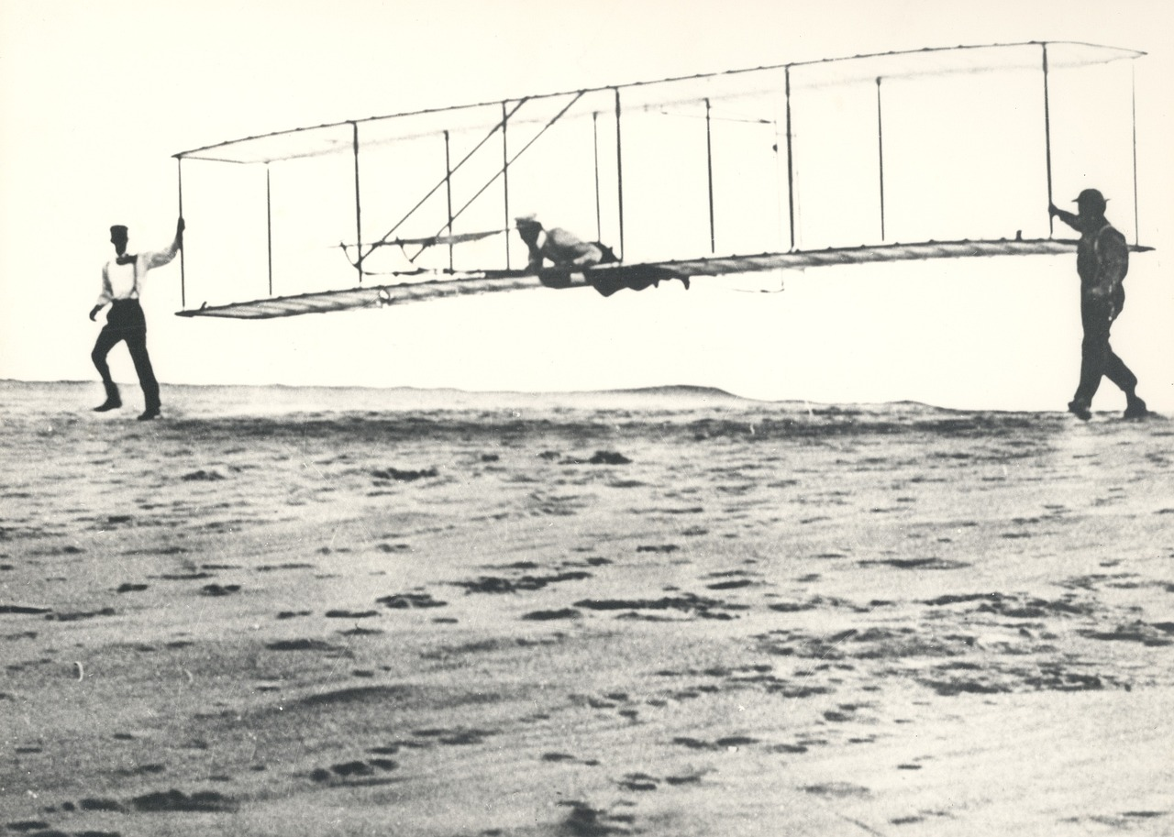
The methods discussion [500 words-ish) provides a complete description of the methodology for the study, including (if applicable):
data collection approach (i.e., interviews, sources of raw data, etc.)
variables defined
data analysis conducted (i.e., reliability of raw data, text critique)
challenges faced; limitations
processes, procedures, preparations

Slide 26
TABLES and FIGURES and EQUATIONS
Can you spot the flaw in this figure?

Slide 27
By design, your executive summary will contain NO tables, figures, or equations.
Ha! That is a trick question.

Slide 28
Your Executive Summary Will Be Less Technical than the Original Work
“For naval surface vessels, we anticipated the usage of the Over-the-Horizon GOLD (OTH-GOLD) messaging format for translation and visualization on the Global Command and Control System Maritime (GCCS-M). For civilian and other industry ships, we used a simulation interoperability application, which translates raw AIS data to Distributed Interactive Simulation (DIS) data. Alternatively for naval surface vessels, we created a similar application mapping the AIS data to OTH-GOLD as well, consolidating our tracks into one C2 system.”
“Using a variety of applications, we mapped ships’ tracks.”

Slide 29
“Baseline barometric testing will be conducted prior to administration of the medication, followed by a repeat assessment after drug administration, in order to determine whether there are any objectively measurable neuropsychiatric effects associated with this drug.”
Revised:
“The drug will be tested for side effects.”
“Following revegetation any disturbed areas will be reoccupied by a like assemblage of native avian and mammalian species.”
Revised:
“After the plants grow back, birds and animals will return.”
REWRITE FOR SIMPLICITY

Slide 30
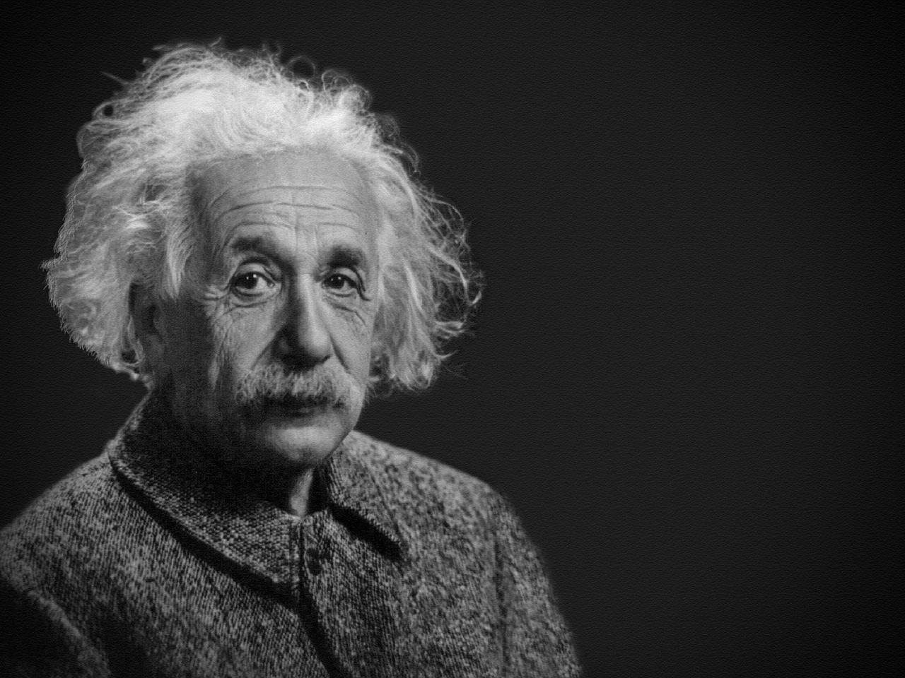
REWRITE A LA EINSTEIN
“To meet demand, we find that almost no combination of LSMs and PSV would be sufficient to meet demand at the EABOs; one or more LLs would always be required. During sustained operations, as few as two LLs, two LSMs, alongside one PSV, could satisfy requirements from CONSOL stations, assuming 100 percent delivery asset availability. However, surge operations would necessitate pre-positioning LSMs closer to EAB Platoons and adopting LLs; under these conditions, three to six LSMs, two LLs, and two PSVs were required for on-time deliveries from any CONSOL stations. The importance of the LLs to supplement floating delivery assets cannot be overstated.”
“…as simple as possible, but not simpler”
Whatever you choose to say here, remember:
AVOID or at least LIMIT ACRONYMS.

Slide 31
FINDINGS / CONCLUSIONS

Slide 32
In 300 to 500 words…
Do your results confirm, in full or in part, your original expectations or predictions?
Which hypotheses were supported, and why? Which hypotheses were not supported, and why?
Did you find that any hypotheses or variables were interrelated? If so, what and why?
What limitations are inherent in your research procedures and what, if any, are the implications for results?
Discuss the relationship of your results to the original problem and purpose., e.g.: Will any of your research conclusions make a difference, help solve the problem, or improve the situation? If so, how?
What are the long- and short-term implications of your findings? How do your findings relate to those of other cited researchers?
What did you discover?

Slide 33
RECOMMENDATIONS

Slide 34
In the recommendations discussion (300 words, more or less), you will present and discuss actions for future researchers, policy drafters, or relevant parties.
Ideally, you will make a formal recommendation regarding solutions best supported by your findings.
If your recommendations are to be implemented, what additional research or actions will be needed beforehand?
If applicable, you may recommend actions to be taken [or not] within your organization.
Do not simply reference other sections in your executive summary.
_______________________

Slide 35
Chief of Naval Operations, Fleet Readiness and Logistics (OPNAV N4) should consider a series of recurring wargames to examine select facets of logistics agility to inform Naval logistics manning, equipping, policies, and operational concepts.
This research identified a couple of critical areas of future exploration. This includes adjusting the type of supplies or commodities the logistics connectors move and the operational environment. Most research has focused on the movement of only one logistics commodity to support the expeditionary advanced bases. Future efforts should consider, at a minimum, fuel, ammunition, and causality evacuation.
In addition, future research should explore logistics risk to adversary exposure. In this research, the adversary only interdicts the logistics connectors in the vicinity of expeditionary advanced bases, and the logistics connectors have extensive freedom of maneuver. Future research should explore the impact of adversary actions on the entire distribution system.
___________________
_________________________
LIKE THIS!

Slide 36
Be clear! Be brief! Be bold!
You never get a second chance to make a first impression: BE INTERESTING!
To identify any gaps, contradictions, and misalignments in your project, write your executive summary last:
After you have identified all key insights, recommendations, etc.
After you perhaps have created a bulleted list or outline of main points of your research
Subheadings are nice.
But note that each section will vary in length, depending on the importance of the same section in the original work.
Run your finished summary by a friend or writing coach.
Does someone with no familiarity with your project or report understand what it is about?

Slide 37
Questions?
coletteoconnor.ctr@nps.edu
Find help, guidance, instruction, and more at GWC
resources, online workshops, and videos.

