Slide 2
WCCG Faculty Workshop
10 April, 2024
How to Use Generative AI
to Teach Critical Thinking
Carolyn Stoermer (she/her) Writing & Communications Specialist
U.S. Air Force Institute of Technology, WPAFB
- Contractor, Kellog, Brown, & Root -
The views expressed in this presentation are those of the author and do not reflect the official policy or position of KBR, the United States Air Force, the Department of Defense, or the United States Government.

Slide 3
How to Use Generative AI to Teach Critical Thinking
TODAY’S PLAN
Critical Thinking as Discourse
The Generative AI Wrench
Layered Literacies
Context: AERO 580
The Game: AI/Human Showdown
Results
Faculty Roles
Play!

Slide 4
How to Use Generative AI to Teach Critical Thinking
CRITICAL THINKING IS
“the intellectually disciplined process of actively and skillfully conceptualizing, applying, analyzing, synthesizing, and/or evaluating information gathered from, or generated by, observation, experience, reflection, reasoning, or communication, as a guide to belief and action.’’
(Scriven & Paul, 1987)
“reasonable reflective thinking focused on deciding what to believe or do.’’
(Ennis, 2018)
‘

Slide 5
How to Use Generative AI to Teach Critical Thinking
CRITICAL THINKING AS DISCOURSE
“Less than it is an individual ability or skill, critical thinking is a dialogic practice people engage in and commit to, initially interactively and then in interiorized form with the other only implicit.”
“Students who engage in sustained peer-to-peer discourse on demanding topics... enter into a community of practice -- one that we might regard as a community committed to the practice of critical thinking as discourse.”
(Kuhn, 2019)

Slide 6
How to Use Generative AI to Teach Critical Thinking
CHATGPT: COMMON CONCERNS
Student motivation
Hallucinated data and citations
Superficial content
Ethical considerations
* Confidentiality, spillage
(Gelvanovsky & Saduov, 2024)

Slide 7
How to Use Generative AI to Teach Critical Thinking
The requirements of DoD technical writing amplify these concerns.
Layered Literacies
The multiple fluencies tech writers draw from to complete complex tasks (Cargile Cook, 2002; Swacha, 2018).
Dynamic processes
Complex writing tasks require nimble thinking and adaptation, not rote use of templates (Ballentine, 2010; Bazerman, 1988).

Slide 8
How to Use Generative AI to Teach Critical Thinking
AERO 580: Technical Writing in Aerospace
14 students, variety of disciplinary fields
Course as desgined focuses on academic technical writing
Literature review for thesis
Technical briefing
My addition = foundational TPC thinking, processes
Rhetorical situation
Introduction to various genres...
with emphasis on need for nimble application
“New” ChatGPT looped into many discussions

Slide 9
How to Use Generative AI to Teach Critical Thinking
ACTIVITY GOALS
Think critically about the abilities and limitations of generative AI in high-level scientific writing
Apply prompting best practices
Write collaboratively to articulate clear, direct answers to technical questions
Use textual evidence to support writing assessments
Analyze and adapt processes for improved outcomes

Slide 10
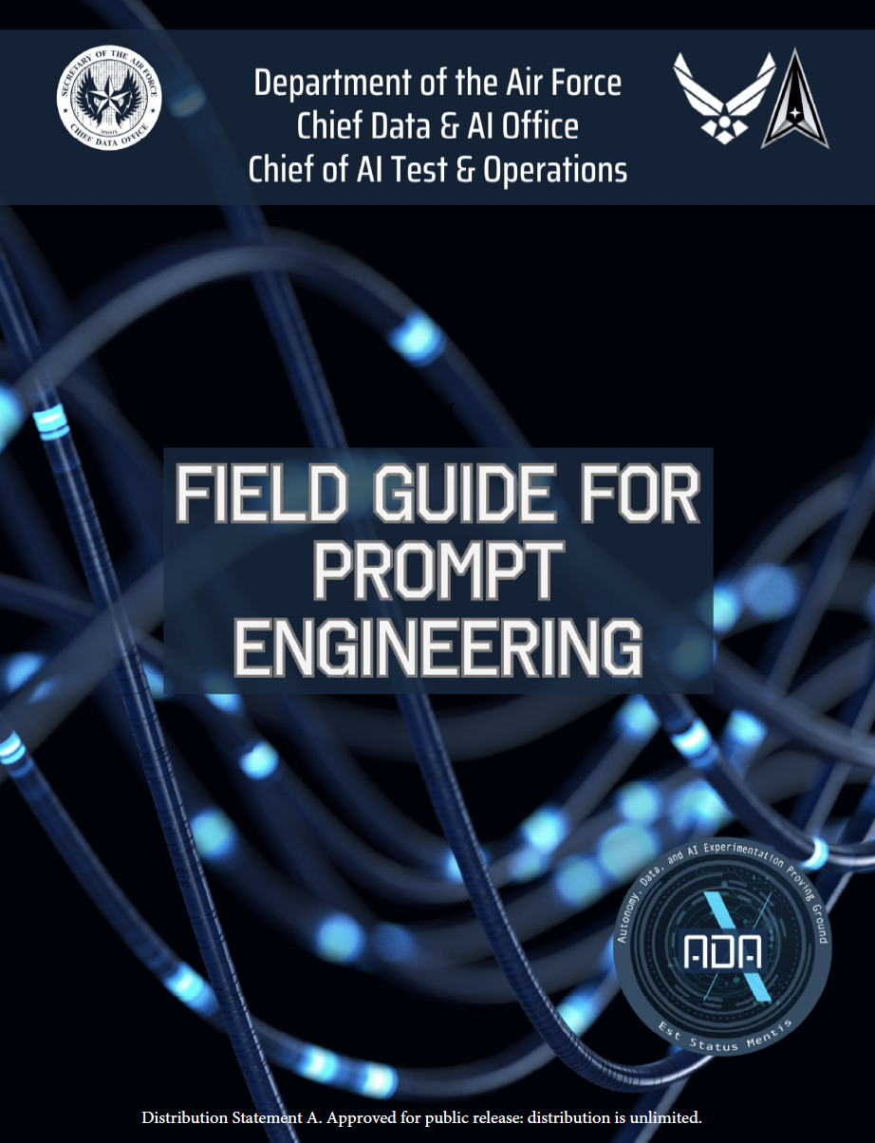
How to Use Generative AI to Teach Critical Thinking
AI-Human Showdown
Pre-game preparations
Review prompting best practices for LLM
Develop rubric criteria for aerospace trivia answers
What do we need to know/consider when we craft an answer to a question like this one?
What qualities do effective answers have in common?

Slide 11
How to Use Generative AI to Teach Critical Thinking
Describe the concept of boundary layer separation and its implications on aircraft and spacecraft performance.
Sample Question
TRIVIA ANSWER GRADING RUBRIC | Poor | … | Adequate | … | Excellent
Content Accuracy | 1 | 2 | 3 | 4 | 5
Clarity | 1 | 2 | 3 | 4 | 5
Mechanical Correctness | 1 | 2 | 3 | 4 | 5
Student-generated
rubric

Slide 12
How to Use Generative AI to Teach Critical Thinking
AI-HUMAN SHOWDOWN WALKTHROUGH
Each round:
Teams assigned roles: AI, Human, or Grader
Trivia question displayed; timer begins - 10 minutes to craft answer.
AI and Human teams display answers side by side.
Teams present, walk through their goals, processes, and difficulties.
Grading teams confer, use rubric to assess, then share out their scoring and rationale.
Pause for instructor facilitated discussion. What did we learn there? Is the rubric still working? What was challenging?
New round, new role assignment for each team.

Slide 13
How to Use Generative AI to Teach Critical Thinking
RULES OF ENGAGEMENT
Humans can use the internet to confirm facts but must practice ethical paraphrasing and citation.
AI team must use ChatGPT and may only use two prompts, one initial and one to refine. They may not edit or revise the final product.
Graders should use the 10 minutes to discuss what content and characteristics they want to see in this answer and why.

Slide 14
How to Use Generative AI to Teach Critical Thinking
RESULTS
Split! AI = 1, Humans = 1, Tie = 1
Rubric deemed inadequate to address issues of audience, tone, citation, and length.
Deep thinking and debate about what made effective answers, best prompts to elicit desired results.
Frequent callback to activity in later class discussions.
3

Slide 15
How to Use Generative AI to Teach Critical Thinking
POST-GAME QUESTIONS
What was ChatGPT able to do “better” than the humans? Where did it struggle?
What prompts worked best for this activity? Why?
What processes worked best for the collaborating human writers?
When we engage with generative AI, at what point does the writing cease to be ours? When and how does that matter?
3

Slide 16
How to Use Generative AI to Teach Critical Thinking
HOW DOES THIS GAME DEVELOP CRITICAL THINKING?
Creates a discourse community of SMEs.
As students vocalize their critiques, engage with others who disagree or are invested in an outcome, they internalize the sort of negotiated thinking required in technical writing.
Puts critique and onus for rationale in their hands, literally, with the grading rubric.

Slide 17
How to Use Generative AI to Teach Critical Thinking
WHAT IS THE INSTRUCTOR’S ROLE?
Facilitate.
Prompt global considerations.
Play the idiot.
Name and define what they notice.
Push for evidence, explanation.
Recap and repeat back for clarity.

Slide 18
How to Use Generative AI to Teach Critical Thinking
Questions?
Comments?
Carolyn Stoermer
Writing & Communications Specialist (CTR)
U.S. Air Force Institute of Technology
carolyn.stoermer.ctr@us.af.mil

Slide 19
How to Use Generative AI to Teach Critical Thinking
References
Bazerman, C. (1988). Shaping written knowledge: The genre and activity of the experimental article in science. U of WI P.
Ballentine, B. D. (2010). English and engineering, pedagogy and politics. In D. Franke, A. Reid, and A. DiRenzo (Eds.), Design discourse: Composing and revising programs in professional and technical writing (pp. 219-240). The WAC Clearinghouse.
Cargile Cook, K. (2002). Layered literacies: A theoretical frame for technical communication pedagogy. Technical Communication Quarterly, 11(1), 5–29.
Gelvanovsky, G. & Saduov, R. (2024). The impact of ChatGPT on academic writing instruction for computer science students. https://doi.org/10.13140/RG.2.2.30899.40481
Scriven, M. & Paul, R. (1987). Presentation. 8th Annual international conference on critical thinking and education reform. http:// www.criticalthinking.org/pages/defining-critical-thinking/766.
Swacha, K. Y. (2018). Bridging the gap between food pantries and the kitchen table: Teaching embodied literacy in the technical communication classroom. Technical Communication Quarterly, 27(3), 261–282. https://doi.org/10.1080/10572252.2018.1476589

Slide 20
How to Use Generative AI to Teach Critical Thinking
Round 1
Define accessibility as it relates to technical writing.

Slide 21
How to Use Generative AI to Teach Critical Thinking
Round 2
What precautions should one take when viewing a solar eclipse, and why are they necessary?

Slide 22
How to Use Generative AI to Teach Critical Thinking
What is the phenomenon known as “shockwave drag” and how does it impact supersonic flight?
AI:
Shock wave drag arises in supersonic flight due to the formation of shock waves, which are compression waves that occur when an object travels through the air at a speed greater than the local speed of sound. As an aircraft accelerates to supersonic speeds, the air in front of it can't respond quickly enough to move out of the way, resulting in the creation of shock waves at the aircraft's leading edges. These shock waves generate abrupt changes in pressure and temperature, causing a sudden increase in aerodynamic drag. This phenomenon not only limits the achievable speed of a supersonic vehicle but also significantly contributes to the energy requirements, necessitating careful design considerations to minimize its impact and enhance overall efficiency.
Humans:
Shock wave drag, commonly known as wave drag, is the increase in drag coefficient over an aircraft that is moving faster than its critical Mach number. This is caused by increased pressure from the shock waves as they form on surfaces of the aircraft. This requires additional thrust to overcome, which reduces fuel efficiency and range. The spike down below (see Figure 1) is indicative of where the critical Mach number begins into the supersonic regime.

