Slide 1
Prof. Ralucca Gera, rgera@nps.edu
Applied Mathematics Department,
Naval Postgraduate School
Excellence Through Knowledge
MA4404 Complex Networks
Community Detection

Slide 2
Learning Outcomes
Understand why and how community detection and validation work:
  Explain the connection to modularity
Distinguish methodologies used for overlapping and non-overlapping community detection;
Contrast methodology used in networks built as stochastic block models from random models.

Slide 3
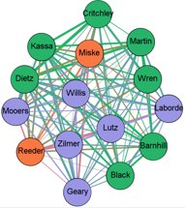
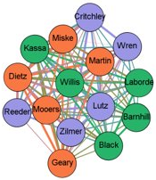
Why Community Detection?
Unweighted Edges
Communities are features that appear in real networks
  We generally try to identify them through the structural properties of the network: nodes tend to cluster based on common interests;
Massive amount of research since 2002 in this area;
Based on its usefulness, community detection became one of the most prominent directions of research in network science.
It is one of the common analysis
tools in understanding networks
A community ~ a group of people
with common characteristic or
shared interests
Weighted Edges
LTC Miske, MAJ LaBorde, MAJ Willis, & MAJ Wren, 2021

Slide 4
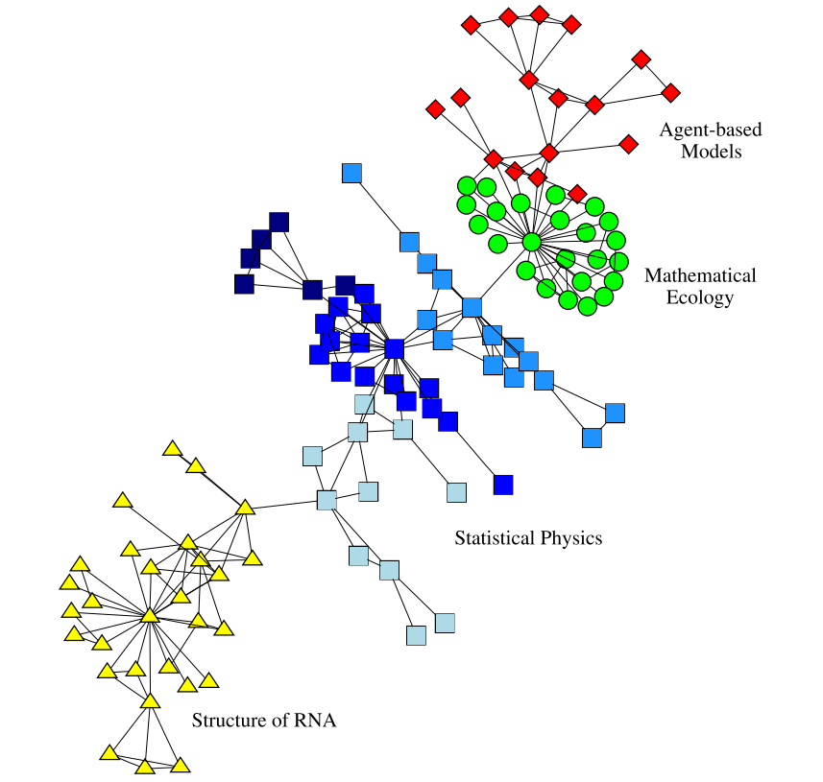
What is a community?
A community is a subset of nodes that share common or similar characteristics, based on which they tend to group.
In a social network it might be a circle of friends,
In the World Wide Web it might indicate a group of pages on closely related topics,
In a network of emails it may indicate groups of emails that have similar patterns or domain or belong to individuals that correspond on a regular basis.
Community detection: identifying what nodes belong to what communities (fast algorithms are usually not deterministic).
http://www.cs.cornell.edu/courses/cs6241/2019sp/readings/Fortunato-2016-guide.pdf

Slide 5
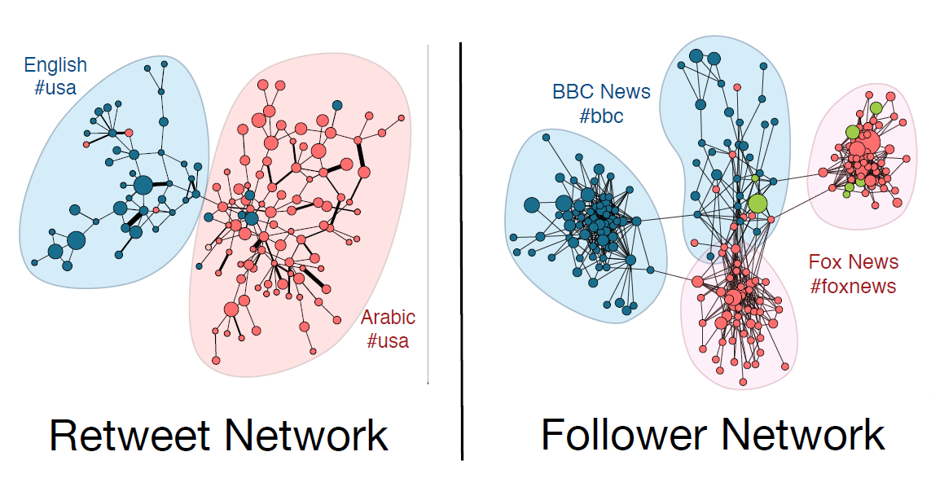
What might influence a community?
Homophily: similar nodes cluster together: for example based on Language
(or based on degree for degree homophily)
__________________________________________________________________________
Virality Prediction and Community Structure in Social Networks Yong-Yeol “YY” Ahn

Slide 6
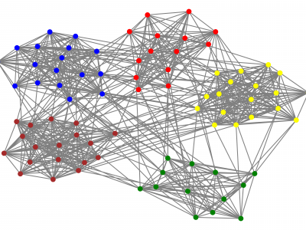
Fundamental concepts for clustering
- Identification and Evaluation

Slide 7
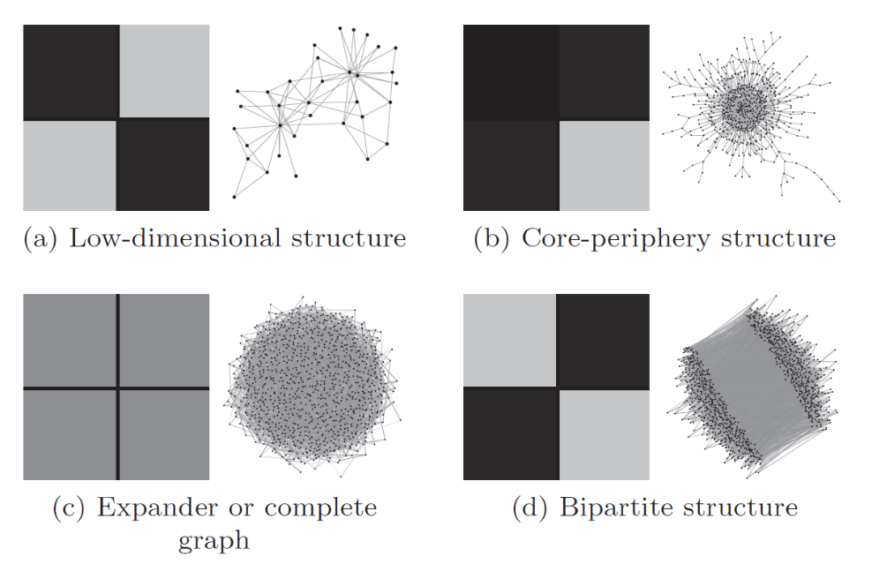
Adjacency matrices of different types of networks
What do networks look like?
Legend:
Different types of adjacency matrices and associated networks:
Dark = 1
(edge is present)
Gray = 0
(no edge)
Figure: (a) good spectral clustering (b) core-periphery structure (c) unstructured, (d) either way
Ref: “Think locally, act locally: Detection of small, medium-sized, and large communities in large networks” by Jeub et al, 2015

Slide 8
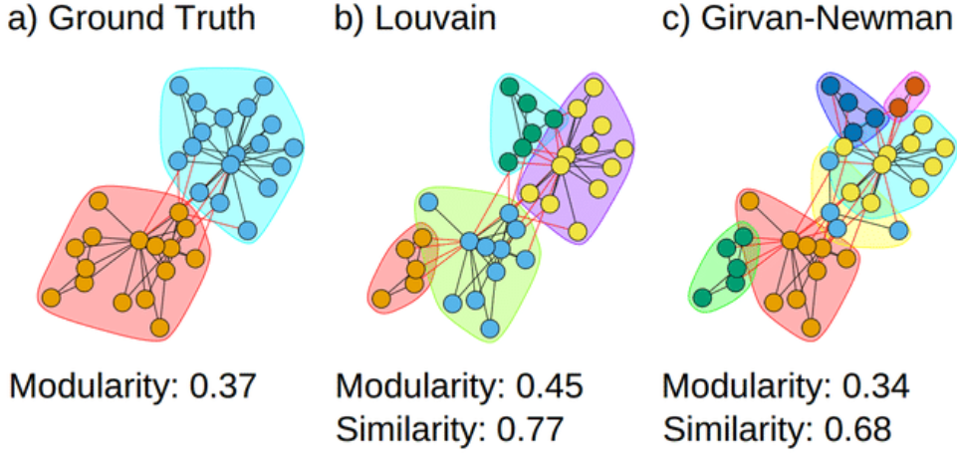
Community detection
Methodology
  Data is modeled by an
  “interaction graph”.
  Hypothesis: the world
  contains groups that
  interact more strongly amongst within the group than with the outside world.
  An objective function or metric is chosen to formalize this idea of groups.
  An algorithm is then selected to find sets of nodes that exactly or approximately optimize this function
  The clusters (communities) are then evaluated.
https://cs.stanford.edu/people/jure/pubs/ncp-www08.pdf

Slide 9
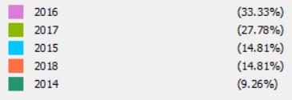
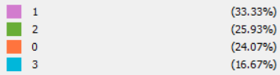
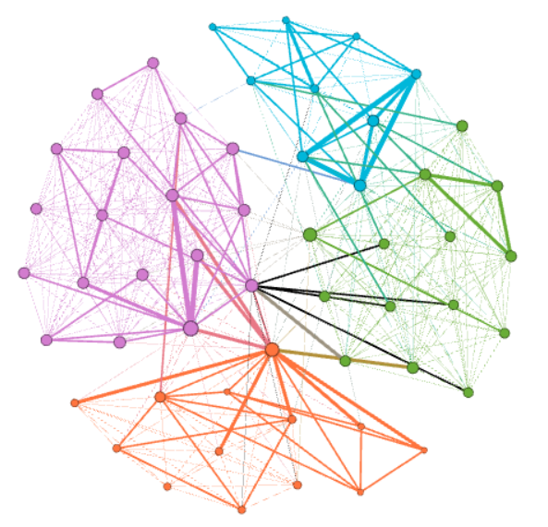
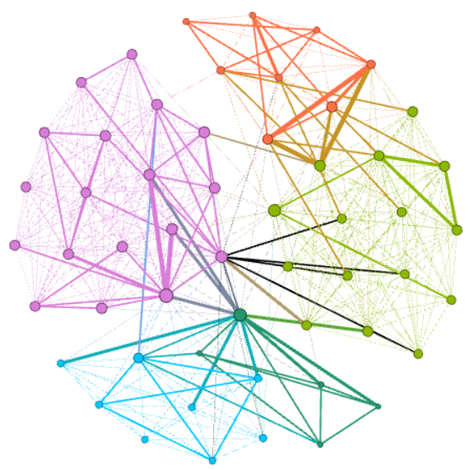
Community evaluation
How do we validate the community detection?
Ideally:
validating algorithms on community-labeled data (also called ground truth),
comparing against existing algorithms.
Alternatively: since community detection identifies sets of nodes that should naturally be in a community in the real world, then search for an understanding to whether they appear to make intuitive sense as a plausible community.
Detected Communities
Network Science Cohort

Slide 10
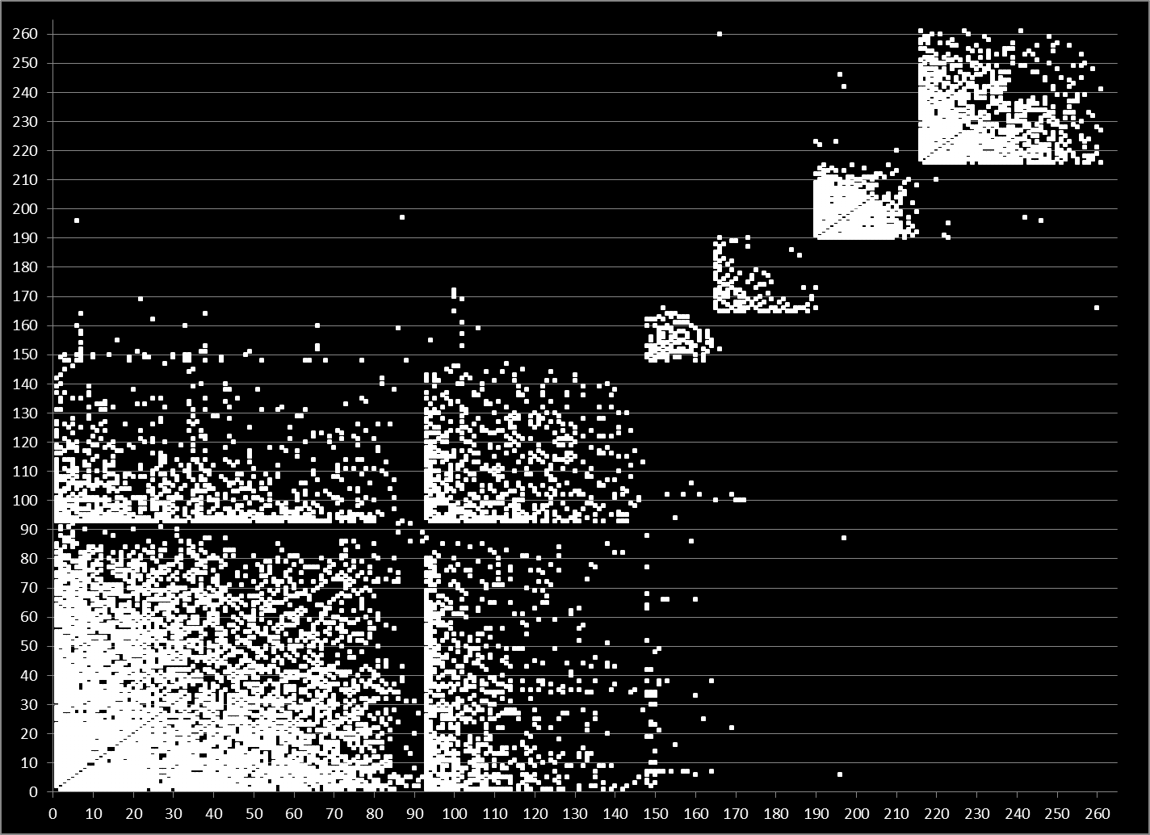
Evaluation
CRYSTAL
CITY
MARYLAND
MILITARY AFFILIATION
VA BEACH
& JAPAN
NO MILITARY AFFILIATION
PENTAGON
NAVY CEC
NAVY CEC

Slide 11
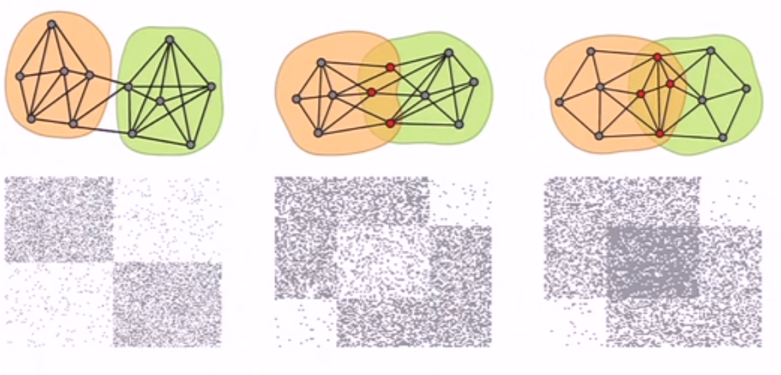
Overlapping vs non-overlapping
Adjacency matrices (some overlapping communities)
Overview of different types of adjacency matrices and associated networks:
Dark = 1 (or nonnegative weights) and Gray = 0 (no edge)
Reference: Jure Leskovec https://www.youtube.com/watch?v=htWQWN1xAZQ

Slide 12
Common clustering methodologies
Non-overlapping
Overlapping
Louvain
Girvan-Newman
Minimum-cut method
Modularity maximization
Clique Percolation

Slide 13
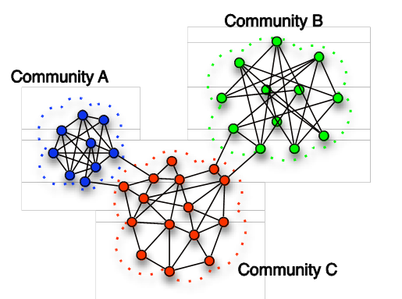
Non-overlapping communities
(node partitioning into communities)

Slide 14
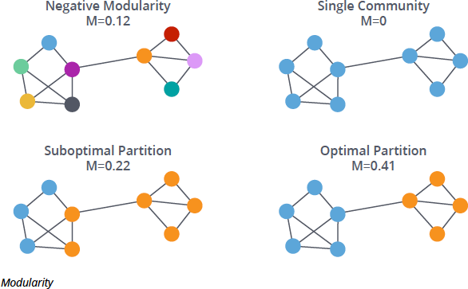
Partitioning Nodes Methods
We will discuss the two most used methods for community detection partitioning the node set:
  Method 1: Louvain
  Method 2: Girvan Newman
First, let’s talk about
modularity:
  Goal of modularity
  based community
  detection: assign
  nodes to communities
  to maximize modularity
https://neo4j.com/blog/graph-algorithms-neo4j-louvain-modularity/

Slide 15
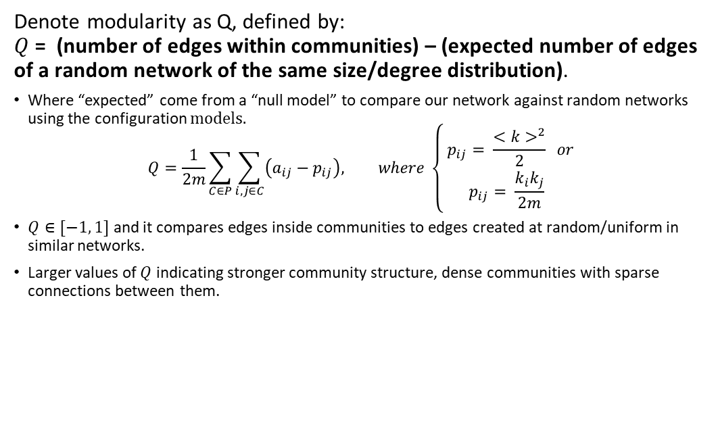
Modularity
Denote modularity as Q, defined by:
$Q$= (number of edges within communities) – (expected number of edges of a random network of the same size/degree distribution).
Where “expected” come from a “null model” to compare our network against random networks using the configuration $models.$
$$Q=\frac{1}{2m}\sum_{C∈P}{\sum_{i, j∈C}{\left(a_{ij}−p_{ij}\right), where \left\{\begin{aligned} p_{ij}= \frac{<k>^{2}}{2} or \\ p_{ij}= \frac{k_{i}k_{j}}{2m} \end{aligned}\right.}}$$
$Q∈[−1, 1]$ and it compares edges inside communities to edges created at random/uniform in similar networks.
Larger values of $Q$ indicating stronger community structure, dense communities with sparse connections between them.

Slide 16
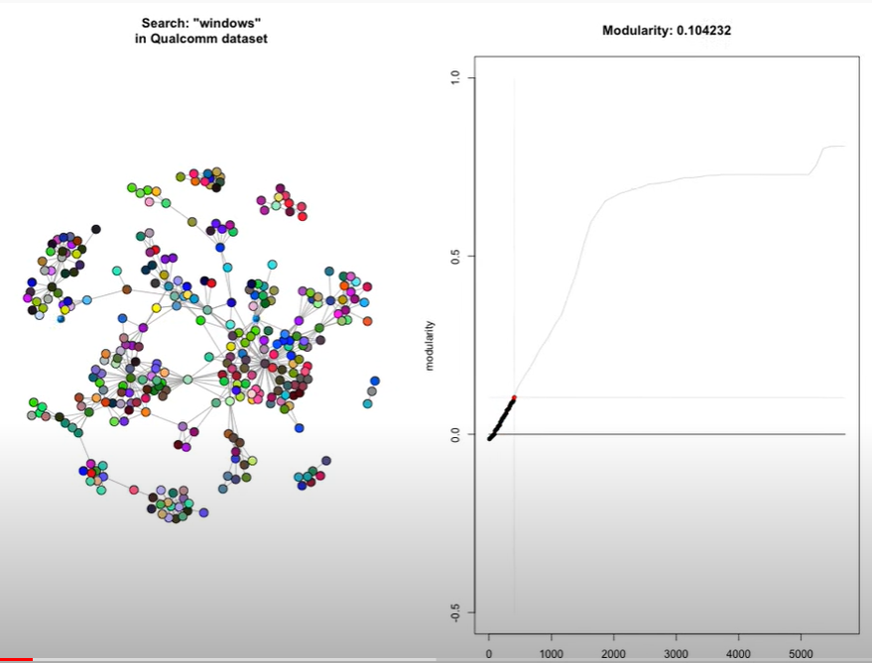
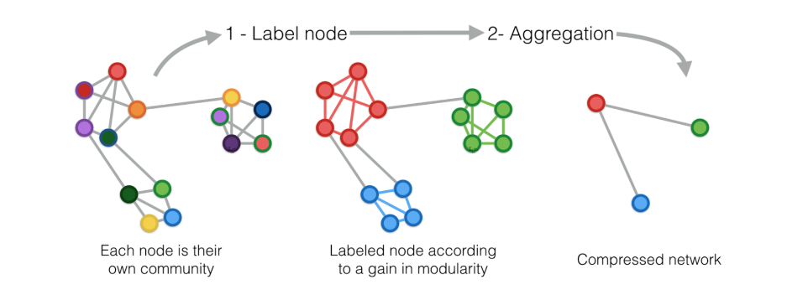
Method 1: Louvain
Goal: optimize modularity → theoretically this results in the best possible grouping of the nodes
  Note: modularity may not capture the right
  communities as they depend on the function
  of the network versus the definition of edges
The Louvain Method algorithm:
  Step 1: find small communities by optimizing
  modularity locally on all nodes,
  Step 2: each small community is grouped into
  one node
  Step 3: repeat Step 1 on the new graph
Louvain’s visualization
https://blog.insightdatascience.com/graph-based-machine-learning-6e2bd8926a0

Slide 17
Method 1: Louvain (slide 2)
Simple, efficient and easy-to-implement (NetworkX, Matlab, C++, and Gephi, and R):
For community detection in large networks
  For sizes up to 100 million nodes and billions of links.
  The analysis of a typical network of 2 million nodes takes 2 minutes on a standard PC.
The method unveils hierarchies of communities and allows to zoom within communities to discover sub-communities, sub-sub-communities, etc.
It is today one of the most widely used method for detecting communities in large networks.

Slide 18
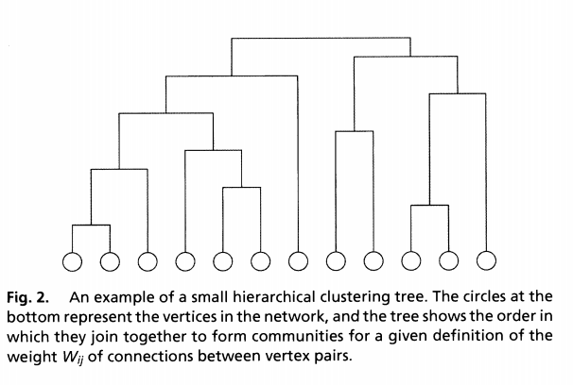
Method 2: Girvan Newman
The Girvan–Newman algorithm detects communities by progressively removing edges (with high betweeness centrality) from the original network.
These edges are
believed connect
communities
Algorithm stops
when there are no
edges between the
identified
communities.

Slide 19
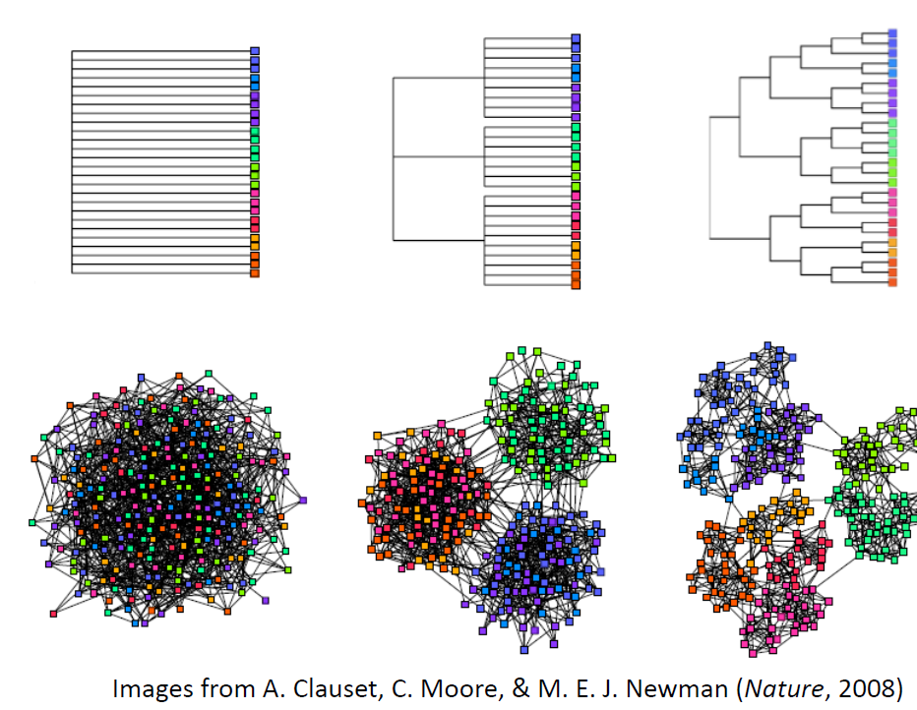
Method 2: Girvan Newman (slide 2)
Implementation in Python and R.

Slide 20
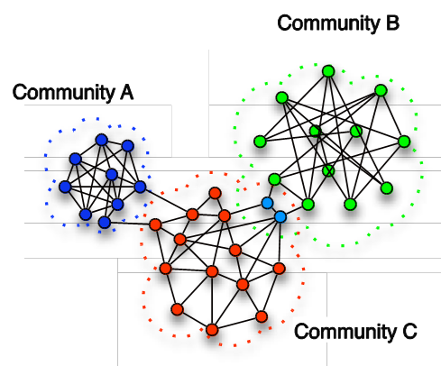
Overlapping communities
(not a partition of the vertex set into communities)

Slide 21
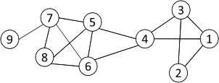
Cliques
Recall that a clique: a maximum complete subgraph in which all nodes are adjacent to each other
NP-hard to find the maximum clique in a network
Straightforward implementation to find cliques is very expensive in time complexity
Note:
Nodes 6, 7 and 8 form a clique
Nodes 5, 6, 7 and 8 form a maximum clique
21

Slide 22
Clique Percolation Method
It uses cliques as a core or a seed to find larger communities
Clique Percolation Method (CMP) to find overlapping communities (diagram on next page)
  Input
    A parameter k, and a network
  Procedure
    Find all cliques of size k in a given network
    Construct a clique graph: two cliques are adjacent if they share k-1 nodes
    The nodes depicted in the labels of each connected components in the clique graph form a community
22

Slide 23

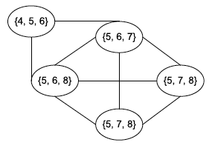
CPM Example
Parameter = 3
Cliques of size 3:
{1, 2, 3}, {1, 3, 4}, {4, 5, 6}, {5, 6, 7}, {5, 6, 8}, {5, 7, 8},
{6, 7, 8}
Clique graph
Communities:
{1, 2, 3, 4}
{4, 5, 6, 7, 8}
Source and code in R using igraph: http://infernusweb.altervista.org/wp/?p=1479
23

Slide 24
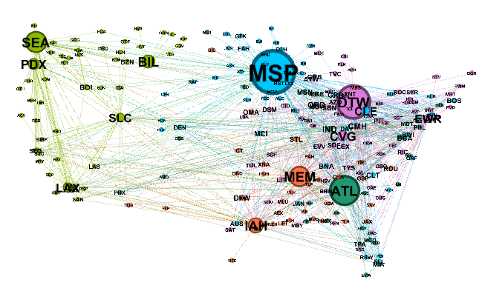
Community Detection Evaluation

Slide 25
Community detection evaluation
Seek their interpretation:
do they make intuitive sense as a plausible social community?
Compare against ground truth
Use metrics (Modularity and Conductance as the popular theoretical metric) to evaluate the quality of the communities.
  Network Community Profile: identifies the best community among all the communities of the same size (next page)

Slide 26
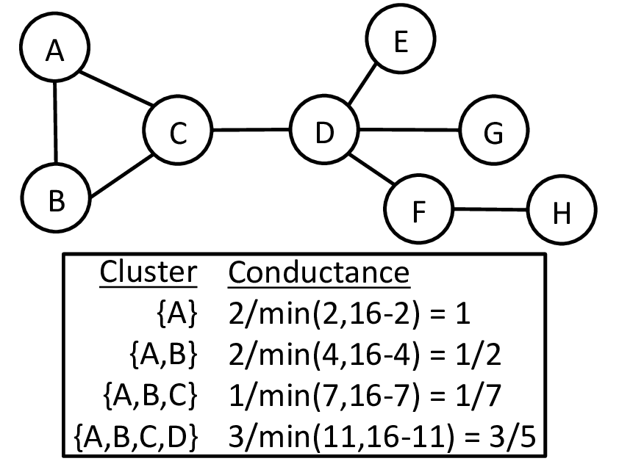

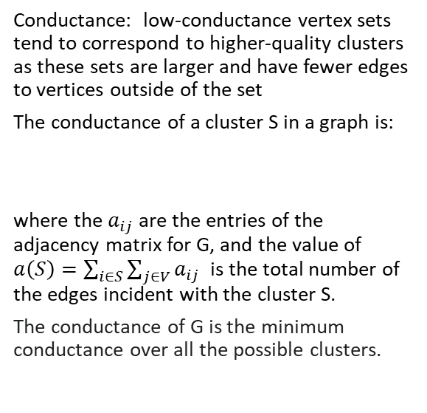
Conductance
Conductance: low-conductance vertex sets tend to correspond to higher-quality clusters as these sets are larger and have fewer edges to vertices outside of the set
The conductance of a cluster S in a graph is:
where the $a_{ij}$are the entries of the adjacency matrix for G, and the value of $a\left(S\right)=\sum_{i∈S}{\sum_{j∈V}{a_{ij}}}$ is the total number of the edges incident with the cluster S.
The conductance of G is the minimum conductance over all the possible clusters.
https://www.researchgate.net/publication/301817085_Parallel_Local_Graph_Clustering

Slide 27
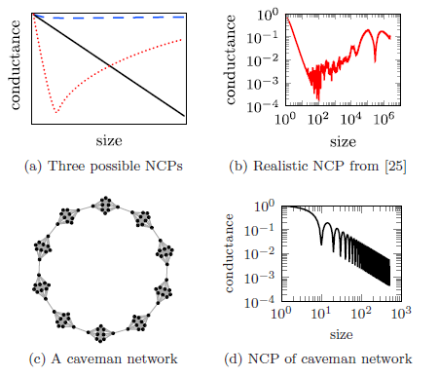
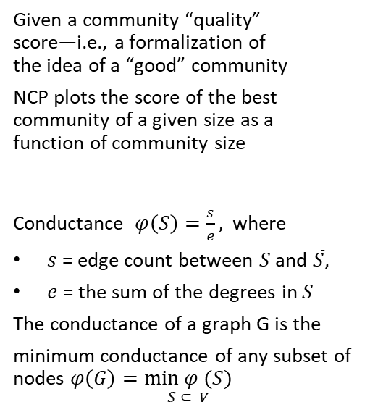
Network Community Profile
Given a community “quality”
score—i.e., a formalization of
the idea of a “good” community
NCP plots the score of the best
community of a given size as a
function of community size
Conductance $φ\left(S\right)=\frac{s}{e},$ where
$s$ = edge count between $S$ and $\overline{S}$,
$e$ = the sum of the degrees in $S$
The conductance of a graph G is the
minimum conductance of any subset of nodes $φ\left(G\right)=\underset{S ⊂ V}{min φ (S)}$
“Think locally, act locally: Detection of small, medium-sized, and large communities in large networks” by Jeub et al, 2015

Slide 28
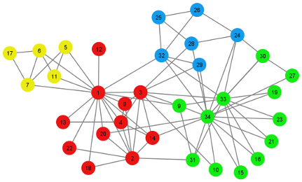
Synthetic models preserving community structure

Slide 29
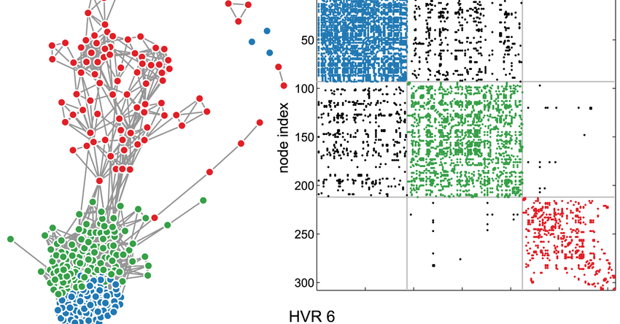
Synthetic models with communities
Fitting of the model to specific empirical data is not easy.
Most commonly used: Stochastic Block Model (SBM)
  Most methods are a variation of SBM
  But … other methods exist as well
https://www.researchgate.net/figure/Stochastic-block-modeling-identifies-network-communities-HVR-6-is-shown-in-two-forms_fig7_257839768

Slide 30
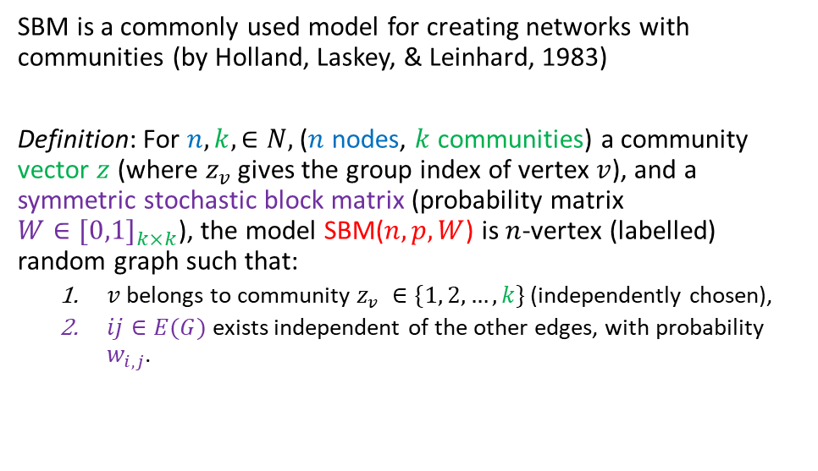
Stochastic Bock Models (SBM)
SBM is a commonly used model for creating networks with communities (by Holland, Laskey, & Leinhard, 1983)
Definition: For $n, k, ∈N,$($n$ nodes, $k$ communities) a community vector $z$ (where $z_{v}$ gives the group index of vertex $v$), and a symmetric stochastic block matrix (probability matrix ${W∈[0,1]}_{k×k}$), the model SBM($n, p, W$) is $n$-vertex (labelled) random graph such that:
  $v$belongs to community $z_{v} ∈\{1, 2, …, k\}$ (independently chosen),
  $ij∈E(G)$ exists independent of the other edges, with probability $w_{i,j}$.

Slide 31
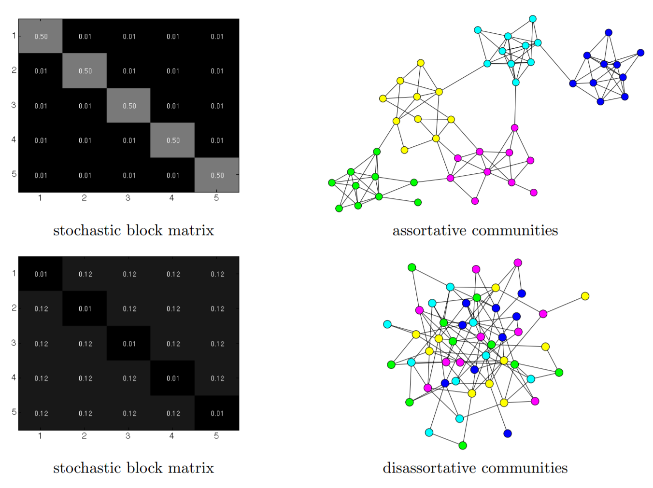
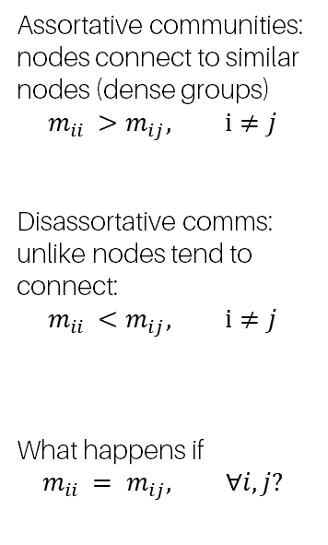
Two examples with k=5
Assortative communities: nodes connect to similar nodes (dense groups)
$$m_{ii }>m_{ij}, i≠j$$
Disassortative comms:
unlike nodes tend to connect:
$$m_{ii }<m_{ij}, i≠j$$
What happens if
$$m_{ii }= m_{ij}, ∀i, j?$$
http://tuvalu.santafe.edu/~aaronc/courses/5352/fall2013/csci5352_2013_L16.pdf

Slide 32
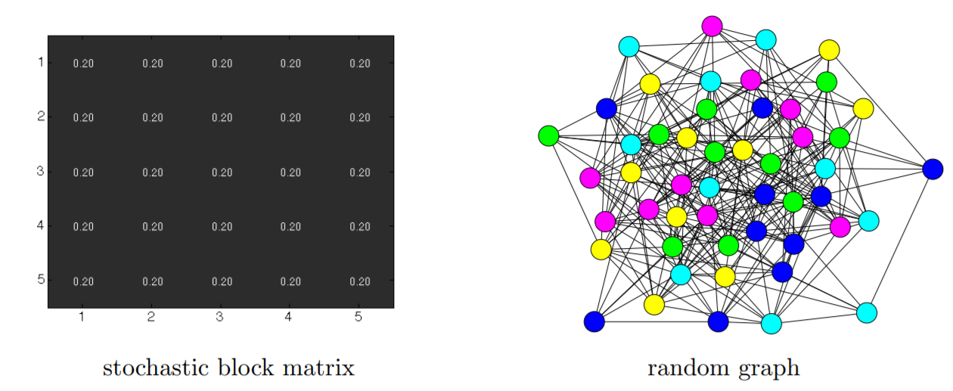
An example with constant probability (k=5)
What happens if $m_{ii }=m_{ij}, ∀ i, j$?
http://tuvalu.santafe.edu/~aaronc/courses/5352/fall2013/csci5352_2013_L16.pdf

Slide 33
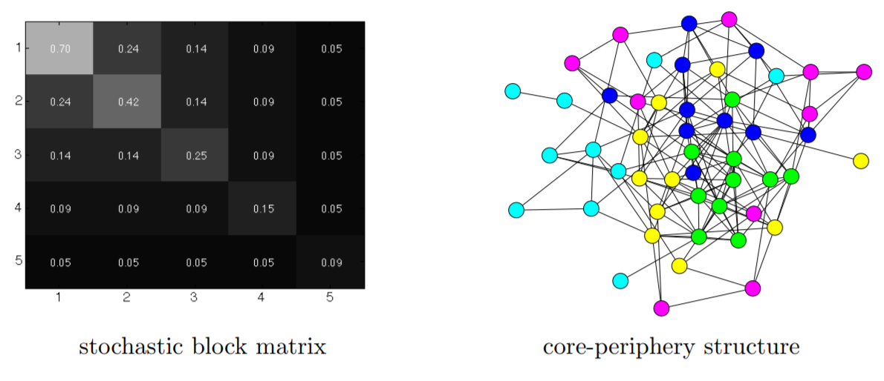
Core-periphery type
SBM with communities, where the density of connections decreases with the community index.
inner
core
Outer
periphery
inner
core
Outer
periphery
http://tuvalu.santafe.edu/~aaronc/courses/5352/fall2013/csci5352_2013_L16.pdf

Slide 34
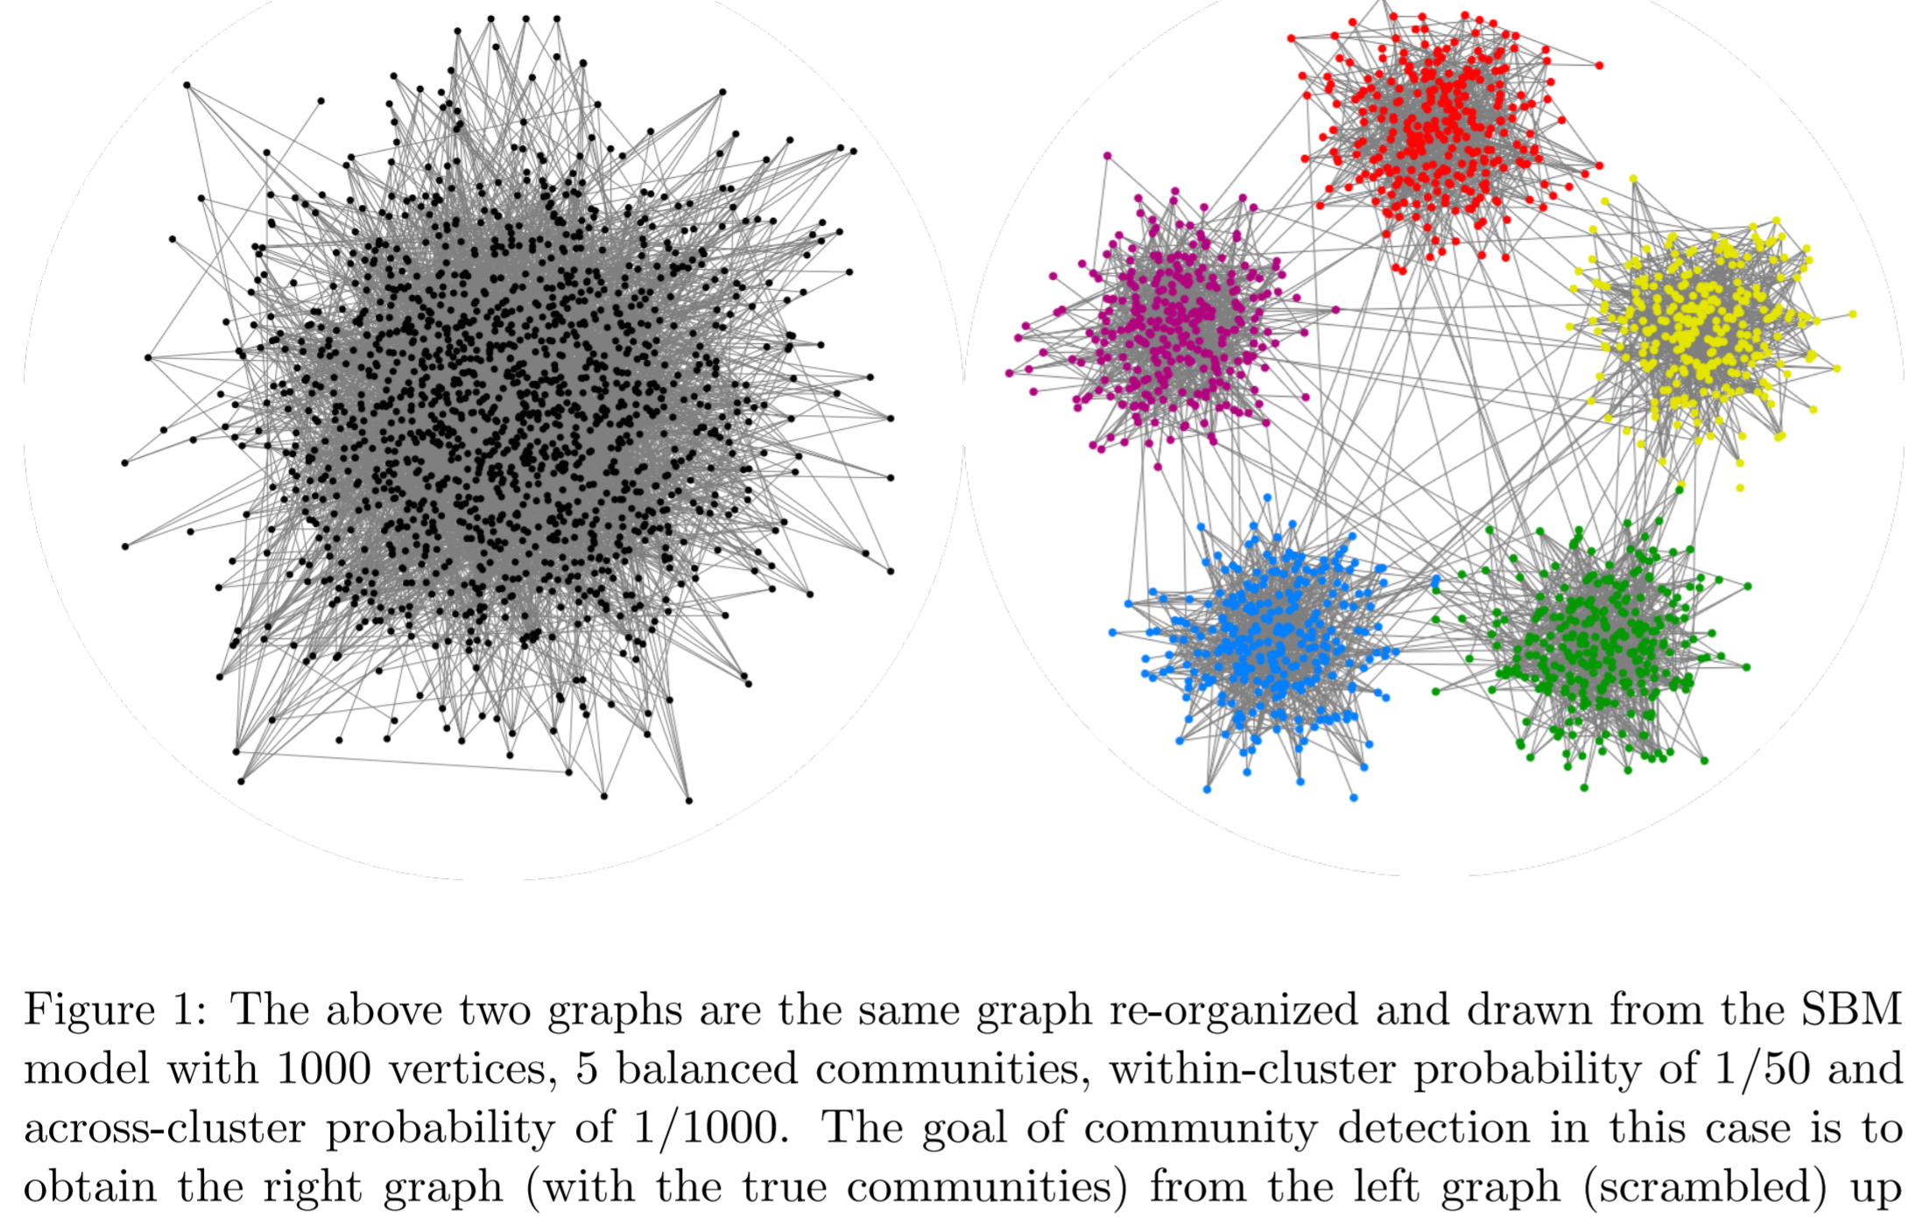
Good visualization can help!
https://arxiv.org/pdf/1703.10146.pdf

Slide 35
Extensions of SBM
binomial SBM [Holland et al. 1983, Wang & Wong 1987]
simple assortative SBM [Hofman & Wiggins 2008]
mixed-membership SBM [Airoldi et al. 2008]
hierarchical SBM [Clauset et al. 2006,2008, Peixoto 2014]
fractal SBM [Leskovec et al. 2005]
infinite relational model [Kemp et al. 2006]
degree-corrected SBM [Karrer & Newman 2011]
SBM + topic models [Ball et al. 2011]
SBM + vertex covariates [Mariadassou et al. 2010, Newman & Clauset 2016]
SBM + edge weights [Aicher et al. 2013,2014, Peixoto 2015]
bipartite SBM [Larremore et al. 2014]
multilayer SBM [Peixoto 2015, Valles-Catata et al. 2016, N. Stanly et al. 2016]
http://tuvalu.santafe.edu/~aaronc/courses/5352/csci5352_2017_L6_supplement.pdf

Slide 36
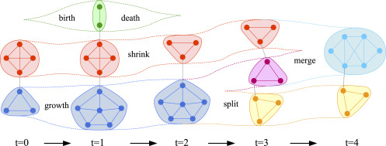
Common methods for dynamic networks
Synthetic models describing the evolution of communities in dynamic networks:
Spectral graph theory;
Dirichlet process
mixture model;
Stochastic block model;
Quantifying the evolution of communities;
And others ….
[1] Lei Tang, Huan Liu, Jianping Zhang, and Zohreh Nazeri. Community evolution in dynamic multi-mode networks. In Proceedings of the 14th ACM SIGKDD international conference on Knowledge discovery and data mining, pages 677–685. ACM, 2008.
[2] Yizhou Sun, Jie Tang, Jiawei Han, Manish Gupta, and Bo Zhao. Community evolution detection in dynamic heterogeneous information networks. In Proceedings of the Eighth Workshop on Mining and Learning with Graphs, pages 137–146. ACM, 2010
[3] Yu-Ru Lin, Yun Chi, Shenghuo Zhu, Hari Sundaram, and Belle L Tseng. Analyzing communities and their evolutions in dynamic social networks. ACM Transactions on Knowledge Discovery from Data (TKDD), 3(2):8, 2009.
[4] Gergely Palla, Albert-L ́aszl ́o Barab ́asi, and Tam ́as Vicsek. Quantifying social group evolution. Nature, 446(7136):664–667, 2007

Slide 37
Conclusion
Most probably no general-purpose algorithm (Peel et al. 2016):
  a cut-based method provides good separation of balanced groups,
  a clustering method provides strong cohesiveness of groups with high internal density,
  stochastic block models provide strong similarity of nodes inside a group in terms of their connectivity profiles,
  alg. driven by communities as dynamical building blocks aim to provide node groups that influence or are influenced by dynamics.
https://appliednetsci.springeropen.com/articles/10.1007/s41109-017-0023-6

Slide 38
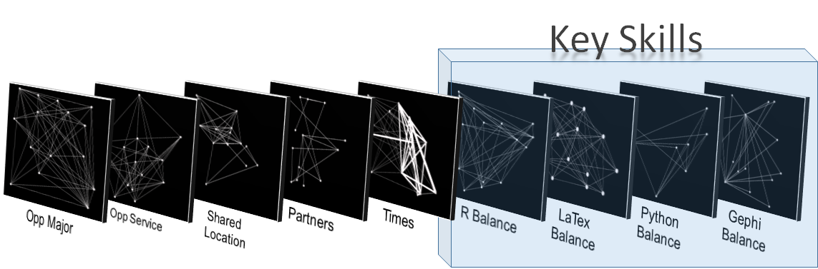
Conclusion (page 2)
Instead of a ‘best’ community-detection algorithm to understand complex networks, focus on a careful treatment of what network aspects we seek to understand when applying community detection.
LTC Miske, MAJ LaBorde, MAJ Willis, & MAJ Wren, 2021

Slide 39
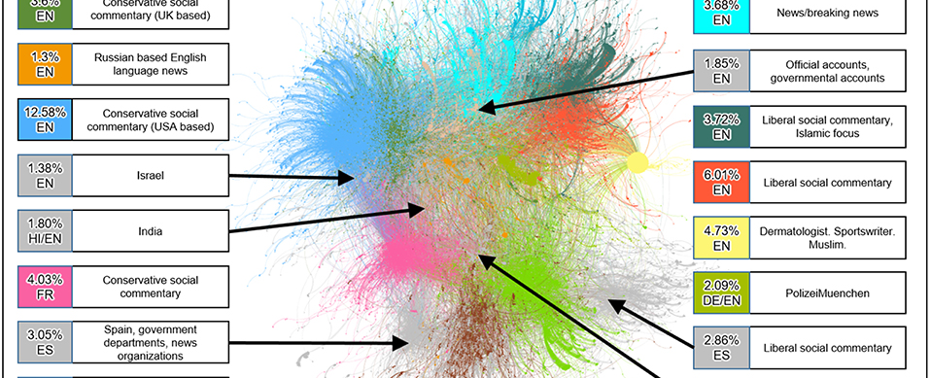
Code for community analysis
Python with NetworkX: Community library
Matlab: http://commdetect.weebly.com/
R: http://infernusweb.altervista.org/wp/?p=1479
Gephi:DyCoNet
Girvan Newman’s method in Python and R
Create SBM in Python and R with igraph;
Python visualization libraries Bokeh and VisPy

Slide 40
Main References
“Statistical Properties of Community Structure in Large Social and Information Networks” by Jure Leskovec, Kevin J. Lang, Anirban Dasgupta, Michael W. Mahoney
Porter, Mason A., Jukka-Pekka Onnela, and Peter J. Mucha. "Communities in networks." Notices of the AMS 56.9 (2009): 1082-1097.
Conversations and PPT from Mason Porter, Oxford.
https://networkit.iti.kit.edu/
Vishwanathan, S. Vichy N., et al. "Graph Kernels" The Journal of Machine Learning Research 11 (2010): 1201-1242.
Fast computing random walk kernels: Borgwardt, Karsten M., Nicol N. Schraudolph, and S. V. N. Vishwanathan. "Fast computation of graph kernels." Advances in neural information processing systems. 2006.
An alternative to kernels using graphlets: Shervashidze, Nino, et al. "Efficient graphlet kernels for large graph comparison." International conference on artificial intelligence and statistics. 2009.
Karsten M. Borgwardt and Hans-Peter Kriege Shortest path kernels, IEEE International Conference on Data Mining (ICDM’05) 2005
Robustness in Modular structure
Relative centrality and local community

Slide 41
Main References
Kivelä, M., Arenas, A., Barthelemy, M., Gleeson, J.P., Moreno, Y. and Porter, M.A., 2014. Multilayer networks. Journal of complex networks, 2(3), pp.203-271.
Lucas G. S. Jeub, Prakash Balachandran, Mason A. Porter, Peter J. Mucha, and Michael W. Mahoney, “Think locally, act locally: Detection of small, medium-sized, and large communities in large networks” PHYSICAL REVIEW E 91, 012821 (2015)
J. Leskovec, K. J. Lang, A. Dasgupta, and M. W. Mahoney, Internet Math. 6, 29 (2009).
M. E. Newman “Finding community structure in networks using the eigenvectors of matrices” PHYSICAL REVIEW E 74, 036104 (2006)
Aggarwal, Charu C., and Haixun Wang. "Graph data management and mining: A survey of algorithms and applications." Managing and Mining Graph Data. Springer US, 2010. 13-68.
Malliaros, Fragkiskos D., and Michalis Vazirgiannis. "Clustering and community detection in directed networks: A survey." Physics Reports 533.4 (2013): 95-142.
Social Media: http://link.springer.com/article/10.1007/s10618-011-0224-z#page-1
Graph mining and management (clustering networks):Aggarwal, Charu C., and Haixun Wang. "Graph data management and mining: A survey of algorithms and applications." Managing and Mining Graph Data. Springer US, 2010. 13-68.
Encyclopedia of Distances

