Slide 1
Prof. Ralucca Gera, rgera@nps.edu
Applied Mathematics Department, Naval Postgraduate School
Excellence Through Knowledge
MA4404 Complex Networks
Groups of vertices and Core-periphery structure

Slide 2
Learning Outcomes
Understand and contrast the different k-clique relaxation definitions:
k-dense
k-core
k-plex
Contrast macro-scale to meso-scale to micro-scale structure analysis.
Determine which nodes are part of a densely connected core and which are part of a sparsely connected periphery:
A node belongs to a core if and only if it is well connected both to other core nodes and to peripheral nodes

Slide 3
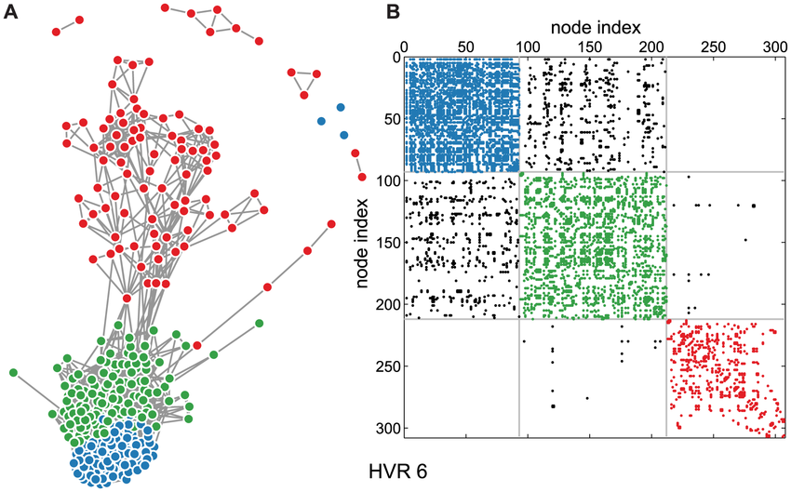
Why?
Most observed real networks have:
Heavy tail (powerlaw, exponential)
High clustering (high number of triangles especially in social networks, lower count otherwise)
Small average path (usually small diameter)
Communities/periphery/hierarchy
Homophily and assortative mixing (similar nodes tend to be adjacent)
Where does the structure come from? How do we model it?

Slide 4
Macro and Meso Scale properties
Macro Scale properties (using all the interactions):
Small world (small average path, high clustering)
Powerlaw degree distr. (generally pref. attachment)
Meso Scale properties applying to groups (using k-clique, k-core, k-dense):
Community structure
Core-periphery structure
Micro Scale properties applying to small units:
Edge properties (such as who it connects, being a bridge)
Node properties (such as degree, cut-vertex)
Notes:
Core structure in a network is thus not merely densely connected but also tends to be “central” to the network(e.g.,in terms of short paths through the network)

Slide 5
Some local and global metrics pertaining to structure of networks
Structure they capture | Local Statistics | Global statistics
Direct influence General feel for the distribution of the edges | Vertex degree, in and out degree | Degree distribution
Closeness, distance between nodes | Geodesic (shortest path between two nodes) Distance (numerical value – length of a geodesic) | Diameter, radius, average path length
Connectedness of the network How critical are vertices to the connectedness of the graph? How much damage can a network take before disconnecting? | Existence of a bridge (cut-edge) Existence of a cut vertex | Vertex cut Edge cut
Tight node/edge neighborhoods, important nodes as a group | Clique, plex, core, community, k-dense (for edges) | Community detection Core-periphery structure

Slide 6
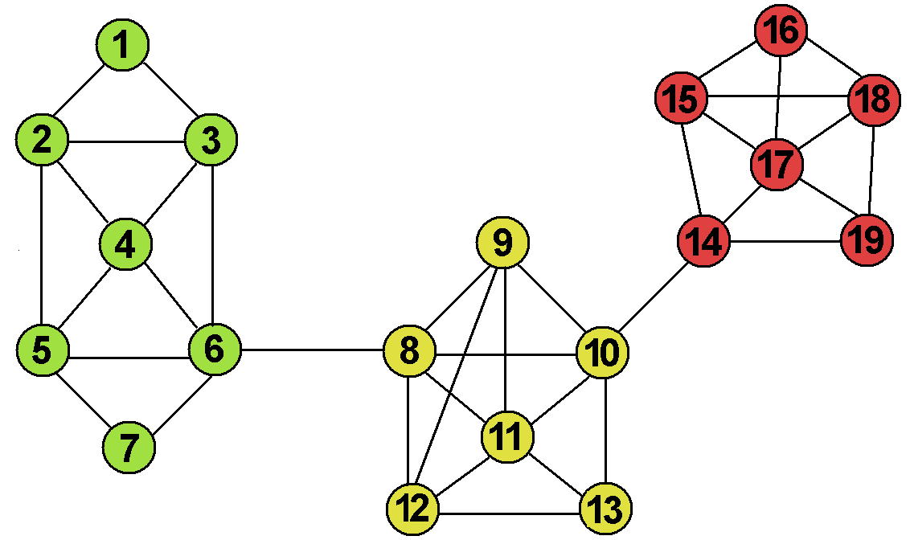
Groups and subgroups identifications
Some common approaches to subgroup identification and analysis:
K-cliques
K-cores (k-shell)
K-denseness
Components
Community detection
Communities are used to explore how large networks can be built up out of small and tight groups.
Core structure in a network is thus not merely densely connected but also tends to be “central” to the network(e.g.,in terms of short paths through the network)
0 | 1 | 1 | 0 | 0 | 0 | 0 | 0 | 0 | 0 | 0 | 0 | 0 | 0 | 0 | 0 | 0 | 0 | 0
1 | 0 | 1 | 1 | 0 | 0 | 0 | 0 | 0 | 0 | 0 | 0 | 0 | 0 | 0 | 0 | 0 | 0 | 0
1 | 1 | 0 | 1 | 0 | 1 | 0 | 0 | 0 | 0 | 0 | 0 | 0 | 0 | 0 | 0 | 0 | 0 | 0
0 | 1 | 1 | 0 | 1 | 1 | 0 | 0 | 0 | 0 | 0 | 0 | 0 | 0 | 0 | 0 | 0 | 0 | 0
0 | 1 | 0 | 0 | 0 | 1 | 1 | 0 | 0 | 0 | 0 | 0 | 0 | 0 | 0 | 0 | 0 | 0 | 0
0 | 0 | 1 | 1 | 1 | 0 | 1 | 1 | 0 | 0 | 0 | 0 | 0 | 0 | 0 | 0 | 0 | 0 | 0
0 | 0 | 0 | 0 | 1 | 1 | 0 | 0 | 0 | 0 | 0 | 0 | 0 | 0 | 0 | 0 | 0 | 0 | 0
0 | 0 | 0 | 0 | 0 | 1 | 0 | 0 | 1 | 1 | 1 | 1 | 0 | 0 | 0 | 0 | 0 | 0 | 0
0 | 0 | 0 | 0 | 0 | 0 | 0 | 1 | 0 | 1 | 1 | 1 | 0 | 0 | 0 | 0 | 0 | 0 | 0
0 | 0 | 0 | 0 | 0 | 0 | 0 | 1 | 1 | 0 | 1 | 0 | 1 | 1 | 0 | 0 | 0 | 0 | 0
0 | 0 | 0 | 0 | 0 | 0 | 0 | 1 | 1 | 1 | 0 | 1 | 1 | 0 | 0 | 0 | 0 | 0 | 0
0 | 0 | 0 | 0 | 0 | 0 | 0 | 1 | 1 | 0 | 1 | 0 | 1 | 0 | 0 | 0 | 0 | 0 | 0
0 | 0 | 0 | 0 | 0 | 0 | 0 | 0 | 0 | 1 | 1 | 1 | 0 | 0 | 0 | 0 | 0 | 0 | 0
0 | 0 | 0 | 0 | 0 | 0 | 0 | 0 | 0 | 1 | 0 | 0 | 0 | 0 | 1 | 0 | 1 | 0 | 1
0 | 0 | 0 | 0 | 0 | 0 | 0 | 0 | 0 | 0 | 0 | 0 | 0 | 1 | 0 | 1 | 1 | 1 | 0
0 | 0 | 0 | 0 | 0 | 0 | 0 | 0 | 0 | 0 | 0 | 0 | 0 | 0 | 1 | 0 | 1 | 1 | 0
0 | 0 | 0 | 0 | 0 | 0 | 0 | 0 | 0 | 0 | 0 | 0 | 0 | 1 | 1 | 1 | 0 | 1 | 1
0 | 0 | 0 | 0 | 0 | 0 | 0 | 0 | 0 | 0 | 0 | 0 | 0 | 0 | 1 | 1 | 1 | 0 | 1
0 | 0 | 0 | 0 | 0 | 0 | 0 | 0 | 0 | 0 | 0 | 0 | 0 | 1 | 0 | 0 | 1 | 1 | 0
Source: Guido Caldarelli, Communities and Clustering in Some social Networks, NetSci 2007 New York, May 20th 2007

Slide 7
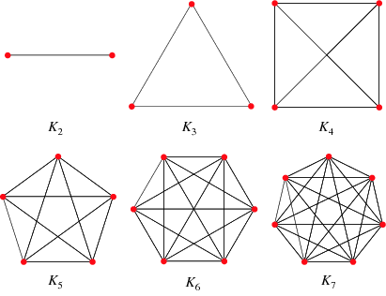
k-clique
Notes:
https://www.researchgate.net/figure/a-k-core-decomposition-illustrative-example-Note-that-while-nodes-and-have-same_fig2_311990870

Slide 8
k-clique
A clique of size $k$: a complete subgraph on $k$ nodes (i.e. s subset $S$ of $k$nodes such that $\deg_{G[S]}{v=k−1}$).
We usually search for the maximum cliques, or the node count in a maximum cliques (the clique number).
Is it realistic and useful in large graphs?
Why is it hard to use this concept on real networks?
Because one might not infer/know all the edges of the true network, so clique may exist but it may not be captured in the data to be analyzed
Hard to find the largest clique in the network (decision problem for the clique number is NP-Complete)
A relaxed version of a clique might be just as useful in large networks.

Slide 9
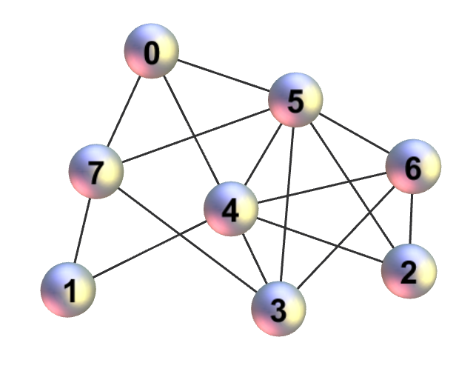
In class exercise
A clique of size $k$: a complete subgraph on $k$ nodes (i.e. s subset $S$ of $k$nodes such that $\deg_{G[S]}{v=k−1}$).
Identify a:
1-clique
2-clique
3-clique
4-clique
Relaxed versions of a $k$-clique are $k$-dense and $k$-core

Slide 10
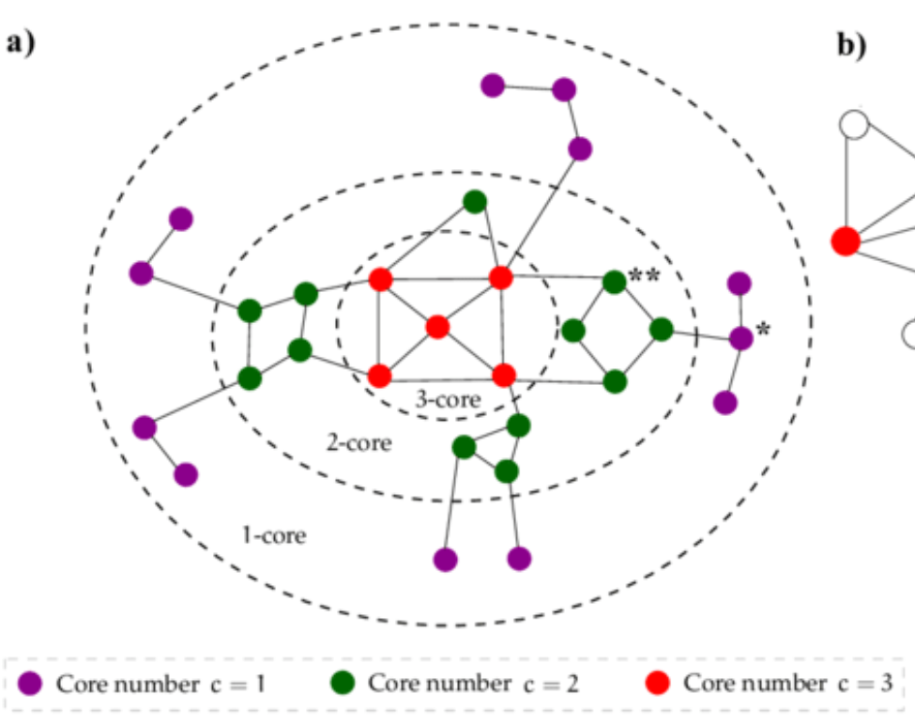
k-core

Slide 11
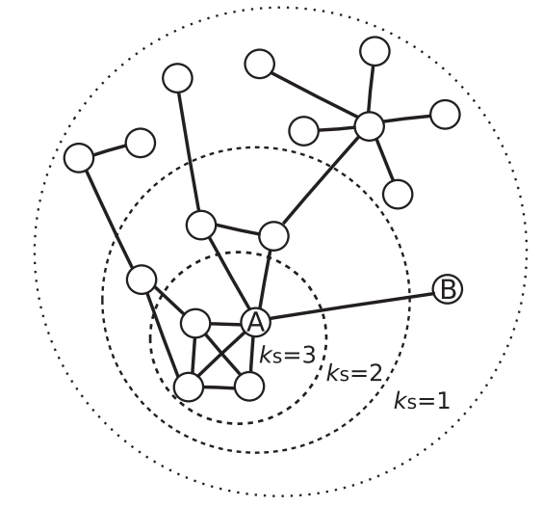
k-core
A $k$-core of size n: maximal subset of $α$ nodes ($α≥k+1$), each with $\deg_{G[S]}{v ≥k}$, where $G[S]$ is the subgraph induced by $S$
Idea for a $k$-core: enough edges are present between the group of $α$nodes to make a group strong even if it is not a clique.
Algorithm for finding the core:
eliminate lower order $k$-cores
the k-core is subgraph of nodes associated with the highest $k$ value
http://iopscience.iop.org/article/10.1088/1367-2630/14/8/083030

Slide 12
In-class exercise
A $k$-core of size n: maximal subset of $α≥k+1$ nodes, each with $\deg_{G[S]}{v ≥k}$, where $G[S]$ is the subgraph induced by $S$
Identify the:
1-core
2-core
3-core
4-core
the core.

Slide 13
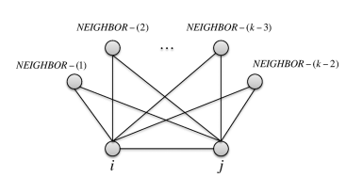
k-dense

Slide 14
k-dense
A k- dense sub-graph is a group of some $α$ vertices ($α≥k$ ), in which each pair of vertices {i, j} has at least $k$-2 common neighbors.
Idea: a relaxed $k$clique ($k$–dense looks at neighbors of edges/friendships rather than vertices, in making the $α$ nodes part of the $α$group)

Slide 15
In class exercise
A k- dense sub-graph is a group of some $α≥k$ vertices, in which each pair of vertices {i, j} has at least $k$-2 common neighbors.
Identify a:
2-dense
3-dense
4-dense
5-dense

Slide 16
k-dense
A k- dense sub-graph is a group of some $α≥k$ vertices, in which each pair of vertices {i, j} has at least $k$-2 common neighbors.
k - clique $⊂$ k - dense $⊂$ k-1 – core

Slide 17
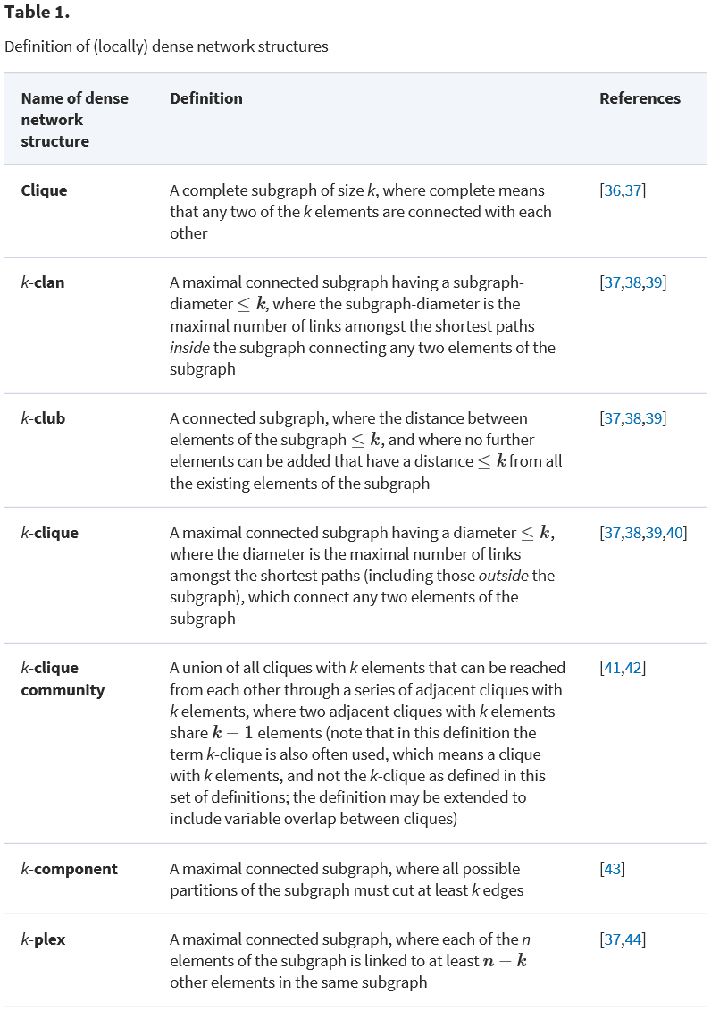
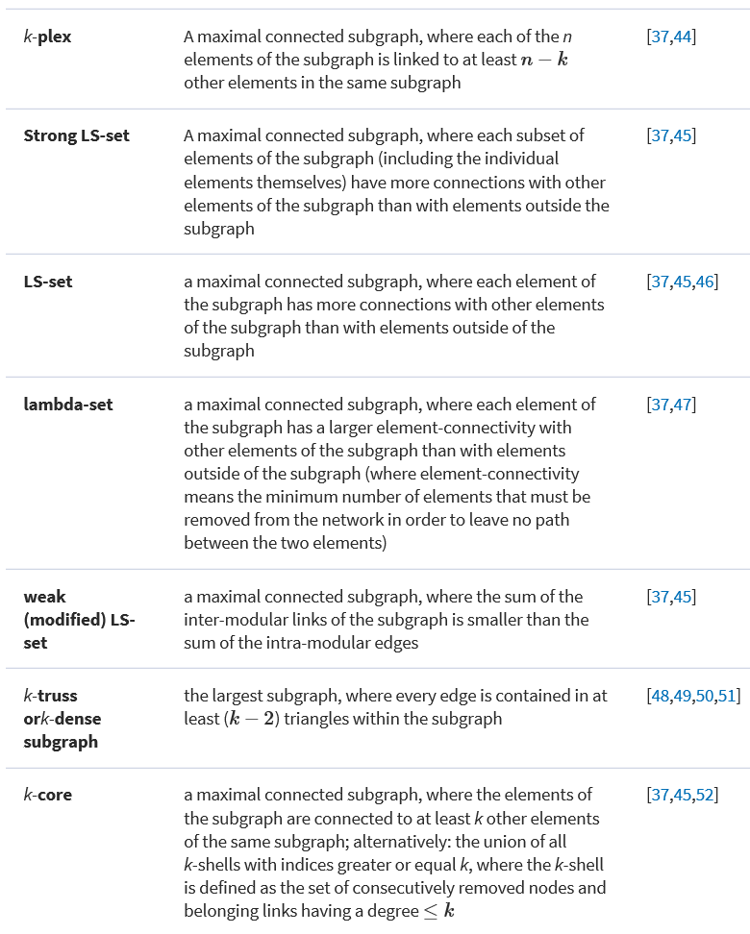
Other extensions
https://academic.oup.com/comnet/article/doi/10.1093/comnet/cnt016/2392115/Structure-and-dynamics-of-core-periphery-networks

Slide 18
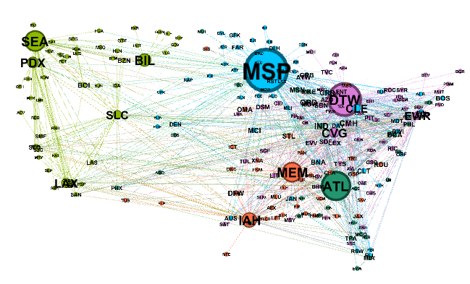
Using them globally

Slide 19
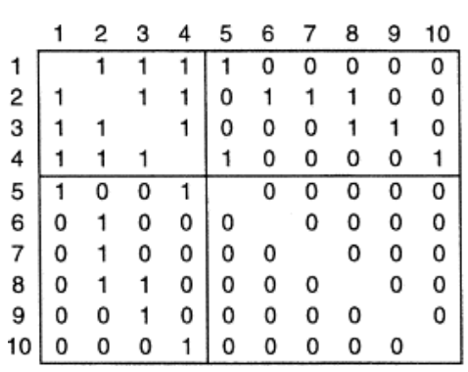
Communities vs. core/dense/clique
A clique of size $k$: a complete subgraph on $k$ nodes (i.e. s subset $S$ of $k$nodes such that $\deg_{G[S]}{v=k−1}$).
A $k$-core of size n: maximal subset of $α≥k+1$ nodes, each with $\deg_{G[S]}{v ≥k}$, where $G[S]$ is the subgraph induced by $S$
A k- dense sub-graph is a group of some $α≥k$ vertices, in which each pair of vertices {i, j} has at least $k$-2 common neighbors.
K-core/dense/clique: look at the connections inside the group of nodes
Communities look both at internal and external ties (high internal and low external ties)
Core-periphery decomposition is also looking at internal and external to the core (doesn’t have to be a k-core)

Slide 20
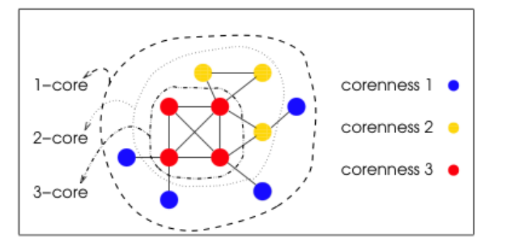
K-core (k-shell) decomposition
The decomposition identifies the shells for different k-values.
Generally (but not well defined): the core of the network (the $k$-core for the largest $k$) and the outer periphery (last layer: 1-core taking away the 2-core). There are modifications where several top values of $k$ make the core.
http://3.bp.blogspot.com/-TIjz3nstWD0/ToGwUGivEjI/AAAAAAAAsWw/etkwklnPNw4/s1600/k-cores.png

Slide 21
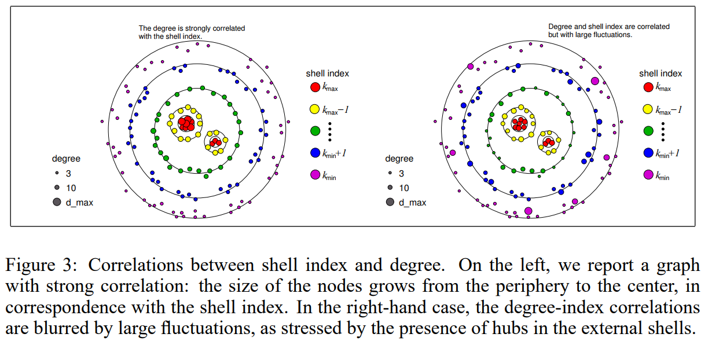
The shells in the k-core and degree
http://papers.nips.cc/paper/2789-large-scale-networks-fingerprinting-and-visualization-using-the-k-core-decomposition.pdf

Slide 22
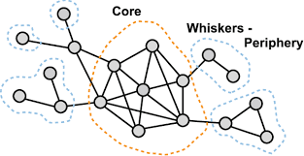
Core-periphery

Slide 23
Core-periphery adjacency matrix
https://www.researchgate.net/figure/Stochastic-block-modeling-identifies-network-communities-HVR-6-is-shown-in-two-forms_fig7_257839768

Slide 24
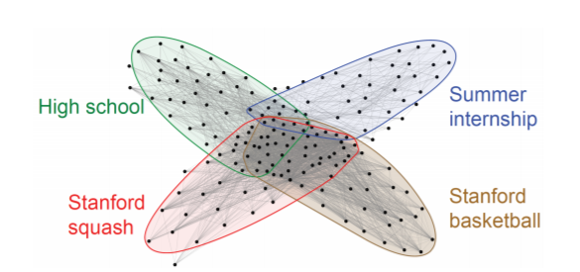
Core-periphery decomposition
The core-periphery decomposition captures the notion that many networks decompose into:
a densely connected core, and
a sparsely connected periphery (see Ref [6] & [12]).
The core-periphery structure is a pervasive and crucial characteristic of large networks [13], [14], [15].
If overlapping communities are considered: the network core forms as a result of many overlapping communities
http://ilpubs.stanford.edu:8090/1103/2/paper-IEEE-full.pdf

Slide 25
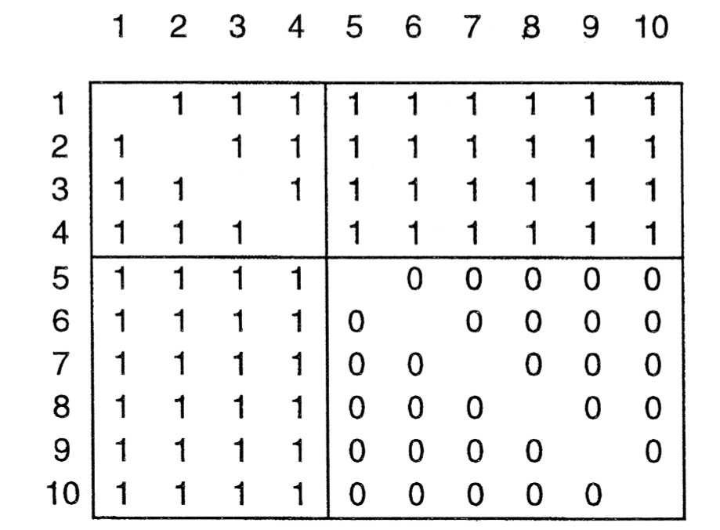
Measuring core-periphery
Not standardized, but generally the density of the $k$-core must be high, checked against the ideal matrix for core-periphery. This is computer by the correlation, $ρ$, defined as $ρ=\sum_{i,j}{a_{ij}δ_{ij}},$
where $a_{ij}$ is the (i,j) adjacency matrix entry of the network, and $$δ_{ij}=\left\{\begin{aligned}1, if either node i or j is in the core \\ 0, otherwise \end{aligned}\right.$$
The
ideal
core-periphery
matrix
http://www.sciencedirect.com/science/article/pii/S0378873399000192

Slide 26
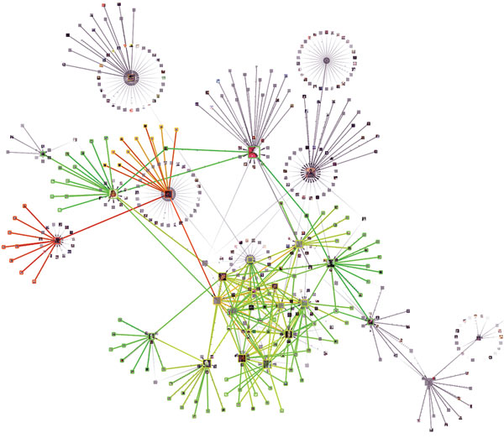
Extensions of core-periphery?!
Limitation:
There are just two classes of nodes: core and periphery.
Is a three-class partition consisting of core, semi-periphery, and periphery more realistic?
Or even partitioning with more classes?
The problem becomes more difficult as the number of classes is increased, and good justification is needed.
http://www.sciencedirect.com/science/article/pii/S0378873399000192

Slide 27
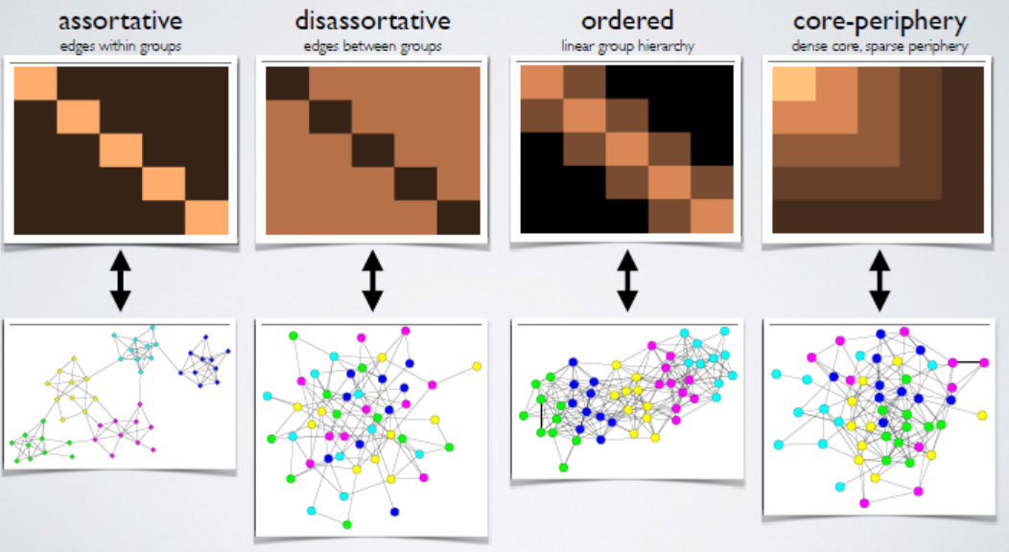
Possible structures
dark shade = 0 (nonadjacent)
light shade = 1 (adjacent)
From Aaron Clauset and Mason Porter

Slide 28
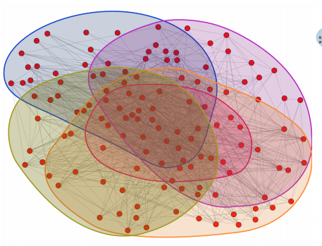
Core and communities
The network core was traditionally viewed as a single giant community (lacking internal communities, see references [7], [8], [9], [10]).
Yang and Leskovec (2014, reference [11]) showed that dense cores form as a result of many overlapping communities.
General observations:
foodweb, social, and web networks exhibit a single dominant core, while
protein-protein interaction and product co-purchasing networks contain many local cores formed around the central core
http://ilpubs.stanford.edu:8090/1103/2/paper-IEEE-full.pdf

Slide 29
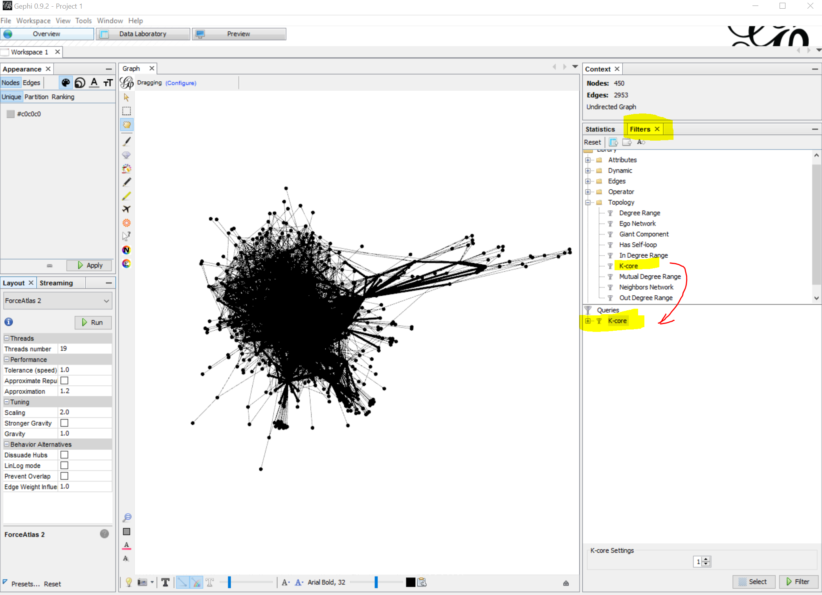
Finding the Core in Gephi
Under “Statistics” run “average degree” and then use “Filters”

Slide 30
1-core

Slide 31
4-core

Slide 32
Bring back the whole network

Slide 33
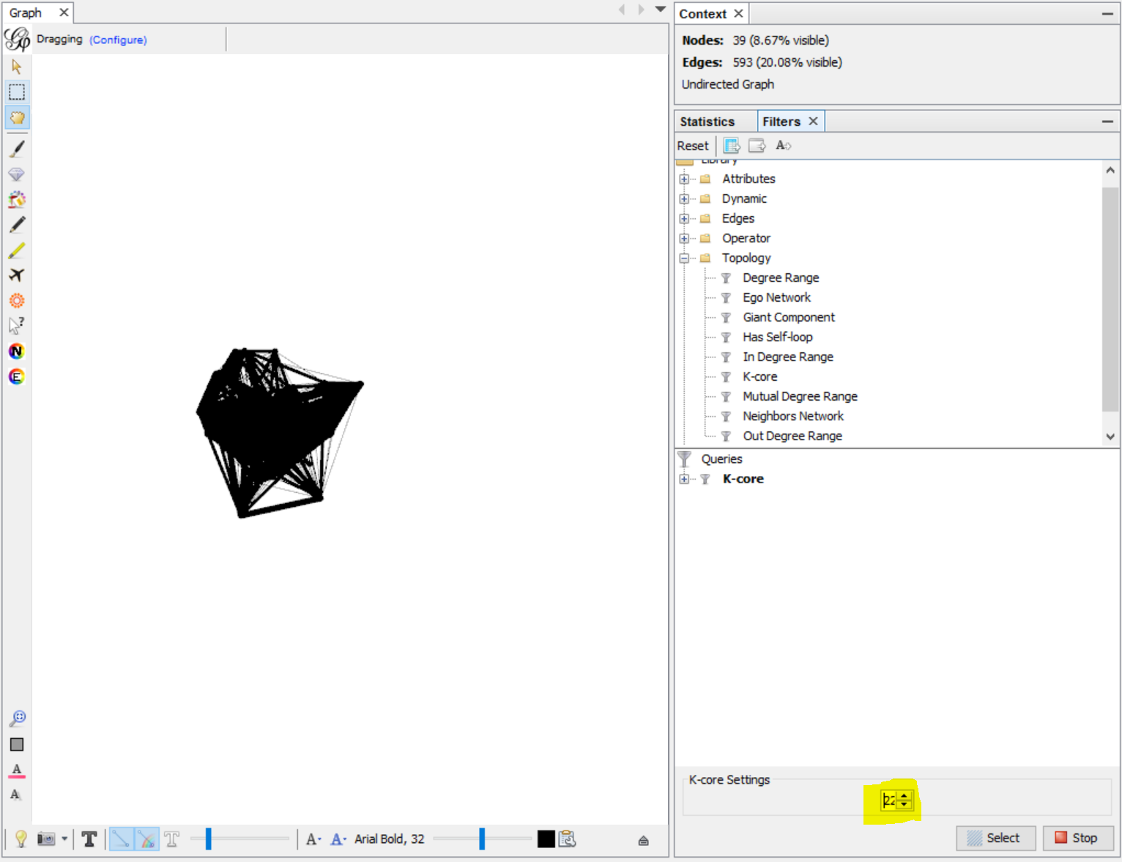
The core of the network
For this network the core is the 22-core, since the 23-core vanishes

Slide 34
Let’s practice in Gephi!

Slide 35
Main References
M. E. Newman, Analysis of weighted networks Physical Review E, vol. 70, no. 5, 2004.
Borgatti, Stephen P., and Martin G. Everett. "Models of core/periphery structures“ Social networks 21.4 (2000): 375-395.
Csermely, Peter, et al. "Structure and dynamics of core/periphery networks.“ Journal of Complex Networks 1.2 (2013): 93-123.
Kitsak, Maksim, et al. "Identification of influential spreaders in complex networks." Nature Physics 6.11 (2010): 888-893
S. B. Seidman, Network structure and minimum degree, Social networks, vol. 5, no. 3, pp. 269287, 1983
Borgatti, Stephen P., and Martin G. Everett. "Models of core/periphery structures." Social networks 21.4 (2000): 375-395.
J. Leskovec, K. J. Lang, A. Dasgupta, and M. W. Mahoney, “Community structure in large networks: Natural cluster sizes and the absence of large well-defined clusters,” Internet Mathematics, vol. 6, no. 1, pp. 29–123, 2009.
A. Clauset, M. Newman, and C. Moore, “Finding community structure in very large networks,” Physical Review E, vol. 70, p. 066111, 2004.
M. Coscia, G. Rossetti, F. Giannotti, and D. Pedreschi, “Demon: a local-first discovery method for overlapping communities,” in Proceedings of the ACM SIGKDD International Conference on Knowledge Discovery and Data Mining (KDD), 2012, pp. 615–623.
J. Leskovec, K. Lang, and M. Mahoney, “Empirical comparison of algorithms for network community detection,” in Proceedings of the International Conference on World Wide Web (WWW), 2010
Jaewon Yang and Jure Leskovec. “Overlapping Communities Explain Core-Periphery Organization of Networks” Proceedings of the IEEE (2014)
P. Holme, “Core-periphery organization of complex networks,” Physical Review E, vol. 72, p. 046111, 2005.
F. D. Rossa, F. Dercole, and C. Piccardi, “Profiling coreperiphery network structure by random walkers,” Scientific Reports, vol. 3, 2013.
J. Leskovec, K. J. Lang, A. Dasgupta, and M. W. Mahoney, “Community structure in large networks: Natural cluster sizes and the absence of large well-defined clusters,” Internet Mathematics, vol. 6, no. 1, pp. 29–123, 2009.
M. P. Rombach, M. A. Porter, J. H. Fowler, and P. J. Mucha, “Core-periphery structure in networks,” SIAM Journal of Applied Mathematics, vol. 74, no. 1, pp. 167–190, 2014

