Slide 1
Prof. Ralucca Gera, rgera@nps.edu
Applied Mathematics Department,
Naval Postgraduate School
Excellence Through Knowledge
MA4404 Complex Networks
Eigenvector Centrality

Slide 2
Learning Outcomes
Compute eigenvector centrality.
Interpret the meaning of the values of eigenvector centrality.
Explain why the eigenvector centrality is an extension of degree centrality.

Slide 3
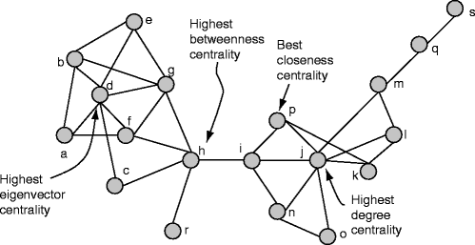
MA4404: Centralities categories
Adjacencies
Distances
Degree
Closeness
Eigenvector
Betweenness
Katz
HITS
PageRank
Discovering Sets of Key Players in Social Networks | SpringerLink

Slide 4
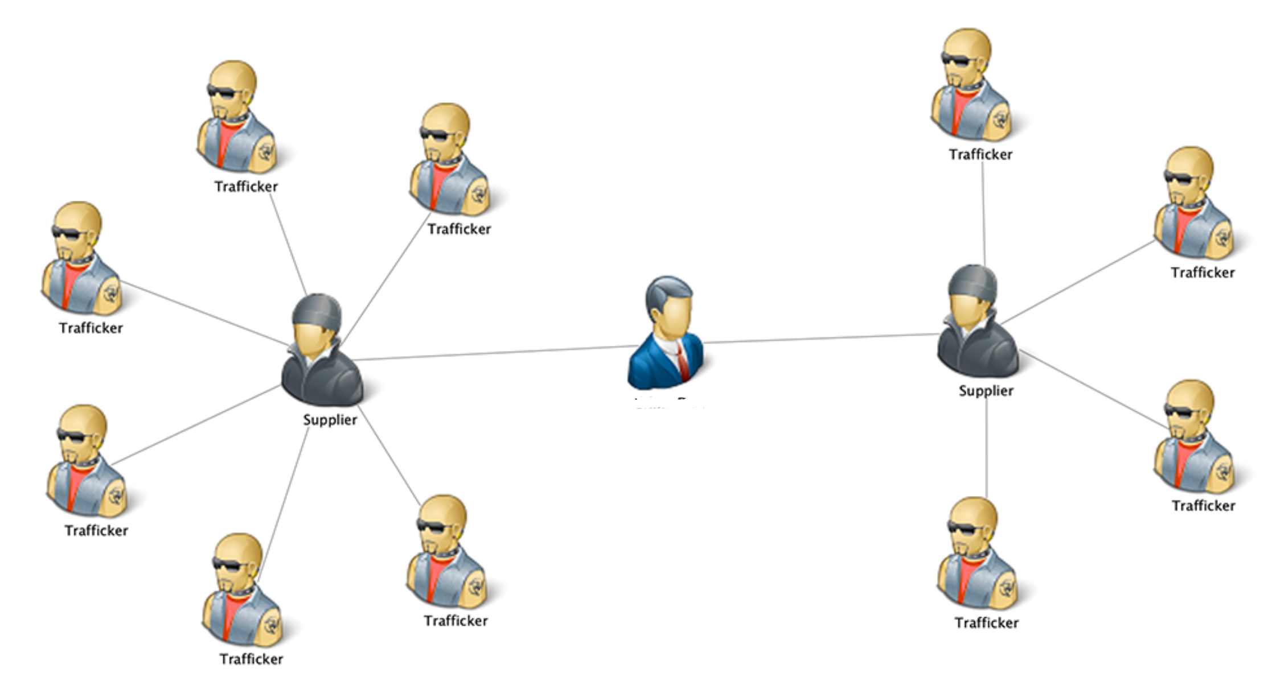
Eigenvector Centrality

Slide 5
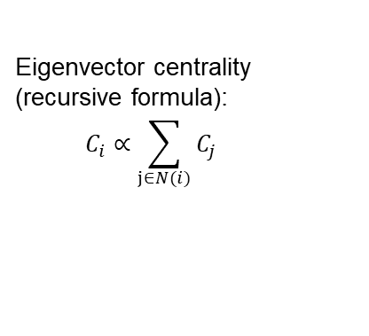
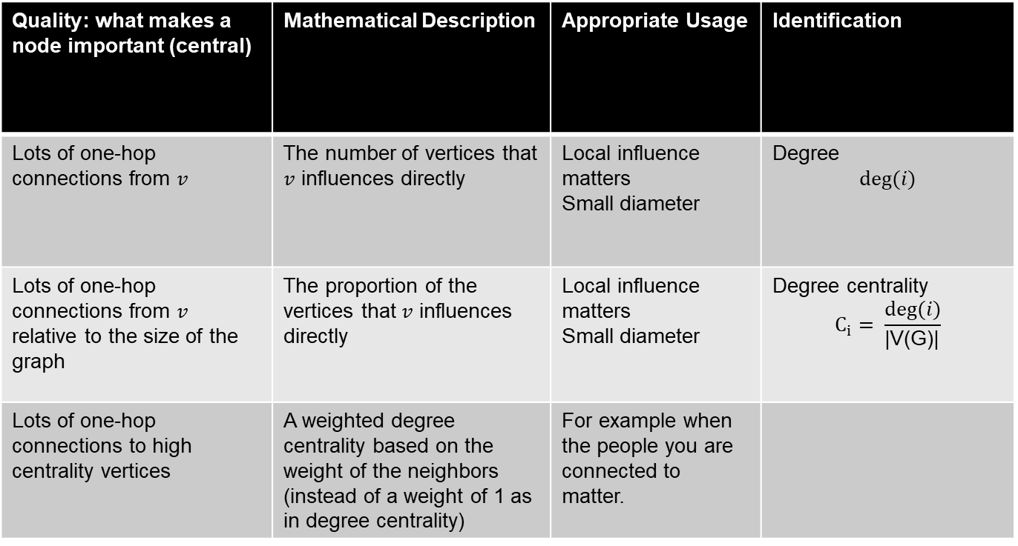
Recall:
Quality: what makes a node important (central) | Mathematical Description | Appropriate Usage | Identification
Lots of one-hop connections from $v$ | The number of vertices that $v$ influences directly | Local influence matters Small diameter | Degree $$deg⁡(i)$$
Lots of one-hop connections from $v$ relative to the size of the graph | The proportion of the vertices that $v$ influences directly | Local influence matters Small diameter | Degree centrality $$C_{i}= \frac{deg⁡(i)}{\text{|}\text{V}\text{(}\text{G}\text{)|}}$$
Lots of one-hop connections to high centrality vertices | A weighted degree centrality based on the weight of the neighbors (instead of a weight of 1 as in degree centrality) | For example when the people you are connected to matter.
HOW?
Eigenvector centrality
(recursive formula):
$$C_{i}∝\sum_{j∈N(i)}{C_{j}}$$

Slide 6
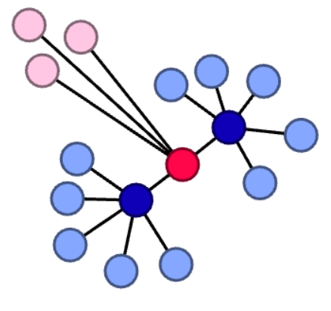
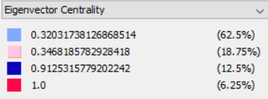
Eigenvector Centrality
A generalization of the degree centrality:
a weighted degree vector that depends on the centrality of its neighbors (rather than every neighbor having a fixed centrality of 1)
How do we find it? By finding the largest eigenvalue and its associated eigenvector (leading eigenvector) of the adjacency matrix
Let’s see why

Slide 7
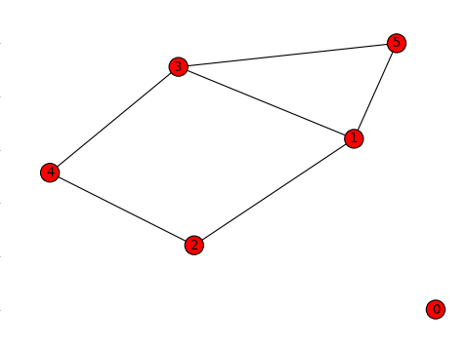

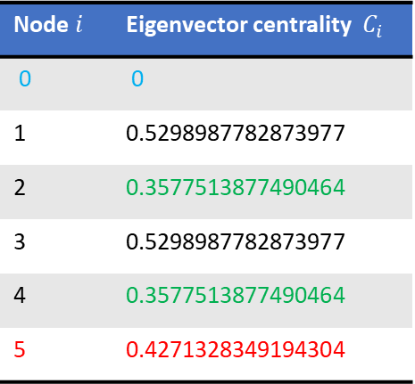
Example 1 (Eigenvector centrality)
Node $i$ | Eigenvector centrality $C_{i}$
0 | 0
1 | 0.5298987782873977
2 | 0.3577513877490464
3 | 0.5298987782873977
4 | 0.3577513877490464
5 | 0.4271328349194304
Notice that deg(5) =deg (1) = deg(3).
Why $C_{5}>C_{2}$ and $C_{5}>C_{4}$ ?

Slide 8
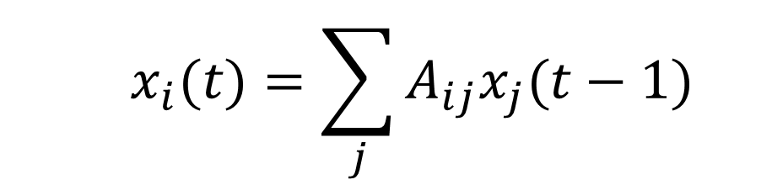

Computing
Eigenvector
Centrality
  $$x_{i}(t)=\sum_{j}{A_{ij}x_{j}(t−1)}$$
  with the centrality at time t=0 being $x_{j}\left(0\right)=1, ∀j$
Notes:
https://www.researchgate.net/figure/a-k-core-decomposition-illustrative-example-Note-that-while-nodes-and-have-same_fig2_311990870

Slide 9
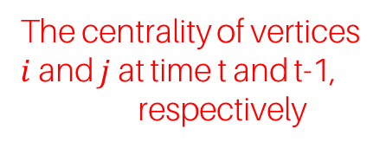
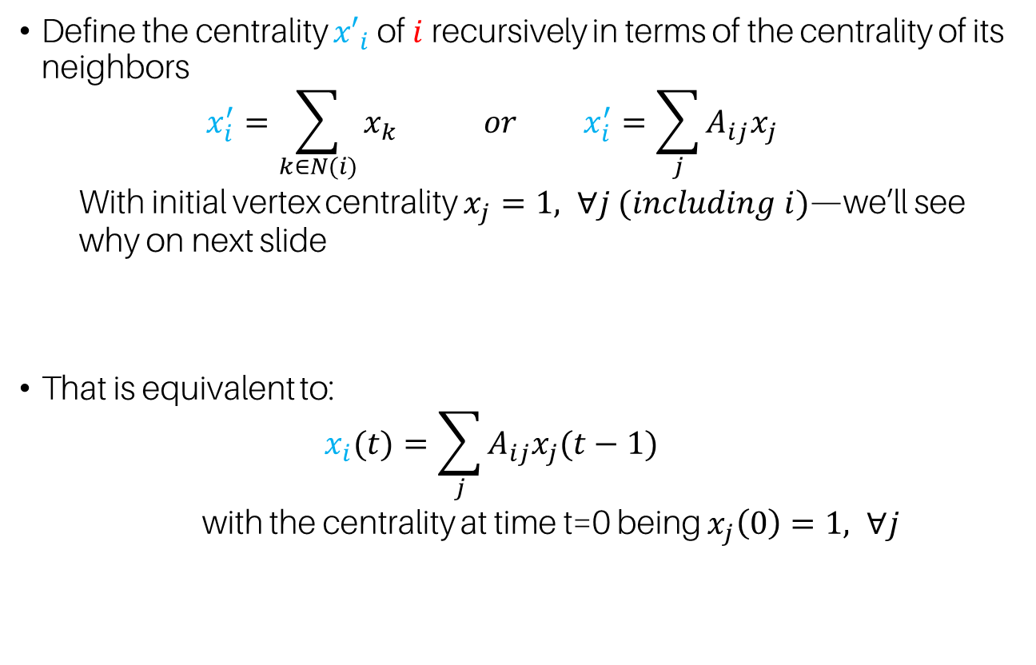
Eigenvector Centrality
Define the centrality ${x′}_{i}$ of $i$recursively in terms of the centrality of its neighbors
  $$x_{i}^{′}=\sum_{k∈N(i)}{x_{k}} or x_{i}^{′}=\sum_{j}{A_{ij}x_{j}}$$
  With initial vertex centrality $x_{j}=1, ∀j (including i)$—we’ll see why on next slide
That is equivalent to:
  $$x_{i}(t)=\sum_{j}{A_{ij}x_{j}(t−1)}$$
  with the centrality at time t=0 being $x_{j}\left(0\right)=1, ∀j$
The centrality of vertices
$i$ and $j$ at time t and t-1,
respectively

Slide 10
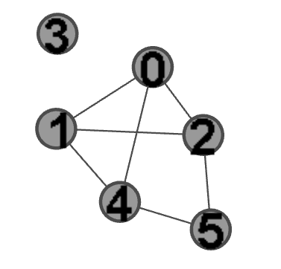

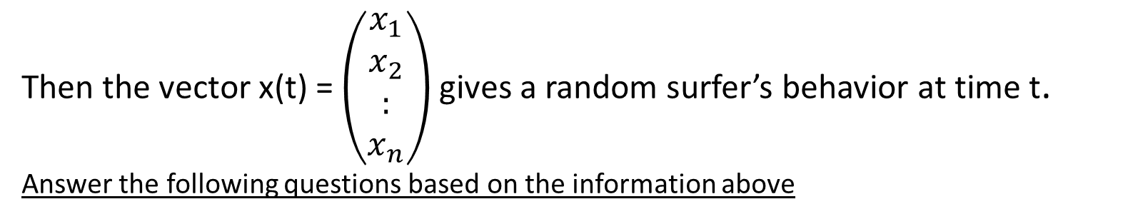
In class: Eigenvector Centrality
Adjacency matrix A for the graph to the right:
A= $\left(\begin{aligned}\begin{matrix}0 & 1 & 1 \\ 1 & 0 & 1 \\ 1 & 1 & 0\end{matrix} \begin{matrix}0 & 1 & 0 \\ 0 & 1 & 0 \\ 0 & 0 & 1\end{matrix} \\ \begin{matrix}0 & 0 & 0 \\ 1 & 1 & 0 \\ 0 & 0 & 1\end{matrix} \begin{matrix}0 & 0 & 0 \\ 0 & 0 & 1 \\ 0 & 1 & 0\end{matrix}\end{aligned}\right)$
Then the vector x(t) = $\left(\begin{aligned}x_{1} \\ x_{2} \\ : \\ x_{n}\end{aligned}\right)$ gives a random surfer’s behavior at time t. Answer the following questions based on the information above

Slide 11

In class activity: Eigenvector Centrality
Q1: Find x(1). What does it represent?
Answer: $x(1)=\left(\begin{aligned}\begin{matrix}0 & 1 & 1 \\ 1 & 0 & 1 \\ 1 & 1 & 0\end{matrix} \begin{matrix}0 & 1 & 0 \\ 0 & 1 & 0 \\ 0 & 0 & 1\end{matrix} \\ \begin{matrix}0 & 0 & 0 \\ 1 & 1 & 0 \\ 0 & 0 & 1\end{matrix} \begin{matrix}0 & 0 & 0 \\ 0 & 0 & 1 \\ 0 & 1 & 0\end{matrix}\end{aligned}\right)\left(\begin{matrix}\begin{aligned}1 \\ 1 \\ 1 \\ 1 \\ 1\end{aligned} \\ 1\end{matrix}\right)$=$\left(?\right)$

Slide 12

In class activity: Eigenvector Centrality
Q1: Find x(1). What does it represent?
Answer: $x(1)=\left(\begin{aligned}\begin{matrix}0 & 1 & 1 \\ 1 & 0 & 1 \\ 1 & 1 & 0\end{matrix} \begin{matrix}0 & 1 & 0 \\ 0 & 1 & 0 \\ 0 & 0 & 1\end{matrix} \\ \begin{matrix}0 & 0 & 0 \\ 1 & 1 & 0 \\ 0 & 0 & 1\end{matrix} \begin{matrix}0 & 0 & 0 \\ 0 & 0 & 1 \\ 0 & 1 & 0\end{matrix}\end{aligned}\right)\left(\begin{matrix}\begin{aligned}1 \\ 1 \\ 1 \\ 1 \\ 1\end{aligned} \\ 1\end{matrix}\right)$= $\left(\begin{matrix}\begin{aligned}3 \\ 3 \\ 3 \\ 0 \\ 3\end{aligned} \\ 2\end{matrix}\right)$
The degree vector

Slide 13

In class activity: Eigenvector Centrality
Q2: Find x(2). What does it represent?
Answer: $x(2)=\left(\begin{aligned}\begin{matrix}0 & 1 & 1 \\ 1 & 0 & 1 \\ 1 & 1 & 0\end{matrix} \begin{matrix}0 & 1 & 0 \\ 0 & 1 & 0 \\ 0 & 0 & 1\end{matrix} \\ \begin{matrix}0 & 0 & 0 \\ 1 & 1 & 0 \\ 0 & 0 & 1\end{matrix} \begin{matrix}0 & 0 & 0 \\ 0 & 0 & 1 \\ 0 & 1 & 0\end{matrix}\end{aligned}\right)\left(\begin{matrix}\begin{aligned}3 \\ 3 \\ 3 \\ 0 \\ 3\end{aligned} \\ 2\end{matrix}\right)$= $\left(?\right)$

Slide 14
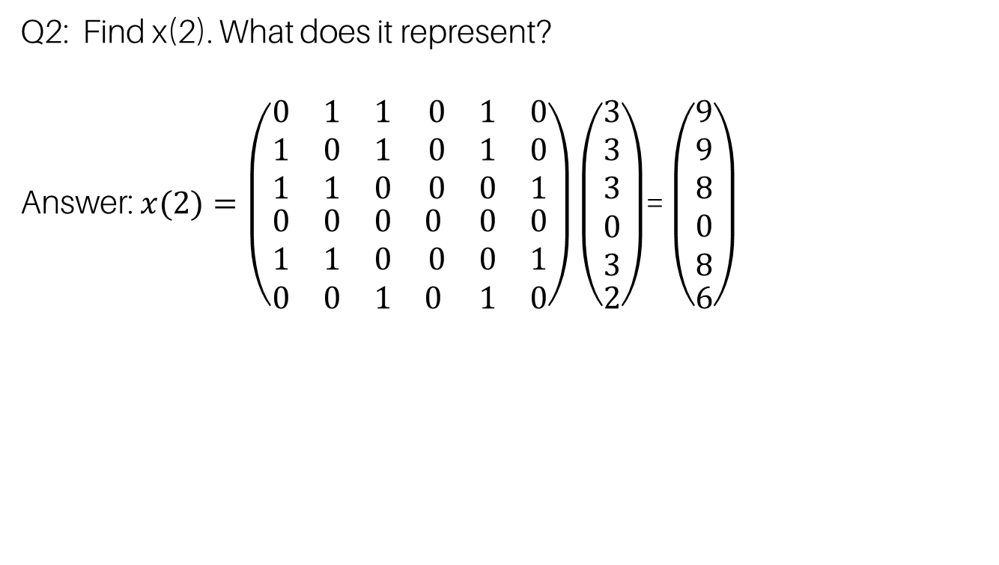
In class activity: Eigenvector Centrality
Q2: Find x(2). What does it represent?
Answer: $x(2)=\left(\begin{aligned}\begin{matrix}0 & 1 & 1 \\ 1 & 0 & 1 \\ 1 & 1 & 0\end{matrix} \begin{matrix}0 & 1 & 0 \\ 0 & 1 & 0 \\ 0 & 0 & 1\end{matrix} \\ \begin{matrix}0 & 0 & 0 \\ 1 & 1 & 0 \\ 0 & 0 & 1\end{matrix} \begin{matrix}0 & 0 & 0 \\ 0 & 0 & 1 \\ 0 & 1 & 0\end{matrix}\end{aligned}\right)\left(\begin{matrix}\begin{aligned}3 \\ 3 \\ 3 \\ 0 \\ 3\end{aligned} \\ 2\end{matrix}\right)$= $\left(\begin{matrix}\begin{aligned}9 \\ 9 \\ 8 \\ 0 \\ 8\end{aligned} \\ 6\end{matrix}\right)$
A weighted degree vector (distance 2 or less)

Slide 15

In class activity: Eigenvector Centrality
Q3: Find x(3). What does it represent?
Answer: $x(3)=\left(\begin{aligned}\begin{matrix}0 & 1 & 1 \\ 1 & 0 & 1 \\ 1 & 1 & 0\end{matrix} \begin{matrix}0 & 1 & 0 \\ 0 & 1 & 0 \\ 0 & 0 & 1\end{matrix} \\ \begin{matrix}0 & 0 & 0 \\ 1 & 1 & 0 \\ 0 & 0 & 1\end{matrix} \begin{matrix}0 & 0 & 0 \\ 0 & 0 & 1 \\ 0 & 1 & 0\end{matrix}\end{aligned}\right)\left(\begin{matrix}\begin{aligned}9 \\ 9 \\ 8 \\ 0 \\ 8\end{aligned} \\ 6\end{matrix}\right)$= $\left(?\right)$

Slide 16
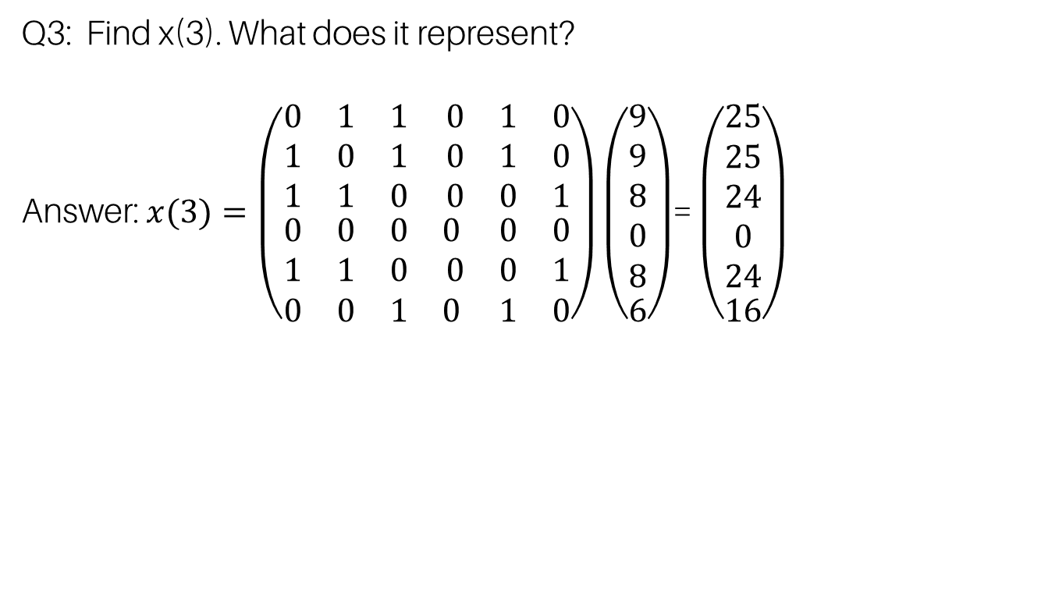
In class activity: Eigenvector Centrality
Q3: Find x(3). What does it represent?
Answer: $x(3)=\left(\begin{aligned}\begin{matrix}0 & 1 & 1 \\ 1 & 0 & 1 \\ 1 & 1 & 0\end{matrix} \begin{matrix}0 & 1 & 0 \\ 0 & 1 & 0 \\ 0 & 0 & 1\end{matrix} \\ \begin{matrix}0 & 0 & 0 \\ 1 & 1 & 0 \\ 0 & 0 & 1\end{matrix} \begin{matrix}0 & 0 & 0 \\ 0 & 0 & 1 \\ 0 & 1 & 0\end{matrix}\end{aligned}\right)\left(\begin{matrix}\begin{aligned}9 \\ 9 \\ 8 \\ 0 \\ 8\end{aligned} \\ 6\end{matrix}\right)$= $\left(\begin{matrix}\begin{aligned}25 \\ 25 \\ 24 \\ 0 \\ 24\end{aligned} \\ 16\end{matrix}\right)$
A weighted degree vector (distance 3 or less)

Slide 17
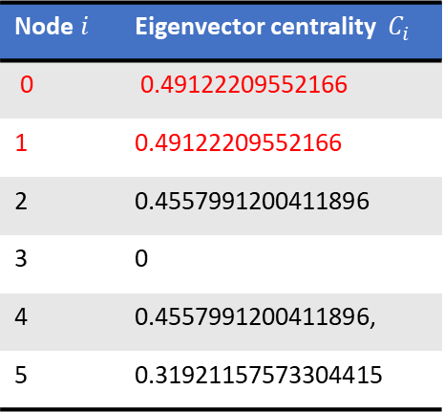
In class: Eigenvector Centrality Results
Node $i$ | Eigenvector centrality $C_{i}$
0 | 0.49122209552166
1 | 0.49122209552166
2 | 0.4557991200411896
3 | 0
4 | 0.4557991200411896,
5 | 0.31921157573304415
A normalized weighted degree vector

Slide 18
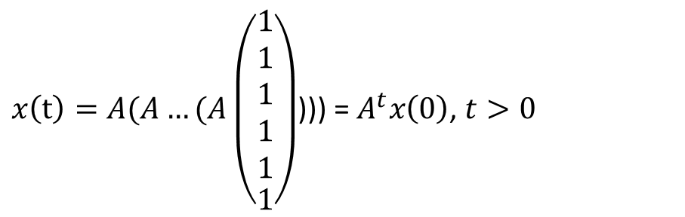
The derivation of eigenvector centrality
$x\left(t\right)=A(A…(A\left(\begin{matrix}\begin{aligned}1 \\ 1 \\ 1 \\ 1 \\ 1\end{aligned} \\ 1\end{matrix}\right)$))) = $A^{t}x\left(0\right)$, $t>0$

Slide 19
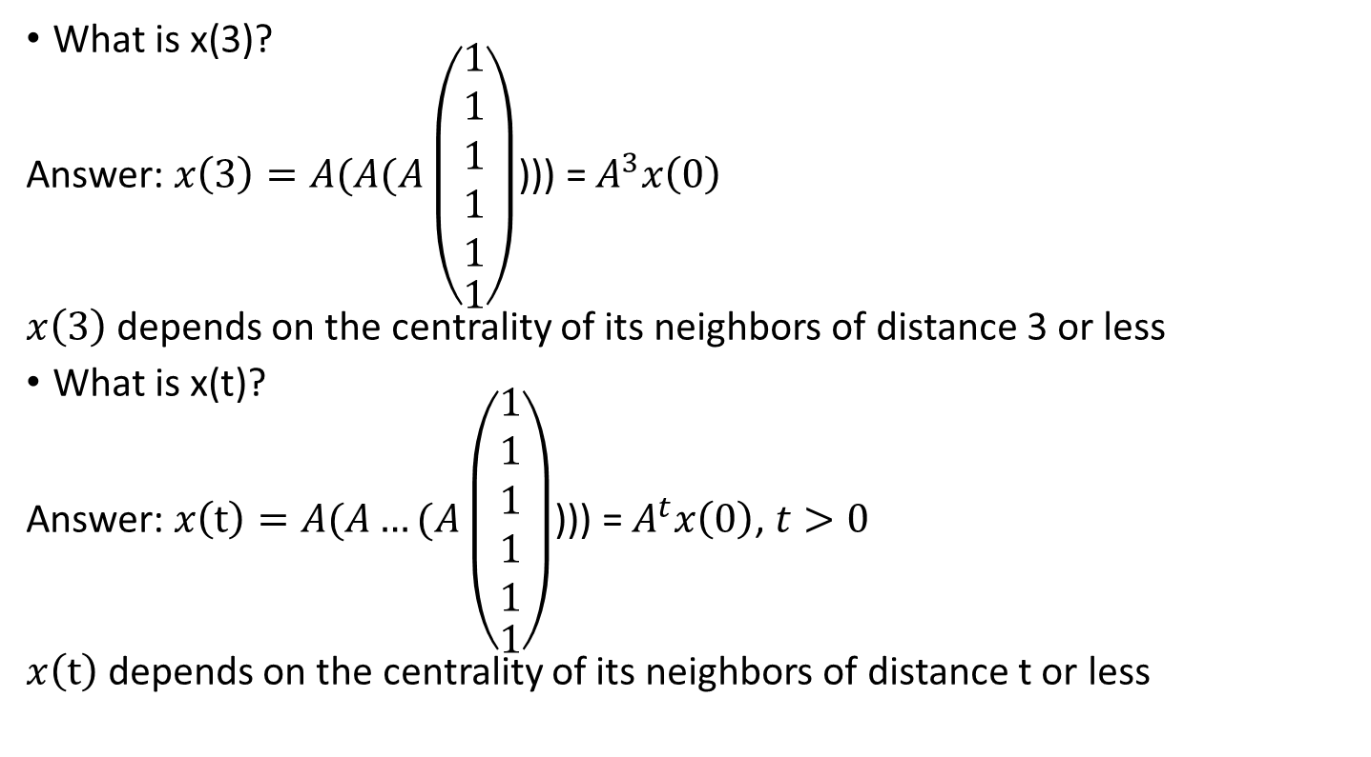
Discussion: What did you notice?
What is x(3)?
Answer: $x\left(3\right)=A(A(A\left(\begin{matrix}\begin{aligned}1 \\ 1 \\ 1 \\ 1 \\ 1\end{aligned} \\ 1\end{matrix}\right)$))) = $A^{3}x\left(0\right)$
$x\left(3\right)$ depends on the centrality of its neighbors of distance 3 or less
What is x(t)?
Answer: $x\left(t\right)=A(A…(A\left(\begin{matrix}\begin{aligned}1 \\ 1 \\ 1 \\ 1 \\ 1\end{aligned} \\ 1\end{matrix}\right)$))) = $A^{t}x\left(0\right)$, $t>0$
$x\left(t\right)$ depends on the centrality of its neighbors of distance t or less

Slide 20
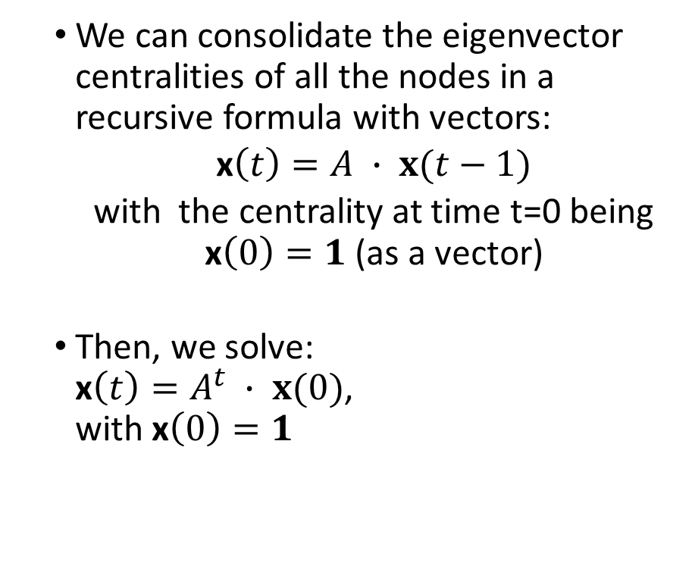
Eigenvector Centrality Derivation
  We can consolidate the eigenvector centralities of all the nodes in a recursive formula with vectors:
  x$\left(t\right)=A ∙ x(t−1)$
  with the centrality at time t=0 being x$\left(0\right)=1$ (as a vector)
  Then, we solve:
  x$\left(t\right)=A^{t} ∙ x(0)$,
  with x$\left(0\right)=1$

Slide 21
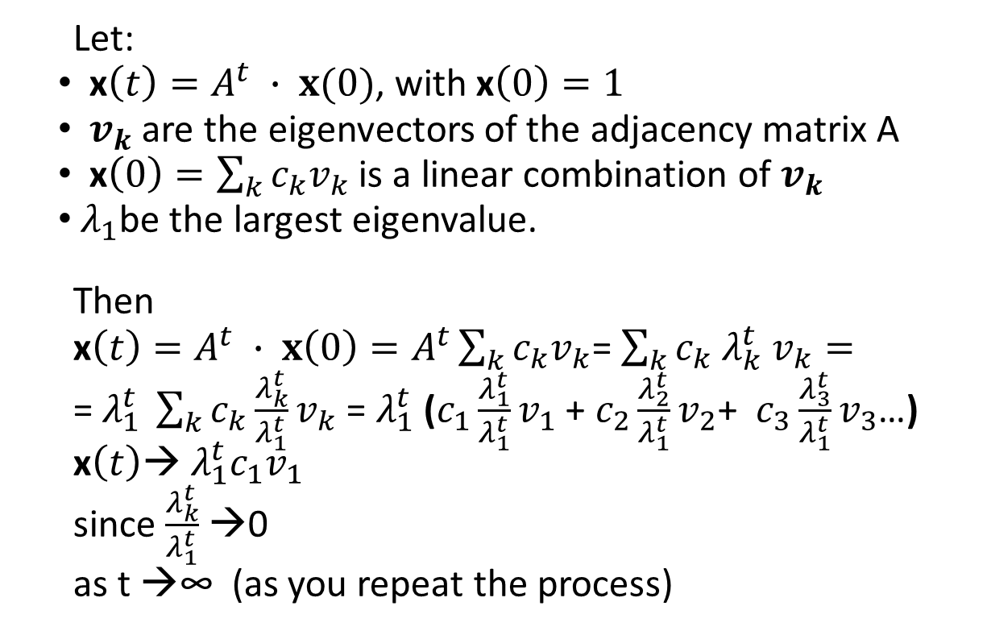
Eigenvector Centrality Derivation
  Let:
  x$\left(t\right)=A^{t} ∙ x(0)$, with x$\left(0\right)=1$
  $v_{k}$ are the eigenvectors of the adjacency matrix A
  x$\left(0\right)=\sum_{k}{c_{k}v_{k}}$ is a linear combination of $v_{k}$
  $λ_{1}$be the largest eigenvalue.
  Then
  x$\left(t\right)=A^{t} ∙ x\left(0\right)=A^{t}\sum_{k}{c_{k}v_{k}}$= $\sum_{k}{c_{k} λ_{k}^{t} v_{k}}=$
  = $λ_{1}^{t} \sum_{k}{c_{k}\frac{λ_{k}^{t}}{λ_{1}^{t}}v_{k}}$ = $λ_{1}^{t}$($c_{1}\frac{λ_{1}^{t}}{λ_{1}^{t}}v_{1}$ + $c_{2}\frac{λ_{2}^{t}}{λ_{1}^{t}}v_{2}$+ $c_{3}\frac{λ_{3}^{t}}{λ_{1}^{t}}v_{3}$…) x$\left(t\right)$→ $λ_{1}^{t}c_{1}v_{1}$
  since $\frac{λ_{k}^{t}}{λ_{1}^{t}}$ →0
  as t →∞ (as you repeat the process)

Slide 22
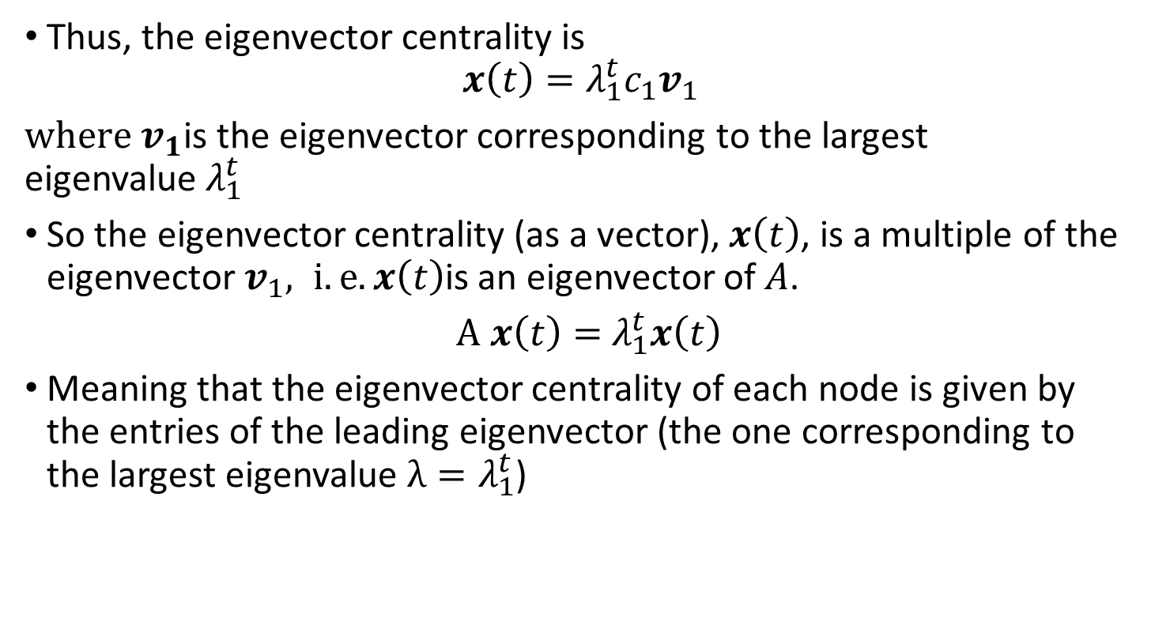
Eigenvector Centrality
Thus, the eigenvector centrality is
$$x\left(t\right)=λ_{1}^{t}c_{1}v_{1}$$
$where{ v}_{1}$is the eigenvector corresponding to the largest eigenvalue${ λ}_{1}^{t}$
So the eigenvector centrality (as a vector), $x\left(t\right)$, is a multiple of the eigenvector${ v}_{1}, i.e. x\left(t\right)$is an eigenvector of$A$.
$A x\left(t\right)=$ $λ_{1}^{t}x\left(t\right)$
Meaning that the eigenvector centrality of each node is given by the entries of the leading eigenvector (the one corresponding to the largest eigenvalue $λ=λ_{1}^{t}$)

Slide 23
Is it well defined?
That is:
  Is the eigenvector guaranteed to exist?
  Is the eigenvector unique?
  Is the eigenvalue unique?
  Can we have negative entries in the eigenvector?
We say that a matrix/vector is positive if all of its entries are positive
Perron-Frobenius theorem: A real square matrix with positive entries has a unique largest real eigenvalue and that the corresponding eigenvector has strictly positive components
Perron-Frobenius theorem applies to positive matrices (but it gives similar information for nonnegative ones)

Slide 24
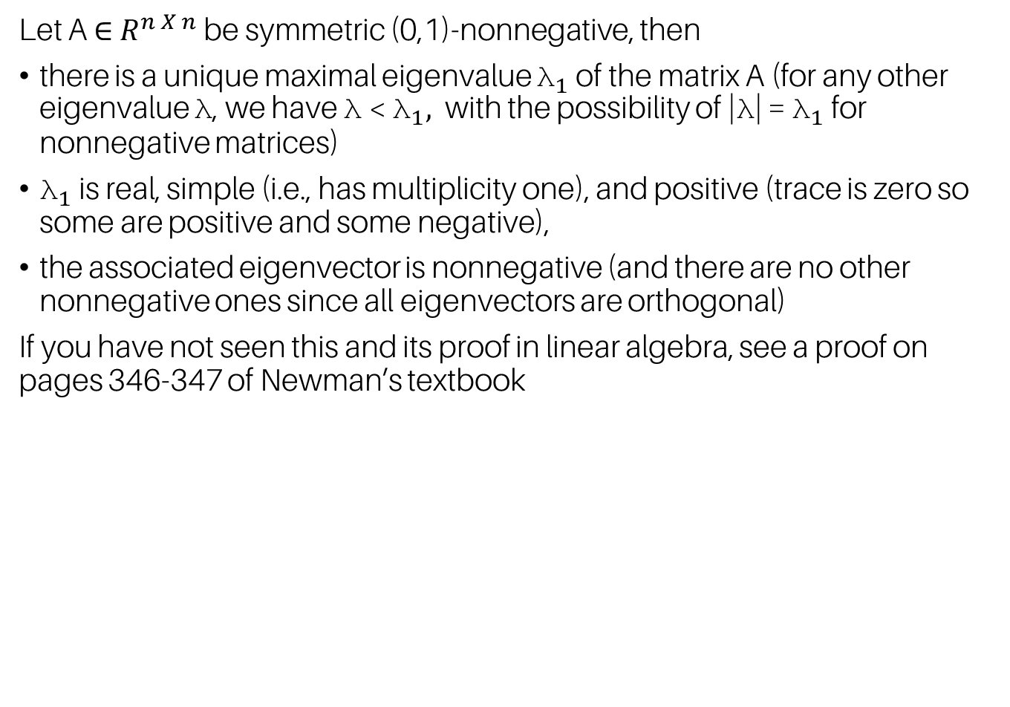
Perron-Frobenius theorem for nonnegative symmetric (0,1)-matrices
Let A ∈ $R^{n X n}$ be symmetric (0,1)-nonnegative, then
there is a unique maximal eigenvalue ${\text{λ}}_{1}$of the matrix A (for any other eigenvalue λ, we have λ < ${\text{λ}}_{1},$ with the possibility of |λ| = ${\text{λ}}_{1}$ for nonnegative matrices)
${\text{λ}}_{1}$ is real, simple (i.e., has multiplicity one), and positive (trace is zero so some are positive and some negative),
the associated eigenvector is nonnegative (and there are no other nonnegative ones since all eigenvectors are orthogonal)
If you have not seen this and its proof in linear algebra, see a proof on pages 346-347 of Newman’s textbook

Slide 25
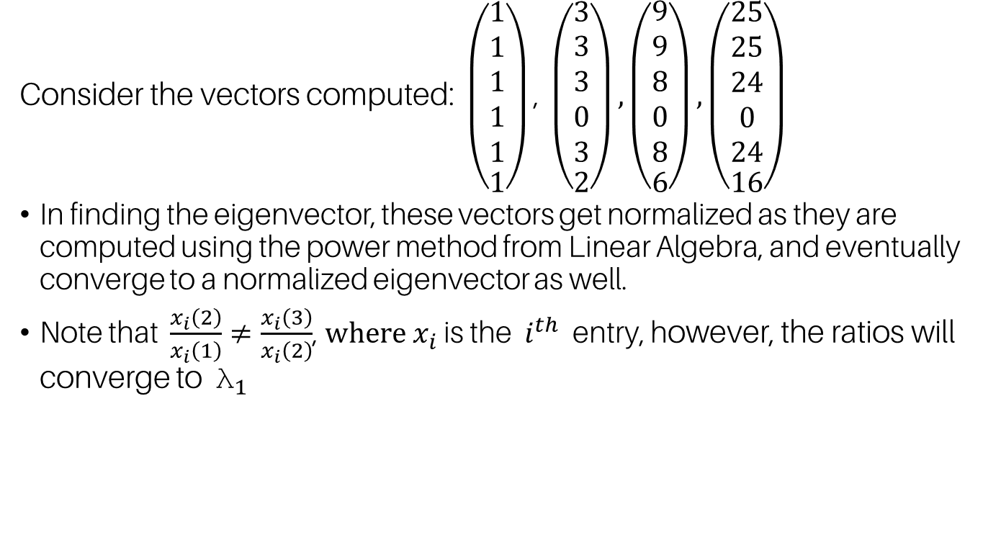
Note
Consider the vectors computed: $\left(\begin{matrix}\begin{aligned}1 \\ 1 \\ 1 \\ 1 \\ 1\end{aligned} \\ 1\end{matrix}\right)\text{, }\left(\begin{matrix}\begin{aligned}3 \\ 3 \\ 3 \\ 0 \\ 3\end{aligned} \\ 2\end{matrix}\right), \left(\begin{matrix}\begin{aligned}9 \\ 9 \\ 8 \\ 0 \\ 8\end{aligned} \\ 6\end{matrix}\right),\left(\begin{matrix}\begin{aligned}25 \\ 25 \\ 24 \\ 0 \\ 24\end{aligned} \\ 16\end{matrix}\right)$
In finding the eigenvector, these vectors get normalized as they are computed using the power method from Linear Algebra, and eventually converge to a normalized eigenvector as well.
Note that $\frac{x_{i}\left(2\right)}{x_{i}\left(1\right)}≠\frac{x_{i}\left(3\right)}{x_{i}\left(2\right)}$, $where x_{i}$ is the $i^{th}$ entry, however, the ratios will converge to ${\text{λ}}_{1}$

Slide 26
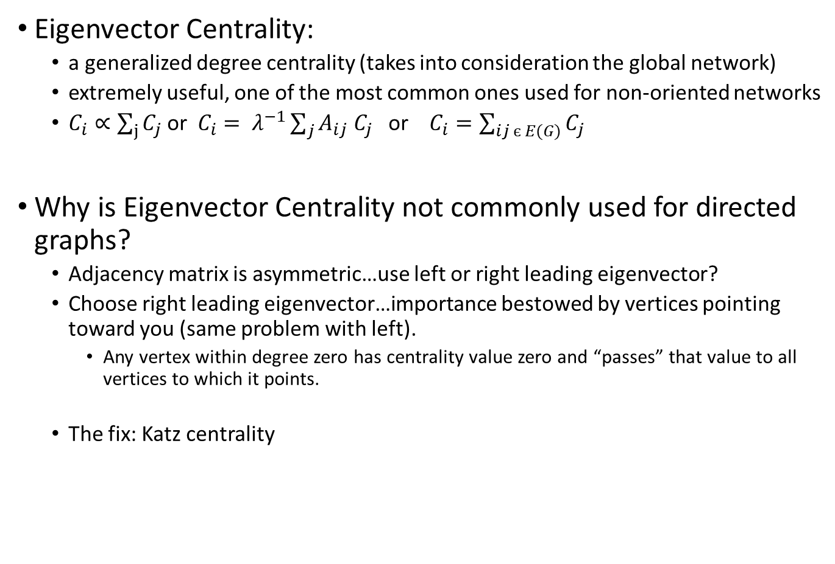
Conclusion: Eigenvector Centrality
Eigenvector Centrality:
  a generalized degree centrality (takes into consideration the global network)
  extremely useful, one of the most common ones used for non-oriented networks
  $C_{i}∝\sum_{j}{C_{j}}$ or $C_{i}= λ^{−1}\sum_{j}{A_{ij} C_{j}}$ or $C_{i}=\sum_{ij є E(G)}{C_{j}}$
Why is Eigenvector Centrality not commonly used for directed graphs?
  Adjacency matrix is asymmetric…use left or right leading eigenvector?
  Choose right leading eigenvector…importance bestowed by vertices pointing toward you (same problem with left).
    Any vertex within degree zero has centrality value zero and “passes” that value to all vertices to which it points.
  The fix: Katz centrality

Slide 27
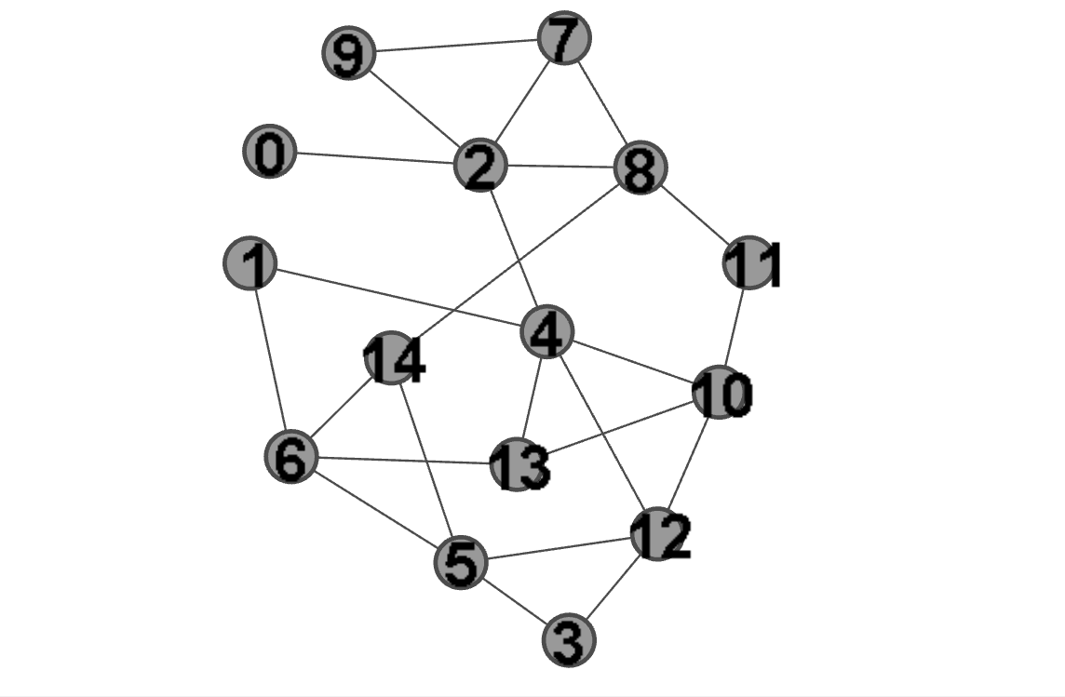
Extra example 2 (Adjacency matrix, eigenvector centrality and the graph)
0: 0.08448651593556764,
1: 0.1928608426462633,
2: 0.3011603786470362,
3: 0.17530527234882679,
4: 0.40835121533077895,
5: 0.2865100597893966,
6: 0.2791290343288953,
7: 0.1931920790704947,
8: 0.24881035953707603,
9: 0.13868390351302598,
10: 0.336067959653752,
11: 0.16407815738375933,
12: 0.33838887484747293,
13: 0.2871391639624871,
14: 0.22848023925633135
0. 0. 1. 0. 0. 0. 0. 0. 0. 0. 0. 0. 0. 0. 0.
0. 0. 0. 0. 1. 0. 1. 0. 0. 0. 0. 0. 0. 0. 0.
1. 0. 0. 0. 1. 0. 0. 1. 1. 1. 0. 0. 0. 0. 0.
0. 0. 0. 0. 0. 1. 0. 0. 0. 0. 0. 0. 1. 0. 0.
0. 1. 1. 0. 0. 0. 0. 0. 0. 0. 1. 0. 1. 1. 0.
0. 0. 0. 1. 0. 0. 1. 0. 0. 0. 0. 0. 1. 0. 1.
0. 1. 0. 0. 0. 1. 0. 0. 0. 0. 0. 0. 0. 1. 1.
0. 0. 1. 0. 0. 0. 0. 0. 1. 1. 0. 0. 0. 0. 0.
0. 0. 1. 0. 0. 0. 0. 1. 0. 0. 0. 1. 0. 0. 1.
0. 0. 1. 0. 0. 0. 0. 1. 0. 0. 0. 0. 0. 0. 0.
0. 0. 0. 0. 1. 0. 0. 0. 0. 0. 0. 1. 1. 1. 0.
0. 0. 0. 0. 0. 0. 0. 0. 1. 0. 1. 0. 0. 0. 0.
0. 0. 0. 1. 1. 1. 0. 0. 0. 0. 1. 0. 0. 0. 0.
0. 0. 0. 0. 1. 0. 1. 0. 0. 0. 1. 0. 0. 0. 0.
0. 0. 0. 0. 0. 1. 1. 0. 1. 0. 0. 0. 0. 0. 0.

Slide 28
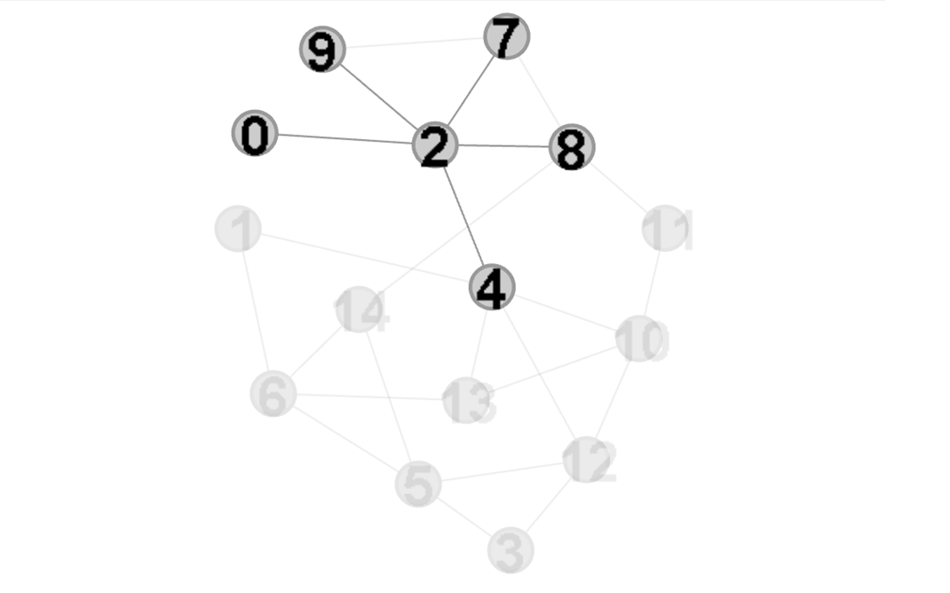
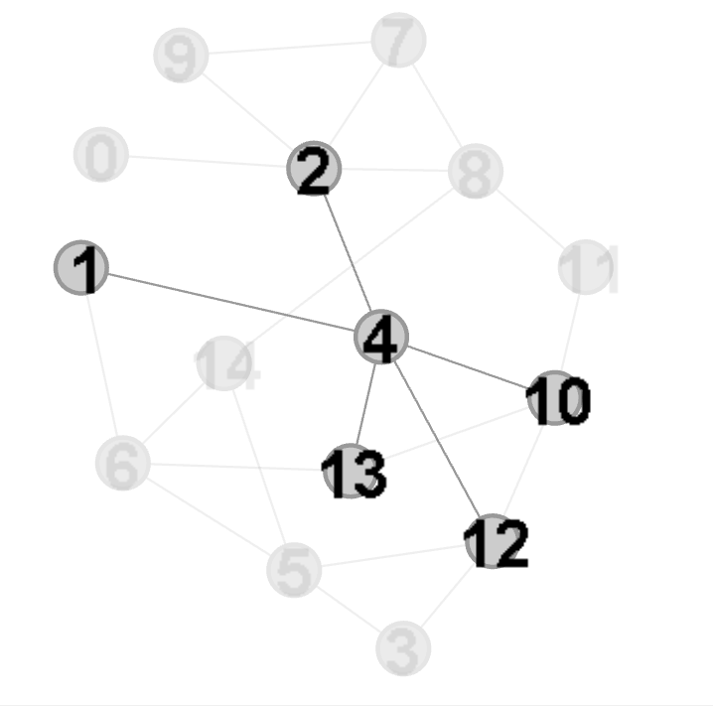
Extra example 2 (Eigenvector centrality)
C2 = 0.3011603786470362
C4 = 0.40835121533077895
Adjacent to vertices of small degree
Adjacent to vertices of large degree

