Slide 1
Excellence Through Knowledge
Prof. Ralucca Gera, rgera@nps.edu
Applied Mathematics Department,
Naval Postgraduate School
Real Networks

Slide 2
Learning Outcomes
Be able to grasp the meaning new research in complex networks:
    Recognize the roles of networks in life, nature, and research
Distinguish between network categories
Give examples of real networks
Illustrate the need for network models:
    Structure & dynamics

Slide 3

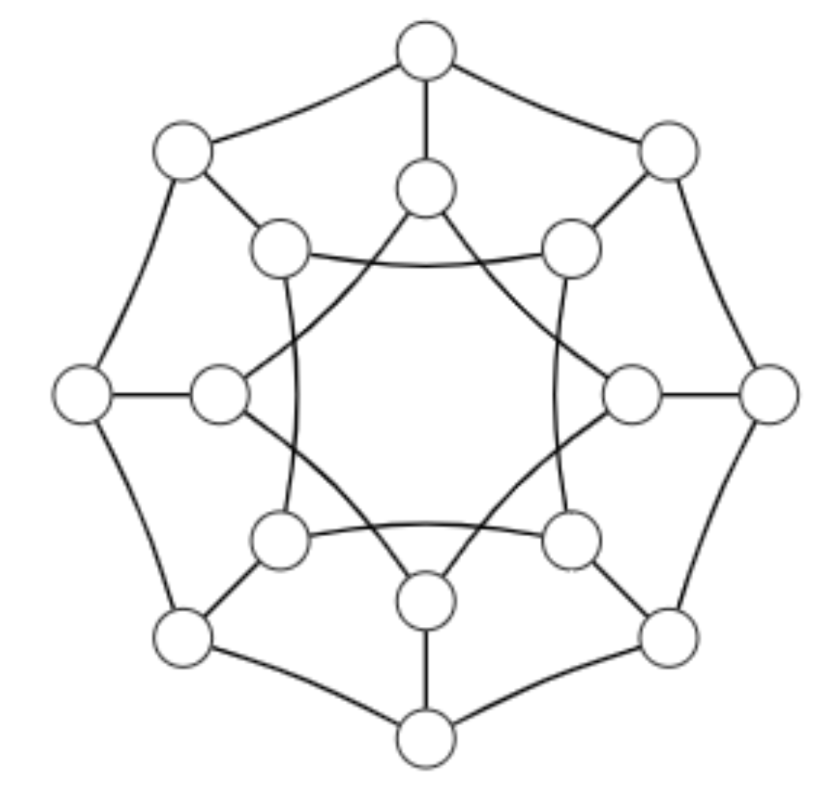
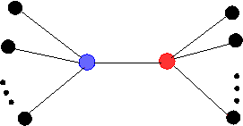
Recall: MA 4027
(Graph Theory)
A vertex generally represents an object/idea
An edge relationships between objects/ideas
Small graphs or graphs with a pattern
Edges (well understood laws)
Usually static in time

Slide 4
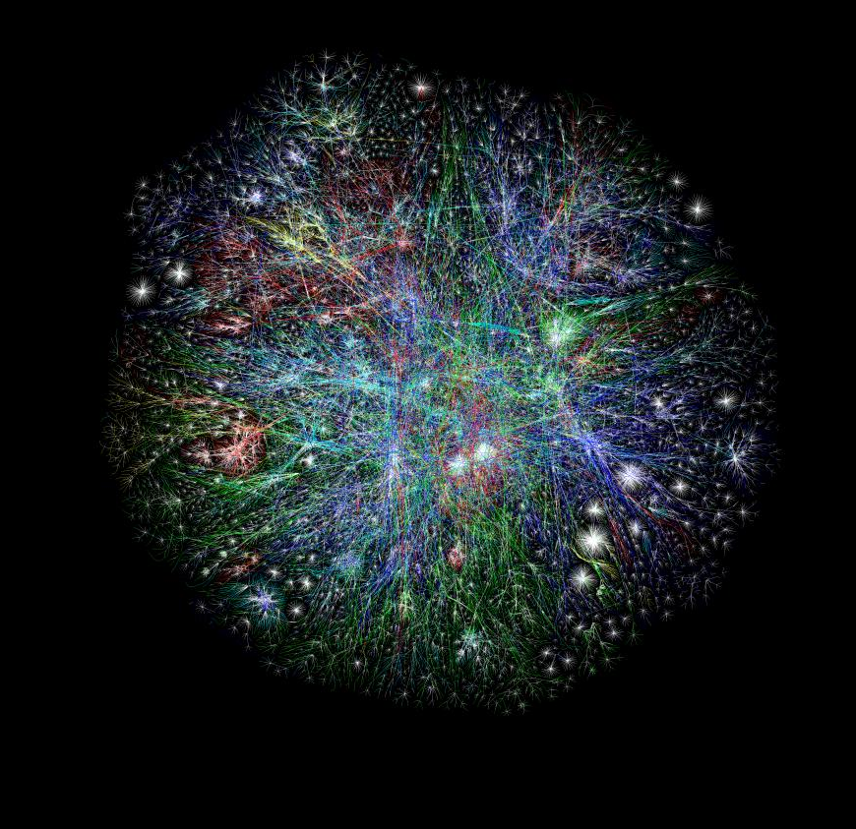
MA 4404:
Complex Networks
Complex networks (nontrivial to define, here are some characteristics):
generally very large,
nodes may or may not have well-defined roles
nodes may interact according to rules that generally are not understood
the change or failure of a small subset may have a significant impact on the entire network
mixed type of nodes/edges (layered social network and a communication network)
they self-organize (emergent properties)
such networks adapt, and therefore evolve

Slide 5
The Future of Networks
Networks seem to be here to stay
  More and more systems are modeled as networks
  Scientists from various disciplines are working on networks (physicists, computer scientists, mathematicians, biologists, sociologist, economists)
  A very young, cutting edge research field with an international and interdisciplinary community
  Watch this introduction to understanding the brain as a network…

Slide 6
Common types of networks
Sections 2-5 of Newman’s book present discussions of the following common networks:
Technological networks
Social networks
Networks of Information
Biological networks
Most pictures in this PPT are from Newman’s gallery of pictures: http://www-personal.umich.edu/~mejn/networks/

Slide 7
Technological networks
Networks built for distribution of commodity
What are some examples that you can think of?

Slide 8
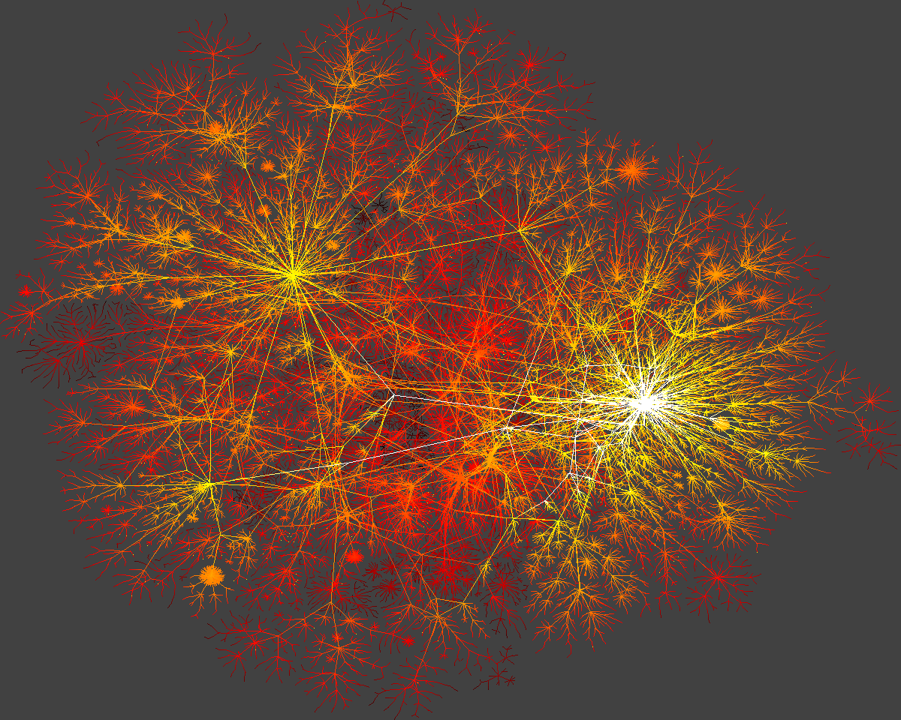
Technological networks
Networks built for distribution of commodity
  The Internet
    Interface, router level, AS level
  Power Grids
  Airline networks
  Telephone networks
  Transportation Networks
    roads, railways, pedestrian traffic
  Software graphs
Source: “Networks, An introduction” by Newman

Slide 9
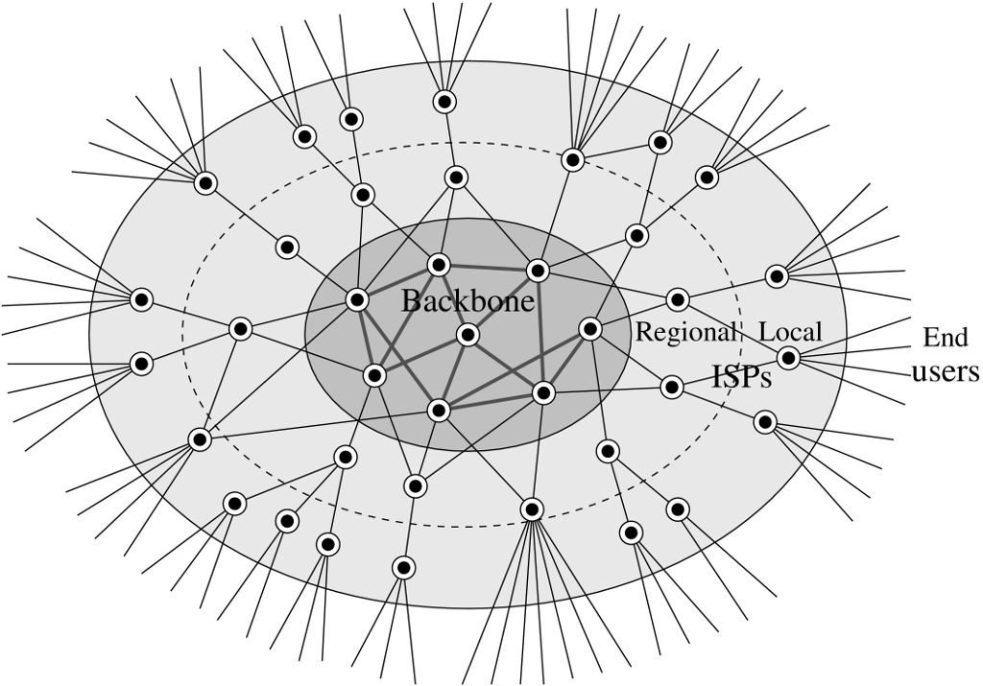
The Structure of the Internet
A physical network of computers linked by actual cables (vs. the www)
Its structure is derived from experiments rather than from a central repository
The “highways” of the internet
(high-bandwidth, high performance
Routers and switching centers)
operated by national governments and
communication companies (AT&T)
Commercial companies that
contract for connection to
the backbone and
resell to end users
Source: “Networks, An introduction” by Newman

Slide 10
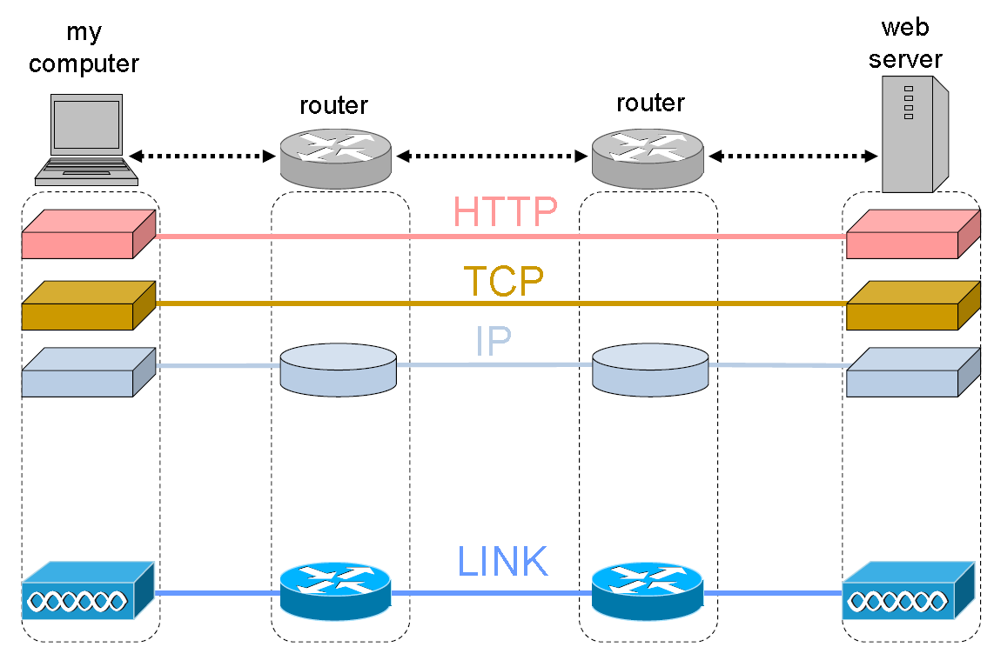
The internet is a layered network
Source: Dave Alderson, NPS

Slide 11
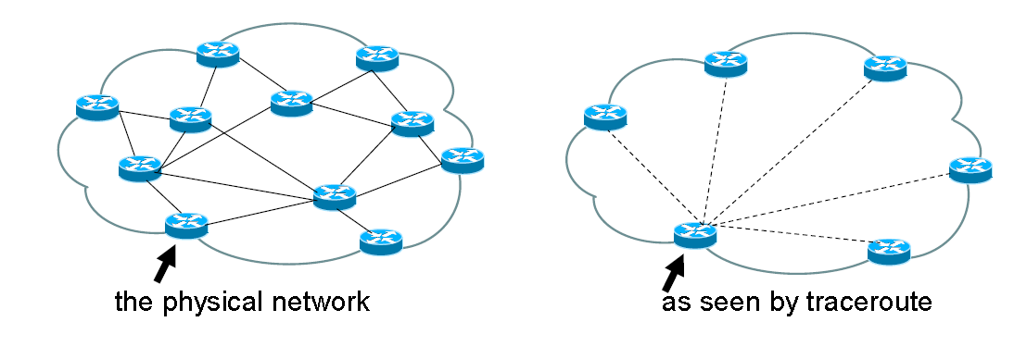
Exploring the Internet
Empirically-based topology modeling of the Internet using traceroutes (tool that traces the IP-route that a data packet travels), to infer the IP-level
From: Dave Alderson, NPS

Slide 12
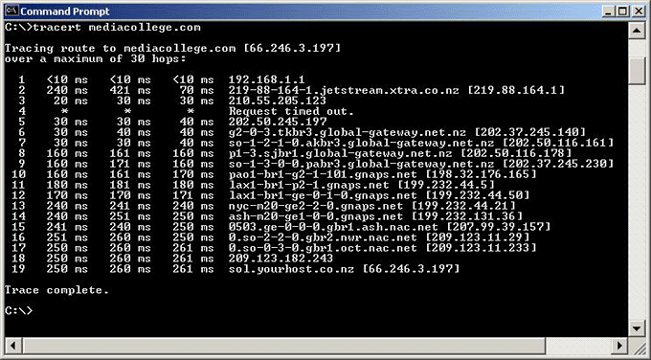
Sample Traceroute
Internet routing is based on policy (i.e. economics) so traceroutes do not give shortest-paths

Slide 13
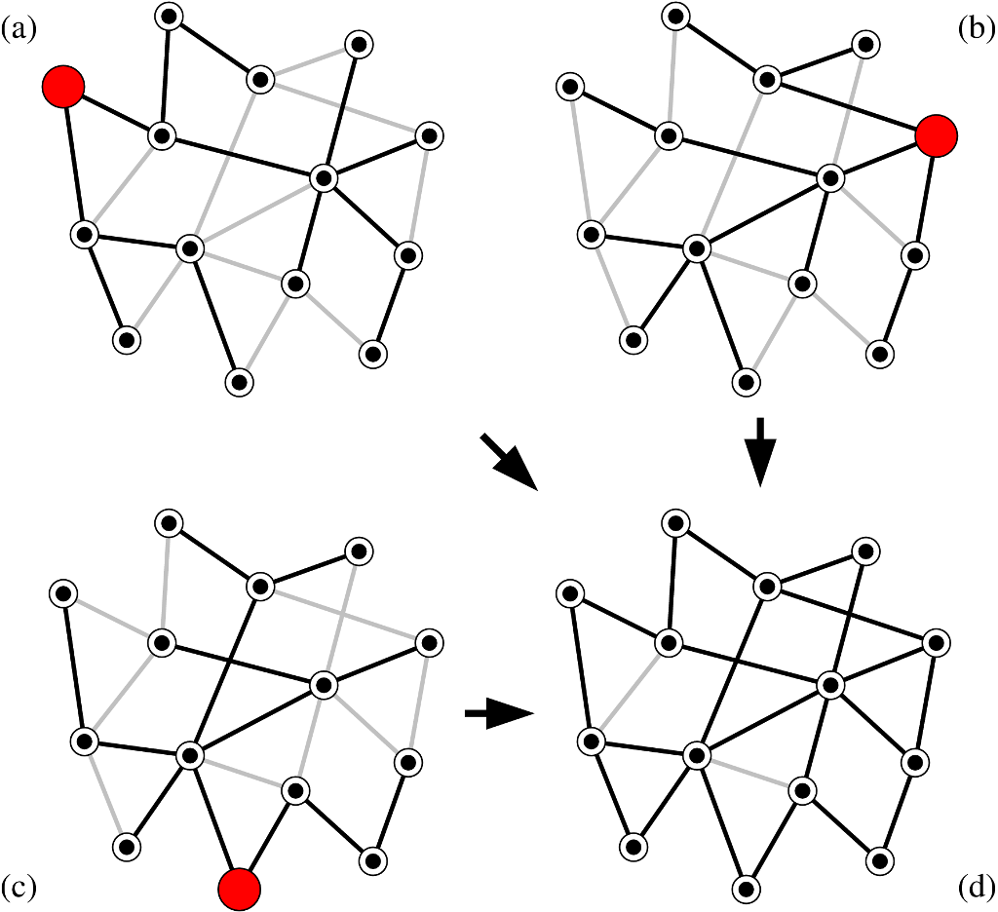
Constructing the Internet Topology using traceroutes data
Vantage Points
(routers)
Source: “Networks, An introduction” by Newman

Slide 14
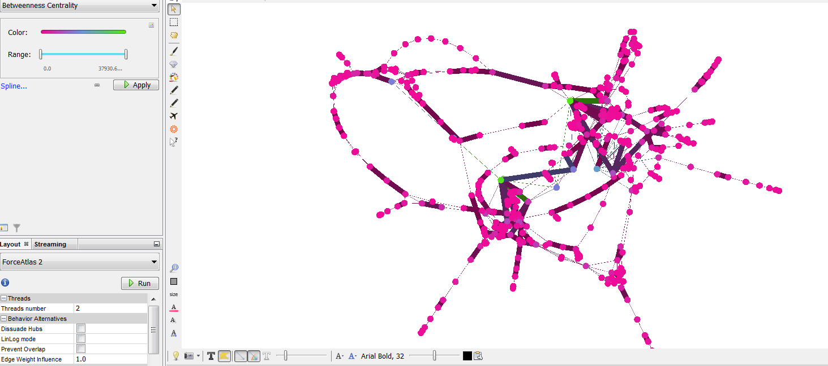
How We Can View Data in Gephi

Slide 15
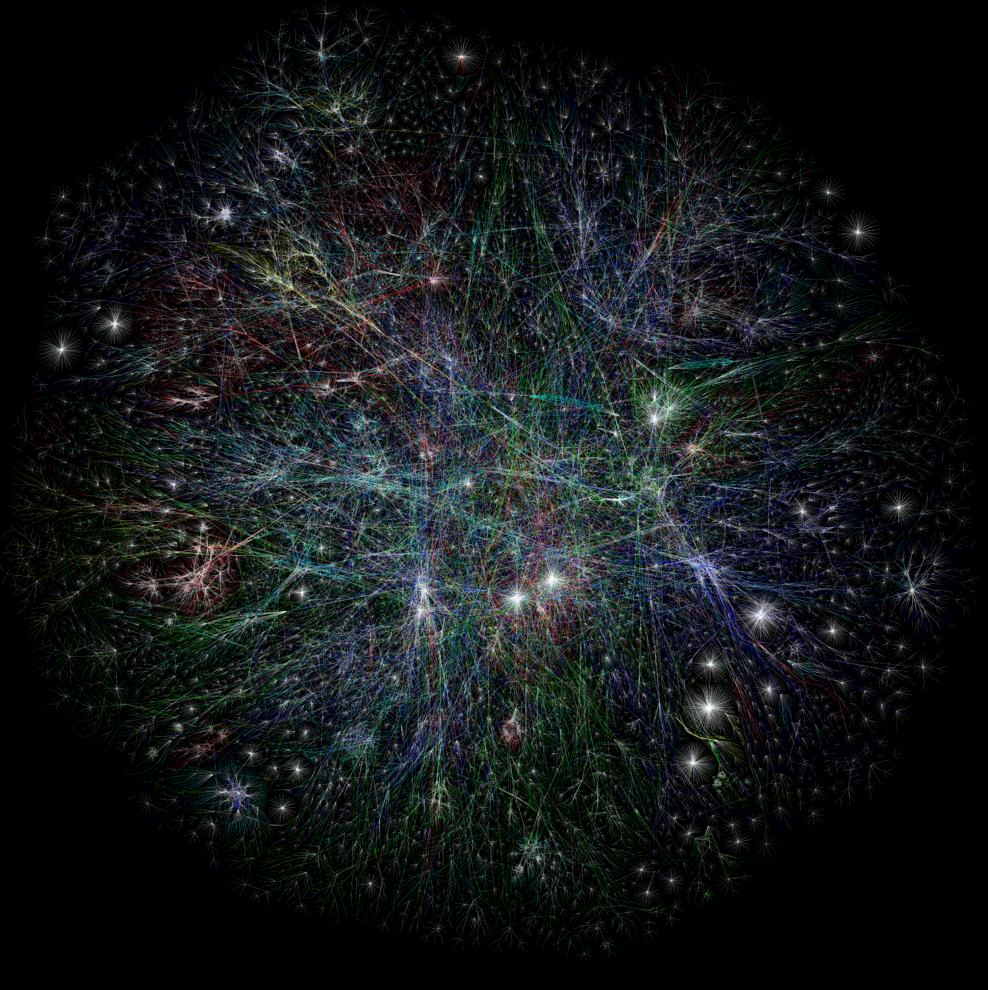
The Internet (IP level)
Bright clusters and points with many edges originating at them represent ISPs or DNS servers which redirect users to destination sites.
Colors represent different countries
Figure created by www.opte.org
Source: https://entropychaos.files.wordpress.com/2010/11/1069646562-lgl-2d-4000x4000.png

Slide 16
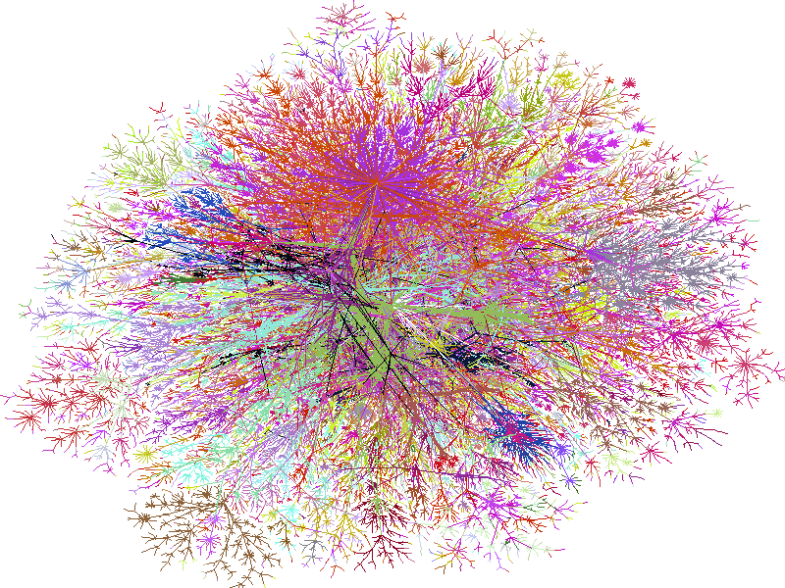
The Internet
(at the AS level)
Nodes are autonomous systems
Edges are routes taken by data
using trace-routes
Figure created by www.opte.org

Slide 17
The Internet
Graphical representations are not inspiring
We can still describe it as we will see in this class, just keep in mind that it is an inferred topology not a true one
However the graphs will be different at different granularity levels (the graphical representation might look the same)

Slide 18
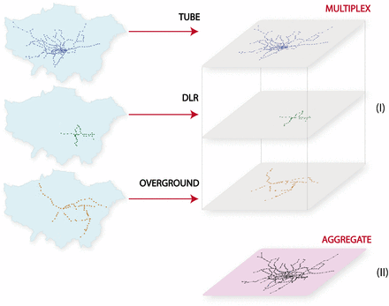
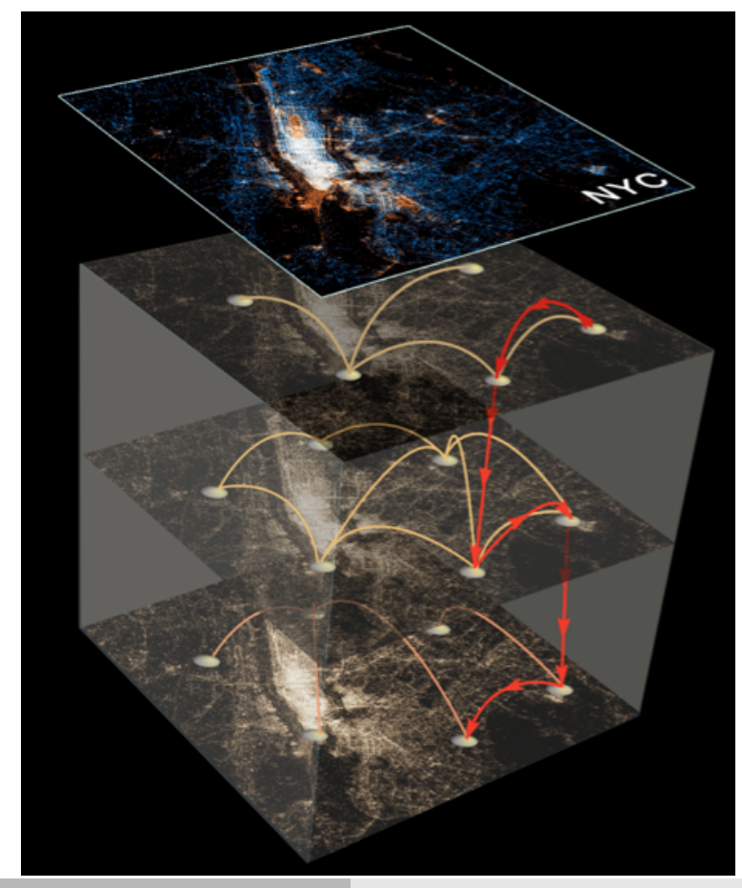
London Transport Netw. - Multiplex
London
NYC
Source: http://www.pnas.org/content/111/23/8351.figures-only

Slide 19
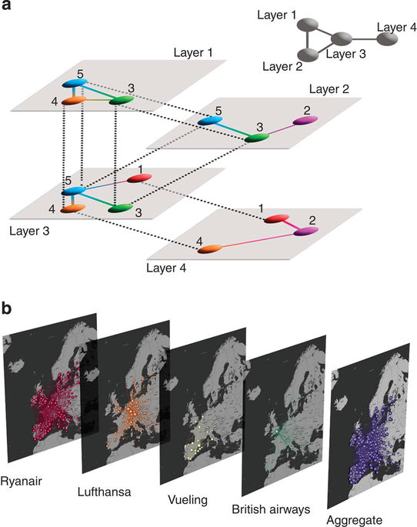
Airline network (multilayer)
Source: https://www.nature.com/articles/ncomms7868

Slide 20
Social Networks
Links denote a social interaction
What are some examples that you can think of?

Slide 21
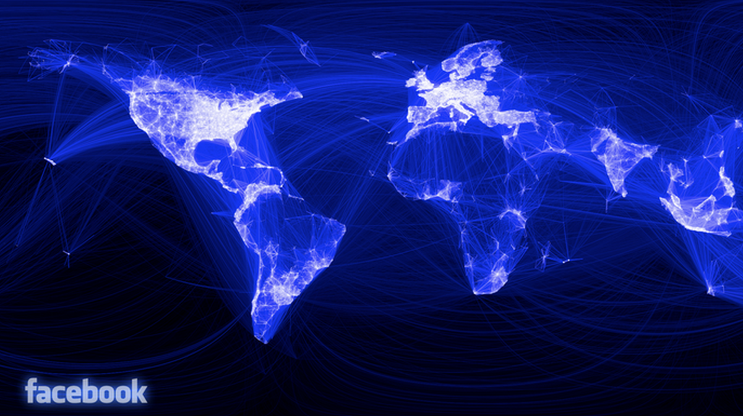
Facebook
Source: http://blog.revolutionanalytics.com/2010/12/facebooks-social-network-graph.html

Slide 22
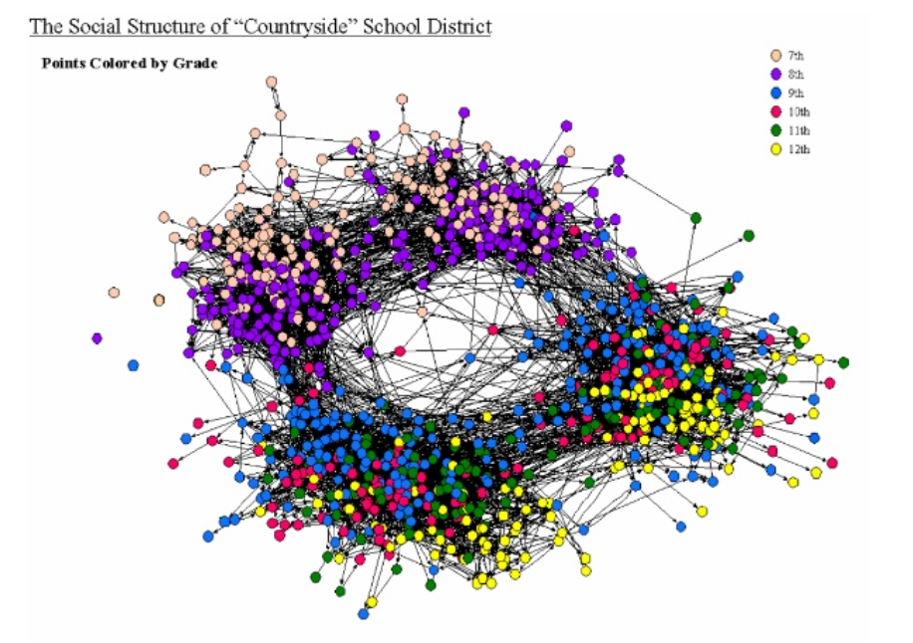
Social Networks
Links denote a social interaction
  Networks of acquaintances
  actor networks (Bacon)
  co-authorship networks (Erdos)
  director networks
  phone-call networks
  e-mail networks
  IM networks
    Microsoft buddy network
  Bluetooth networks
  sexual networks
  home page networks
Source: https://www.slideshare.net/charthur/slides-networks-2017-r1

Slide 23
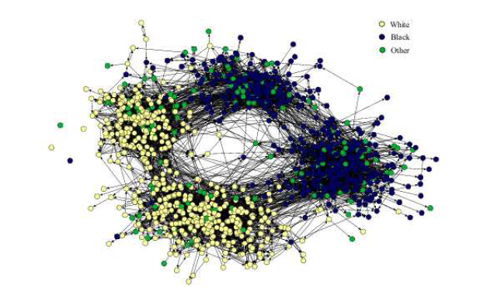
Social Networks
Links denote a social interaction
  Networks of acquaintances
  actor networks (Bacon)
  co-authorship networks (Erdos)
  director networks
  phone-call networks
  e-mail networks
  IM networks
    Microsoft buddy network
  Bluetooth networks
  sexual networks
  home page networks
Source: “Networks, An introduction” by Newman

Slide 24
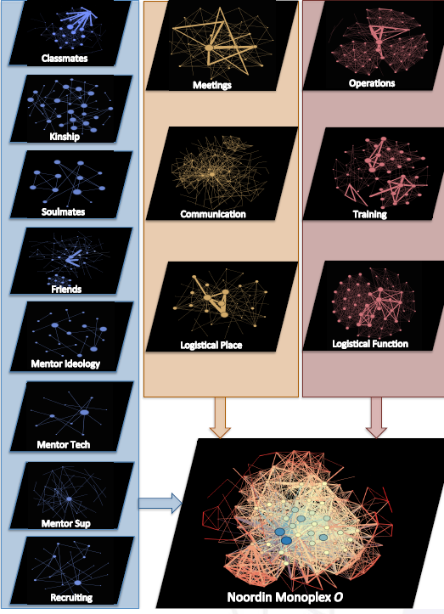
Dark Networks (Multilayered)
Organized the 14 layers of Noordin Top into 3 categories that become the layers of our multilayered network
Trust
LoC
Knowledge
LoC
Knowledge
Trust
Figure: HIGGS Multiplex Social
Interaction Twitter Data:
retrieved from
http://deim.urv.cat/manlio.dedomenico/images/muxviz/muxViz community5.png
Source for Noordin Top network: Ryan Miller, NPS student

Slide 25
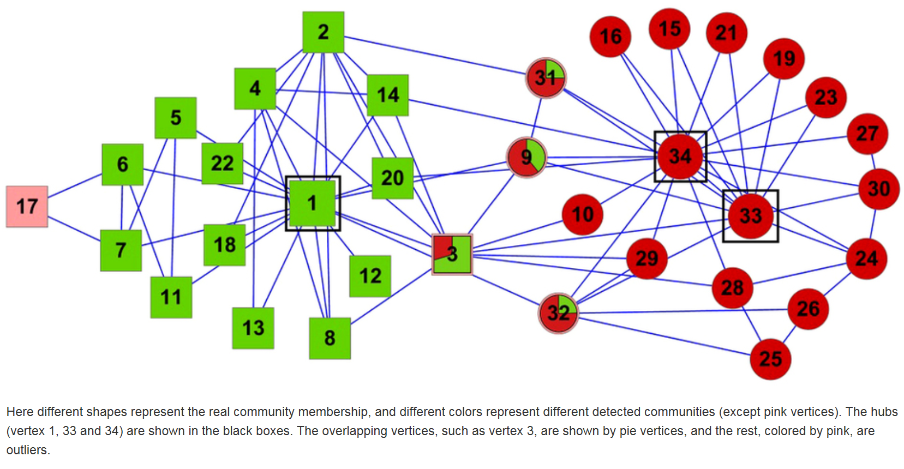
Zachary’s Karate Club
The paper referenced in the source tried a community detection algorithm on the reference Zachary’s karate club
34 members 78 relations, 2 years, disagreements between instructor and club administrator, the club split into two
Source: Identifying overlapping communities as well as hubs and outliers via nonnegative matrix factorization in Scientific Reports by Xiaochun Cao, Xiao Wang, Di Jin, Yixin Cao & D. He,
Notes:
Karate: 34 members 78 relations, 2 years, disagreements between instructor and club administrator, the club split into two
The paper referenced in the source tried a community detection algorithm on the reference Zachary’s karate club

Slide 26
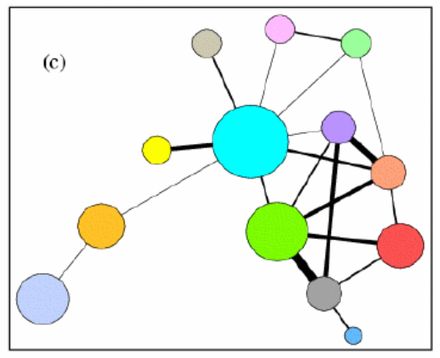
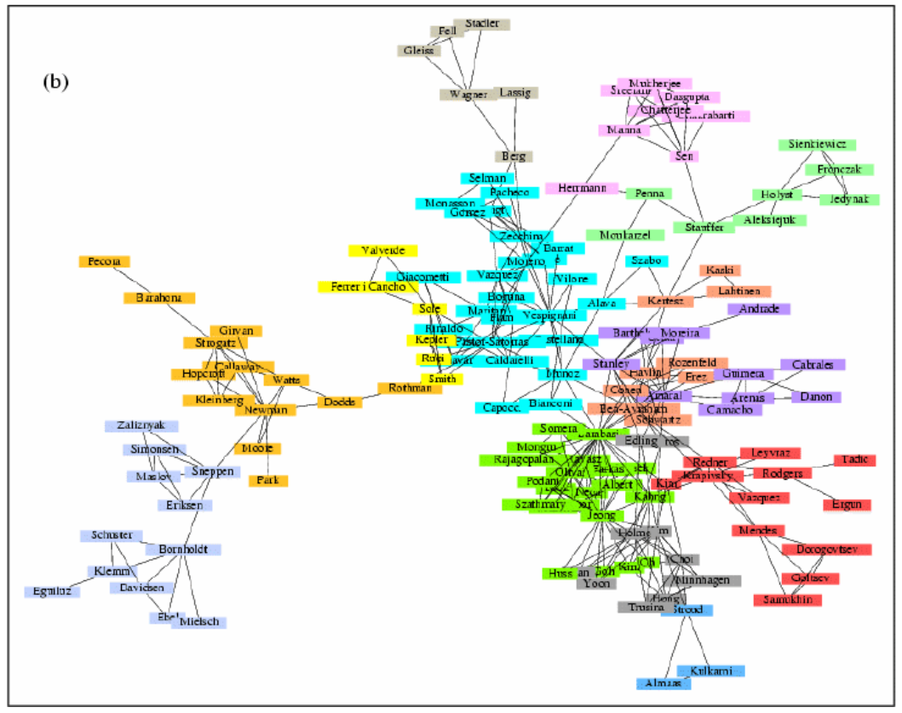
Physicist Collaboration
Just like the IP vs AS level of the internet
You get different graphs at different granularity levels
source: Newman’s gallery of pictures:
http://www-personal.umich.edu/~mejn/networks/

Slide 27
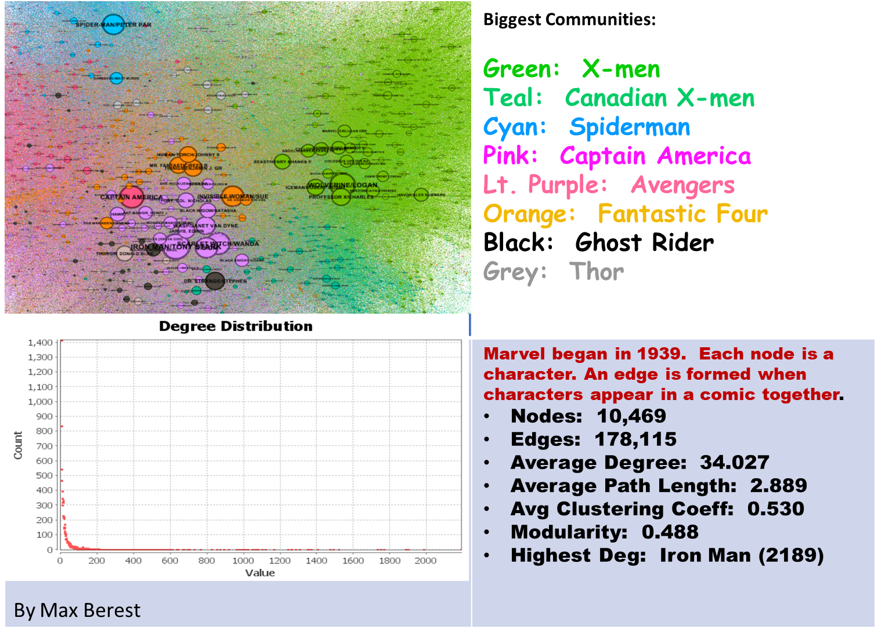
Marvel Comics Characters
By Max Barest, NPS student

Slide 28
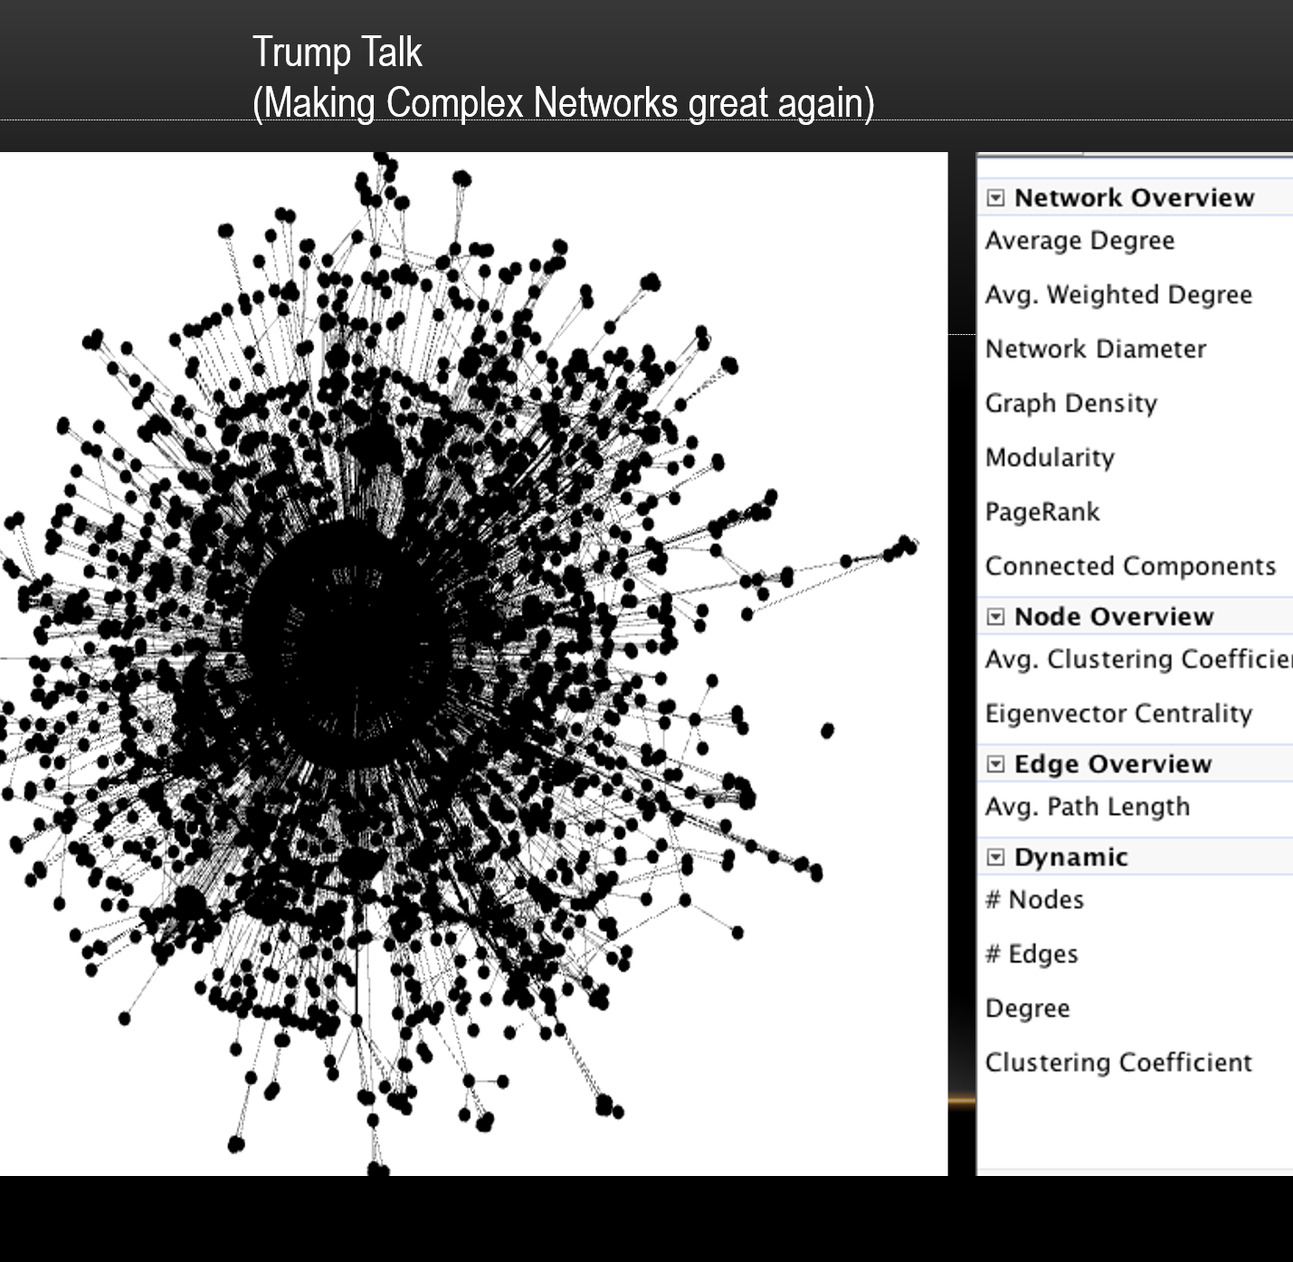
Trump talk (Twitter using www.netlytic.org)
Source: Tom Knuth, NPS student

Slide 29
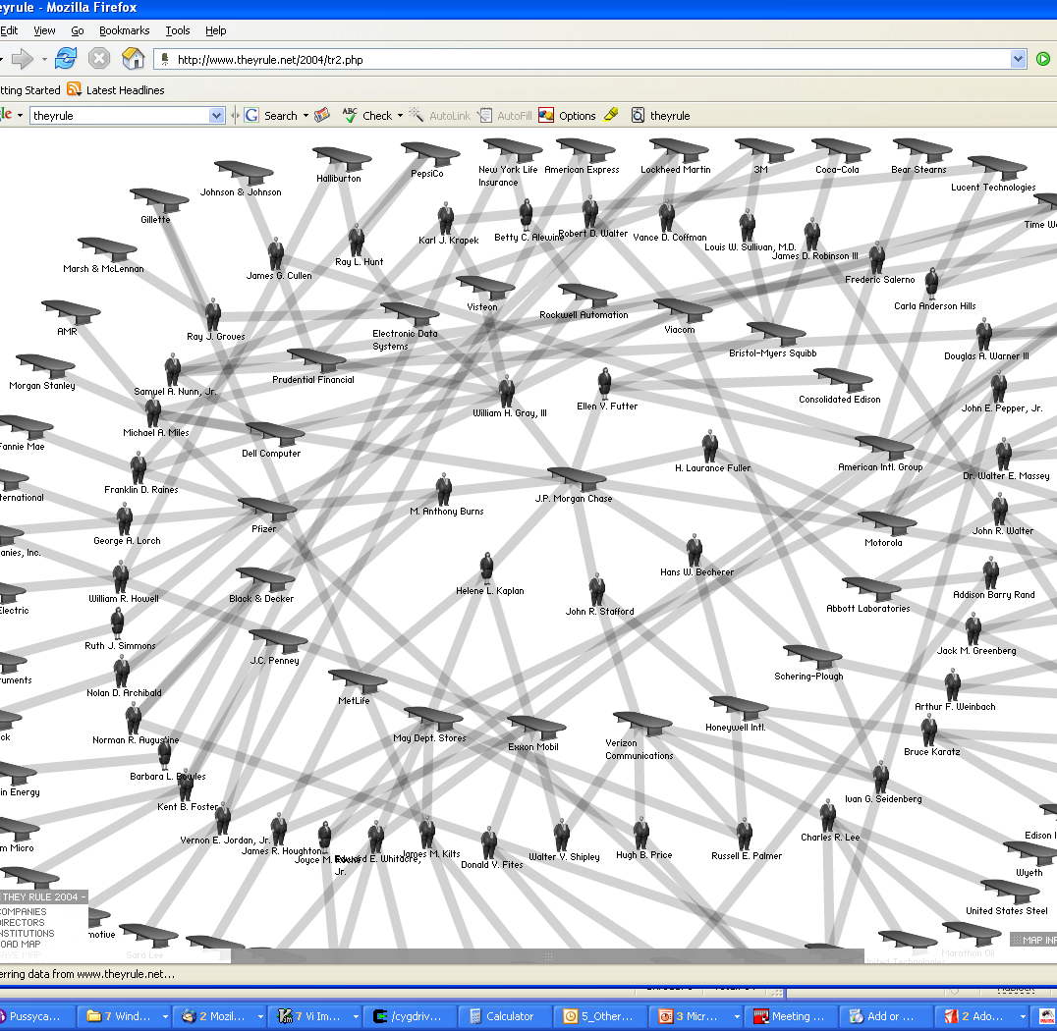
Boards of directors
(mixed data types of the vertices)
Source: http://theyrule.net

Slide 30
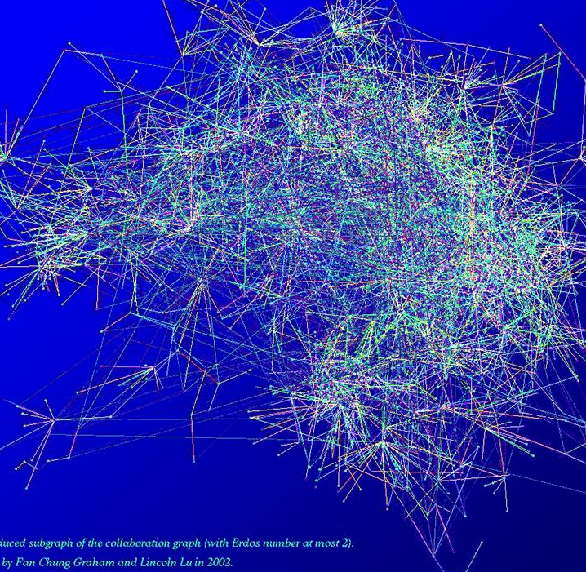
Erdos graph
Source: http://www.math.ucsd.edu/~fan/complex/

Slide 31
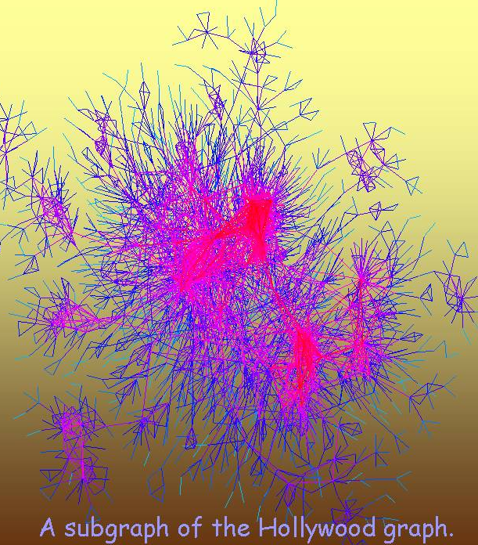
A subgraph of the Hollywood graph
Source: http://www.math.ucsd.edu/~fan/complex/

Slide 32
Networks of information
Nodes store information, links associate information
What are some examples that you can think of?

Slide 33
Networks of information
Nodes store information, links associate information
  Citation network
  The Web (a network of information stored on web pages)
  Peer-to-Peer networks
  Word networks
  Networks of Trust
  Bluetooth networks

Slide 34
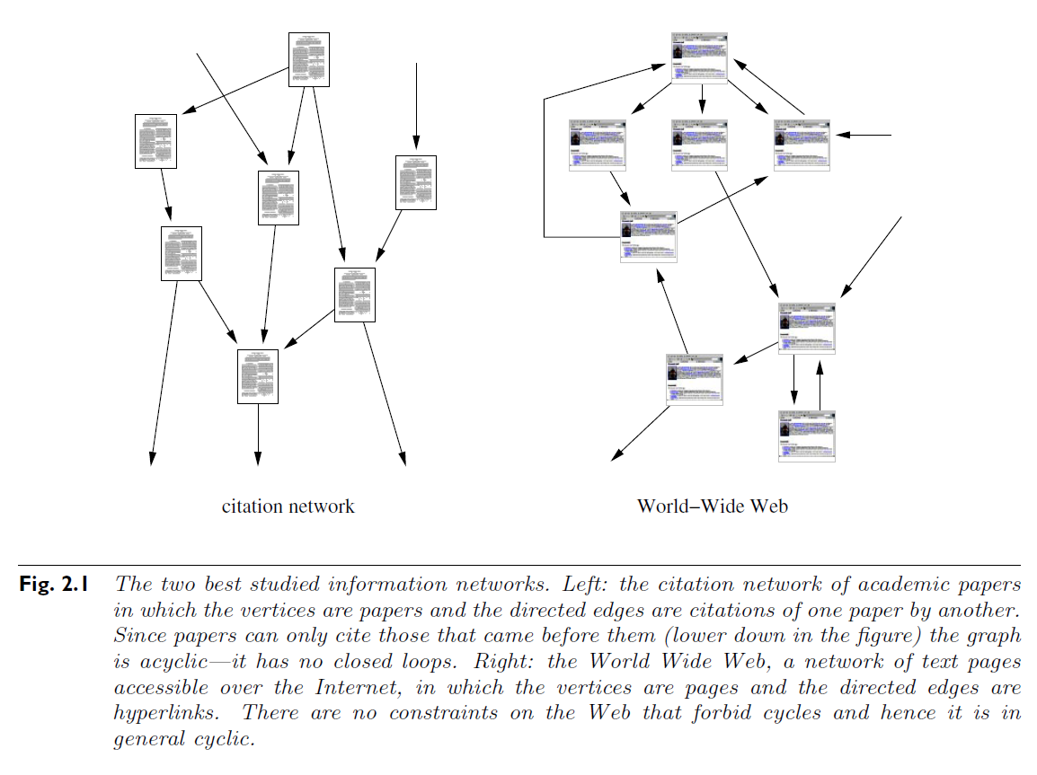
Citation Networks and WWW
Source: “The Structure and Function of Complex Networks” by Newman

Slide 35
Networks of personal homepages
Vertices are webpages;
Edges are hyperlinks
Created using a crawler
(a computer program that automatically surfs the web)
Stanford
MIT
Source: Lada A. Adamic and Eytan Adar, ‘Friends and neighbors on the web’, Social Networks, 25(3):211-230, July 2003.

Slide 36
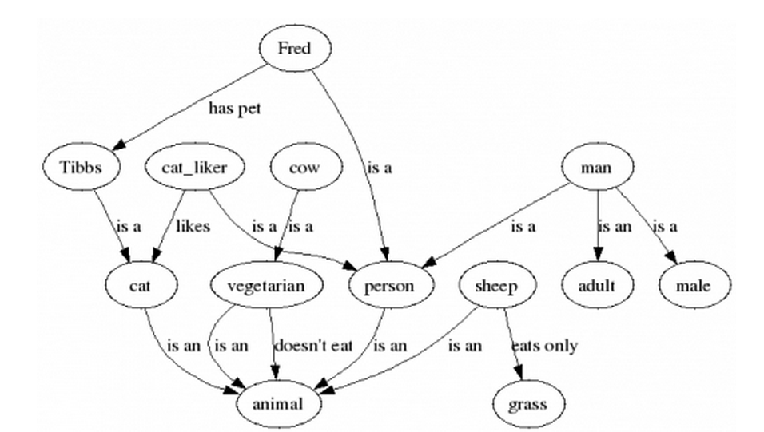
Semantic networks
The goal is “to make the Web content understandable for machines and enable automated reasoning over it”
Edge labels
Source: http://ai.ia.agh.edu.pl/wiki/_export/s5/hekate:dl_intro

Slide 37
Biological networks
They apply to biological systems
What are some examples that you can think of?

Slide 38
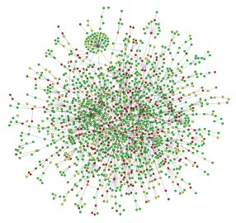
Biological networks
Biological systems represented as networks
  Protein-Protein Interaction Networks
  Gene regulation networks
  Metabolic pathways
  The Food Web
  Neural Networks
Source: “Networks, An introduction” by Newman

Slide 39
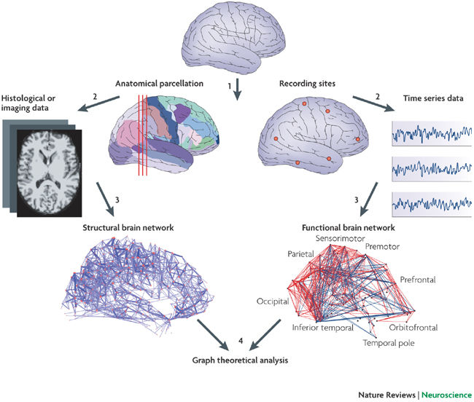
The Brain
Source: https://media.nature.com/full/nature-assets/nrn/journal/v10/n3/images/nrn2575-i1.jpg

Slide 40
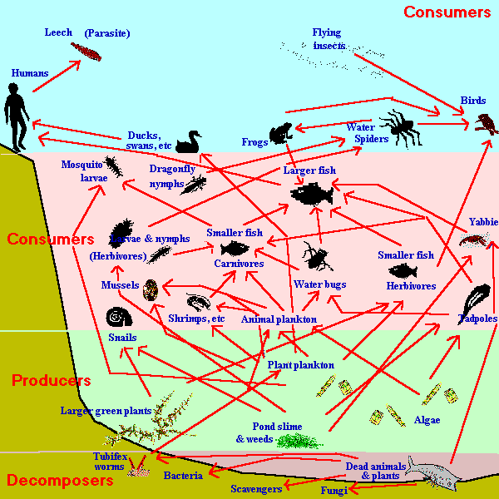
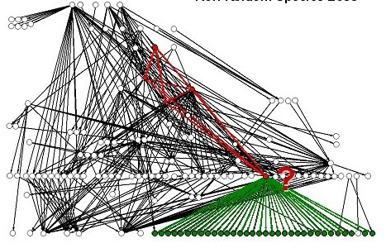
The Ecosystem Environment
biomass-size distribution of aquatic ecosystems (trophic web or food-web)
Particular network: ecosystem evolution of the lake Constance
Source: http://www.bordalierinstitute.com/target1.html

Slide 41
Conclusion
Networks are everywhere!

Slide 42
What do we do with them?
  Understand their topology
  Understand how they formed/function
  Measure their properties
  Study their evolution and dynamics
  Create realistic models (generative models)
    create algorithms for synthetic networks (that make use of the real network structure to mimic the existing ones)
    they allow researcher to study several examples of like networks, at different scales.

Slide 43
Traditional approach in studying networks
Graph theory introduced graphs, as simplified networks (static, with patterns, well understood laws create them).
Sociologists were the first to study social networks:
  Study of patterns of connections between people to understand how society functions
  Surveys are used to collect data (hard to obtain, inaccurate, subjective)
  Typical research questions: Centrality and connectivity
Used to be limited (we now have bigdata)

Slide 44
Newer approaches
Networks got Larger (e.g., Web, Internet, on-line social networks) with millions of nodes
  Many traditional questions not useful anymore:
    Traditional: What happens if a node x is removed?
    Now: What percentage of nodes needs to be removed to affect network connectivity?
    Cannot draw (plot) the network with the purpose of examining it
Focus moves from a single node to study of statistical properties of the network as a whole
Develop tools to analyze large networks:
  Statistical properties of large networks
  Develop models that help understand these properties
  Predict behavior of networked systems based on measured structural properties

Slide 45
Statistical properties of real networks
Features that tend to be used to capture part of the structure (cannot have characterization):
    Degree distributions
    Small-world effect
    Clustering coefficient
    Network resilience
    Community structure
    Subgraphs or motifs
Capturing the structure helps to:
  Generalize/transfer known properties to unknown data
  Extend small networks to larger scales
  Attempt to understand the future of the network

Slide 46
References
“The structure and Function of Complex Networks” by M.E.J. Newman
Most pictures in this PPT are from Newman’s gallery of pictures

