Slide 1
Excellence Through Knowledge
Prof. Ralucca Gera, rgera@nps.edu
Applied Mathematics Department,
Naval Postgraduate School
MA4404 Complex Networks
Network Science Overview (part 1)

Slide 2
Learning Outcomes
Identify the main concepts of complex network analysis used in network analysis.
Distinguish methodologies used in analyzing networks.
Restate the meaning of:
  Random graphs

Slide 3
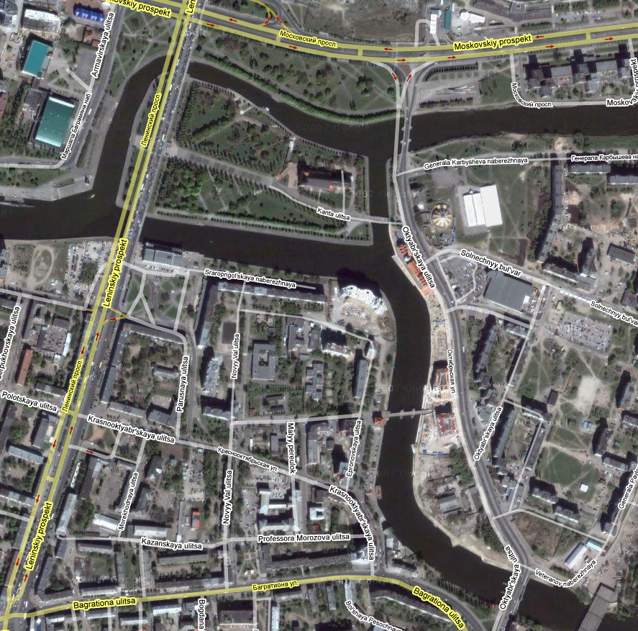
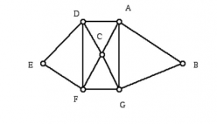
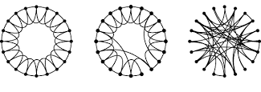
Overview
Section 1: Graph theory:
  Origins (Eulerian graphs)
Section 2: Complex networks:
  Random graphs (Erdos-Renyi)
  Small world graphs (Watts-Strogatz)
  Scale free graphs (Barabasi-Albert)
  The configuration model (Molloy-Reed)

Slide 4
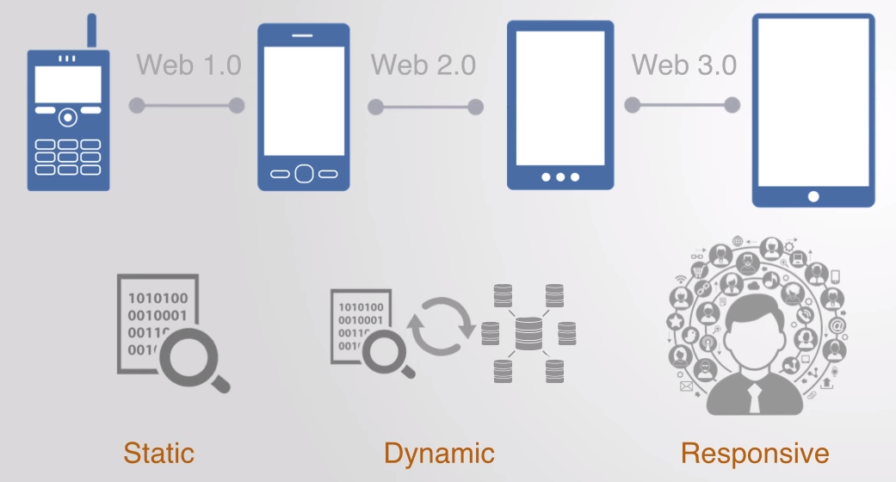
Complexity
The need for the development of tools to study networks as the systems modeling the world have evolved:
Complexity: as the networks have shifted from simple and small to complex and extremely large,
  Complex vs. complicated: car example.
Adaptively: as the modeling transitioned from static graphs to dynamic graphs (like geometry to calculus), and now to responsive graph
play video to minute 2:27

Slide 5
Why Networks?
Nothing happens in isolation: “everything is connected, caused by, and interacting with a huge number of other pieces of a complex universal puzzle” (AL Barabasi, “Linked”)
The power of the network is in the links
However, most people don’t see the links till they are exposed to them.

Slide 6
Why Network Science?
It is the newest science (20 years old or so) and a very active field, relevant to the type and amount of data available nowadays
It is applicable to the study of the structural evolution of large networks
It studies networks holistically
It models phenomena around us: can be done in multiple ways and at different levels/depths
It can be used both for passive and active measurements

Slide 7
Network Science Original Papers
1998
Watts-Strogatz paper in the most cited Nature publication from 1998; highlighted by ISI as one of the ten most cited papers in physics in the decade after its publication.
1999
Barabasi and Albert paper is the most cited Science paper in 1999; highlighted by ISI as one of the ten most cited papers in physics in the decade after its publication.
2001
Pastor-Satorras and Vespignani is one of the two most cited papers among the papers published in 2001 by Physical Review Letters.
2002
Girvan-Newman is the most cited paper in 2002 Proceedings of the National Academy of Sciences.

Slide 8
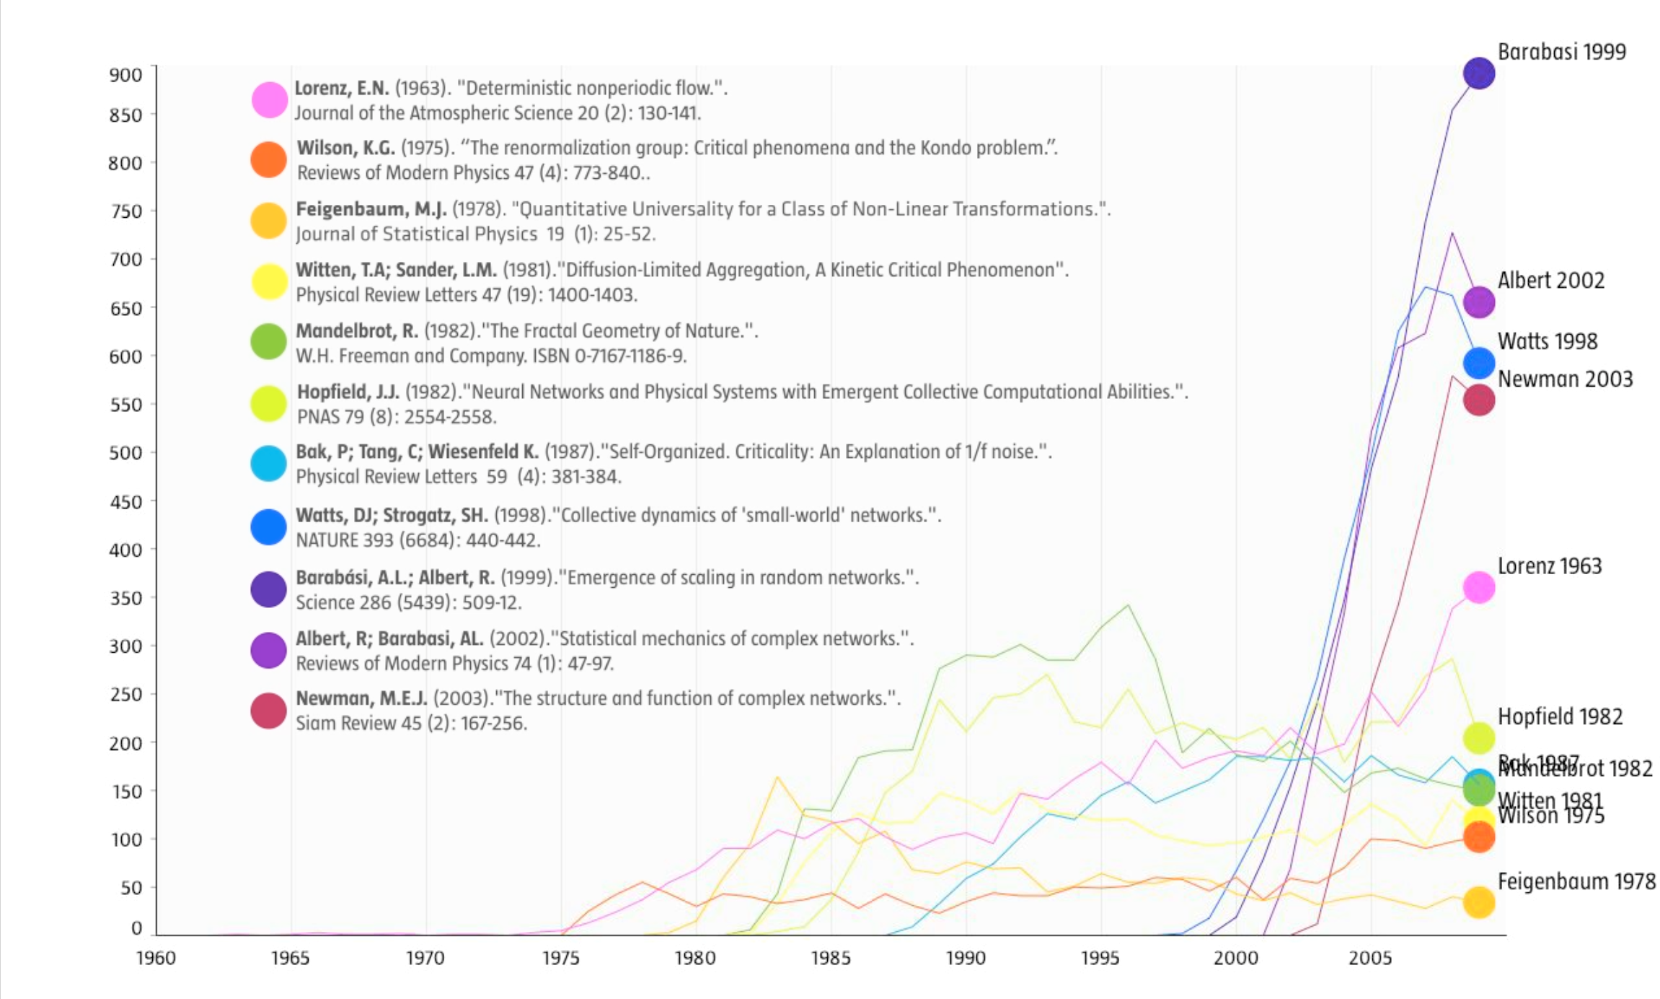
Network
Science:
The Science of the
21stcentury
Network Science: Introduction 2012

Slide 9
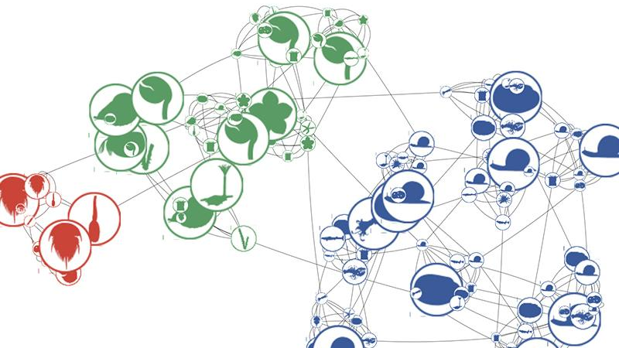
History of Network Science:
Origins
1735: Euler was puzzled by solving the bridges of Königsberg (origins of graph theory)
1950: Erdos was puzzled by social networks structure
1999: Barabasi was puzzle by the Internet
Now: we are puzzled by all of them (brain, social networks, communication and transportation networks, etc)

Slide 10
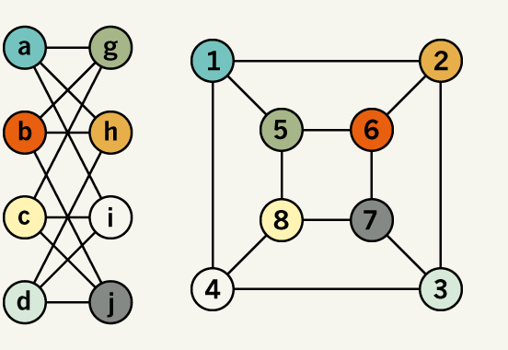
1735: Graph Theory

Slide 11
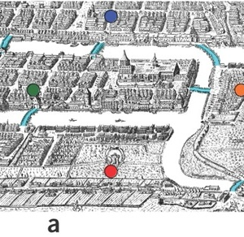
Origins of Graph Theory:
Seven Bridges of Königsberg
The Seven Bridges of Königsberg (the problem that is at the origin of graph theory) was posed by Leonhard Euler in 1735
(also prefigured the idea of topology)
The citizens of Königsberg supposedly walked about on Sundays trying to find a route that crosses each bridge Königsberg of exactly once, and return to the starting point.

Slide 12
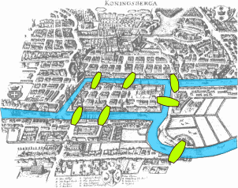
Königsberg Bridges
(now Kaliningrad, Russia)
e₁
X
e₂
e₆
Find a route that:
Starts and finishes at the same place?
Crosses each bridge exactly once?
A vertex : a region
An edge : a bridge between two regions
W
e₅
Y
e₄
e₃
e₇
Z
X
W
Y
Z

Slide 13
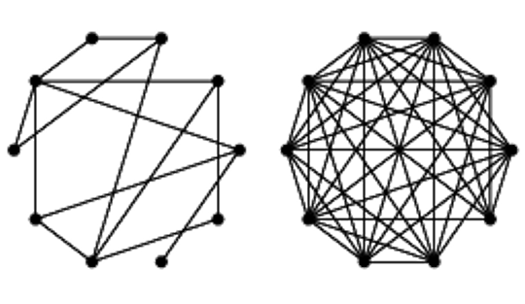
Analysis of Complex Networks
1950: Erdos-Renyi (ER) random graph model

Slide 14
From Simple to Complex Networks
Simple graphs (the ones we have seen in graph theory):
have a small number of vertices,
which interact according to well understood laws
usually static in time (at least on small time intervals).
Complex networks (no established definition):
very large and contain mixt type of data
evolve (In 1990 the WWW had only one page. Now it has a few billion pages)
generally, display organization with no apparent external organizing principle being applied, and no internal control

Slide 15
Goals (for Complex Networks)
Goals of studying complex networks
to extract emergent properties
to understand the function of such complex systems
to be able to predict changes in the network
to control how the network evolves
In order to understand a complex system, we need to grasp the network that models it.

Slide 16
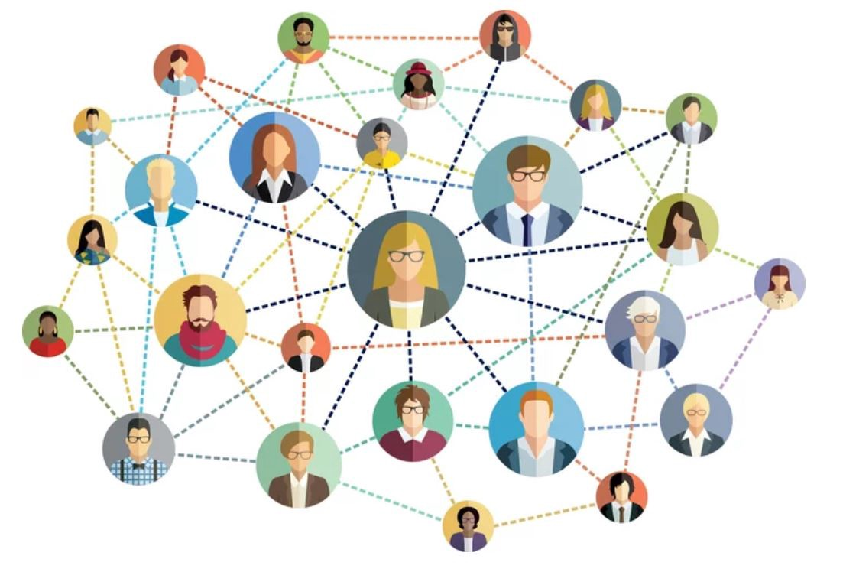
Graph Theory
The formulation of graph theory is attributed to Euler (bridges of Königsberg)
Graph Theory became more popular due in great part to Erdös.
  Erdös interest in networks was also a puzzle (a social puzzle):
What is the structure of social networks?
He formally introduced random graphs (1950s):
  graphs in which the existence of an edge is given with a probability p.

Slide 17
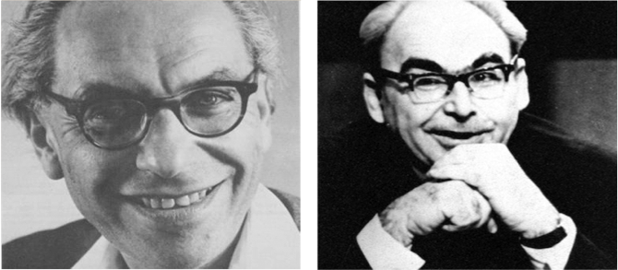
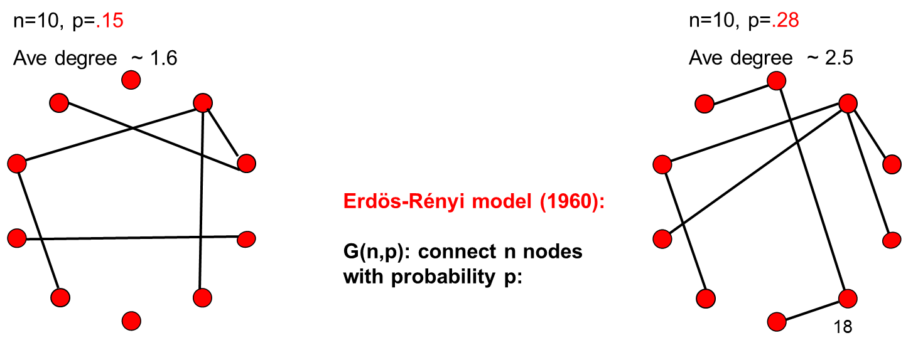
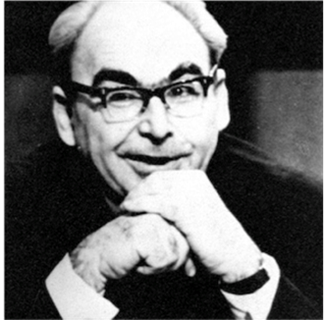
Erdös and Rényi
Erdös and Rényi, pursued the theoretical analysis of the properties of random graphs: How do networks form?
Pául Erdös (1913-1996)
Alfréd Rényi (1921-1970)

Slide 18
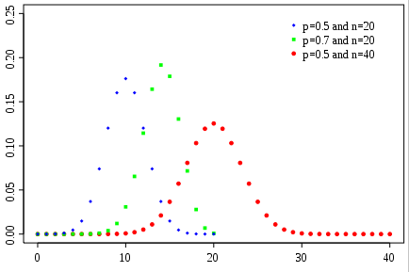

ER(n,p) graphs
ER(100,.03)
Given n nodes,
Expected number of edges is $m=\left(\begin{aligned}n \\ 2\end{aligned}\right)p$
Expected average degree is $\left(n−1\right)p$ since
$\frac{\sum_{v}{\deg{v}}}{n}=\frac{2m}{n}$ =$\frac{1}{n}2\left(\begin{aligned}n \\ 2\end{aligned}\right)p=\frac{1}{n}2\frac{n(n−1)}{2}p=\left(n−1\right)p$
Examples of G(n, density): https://www.youtube.com/watch?v=mpe44sTSoF8
Binomial degree distribution
frequency
degree
Source for pictures: Network Science: Random Graphs 2012
Network Science: Random Graphs 2012

Slide 19
Erdos and Renyi’s work
They equated complexity with randomness.
Is that really the case? Do connections form at random with equal probably of attachment?
  Researchers don’t believe that now (we’ll see why)
  However, it was a good model to begin with (still used today as the null model, in part due to the ease of analysis due to the independence of the edges being present).
Erdos and Renyi didn’t providing universal theory for network formation
  Rather the mathematical beauty got them intrigued more than capturing the way nature creates networks.

Slide 20
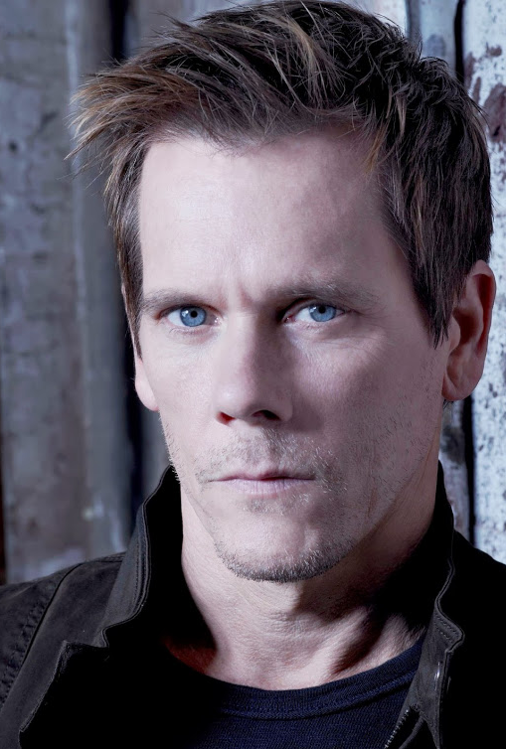
Data-driven research:
Lots of experimental work led to the discovery that social networks are not random, rather they display:
(1) small-world phenomenon:
  Small average distance (six-degree of separation phenomenon) and
  high clustering coefficient
  (2) power law/exponential degree distribution: few hubs and many small degree vertices
Thus, researchers got more interested in the applications (along with the beauty and depth of then mathematics)
  Kevin Bacon number

Slide 21
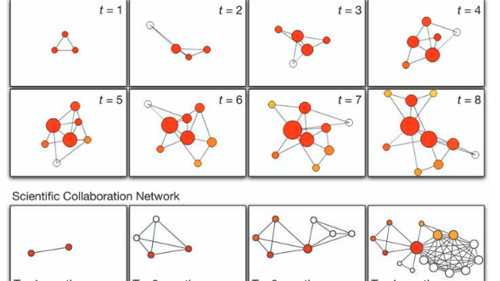
Next exploration:
Analysis of Complex Networks
  Small worlds (Watz-Strogatz)
  Scale free graphs (Barabási-Albert)
  The configuration model (Molloy-Reed)
  Random geometric model (Gilbert)

Slide 22
Main References
Newman, ME, The Structure and Function of Complex Networks, SIAM 2003
Watts, DJ; Strogatz, S H. 1998.
Collective dynamics of 'small-world' networks, NATURE 393(668).
Barabasi, AL. Network Science

