Slide 1
Excellence Through Knowledge
Prof. Ralucca Gera, rgera@nps.edu
Applied Mathematics Department,
Naval Postgraduate School
MA4404 Complex Networks
Network Science Overview (part 2)

Slide 2
Learning Outcomes
Identify the main concepts of complex network analysis used in network analysis.
Distinguish methodologies used in analyzing networks.
Restate the meaning of:
  Small world

Slide 3
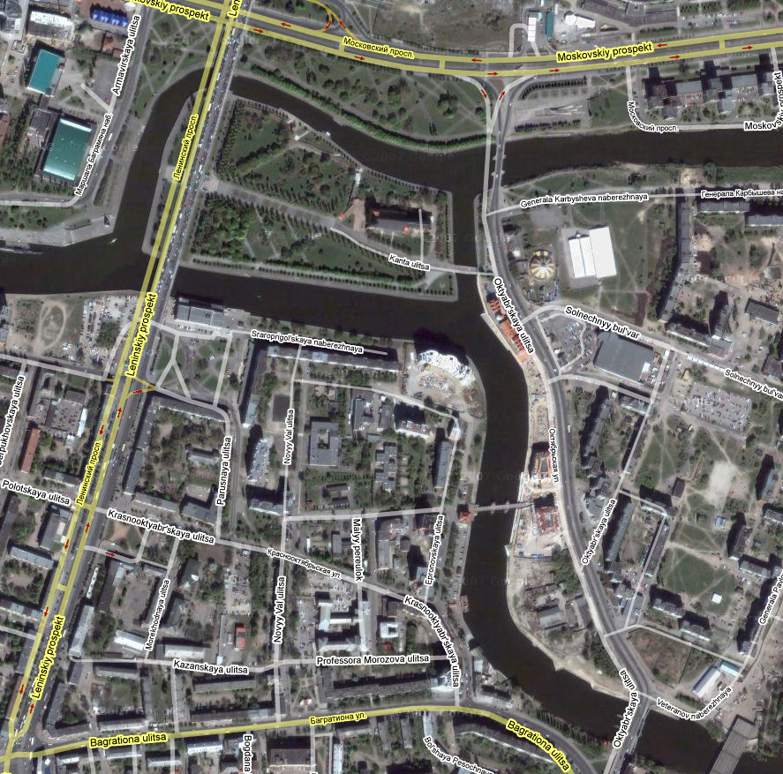
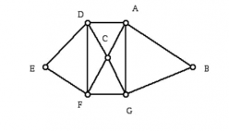
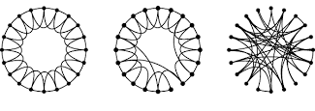
Overview
Section 1: Graph theory:
  Origins (Eulerian graphs)
Section 2: Complex networks:
  Random graphs (Erdos-Renyi)
  Small world graphs (Watts-Strogatz)
  Scale free graphs (Barabasi-Albert)
  The configuration model (Molloy-Reed)

Slide 4
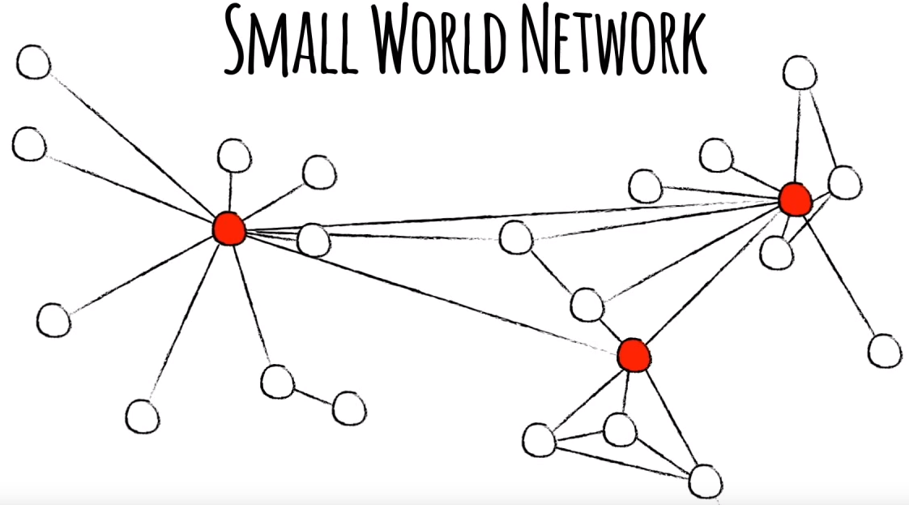
1998: Small World Model​
(Watts & Strogatz, 1998)​
​

Slide 5

Data Driven Research:
Lots of experimental work led to the discovery that social networks are not random, rather they display:
(1) small-world phenomenon:
  Small average distance (six-degree of separation phenomenon) and
  High clustering coefficient (your friends are friends with eachother)
  (2) power law/exponential degree distribution: few hubs and many small degree vertices
Thus, researchers got more interested in the applications (along with the beauty and depth of then mathematics)
Kevin Bacon number

Slide 6
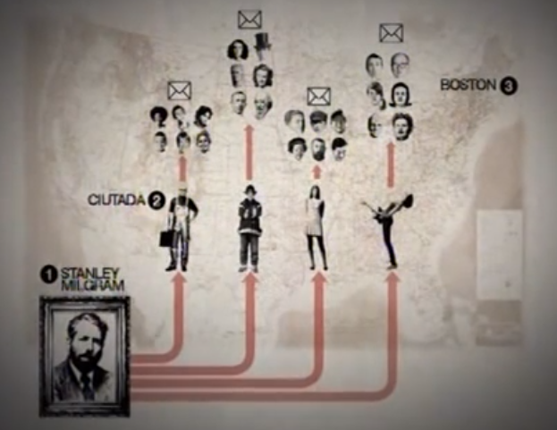
Stanly Milgram's Experiment
The 1st experiment of this kind dates back to the 60s to Prof. Milgram (a Harvard psychology professor)
In 1967 Milgram studied the structure of social networks:
  What is the average path length for social networks?
  Experiment: 296 random individuals from two US cities (Omaha, Nebraska and Wichita, Kansas), were asked to forward a letter to a target contact in Boston.
  Results:
    only 20 percent of the packages sent reached their target,
    an average number of hops of 6 (although this number does not take into account the remaining 80 percent of the undelivered packages).
Play video

Slide 7
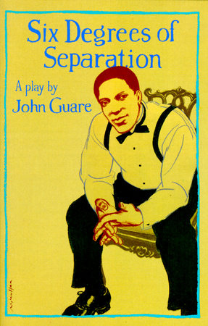
Stanly Milgram's Experiment (2)
His experiment was confined to US,
linking people “out there” in Wichita and Omaha to
“over here” in Boston
This was coined “small world” in network science
In 1991 a play by John Guare named
“Everybody on this planet is separated
by only six other people”
  made the “six degree of separation” expression into
  a myth (yet famous) applied to the world since more
  people watch movies than read sociology.
https://www.penguinrandomhouse.com/books/72632/six-degrees-of-separation-by-john-guare/
  Source: (Barabasi from “Linked”)

Slide 8
More Recently on Small World:
The experiment was later reproduced by Dodds:
  used email as a medium to collect data for research
  at a more global scale (18 targets, 13 countries, 60K participants) which resulted in 384 messages reaching their target,
  yielding an average path length of 4.
Recently using FB and LinkedIn social media.
Same pattern in Nature:
Play video

Slide 9
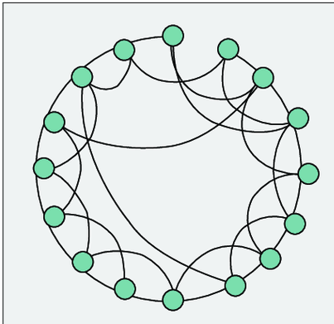
Small World
So small world referrers to small average path length compared to the number of nodes in the network and high clustering coefficient
It is a property that has been observed in networks in general, regardless of the physical distance between the people the network connects
Original belief: some nodes are believed to be at the core of a network
  Updated current belief: it is an effect of everyone being close to everyone

Slide 10
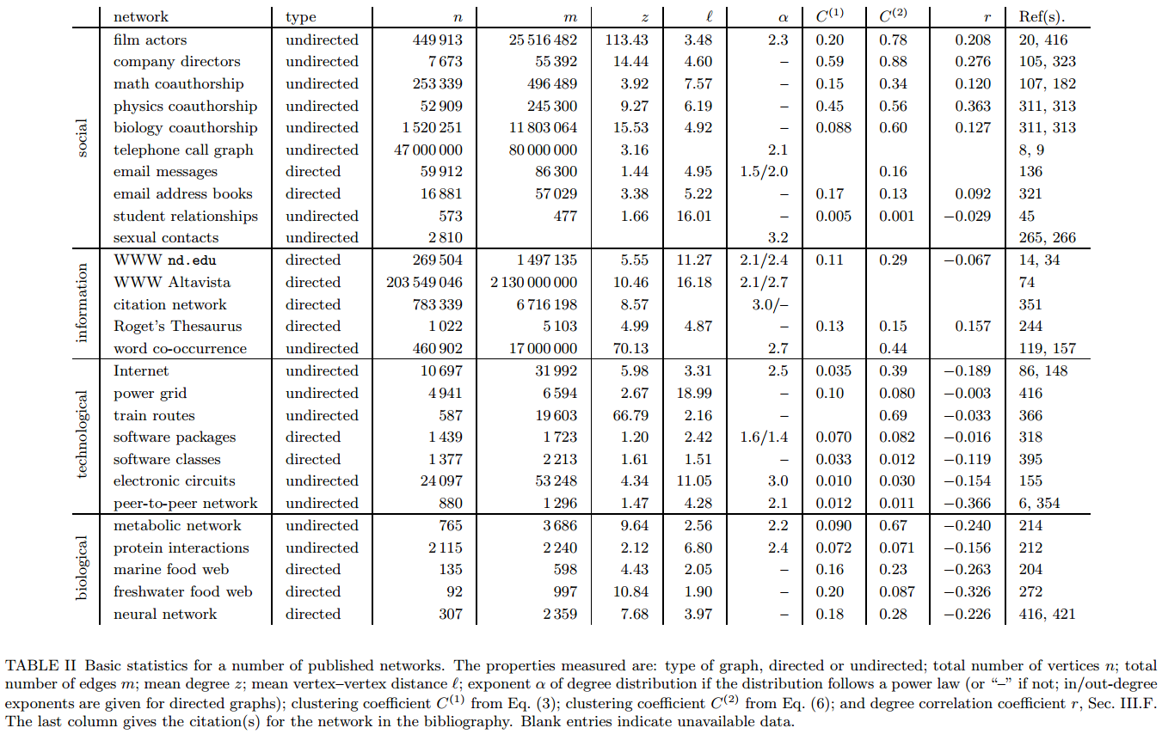
Newman’s overview table of networks
Avg
deg
Avg
path
Eponent
powerlaw
|V(G)|
|E(G)|
Clustering coeff
homophily
Source: Newman, The Structure and Function of Complex Networks, SIAM 2003

Slide 11
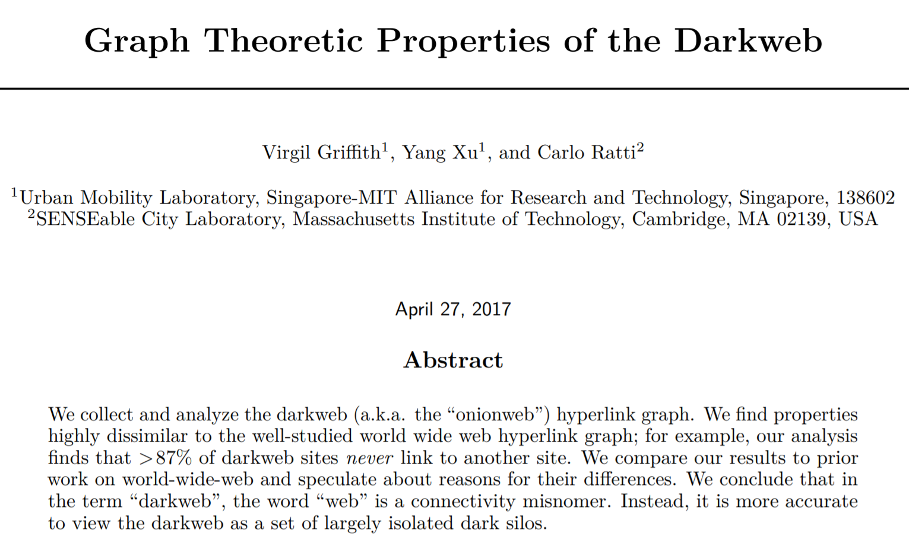
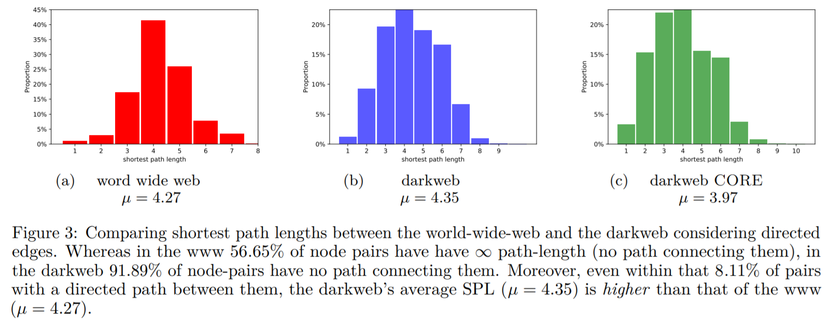
“Small” Path Length: Examples
Source: https://arxiv.org/pdf/1704.07525.pdf
11

Slide 12
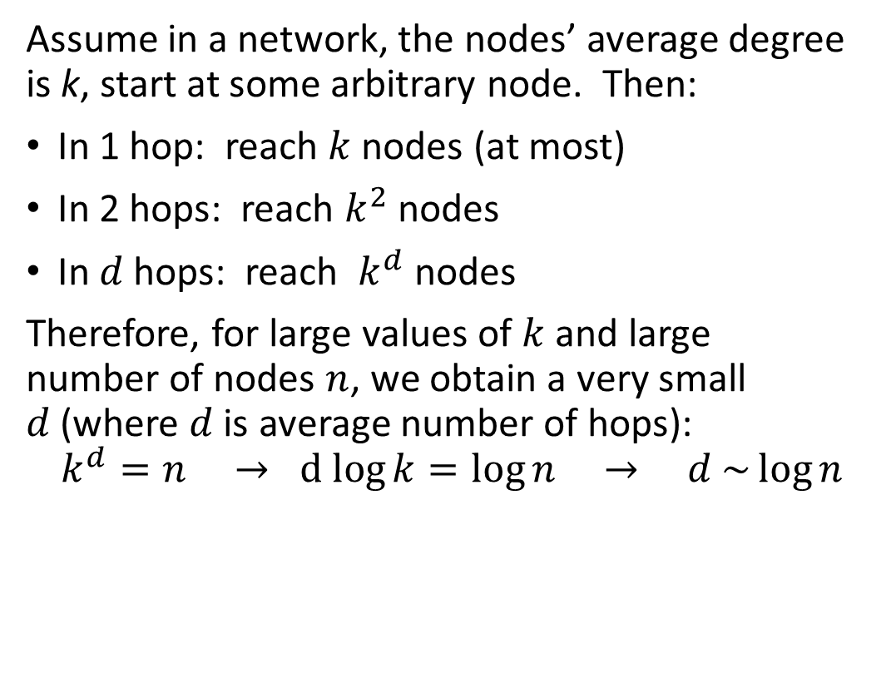

Small Path Length: Derivation
Assume in a network, the nodes’ average degree is k, start at some arbitrary node. Then:
In 1 hop: reach $k$nodes (at most)
In 2 hops: reach $k^{2}$ nodes
In $d$ hops: reach $k^{d}$ nodes
Therefore, for large values of $k$ and large
number of nodes $n$, we obtain a very small
$d$ (where $d$ is average number of hops):
$$k^{d}=n →d log{k}=\log{n → d \sim \log{n}}$$
$log_{10} (n)$, where n is number of nodes

Slide 13
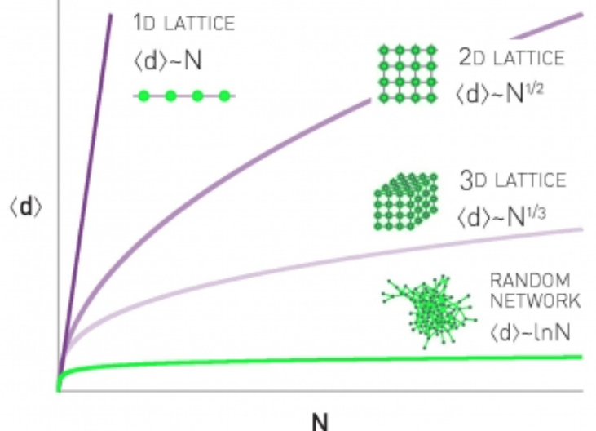
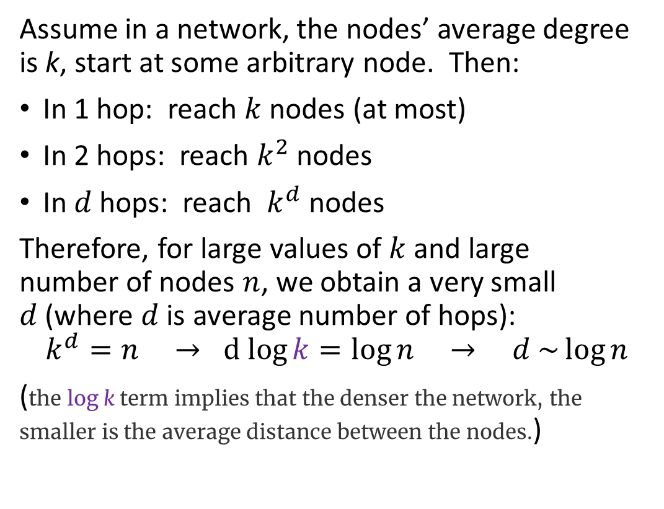
Small Path Length: Derivation
Assume in a network, the nodes’ average degree is k, start at some arbitrary node. Then:
In 1 hop: reach $k$nodes (at most)
In 2 hops: reach $k^{2}$ nodes
In $d$ hops: reach $k^{d}$ nodes
Therefore, for large values of $k$ and large
number of nodes $n$, we obtain a very small
$d$ (where $d$ is average number of hops):
$$k^{d}=n →d log{k}=\log{n → d \sim \log{n}}$$
(the log k term implies that the denser the network, the smaller is the average distance between the nodes.)
http://networksciencebook.com/chapter/3#small-worlds

Slide 14
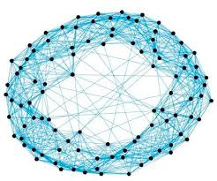
How Do We construct Small-words?
Watts offered a modified alternative of the
E-R random graphs, that
  reconciled clustering/short path
  with radon graphs
By envisioning that people live on a circle, and they make friends based on proximity to neighbors → not a small world anymore
So to make it realistic, they add randomness to this world (since we have friends and relatives that could be half way across the world)

Slide 15
Small-words: Watts-Strogatz model
This is a model introduced by Watts-Strogatz: Networks that share properties of both regular and random graphs
(Watts was the PhD student, and Strogatz was his advisor) :
Begin with a low-dimensional regular lattice Randomly rewire some of the links with a probability p For small p a mostly regular graph is produced Small-world properties are obtained through the randomly wired links
 | Regular/lattice | Small world | Random graphs
clustering coefficient | High | High | Low
average path length | High | Low | Low
p = probability of rewiring edges of the lattice
Source: Watts, DJ; Strogatz, S H. 1998.
Collective dynamics of 'small-world' networks, NATURE 393(668).

Slide 16
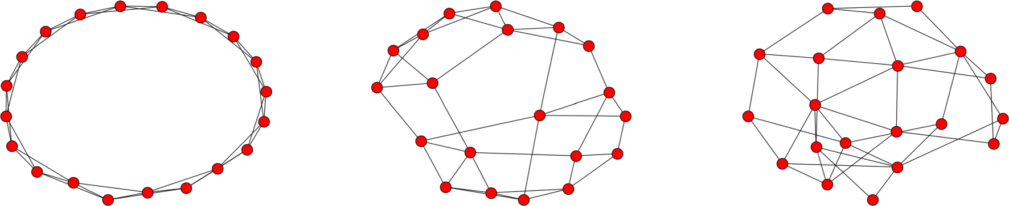
WS model of small world
The WS model turned out to be a wonderful model generating interests among the researchers, and still used today in complex networks analysis, as an ordered world sprinkled with randomness.
Downsides:
  both ER and WS depict an egalitarian world, where edges attach to existing equal nodes based on rolling a dice
  WS networks don’t grow
https://link.springer.com/article/10.1007/s13538-020-00772-9/figures/9

Slide 17
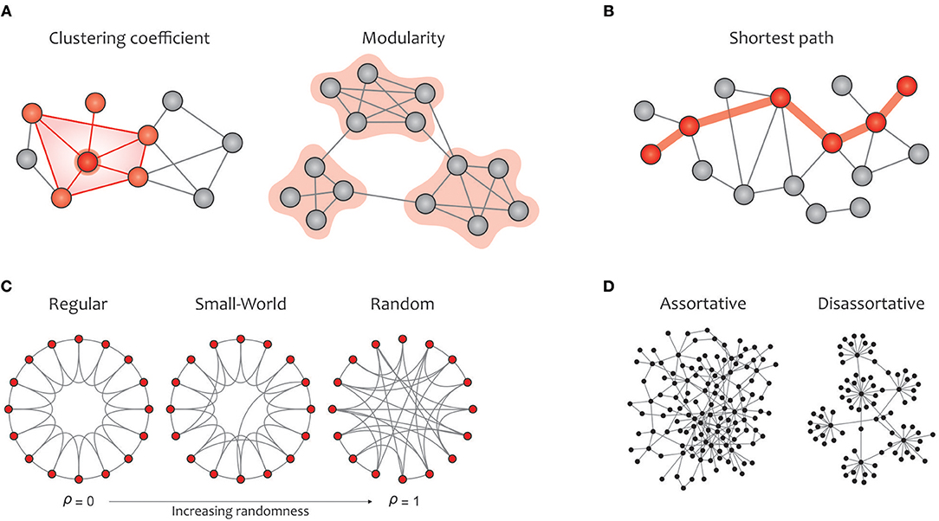
Average path + clustering = ?
Moreover, average path length is not enough to study these networks.
Has been augmented by clustering, and even that is not enough
Generally: degree distribution, average path and clustering, plus possibly more,
And even together
they don’t characterize networks
(There are plenty of networks with the same values for all 3, yet they are not the same network)

Slide 18
Next: Analysis of Complex Networks
  Scale free graphs (Barabási-Albert)
  The configuration model (Molloy-Reed)
  Random geometric model (Gilbert)

Slide 19
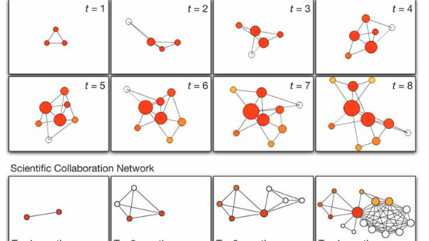
Next exploration:
Analysis of Complex Networks
  Scale free graphs (Barabási-Albert)
  The configuration model (Molloy-Reed)
  Random geometric model (Gilbert)

Slide 20
Main References
Newman, ME, The Structure and Function of Complex Networks, SIAM 2003
Watts, DJ; Strogatz, S H. 1998.
Collective dynamics of 'small-world' networks, NATURE 393(668).
Barabasi, AL. Network Science

