Slide 1
Excellence Through Knowledge
Prof. Ralucca Gera, rgera@nps.edu
Applied Mathematics Department, Naval Postgraduate School
MA4404 Complex Networks
Network Science Overview (part 3)

Slide 2
Learning Outcomes
Identify the main concepts of complex network analysis used in network analysis.
Distinguish methodologies used in analyzing networks.
Restate the meaning of:
Scale free
Configuration model

Slide 3
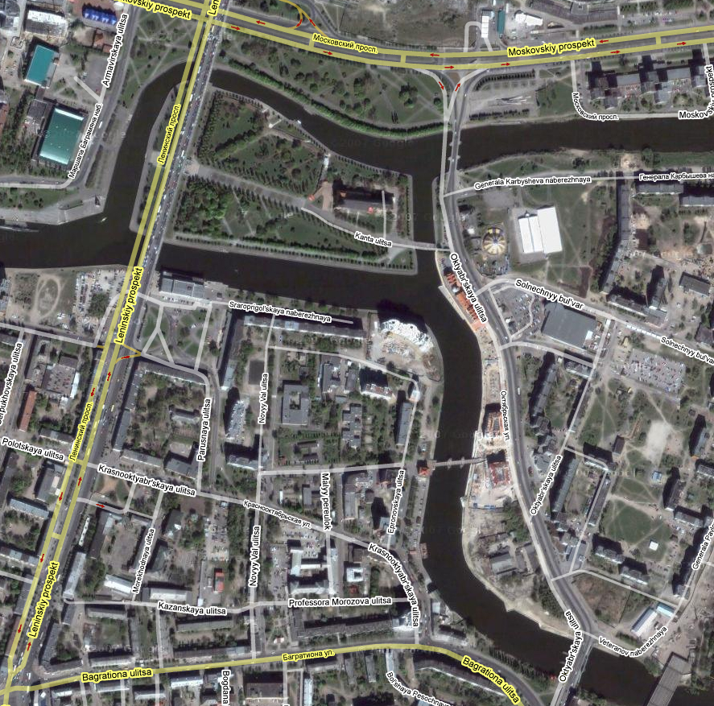
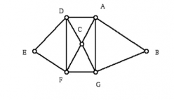
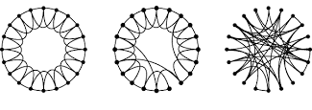
Overview
Section 1: Graph theory:
Origins (Eulerian graphs)
Section 2: Complex networks:
Random graphs (Erdos-Renyi)
Small world graphs (Watts-Strogatz)
Scale free graphs (Barabasi-Albert)
The configuration model (Molloy-Reed)

Slide 4
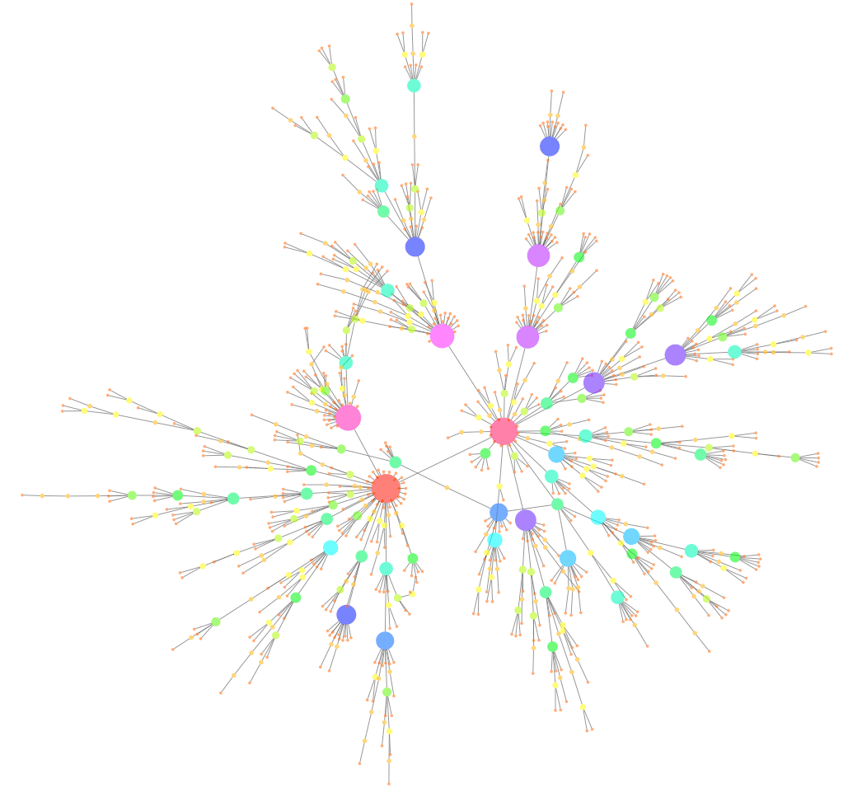
Barabási-Albert (BA) Preferential Attachment Model (Barabási & Albert, 1999)

Slide 5
Why?
The Inception of the World Wide Web
Tim Berners-Lee in 1980 said “Suppose all the information stored on computers everywhere were linked…All the best information in every computer at CERN (European Organization for Nuclear Research, a French organization) and on the planet would be available to me and everyone else.” He wrote a program that allowed computers to share information. A year later, this turned into the WWW.
A history of the Internet through pictures here!
https://www.theguardian.com/technology/2017/mar/11/tim-berners-lee-web-inventor-save-internet
https://webdesign.tutsplus.com/articles/a-brief-history-of-the-world-wide-web--webdesign-8710
Source: Barabasi, “Linked”, 2002

Slide 6
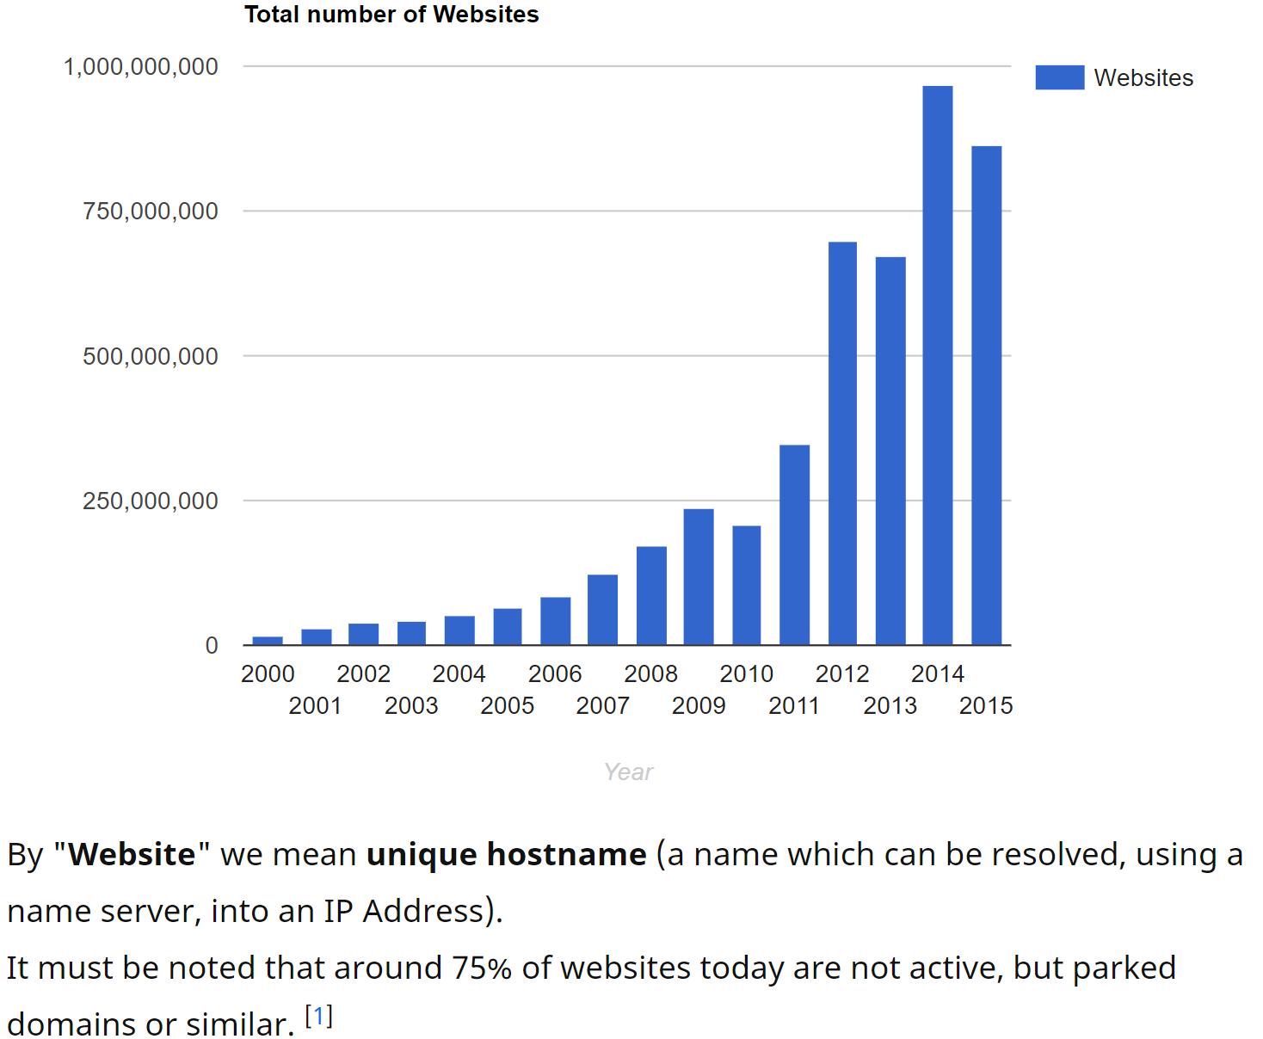
What?
The WWW is a network:
Nodes: website (web pages) containing all the information publicly available
Links: hyperlinks (directed network)
The strength of this network is in the links: they provide correlations between documents
In a decade (in 1999) WWW had a billion docs.
Question to answer: What does WWW look like? Is it a random graph? Is it a small world?
There are about 47billion webpage
http://www.worldwidewebsize.com/

Slide 7
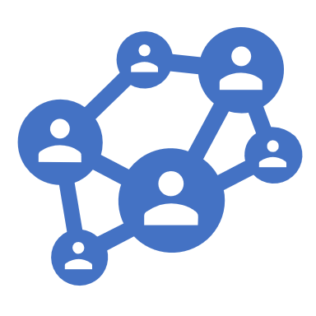
Measuring the World Wide Web
What does WWW look like? Why would we care if the WWW is a small word?
Are the WWW and social networks similar? Or like the brain? Or other networks..
Is there hope to learn from one network and transfer to the other if they are similar?
We don’t really know how to measure this similarity: are we saying that if two networks have the same property (small world) then they are similar?
If they are different, then why? Finding the “why” behind the observations is what we search for in Complex Networks.

Slide 8
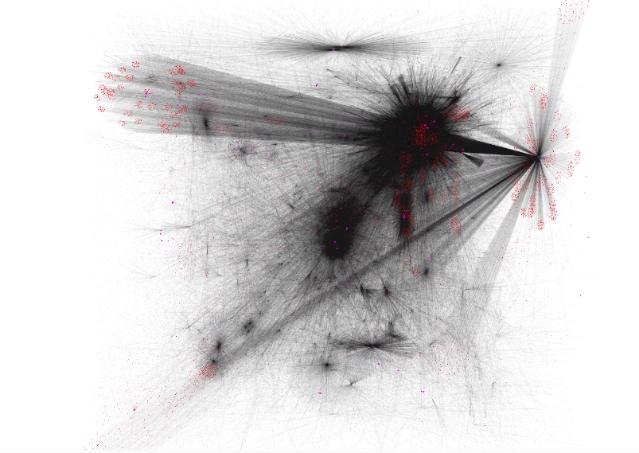
How?
How to infer the WWW?
Barabási and Albert (1999) created a crawler that randomly walked the Notre Dame (nd.edu) domain and gathered information that created a map of this domain:
300,000 nodes
Average number of hops = 11
Average degree is 7
They asked:
How does this information from nd.edu transfer to the WWW that was 3,000 times larger in 1999?
Is the average path length of 3,000 x 11 = 33,000?
Source: http://barabasi.com/networksciencebook/chapter/4

Slide 9
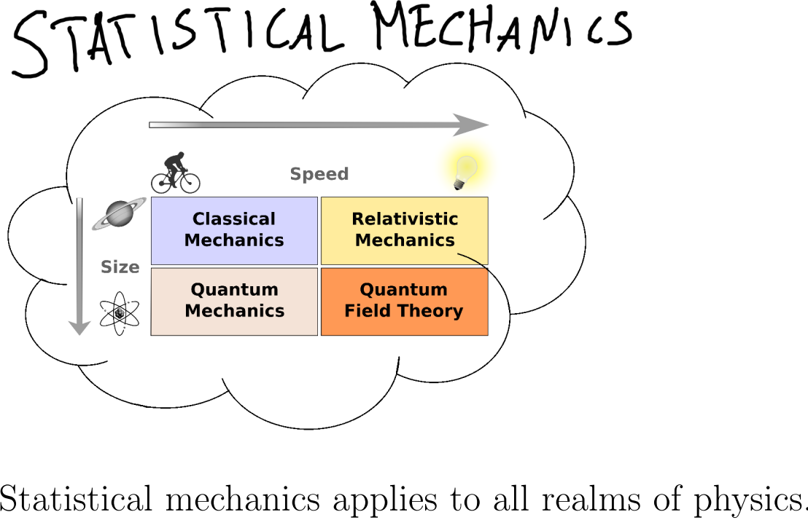
Statistical mechanics
Since nobody has a true map of the WWW (called ground truth), researchers turned to statistical mechanics' approaches.
Statistical mechanics is a field of physics that studies random systems and unpredictable outcomes
https://scholar.harvard.edu/files/noahmiller/files/statistical_mechanics.pdf

Slide 10
Statistical mechanics (2)
“Through analyzing the data of BGP tables in recent 5 years, we find that the average path length of the Internet is descending and the descending rate is about 0.00025 which is much different from the result induced from the theories.”
Form “Does the Average Path Length Grow in the Internet?”
By Jinjing Zhao, Peidong Zhu, Xicheng Lu, Lei Xuan
Average path
Size of the internet

Slide 11
So what?
Since the average degree for WWW is 7, it follows that
in 1 click we can discover 7 pages,
in 2 clicks we can discover $7^{2}$ pages, and so on, and
in 19 clicks we can discover $7^{19}$ pages which is 10 million more pages than the pages available on the Web.
Why?
Some of them repeat.

Slide 12
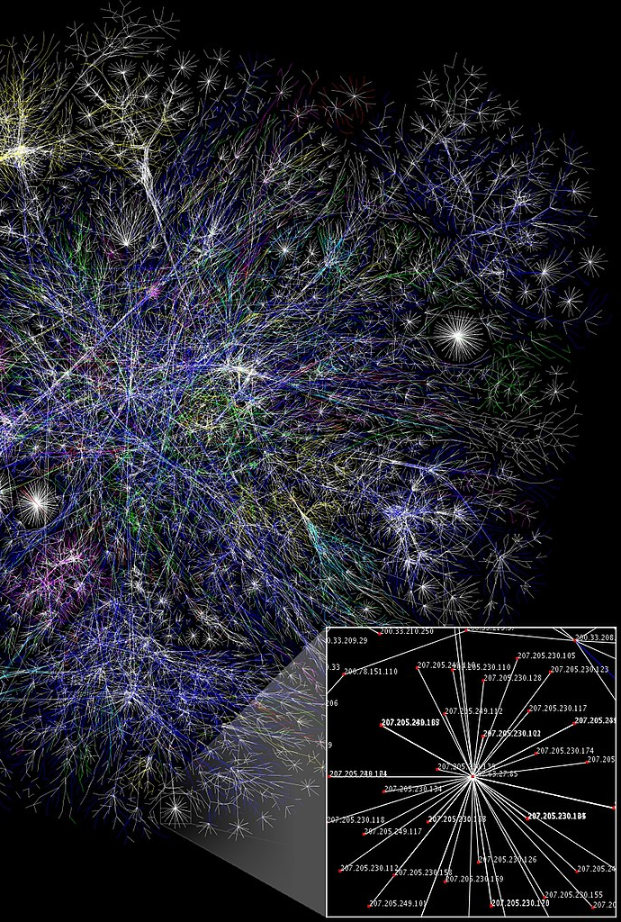
What is new?
The crawler that Barabási and Albert use for the Web discovered hubs (high-degree nodes) that tend to connect different parts of the networks.
There is a need for a new model to account for the hubs (ER and WS models didn’t have hubs)
Do you believe that everybody’s website has an equal chance of being discovered in a random path?
Thinking of the topology (the layout and connections), what does this discovery depend on?
http://networksciencebook.com/chapter/4#hubs

Slide 13
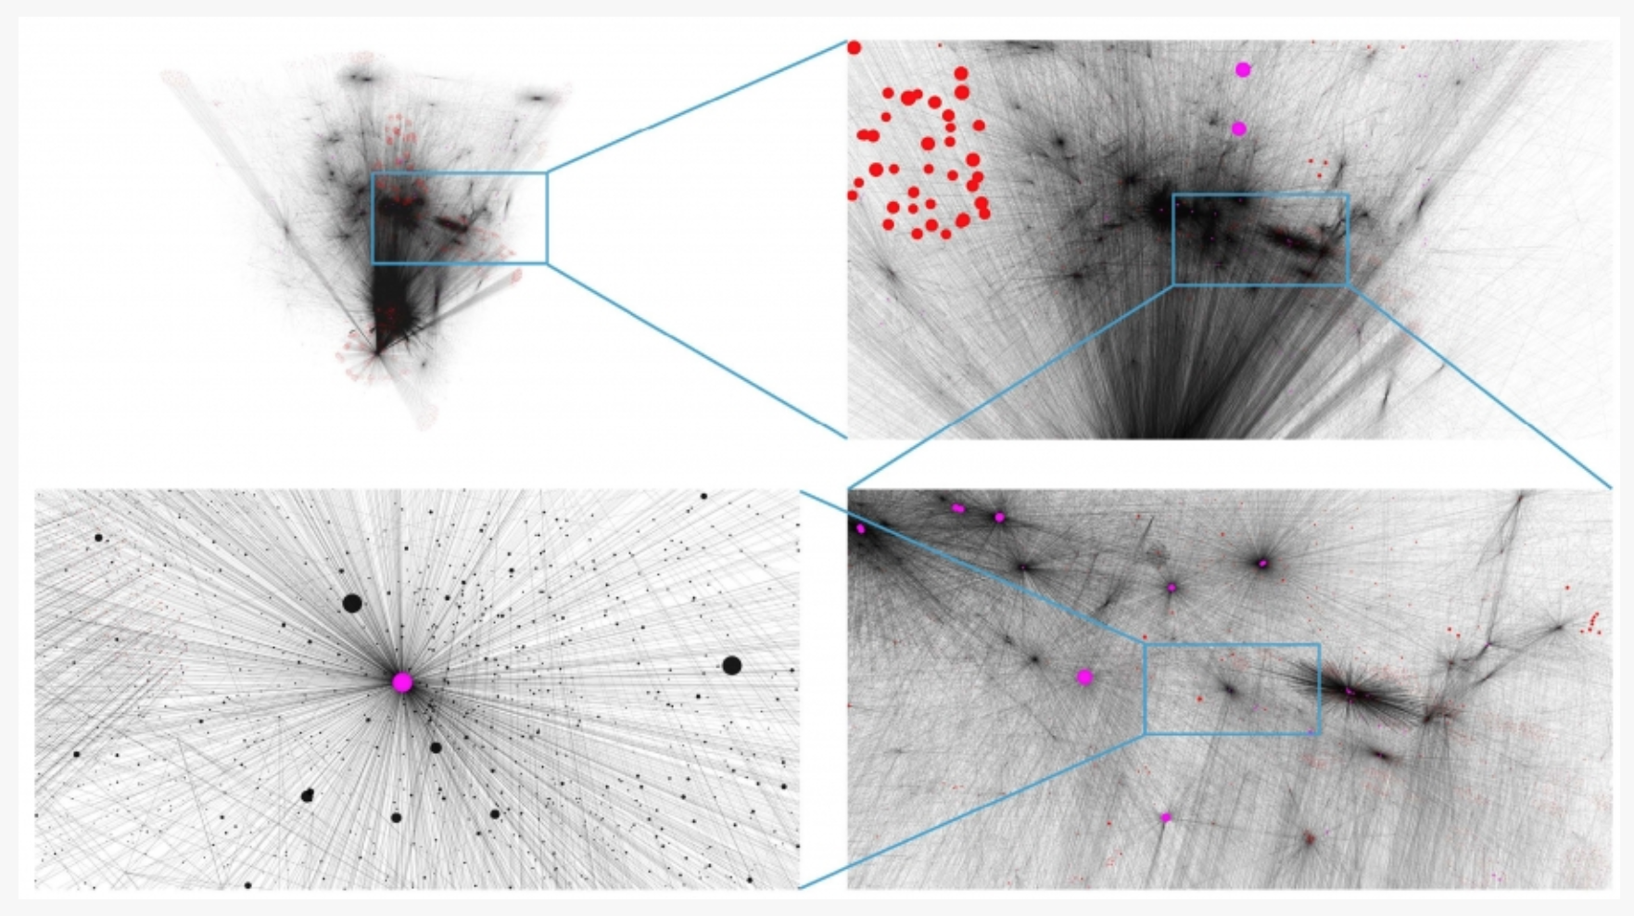
What is new?
325,729 nodes, offering a global view of WWW in 1998
$$\deg{x≥500 }$$
$$\deg{x≥50 }$$
hub
http://networksciencebook.com/chapter/4
Snapshots of the World Wide Web sample mapped out by Hawoong Jeong in 1998

Slide 14
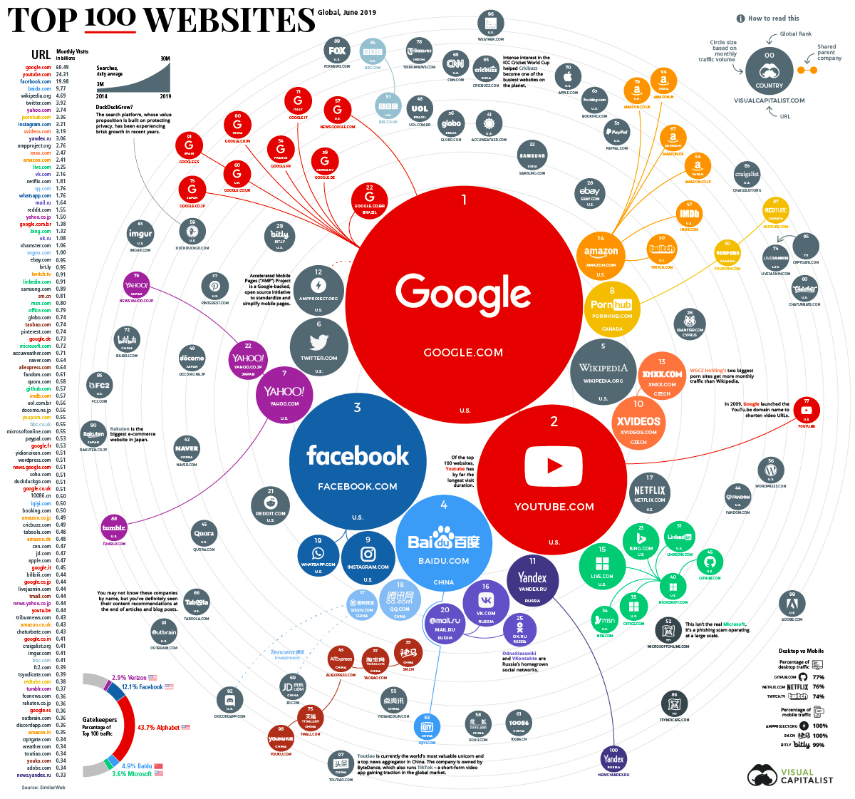
So what?
Will the information a professor posts on personal website be discovered with the same probability as a university department’s website?
One study: If you look at the Web as directed (in the direction of hyperlinks, and some could be bidrectional) then 82% of the pages had less than 3 incoming hyperlinks (only 42 pages had more than 1000 incoming hyperlinks). (from Barabasi, “Linked”)
https://www.visualcapitalist.com/ranking-the-top-100-websites-in-the-world/

Slide 15
Bell shape vs. Scale Free
The same way that WS networks challenged the belief that ER is the model for social networks (ER is missing the small world short average path),
Now a new challenge is present for the small worlds: hubs are not present in neither ER nor WS
Nature generates random distributions (distribution of heights among people) and power law distributions (i.e. scale-free networks)
Notes:
The term “scale-free” is rooted in a branch of statistical physics called the theory

Slide 16
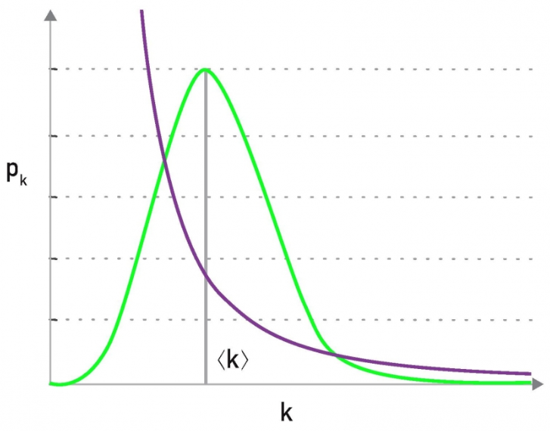
Scale-free Networks
A scale-free network is a network whose degree distribution is power-law. What are some ways of this to emerge?
Generally, it emerges under preferential attachment, but it doesn’t have to.
In a random network, nodes have comparable degrees, the average serves as the “scale” of the network
In a scale free network, the fluctuation from the average degree is large, so the average degree cannot serve as the “scale” of the network.
http://networksciencebook.com/chapter/4#scale-free
Notes:
Random Networks Have a Scale For a random network with a Poisson degree distribution σ_{k} = ‹k›^{1/2}, which is always smaller than 〈k〉. Hence the network’s nodes have degrees in the range k = 〈k〉 ± 〈k〉^{1/2}. In other words nodes in a random network have comparable degrees and the average degree 〈k〉 serves as the “scale” of a random network.
Scale-free Networks Lack a Scale For a network with a power-law degree distribution with γ < 3 the first moment is finite but the second moment is infinite. The divergence of 〈k²〉 (and of σ_{k}) for large N indicates that the fluctuations around the average can be arbitrary large. This means that when we randomly choose a node, we do not know what to expect: The selected node’s degree could be tiny or arbitrarily large. Hence networks with γ ‹ 3 do not have a meaningful internal scale, but are “scale-free”
of phase transitions that extensively explored power laws in the 1960s and 1970s

Slide 17
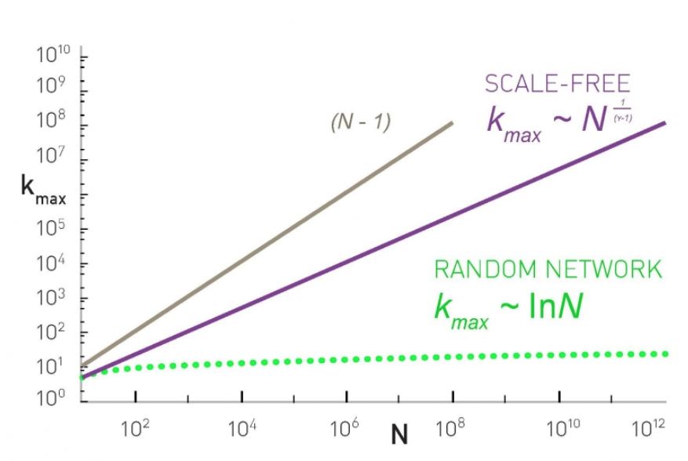
Scale-free Networks
A scale-free network is a network whose degree distribution is power-law. What are some ways of this to emerge?
Generally, it emerges under preferential attachment, but it doesn’t have to.
In a random network, nodes have comparable degrees, the average serves as the “scale” of the network
In a scale free network, the fluctuation from the average degree is large, so the average degree cannot serve as the “scale” of the network.
The degree of a hub
http://networksciencebook.com/chapter/4#scale-free

Slide 18
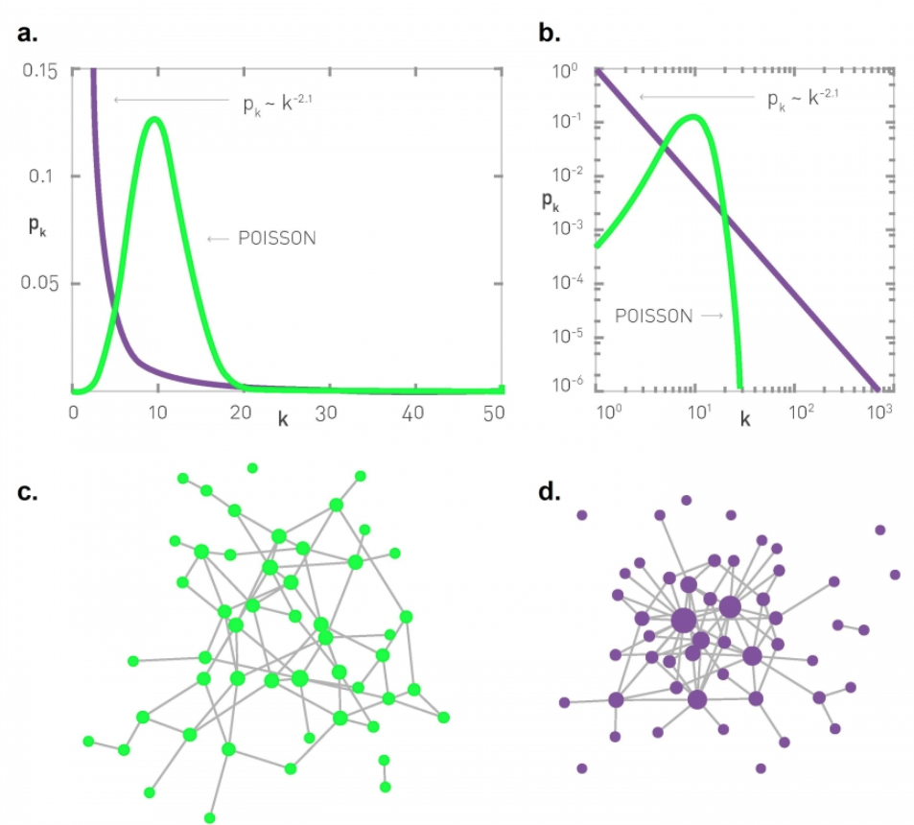
Scale-free Networks
a. Poisson vs. Power-law Distributions Comparing a Poisson function with a power-law function (γ= 2.1) on a linear plot. Both distributions have 〈k〉= 11.
b. The same curves as in (a), but shown on a log-log plot, allowing us to inspect the difference between the two functions in the high-k regime.
c. A random network with 〈k〉= 3 and N = 50, illustrating that most nodes have comparable degree k≈〈k〉
d. A scale-free network with γ=2.1 and 〈k〉=3, illustrating that numerous small-degree nodes coexist with a few highly connected hubs. The size of each node is proportional to its degree.
http://networksciencebook.com/chapter/4#scale-free

Slide 19
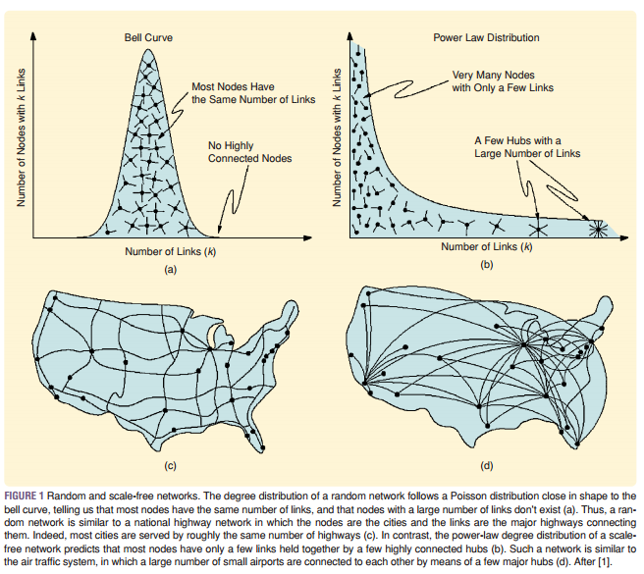
What are the implications of the existence of hubs?
Consider attacks, virus propagation, news dissemination
Airline traffic
network
National highway network
source: Barabási. Linked

Slide 20
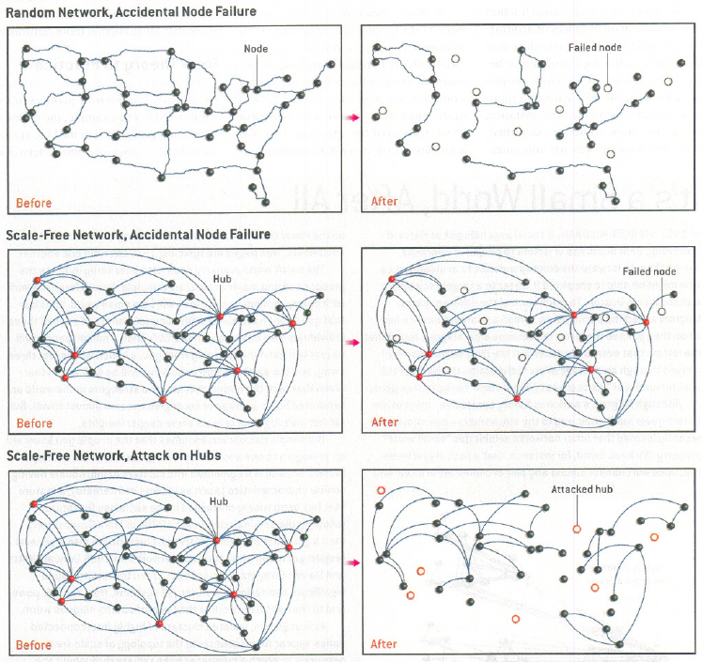
Random vs. Targeted Attack
Robustness
Source:
BARABÁSI and BONABEAU. Scale-Free Networks in SCIENTIFIC AMERICAN (2003)

Slide 21
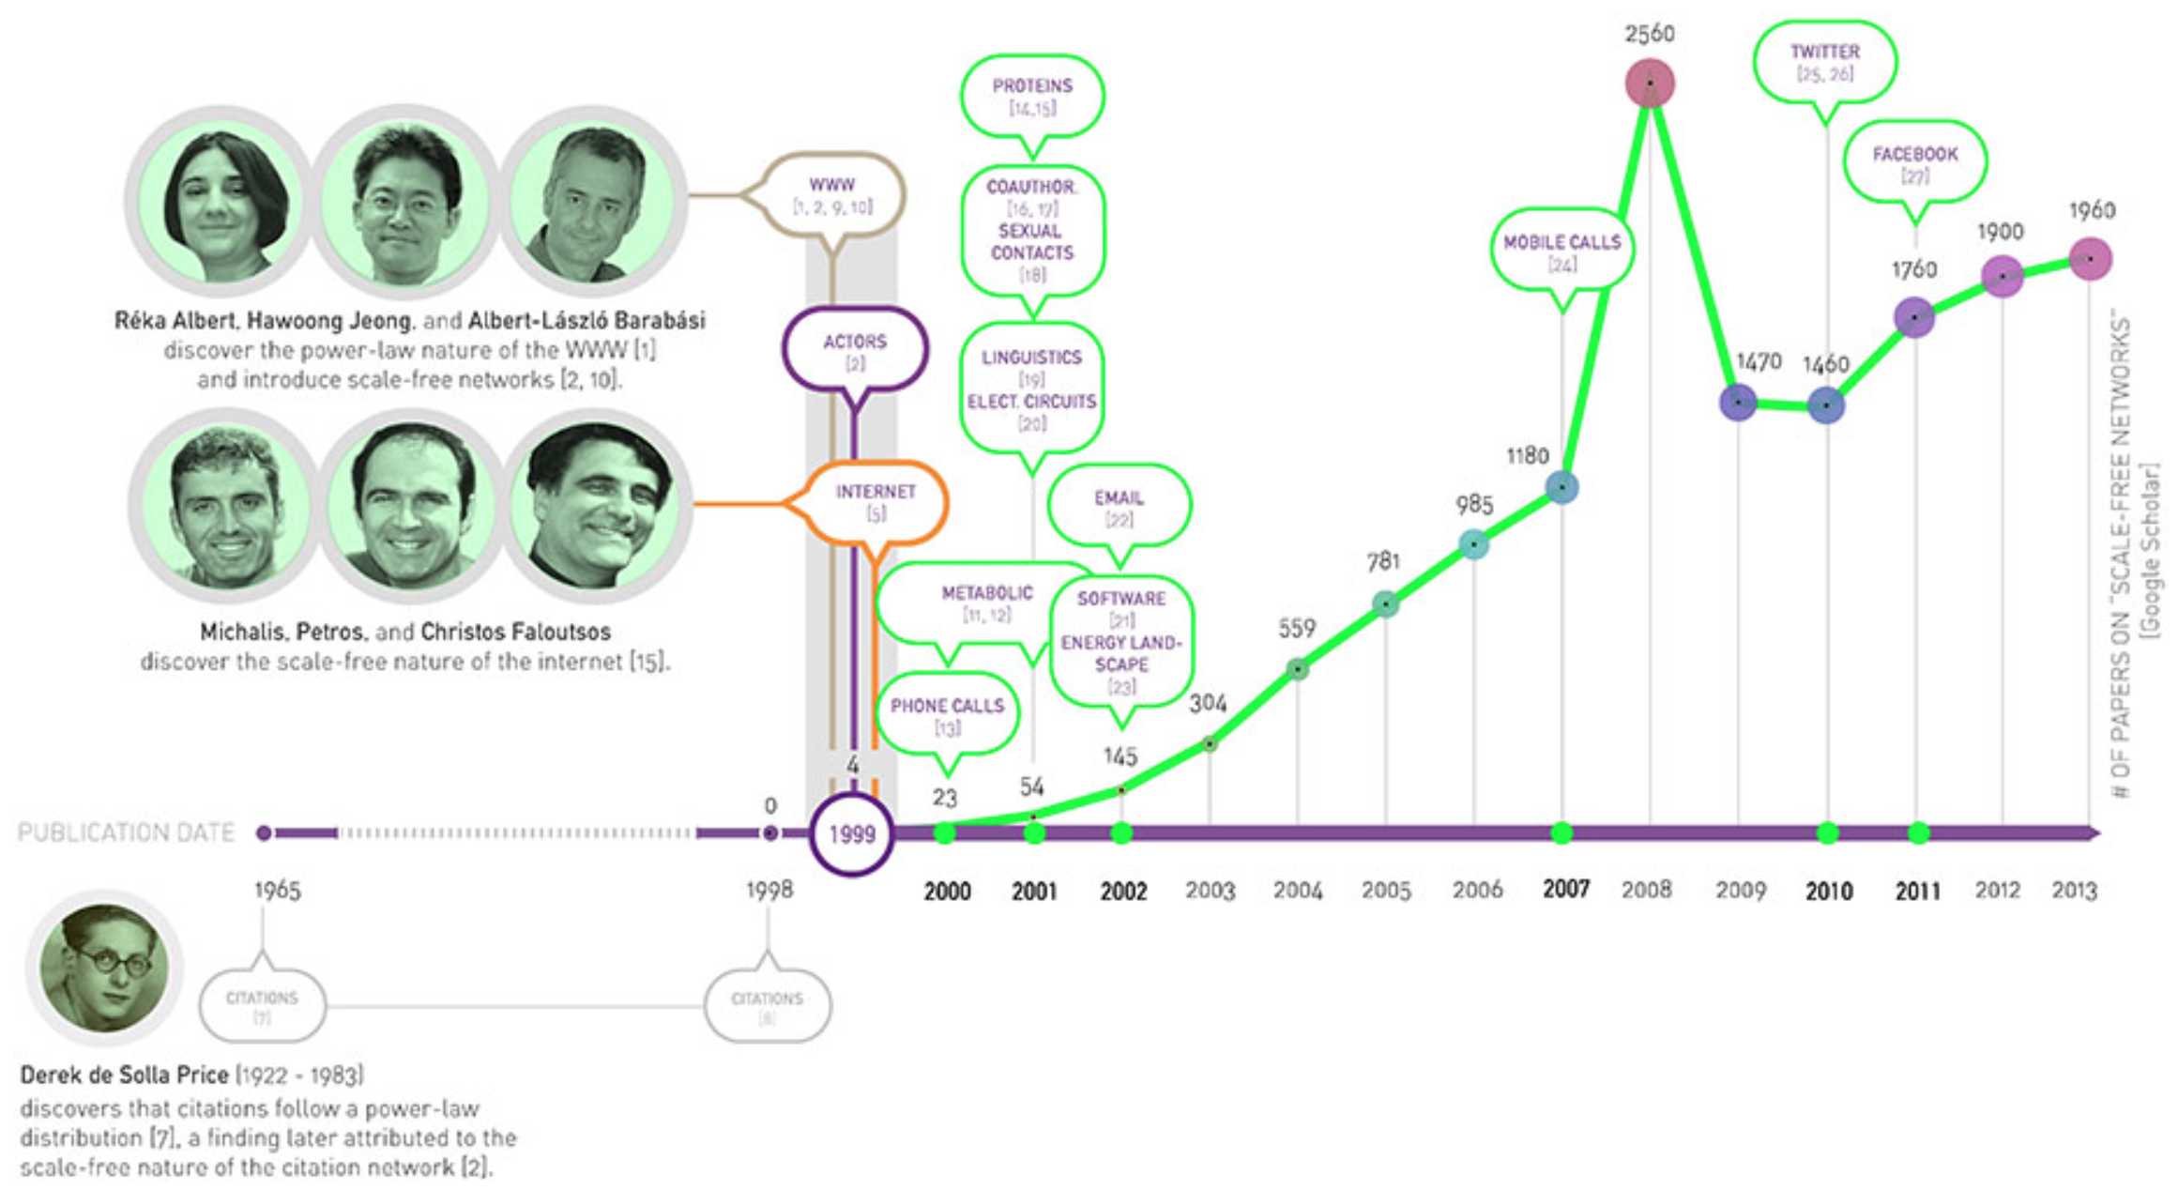
Timeline: Scale-Free Networks (Not All Network Are Scale-Free: power grid for example)
http://networksciencebook.com/chapter/4#universality

Slide 22
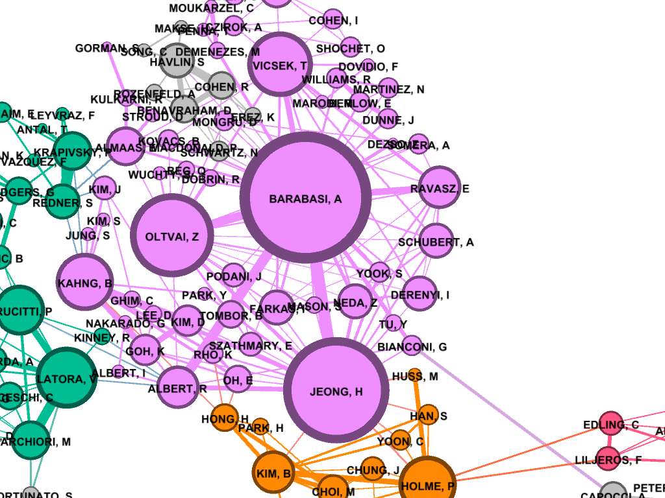
Preferential attachment

Slide 23
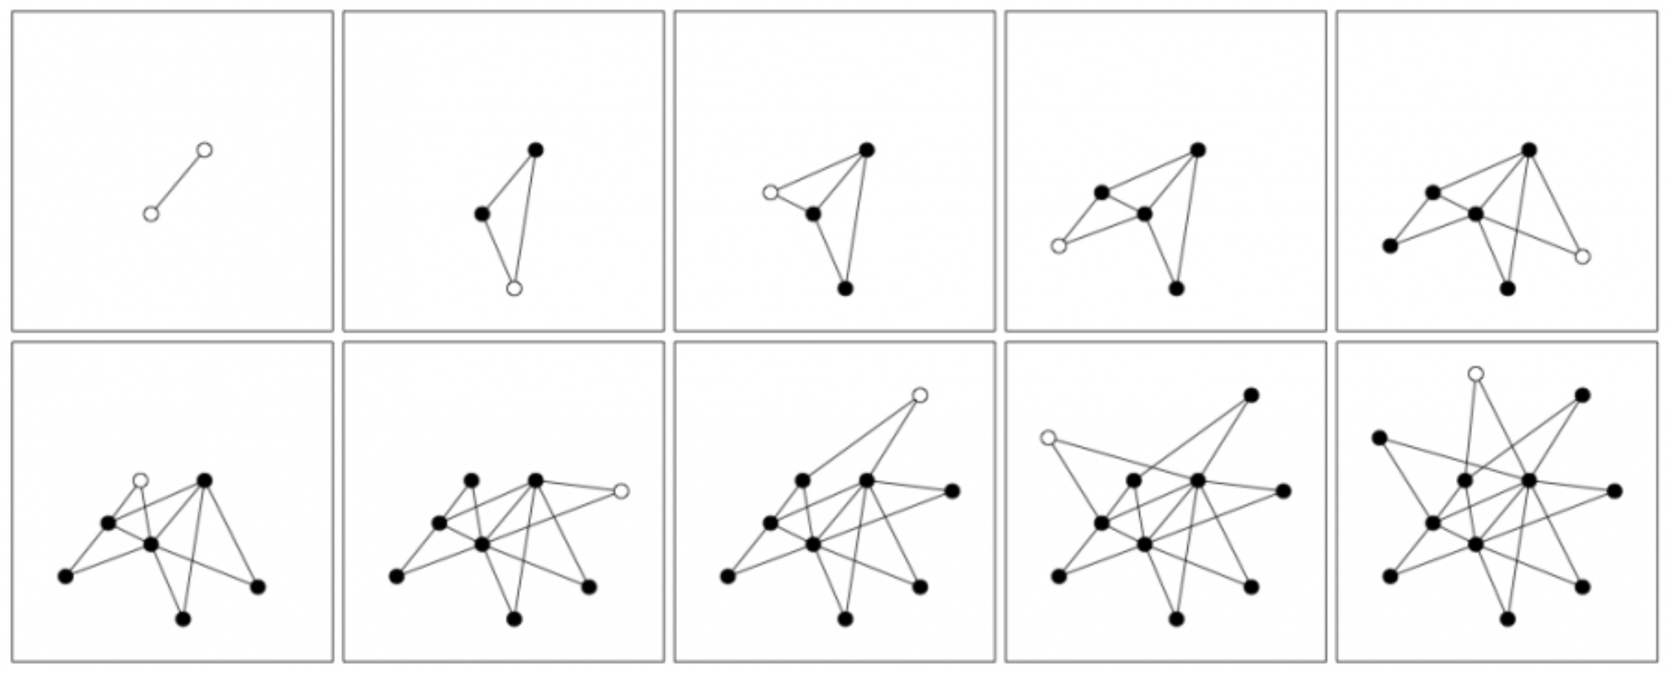
What is the essence of the BA networks?
An edge appears with probability proportional to the degree of the node it connects (preference for hubs):
Existing nodes are filled, and the new node is hallow
(more than one new node can join the existing graph at one time).
Source: http://barabasi.com/networksciencebook/chapter/5#growth

Slide 24
The BA model: BA(n, m)
Input: $n$ (node count),$m$ (degree of incoming node)
Output: $BA(n, m)$ with $n$ nodes, and each of the $n−m_{0}$ added nodes attaches with $m$edges.
Algorithm:
Start: A set S of $m_{0}$ nodes randomly connected ($\deg{u}≥1, ∀u∈S, m_{0}<m$).
Grow: add a new node $x$ with m (≤ m₀) edges that connect $x$to m nodes already in the network (in the first step connect to $S$, then to $S∪x$, and so on).
Preferential attachment in the growth process:
The probability $Π(k_{i})$ that a the new node connects to node i depends on the degree $k_{i}$ as$Π\left(k_{i}\right)=\frac{k_{i}}{\sum_{j}{k_{j}}}$
BA(11, 2)
Source: http://barabasi.com/networksciencebook/chapter/5#growth

Slide 25
Python: Generating BA networks
http://networkx.lanl.gov/reference/generated/networkx.generators.random_graphs.barabasi_albert_graph.html#networkx.generators.random_graphs.barabasi_albert_graph

Slide 26
Modified BA
Many modifications of this model exists, based on:
Nodes “retiring” and losing their status
Nodes disappearing (such as website going down)
Links appearing or disappearing between the existing nodes (called internal links)
Fitness of nodes (modeling newcomers like Google)
Most researchers still use the standard BA model when studying new phenomena and metrics.
Why? It is a simple model, and it was the first model that brought in growth (as well as preferential attachment)

Slide 27
Back to Overview
Section 1: Graph theory:
Origins (Eulerian graphs)
Section 2: Complex networks:
Random graphs (Erdos-Renyi)
Small world graphs (Watts-Strogatz)
Scale free graphs (Barabasi-Albert)
The configuration model (Molloy-Reed)

Slide 28
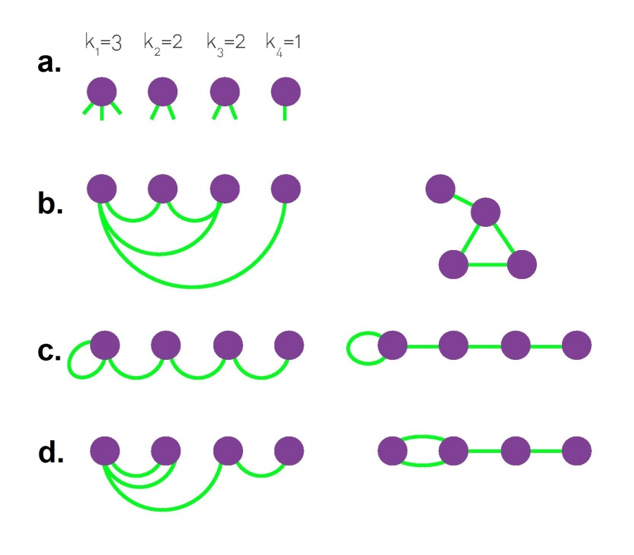
The Molloy Reed Configuration Model (Molloy & Reed, 1995)

Slide 29
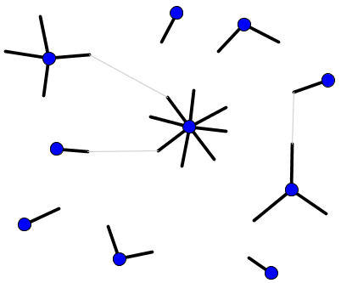
The MR configuration model
A random graph model created based on a degree sequence of choice:
can be scale free, random, small world, …
Maybe more than degree sequence is needed to be controlled in order to create realistic models
https://mathinsight.org/generating_networks_desired_degree_distribution

Slide 30
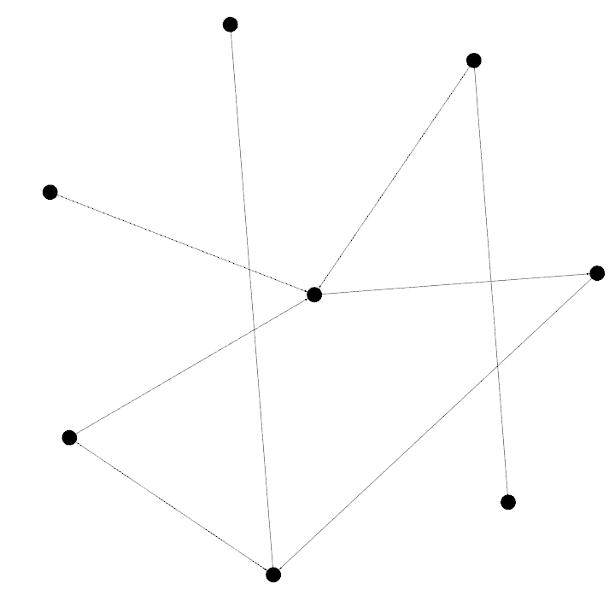
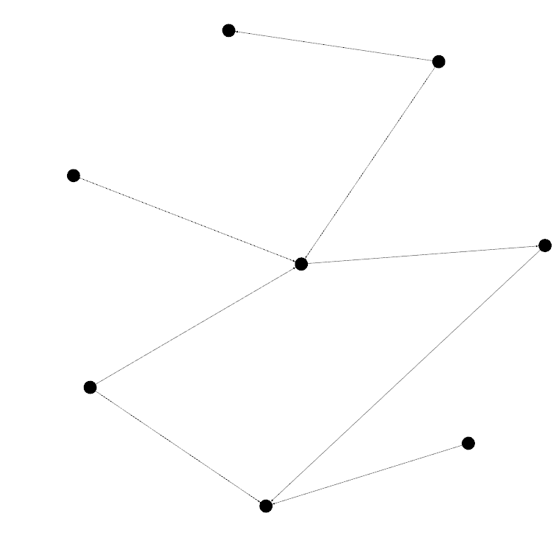
The MR configuration model
1
2
A random graph model created based on a degree sequence of choice: 4, 3, 2, 2, 2, 1, 1, 1
Step 1:
1
4
2
2
1
3
A possible Step 2:
Or this step 2:

Slide 31
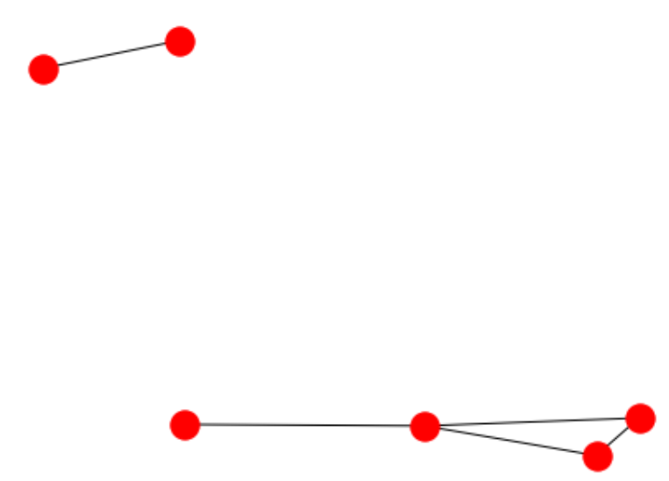
Python: Generating MR networks

Slide 32
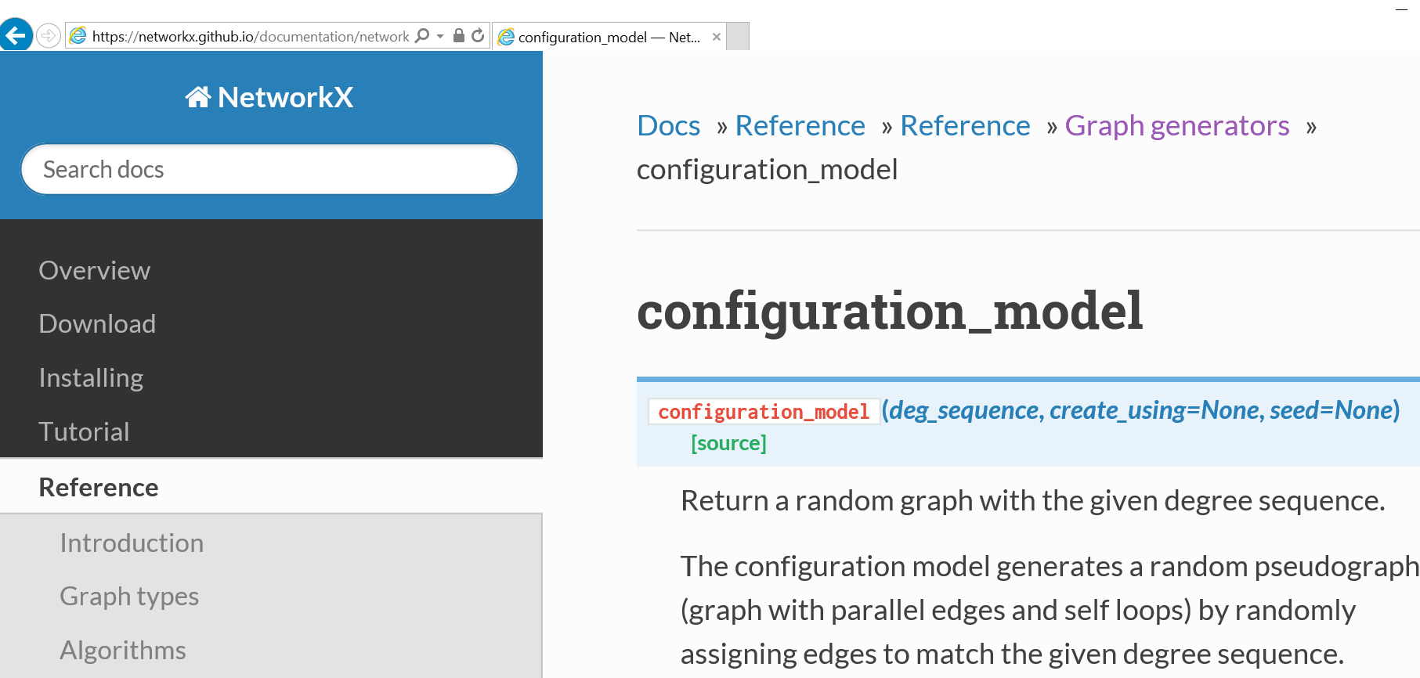
Generating Config Model in Python
https://networkx.github.io/documentation/networkx-1.10/reference/generated/networkx.generators.degree_seq.configuration_model.html

Slide 33
Networks and their degree distributions
Rather:
If G is a random graphs, then G has Poisson degree distribution
If G is scale free, then G most probably has a power-law degree distribution.
If G was constructed using preferential attachment, then G has a power-law degree distribution.
Networks are not characterized by degree distributions:
Random graphs $≠$ Poisson degree distribution
Scale-free $≠$ power-law degree distribution.

Slide 34
Main References
Newman, ME, The Structure and Function of Complex Networks, SIAM 2003
Watts, DJ; Strogatz, S H. 1998. Collective dynamics of 'small-world' networks, NATURE 393(668).
Barabasi, AL. Network Science

