Slide 1
Models of networks (synthetic networks or generative models): Erdős-Rényi
Excellence Through Knowledge

Slide 2
Learning Outcomes
Identify network models and explain their structures;
Contrast networks and synthetic models;
Understand how to design new network models (based on the existing ones and on the collected data)
Distinguish methodologies used in analyzing networks.

Slide 3
The three papers for each of the models
Synthetic models are used as reference/null models to compare against and build new complex networks
“On Random Graphs I” by Paul Erdős and Alfed Rényi in Publicationes Mathematicae (1958) Times cited: ∼ 3, 517 (as of January 1, 2015)
“Collective dynamics of ‘small-world’ networks” by Duncan Watts and Steve Strogatz in Nature, (1998) Times cited: ∼ 24, 535 (as of January 1, 2015)
“Emergence of scaling in random networks” by László Barabási and Réka Albert in Science, (1999) Times cited: ∼ 21, 418 (as of January 1, 2015)

Slide 4
Why care?
Epidemiology:
A virus propagates much faster in scale-free networks.
Vaccination of random nodes in scale free does not work, but targeted vaccination is very effective
Create synthetic networks to be used as null models:
What effect does the degree distribution alone have on the behavior of the system? (answered by comparing to the configuration model)
Create networks of different sizes
Networks of particular sizes and structures can be quickly and cheaply generated, instead of collecting and cleaning the data that takes time

Slide 5
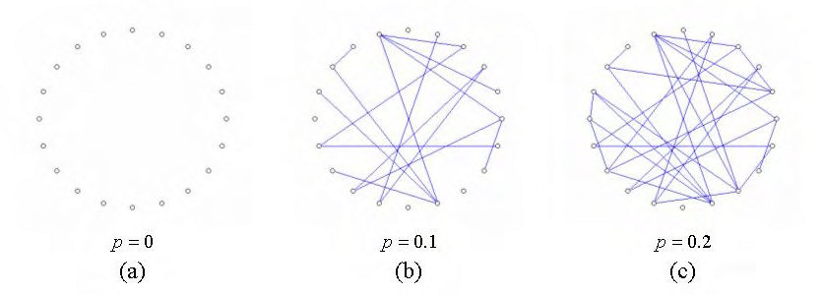
Erdős-Rényi Random Graphs

Slide 6
Random graphs (Erdős-Rényi , 1959)
ERmodel : creates at random with fixed parameters
G(n,m): fix n (node count) and m (edge count)
G(n,p): fix n and probability p of the edge existence between vertices (m is not fixed)
The mean value of edges is $m= \left(\begin{aligned}n \\ 2\end{aligned}\right)⋅p= \frac{n\left(n−1\right)p}{2}$
The average degree is $k = \left(n−1\right)p$
The distribution of finding a node of degree $k$is binomial:
$$P\left(k\right)=\left(\begin{aligned}n−1 \\ k\end{aligned}\right)p^{k}{\left(1−p\right)}^{n−1−k}$$
NetworkX has synthetic models and classes

Slide 7
Creating G(n,m)
Method two and equivalent to the first:
To make a random network $G(n,m)$:
take n nodes,
m pairs of nodes at random to form edges,
place the edges between the randomly chosen nodes.
The average degree: $\overline{k}=\frac{2m}{n}$, where $k_{i}$ is often used to denote the degree of vertex i in complex networks (enumerate the vertices, 1, 2, …)

Slide 8
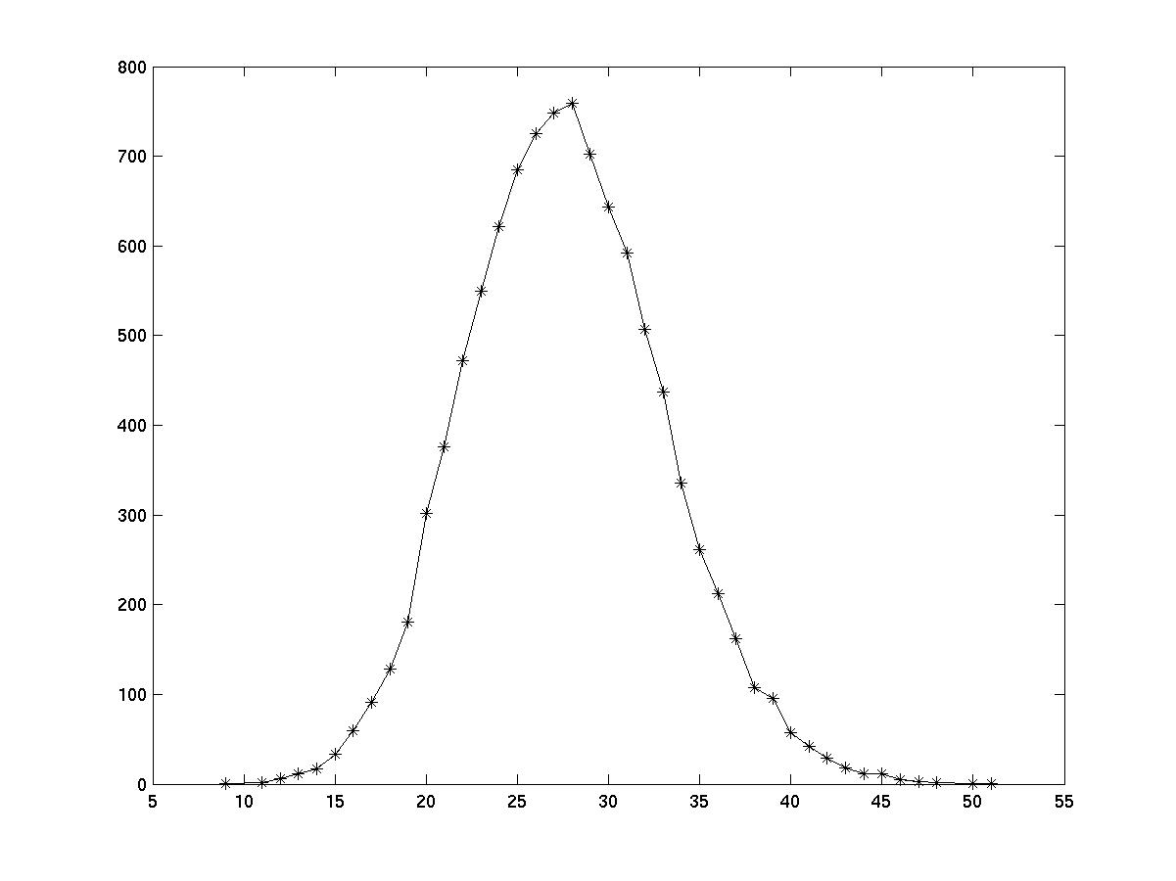
Creating G(n,p)
To create a random network $G(n,p)$:
Take n nodes,
A fixed probability $p$ for the whole graph
Attach edges at random to the nodes, with the probability p
Degree distribution for both for $G(n,m)$ and $G(n,p)$

Slide 9
Results about E-R graphs:
Degree distribution: Binomial
Average path is small compared to n: $\frac{\ln{n}}{ln (\overline{k_{i}}) }$, where $\overline{k}$ is the average degree
Comparable to the $\ln{n}$ of the observed networks
Clustering coefficient is small: $p=\frac{\overline{k}}{n}$ (The probability that two neighbors of a node are connected is equal to the probability of any two random nodes being connected)
However, observed networks have high clustering.

Slide 10
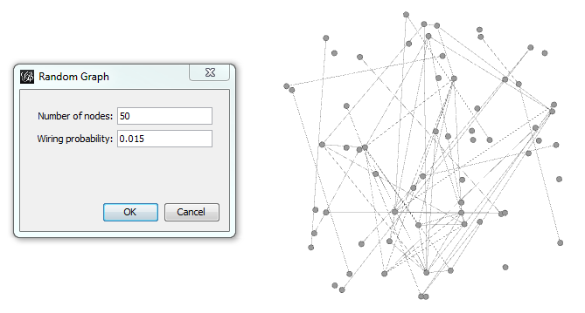
Generating Erdős-Rényi ER(n,p)
Generating Erdős-Rényi ER(n,p) in Gephi
ER graphs are models of a network in which some specific set of parameters take fixed values, but the construction of the network is random (see below in Gephi)

Slide 11
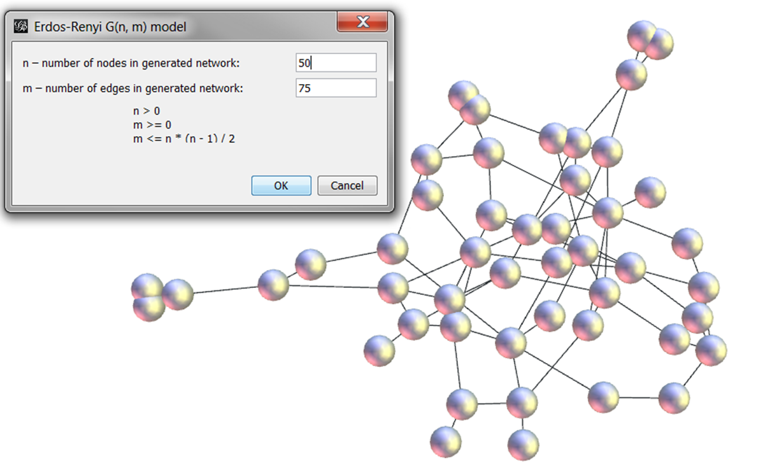
Generating Erdős-Rényi ER(n,m) in Gephi

Slide 12
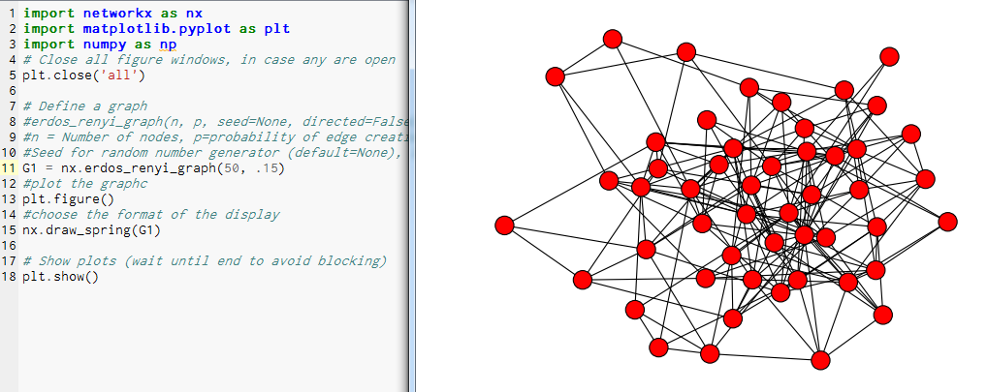
Generating Erdős-Rényi random networks in Python
Reference for python: http://networkx.lanl.gov/reference/generated/networkx.generators.random_graphs.erdos_renyi_graph.html#networkx.generators.random_graphs.erdos_renyi_graph

Slide 13
The Random Geometric model

Slide 14
Random Geometric Model
Again, the connections are created at random, but based on proximity (such as ad hoc networks)
Proximity is relevant: for each node $x$, the edge $xy_{i}$ is created with a probability if ${d(x,y}_{i})≤r$, for given fixed distance r.
There is no perfect model for the world around us, not even for specific types of networks

Slide 15
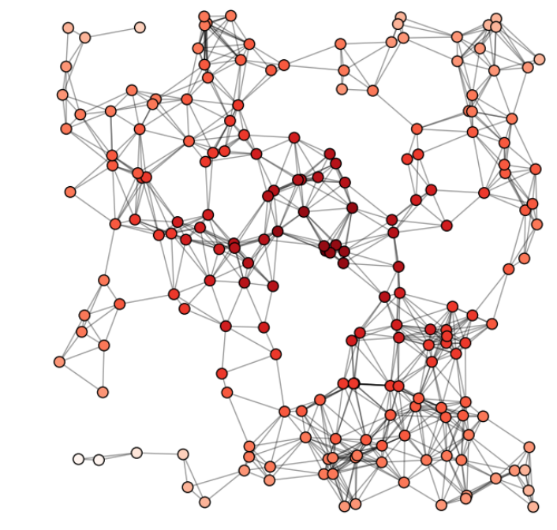
An example of a random geometric
https://www.youtube.com/watch?v=NUisb1-INIE

Slide 16
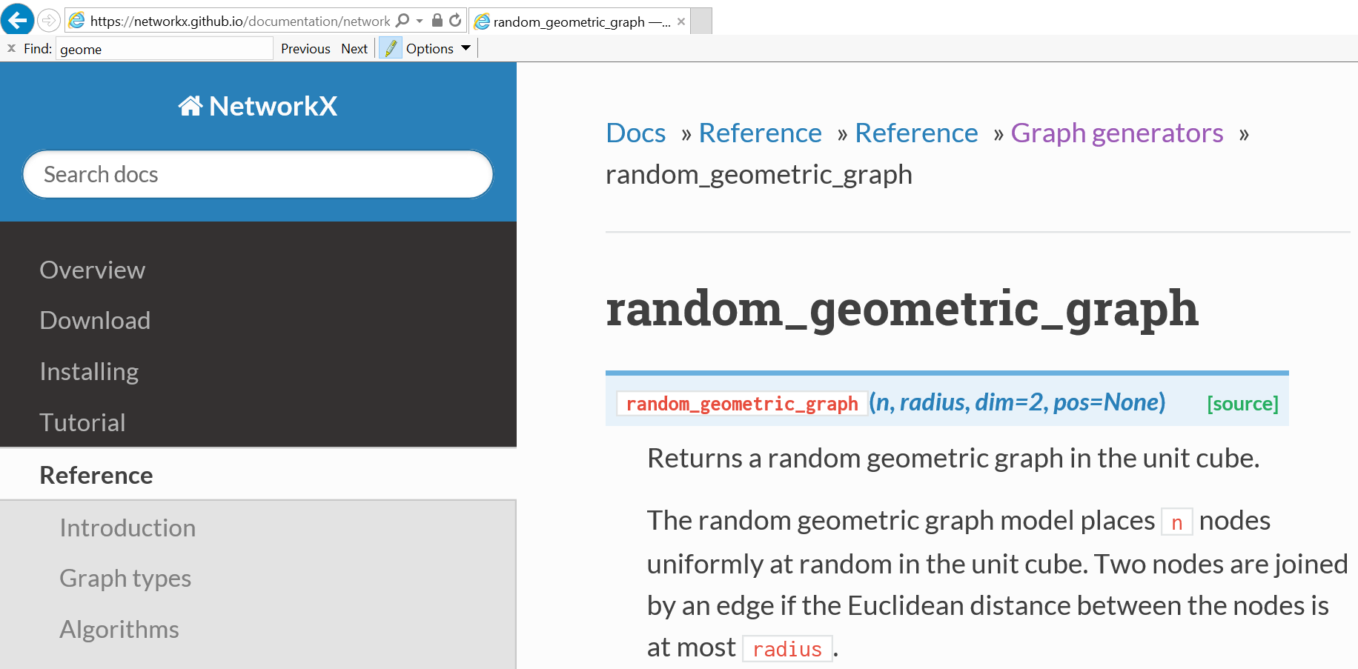
Creating it in Python
https://networkx.github.io/documentation/networkx-1.10/reference/generated/networkx.generators.geometric.random_geometric_graph.html#networkx.generators.geometric.random_geometric_graph

Slide 17
Practice in Cocalc:

Slide 18
Main References
Newman “The structure and function of complex networks” (2003)
Estrada “The structure of complex Networks” (2012)
Barabasi “Network Science” (online: http://barabasi.com/networksciencebook/)
References to the classes that exist in python: http://networkx.lanl.gov/reference/generators.html

