Slide 1
Models of networks (synthetic networks or generative models): Barabási -Albert
Excellence Through Knowledge

Slide 2
Learning Outcomes
Identify network models and explain their structures;
Contrast networks and synthetic models;
Understand how to design new network models (based on the existing ones and on the collected data)
Distinguish methodologies used in analyzing networks.

Slide 3
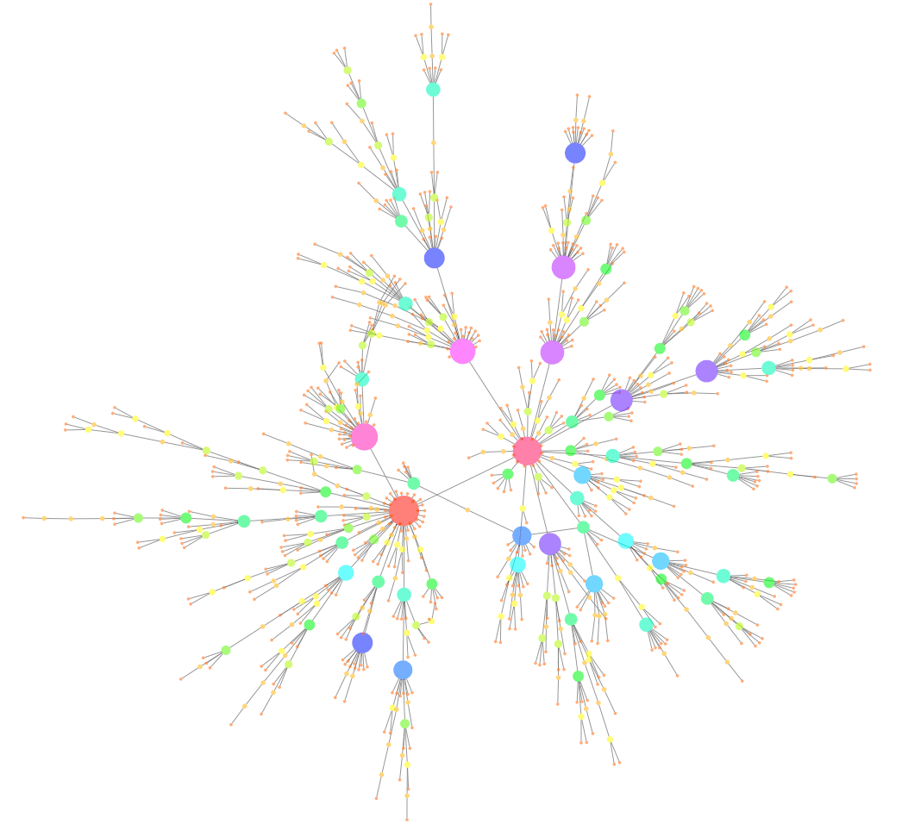
Scale free: Barabási-Albert model (1999)
https://upload.wikimedia.org/wikipedia/commons/d/d4/Barabasi_Albert_1000nodes.png

Slide 4
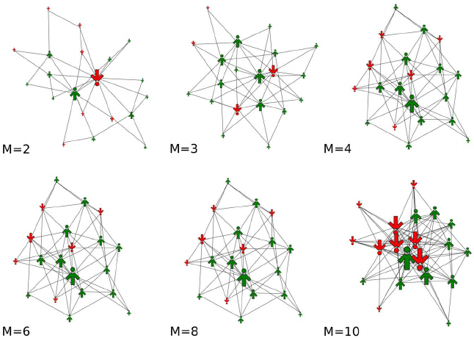
Network growth & resulting structure
Random attachment: new node picks any existing node to attach to
Preferential/fitness attachment: new node picks from existing nodes according to their degrees/fitness (high preference for high degree/fitness)
https://www.researchgate.net/figure/Sample-Barabasi-Albert-network-structures-for-different-densities-of-links-represented_fig1_267762305

Slide 5
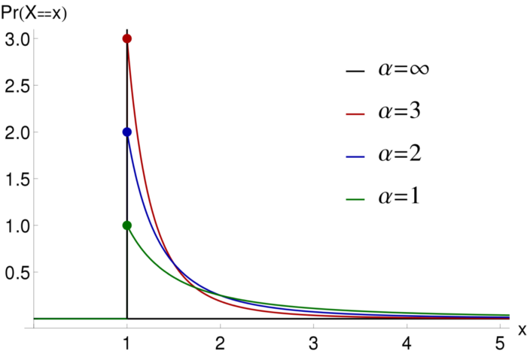
Scale-free
Scale-free networks are a type of small world networks
A power-law degree distribution: $p=C k^{−α}, where 2≤α≤3$for most observed networks
Common ways to grow the network:
Preferential attachment based on degree (for Barabási-Albert type the probability of attachment $p_{u}=\frac{k_{u}}{\sum_{i}{k_{i}}}$, where $k_{i}$ is the degree of node $i$).
Preferential attachment based on fitness (preassigned values).
https://bioinformatics.stackexchange.com/questions/14568/power-law-distribution-alpha-values

Slide 6
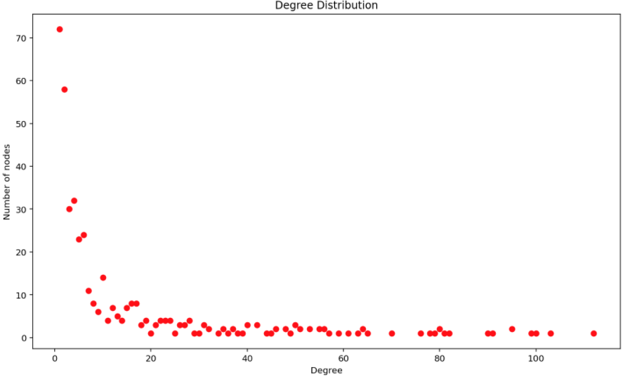
Power law networks
Many real-world networks contain hubs: highly connected nodes
Usually, the distribution of edges is extremely skewed
many nodes with small degree
No “typical” degree node
fat tail: a few nodes with a very large degree

Slide 7
But is it really a power-law?
A power-law will appear as a straight line on a log-log plot: let $p_{k}$ be the count of vertices of degree k.
$p_{k}=C k^{−α}$
$ln p_{k}=−α\ln{k}+c$
Log of number of nodes of that degree
A deviation from a straight line could indicate a different distribution:
exponential
lognormal
log of the degree

Slide 8
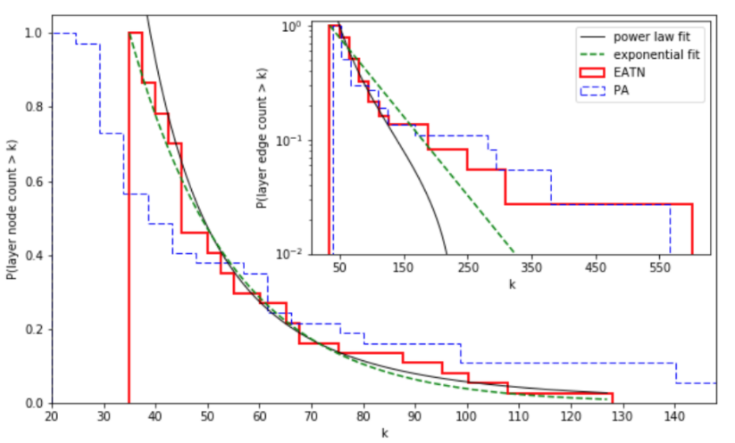
Fitting distributions
Airlines Transportation (2 networks: one in blue and one in red) Network's layers with distribution fitting:
Node count (frame)
Edge count (inset)
http://faculty.nps.edu/rgera/ANGEL.html

Slide 9
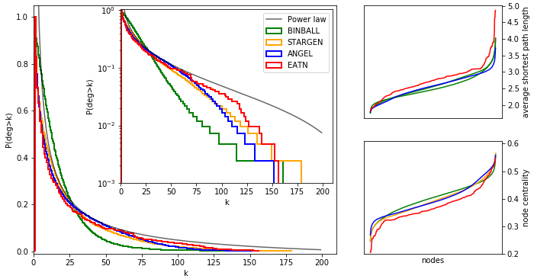
Fitting distributions
Airlines Transportation:
Degree histogram of the multiplexes with:
log scale in the inset.
Upper right: average shortest path,
Lower right: centrality coefficient per node
http://faculty.nps.edu/rgera/ANGEL.html

Slide 10
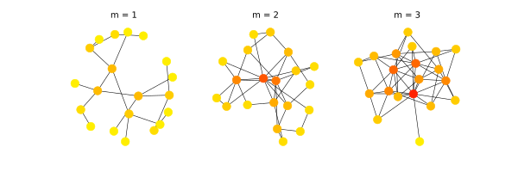
Scale Free networks
Barabási-Albert Model Generation
One example is introduced by Albert Laslo Barabási and Reka Albert (BA model) as a degree based preferential attachment :
Start with a small set of nodes ($m_{0}$) and random edge attachment
Attach new nodes one at the time:
each with the same fixed number $l$of new edges, attaching to the existing nodes in the network, with preference for high degrees (once the high degrees appear)
https://www.youtube.com/watch?v=5YdkhWB_uYQ
Network growth (measured by node count).
Not the only way to get scale–free networks!
https://www.wikiwand.com/en/Barab%C3%A1si%E2%80%93Albert_model

Slide 11
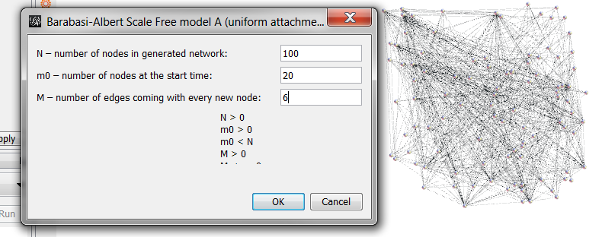
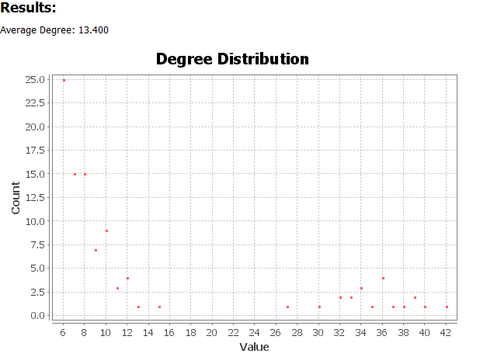
Generating BA networks in Gephi

Slide 12
Generating BA networks in Python
http://networkx.lanl.gov/reference/generated/networkx.generators.random_graphs.barabasi_albert_graph.html#networkx.generators.random_graphs.barabasi_albert_graph

Slide 13
Modified Barabási-Albert
Many modifications of this model exists, based on:
Nodes “retiring” and losing their status/outdated
Nodes disappearing (such as website going down)
Links appearing or disappearing between the existing nodes (called internal links)
Fitness of nodes (modeling newcomers like Google)
Most researchers still use the standard BA model when studying new phenomena and metrics.
It is a simple model (allows consistent research) that has growth and preferential attachment
One can add more conditions to this basic model, in order to mimic reality

Slide 14
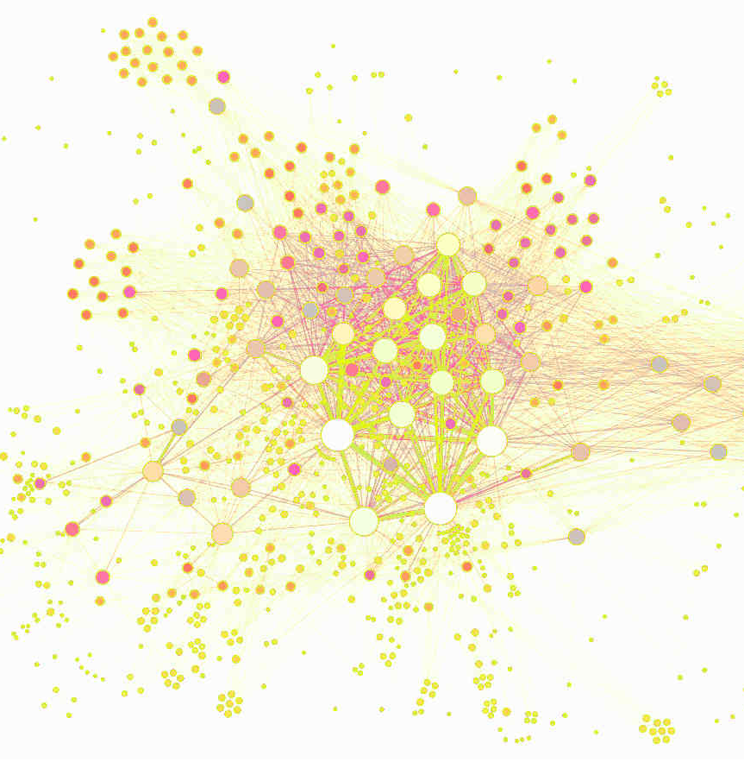
A zoo of complex networks

Slide 15
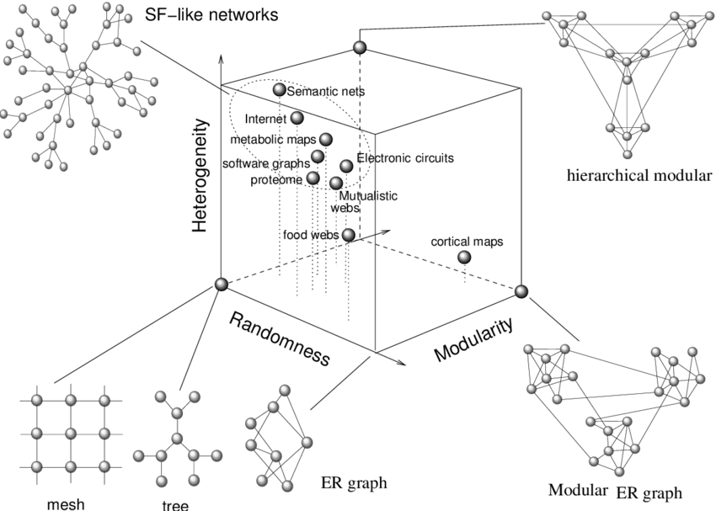
Random, Small-World, Scale-Free
Scale Free networks:
High degree heterogeneity
Various levels of modularity
Various levels of randomness
Man made, “large world”:
https://www.researchgate.net/figure/A-zoo-of-complex-networks-In-this-qualitative-space-three-relevant-characteristics-are_fig4_225782040

Slide 16
Back to coding in CoCalc

Slide 17
Main References
Newman “The structure and function of complex networks” (2003)
Estrada “The structure of complex Networks” (2012)
Barabasi “Network Science” (online: http://barabasi.com/networksciencebook/)
References to the classes that exist in python:
http://networkx.lanl.gov/reference/generators.html

