Slide 1
Prof. Ralucca Gera, rgera@nps.edu
Applied Mathematics Department,
Naval Postgraduate School
Excellence Through Knowledge
MA4404 Complex Networks
Betweenness Centrality

Slide 2
Learning Outcomes
Compute Betweenness Centrality per node.
Interpret the meaning of the values of Betweenness Centrality.

Slide 3
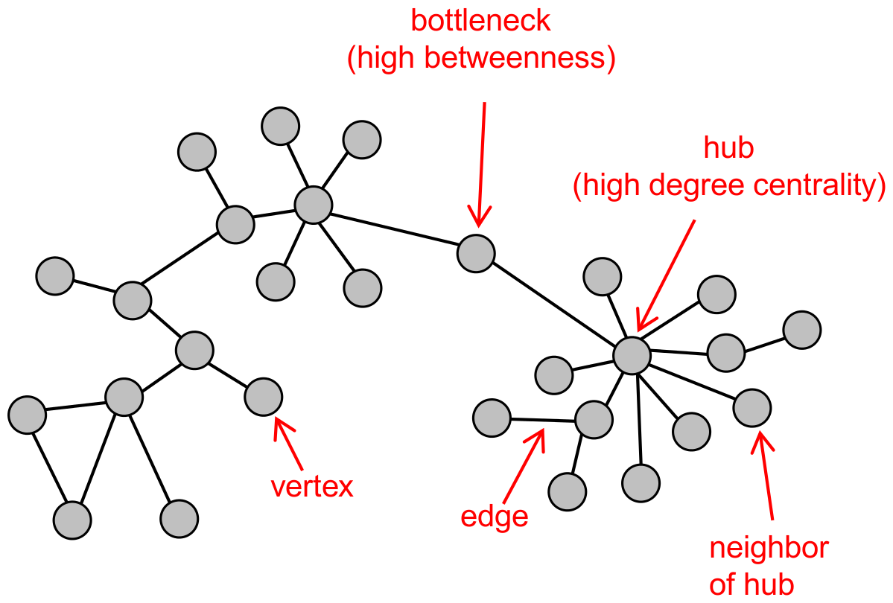
Why?!
Intuition: how many pairs of individuals would have to go through you in order to reach one another in the minimum number of hops?
Interactions between two individuals depend on the other individuals in the set of nodes. The nodes in the middle have some control over the paths in the graph.
Useful for flow, such as information or data packages
PLOS ONE: A Network Integration Approach to Predict Conserved Regulators Related to Pathogenicity of Influenza and SARS-CoV Respiratory Viruses

Slide 4
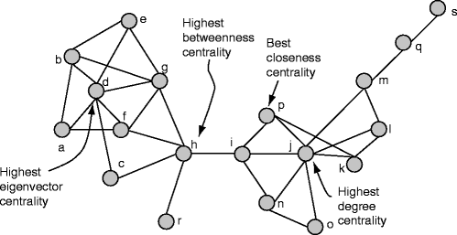
Assumptions
If more than one geodesic → all geodesics are equally likely to be used.
Flow takes the shortest path (we’ll look at alternatives)
Every pair of nodes exchanges a message with equal probability per unit time.
Question: How many messages, on average, will have passed through each vertex en route to their destination?
  A node’s betweenness is given by all pairs of nodes, including the node in question.
Discovering Sets of Key Players in Social Networks | SpringerLink

Slide 5
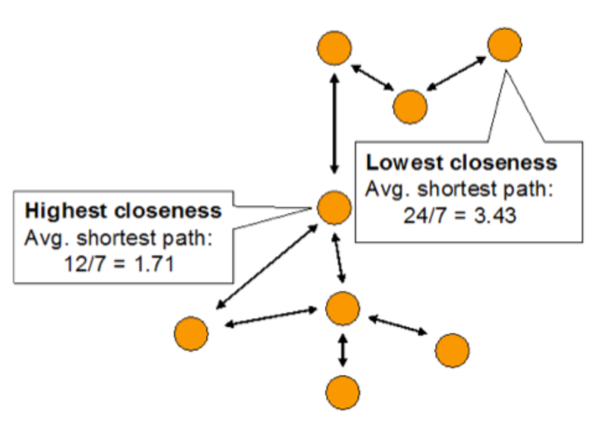
Intuition Closeness Centrality

Slide 6
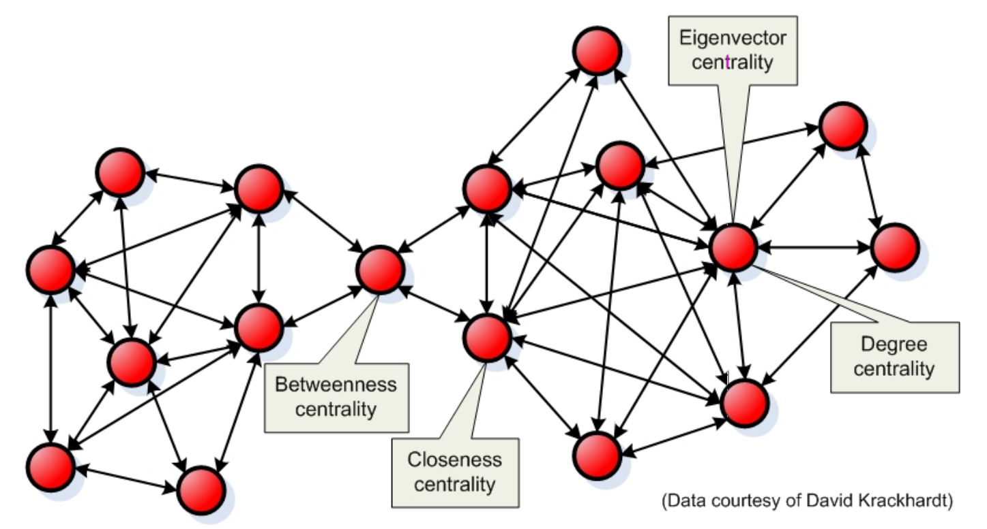
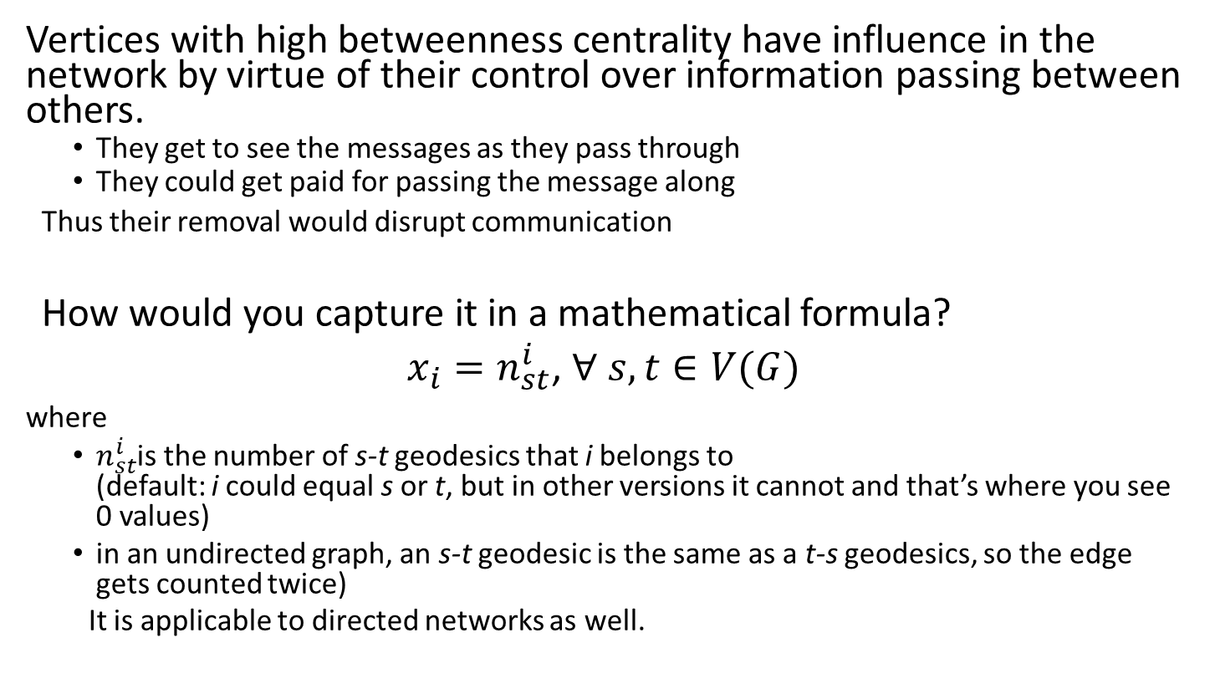
Meaning of betweenness centrality
Vertices with high betweenness centrality have influence in the network by virtue of their control over information passing between others.
  They get to see the messages as they pass through
  They could get paid for passing the message along
Thus their removal would disrupt communication
How would you capture it in a mathematical formula?
$x_{i}=n_{st}^{i}$, $∀ s, t∈V(G)$
where
  $n_{st}^{i}$is the number of s-t geodesics that i belongs to
  (default: i could equal s or t, but in other versions it cannot and that’s where you see 0 values)
  in an undirected graph, an s-t geodesic is the same as a t-s geodesics, so the edge gets counted twice)
  It is applicable to directed networks as well.
FULLTEXT01.pdf (diva-portal.org)

Slide 7
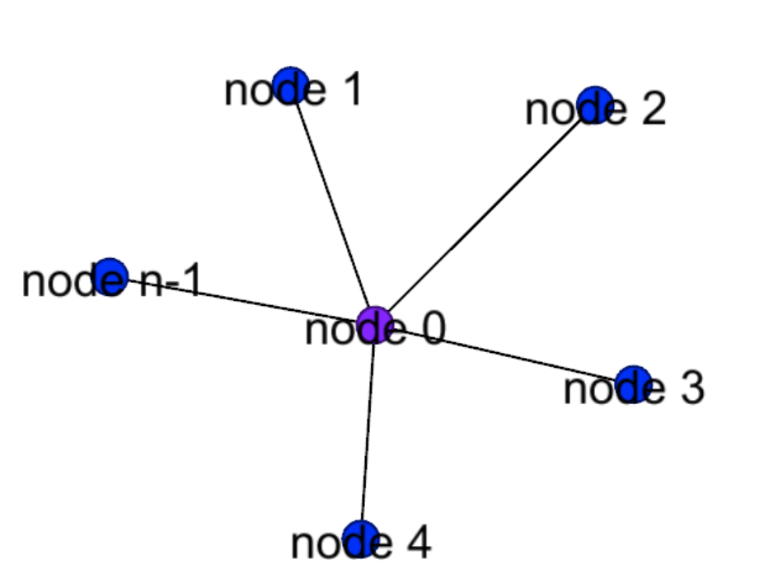
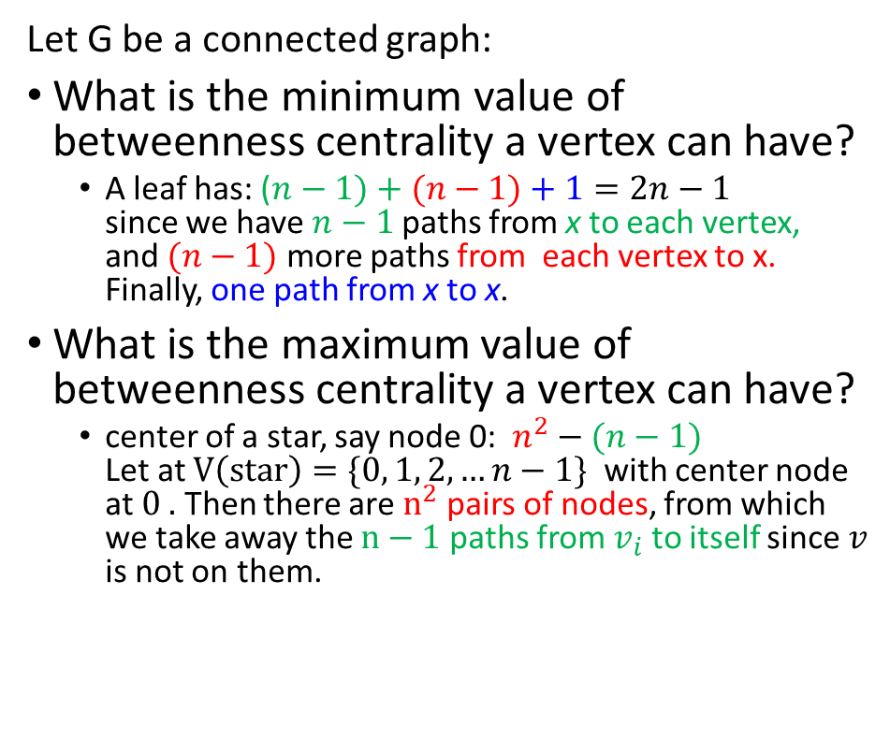
Bounds for BC in connected graphs
Let G be a connected graph:
What is the minimum value of betweenness centrality a vertex can have?
  A leaf has: ($n−1)+(n−1)+1=2n−1$
  since we have $n−1$paths from x to each vertex,
  and $(n−1)$ more paths from each vertex to x. Finally, one path from x to x.
What is the maximum value of betweenness centrality a vertex can have?
  center of a star, say node 0: $n^{2}−(n−1)$
  Let at $V\left(star\right)=\{0, 1, 2, …n−1\}$ with center node at $0 .$ Then there are $n^{2}$ pairs of nodes, from which we take away the $n−1$ paths from $v_{i}$ to itself since $v$ is not on them.

Slide 8
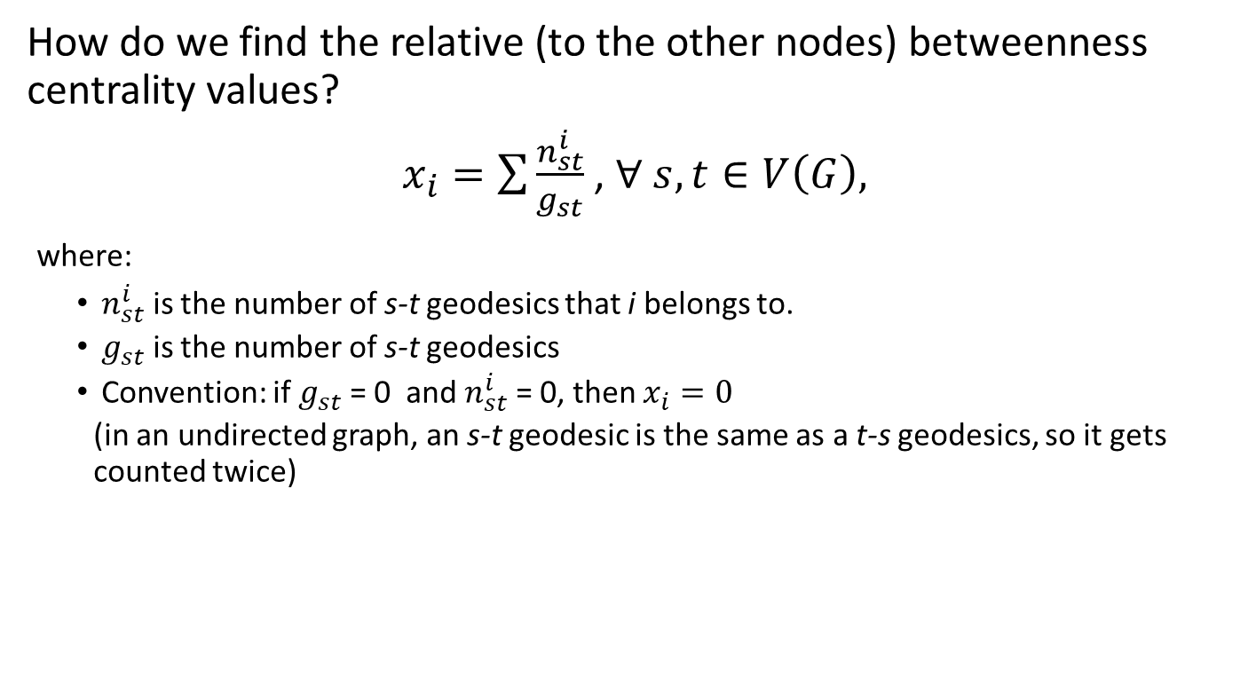
A refined formula
How do we find the relative (to the other nodes) betweenness centrality values?
$x_{i}=\sum{\frac{n_{st}^{i}}{g_{st}}}$ , $∀ s, t∈V\left(G\right),$
where:
  $n_{st}^{i}$ is the number of s-t geodesics that i belongs to.
  $g_{st}$ is the number of s-t geodesics
  Convention: if $g_{st}$ = 0 and $n_{st}^{i}$ = 0, then $x_{i}=0$
  (in an undirected graph, an s-t geodesic is the same as a t-s geodesics, so it gets counted twice)

Slide 9
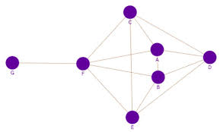
An in-class activity

Slide 10
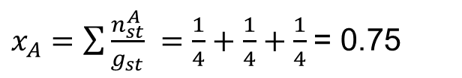
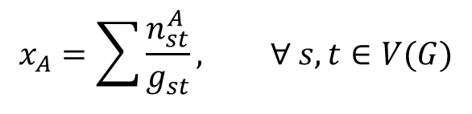
What is the betweenness of A?
Fraction of shortest paths that include vertex A
$$x_{A}=\sum{\frac{n_{st}^{A}}{g_{st}}, ∀ s, t∈V(G)}$$
1 shortest path of 4 goes through A
Number of paths
 | A | B | C | D | E | F | G
A | - | 1 | 1 | 1 | 4 | 1 | 1
B |  | - | 4 | 1 | 1 | 1 | 1
C |  |  | - | 1 | 1 | 1 | 1
D |  |  |  | - | 1 | 4 | 4
E |  |  |  |  | - | 1 | 1
F |  |  |  |  |  | - | 1
G |  |  |  |  |  |  | -
1 shortest path of 4 goes through A
$x_{A}=\sum{\frac{n_{st}^{A}}{g_{st}}} =\frac{1}{4}+\frac{1}{4}+\frac{1}{4}$= 0.75
1 shortest path of 4 goes through A

Slide 11
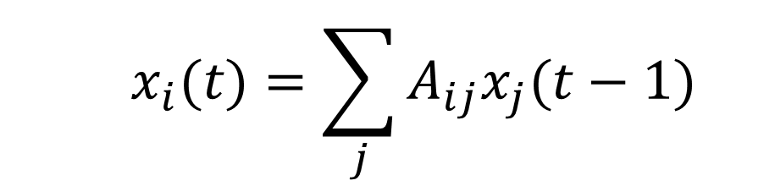

Refinement of the BC formula
  $$x_{i}(t)=\sum_{j}{A_{ij}x_{j}(t−1)}$$
  with the centrality at time t=0 being $x_{j}\left(0\right)=1, ∀j$
Notes:
https://www.researchgate.net/figure/a-k-core-decomposition-illustrative-example-Note-that-while-nodes-and-have-same_fig2_311990870

Slide 12
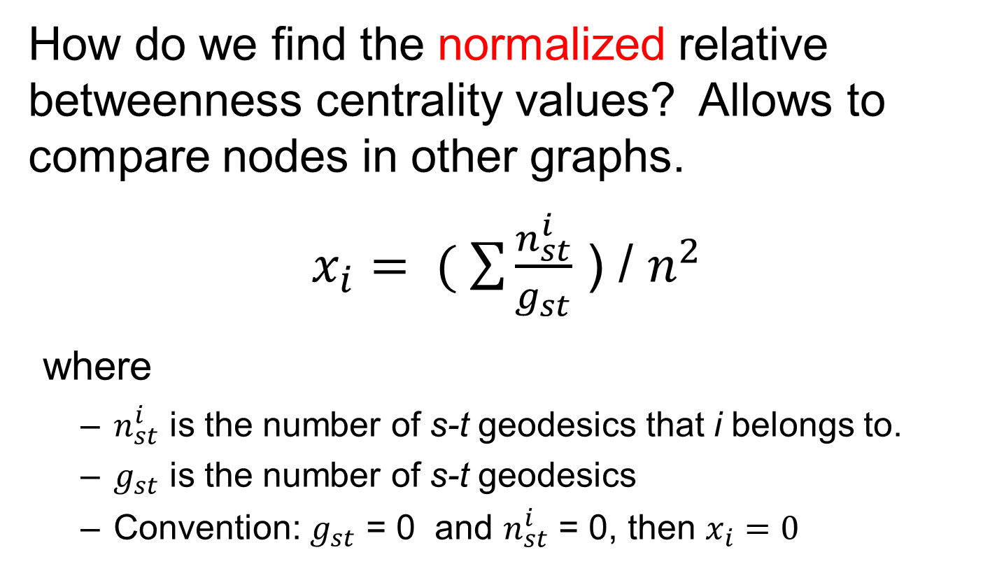
A normalized refined formula
How do we find the normalized relative betweenness centrality values? Allows to compare nodes in other graphs.
$x_{i}= ( \sum{\frac{n_{st}^{i}}{g_{st}}}$ ) / $n^{2}$
where
  $n_{st}^{i}$ is the number of s-t geodesics that i belongs to.
  $g_{st}$ is the number of s-t geodesics
  Convention: $g_{st}$ = 0 and $n_{st}^{i}$ = 0, then $x_{i}=0$

Slide 13
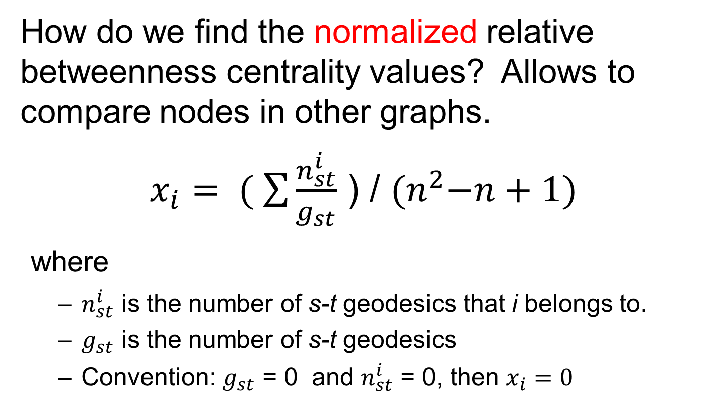
Another normalized formula
How do we find the normalized relative betweenness centrality values? Allows to compare nodes in other graphs.
$x_{i}= ( \sum{\frac{n_{st}^{i}}{g_{st}}}$ ) / ${(n}^{2}−n+1)$
where
  $n_{st}^{i}$ is the number of s-t geodesics that i belongs to.
  $g_{st}$ is the number of s-t geodesics
  Convention: $g_{st}$ = 0 and $n_{st}^{i}$ = 0, then $x_{i}=0$

Slide 14
Betweenness Centrality
Used generally for Information flow
Typically distributed over a wide range
Betweenness only uses geodesic paths
Information can also flow on longer paths
Sometimes we hear it through the grapevine
While betweenness focuses just on the geodesic, flow betweenness centrality focuses on how information might flow through many different paths.

Slide 15
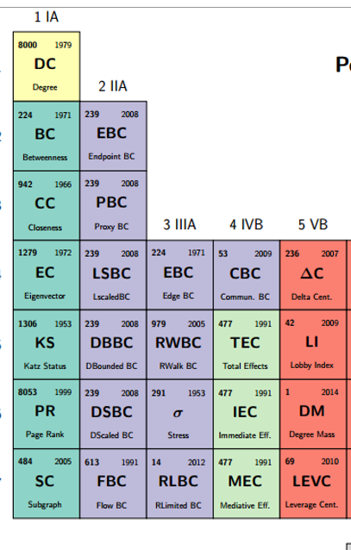

Extensions of Betweenness Centrality

Slide 16
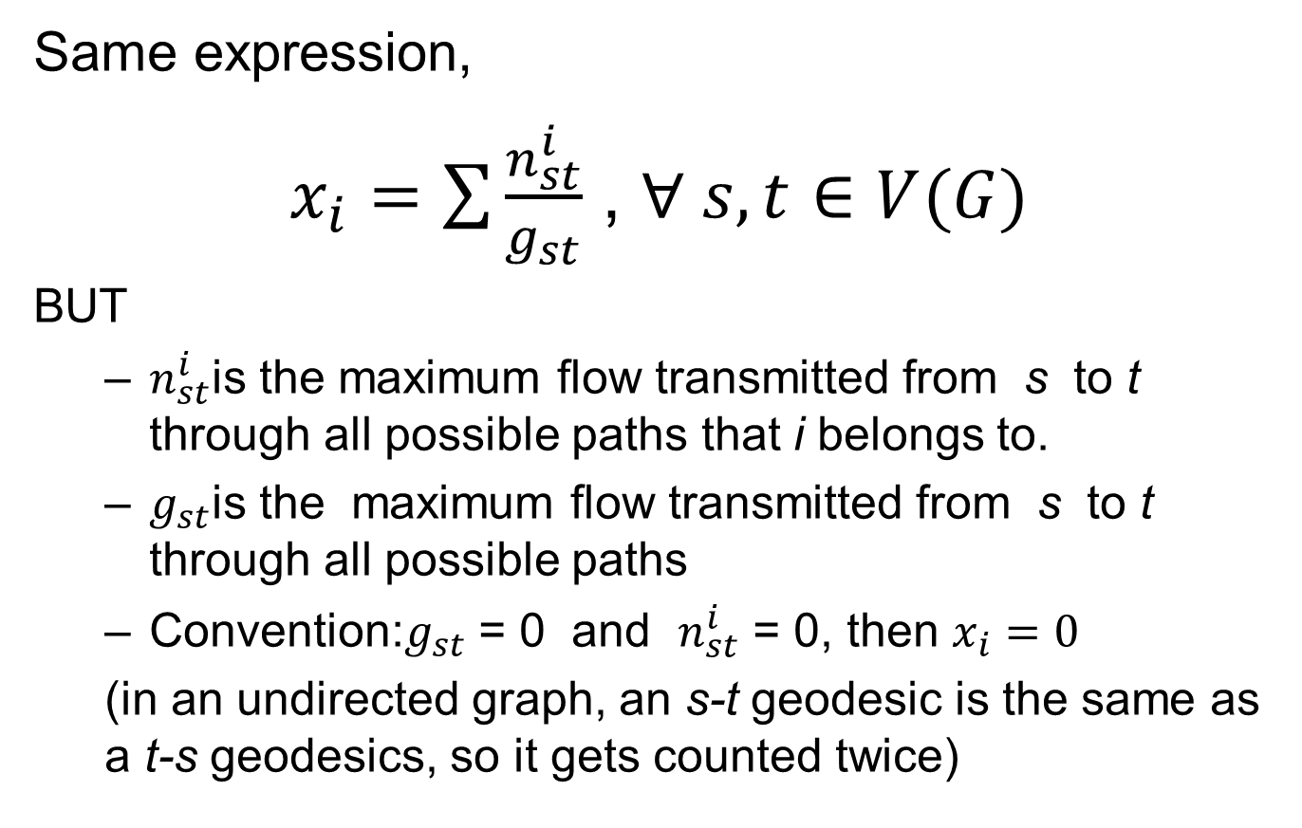
Flow betweenness centrality
Same expression,
$x_{i}=\sum{\frac{n_{st}^{i}}{g_{st}}}$ , $∀ s, t∈V(G)$
BUT
  $n_{st}^{i}$is the maximum flow transmitted from s to t through all possible paths that i belongs to.
  $g_{st}$is the maximum flow transmitted from s to t through all possible paths
  Convention:$g_{st}$ = 0 and $n_{st}^{i}$ = 0, then $x_{i}=0$
  (in an undirected graph, an s-t geodesic is the same as a t-s geodesics, so it gets counted twice)

Slide 17
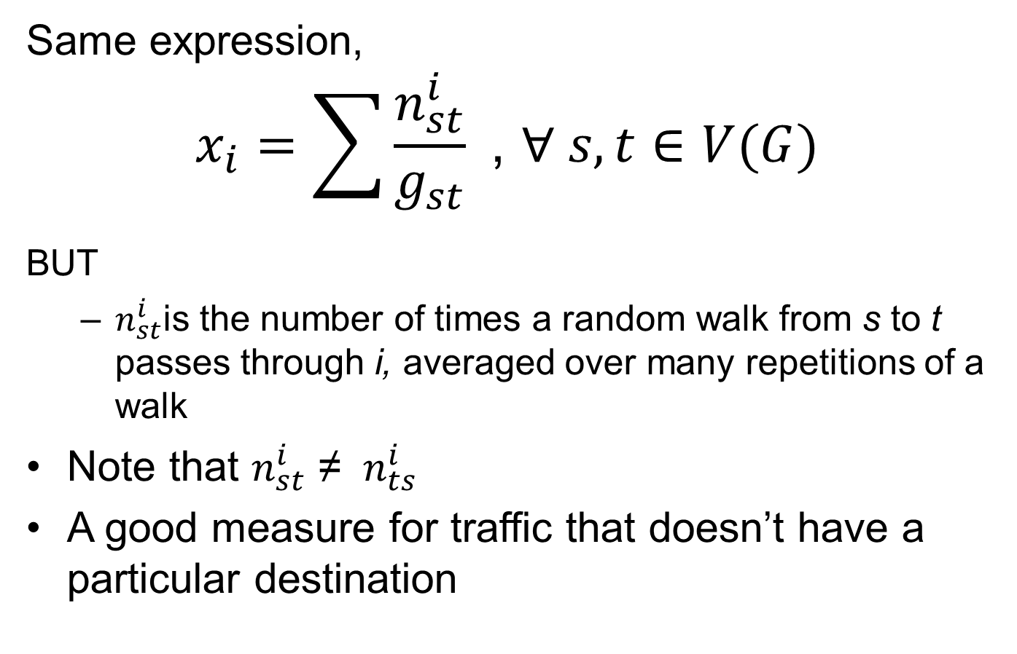
Random walk betweenness centrality
Same expression,
$$x_{i}=\sum{\frac{n_{st}^{i}}{g_{st}}}\text{ , }∀ s, t∈V(G)$$
BUT
  $n_{st}^{i}$is the number of times a random walk from s to t passes through i, averaged over many repetitions of a walk
Note that $n_{st}^{i}$ ≠ ${ n}_{ts}^{i}$
A good measure for traffic that doesn’t have a particular destination

Slide 18
Other extensions of centralities
How would you extend the centralities you have seen? What else would you introduce that would capture the centrality of a vertex?
Would you use it for edges?
This is a good time to share your thoughts
Subgraph/subset centrality?
  How central are you to that particular subgraph?
  How central is the subgraph to the network?
  If so, would you repeat the centralities seen before for that subgraph?

Slide 19
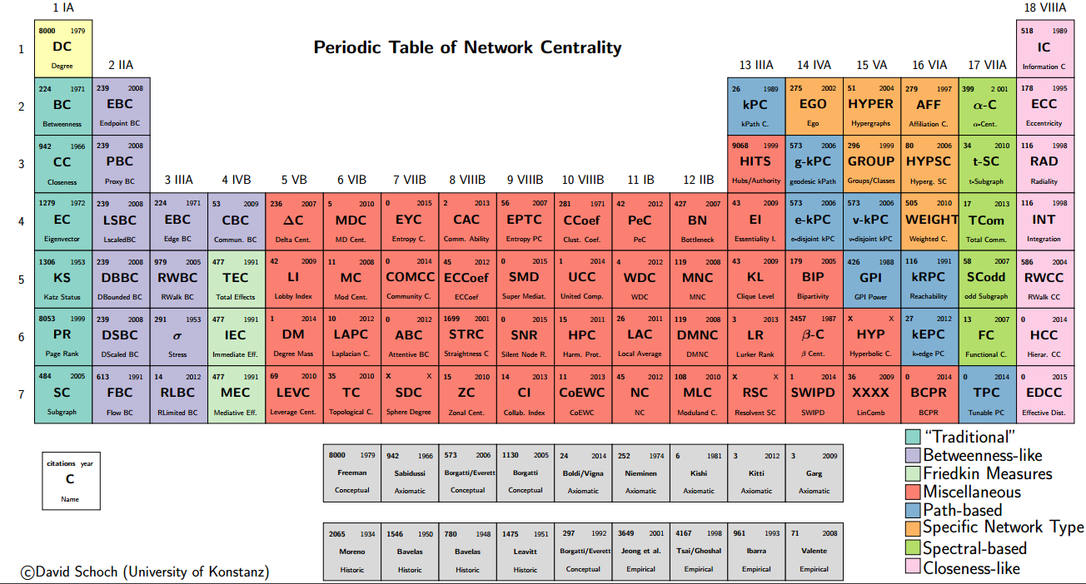
A periodic table of centralities
http://schochastics.net/sna/periodic.html

