Slide 1
Prof. Ralucca Gera, rgera@nps.edu
Applied Mathematics Department,
Naval Postgraduate School
Excellence Through Knowledge
MA4404 Complex Networks
Closeness Centrality

Slide 2
Learning Outcomes
Understand the new categories of centralities that includes closeness centrality.
Compute Closeness Centrality per node.
Interpret the meaning of the values of Closeness Centrality.

Slide 3
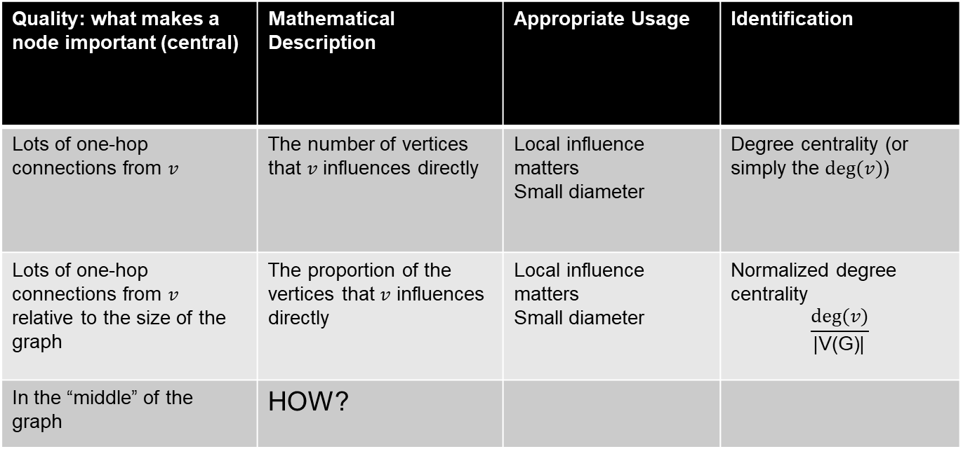
Recall…back to Degree Centrality
Quality: what makes a node important (central) | Mathematical Description | Appropriate Usage | Identification
Lots of one-hop connections from $v$ | The number of vertices that $v$ influences directly | Local influence matters Small diameter | Degree centrality (or simply the $deg⁡(v)$)
Lots of one-hop connections from $v$ relative to the size of the graph | The proportion of the vertices that $v$ influences directly | Local influence matters Small diameter | Normalized degree centrality $$\frac{deg⁡(v)}{\text{|}\text{V}\text{(}\text{G}\text{)|}}$$
In the “middle” of the graph | HOW?

Slide 4

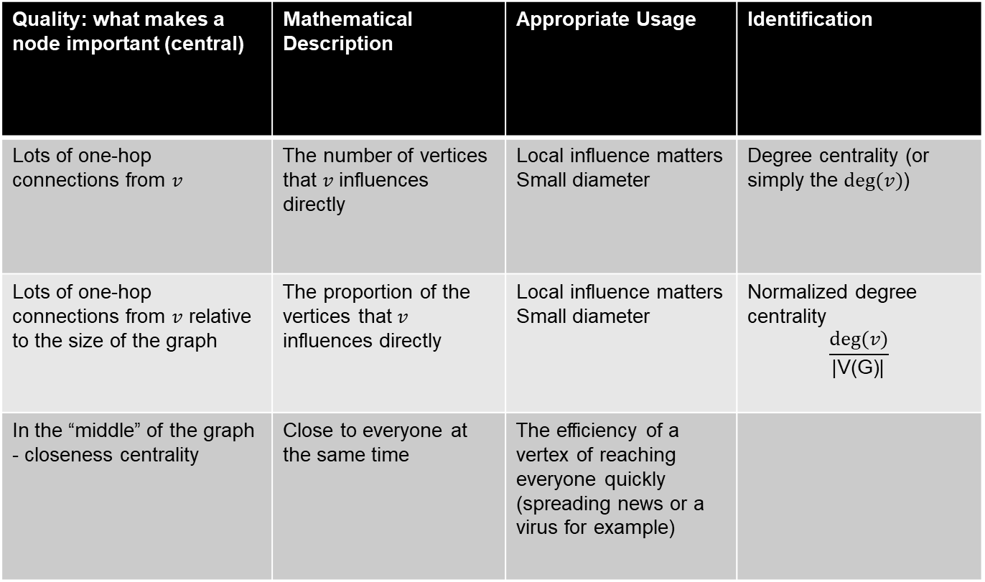
How to measure it?
Quality: what makes a node important (central) | Mathematical Description | Appropriate Usage | Identification
Lots of one-hop connections from $v$ | The number of vertices that $v$ influences directly | Local influence matters Small diameter | Degree centrality (or simply the $deg⁡(v)$)
Lots of one-hop connections from $v$ relative to the size of the graph | The proportion of the vertices that $v$ influences directly | Local influence matters Small diameter | Normalized degree centrality $$\frac{deg⁡(v)}{\text{|}\text{V}\text{(}\text{G}\text{)|}}$$
In the “middle” of the graph - closeness centrality | Close to everyone at the same time | The efficiency of a vertex of reaching everyone quickly (spreading news or a virus for example)
$$C_{i}=1/{\sum_{j=1}^{n}{d(i,j)}}$$

Slide 5
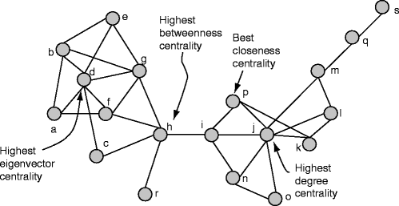
MA4404: Centralities categories
Adjacencies
Distances
Degree
Closeness
Eigenvector
Betweenness
Katz
HITS
PageRank
Discovering Sets of Key Players in Social Networks | SpringerLink

Slide 6
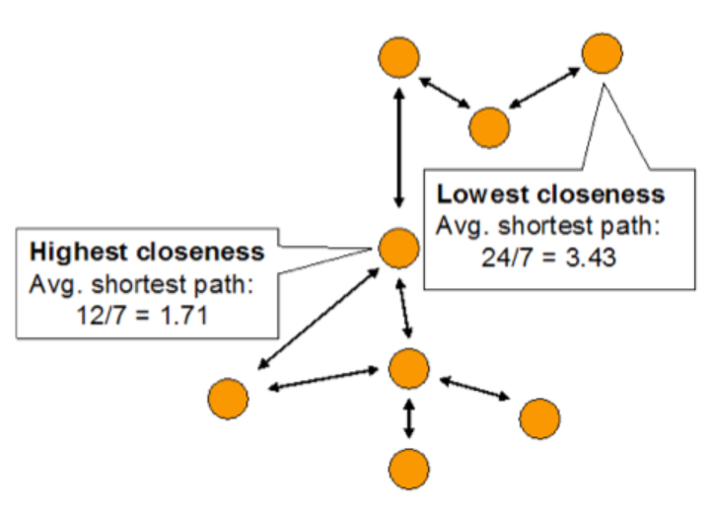
Intuition Closeness Centrality

Slide 7
Why?!
What if it’s not so important to have many direct friends?
But one still wants to be in the “middle” of the network by being close to many friends.
What metric could identify these central nodes?
  Graph theory:
  Cen(G) = {v : e(v) is the smallest of all vertices in G}
  Complex networks:
  Closeness centrality
centrality-measures.png (942×564) (compjournalism.com)

Slide 8
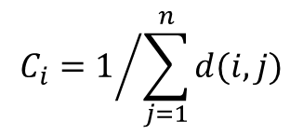
Closeness centrality: definition
Closeness is based on the average distance between a vertex i and all vertices in the graph (consider vertices in the same component only):
$$C_{i}=1/{\sum_{j=1}^{n}{d(i,j)}}$$
  depends on inverse distance to other vertices
Closeness centrality can be viewed as the efficiency of a vertex in spreading information to all other vertices.
Drawback: only computed per component

Slide 9

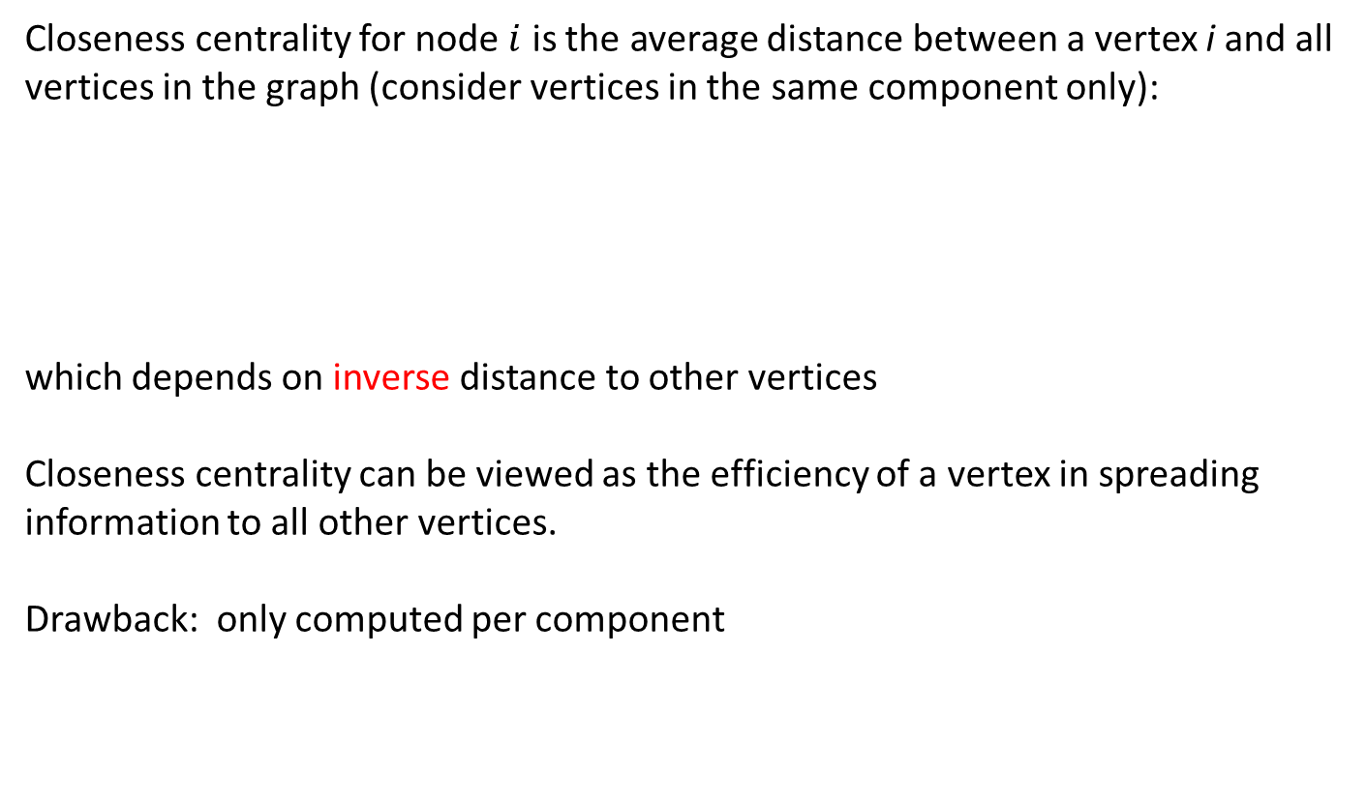
Closeness centrality: definition
Closeness centrality for node $i$ is the average distance between a vertex i and all vertices in the graph (consider vertices in the same component only):
which depends on inverse distance to other vertices
Closeness centrality can be viewed as the efficiency of a vertex in spreading information to all other vertices.
Drawback: only computed per component
$$C_{i}=1/{\sum_{j=1}^{n}{d(i,j)}}$$

Slide 10
Examples

Slide 11

Closeness Centrality
$$C_{i}=1/{\sum_{j=1}^{n}{d(i,j)}}$$
$$C_{A}=\frac{1}{d\left(AB\right)+d\left(AC\right)+d\left(AD\right)+d\left(AE\right)+d\left(AF\right)+d\left(AG\right)}$$
$$C_{A}=\frac{1}{1+1+1+2+1+2}$$
$$C_{A}=\frac{1}{8}=0.125$$

Slide 12
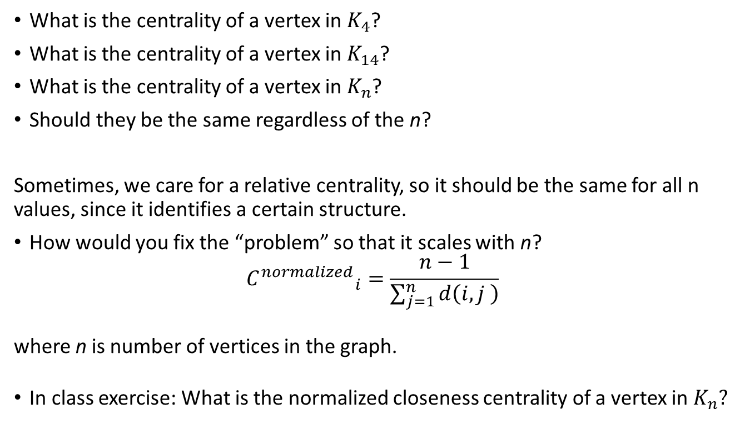
In class exercise: closeness centrality
What is the centrality of a vertex in $K_{4}$?
What is the centrality of a vertex in $K_{14}$?
What is the centrality of a vertex in $K_{n}$?
Should they be the same regardless of the n?
Sometimes, we care for a relative centrality, so it should be the same for all n values, since it identifies a certain structure.
How would you fix the “problem” so that it scales with n?
$${C^{normalized}}_{i}=\frac{n−1}{\sum_{j=1}^{n}{d\left(i,j \right)}}$$
where n is number of vertices in the graph.
In class exercise: What is the normalized closeness centrality of a vertex in $K_{n}?$

Slide 13

$$C_{i}=1/{\sum_{j=1}^{n}{d(i,j)}}$$
Well Defined?!
Notes:
https://www.researchgate.net/figure/a-k-core-decomposition-illustrative-example-Note-that-while-nodes-and-have-same_fig2_311990870

Slide 14

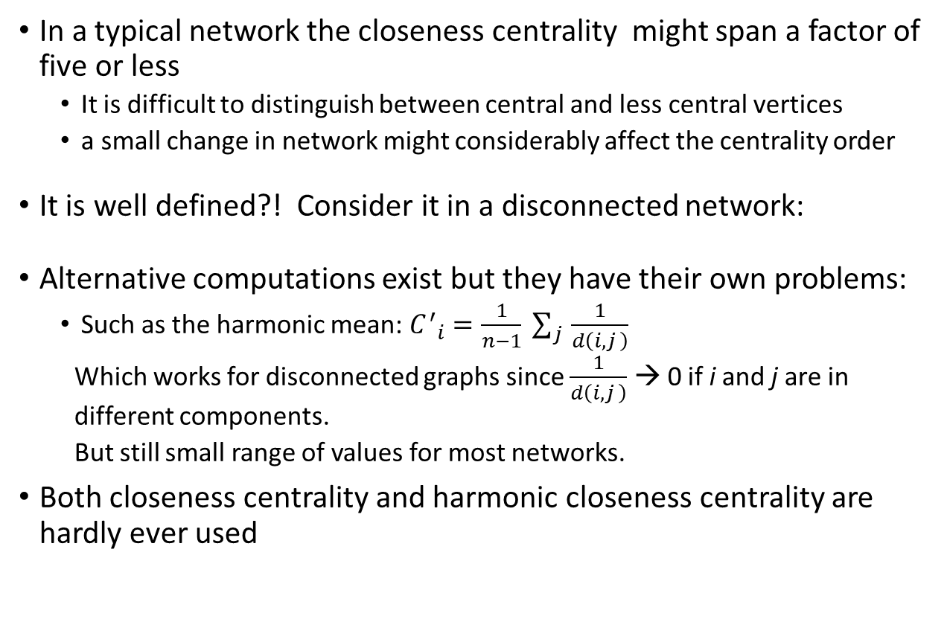
Closeness centrality
In a typical network the closeness centrality might span a factor of five or less
  It is difficult to distinguish between central and less central vertices
  a small change in network might considerably affect the centrality order
It is well defined?! Consider it in a disconnected network:
Alternative computations exist but they have their own problems:
  Such as the harmonic mean: ${C^{′}}_{i}=\frac{1}{n−1} \sum_{j }{\frac{1}{d\left(i,j \right)}}$
  Which works for disconnected graphs since $\frac{1}{d\left(i,j \right)}$ → 0 if i and j are in different components.
  But still small range of values for most networks.
Both closeness centrality and harmonic closeness centrality are hardly ever used
$$C_{i}=1/{\sum_{j=1}^{n}{d(i,j)}}$$

Slide 15
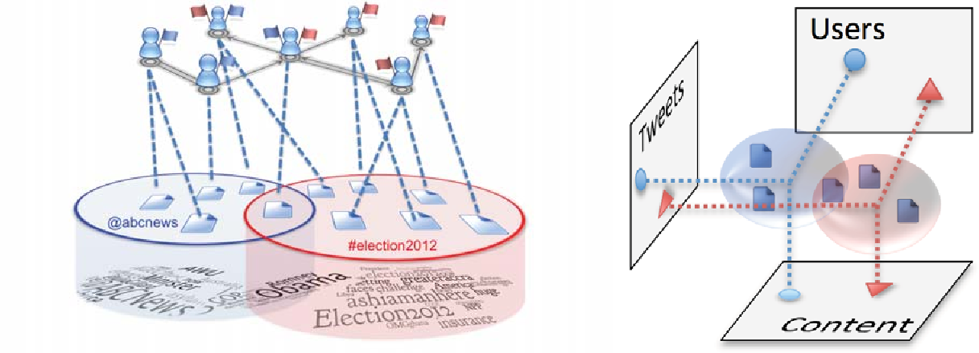
Generalization
How would you generalize this centrality?
This is a good time to share your thoughts
Closeness centrality of a set rather than a vertex?
[PDF] Clustering memes in social media | Semantic Scholar

