Slide 1
Prof. Ralucca Gera, rgera@nps.edu
Applied Mathematics Department,
Naval Postgraduate School
Excellence Through Knowledge
MA4404 Complex Networks
Degree Centrality

Slide 2
Learning Outcomes
Compute degree centrality.
Interpret the meaning of the values of degree centrality.
Distinguish between the degree and degree centrality.

Slide 3
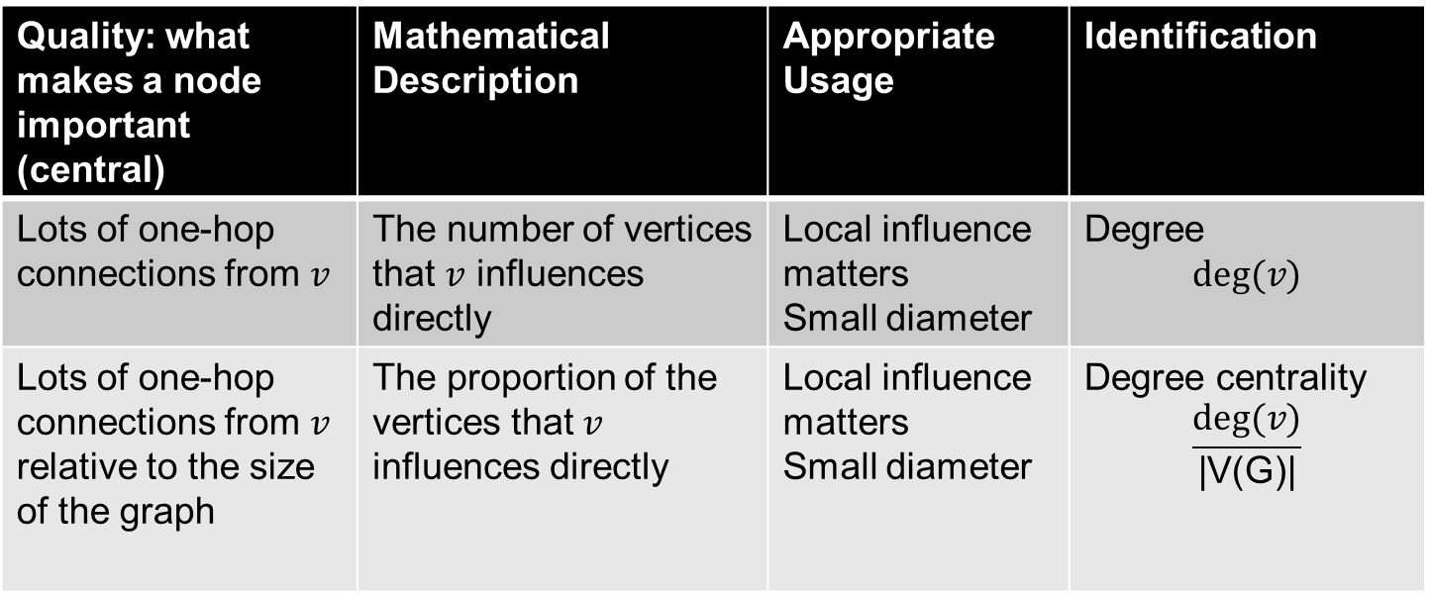
Degree Centrality
Quality: what makes a node important (central) | Mathematical Description | Appropriate Usage | Identification
Lots of one-hop connections from $v$ | The number of vertices that $v$ influences directly | Local influence matters Small diameter | Degree $$deg⁡(v)$$
Lots of one-hop connections from $v$ relative to the size of the graph | The proportion of the vertices that $v$ influences directly | Local influence matters Small diameter | Degree centrality $$\frac{deg⁡(v)}{\text{|}\text{V}\text{(}\text{G}\text{)|}}$$

Slide 4
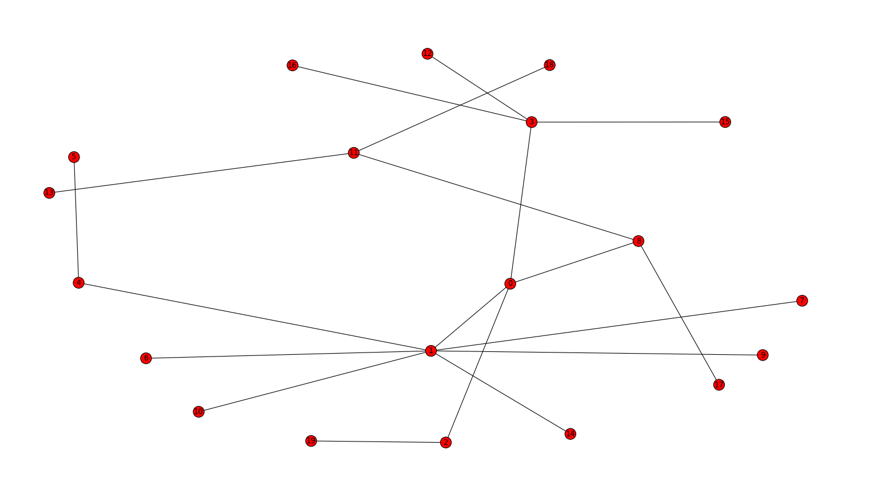
Degree per vertex as a vector
4
7
2
4
2
1
1
1
3
1
1
3
1
1
1
1
1
1
1
1

Slide 5
Degree Centrality per vertex
4/20
7 20
2/20
4/20
2/20
1/20
1/20
1/20
3/20
1/20
1/20
3/20
1/20
1/20
1/20
1/20
1/20
1/20
1/20
1/20
Divide by $n−1$ not counting the vertex at which centrality is computed.
Or divide by $Δ(G)$ to normalize it since we only care for the relative centrality.
5

Slide 6
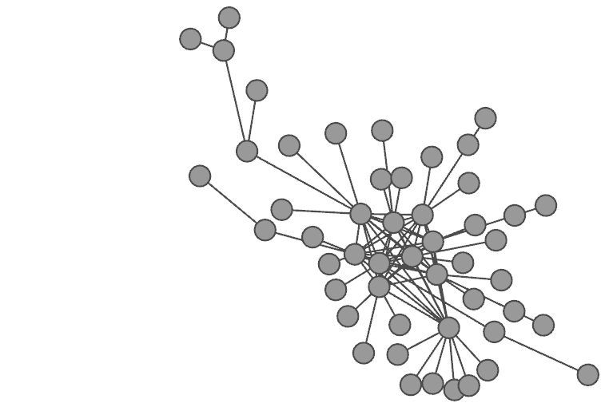
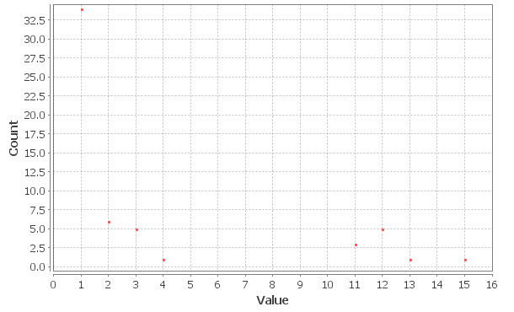
Degree distribution
And you can also compute
Degree centrality distribution

Slide 7
MA4404: Centralities categories
Adjacencies
Distances
Degree
Closeness
Eigenvector
Betweenness
Katz
HITS
PageRank

