Slide 1
Prof. Ralucca Gera, rgera@nps.edu
Applied Mathematics Department, Naval Postgraduate School
Excellence Through Knowledge
MA4404 Complex Networks: HITS (Hyperlink Induced Topic Search )Centrality

Slide 2
Learning Outcomes
Understand the difference between Hubs and Authority in directed graphs.
Compute HITS per node.
Interpret the meaning of the values of HITS.

Slide 3
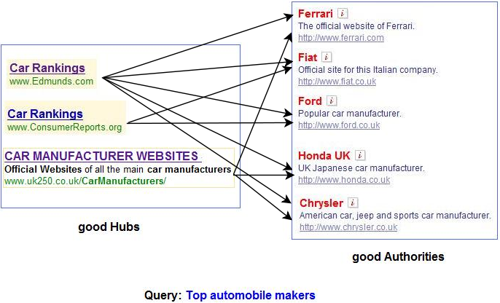
What have we considered to this point?
Identified
vertices that are important because of their number of connections (degree centrality), and
vertices that are important because they are adjacent to important vertices (eigenvector centrality), and
Generalized these ideas to directed networks (Katz centrality), and
Identified a mechanism to control the “flow of centrality” from high centrality vertices in an appropriate manner (PageRank centrality).
What we’ve not done is classify the important vertices by what makes them important:
A good hub points to many good authorities.
A good authority is pointed to by many good hubs.
Authorities and hubs have a mutual reinforcement relationship.
http://pi.math.cornell.edu/~mec/Winter2009/RalucaRemus/Lecture4/lecture4.html
http://web.eecs.umich.edu/~michjc/eecs584/notes/lecture19-kleinberg.pdf

Slide 4
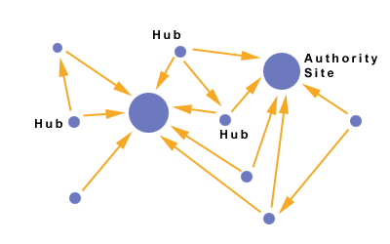
Authority and Hub Centralities
Authority centrality: i’s rank score $x_{i}$ is proportional to the sum of the hub centralities that point to it:
$$x_{i}=α\sum_{j}{A_{ij}y_{j}},$$
where $α$ is a constant and $y_{j}$ are hub centralities of those vertices pointing to $x_{i}$.
Hub centrality: i’s rank score $y_{i}$ is proportional to the sum of the authority centralities it points to:
$$y_{i}=β\sum_{j}{A_{ij}x_{j}},$$
where $β$ is another constant and $x_{j}$ are authority centralities of those vertices pointing to $y_{i}$.
https://www.pinterest.com/pin/142637513171560799/

Slide 5
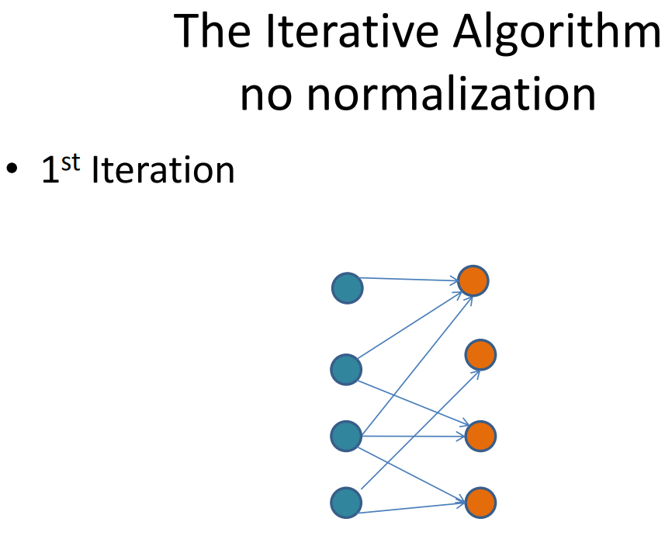
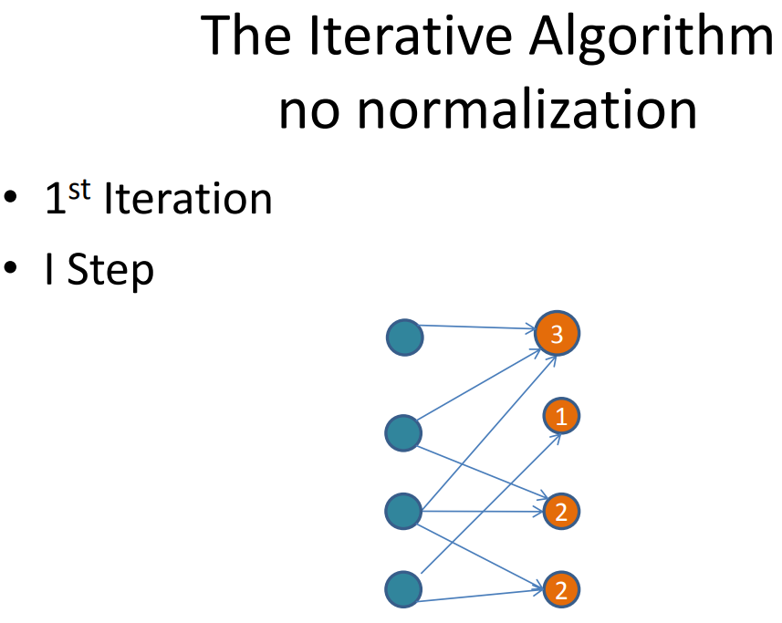
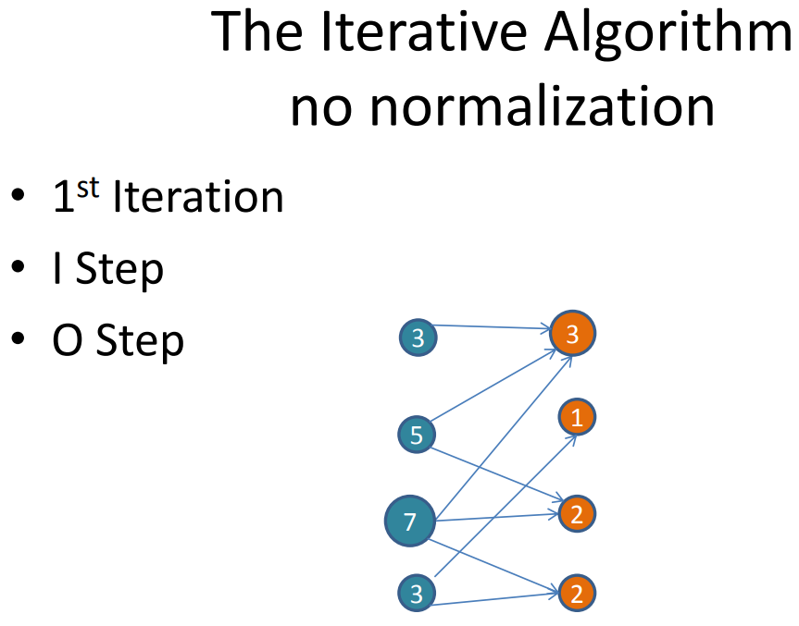
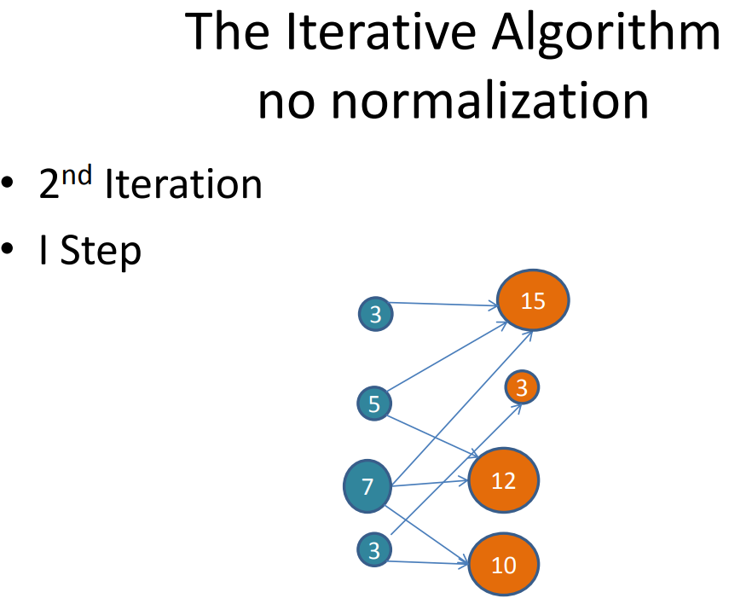
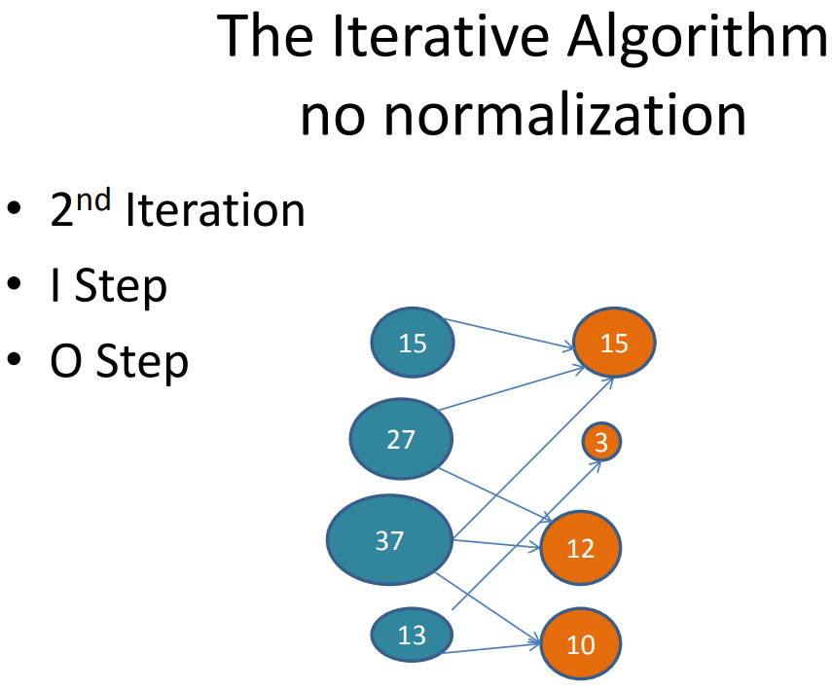
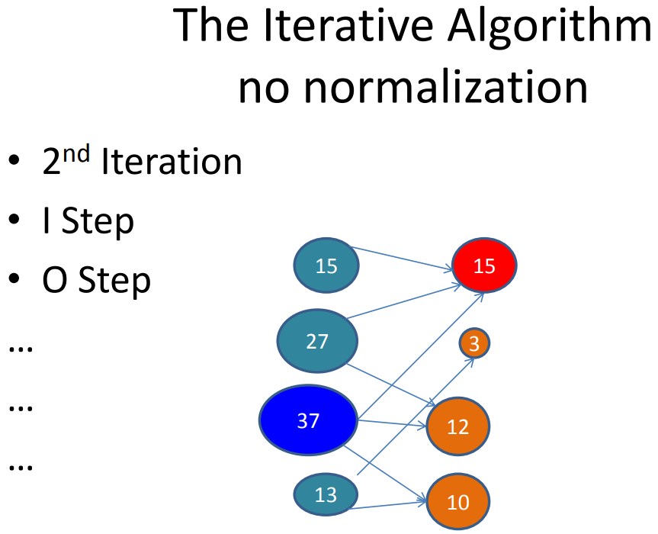
The Iterative Algorithm $${I Step: x}_{i}=α\sum_{j}{A_{ij}y_{j}} O Step: y_{i}=β\sum_{j}{A_{ij}x_{j}},$$
http://web.eecs.umich.edu/~michjc/eecs584/notes/lecture19-kleinberg.pdf

Slide 6
Matrix notation: leading eigenvalue
We re-write authority and hub centrality
$x_{i}=α\sum_{j}{a_{ij}y_{j}}$ and $y_{i}=β\sum_{j}{a_{ji}x_{j}}$ in matrix-vector form, where ${A=a}_{ij}$:
$x=αAy$, $y=βA^{T}x$, and combine these two equations to obtain:
$x=αAβA^{T}x ↔ x=αβ{AA}^{T}x$ $↔\frac{1}{αβ}x={AA}^{T}x$ , and similarly for y :
$AA^{T}x= λx$ and $A^{T}Ay= λy$, where $λ=\frac{1}{αβ}$.
Authority and hub centralities are given by leading eigenvectors of $AA^{T} and A^{T}A$, (it is the same eigenvalue for both matrices $AA^{T} and A^{T}A$).
Now, how do we find the eigenvectors?

Slide 7
Matrix notation: leading eigenvectors
Multiply both sides of $AA^{T}x= λx$ by the matrix $A^{T}$ :
$$A^{T}AA^{T}x=A^{T}λx$$
$$A^{T}AA^{T}x ={λA}^{T}x$$
And we note that $A^{T}x$ is an eigenvector of $A^{T}A$ with eigenvalue $λ$ → gives the authority centrality.
And to compute hub centrality:
$$y=βA^{T}x$$

Slide 8
Overview
Quality: what makes a node important (central) | Mathematical Description | Appropriate Usage | Identification
Lots of one-hop connections to high out-degree vertices | A weighted degree centrality based on the out degree of the neighbors | Directed graphs that are not strongly connected | Katz $C_{i}=α \sum_{j}{A_{ij}C_{j}}$+ β Where β is some small weight for each node
As above but distribute the weight that a node has to the nodes it points to | $$\frac{C_{j}}{out\deg{j}}$$ | As above but distributing the wealth of a node to the ones it points to | Page Rank: $$C_{i}= α \sum_{j}{A_{ij} \frac{C_{j}}{out\deg{j}}} + β$$ or $$x= α AD^{−1}x + β1$$
Authority: important if hubs point to it; Hub: important if it points to authorities | Authority: $x=αAy$, Hub: $y=βA^{T}x$ $α$, $β$ constants | ID entities that have information, as in co-citation and bibliographic coupling | Hub Centrality: $$y=αA^{T}x$$ Authority Centrality: $$x=βA^{T}y$$

Slide 9
Why is HITS not used as much as, say, PageRank?
PageRank
Computed for all web pages stored prior to query
It computes authorities
Computationally fast
HITS
Performed on a query-based subset
It computes authorities and hubs
Easy to compute, but hard to compute real time
http://web.eecs.umich.edu/~michjc/eecs584/notes/lecture19-kleinberg.pdf

