Slide 1
Prof. Ralucca Gera, rgera@nps.edu
Applied Mathematics Department, Naval Postgraduate School
Excellence Through Knowledge
MA4404 Complex Networks
Katz Centrality for directed graphs

Slide 2
Learning Outcomes
Understand how Katz centrality is an extension of Eigenvector Centrality to directed graphs.
Compute Katz centrality per node.
Interpret the meaning of the values of Katz centrality.

Slide 3
Recall: Centralities
Quality: what makes a node important (central) | Mathematical Description | Appropriate Usage | Identification
Lots of one-hop connections from $v$ | The number of vertices that $v$ influences directly | Local influence matters Small diameter | Degree $$deg⁡(i)$$
Lots of one-hop connections from $v$ relative to the size of the graph | The proportion of the vertices that $v$ influences directly | Local influence matters Small diameter | Degree centrality $$C_{i}= \frac{deg⁡(i)}{\text{|}\text{V}\text{(}\text{G}\text{)|}}$$
Lots of one-hop connections to high centrality vertices | A weighted degree centrality based on the weight of the neighbors (instead of a weight of 1 as in degree centrality) | For example when the people you are connected to matter. | Eigenvector centrality (recursive formula): $$C_{i}∝\sum_{j}{C_{j}}$$

Slide 4
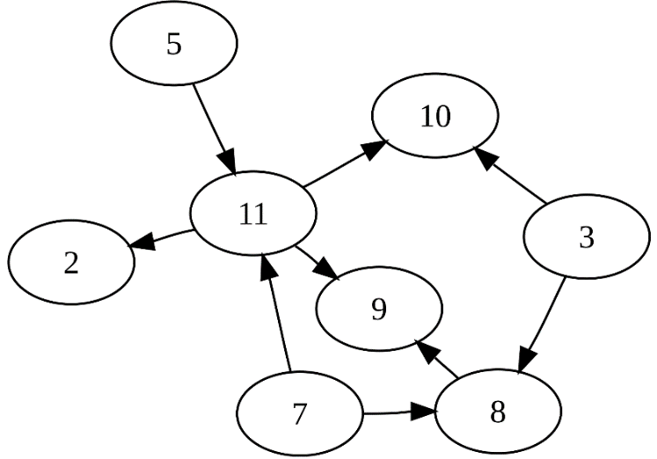
Recall: Strongly connected
Definition: A directed graph D = (V, E) is strongly connected if and only if, for each pair of nodes u, v ∈ V, there is a path from u to v.
The Web graph is not strongly connected since
there are pairs of nodes u and v, there is no path from u to v and from v to u.
This presents a challenge for nodes that have an in-degree of zero
Add a link from each page to
every page and give each link
a small transition probability
controlled by a parameter β.
v
u
Source: http://en.wikipedia.org/wiki/Directed_acyclic_graph

Slide 5
Katz Centrality
Recall that the eigenvector centrality $x\left(t\right)$ is a weighted degree obtained from the leading eigenvector of A: $A \text{x}\left(t\right)$ =$λ_{1}\text{x}\left(t\right)$, so its entries are $x_{i}=\frac{1}{λ_{1}}\sum_{j}{A_{ij}x_{j}}$
Thoughts on how to adapt the above formula for directed graphs?
Katz centrality:${ x}_{i}=\frac{1}{λ_{1}}\sum_{j}{A_{ij}x_{j}}$ + β,
Where β is a constant initial weight given to each vertex so that vertices with zero in degree (or out degree) are included in calculations.
After this augmentation, a random surfer on a particular webpage, has two options:
He randomly chooses an out-link to follow ($A_{ij}$)
He jumps to a random page (β)
Does β have to be the same for each vertex?
An extension: ${\text{β}}_{i}$ is an initial weight given to vertex $i$as a mechanism to differentiate vertices using some quality not modeled by adjacencies. Vertices with zero in degree (or out degree) will be included in calculations.

Slide 6
Katz Centrality
Does
Generalize the concept of eigenvector centrality to directed networks that are not strongly connected
Does not
Control for the fact that a high centrality vertex imparts high centrality on those vertices “downstream,” or all those vertices reachable from that high centrality vertex → PageRank

Slide 7
Updated Overview:
Quality: what makes a node important (central) | Mathematical Description | Appropriate Usage | Identification
Lots of one-hop connections relative to the size of the graph | The proportion of the vertices that $v$ influences directly | Local influence matters Small diameter | Normalized degree centrality $$C_{i}=deg(i)$$
Lots of one-hop connections to high centrality vertices | A weighted degree centrality based on the weight of the neighbors | For example when the people you are connected to matter. | Eigenvector centrality $$C_{i}∝\sum_{j}{C_{j}}$$
Lots of one-hop connections to high out-degree vertices (where each vertex has some pre-assigned weight) | A weighted degree centrality based on the out degree of the neighbors | Directed graphs that are not strongly connected | Katz centrality ${ x}_{i}=\frac{1}{λ_{1}}\sum_{j}{A_{ij}x_{j}}$ + β, Where β is some initial weight

