Slide 1
Prof. Ralucca Gera, rgera@nps.edu
Applied Mathematics Department,
Naval Postgraduate School
Excellence Through Knowledge
MA4404 Complex Networks
PageRank

Slide 2
Learning Outcomes
Understand how PageRank is an extension of Katz and Eigenvector Centrality to directed graphs.
Compute PageRank per node.
Interpret the meaning of the values of PageRank.

Slide 3
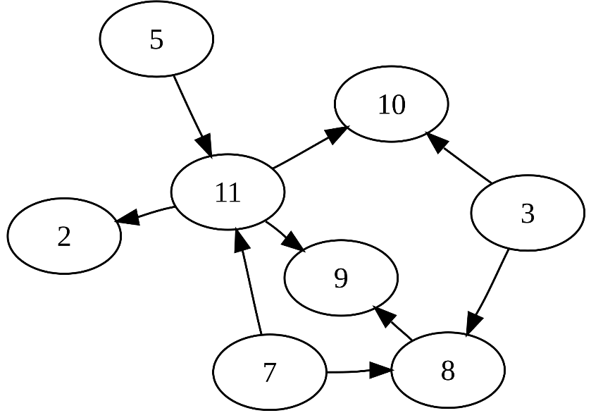
Why?!
Who knows how PageRank works? Guesses?
In directed graphs: some in-degrees are zero.
Fix: Katz centrality used a “free” weight of β
New problem: should the weight of the following edges be the same:
(11, 9),
(5, 11),
(3, 8)?
How should we decide
on the weight? Think
about it while we’re
going through the slides.
Source: http://en.wikipedia.org/wiki/Directed_acyclic_graph

Slide 4
Introduction –web search
Early search engines mainly compared content similarity of the query and the indexed pages. i.e.,
  They use information retrieval methods, cosine similarity, TF-IDF, ...
In the mid 1990’s, it became clear that content similarity alone was no longer sufficient.
  The number of pages grew rapidly in the mid 1990’s.
    How to choose only 30-40 pages and rank them suitably to present to the user?
  Content similarity is easily spammed.
    Webpage can repeat words and add related words to boost the rankings of his pages and/or to make the pages relevant to a large number of queries.

Slide 5
Introduction (cont …)
Starting around 1996, researchers began to work on the problem. They resorted to hyperlinks.
  In 1997, Yanhong Li, Scotch Plains, NJ, created a hyperlink based search patent. The method uses words in anchor text of hyperlinks.
Web pages on the other hand are connected through hyperlinks, which carry important information.
  Some hyperlinks: organize information at the same site (anchors).
  Other hyperlinks: point to pages from other Web sites. Such out-going hyperlinks often indicate an implicit conveyance of authority to the pages being pointed to.
Those pages that are pointed to by many other pages are likely to contain authoritative information.

Slide 6
Introduction (cont …)
During 1997-1998, two most influential hyperlink based search algorithms PageRank and HITS were published.
Both algorithms exploit the hyperlinks of the Web to rank pages according to their levels of “prestige” or “authority”.
  HITS (Section 7.5): Prof. Jon Kleinberg (Cornell University), at Ninth Annual ACM-SIAM Symposium on Discrete Algorithms, January 1998. (HITS stands for Hyperlink-Induced Topic Search)
  PageRank (Section 7.4): Sergey Brin and Larry Page, PhD students from Stanford University, at Seventh International World Wide Web Conference (WWW7) in April, 1998.
Which one have you heard of? Why?
HITS is part of the Ask search engine (www.Ask.com).
PageRank has emerged as the dominant link analysis model
  due to its query-independence,
  its ability to combat spamming, and
  Google’s huge business success.

Slide 7
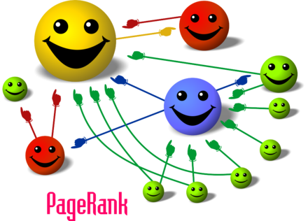
Intuition behind
PageRank

Slide 8
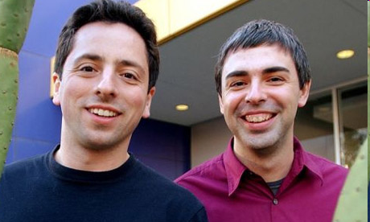
The PageRank Algorithm for WWW
Sergey Brin and Larry Page
in 1998
(quitting their PhD programs at Stanford
to start Google)
Invented the PageRank Algorithm to rank the returned key word searches
PageRank is based on: A webpage is important if it is pointed to by other important pages.
The algorithm was patented in 2001, and refined since.

Slide 9
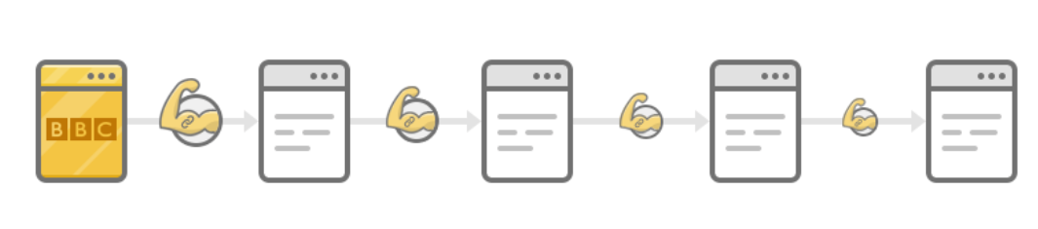
PageRank: the intuitive idea
PageRank relies on the democratic nature of the Web by using its vast link structure as an indicator of an individual page's value or quality.
PageRank interprets a hyperlink from page i to page j as a vote, by page i, for page j.
However, PageRank looks at more than the sheer number of votes; it also analyzes the page that casts the vote.
  A vote casted by an “important” page i weighs more heavily and helps to make page j more "important." (like eigenvector and Katz)
  Also, the vote of page i is shared among the pages that it points to, so page j gets a fraction of the vote.
    How do we find that fraction? Think about it while we’re going through the slides

Slide 10

More specifically
A hyperlink from a page to another page is an implicit transmission of authority to the target page.
  The more in-links that a page i receives, the more prestige the page i has.
Pages that point to page i also have their own prestige scores.
  A page of a higher prestige pointing to i is more important than a page of a lower prestige pointing to i.
  In other words, a page is important if it is pointed to by other important pages.
https://ahrefs.com/blog/google-pagerank/

Slide 11
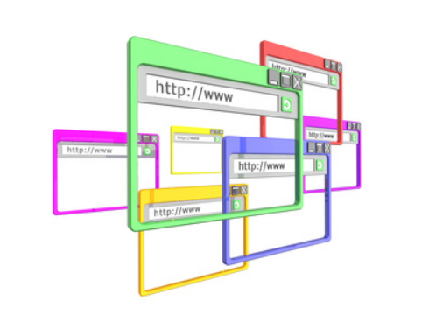
The web can be viewed as directed graph
The nodes or vertices are the web pages.
The edges are the hyperlinks between websites
This digraph has more than 10 billion vertices and it is growing
every second!
Google is useful
because it ranks
these outputs well,
not because it finds
more relevant pages
Source: http://orleansmarketing.com/web-development1/microsites/#.VMX4xntHEqI

Slide 12
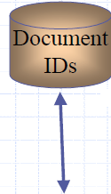
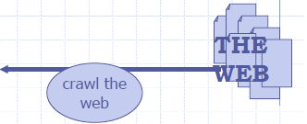
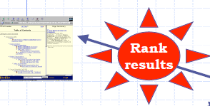
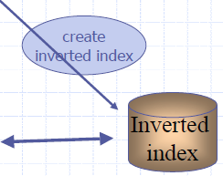

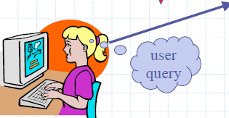
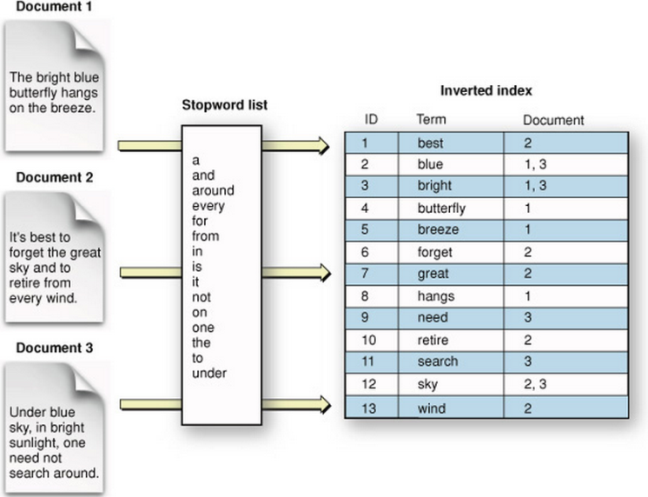
The web at a glance
PageRank Algorithm
Forward Index:
mapping
document
to content
Mapping
content to
location
Query-independent
Source: M. Ram Murty, Queen’s University

Slide 13
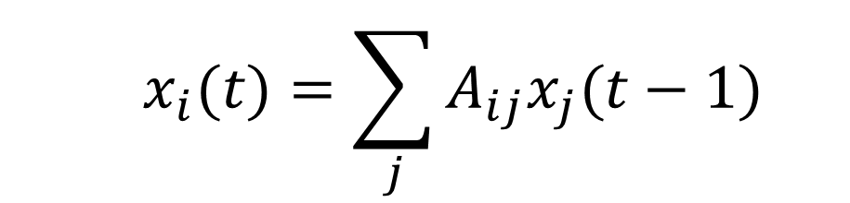

Computing
PageRank
  $$x_{i}(t)=\sum_{j}{A_{ij}x_{j}(t−1)}$$
  with the centrality at time t=0 being $x_{j}\left(0\right)=1, ∀j$
Notes:
https://www.researchgate.net/figure/a-k-core-decomposition-illustrative-example-Note-that-while-nodes-and-have-same_fig2_311990870

Slide 14
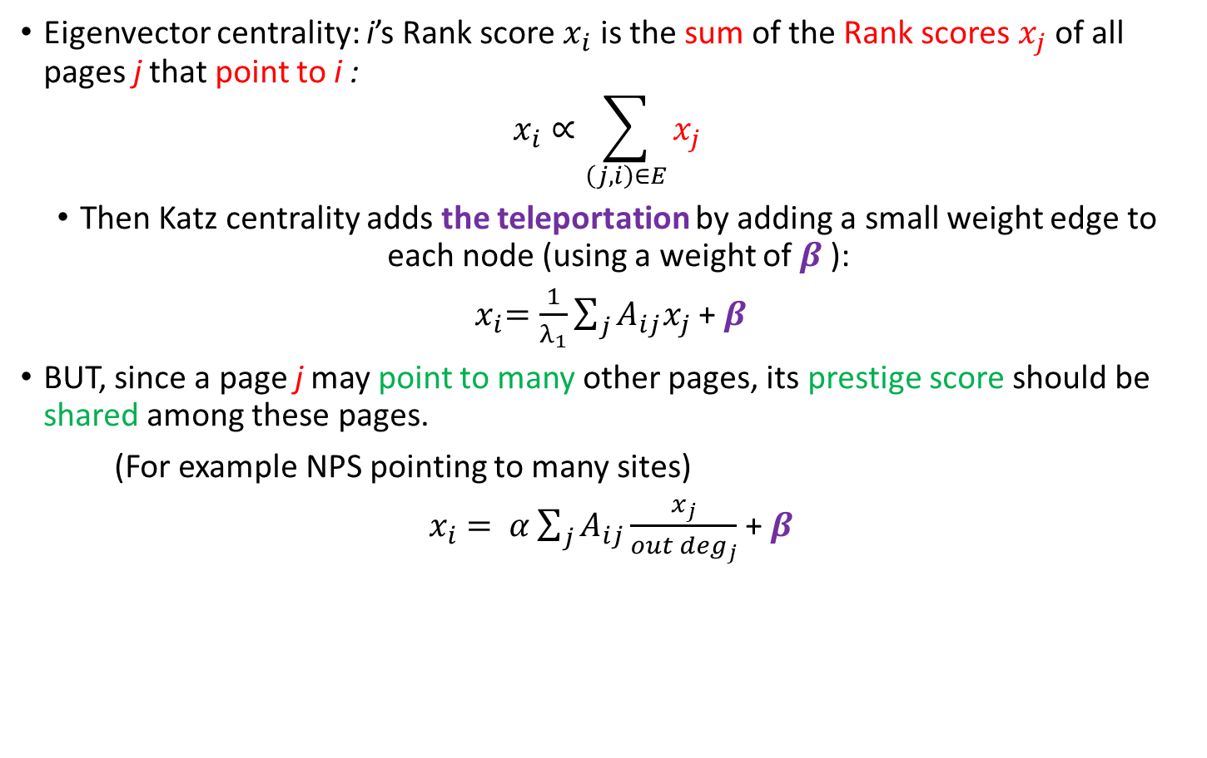
PageRank algorithm
Eigenvector centrality: i’s Rank score $x_{i}$ is the sum of the Rank scores $x_{j}$ of all pages j that point to i :
$$x_{i}∝\sum_{\left(j,i\right)∈E}{x_{j}}$$
Then Katz centrality adds the teleportation by adding a small weight edge to each node (using a weight of $β$):
${ x}_{i}=\frac{1}{λ_{1}}\sum_{j}{A_{ij}x_{j}}$ +$β$
BUT, since a page j may point to many other pages, its prestige score should be shared among these pages.
(For example NPS pointing to many sites)
${ x}_{i} = α\sum_{j}{A_{ij}\frac{x_{j}}{{out deg}_{j}}}$ +$β$

Slide 15
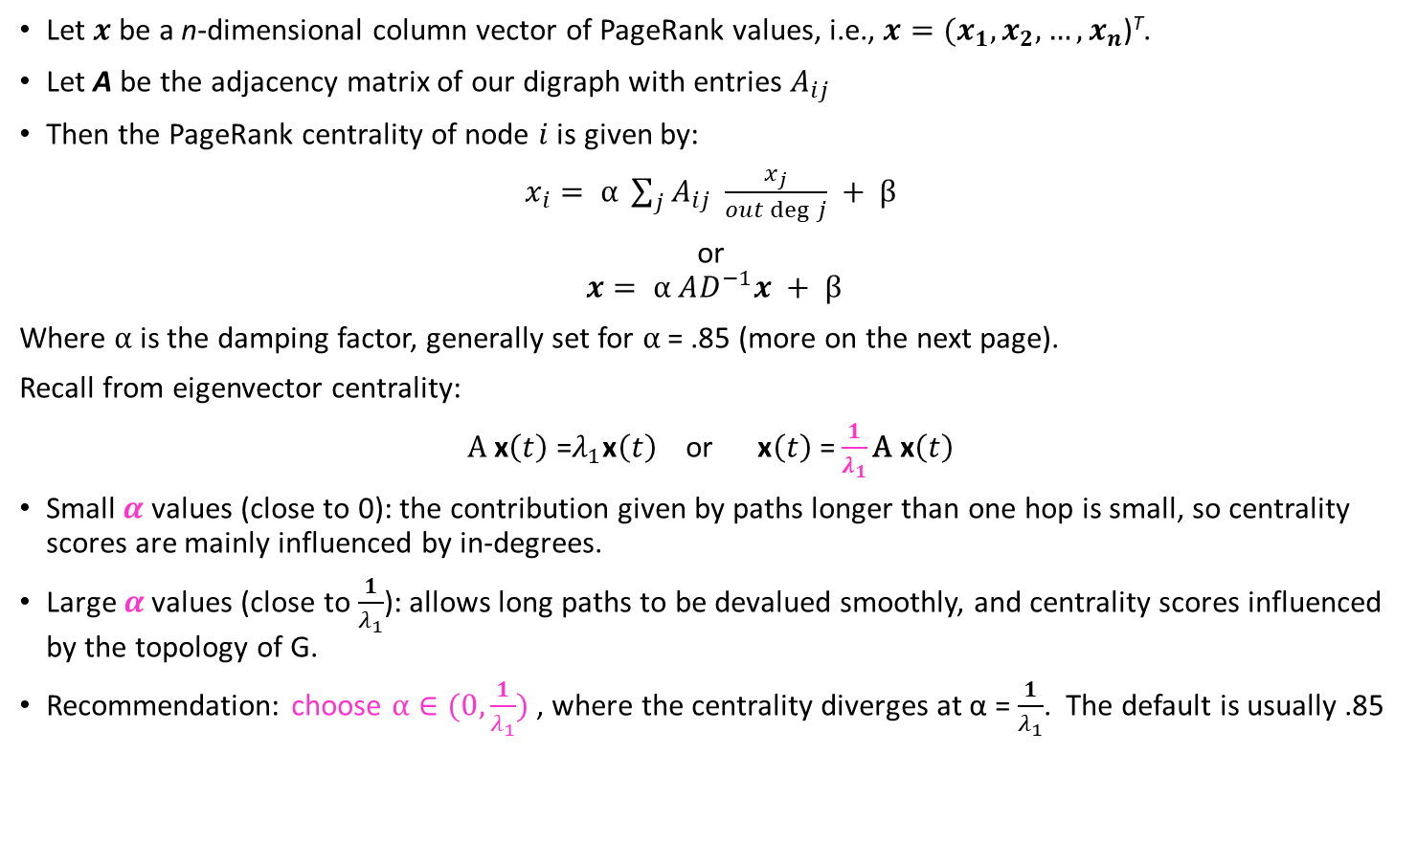
Matrix notation
Let $x$be a n-dimensional column vector of PageRank values, i.e., $x={(x}_{1}, x_{2}, …, x_{n}$)^{T}.
Let A be the adjacency matrix of our digraph with entries $A_{ij}$
Then the PageRank centrality of node $i$ is given by:
$x_{i}= α \sum_{j}{A_{ij} \frac{x_{j}}{out\deg{j}}} + β$
or
$x= α AD^{−1}x + β$
Where $α$ is the damping factor, generally set for $α$ = .85 (more on the next page).
Recall from eigenvector centrality:
$A \text{x}\left(t\right)$ =$λ_{1}\text{x}\left(t\right)$ or $\text{x}\left(t\right)$ =$\frac{1}{λ_{1}}\text{A} \text{x}\left(t\right)$
Small $α$ values (close to 0): the contribution given by paths longer than one hop is small, so centrality scores are mainly influenced by in-degrees.
Large $α$ values (close to $\frac{1}{λ_{1}}$): allows long paths to be devalued smoothly, and centrality scores influenced by the topology of G.
Recommendation: choose $α∈(0,\frac{1}{λ_{1}})$ , where the centrality diverges at α = $\frac{1}{λ_{1}}$. The default is usually .85

Slide 16
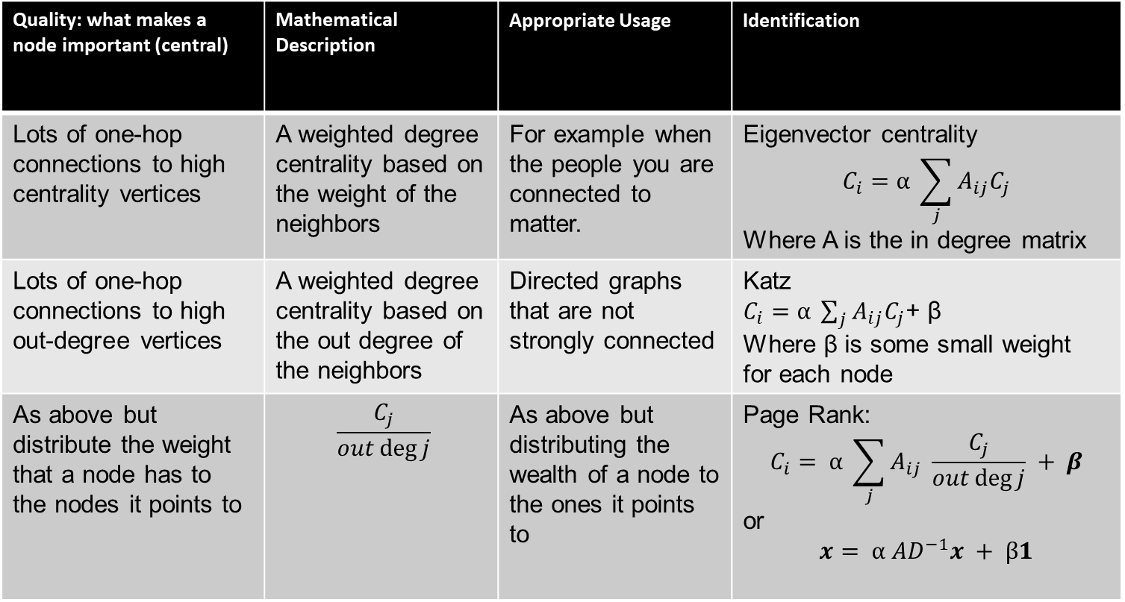
Updated Overview
Quality: what makes a node important (central) | Mathematical Description | Appropriate Usage | Identification
Lots of one-hop connections to high centrality vertices | A weighted degree centrality based on the weight of the neighbors | For example when the people you are connected to matter. | Eigenvector centrality $$C_{i}=α \sum_{j}{A_{ij}C_{j}}$$ Where A is the in degree matrix
Lots of one-hop connections to high out-degree vertices | A weighted degree centrality based on the out degree of the neighbors | Directed graphs that are not strongly connected | Katz $C_{i}=α \sum_{j}{A_{ij}C_{j}}$+ β Where β is some small weight for each node
As above but distribute the weight that a node has to the nodes it points to | $$\frac{C_{j}}{out\deg{j}}$$ | As above but distributing the wealth of a node to the ones it points to | Page Rank: $$C_{i}= α \sum_{j}{A_{ij} \frac{C_{j}}{out\deg{j}}} + β$$ or $$x= α AD^{−1}x + β1$$

Slide 17
An example using the Adjacency and Diagonal Matrices

Slide 18

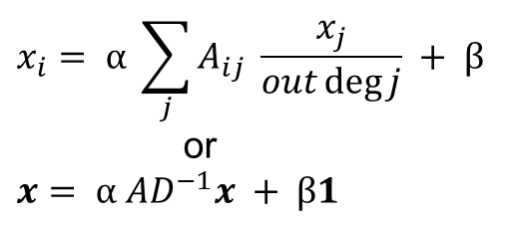
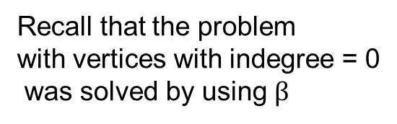
An example as just described:
Problem vertex
(no outgoing links)
Recall that the problem
with vertices with indegree = 0
was solved by using $β$
$$x_{i}= α \sum_{j}{A_{ij} \frac{x_{j}}{out\deg{j}}} + β \\ \text{or} \\ x= α AD^{−1}x + β1$$
in-degree matrix
each row
shows the
in degree
Is the formula above
well defined?
If not, how could we fix
the formula or the matrix?
each column shows the out degree

Slide 19
How can we fix the problem?
Remove those pages with no out-links during the PageRank computation as these pages do not affect the ranking of any other page directly (these pages will get outgoing links in the future).
Add a complete set of outgoing links from each such page i to all the pages on the Web.
each column shows the out degree
in-degree matrix
each row
shows the
in degree
The second choice is used in PR since matrix may get updated

Slide 20

How can we fix the out degree = 0?
$$x= α AD^{−1}x + β1$$
in-degree matrix
Inverse of the out-degree matrix

Slide 21

PR centrality formula is well defined
$$x= α AD^{−1}x + β1$$
By multiplying them we obtain the matrix that captures:
  The in and out degree per vertex
  Divides the centrality of each
  vertex by its degree
  The contribution
  of node 5 is
  insignificant,
  and the formula
  is now well defined
out-degree matrix
in-degree matrix

Slide 22

Transition probability matrix
This modified $AD^{−1}$ matrix is called the state transition probability matrix. Denote its entries by p_{ij} :
p_{ij} represents the transition probability that the surfer in state i (page i) will move to state j (page j).
An extra example in the backup slides of this PPT deck.

Slide 23
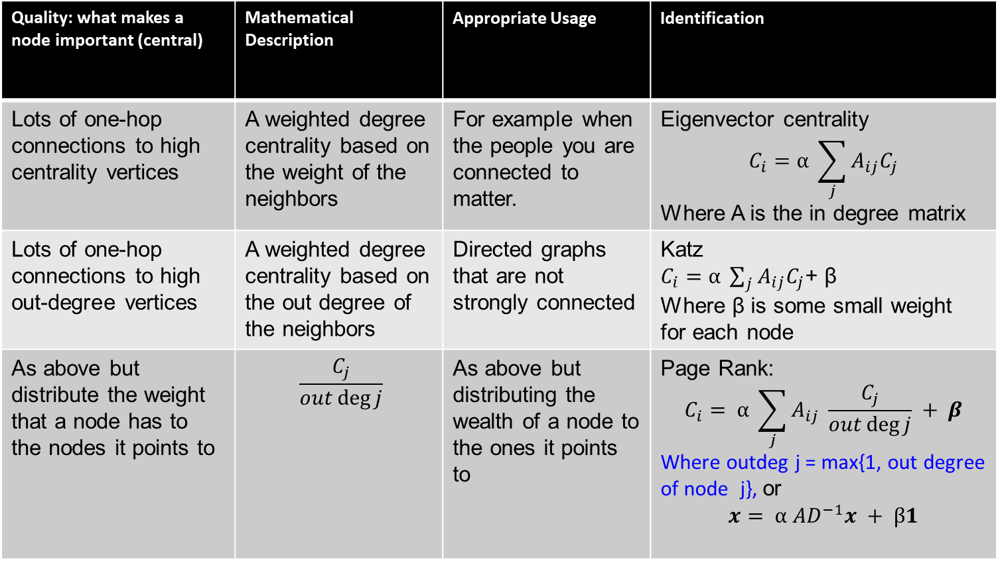
Updated Overview
Quality: what makes a node important (central) | Mathematical Description | Appropriate Usage | Identification
Lots of one-hop connections to high centrality vertices | A weighted degree centrality based on the weight of the neighbors | For example when the people you are connected to matter. | Eigenvector centrality $$C_{i}=α \sum_{j}{A_{ij}C_{j}}$$ Where A is the in degree matrix
Lots of one-hop connections to high out-degree vertices | A weighted degree centrality based on the out degree of the neighbors | Directed graphs that are not strongly connected | Katz $C_{i}=α \sum_{j}{A_{ij}C_{j}}$+ β Where β is some small weight for each node
As above but distribute the weight that a node has to the nodes it points to | $$\frac{C_{j}}{out\deg{j}}$$ | As above but distributing the wealth of a node to the ones it points to | Page Rank: $$C_{i}= α \sum_{j}{A_{ij} \frac{C_{j}}{out\deg{j}}} + β$$ Where outdeg j = max{1, out degree of node j}, or $$x= α AD^{−1}x + β1$$

Slide 24
Final Comments

Slide 25
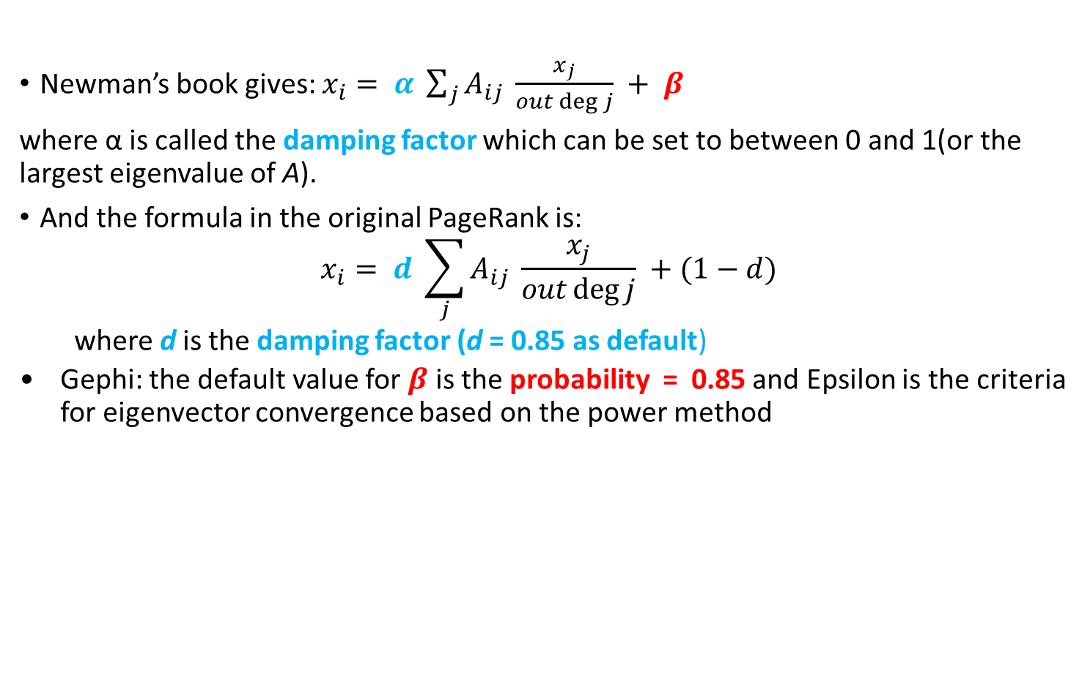
Some comments
Newman’s book gives: $x_{i}= α \sum_{j}{A_{ij} \frac{x_{j}}{out\deg{j}}} + β$
where α is called the damping factor which can be set to between 0 and 1(or the largest eigenvalue of A).
And the formula in the original PageRank is:
$$x_{i}= d \sum_{j}{A_{ij} \frac{x_{j}}{out\deg{j}}} +(1−d)$$
  where d is the damping factor (d = 0.85 as default)
  Gephi: the default value for $β$ is the probability = 0.85 and Epsilon is the criteria for eigenvector convergence based on the power method

Slide 26
Final Points on PageRank
Fighting spam.
  A page is important if the pages pointing to it are important.
  Since it is not easy for Web page owner to add in-links into his/her page from other important pages, it is thus not easy to influence PageRank.
PageRank is a global measure and is query independent.
  The values of the PageRank algorithm of all the pages are computed and saved off-line rather than at the query time => fast
Criticism:
  There are companies that can increase your PageRank by adding it to a cluster and increasing its indegree
  It cannot not distinguish between pages that are authoritative in general and pages that are authoritative on the query topic.
    But it works based on the keyword search

Slide 27
Backup slides
Back up slides: one smaller example
Back up slides

Slide 28
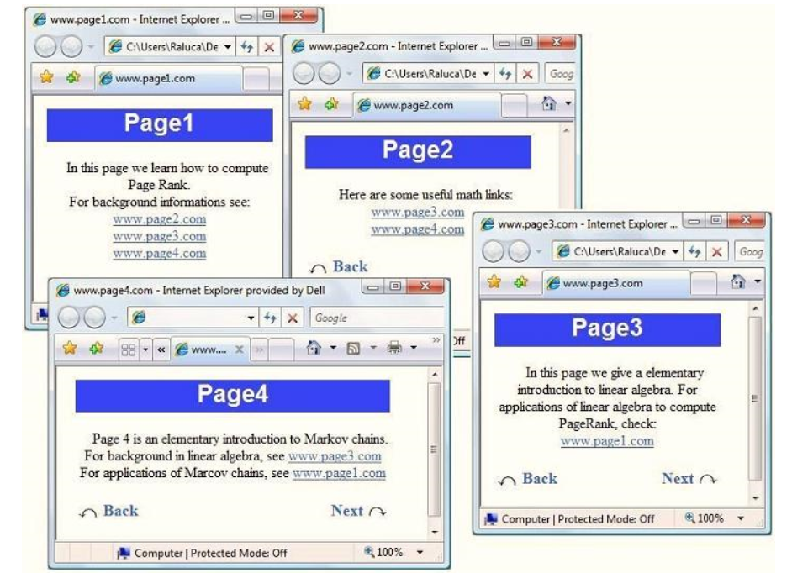
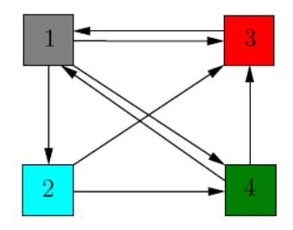
A 4-website Internet
Source: http://www.math.cornell.edu/~mec/Winter2009/RalucaRemus/Lecture3/lecture3.html

Slide 29
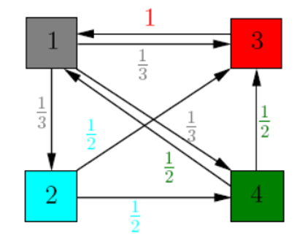
A 4-website Internet
p_{ij} represents the transition probability that the surfer on
page j will move to page i:
Source: http://www.math.cornell.edu/~mec/Winter2009/RalucaRemus/Lecture3/lecture3.html

Slide 30
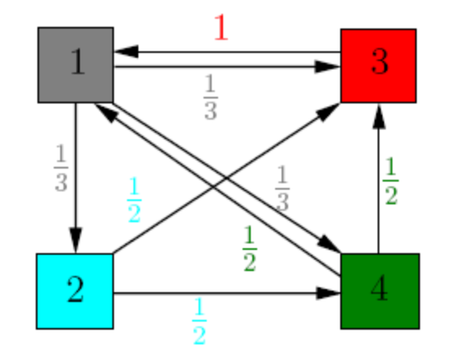
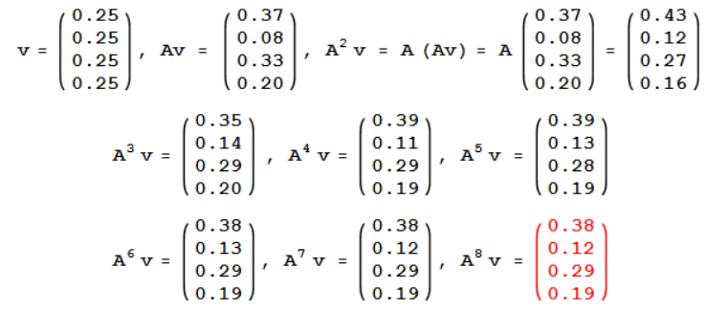
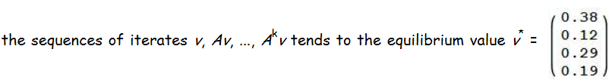
A 4-website Internet
Random surfer: each page has equal probability ¼ to be chosen as a starting point.
The probability that page i will be visited after k steps (i.e. the random surfer ending up at page i ) is equal to $i^{th}$ entry of A ^{k}x.
Simplification for this example: No β was involved since id i > 0, for all i
Source: http://www.math.cornell.edu/~mec/Winter2009/RalucaRemus/Lecture3/lecture3.html

