Slide 1
Prof. Ralucca Gera, rgera@nps.edu
Applied Mathematics Department, Naval Postgraduate School
Excellence Through Knowledge
MA4404 Complex Networks
Centralities: Python and Gephi

Slide 2
Centralities in Cocalc (Python)

Slide 3
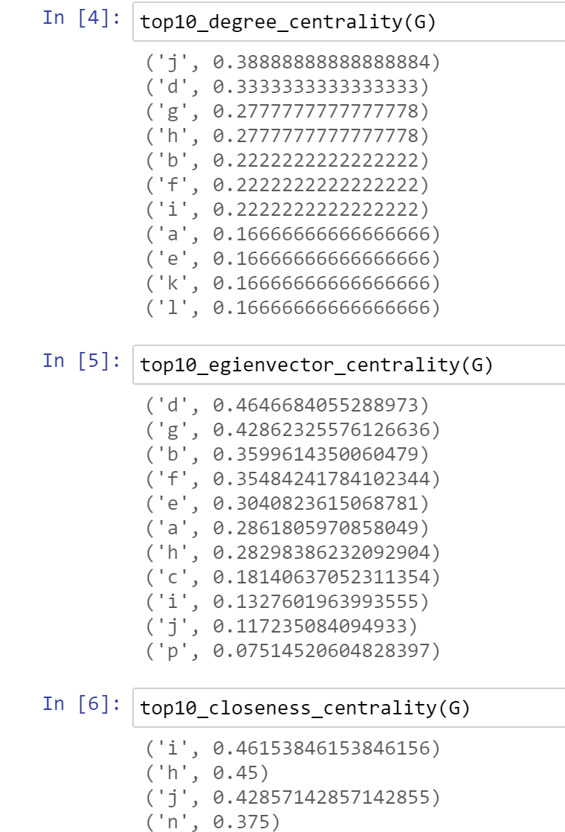
Python code on CoCalc
Use NetworkAnalysis.ipynb for each centrality:
The default is to show 10 nodes of highest values for each centrality. If you wish to display more than 10 nodes, update the value in the definition of centrality below

Slide 4
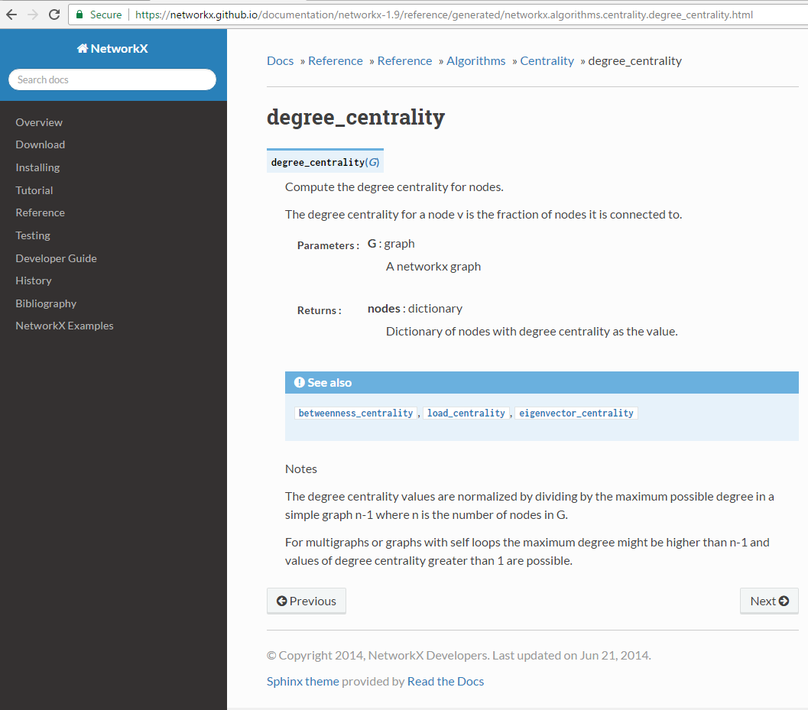
NetworkX References
PDF reference for NetworkX
Github interactive version

Slide 5
Closeness/Eigenvector
The closeness centrality is normalized by dividing by (n-1), where n is the number of nodes in the connected part of graph containing the node. If the graph is not completely connected, this algorithm computes the closeness centrality for each connected part separately.
The eigenvector calculation is done by the power iteration method and has no guarantee of convergence. The iteration will stop after max_iter iterations or an error tolerance of number_of_nodes(G)*tol has been reached.
For directed graphs this is “left” eigevector centrality which corresponds to the in-edges in the graph. For out-edges eigenvector centrality first reverse the graph with G.reverse().
https://networkx.github.io/documentation/networkx-1.9/reference/generated/networkx.algorithms.centrality.eigenvector_centrality.html#networkx.algorithms.centrality.eigenvector_centrality

Slide 6
$$C_{i}=1/{\sum_{j=1}^{n}{d(i,j)}}$$
Centralities in Gephi
Notes:
https://www.researchgate.net/figure/a-k-core-decomposition-illustrative-example-Note-that-while-nodes-and-have-same_fig2_311990870

Slide 7
Resources for Gephi:
Overview and explanations of Gephi
Gephi’s overview tutorial
An introductory video to create data for Gephi and to use degree, closeness and betweeness (also posted on the website unde today’s lecture).
Gephi’s overview of layouts
Basic navigation

Slide 8
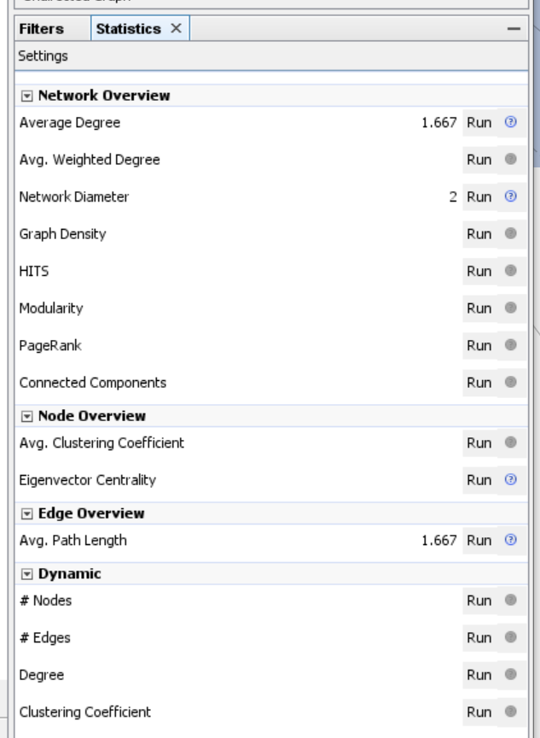
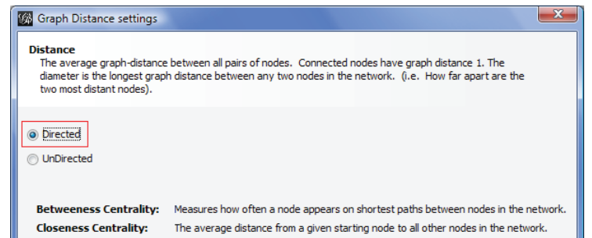
Centralities
Click “Diameter” under the “Statistics” tab module on the right for
Betweenness
Closeness
The other centralities that available:
Eigenvector
PageRank
HITS
For directed graphs, check “directed”:

Slide 9
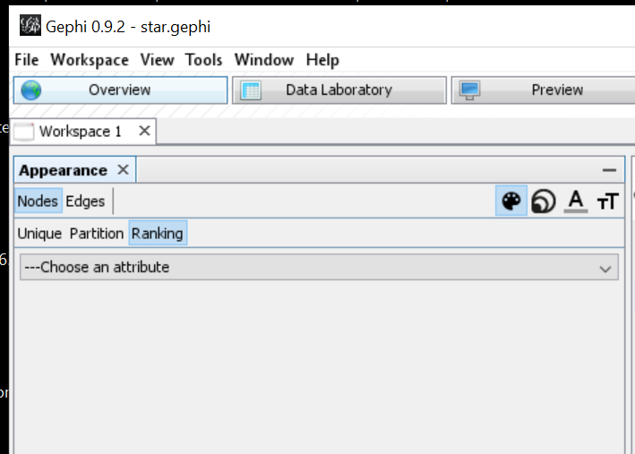
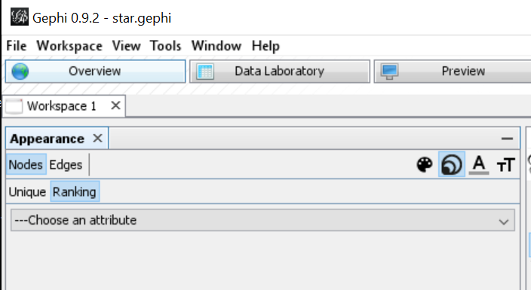
Ranking nodes based on centralities
Once you ran a metric, you can size/color the nodes based on your choices you ran.
Under on the top left, choose Nodes, and either size or color

Slide 10
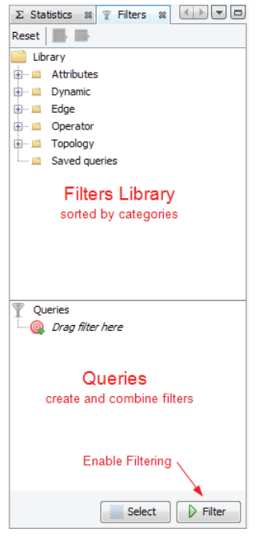
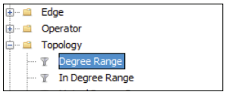
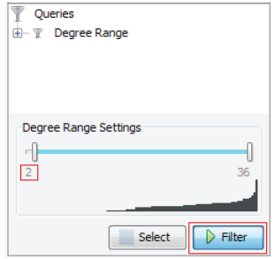
Filtering nodes based on centralities
Find Filters on the top right, next to Statistics
Under topology, you can find the centralities
Choose one, drag and drop it to the Queries
Choose the bounds needed.

Slide 11
Export
You can export the visualized graph as SVG or PDF:
Go to preview (fix if needed)
Resize for large networks
Click SVG (SVG is vectorial graphics like PDF so they scale to different sizes nicely)

Slide 12
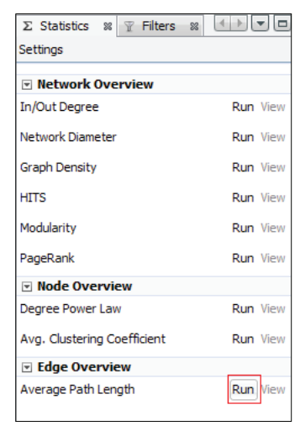
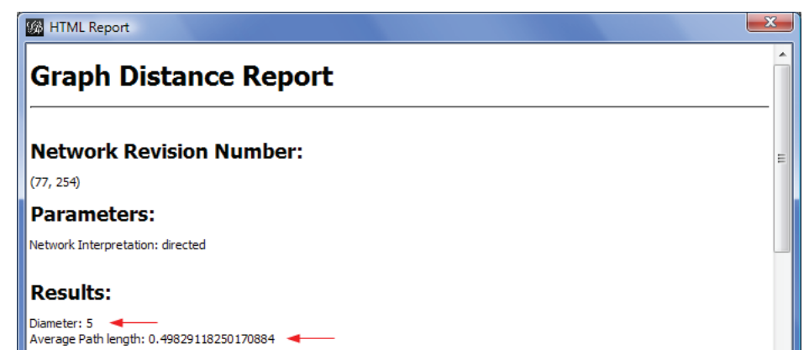
Other metrics
Average path length: under the statics module, right
Computes the average of shortest paths between all pairs of nodes
Result:

