Slide 1
Prof. Ralucca Gera, rgera@nps.edu
Applied Mathematics Department,
Naval Postgraduate School
Excellence Through Knowledge
MA4404 Complex Networks
Clustering Coefficient

Slide 2
Learning Outcomes
Differentiate between:
  Local clustering coefficient,
  Global clustering coefficient, and
  Average clustering coefficient
Understand the computation of clustering coefficients
Create extensions of clustering coefficient

Slide 3
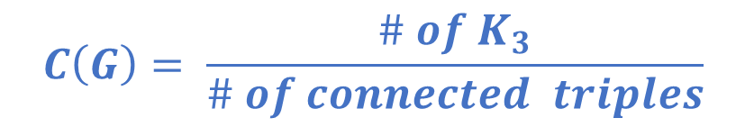
Definition of Clustering
Coefficient
$$C\left(G\right)= \frac{\# of K_{3}}{\# of connected triples}$$

Slide 4
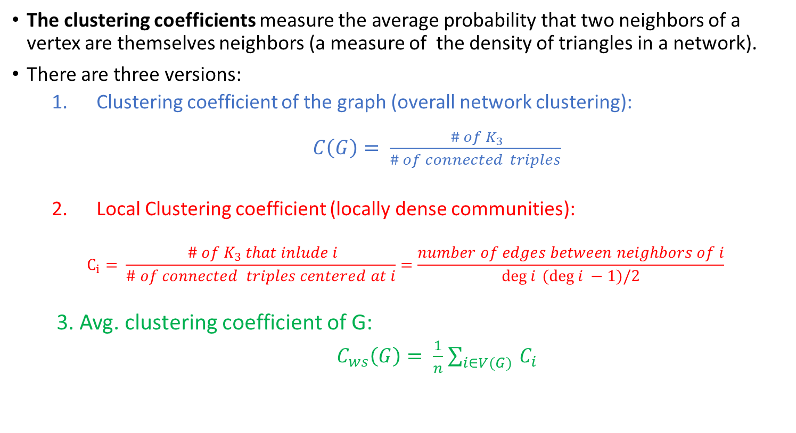
Clustering coefficients for real networks
The clustering coefficients measure the average probability that two neighbors of a vertex are themselves neighbors (a measure of the density of triangles in a network).
There are three versions:
  Clustering coefficient of the graph (overall network clustering):
    $C\left(G\right)= \frac{ \# of K_{3}}{\# of connected triples}$
  Local Clustering coefficient (locally dense communities):
    $$C_{i}= \frac{ \# of K_{3} that inlude i}{\# of connected triples centered at i}=\frac{number of edges between neighbors of i}{\deg{i} (\deg{i} −1)/2}$$
  3. Avg. clustering coefficient of G:
    $C_{ws}\left(G\right)= \frac{1}{n}$ $\sum_{i∈V(G) }{C_{i}}$
Notes:
Mention that if we use the second definition of clustering coefficient (Eq. 7.44) we get different results – usually overestimate of C
Also some studies instead of using the expected clustering coefficient given from the equation on this slide, they use the one for the Poissonian random graph (i.e., edge density), which again will give discrepancies in the results.

Slide 5
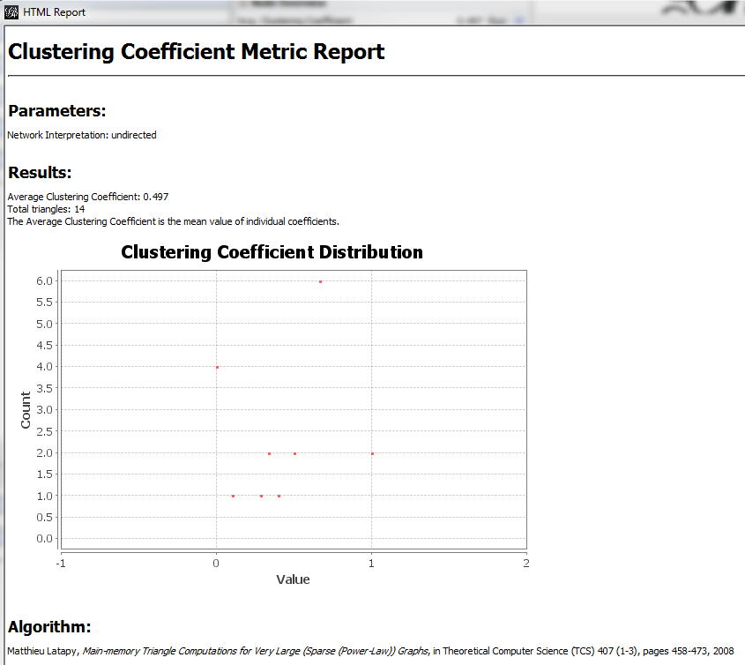
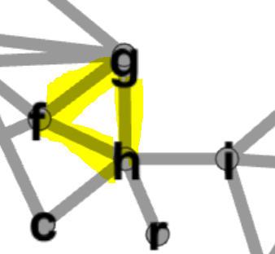
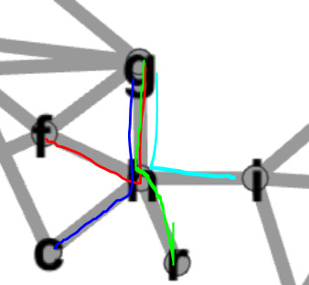
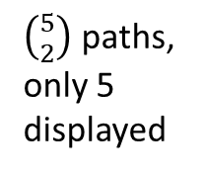


Clustering coeff distribution example in Gephi
$$C_{h}=\frac{1}{\left({5 \atop 2}\right)}$$
$$C_{i}= \frac{\# of K_{3} that inlude i}{\# of connected triples centered at i}$$
Observed: Networks are globally sparse, but locally dense

Slide 6
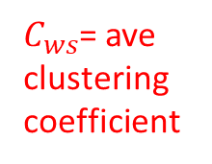
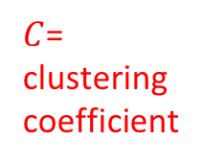
Statistics for real networks
$C$= clustering coefficient
$C_{ws}$= ave clustering coefficient
Newman, “The Structure and Function of Complex Networks” http://epubs.siam.org/doi/pdf/10.1137/S003614450342480

Slide 7
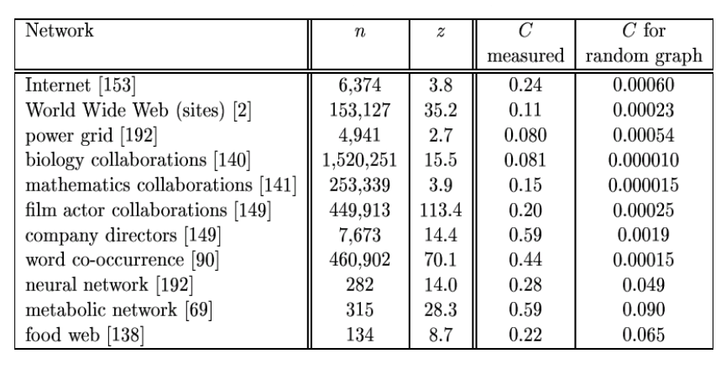
Observed vs. random
ws
ws
Source: N. Przulj. Graph theory analysis of protein-protein interactions. 2005.
Why are they different?

Slide 8
Clustering dependency
on degrees or
size of network

Slide 9
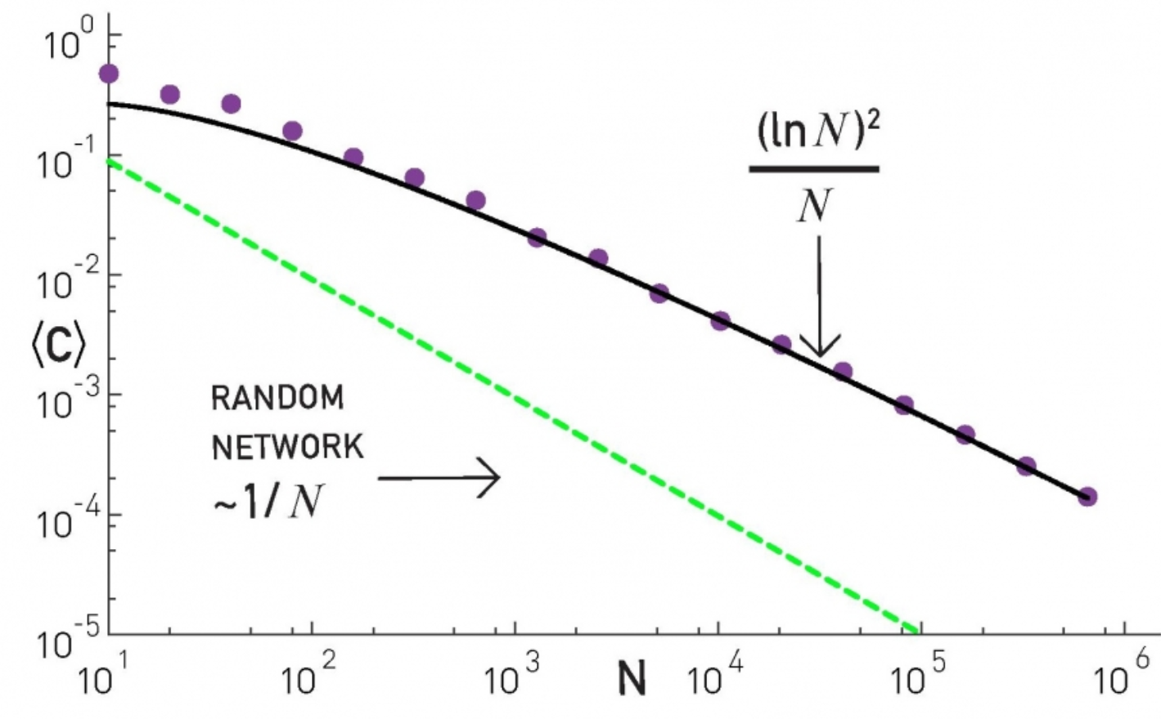

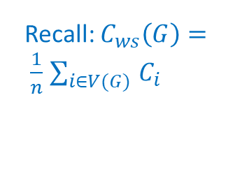
ER & BA model: $C_{ws}$ as a function of the network size (N)
BA model
Analytical prediction
Recall: $C_{ws}\left(G\right)= \frac{1}{n}$ $\sum_{i∈V(G) }{C_{i}}$
ER model
Barabási-Albert network is locally more clustered than a random network.
L. Barab´asi. http://barabasi.com/networksciencebook/chapter/5#diameter

Slide 10
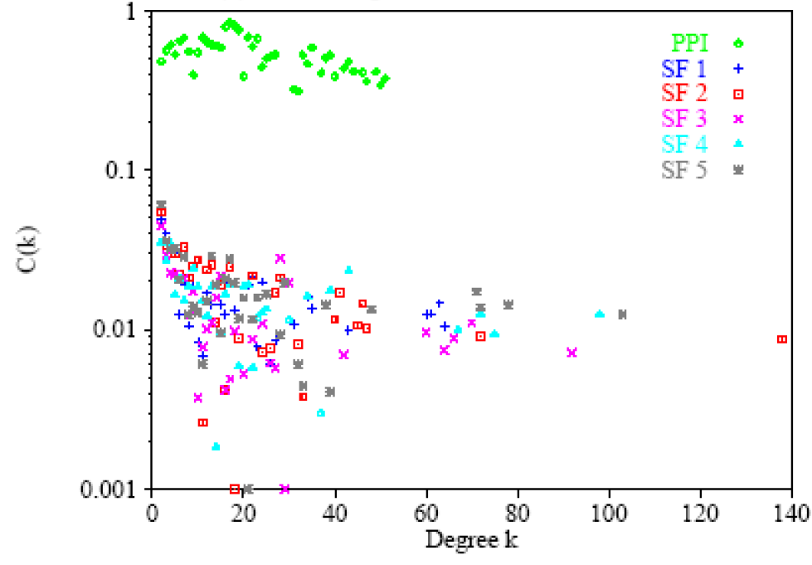

$PPI and SF:$clustering as a function of degree k
PPI: protein-protein
interaction netw.
SF = scale free synthetic network.
Source: N. Prˆzulj, D. G. Corneil, and I. Jurisica. Modeling interactome: Scale free or geometric? arXiv:qbio. MN/0404017, 2004.

Slide 11
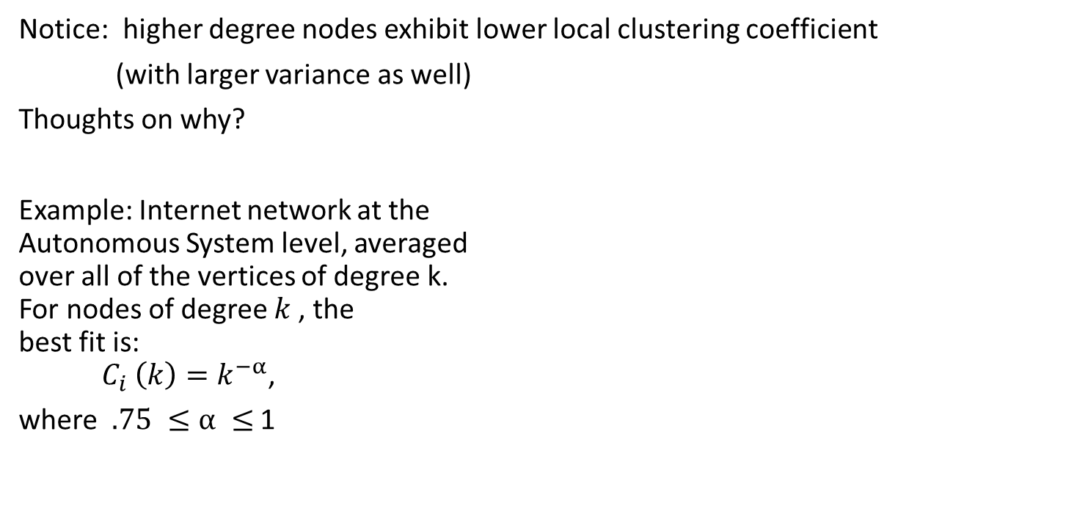
Internet: local clustering coefficient as a function of degree k
Notice: higher degree nodes exhibit lower local clustering coefficient
(with larger variance as well)
Thoughts on why?
Example: Internet network at the
Autonomous System level, averaged
over all of the vertices of degree k.
For nodes of degree $k$, the
best fit is:
${C_{i} \left(k\right)=k}^{−α}$,
where $.75 ≤α ≤$ 1
MIS 644 Social Newtork Analysis 2017/2018 Spring - ppt download)

Slide 12
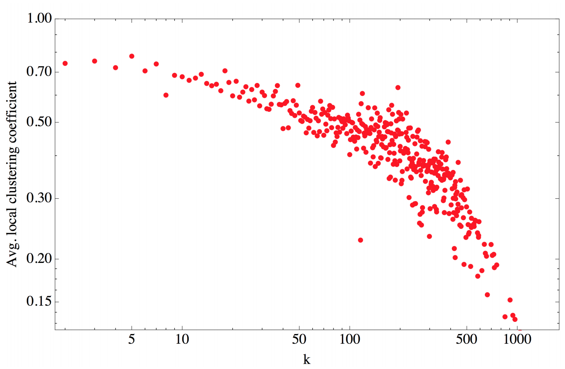
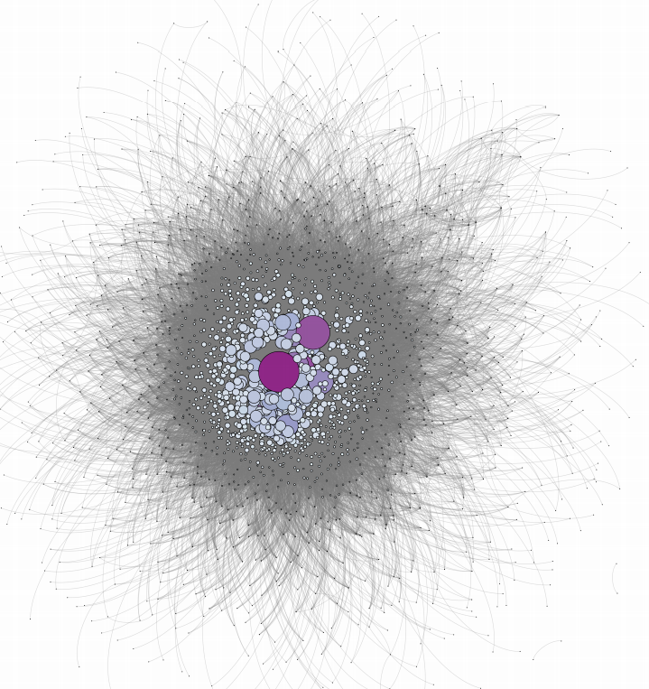

OSN: Avg Local Clustering as a function of degree
A node chosen at random has higher clustering than the one of a hub
DissertationResearchGateversion.pdf

Slide 13
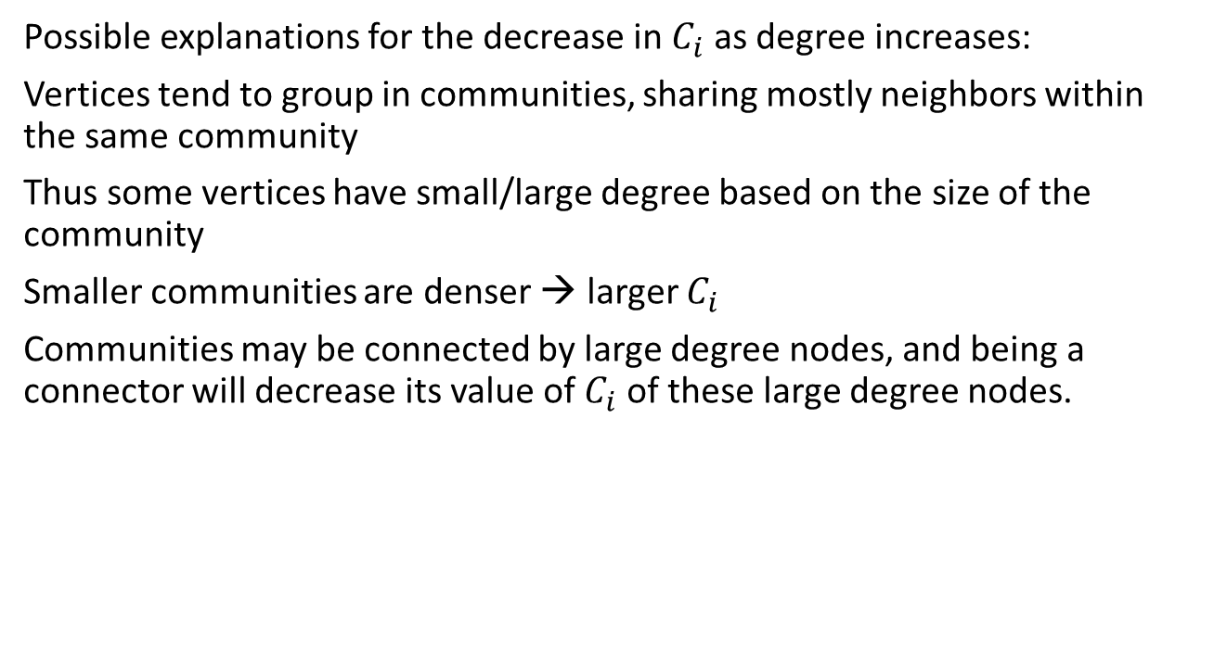
Local clustering coefficient
Possible explanations for the decrease in $C_{i}$ as degree increases:
Vertices tend to group in communities, sharing mostly neighbors within the same community
Thus some vertices have small/large degree based on the size of the community
Smaller communities are denser → larger $C_{i}$
Communities may be connected by large degree nodes, and being a connector will decrease its value of $C_{i}$ of these large degree nodes.

Slide 14
Extension of Clustering Coefficient

Slide 15
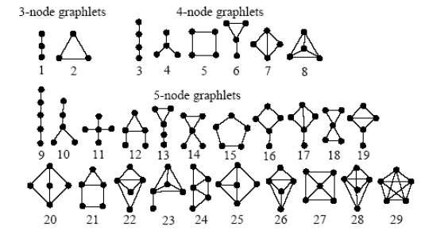
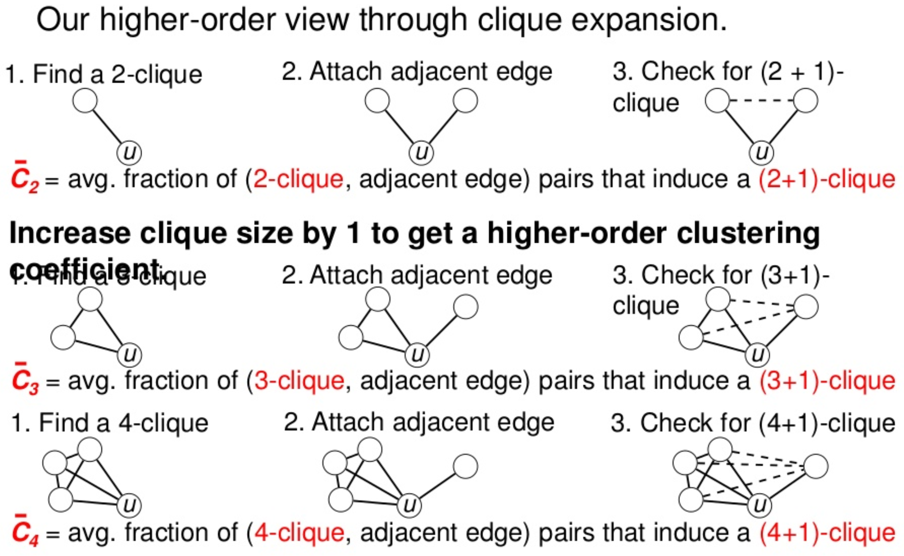

Extensions
Clustering coefficient measures the density of $K_{3}$ in networks
Count the density of:
  other motifs,
  clique expansion (clique + edge).
Enumeration of all graphs of fixed n:
Frequency of cliques in clique+edge occurrences:
Source: N. Prˆzulj, D. G. Corneil, and I. Jurisica. Modeling interactome:
Scale free or geometric? arXiv:qbio. MN/0404017, 2004.
Benson, Yin, Leskovec, “Higher-order clustering coefficient” (2017)
https://www.slideshare.net/arbenson/higherorder-clustering-coefficients-80864022

Slide 16
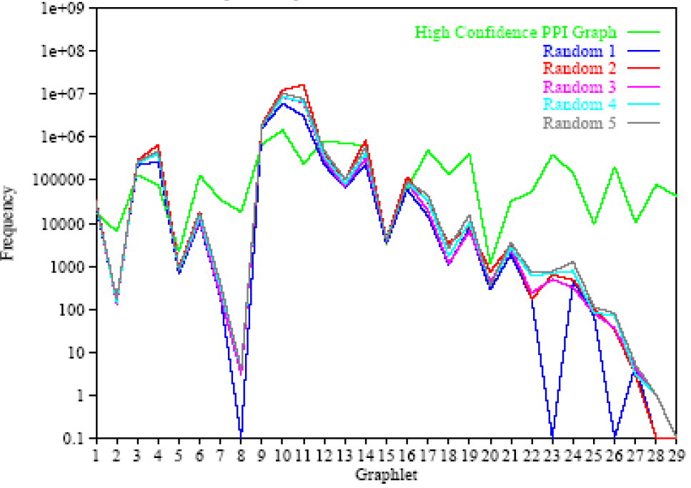
Graphlet frequency in Scale Free network
Source: N. Prˆzulj, D. G. Corneil, and I. Jurisica. Modeling interactome:
Scale free or geometric? arXiv:qbio. MN/0404017, 2004.

Slide 17
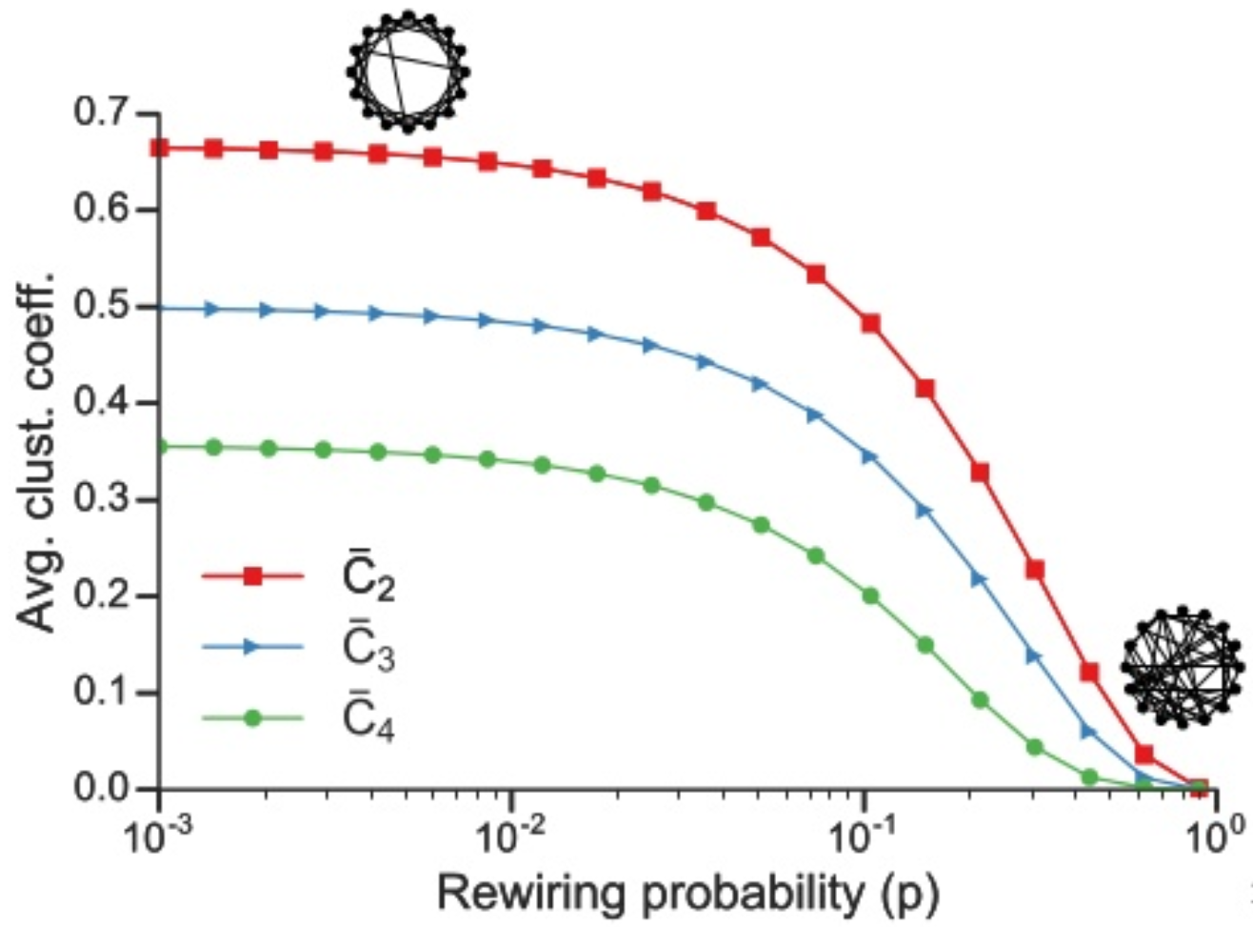
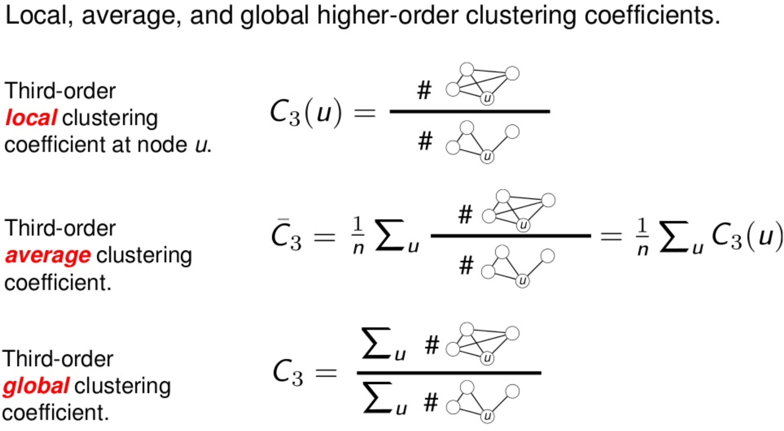
Higher order clustering in WS networks

Slide 18
References
Newman, “The Structure and Function of Complex Networks” http://epubs.siam.org/doi/pdf/10.1137/S003614450342480
Source: L. Barabasi. http://barabasi.com/networksciencebook/chapter/5#diameter
Benson, Yin, Leskovec, “Higher-order clustering coefficient” (2017) https://www.slideshare.net/arbenson/higherorder-clustering-coefficients-80864022
N. Prˆzulj, D. G. Corneil, and I. Jurisica. Modeling interactome: Scale free or geometric?
arXiv:qbio. MN/0404017, 2004.

