Slide 1
Prof. Ralucca Gera, rgera@nps.edu
Applied Mathematics Department,
Naval Postgraduate School
Excellence Through Knowledge
MA4404 Complex Networks
Small World

Slide 2
Learning Outcomes
Understand the definition of small world
Identify methods to compare your network to the small world model

Slide 3

Small world

Slide 4
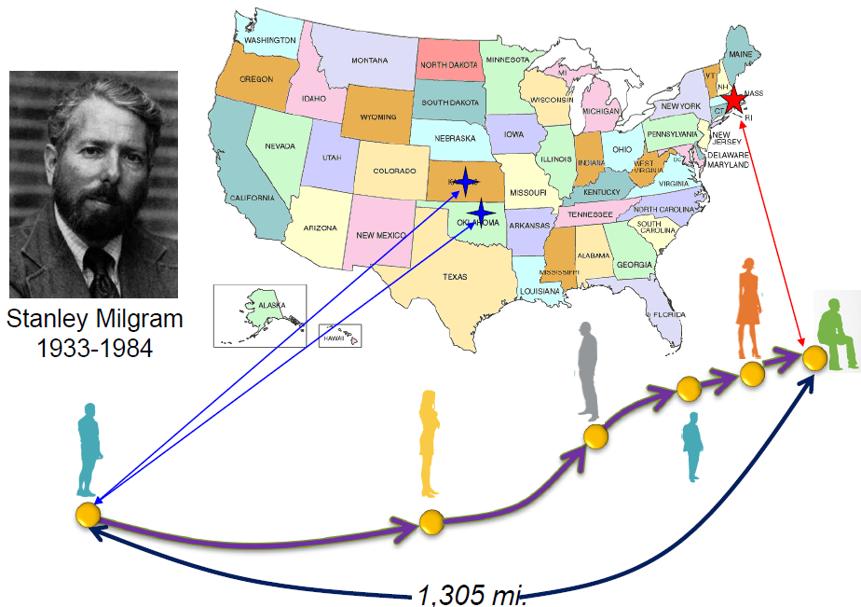
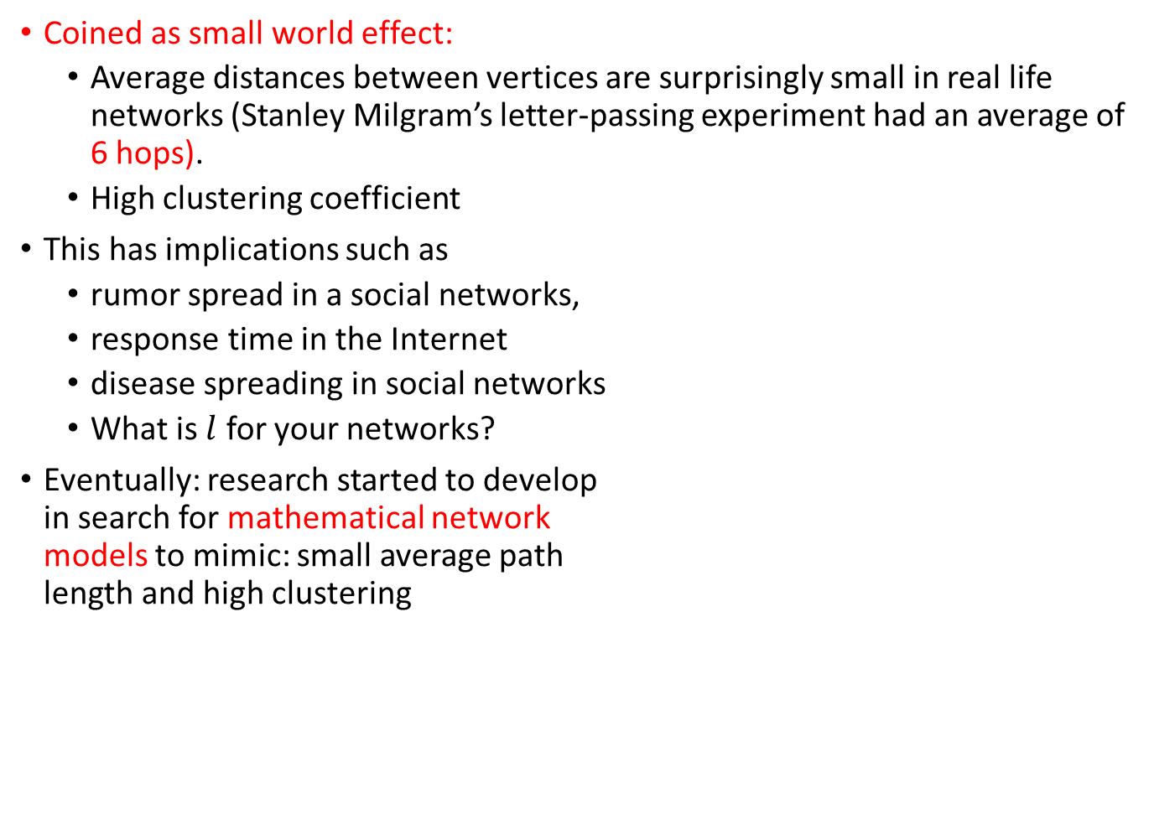
The small world effect
Coined as small world effect:
  Average distances between vertices are surprisingly small in real life networks (Stanley Milgram’s letter-passing experiment had an average of 6 hops).
  High clustering coefficient
This has implications such as
  rumor spread in a social networks,
  response time in the Internet
  disease spreading in social networks
  What is $l$ for your networks?
Eventually: research started to develop
in search for mathematical network
models to mimic: small average path
length and high clustering
Reuven Cohen and Shlomo Havlin Phys. Rev. Lett. 90, 058701 – February 2003

Slide 5

Statistics for real networks
$l$is the average distance

Slide 6
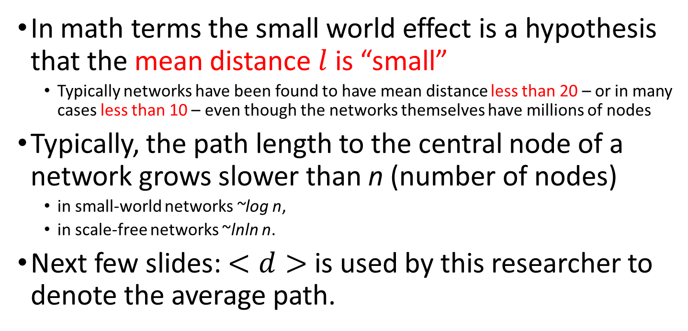
The small average path
In math terms the small world effect is a hypothesis that the mean distance $l$ is “small”
  Typically networks have been found to have mean distance less than 20 – or in many cases less than 10 – even though the networks themselves have millions of nodes
Typically, the path length to the central node of a network grows slower than n (number of nodes)
  in small-world networks ~log n,
  in scale-free networks ~lnln n.
Next few slides: $<d>$ is used by this researcher to denote the average path.
Source: http://barabasi.com/networksciencebook/chapter/5#origins

Slide 7
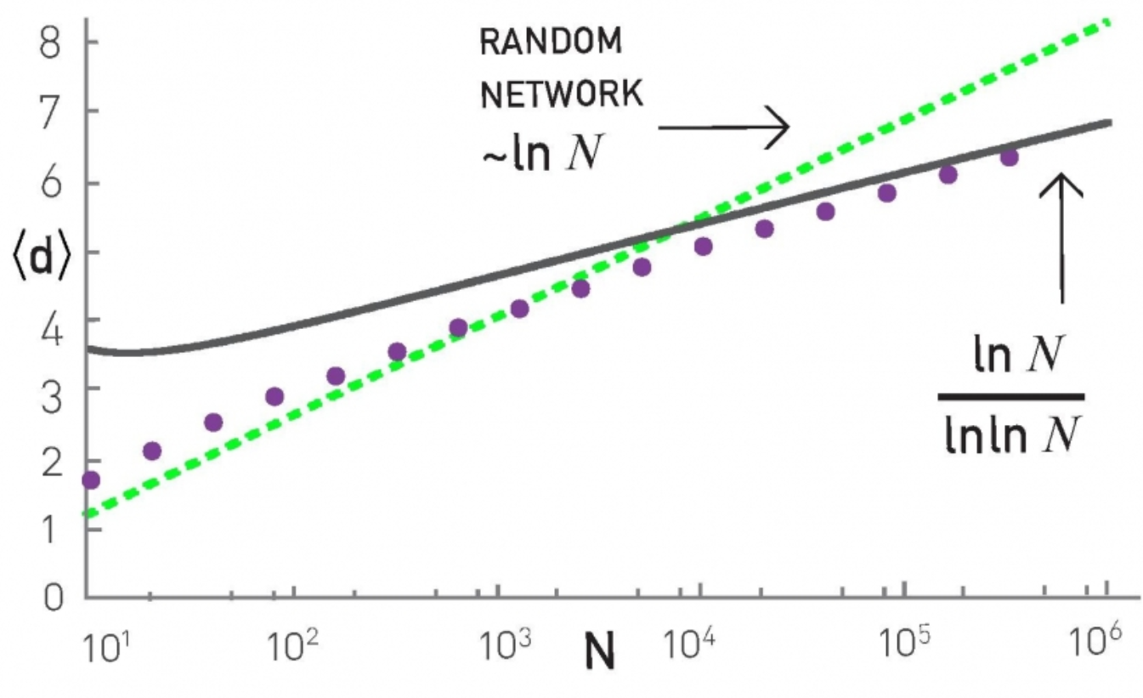
ER & BA model: Average Distance as a function of network size N
Analytical prediction
BA model
ER model
Source: L. Barab´asi. http://barabasi.com/networksciencebook/chapter/5#diameter

Slide 8
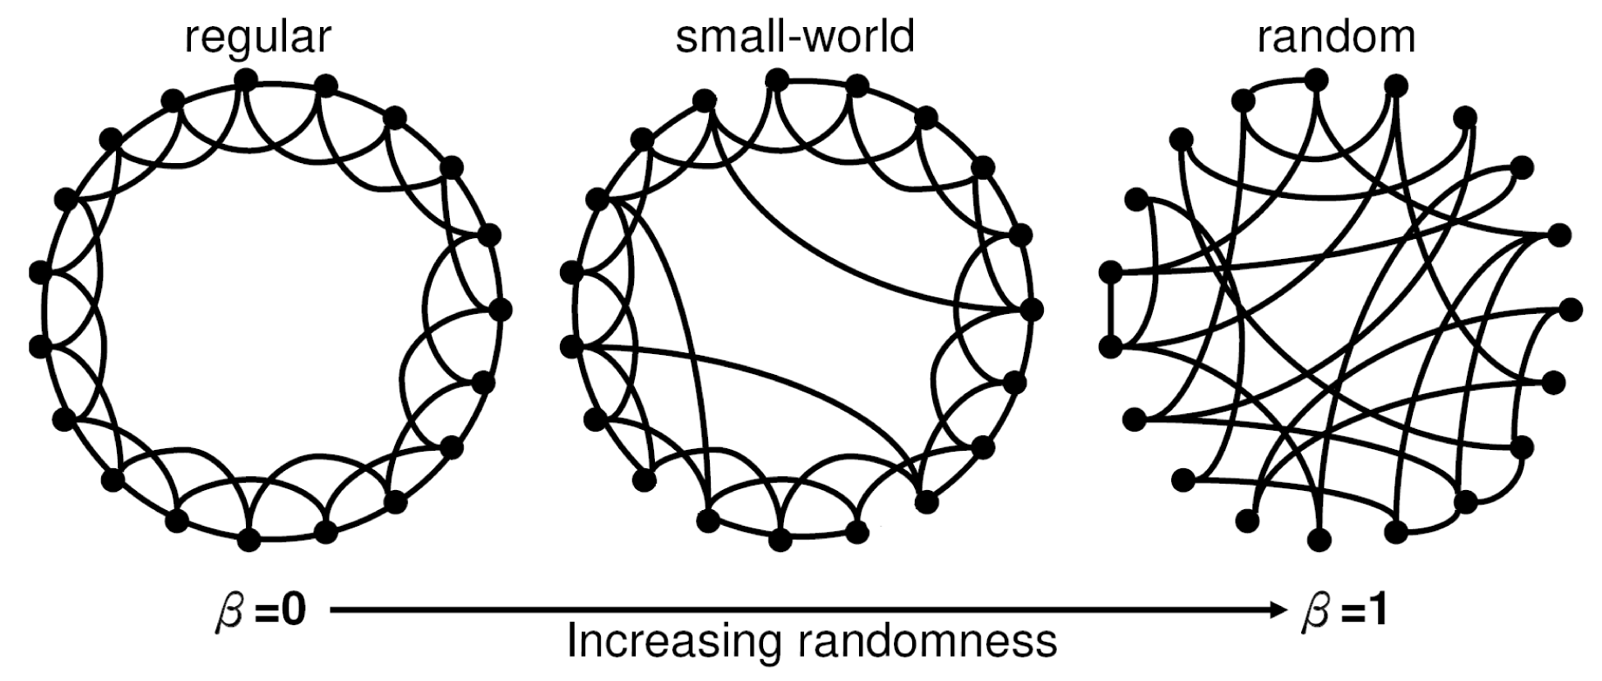
Identifying small worlds
Notes:
https://www.researchgate.net/figure/a-k-core-decomposition-illustrative-example-Note-that-while-nodes-and-have-same_fig2_311990870

Slide 9

Recall: How to construct Small-words?
This is a model introduced by Watts-Strogatz: Networks that share properties of both regular and random graphs (Watts and his advisor Strogatz)
 | Regular/lattice | Small world | Random graphs
clustering coefficient | High | High | Low
average path length | High | Low | Low
$β$ = probability of rewiring edges of the lattice
Source: Watts, DJ; Strogatz, S H. 1998.
Collective dynamics of 'small-world' networks, NATURE 393(668).

Slide 10
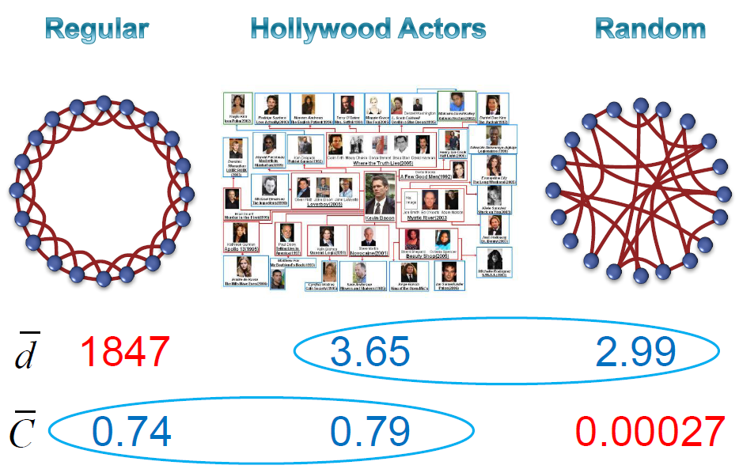
Example small word
Avg path
Avg clust
From Ernesto Estrada’s presentations

Slide 11
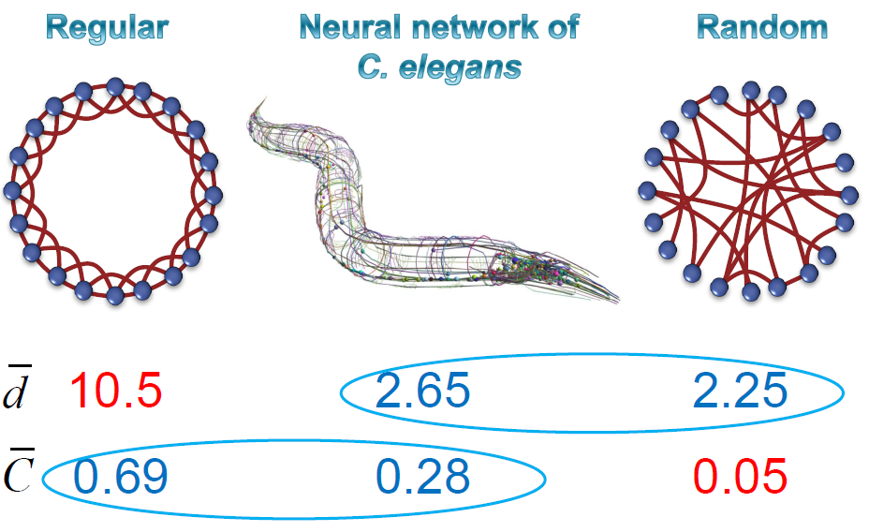
Example small word
Avg path
Avg clust
From Ernesto Estrada’s presentations

Slide 12
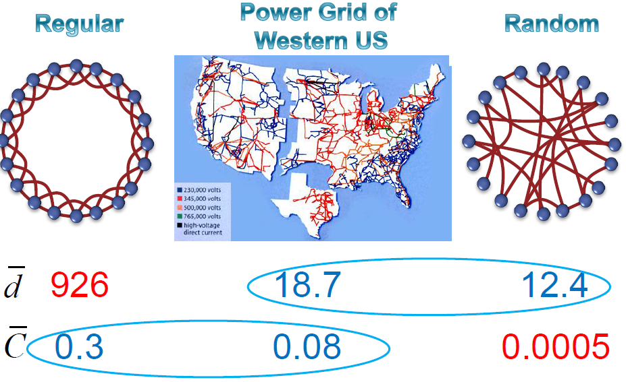
Example small word
Avg path
Avg clust
From Ernesto Estrada’s presentations

Slide 13
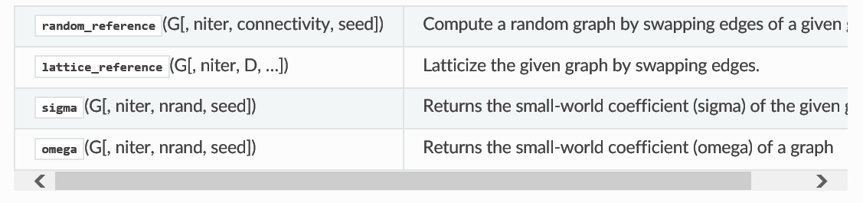
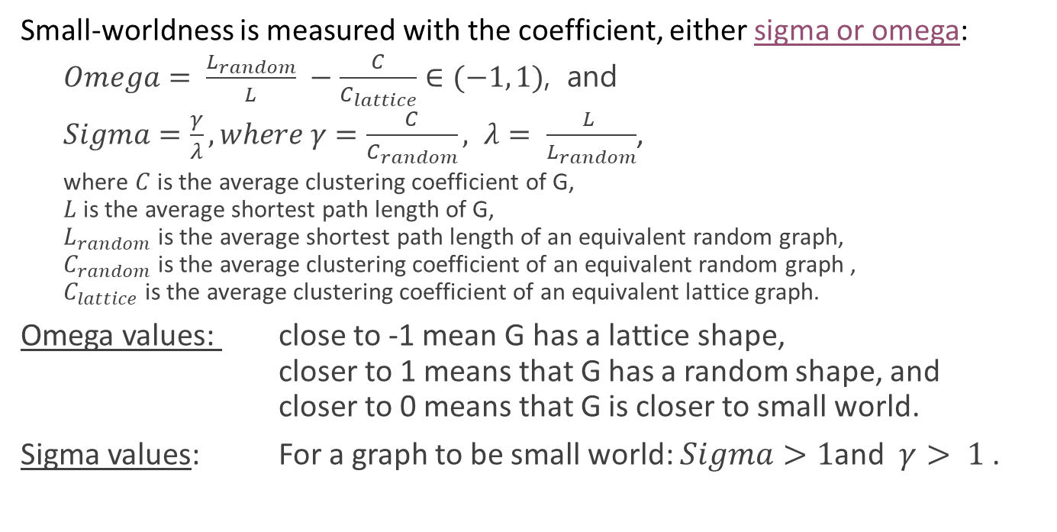
Computing Small World-ness
Small-worldness is measured with the coefficient, either sigma or omega:
  $Omega= \frac{L_{random}}{L} −\frac{C}{C_{lattice}}∈(−1, 1)$, and
  $Sigma=\frac{γ}{λ}, where γ=\frac{C}{C_{random}}, λ= \frac{L }{L_{random}}$,
  where $C$is the average clustering coefficient of G,
  $L$ is the average shortest path length of G,
  $L_{random}$ is the average shortest path length of an equivalent random graph,
  $C_{random}$ is the average clustering coefficient of an equivalent random graph ,
  $C_{lattice}$ is the average clustering coefficient of an equivalent lattice graph.
Omega values: close to -1 mean G has a lattice shape,
closer to 1 means that G has a random shape, and
closer to 0 means that G is closer to small world.
Sigma values: For a graph to be small world: $Sigma>1$and $γ> 1$.
https://networkx.github.io/documentation/latest/reference/algorithms/smallworld.html

Slide 14
References
Newman, “The Structure and Function of Complex Networks” http://epubs.siam.org/doi/pdf/10.1137/S003614450342480
Source: L. Barabasi. Source: http://barabasi.com/networksciencebook/chapter/5#origins
Source: Watts, DJ; Strogatz, S H. 1998.
Collective dynamics of 'small-world' networks, NATURE 393 (668).
Chen, H.; Fan, G.; Xie, L.; Cui, J.-H. A Hybrid Path-Oriented Code Assignment CDMA-Based MAC Protocol for Underwater Acoustic Sensor Networks.Sensors 2013, 13, 15006-15025.14
Reuven Cohen and Shlomo Havlin. Phys. Rev. Lett. 90, 058701 – Published 4 February 2003

