Slide 1
Prof. Ralucca Gera, rgera@nps.edu
Applied Mathematics Department,
Naval Postgraduate School
Excellence Through Knowledge
MA4404 Complex Networks
Homophily (or Assortativity)

Slide 2
Learning Outcomes
Understand how to measure that nodes with similar characteristics tend to cluster,
  Based on enumerative characteristics (nationality)
  Based on scalar characteristics (age, grade)
  Based on degree.
Analyze network using homophily by identifying the assortativity values based on various characteristics.
Evaluate: consider why behind the what is the assortativity values of your network.

Slide 3

Hubs adjacent to hubs?

Slide 4
Are hubs adjacent to hubs?
Real networks usually show a non-zero degree correlation (defined later compared to random).
  If it has a positive degree correlation, the network has assortatively mixed degrees (assort. based other attributes can also be considered).
  If it is negative, it is disassortative.
According to Newman, social networks tend to be assortatively mixed, while other kinds of networks are generally disassortatively mixed.
Homophily or assortativity is a common property of social networks (but not necessary):
  Papers in citation networks tend to cite papers in the same field
  Websites tend to point to websites in the same language
  Political views
  Race
  Obesity

Slide 5
Homophily or assortativity
Sociologists have observed network partitioning based on the following characteristics:
  Friendships, acquaintances, business relationships
  Relationships based on certain characteristics:
    Age
    Nationality
    Language
    Education
    Income level
Homophily is the tendency of individuals to choose friends with similar characteristic. “Like links with like.”

Slide 6
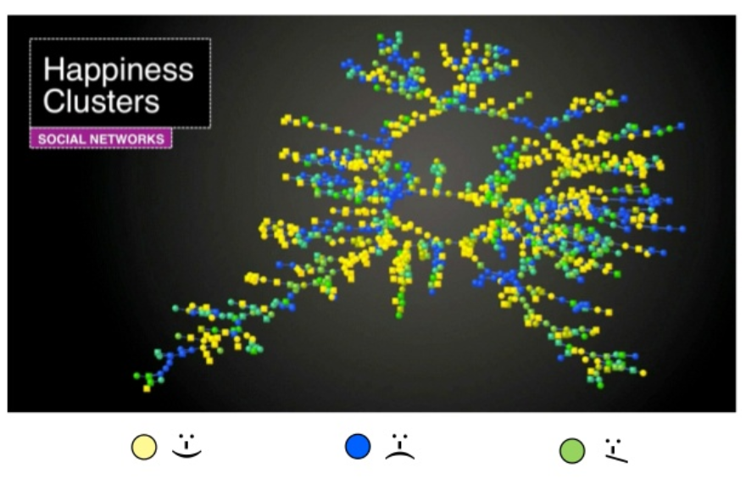
Example of homophily
http://www.slideshare.net/NicolaBarbieri/homophily-and-influence-in-social-networks

Slide 7
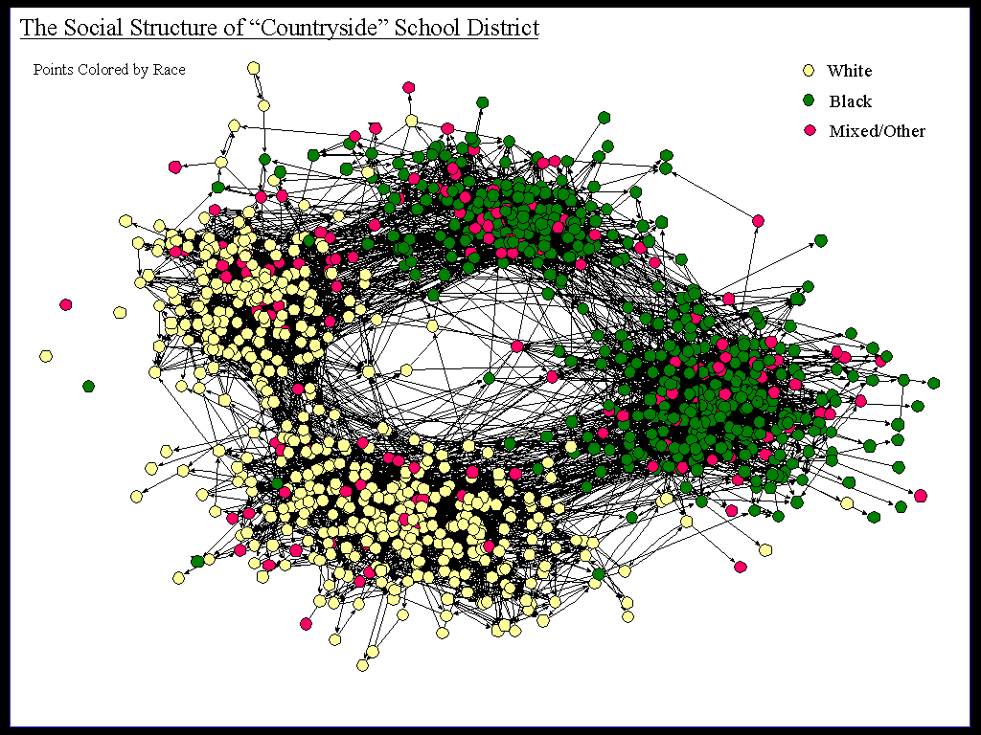
Assortativity by race
James Moody

Slide 8
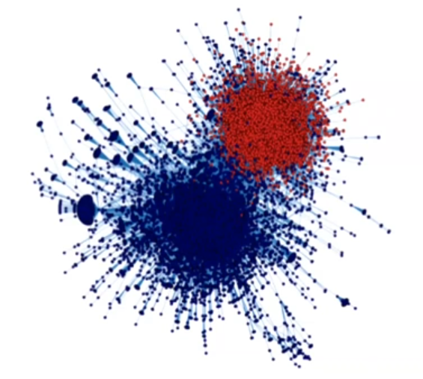
Assortativity by political views
Titter data: political retweet network
Red = Republicans
Blue = Democrats
Note that they mostly
tweet and re-tweet
to each other
Conover et at., 2011

Slide 9
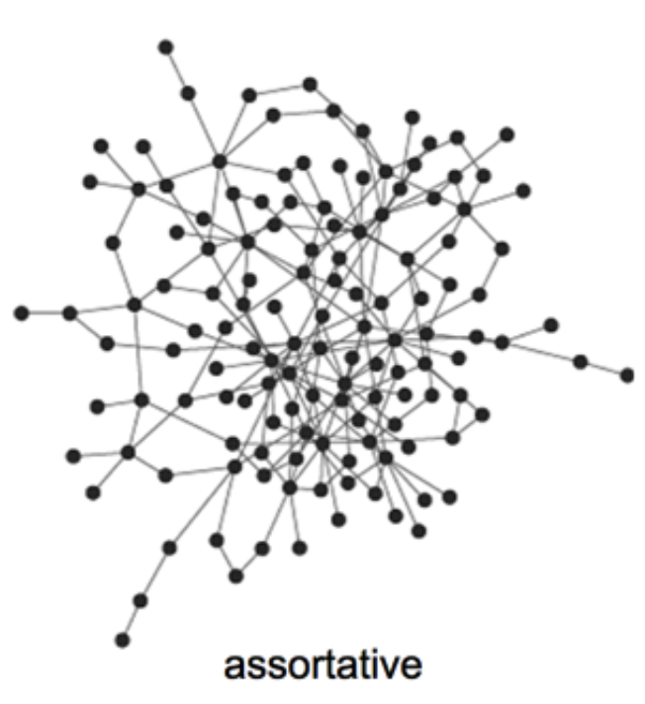
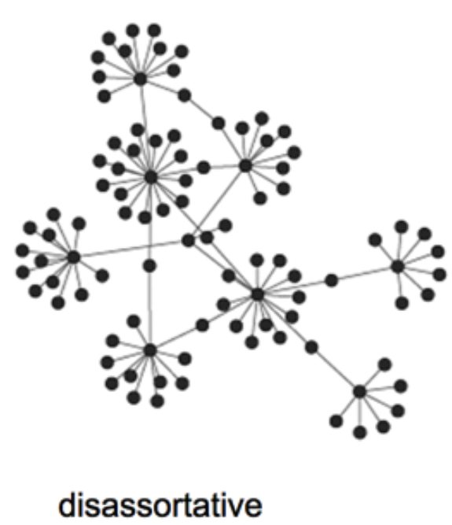
Disassortative
Of course, some networks show disassortative mixing: “like links with dislike”.
Disassortative networks are the ones in which adjacent nodes tend to be dissimilar:
  Dating network (females/males)
  Food web (predator/prey)
  Economic networks (producers/consumers)
  High degree nodes adjancent to small degree nodes
https://stepsandleaps.wordpress.com/2013/08/15/the-financial-ecosystem/

Slide 10
Why care?

Slide 11
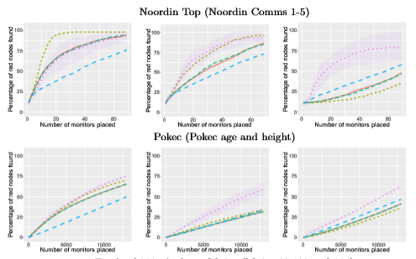
Why?
Identifying people of interest could be easy if the network presents homophily
When assortivity (homophily) is low lie Pokec, RedLearnRS (machine learning algorithm that depends on the count of POIs neighbors of nodes) outperforms all other strategies.
When attributes show high homophily, RedLearnRS performs quite similar to the other algorithms.

Slide 12
How to compute it?
Notes:
https://www.researchgate.net/figure/a-k-core-decomposition-illustrative-example-Note-that-while-nodes-and-have-same_fig2_311990870

Slide 13
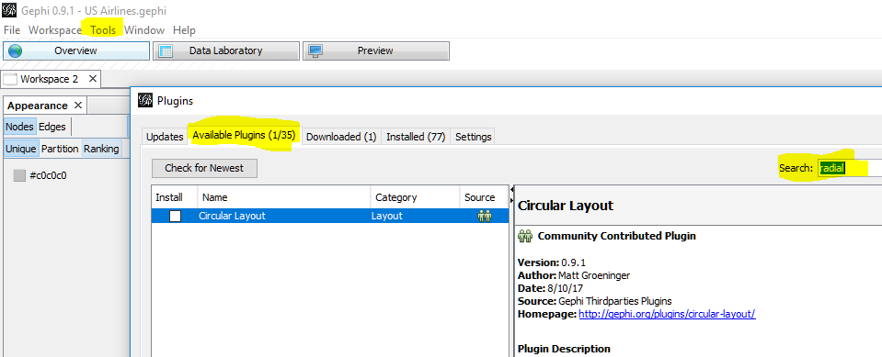
Gephi: Install Circular Layout
The Radial Axis Layout groups nodes and draws the groups in axes :
Group nodes by degree, in degree, out degree, etc.
Group nodes by attribute sort (based on data type of attribute).
Draw axes/spars in ascending or descending order.
Allows top, middle or bottom "knockdown" of axes/spars, along with ability to specify number of spars resulting after knockdown.

Slide 14
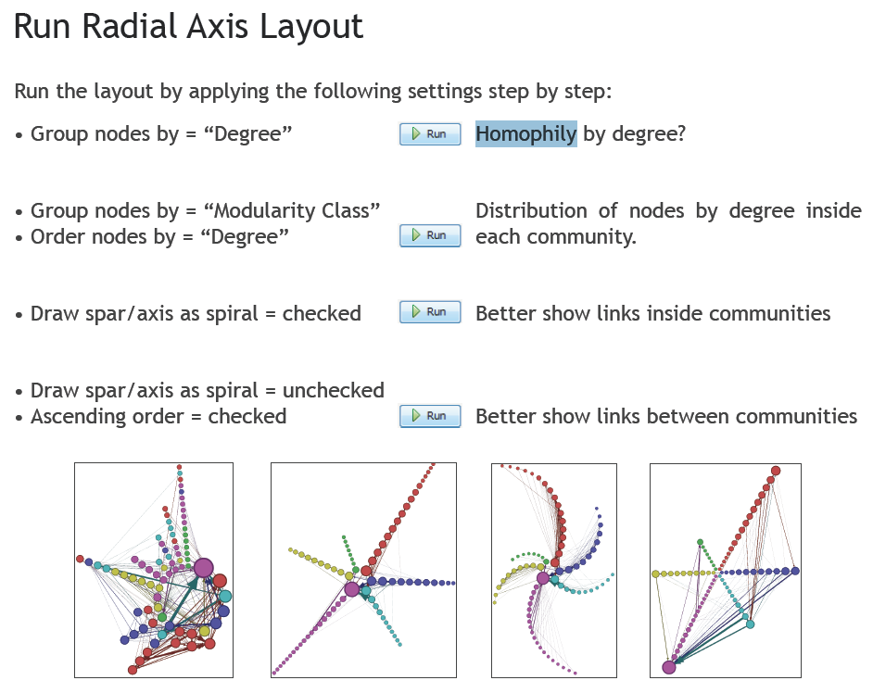
Homophily in Gephi
here
https://gephi.org/users/tutorial-layouts/

Slide 15
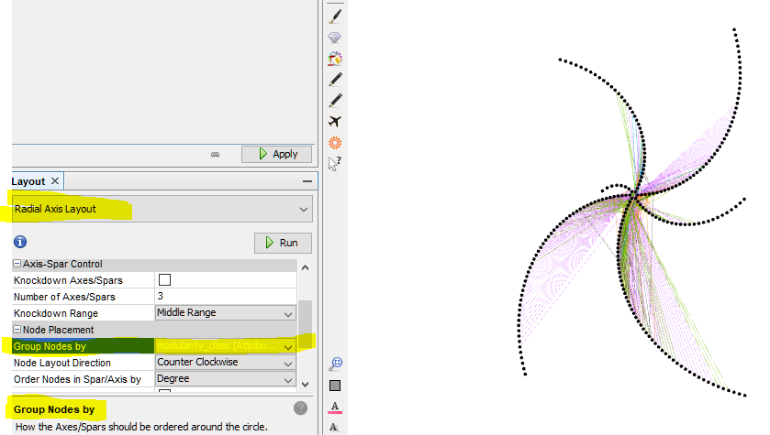
An example: ordered by communities

Slide 16
Homophily in Python
To check an attribute’s assortativity:
assortivity_val=nx.attribute_assortativity_coefficient(G, "color“)
The attribute “color” can be replaced by other attributes that your data was tagged with.
If the attribute is “degree” then we obtain degree assortativity:
r = nx.degree_assortativity_coefficient(G)
If the attribute is “communities” then we obtain modularity:
https://stackoverflow.com/questions/29897243/graph-modularity-in-python-networkx

Slide 17
What do we measure?

Slide 18
Assortative mixing (homophily)
We will study two types of assortative mixing:
Based on enumerative characteristics (the characteristics don’t fall in any particular order):
  Nationality
  Race
  Gender
  Communities
Based on scalar characteristics, such as:
  Age
  Income
By degree: high degree connect to high degree

Slide 19
Type 1: Assortativity based on enumerative characteristics:
1) Nationality
2) Race
3) Gender
4) Communities

Slide 20
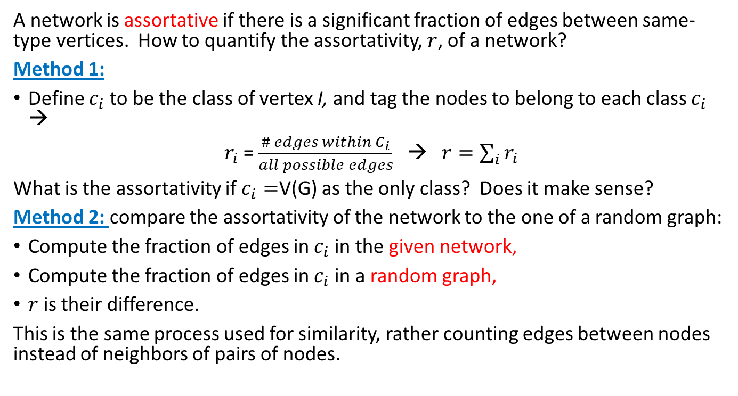
Possible definition of assortativity
A network is assortative if there is a significant fraction of edges between same-type vertices. How to quantify the assortativity, $r$, of a network?
Method 1:
Define $c_{i}$ to be the class of vertex I, and tag the nodes to belong to each class $c_{i}$ →
$r_{i}$ = $\frac{\# edges within C_{i}}{all possible edges}$ → $r=\sum_{i}{r_{i}}$
What is the assortativity if $c_{i}=$V(G) as the only class? Does it make sense?
Method 2: compare the assortativity of the network to the one of a random graph:
Compute the fraction of edges in $c_{i}$ in the given network,
Compute the fraction of edges in $c_{i}$ in a random graph,
$r$ is their difference.
This is the same process used for similarity, rather counting edges between nodes instead of neighbors of pairs of nodes.
Let’s look into this!

Slide 21
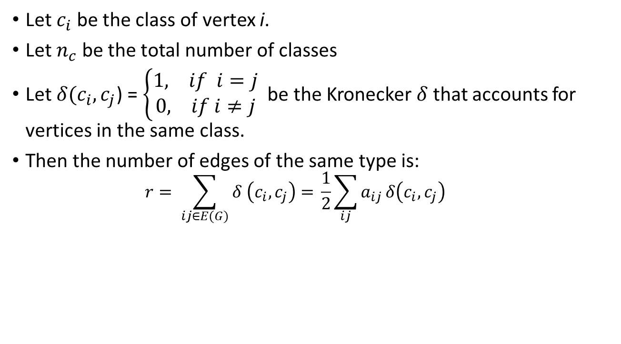
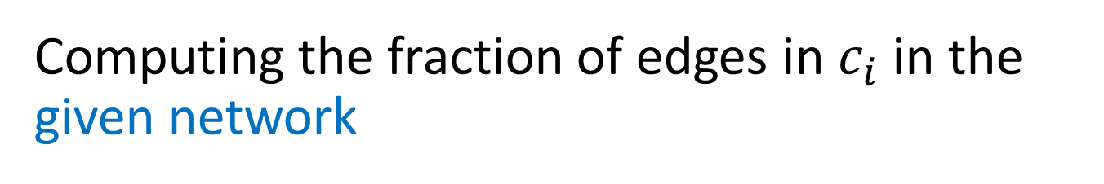
Computing the fraction of edges in $c_{i}$ in the given network
Let $c_{i}$ be the class of vertex i.
Let $n_{c}$ be the total number of classes
Let ${δ(c}_{i}, c_{j}$) = $\left\{\begin{aligned}1, if i=j \\ 0, if i≠j \end{aligned}\right.$ be the Kronecker $δ$that accounts for vertices in the same class.
Then the number of edges of the same type is:
  $$r= \sum_{ij∈E(G)}{δ \left(c_{i}, c_{j}\right)= }\frac{1}{2}\sum_{ij}{a_{ij}}δ\left(c_{i}, c_{j}\right)$$
Checks if vertices
are in the same class
Checks for adjacent nodes

Slide 22
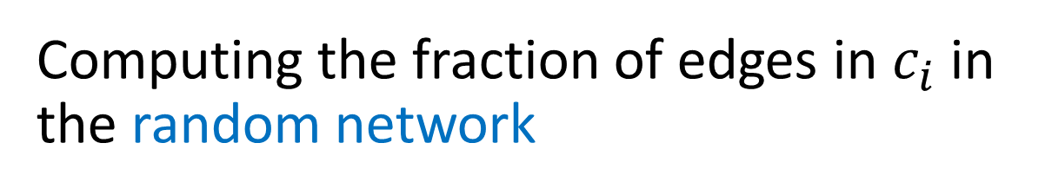
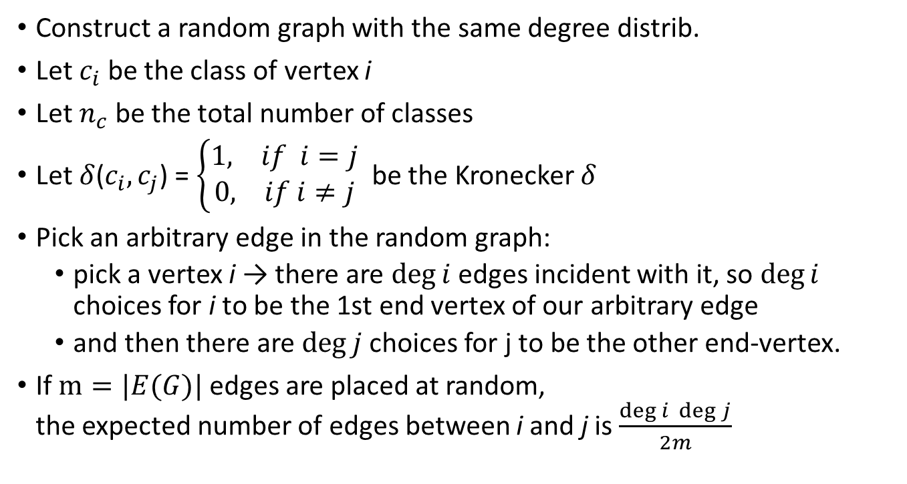
Computing the fraction of edges in $c_{i}$ in the random network
Construct a random graph with the same degree distrib.
Let $c_{i}$ be the class of vertex i
Let $n_{c}$ be the total number of classes
Let $δ$($c_{i}, c_{j}$) = $\left\{\begin{aligned}1, if i=j \\ 0, if i≠j \end{aligned}\right.$ be the Kronecker $δ$
Pick an arbitrary edge in the random graph:
  pick a vertex i → there are $\deg{i}$ edges incident with it, so $\deg{i}$ choices for i to be the 1st end vertex of our arbitrary edge
  and then there are $\deg{j}$ choices for j to be the other end-vertex.
If $m=|E(G)|$ edges are placed at random,
the expected number of edges between i and j is $\frac{\deg{i }\deg{j}}{2m}$
Checks if vertices
are in the same class

Slide 23
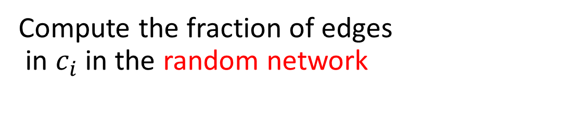
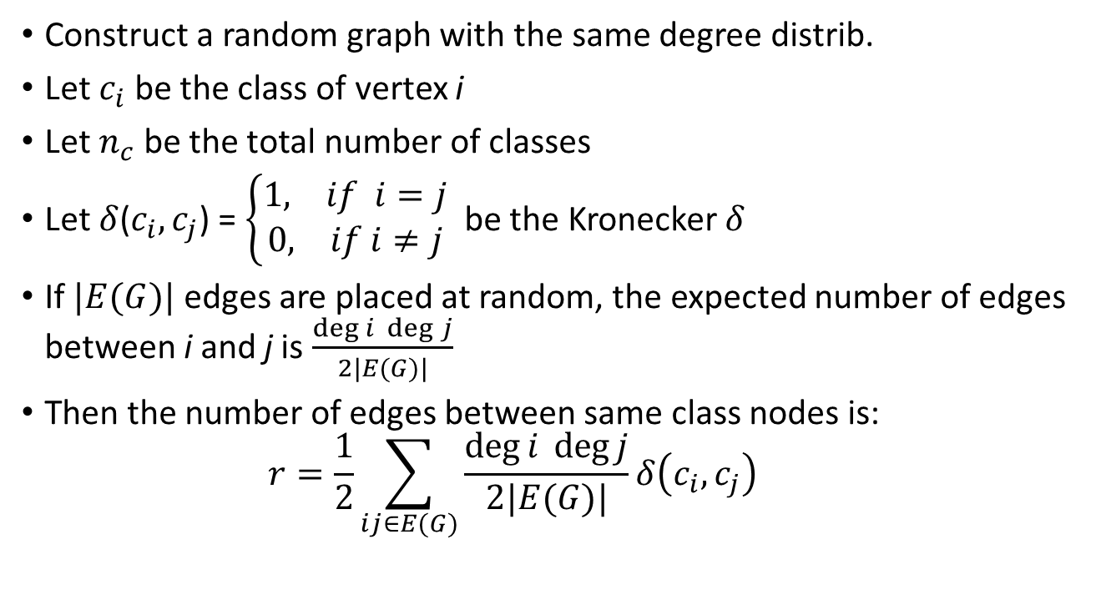
Compute the fraction of edges in $c_{i}$ in the random network
Construct a random graph with the same degree distrib.
Let $c_{i}$ be the class of vertex i
Let $n_{c}$ be the total number of classes
Let $δ$($c_{i}, c_{j}$) = $\left\{\begin{aligned}1, if i=j \\ 0, if i≠j \end{aligned}\right.$ be the Kronecker $δ$
If $|E(G)|$ edges are placed at random, the expected number of edges between i and j is $\frac{\deg{i }\deg{j}}{2|E(G)|}$
Then the number of edges between same class nodes is:
  $$r=\frac{1}{2}\sum_{ij∈E(G)}{\frac{\deg{i }\deg{j}}{2|E(G)|}δ\left(c_{i}, c_{j}\right) }$$
Check if vertices
are in the same class
duplications: as you choose vertex j above, the edge ji will be counted after edge ij was counted

Slide 24
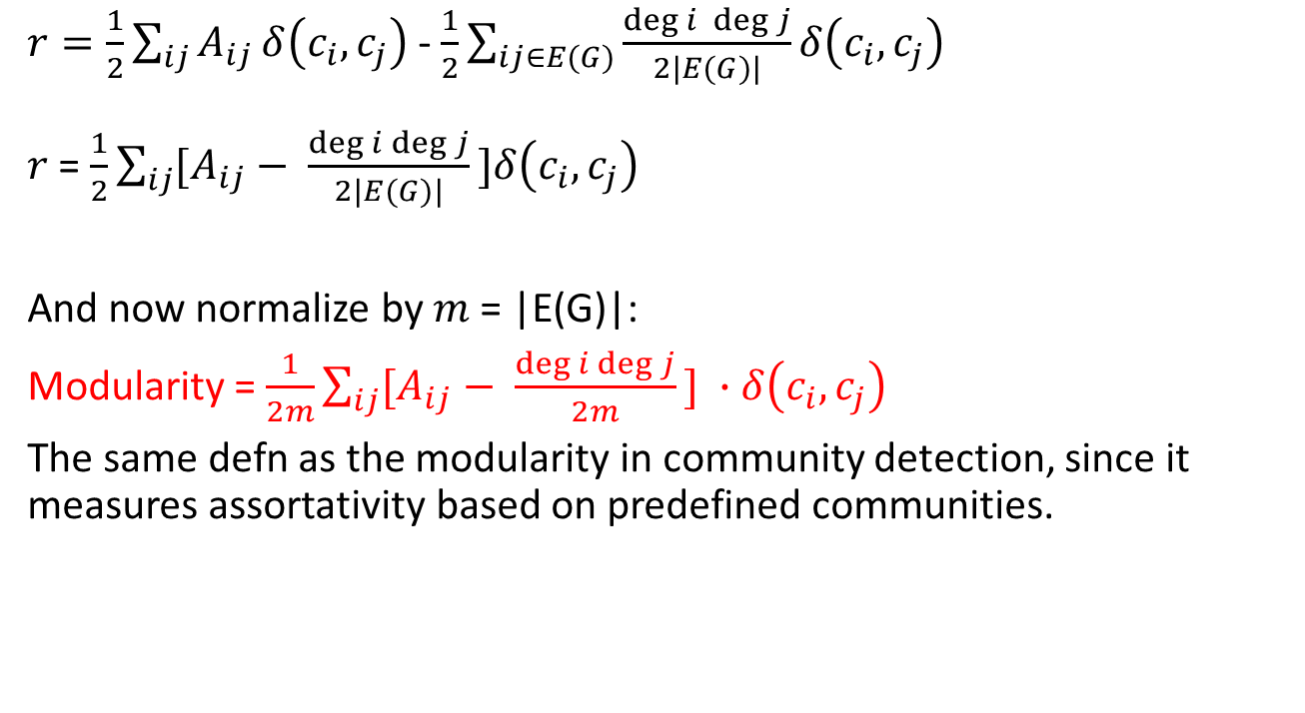
Consider their difference
$r=\frac{1}{2}\sum_{ij}{A_{ij}}δ\left(c_{i}, c_{j}\right)$ - $\frac{1}{2}\sum_{ij∈E(G)}{\frac{\deg{i }\deg{j}}{2|E(G)|}δ\left(c_{i}, c_{j}\right) }$
$r$= $\frac{1}{2}\sum_{ij}{[A_{ij}}− \frac{\deg{i}\deg{j}}{2|E(G)|}\text{]}δ\left(c_{i}, c_{j}\right)$
And now normalize by $m$ = |E(G)|:
Modularity = $\frac{1}{2m}\sum_{ij}{[A_{ij}}− \frac{\deg{i}\deg{j}}{2m}\text{]} ∙δ\left(c_{i}, c_{j}\right)$
The same defn as the modularity in community detection, since it measures assortativity based on predefined communities.
Checks if vertices
are in the same class

Slide 25
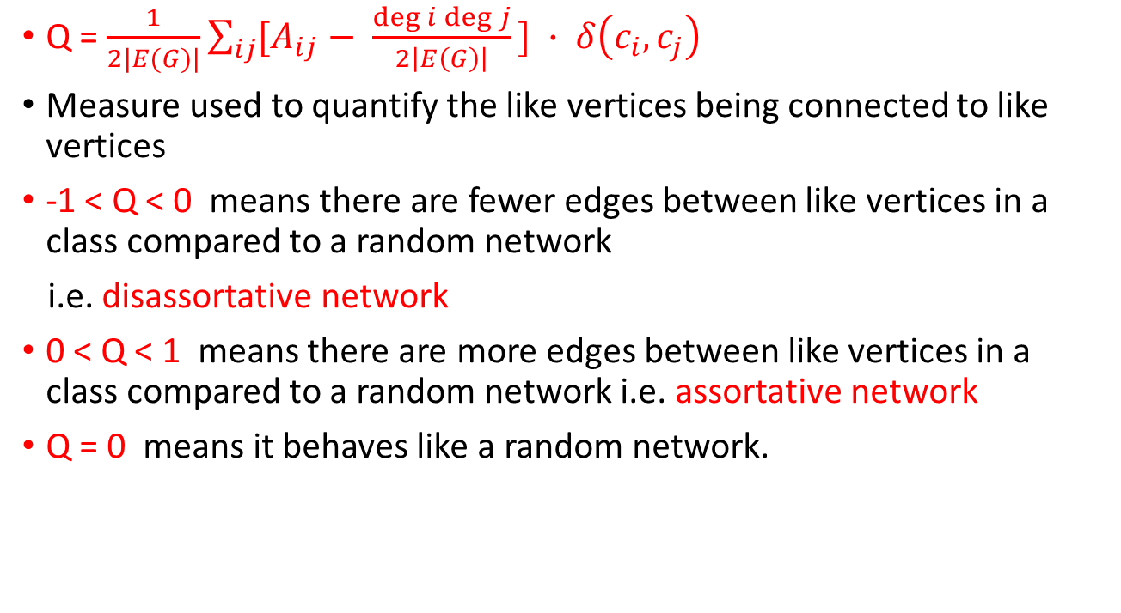
Modularity
Q = $\frac{1}{2|E(G)|}\sum_{ij}{[A_{ij}}− \frac{\deg{i}\deg{j}}{2\left|E\left(G\right)\right|}\text{]} ∙ δ\left(c_{i}, c_{j}\right)$
Measure used to quantify the like vertices being connected to like vertices
-1 < Q < 0 means there are fewer edges between like vertices in a class compared to a random network
i.e. disassortative network
0 < Q < 1 means there are more edges between like vertices in a class compared to a random network i.e. assortative network
Q = 0 means it behaves like a random network.

Slide 26

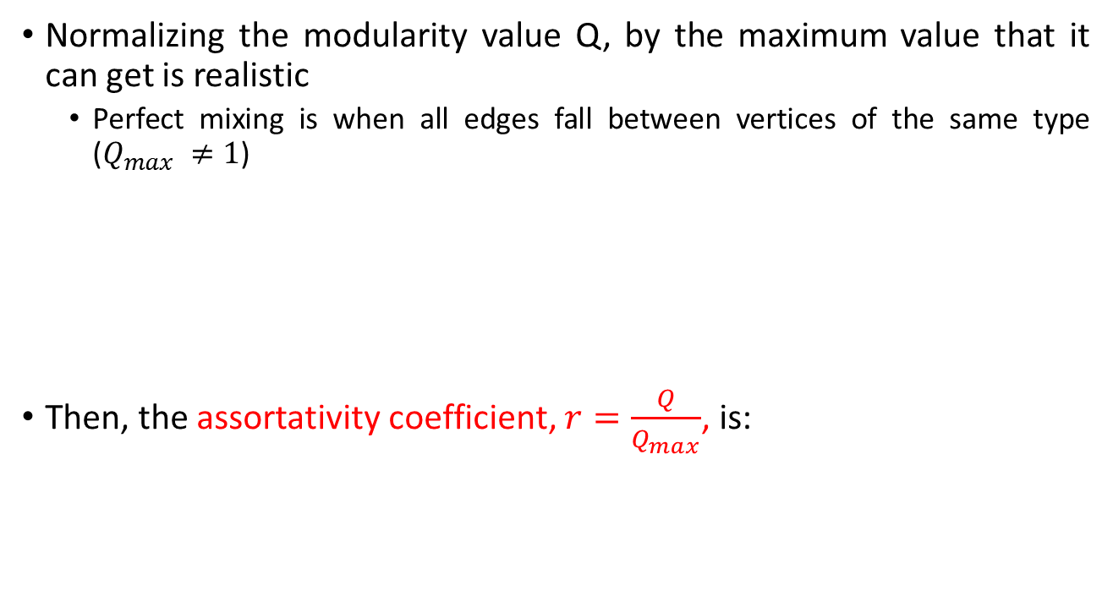
Enumerative characteristics
Normalizing the modularity value Q, by the maximum value that it can get is realistic
  Perfect mixing is when all edges fall between vertices of the same type ($Q_{max} ≠1$)
Then, the assortativity coefficient, $r=\frac{Q}{Q_{max}}$, is:
$∑A_{ij}$

Slide 27
Type 2: Assortativity based on
scalar characteristics,
such as:
Age
Income

Slide 28
Scalar characteristics
Scalar characteristics: enumerative characteristics taking numerical values, such as age, income
For example using age: two people are similar if:
    they are born the same day or
    within a year or within x years,
    They are in the same class
    Same generation
    different granularity based on the data and questions asked.
If people are friends with others of the same age, we consider the network assortatively mixed by age (or stratified by age)

Slide 29
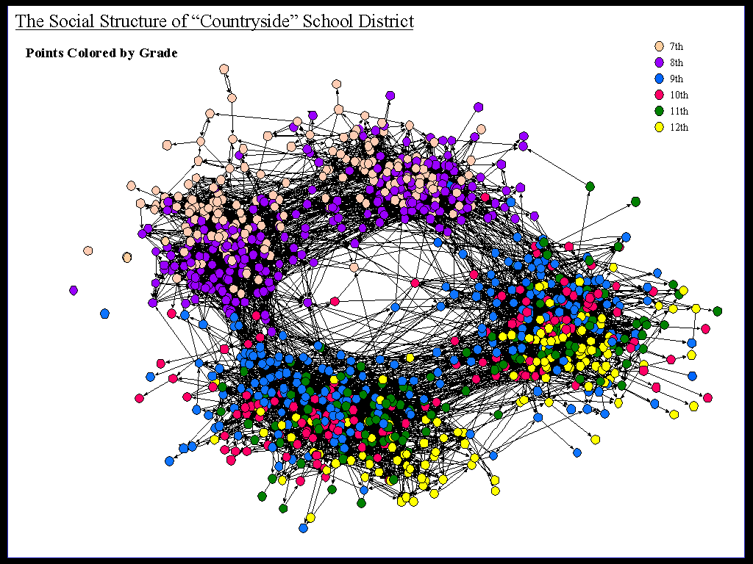
Assortativity by grade/age
James Moody

Slide 30
Scalar characteristics
When we consider scalar characteristics we basically have an approximate notion of similarity between adjacent vertices (i.e. how far/close the values are)
  There is no approximate similarity that can be measured this way when we talk about enumerative characteristics; rather present/absent

Slide 31
Assortativity matrix based on
Scalar characteristics
Friendships at the
same US high school:
each dot represents a
friendship (an edge
from the network)
Denser along the diagonal (communities)
Sparser as the
difference in
grades increases

Slide 32
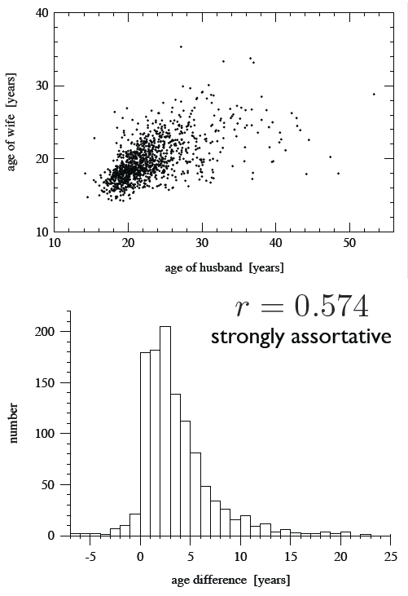
Strongly assortative
Data: 1995 US National Survey of Family Growth
Top figure: A scatter plot of 1141
married couples
Bottom figure: The same data
showing a histogram of the age difference
Newman, Phys Rev E. 67, 026126 (2003)

Slide 33
Scalar characteristics
How do we measure scalar assortative mixing?
Would the idea we use for the enumerative assortative mixing work?
That is to place vertices in bins based on scalar values:
  Treat vertices that fall in the same bin (such as age) as “like vertices” or “identical”
  Apply modularity metric for enumerative characteristics

Slide 34
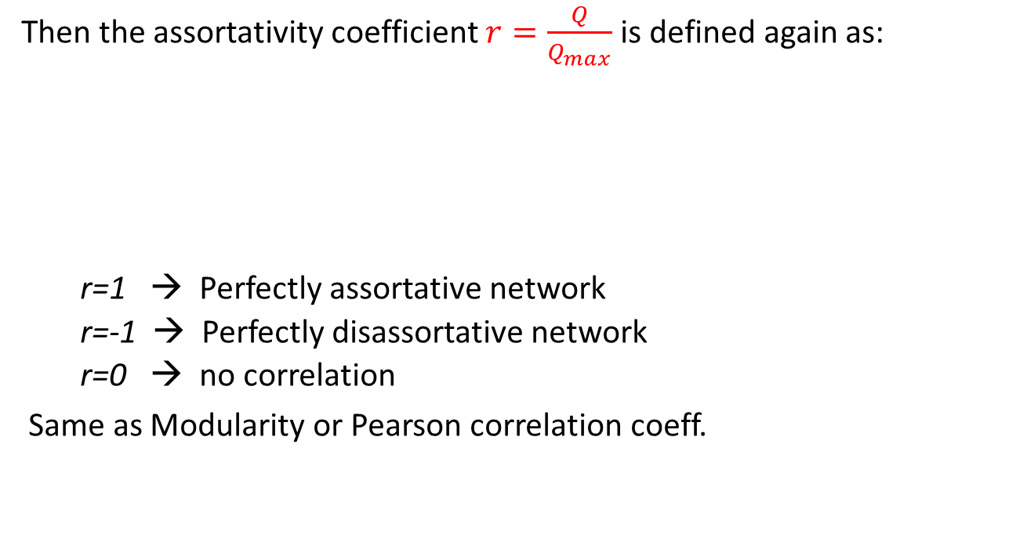
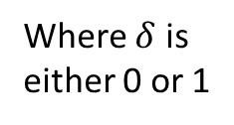
Scalar characteristics
Then the assortativity coefficient $r=\frac{Q}{Q_{max}}$ is defined again as:
  r=1 → Perfectly assortative network
  r=-1 → Perfectly disassortative network
  r=0 → no correlation
Same as Modularity or Pearson correlation coeff.
Similar to the enumerative
one again
Where $δ$ is
either 0 or 1

Slide 35
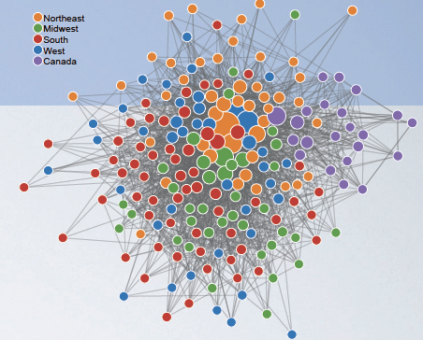
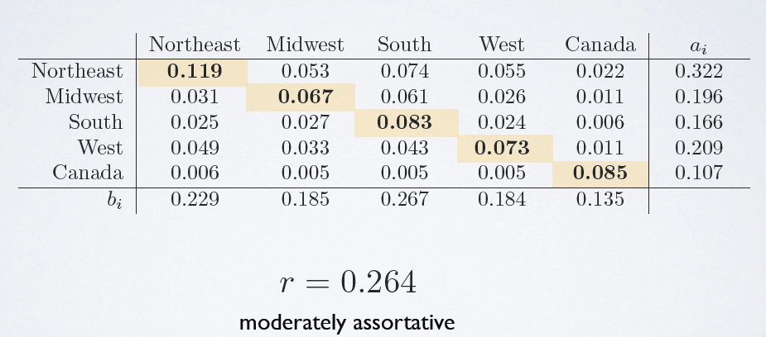
Computer Science faculty
88 Computer Science faculty:
vertices are PhD granting institutions in
North America
edge (i,j) captures that a PhD student at i,
now faculty at j
labels are US census regions + Canada
Five Lectures on Networks, by Aaron Clauset

Slide 36
A particular scalar characteristic is the degree: high degree nodes connect to high degree nodes

Slide 37
Assortative mixing by degree
A special case is when the characteristic of interest is the degree of the node
Commonly used in social networks (the most used one of the scalar characteristics)
More interesting since degree is a topological property of the network (not just a value like age or grade)
This now reduces to Pearson Correlation Coefficient

Slide 38
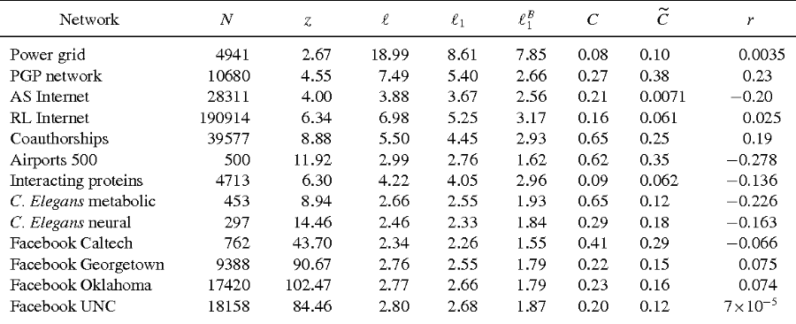
Range of the value r for real networks
Some statistics about real networks published in 2011
https://www.semanticscholar.org/paper/The-unreasonable-effectiveness-of-tree-based-theor-Melnik-Hackett/0ef76143b83257592c4155a648286ba7a0cff474

Slide 39
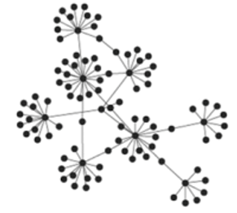
Assortative mixing by degree
Assortative network by degree → core of high degrees and a periphery of low degrees (Figure (a) below)
Disassortative network by degree → uniform: low degree adjacent to high degree (Figure (b) and (c) below)
(a)
(b)
(c)

Slide 40
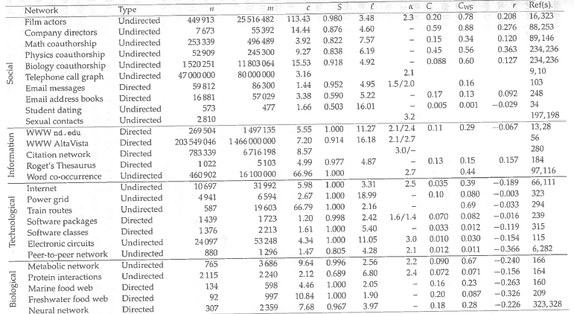
Newman’s book (2003)
r = assortativity coefficient
Newman, M. E. J. "MEJ Newman, SIAM Rev. 45, 167 (2003)." SIAM Rev. 45 (2003): 167.

Slide 41
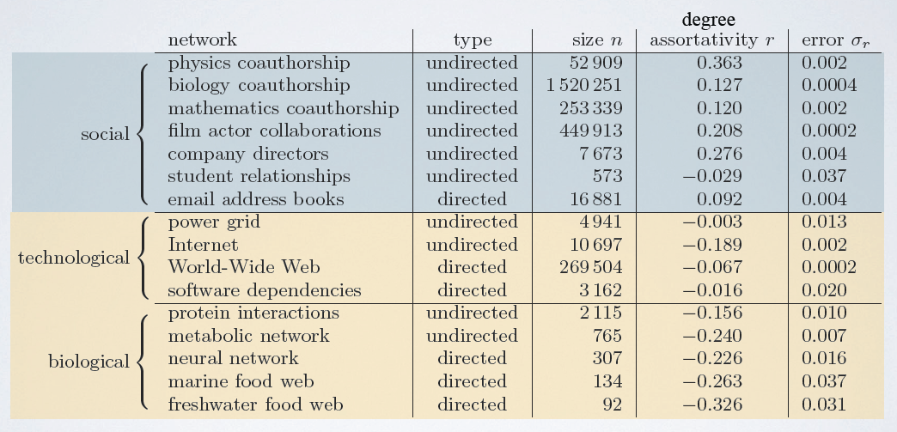
Examples (published in 2003)
Same formula:
Newman, Phys. Rev. E. 67 , 0626126 (2003)

Slide 42
References
Newman, M. E. J. "MEJ Newman, SIAM Rev. 45, 167 (2003)." SIAM Rev. 45 (2003): 167.
Newman, Mark EJ. "Mixing patterns in networks." Physical Review E 67.2 (2003): 026126.

