Slide 1
Robustness or Network Resilience
Ralucca Gera,
Applied Mathematics Dept.
Naval Postgraduate School
Monterey, California
rgera@nps.edu

Slide 2
Network Robustness and resilience
How does a network change as nodes or edges are removed?
How could we measure the change?
Good time to share your thoughts
Some thoughts:
  Change in average path length
  The count and size of the components obtained
  The size of the giant component (whose size is more than 50% of nodes; reference for giant component: http://arxiv.org/pdf/math/9310236.pdf)

Slide 3
Node and edge removal
Node/edge percolation (or random failure): Node removal with some probability p corresponding to random failure
Targeted attack: remove nodes/edges with highest effect (such as componenets or average path length)

Slide 4
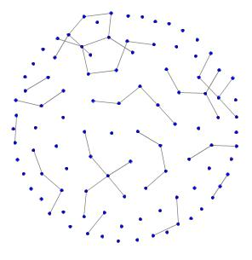
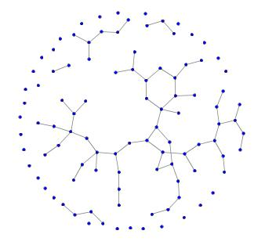
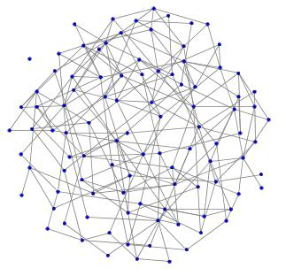
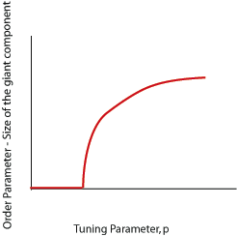
Percolation threshold in Erdos-Renyi Graphs
z=1
av deg = 3.96
av deg = 0.99
av deg = 1.18
As the average degree (z) increases to z = 1, a giant component suddenly appears.
Edge removal is the opposite process:
At some point the average degree drops below 1 and the network becomes disconnected?
Percolation theshold: how many edges have to be removed before the giant component disappears?
size of giant component (S)
average degree (z)
Lada Adamic

Slide 5
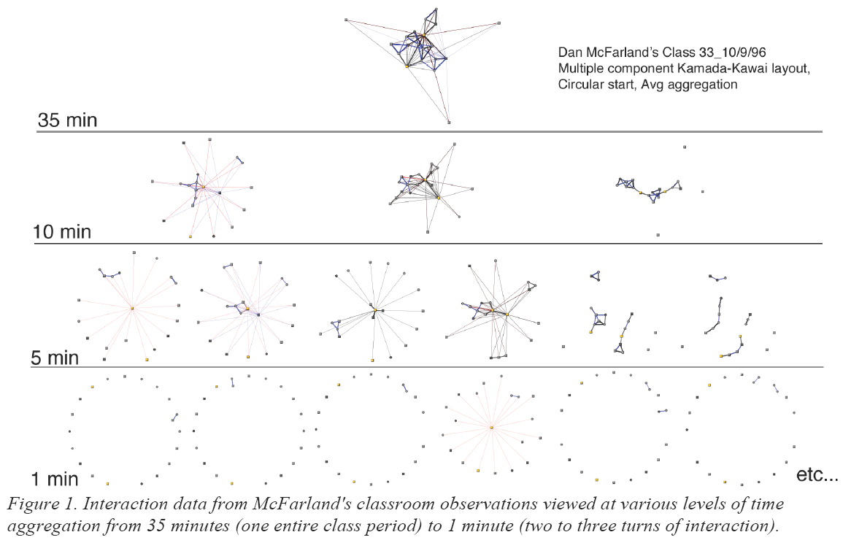
How does a network percolate?
Source: Bender-deMoll & McFarland “The Art and Science of Dynamic Network Visualization” JoSS Forthcoming

Slide 6
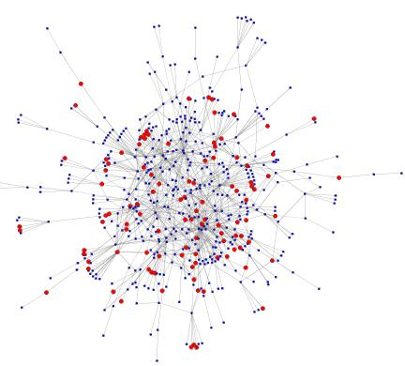
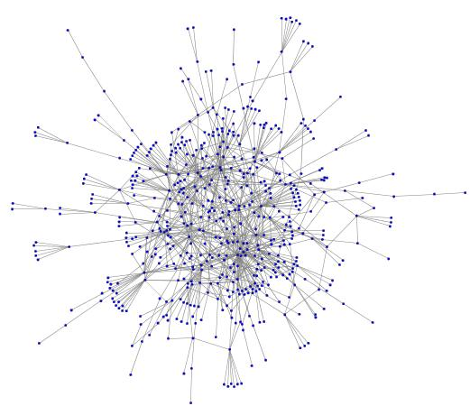
Percolation on Complex Networks
Percolation can be extended to networks of arbitrary topology.
We say the network percolates when a giant component forms.
Scale free networks will always have a giant component (the network always percolates)
Lada Adamic

Slide 7
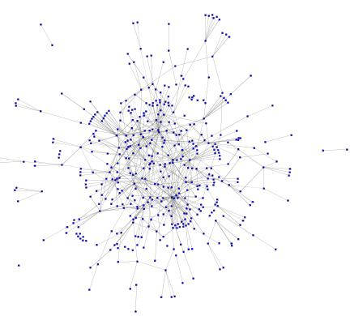
Scale-free networks are resilient with respect to random attack
Example: gnutella network, 20% of the total number of nodes removed
574 nodes in giant component
427 nodes in giant component
Lada Adamic

Slide 8
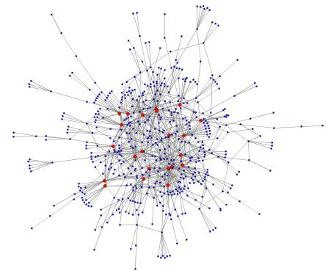
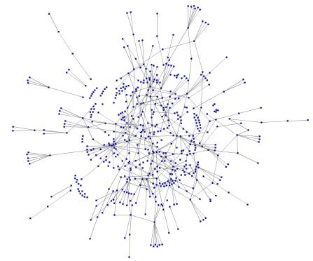
Targeted attacks are affective against scale-free networks
Example: same gnutella network, 22 most connected nodes removed (2.8% of the total number nodes are removed)
574 nodes in giant component
301 nodes in giant component
Lada Adamic

Slide 9
Random failures vs. Attacks
adapted from slide by Reka Albert
Lada Adamic

Slide 10
Network resilience to targeted attacks
Scale-free graphs are resilient to random attacks, but sensitive to targeted attacks. For random networks there is smaller difference between the two
Percent of nodes removed
R. Albert, H. Jeong, and A.-L. Barabasi, Attack and error tolerance of complex networks, Nature, 406 (2000), pp. 378–382.
Lada Adamic

