Slide 1



ASPIRE: All Services Personnel and Institutional Readiness Engine
A Vision of Personalized Learning:
myJourney
Ralucca Gera, PhD
Professor of Mathematics
Naval Postgraduate School
Mark Reith, PhD, CISSP
Assistant Professor of Computer Science
Air Force Institute of Technology
Notes:
ADD –
Emphasize agnostic
Emphasize clustering; skills beyond mere narrow SME zone
Identify and PD; inclusivity
Any Background to Any Position
ADDESS BIAS
Data validation
SDKs APIs for other LMS’s
Are you using predictive criterion-related test validation where test scores collected now are related to real job performance collected in the future?
Could you speak to any data preparation methods you might use to mitigate bias in your training data/ (e.g., balancing data, etc) that you might use in addition to validation methods used on the outputs?
Add slides for catch shoots (Like Resume Reader NLP)?

Slide 2
Overview

Slide 3
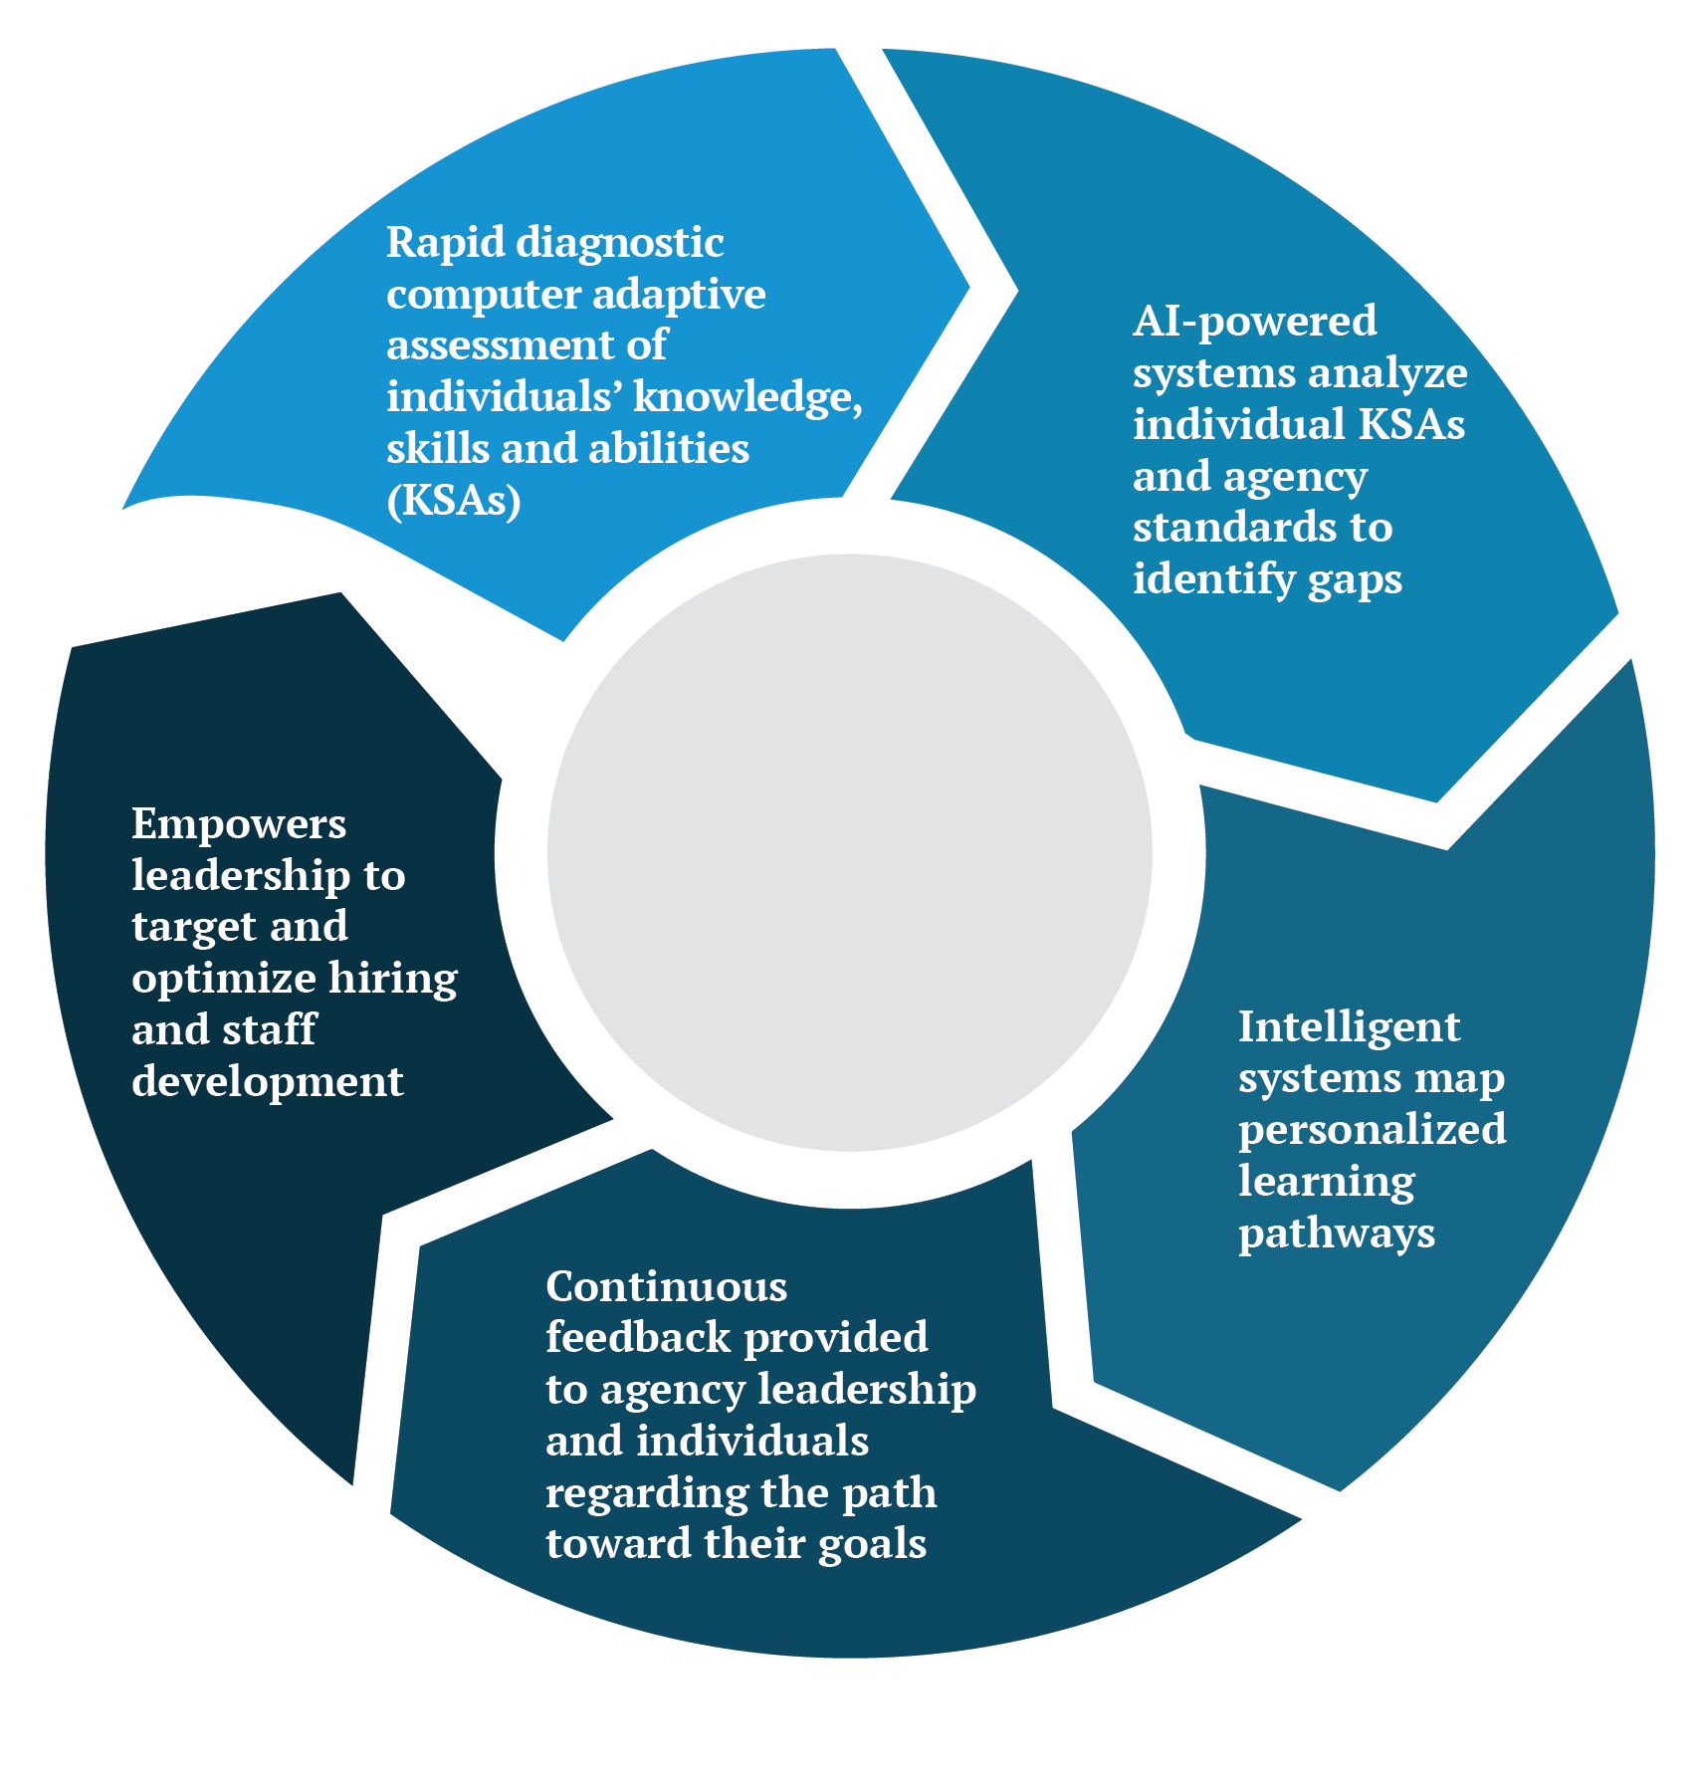

All Services Personnel and Readiness Engine
Assess
Educate
Describe
Make Ready
Find Gaps
An AI driven,
content agnostic,
personnel assessment
& upskilling platform
designed with trustworthiness, accessibility, and equity in mind.

Slide 4

ASPIRE PARTNERS
ASPIRE PM
Anthony Boese
ASPIRE Program Manager
Interagency Programs Manager
National Artificial Intelligence Institute
Veterans Affairs

Slide 5
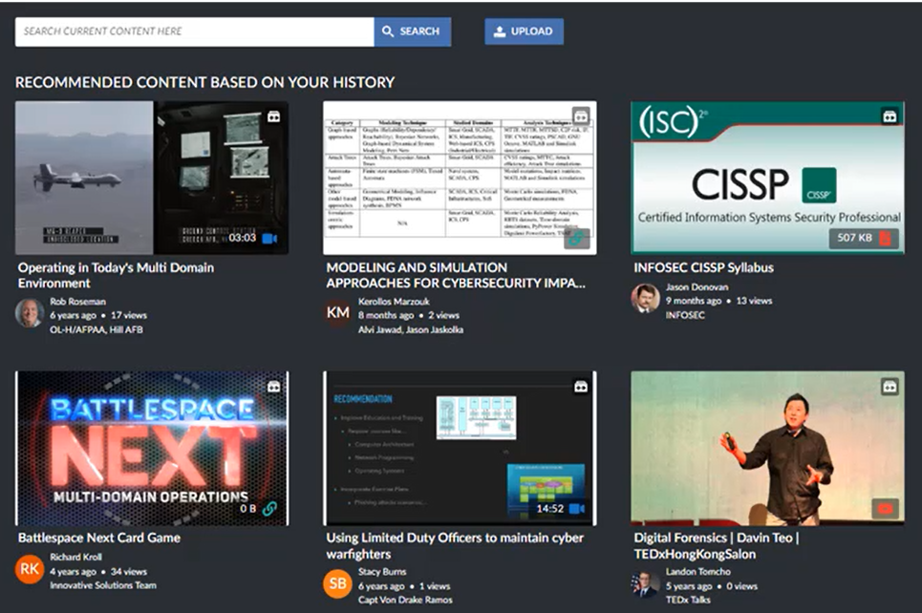
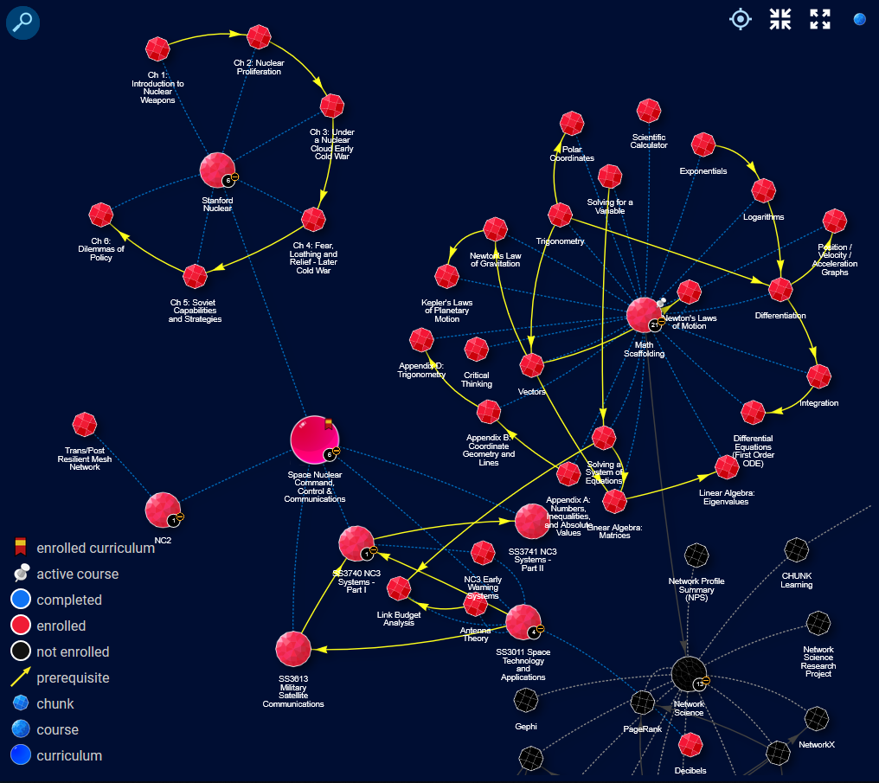
Research

Slide 6

ASPIRE’s education entails…
Learner Profile
Digital
Badges
Gamification &
Microlearning
“myJourney”
Personalized Learning Cycle
Competency Based Assessments
Personalized
Learning
Paths
Notes:
an AI driven, content agnostic, personnel assessment and upskilling platform designed with trustworthiness, accessibility, and equity in mind.
ASPIRE meets a learner where they are and take them to where they need to be specific to their rank, role, and agency.
ASPIRE can be populated with content to assess and teach over any subject; AI is the first subject being developed.
ASPIRE’s design includes self-auditing and human auditing to ensure high functionality, minimized bias, and maximized accessibility and security.
a solution for many policy- and strategy-driven needs.
ASPIRE’s is an efficient and flexible solution for the training requirements included in The AI Training ACT, EO 13960, EO 13859, EO 14091, the National AI R&D Strategy, and elsewhere.
China and possibly others seem to be and/or pulling ahead in terms of technological R&D and in educating their workforce and populous on numerous critical competencies.
a solution for many context-driven needs.
The federal workforce is aging rapidly; development offerings like ASPIRE are shown to be strong recruitment and retention incentives.
Traditional training and education systems are not yet reliable for cultivating and vetting experts in the newest technologies.
designed to be built by and for many stakeholders in parallel to accelerate development and deployment.
Our groundwork research and design efforts established commonality in data model, security procedures, and integration protocols which allow for the system to be built integrated from the ground up regardless of the number of build sites.
Our methods for scalable personalization allow for compounding acceleration in development as more persons are developing content for and being assessed and trained on more subjects.

Slide 7
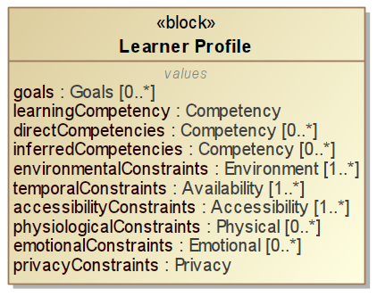
Dynamic Learner Profile as User Progresses
Learning path
Notes:
an AI driven, content agnostic, personnel assessment and upskilling platform designed with trustworthiness, accessibility, and equity in mind.
ASPIRE meets a learner where they are and take them to where they need to be specific to their rank, role, and agency.
ASPIRE can be populated with content to assess and teach over any subject; AI is the first subject being developed.
ASPIRE’s design includes self-auditing and human auditing to ensure high functionality, minimized bias, and maximized accessibility and security.
a solution for many policy- and strategy-driven needs.
ASPIRE’s is an efficient and flexible solution for the training requirements included in The AI Training ACT, EO 13960, EO 13859, EO 14091, the National AI R&D Strategy, and elsewhere.
China and possibly others seem to be and/or pulling ahead in terms of technological R&D and in educating their workforce and populous on numerous critical competencies.
a solution for many context-driven needs.
The federal workforce is aging rapidly; development offerings like ASPIRE are shown to be strong recruitment and retention incentives.
Traditional training and education systems are not yet reliable for cultivating and vetting experts in the newest technologies.
designed to be built by and for many stakeholders in parallel to accelerate development and deployment.
Our groundwork research and design efforts established commonality in data model, security procedures, and integration protocols which allow for the system to be built integrated from the ground up regardless of the number of build sites.
Our methods for scalable personalization allow for compounding acceleration in development as more persons are developing content for and being assessed and trained on more subjects.

Slide 8
Demo

Slide 9

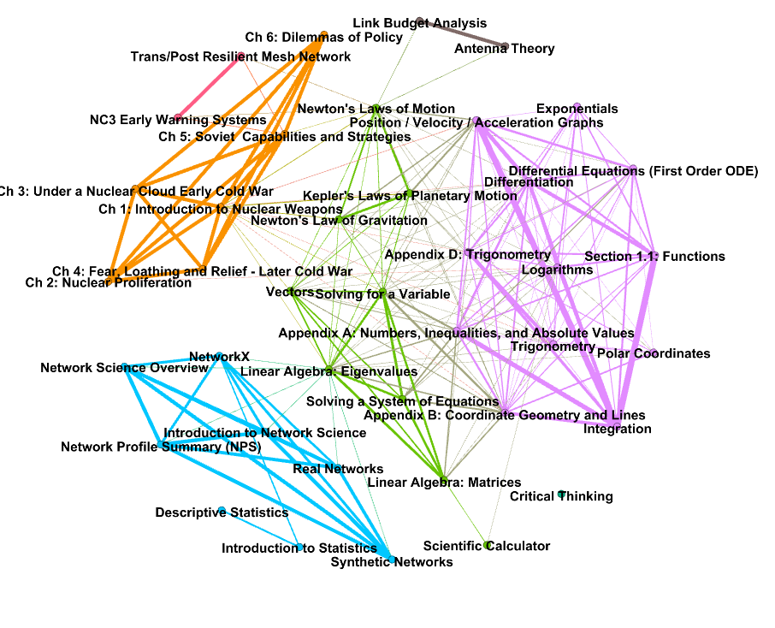
Network of Knowledge → Dynamic Learning paths
Nodes: modules
Edges: correlations
Nodes: modules
Edges: pre-requisites

Slide 10
Modules of Personalized Micro-learning
Legend
Why Learn?
How Used?
Methodology
Assessment
Module
Personalized chunk
Personalized chunk
Module
Applied Math
Operations Research
Notes:
Before formally introducing what we call “The CHUNK Learning” concept, allow me a moment to demonstrate how it might work for a single lesson.
In the upper plane, we have a repository of learning materials. These materials will align themselves in learning modules for each of the two students.
<click>
To begin, both students will watch the same video demonstrating why the particular topic is important.
<click>
Each student will then watch a video demonstrating how that particular topic is applied within his/her discipline (based on his/her profile). The video which best matches the student’s profile will be shown to the student; however, alternative videos loosely connected to the student’s profile are also available for student review.
<click>
Next, the lesson plan is built where, in this example, the assigned reading is different for each student, but the slide review and example problems are the same. Additionally, the cyber systems student has some additional material related to programming. Once again, loosely connect additional learning materials are presented for optional student review. Enabling the student to achieve any desired level of breadth and depth.
<click>
Lastly, in this example, a common assessment is presented to both students. Each student ends up with a real-time and adaptive, personalized CHUNK module.
<next slide>

Slide 11
Demo

Slide 12



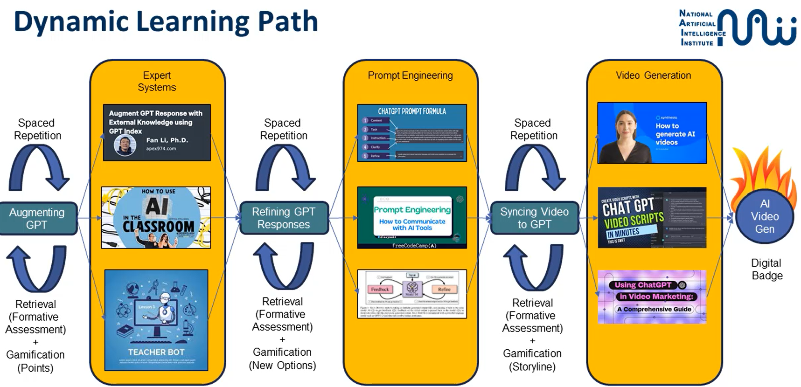

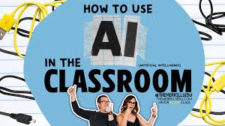

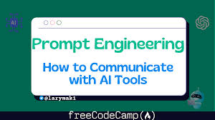
AI-based Dynamic Learning Path
1. Using AI techniques to tag educational content in modules (on learning outcomes
2. Using AI techniques to map relationships between modules as a network of knowledge
3. Using AI techniques to dynamically generate AI-based personalized learning paths
4. SME approved and touched up with teaching best practices to maximize learning
Micro-content
Tags
Video
Generation
Video
Generation
Expert
Systems
Expert
Systems
Prompt Engineering
MULTIMODAL
Prompt Engineering
Understanding How We Learn: A Visual Guide (Weinstein & Sumeracki, 2019)
Notes:
an AI driven, content agnostic, personnel assessment and upskilling platform designed with trustworthiness, accessibility, and equity in mind.
ASPIRE meets a learner where they are and take them to where they need to be specific to their rank, role, and agency.
ASPIRE can be populated with content to assess and teach over any subject; AI is the first subject being developed.
ASPIRE’s design includes self-auditing and human auditing to ensure high functionality, minimized bias, and maximized accessibility and security.
a solution for many policy- and strategy-driven needs.
ASPIRE’s is an efficient and flexible solution for the training requirements included in The AI Training ACT, EO 13960, EO 13859, EO 14091, the National AI R&D Strategy, and elsewhere.
China and possibly others seem to be and/or pulling ahead in terms of technological R&D and in educating their workforce and populous on numerous critical competencies.
a solution for many context-driven needs.
The federal workforce is aging rapidly; development offerings like ASPIRE are shown to be strong recruitment and retention incentives.
Traditional training and education systems are not yet reliable for cultivating and vetting experts in the newest technologies.
designed to be built by and for many stakeholders in parallel to accelerate development and deployment.
Our groundwork research and design efforts established commonality in data model, security procedures, and integration protocols which allow for the system to be built integrated from the ground up regardless of the number of build sites.
Our methods for scalable personalization allow for compounding acceleration in development as more persons are developing content for and being assessed and trained on more subjects.

Slide 13
All Services Personnel and Readiness Engine
Assess
Educate
Describe
Make Ready
Find Gaps
An AI driven,
content agnostic,
personnel assessment
& upskilling platform
designed with trustworthiness, accessibility, and equity in mind.

Slide 14

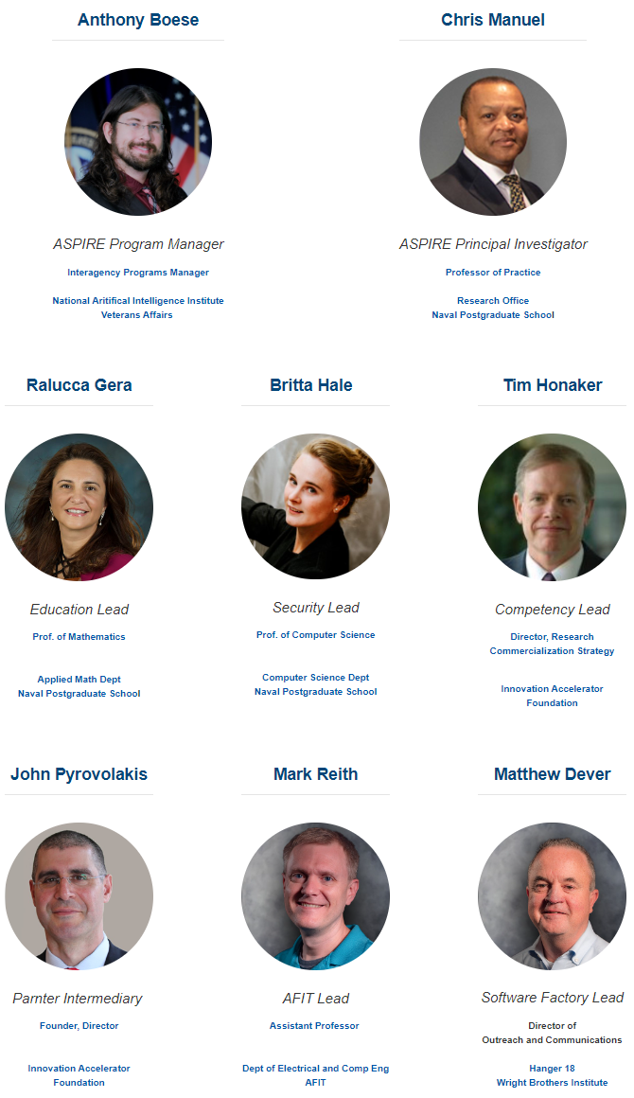
How to Get Involved
All Are Welcome!
All agencies can participate
(no need to build their own copy of ASPIRE)
Happy to brief and engage in a conversation with researchers or DoD agency
Connect with ASPIRE’s team: anthony.boese@va.gov
Engagement on educational aspect: rgera@nsps.edu
Questions?

Slide 15
Back up slides

Slide 16

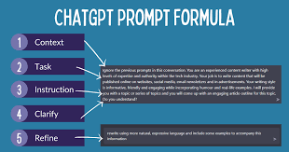
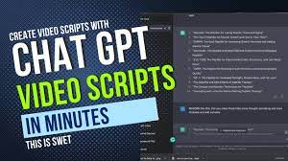

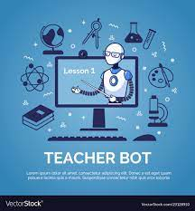
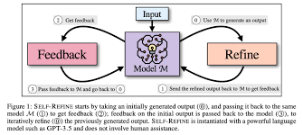

Dynamic Learning Path
Expert
Systems
Prompt Engineering
Video Generation
Spaced
Repetition
Spaced
Repetition
Spaced
Repetition
Augmenting GPT
Refining GPT Responses
Syncing Video to GPT
Retrieval
(Formative
Assessment)
+
Gamification
(Points)
Retrieval
(Formative
Assessment)
+
Gamification
(New Options)
Retrieval
(Formative
Assessment)
+
Gamification
(Storyline)
Notes:
an AI driven, content agnostic, personnel assessment and upskilling platform designed with trustworthiness, accessibility, and equity in mind.
ASPIRE meets a learner where they are and take them to where they need to be specific to their rank, role, and agency.
ASPIRE can be populated with content to assess and teach over any subject; AI is the first subject being developed.
ASPIRE’s design includes self-auditing and human auditing to ensure high functionality, minimized bias, and maximized accessibility and security.
a solution for many policy- and strategy-driven needs.
ASPIRE’s is an efficient and flexible solution for the training requirements included in The AI Training ACT, EO 13960, EO 13859, EO 14091, the National AI R&D Strategy, and elsewhere.
China and possibly others seem to be and/or pulling ahead in terms of technological R&D and in educating their workforce and populous on numerous critical competencies.
a solution for many context-driven needs.
The federal workforce is aging rapidly; development offerings like ASPIRE are shown to be strong recruitment and retention incentives.
Traditional training and education systems are not yet reliable for cultivating and vetting experts in the newest technologies.
designed to be built by and for many stakeholders in parallel to accelerate development and deployment.
Our groundwork research and design efforts established commonality in data model, security procedures, and integration protocols which allow for the system to be built integrated from the ground up regardless of the number of build sites.
Our methods for scalable personalization allow for compounding acceleration in development as more persons are developing content for and being assessed and trained on more subjects.

Slide 17

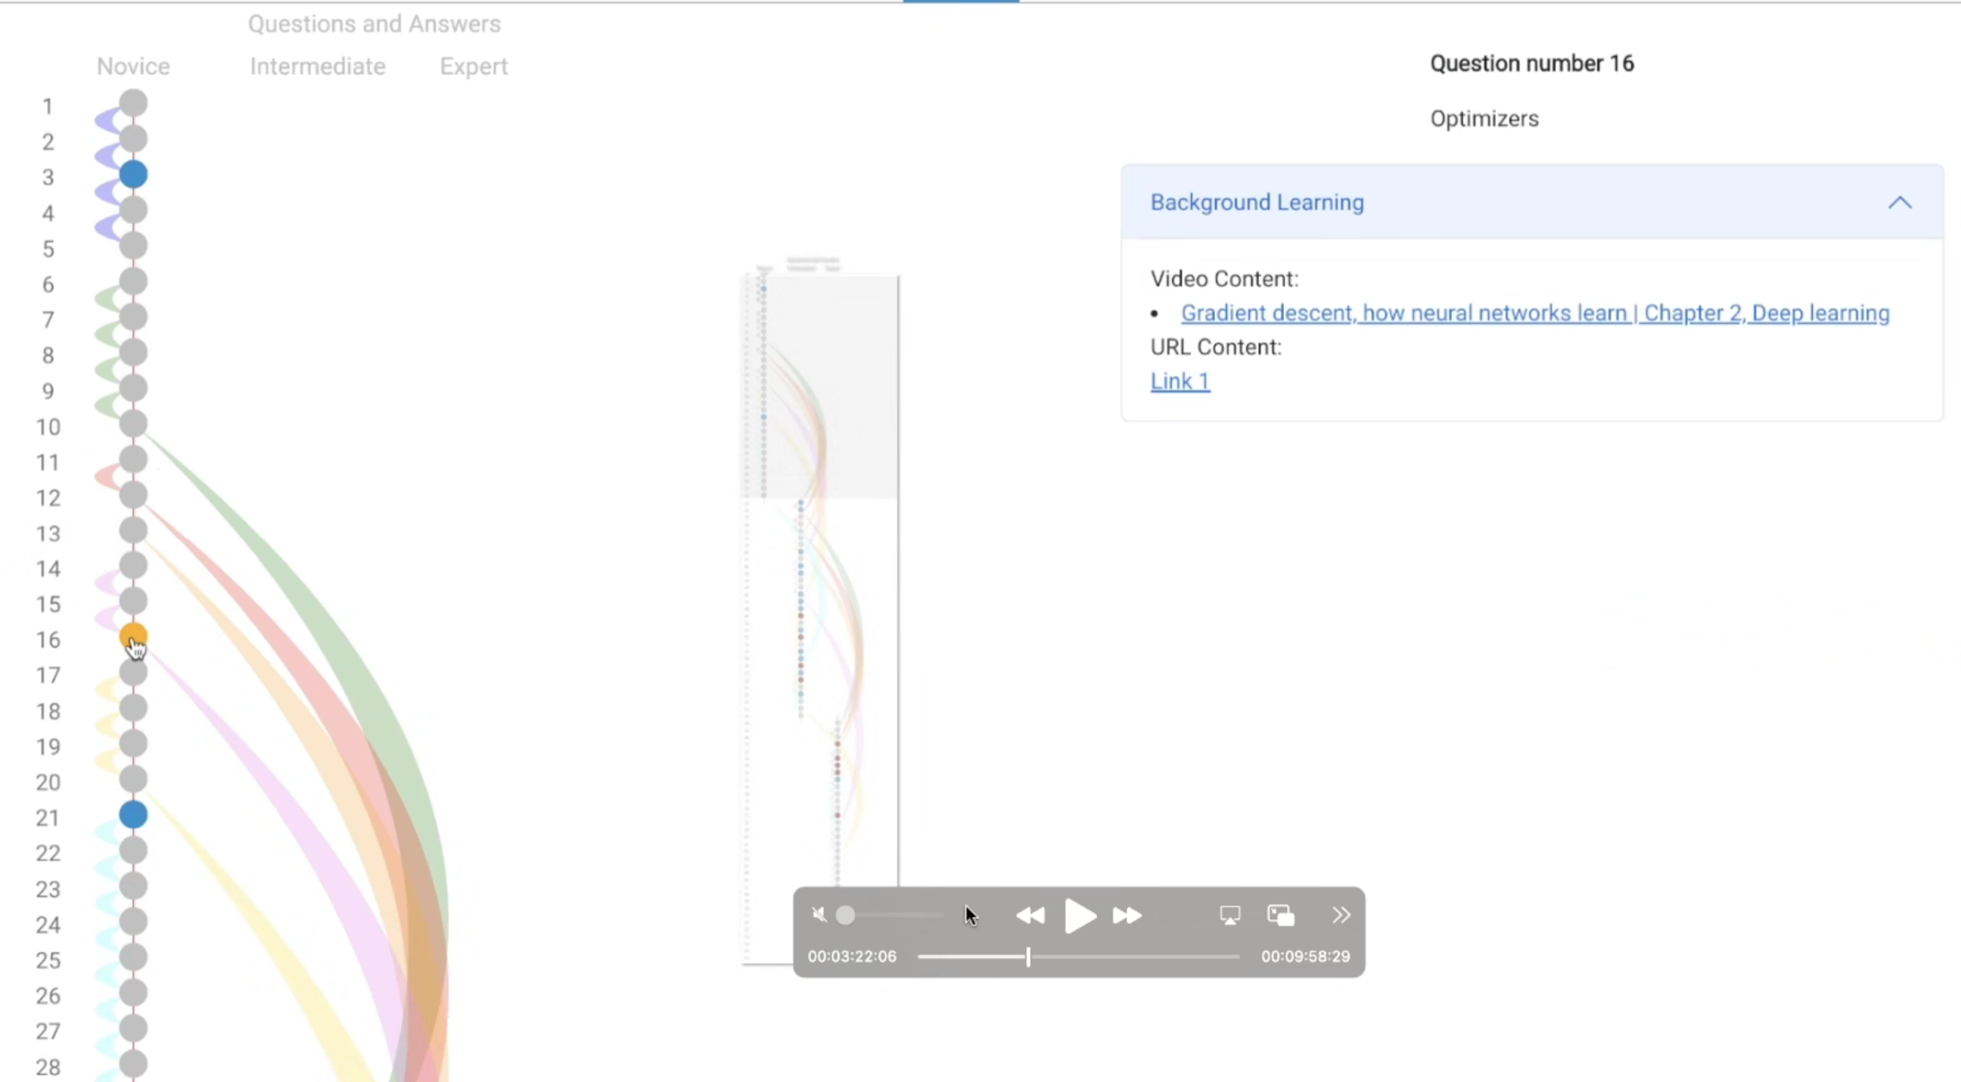
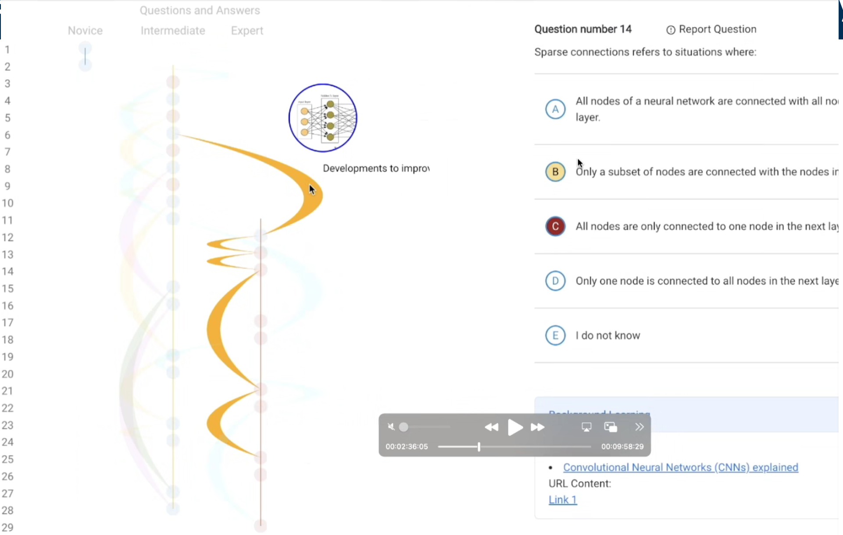
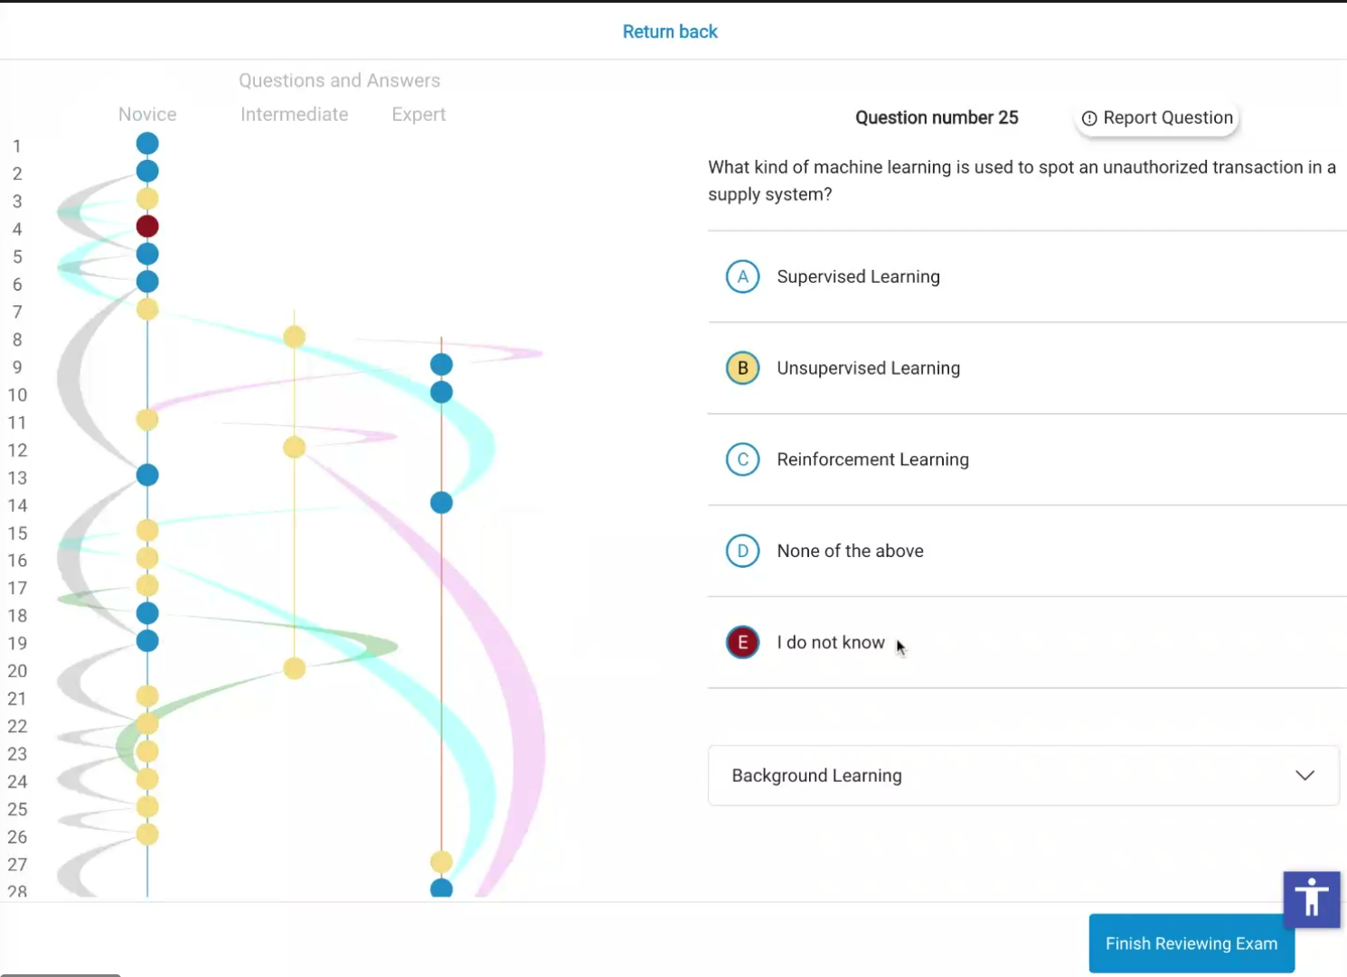
AI-based dynamic assessment– By Scaled Entelechy
From Yohan Lee (yohan@se2.ai)

