Slide 1
Excellence Through Knowledge
Prof. Ralucca Gera, rgera@nps.edu
Applied Mathematics Department, Naval Postgraduate School
Lab exploration: Network Profile Summary

Slide 2
Components of Learning in MA 4404
Network Profile Summary
Each student picks a network to understand and explore
As I teach concepts, each student tests the concepts on the chosen network (Gephi, Python, R)
Deliverables:
Weekly one-slide presentation throughout the quarter
Final comprehensive PPT
Interactive lectures:
New concepts introduction
Conversation driven
Guest lecturers provide different perspectives and application (ie. OR)
Exploratory group projects
Open research topic that is currently relevant
Provide research project experience and thesis in a group format (learn with mutual support)
Focus on exploration not finding a “correct” answer
“Great course! I enjoyed exploring the course concepts by implementing them on my network profile. Great way to learn!” MA4404 student

Slide 3
Why?
Best way to learn is to experiment rather than to observe.
Transition from knowledge exposure to practice (without mimicking the instructor).
You can experiment on your network:
exploring the topics as we present them, and
as your intellectual curiosity inspires you.
“This class is structured in the way I thought graduate school classes should be structured. Open research questions were effective in inspiring more advanced learning. An excellent class.”
MA4404 student

Slide 4
How?
Choose a network that interests you.
You will be analyzing this network and present results about it.
You are welcome to download a data set from http://faculty.nps.edu/rgera/MA4404/NetworkProfileSummaryResources.html or other data of interest
“This was an engaging and interactive course. It covered an incredibly interesting topic and the instructor did a great job bridging the ‘math’ with the real world applications. I enjoyed working in the group for projects and believe that this is by and far the best way to learn. The lectures were interesting, improved my understanding of the material, and contributed directly to the quality of the projects. The instructor is passionate about the topics and passed that enthusiasm to the class. I wouldn’t change anything”
MA404 student

Slide 5
What ?
At the end of each week, create one (or two slides if absolutely needed) with your analysis of the topics presented that week, applied to your network: convincing, coherent, and cohesive
Students will present their findings, followed by a group discussion of all the networks’ analysis (similarities and dissimilarities).
The cumulative PPT slides to be turned in the day of classes.
“Best. Teacher. Ever. Loved the course, and if you had a mic Ralucca, this is the part where you would drop it and walk away.”
MA4404 student
Let’s see some examples!

Slide 6
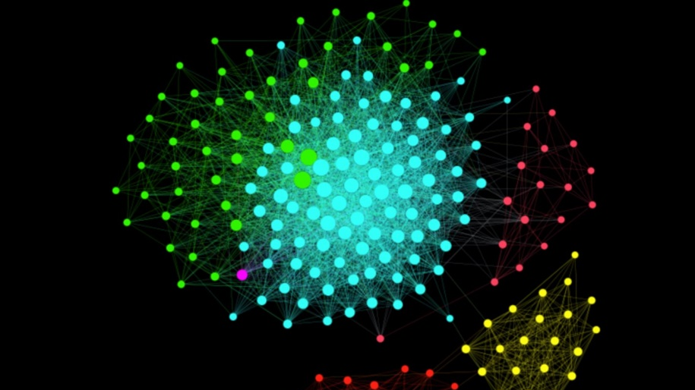
Student Work
Creative, Relevant Learning
Healthcare, Logistics
Public Health,
Travel
Wargaming
Terrorist Networks
Social Influence
Political Influence,
HDD Mapping,
LinkedIn
Personal Interest
Star Wars

Slide 7
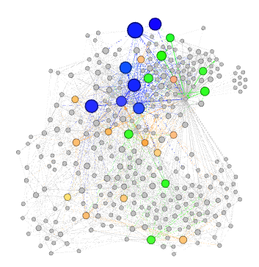
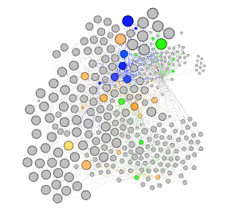
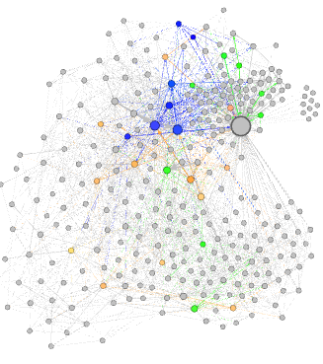
LtCol Mark Raffetto
The Brain Network
Betweeness
Modularity by Betweeness
Wt Degree All Colored
297 Nodes - Neuron
2345 Edges - Synapse
15.79 Ave Degree
3.992 Ave Path
14 Diameter
.482 Modularity
1 Connected Component

Slide 8
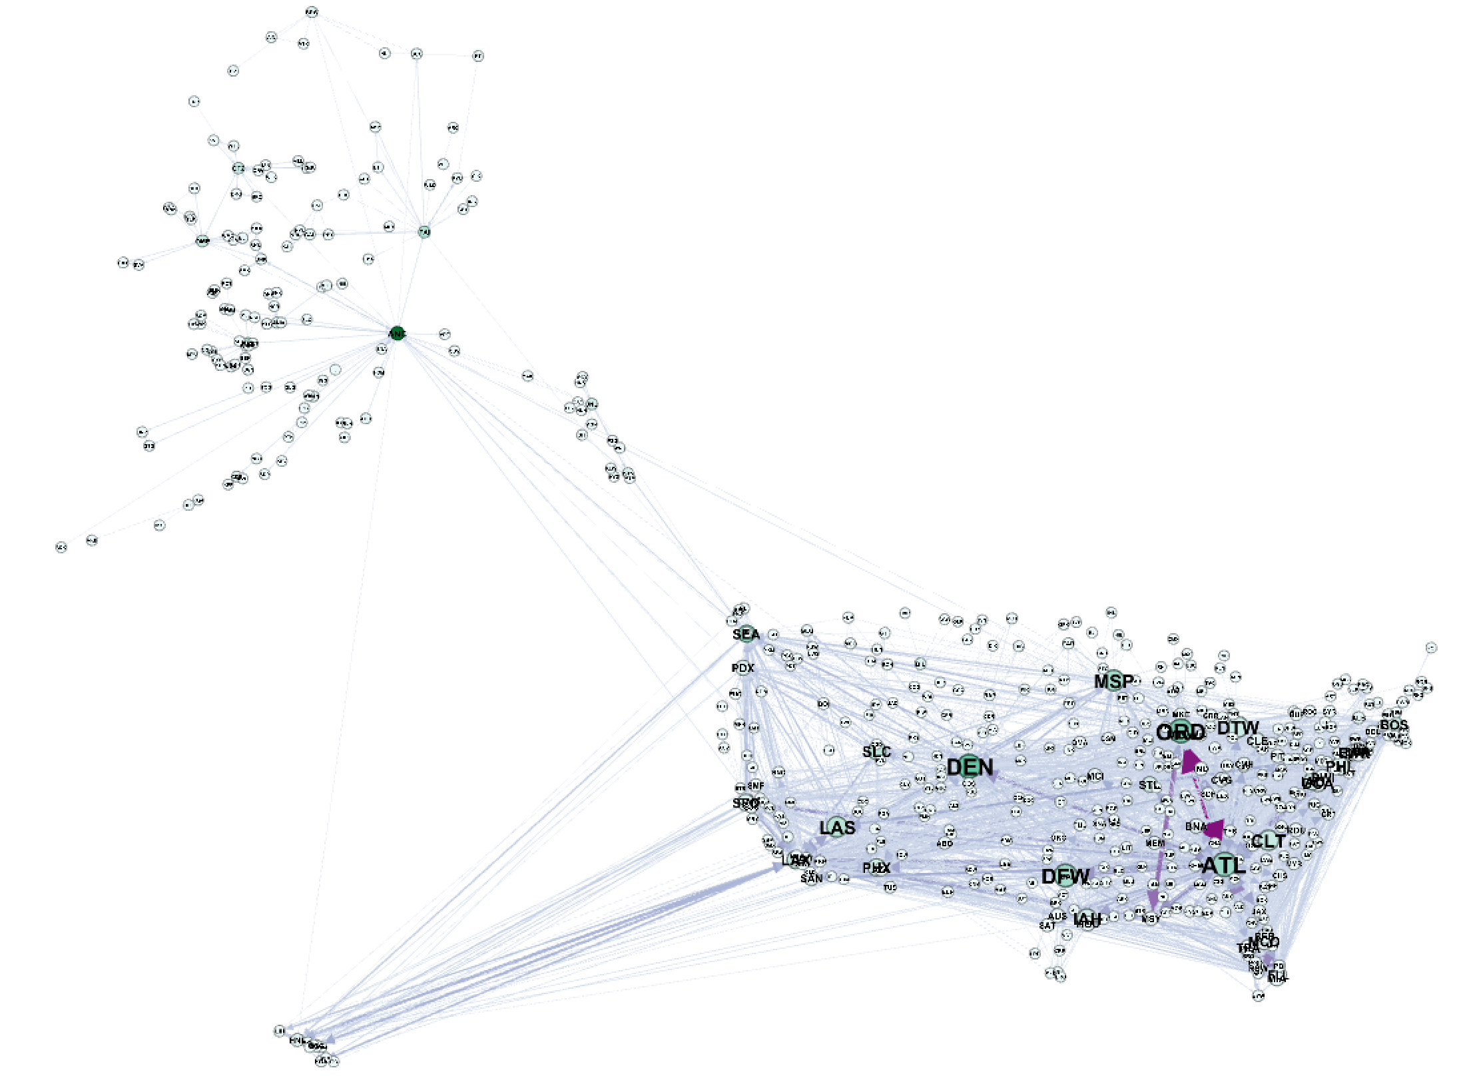
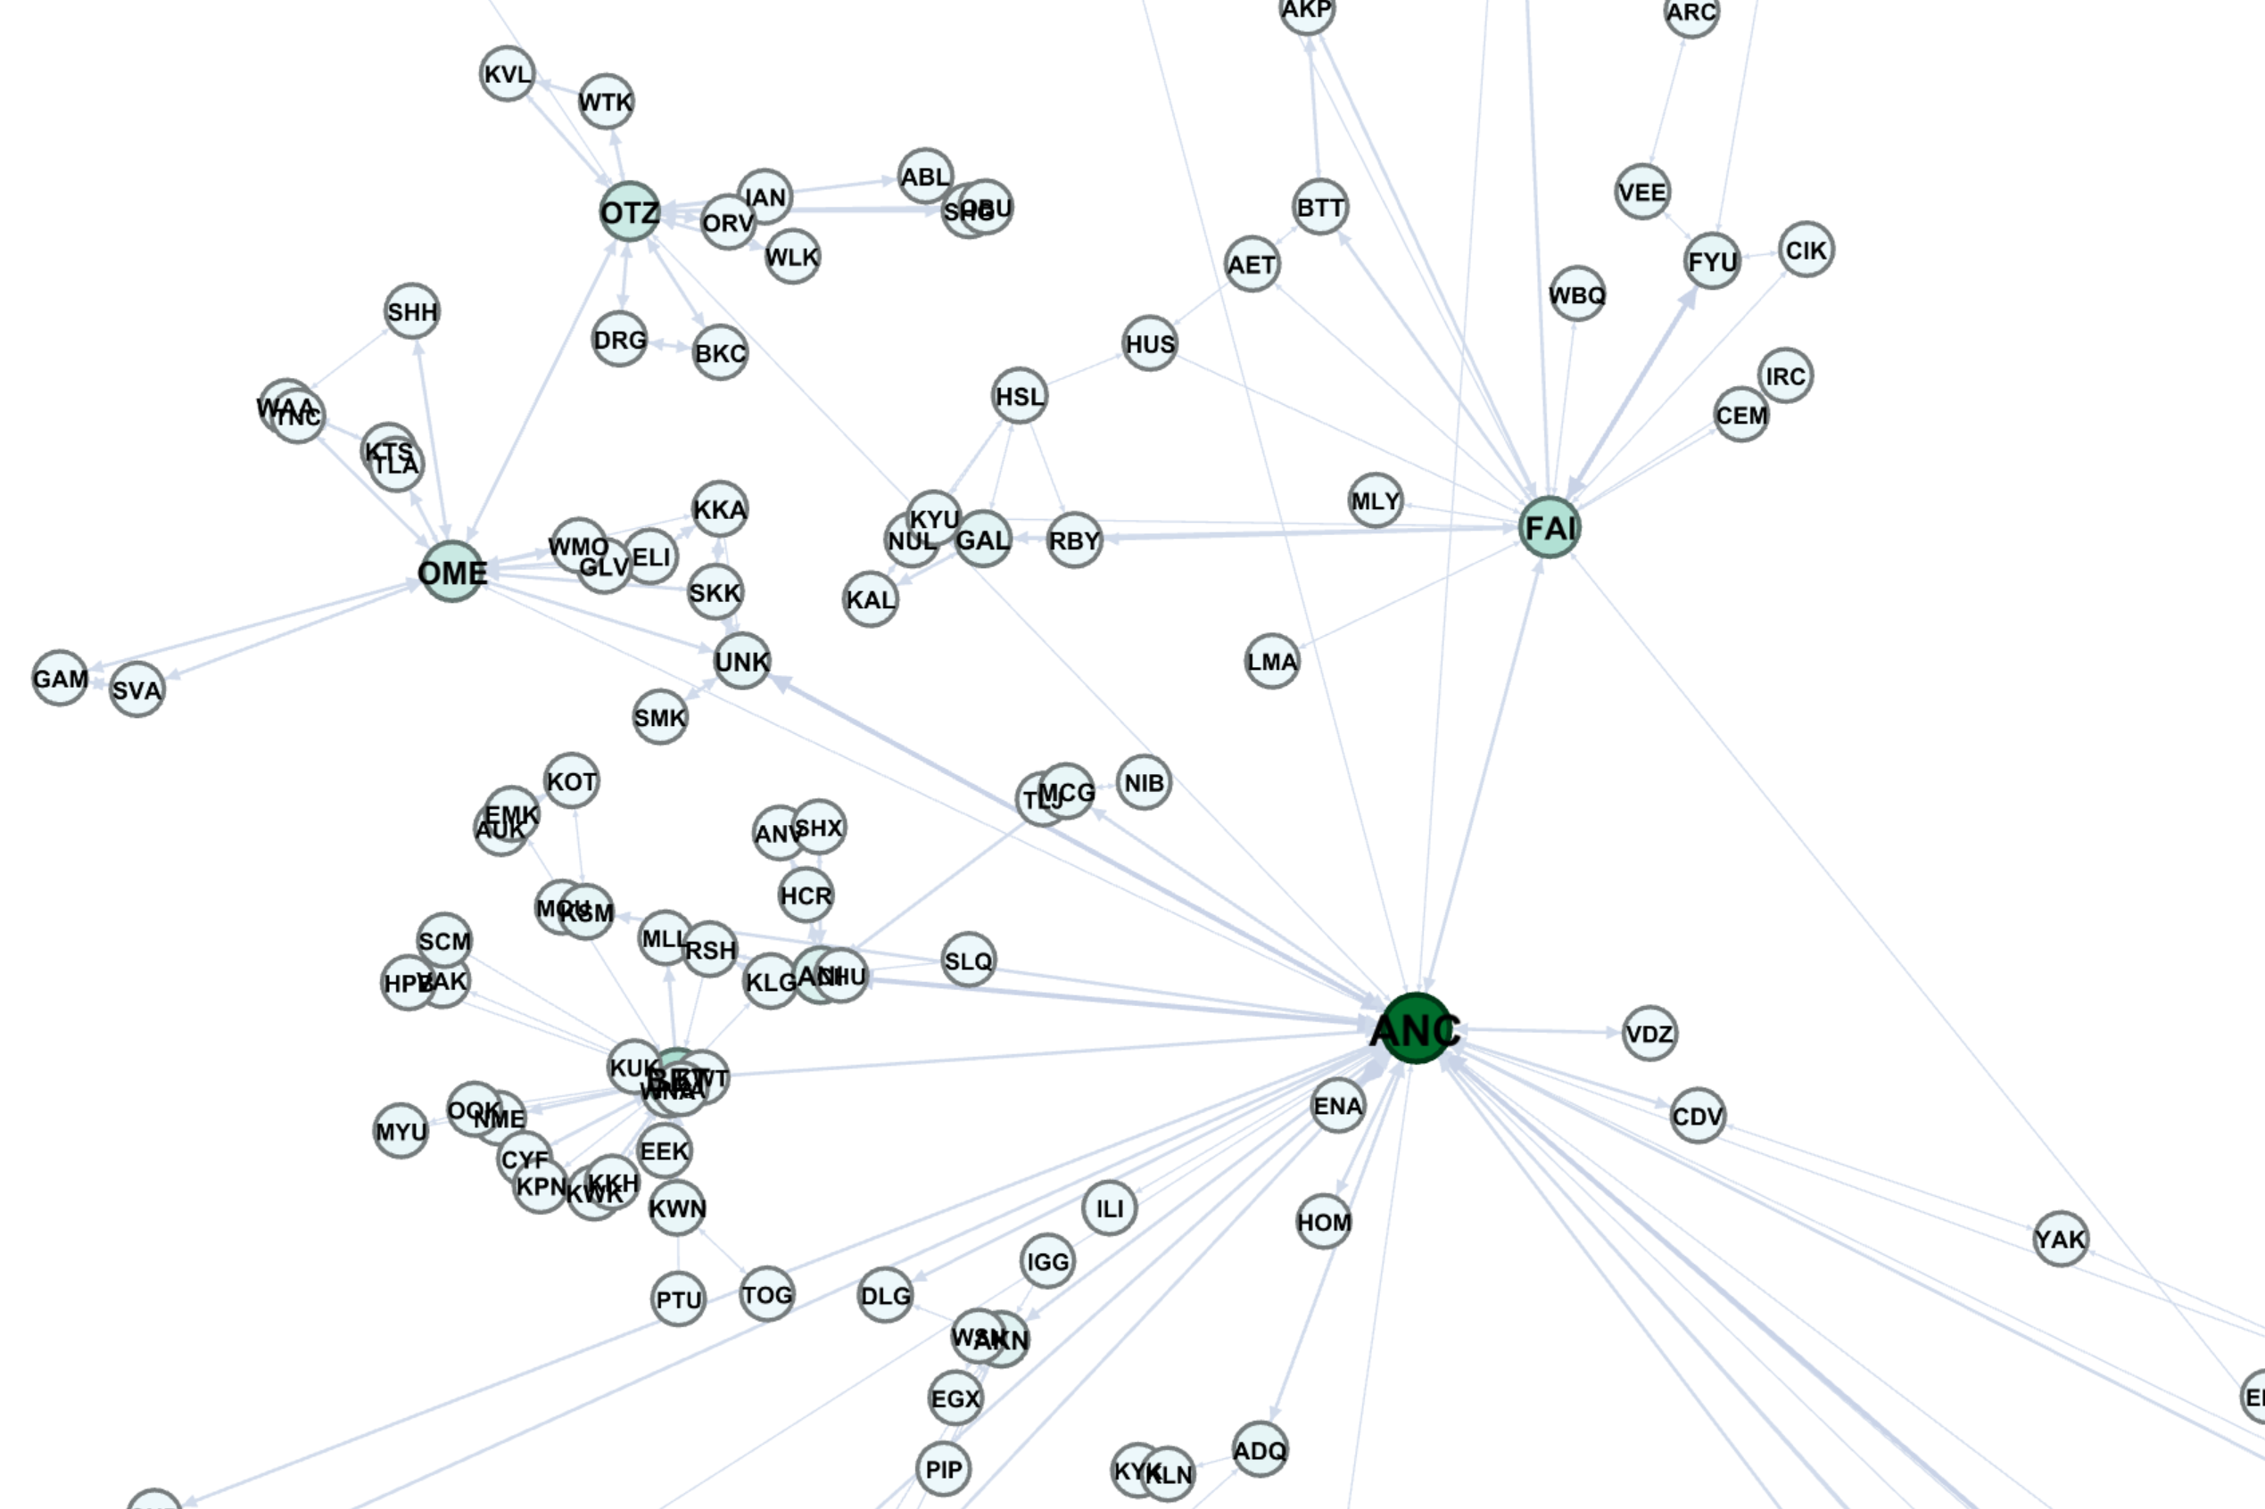
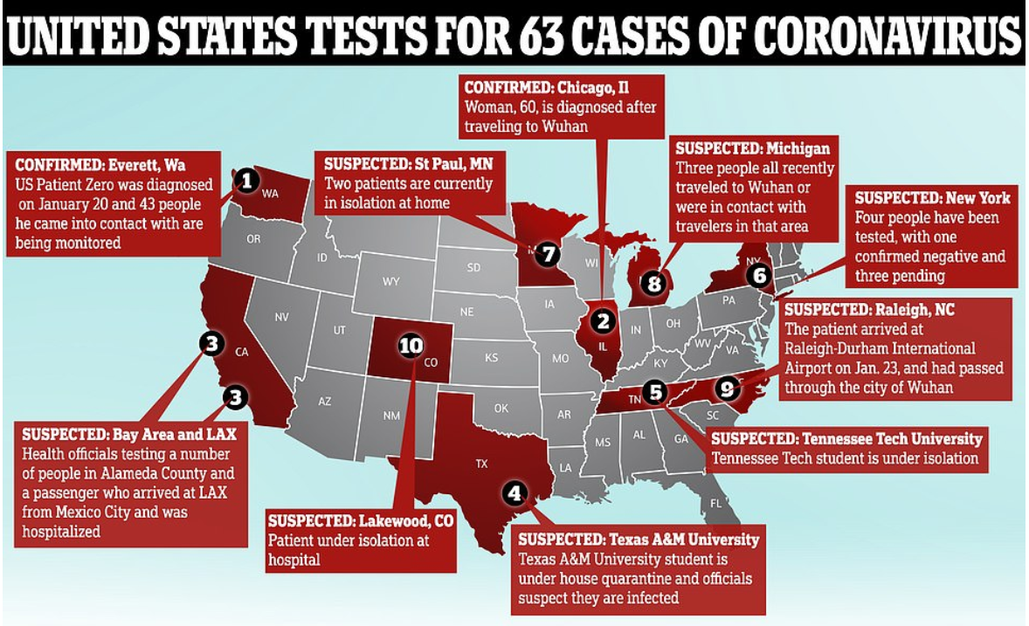
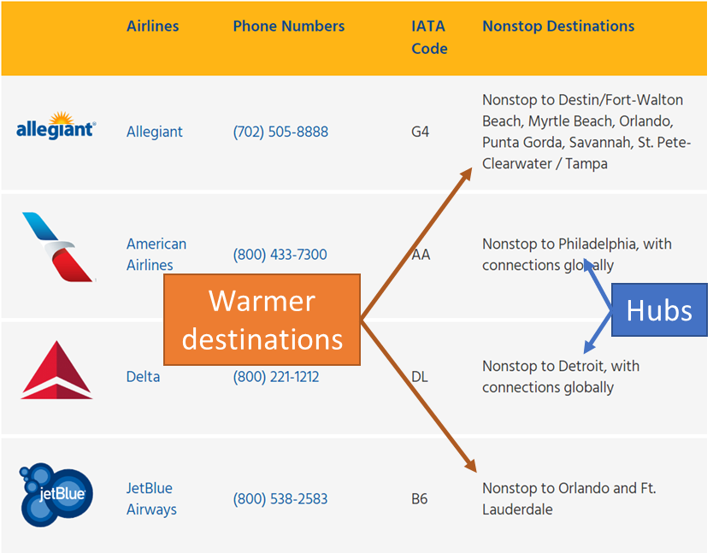
Josephine Cammack
United States Airports and Flights
Nodes: 549 US Airports
Edges: 5450 directed edges
Public Health Application: Understanding the spread and determining measures for preventing the spread of infectious disease, from an airport/airline/travel perspective.
Logistics and Business Decision-Making: Where will they put new airports, and which airports will the new airport be connected to first? Future Capacity of Airports Considerations

Slide 9
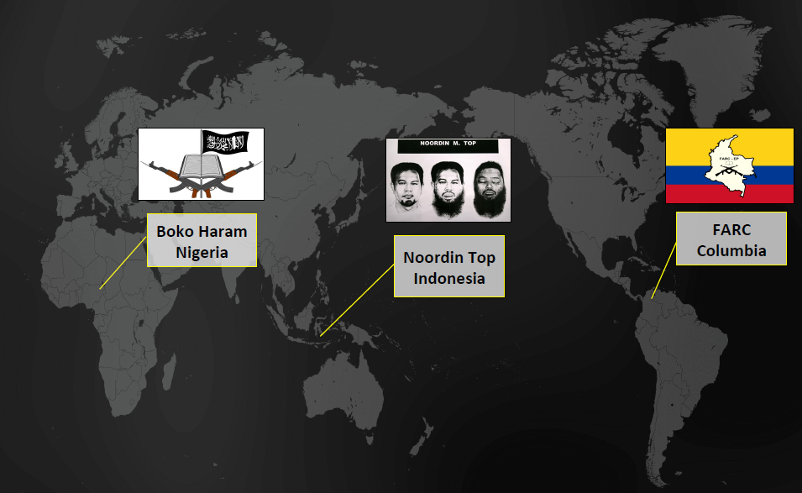
CPT Ryan Miller
Multiplex Terrorist Networks

Slide 10
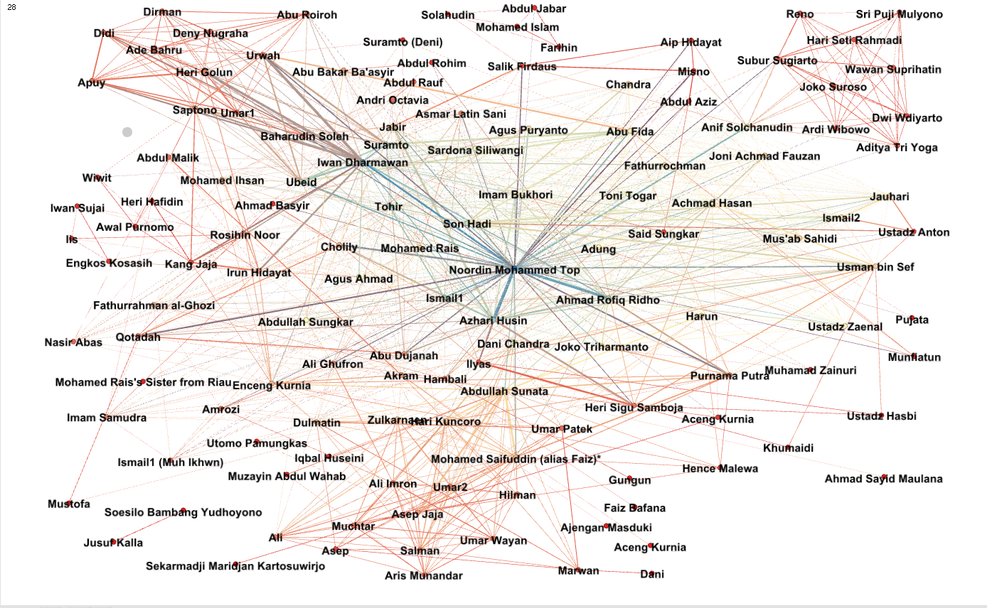
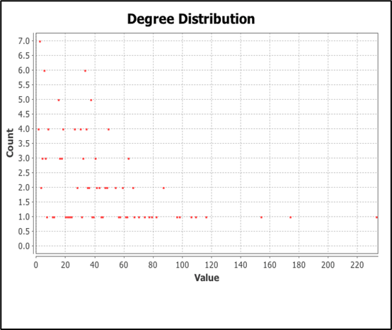
CPT Ryan Miller
Small, Dark, Real, Multiplex Network of the five Terrorist Organizations in Indonesia rendered as a Monoplex Network by Gephi.
V = 133
E = 2451
Layers = 14
AVG Path Length: 2.13
Clustering Coeff: 0.71
Degree Distribution
AVG Degree: 23
AVG Weighted Degree: 37

Slide 11
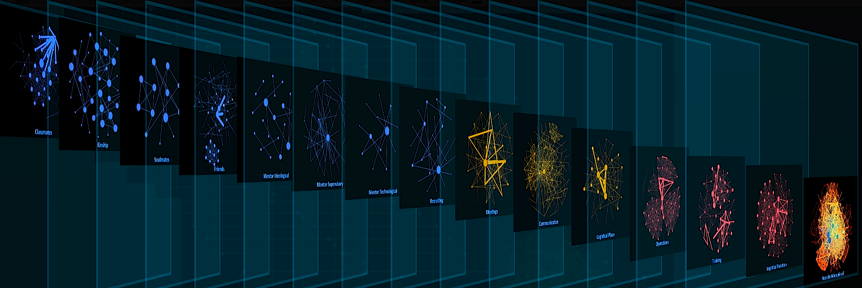
CPT Ryan Miller
Multiplex Terrorist Networks
Trust
Lines of Comms.
Knowledge
The monoplex

Slide 12
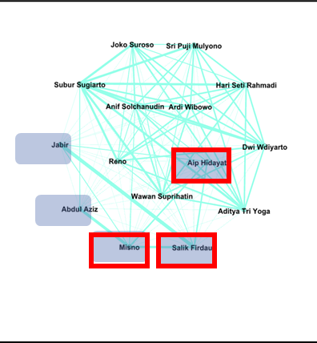
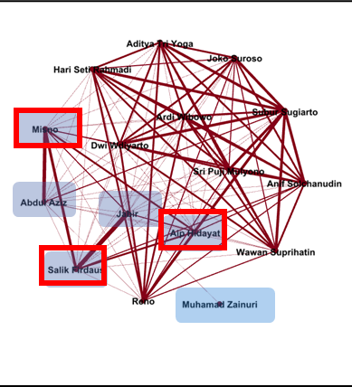
Identified community 1st try
10/15 ID with partial information
Scott Warnke
Targeting a community in Terrorist networks
The same ten individuals appear in the same community in the communication layer.
They represent over 60% of a community in the full network (using only 20% of the ground truth).
This community represents
a group that carried out an
attack in Bali in 2005.
Salik Firdaus, Misno, Aip Hidayat
3 suicide bombers from the Bali attack
Not part of the Community in the Communication layer
Identified community 2nd try
10/16 ID with partial information

Slide 13
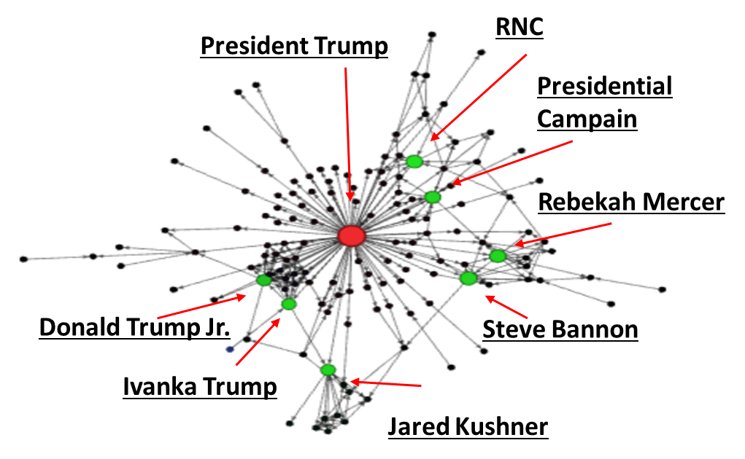
Maria Smith
Trump World Associates
No other American President has taken office with a giant network of businesses, investments and corporate connections.
How are people and organizations connected in this social network?
Who or what organizations have the most influence?
Data Statistics:
Nodes: People and Organizations
#Nodes: 145
Edges: connection type (directed)
#Edges: 281
Strongly connected: 128

Slide 14
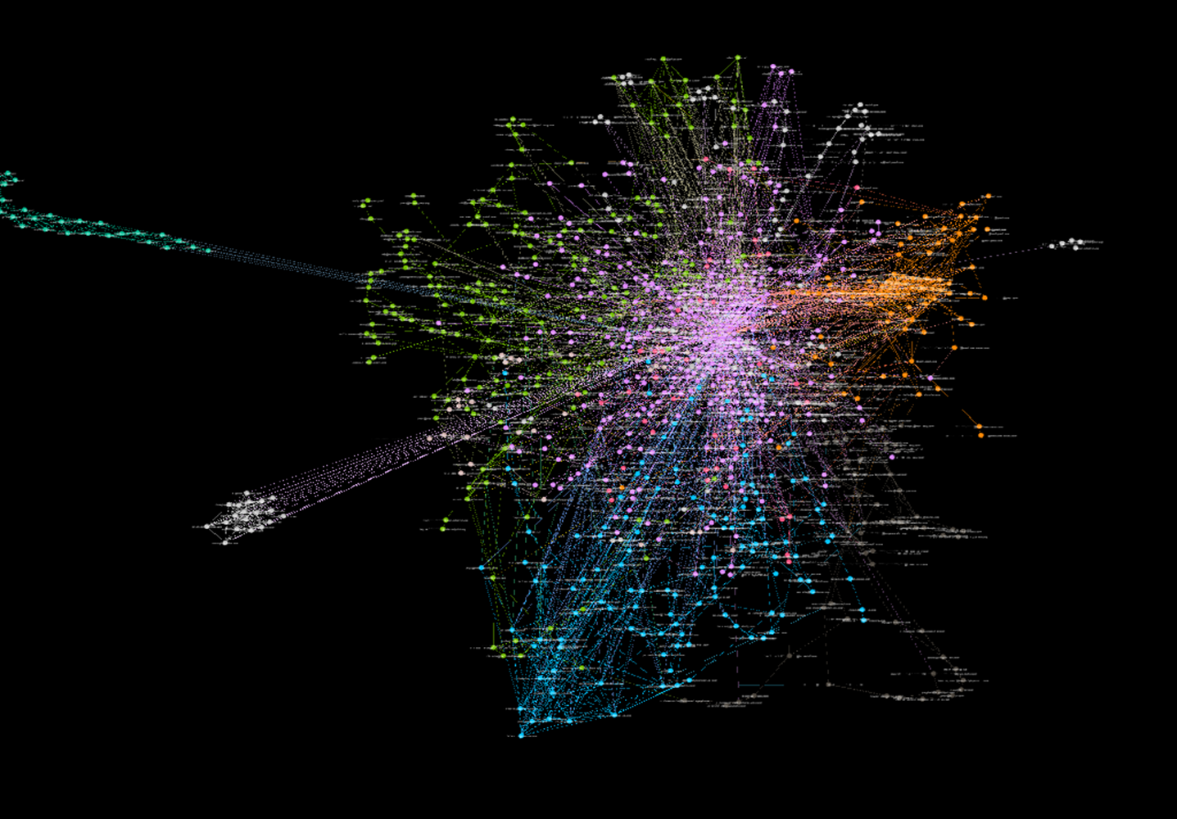
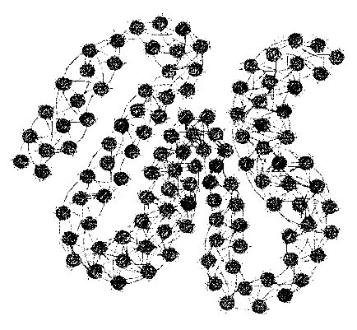
LT Greg Allen
HDD Mapping
Automate extraction and construction of the social network of the user(s) of computers: HDD are scanned with forensic bulk extractor for email addresses
Component 4:
Pearson Similarity: .837
avg degree: 7.678
avg path: 10.889
Possibly the address book?

Slide 15
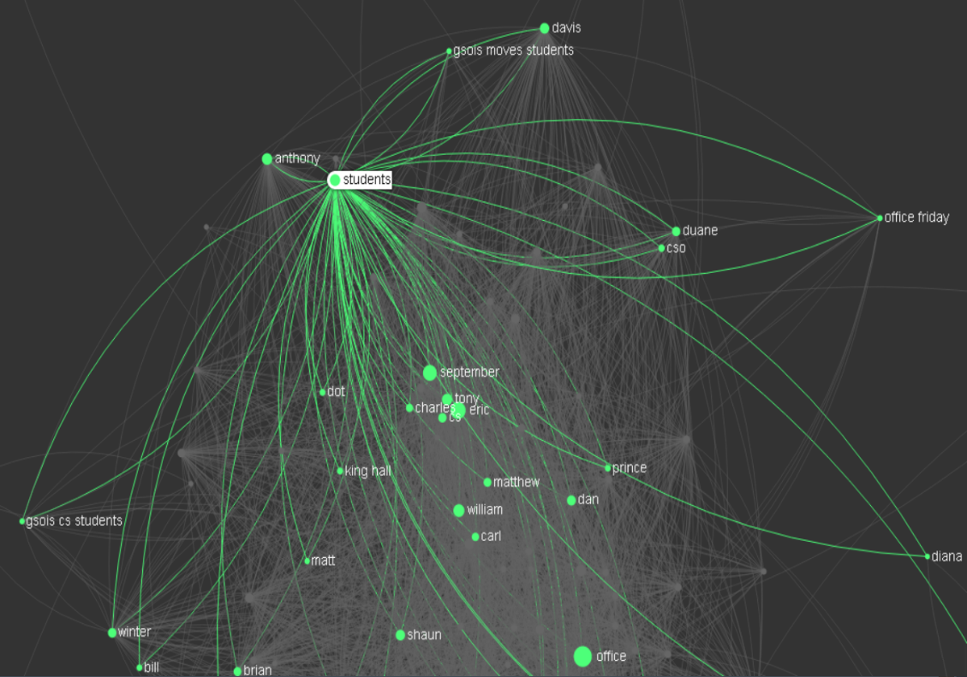
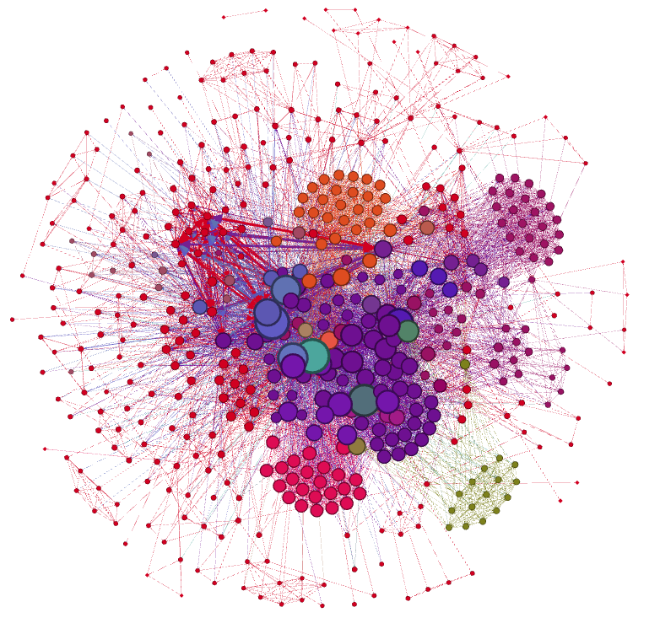
LT Miguel Miranda Lopez
Email mapping
Email traffic from August ‘15 –Jan ‘16, (received and sent emails).
Node: user accounts
Edge: header field users (To, From, CC, BCC)
Colors based on degree
Miguel: Light green one
No weights on edges
Email content mapping
Node: key words
Edges: key words in the same email
Notes:
Email from Sept-Dec 2016, receive and sent emails.
Node: user accounts
Edge: header field users (To, From, CC, BCC)
Colors basedon degree
Miguel: Light green one
No weights on edges

Slide 16
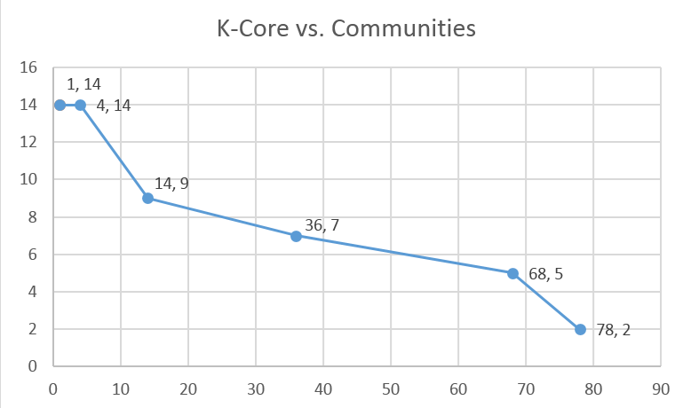
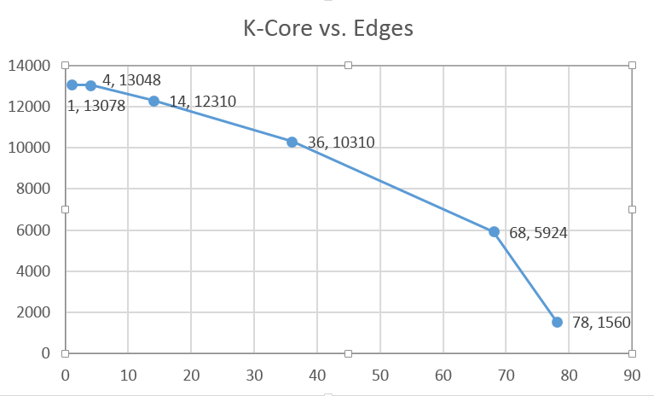
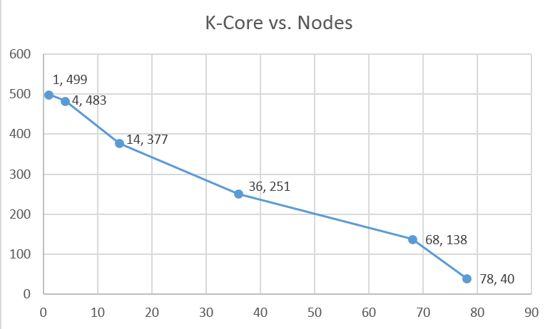
LT Miguel Miranda Lopez
Email content mapping
Nodes: 499 and Edges: 13,078
Avg. Clus. Coeff: 0.829
Avg. Path Length: 2.369
Net Diam.: 5
Avg. Deg.: 52.417
Avg. W. Deg.: 66.725
Density: 0.053
Modularity: 0.467
Centralities
Eigenvector: (↓)
1. ‘Miguel’: 1
2. ‘Office’: 0.9985
3. ‘Eric’: 0.9156
4. ‘September’: 0.8637
5. ‘Student’: 0.8377
Closeness: (↑)
1. ‘Office’: 1.5383
2. ‘Miguel’: 1.5887
3. ‘Student’: 1.6210
4. ‘Eric’: 1.6633
5. ‘September’: 1.7359
Betweenness: (↓)
1. ‘Office’: 42,900
2. ‘Miguel’: 34,736
3. ‘Student’: 31487
4. ‘Eric’: 19,456
5. ‘September’: 14,557
Notes:
PO,
Dept Chair

Slide 17
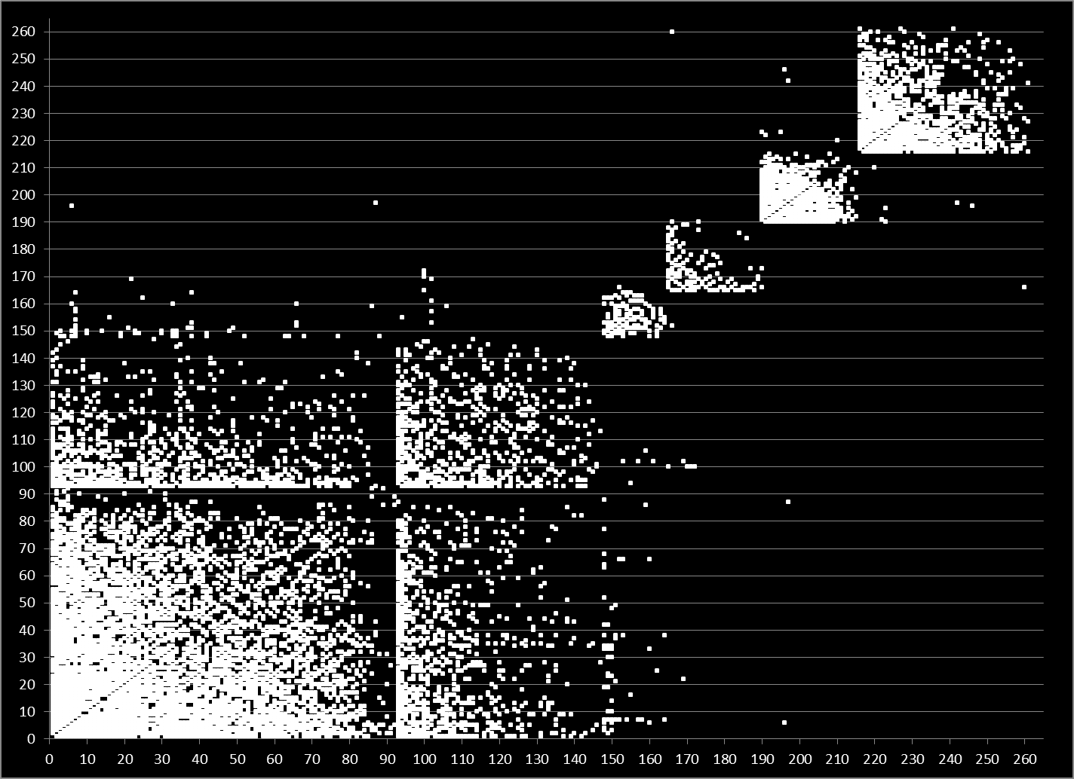
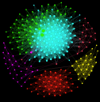
Timothy James
LinkedIn: Community Detection
CRYSTAL
CITY
MARYLAND
MILITARY AFFILIATION
VA BEACH
& JAPAN
NO MILITARY AFFILIATION
PENTAGON
NAVY CEC
NAVY CEC

Slide 18
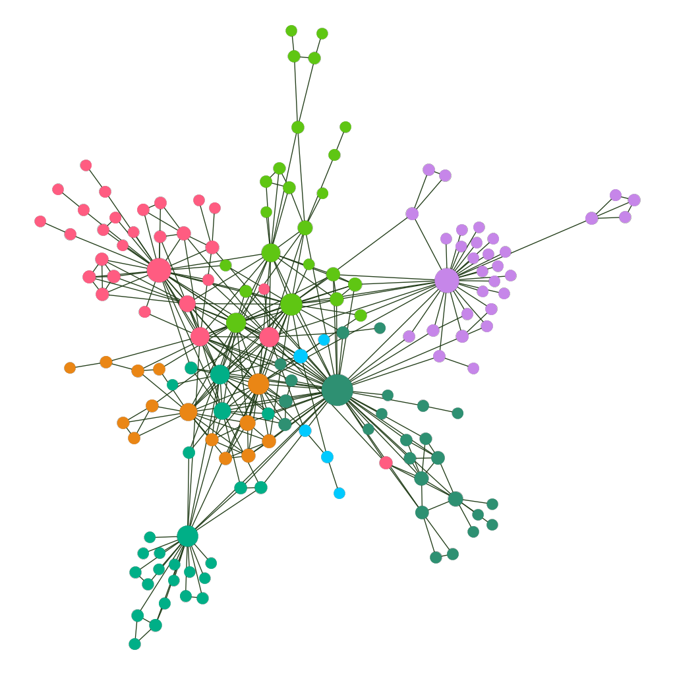
Zac Lukens
STAR WARS IV, V, AND VI
Anakin/Darth Vader
Jabba the Hutt
Edges based on “interaction” in the movie
Talked to
Fought against/with
Related to
Worked for
It is not a 100% representation
Couldn’t find some of the minor characters listed in credits
Bartender
Luke Skywalker

Slide 19
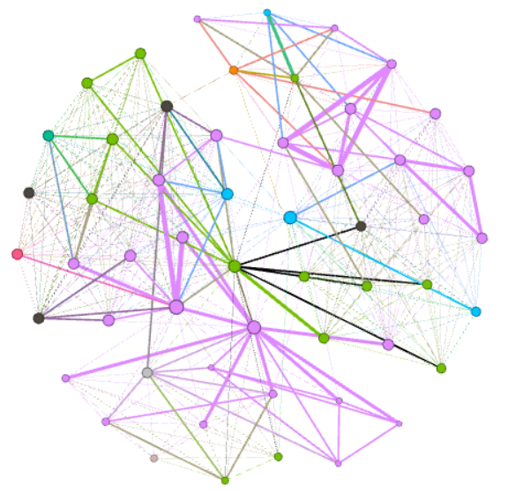
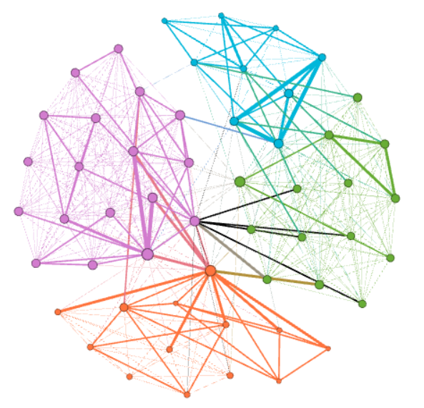
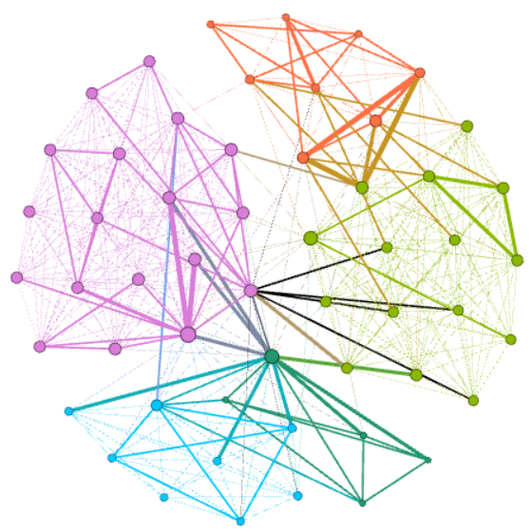
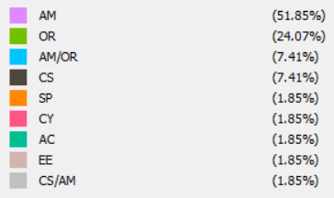
NPS Network Science Certificate cohorts
Erik Kiser
NPS Curriculum
Detected Communities
Network Science Cohort
Network as of 30JAN18
Gephi algorithm repeatedly detected the same communities
Detected communities generally corresponded to Network Science cohorts
13 of 54 students responded
Sorted using Fruchterman Reingold algorithm

Slide 20
Network Profile Summary
Network Profile Summary is:
deck of slides on the personal network.
Network Profile Summary allows students to:
find the why behind the what they observed,
be motivated,
be independent learner,
continually apply newly learned concepts to their selected networks → realize the utility and place of these concepts,
see coursework, concepts, and feedback as productive and globally meaningful rather than corrective and locally meaningful,
engage with topics that mean something to them,
while students are exposed to required material.

Slide 21
Thank you!
Resources for data: https://faculty.nps.edu/rgera/MA4404/NetworkProfileSummaryResources.html
Ralucca’s email: rgera@nps.edu
Course info: http://faculty.nps.edu/rgera/MA4404.html

