Slide 1
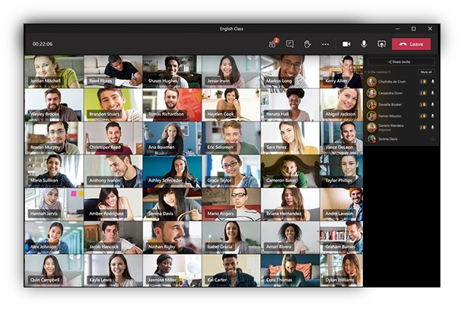
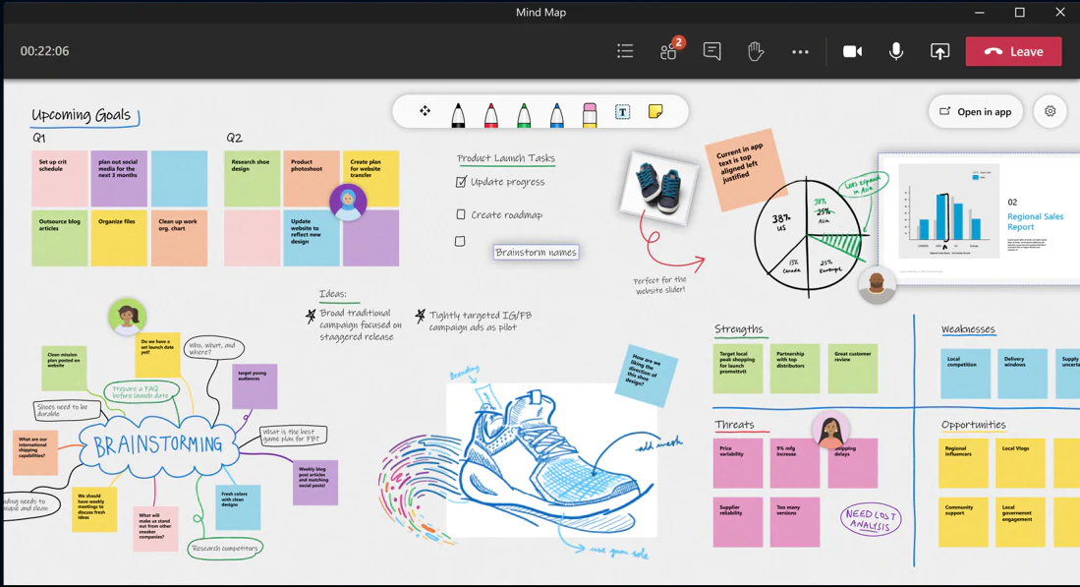
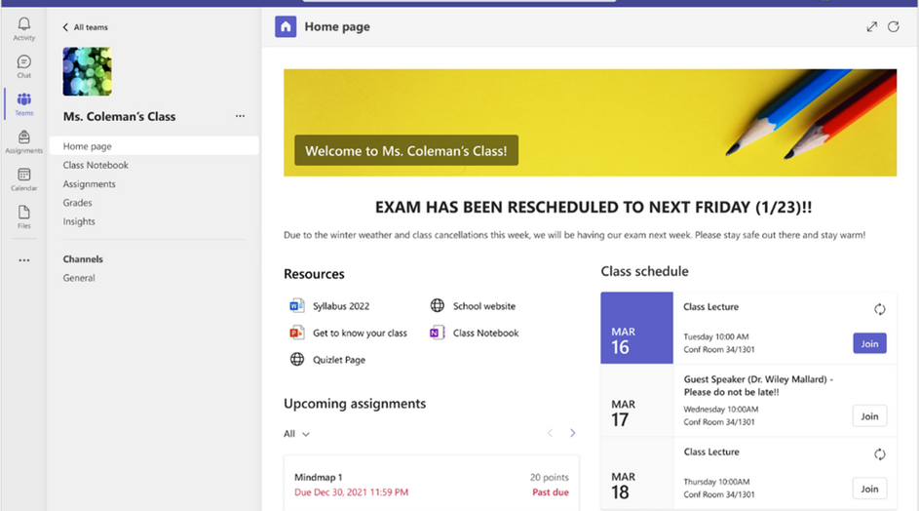
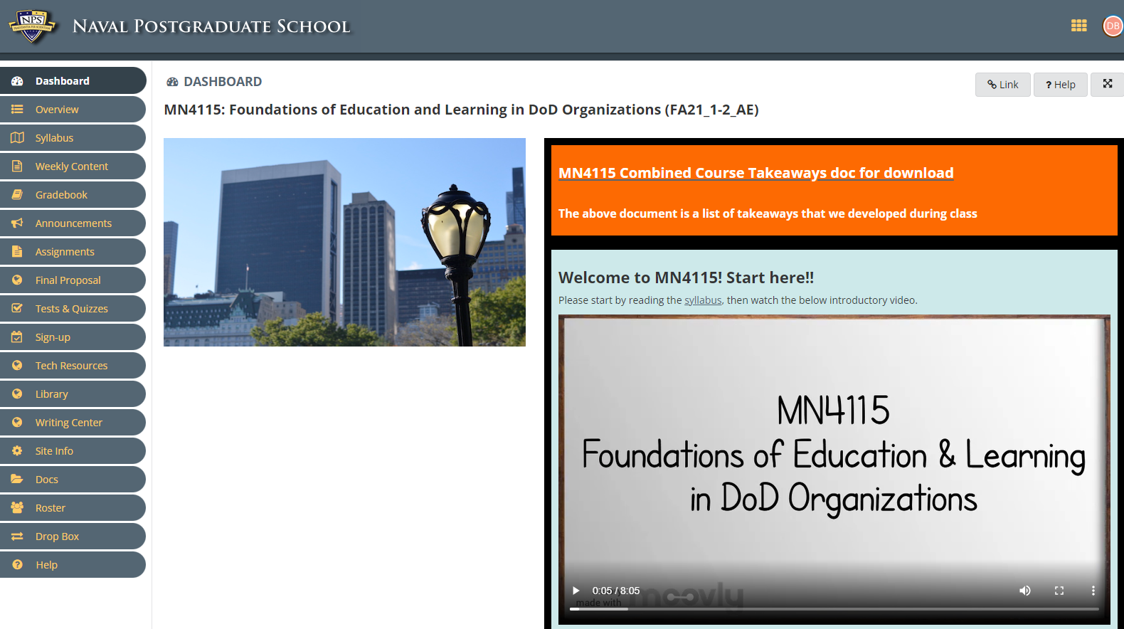
Digital Classroom:
SAKAI + TEAMS
FY 22:
Determination: Sakai plus MS Teams satisfies faculty and student requirements
FY23:
1. Leverage the strengths of both platforms for optimal course delivery
Sakai for course content organization and storage
Teams for communication, real-time formative assessment (polling) and synchronous collaboration
2. Providing a foundation of standardization while still allowing faculty to design and deliver learning activities that support learning achievement
MN4115
Welcome to MN4115
Teams

Slide 2
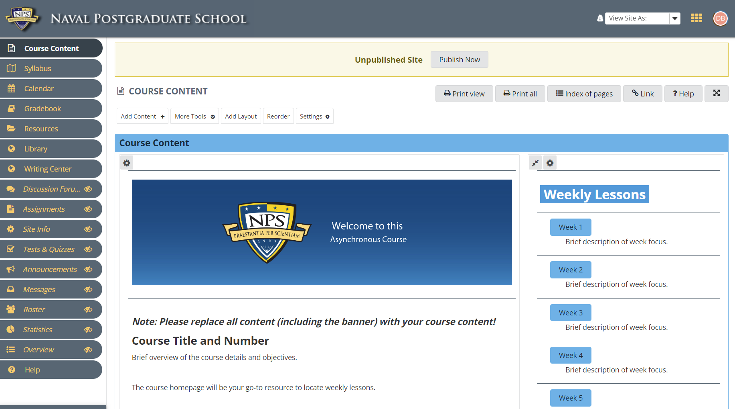
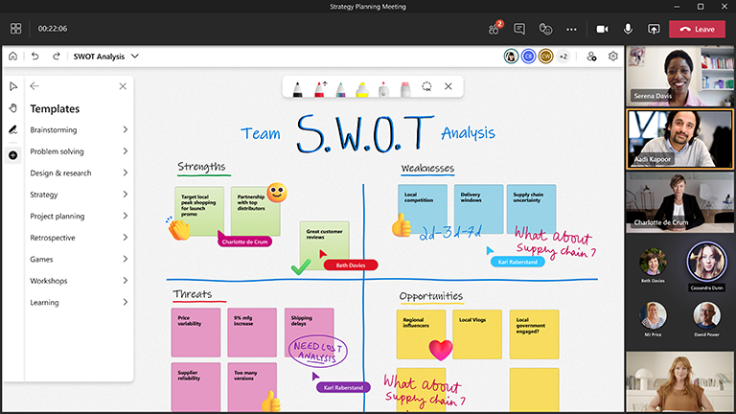
SAKAI
+
TEAMS
Key Limitation: Cross-cloud collaboration with non-.edu participants
* Provides minimum requirements, but not all desired features in these areas are available
Course Design
Develop and implement course templates to be used across organization
Content Storage
Course Resources
Student access to course materials after completion of a course
Student export of course materials
Host interactive, immersive educational media
External file sharing
Communication
Course announcements
Calendar
Management
Course roster
Course duplication
Search keywords within and across courses
Role permissions
Enrollment management
User activity Video management
Communication
Breakout rooms*
Live polling*
Chat
In-platform messaging
External participation in-meeting capabilities*
Dial-in only option
Collaboration
Digital student collaboration space
Whiteboard (native platform cannot record whiteboard)
Virtual lab environment (Azure lab services)
Student export of course materials
External file sharing
Access
Student access to course materials after completion of a course
Recording (no audio only, and no native editing)
Management/Privacy
Password-protect
Roles
Role permissions
Enrollment management
Notes:
FY22 was spent gathering and understanding faculty, student, and administrator requirements for a digital classroom environment. What is needed to provide quality NPS education offerings to operators who remain in the fleet rather than PCS’ing to Monterey, CA? Upon finalization of those requirements, NPS and Microsoft worked to determine whether MS Teams was able to meet those requirements. While there were limitations in some areas, Teams was able to satisfy most of the indicated requirements. Many of the capabilities in Teams are redundant to those in Sakai. Going forward, the goal is to determine how pairing Teams with Sakai creates the necessary environment for delivering quality distance learning micro-learning – addressing and resolving questions about redundancy and providing foundation of standardization for distance learning.

