Slide 1
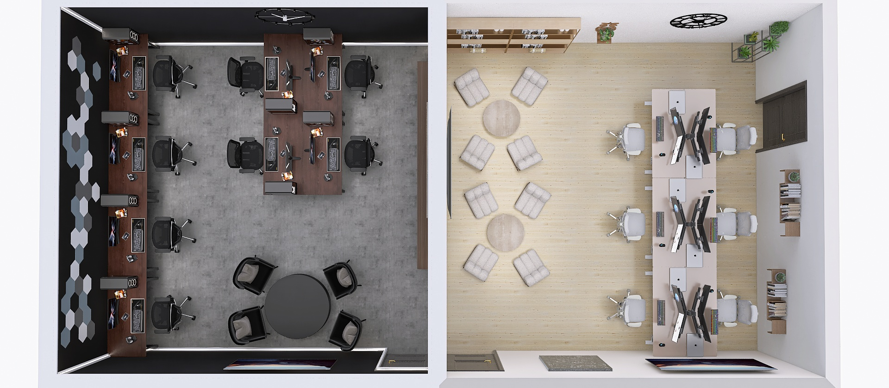
SILAS+ Remodel v3
4 September 2022

Slide 2
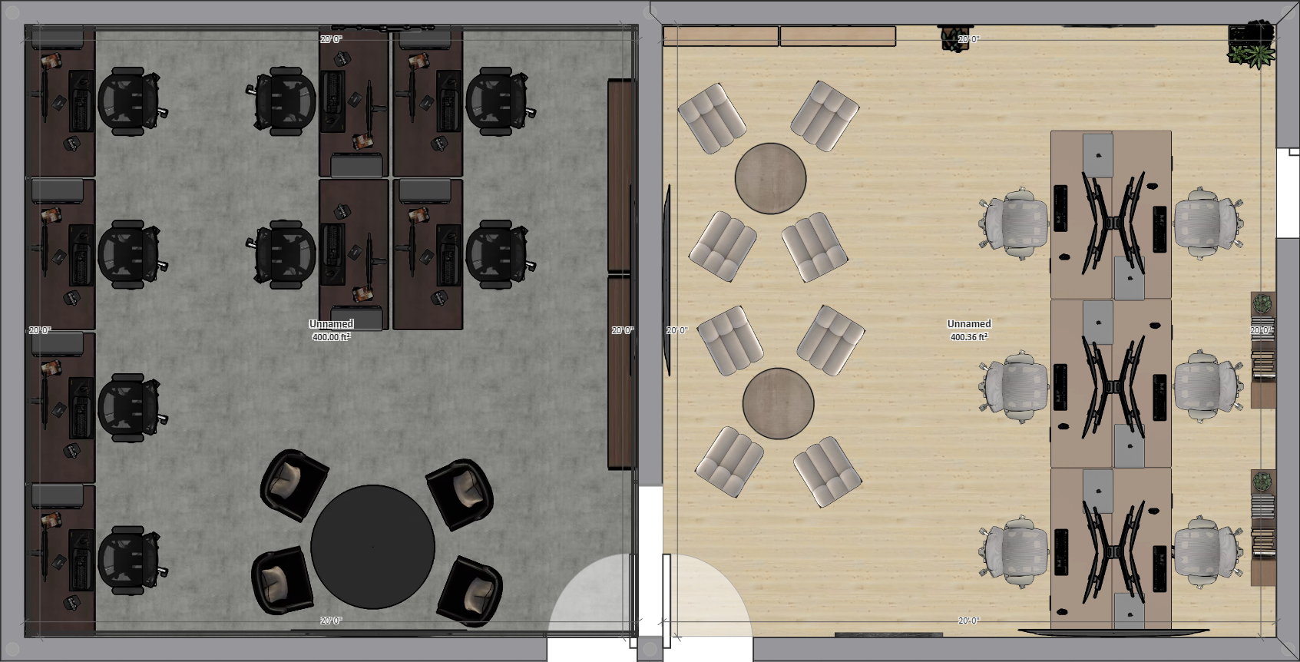
Blueprint
GAMIFICATION ROOM
ideation ROOM

Slide 3
Gamification Room Video

Slide 4
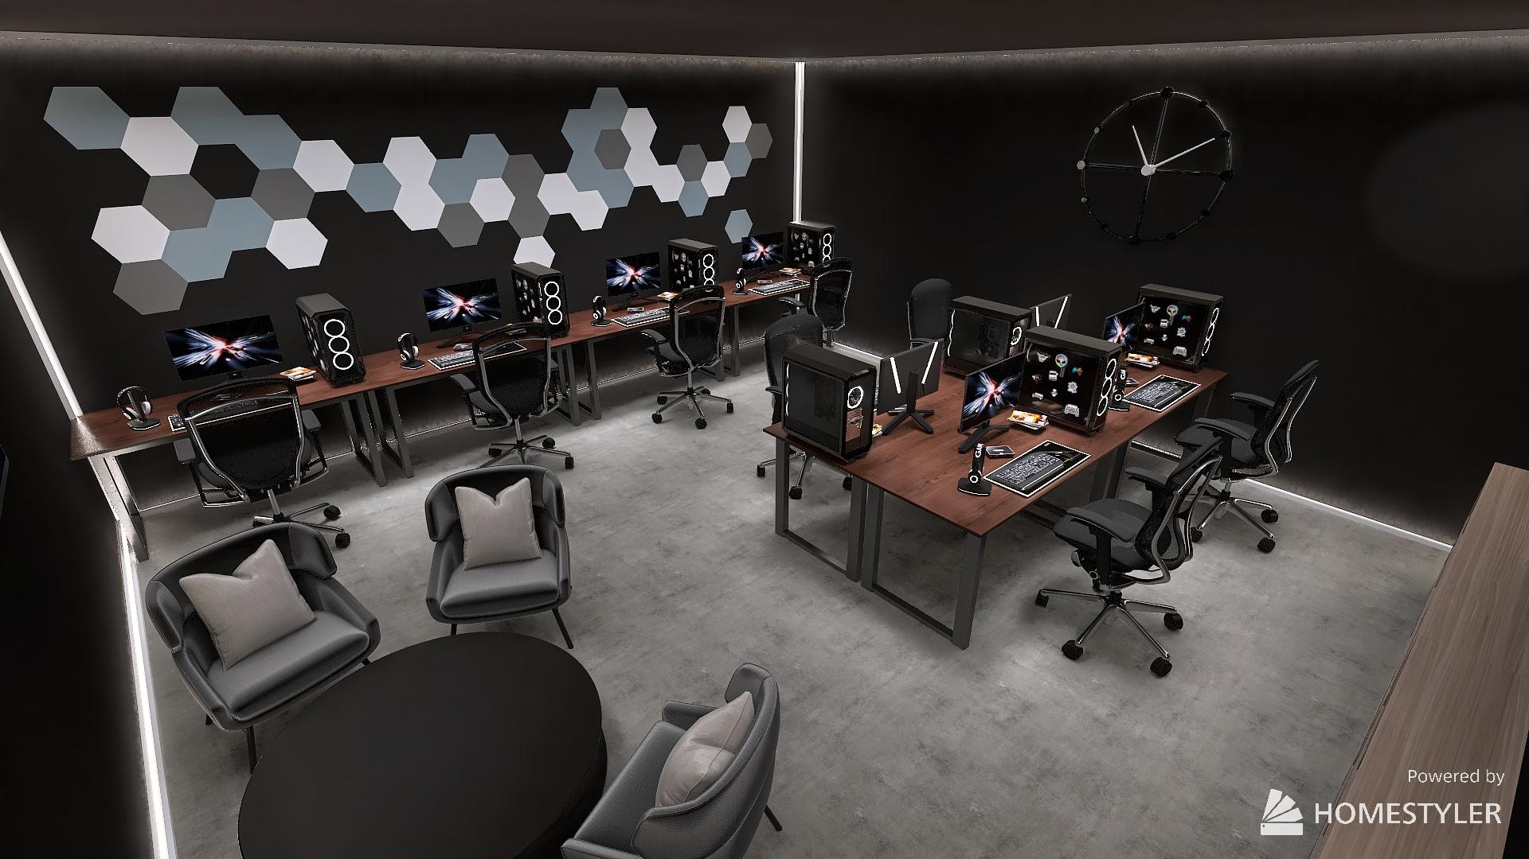
Gamification Room

Slide 5
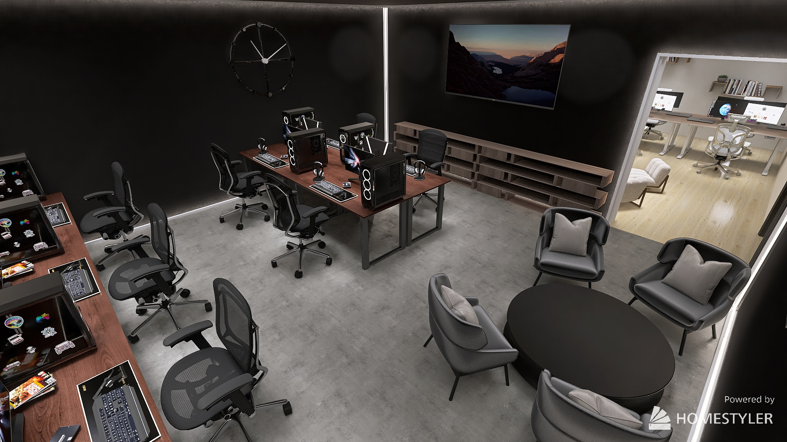
Gamification Room

Slide 6
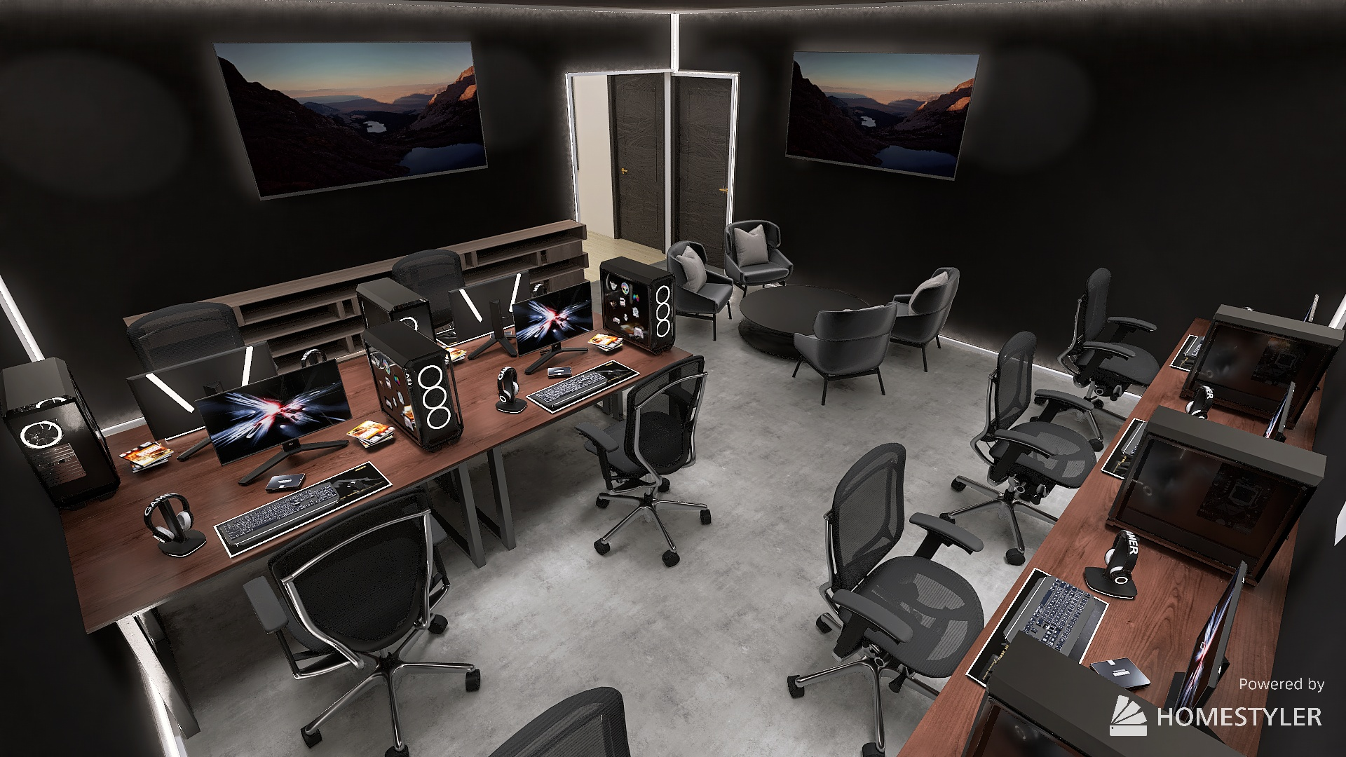
Gamification Room

Slide 7
ideation Room Video

Slide 8
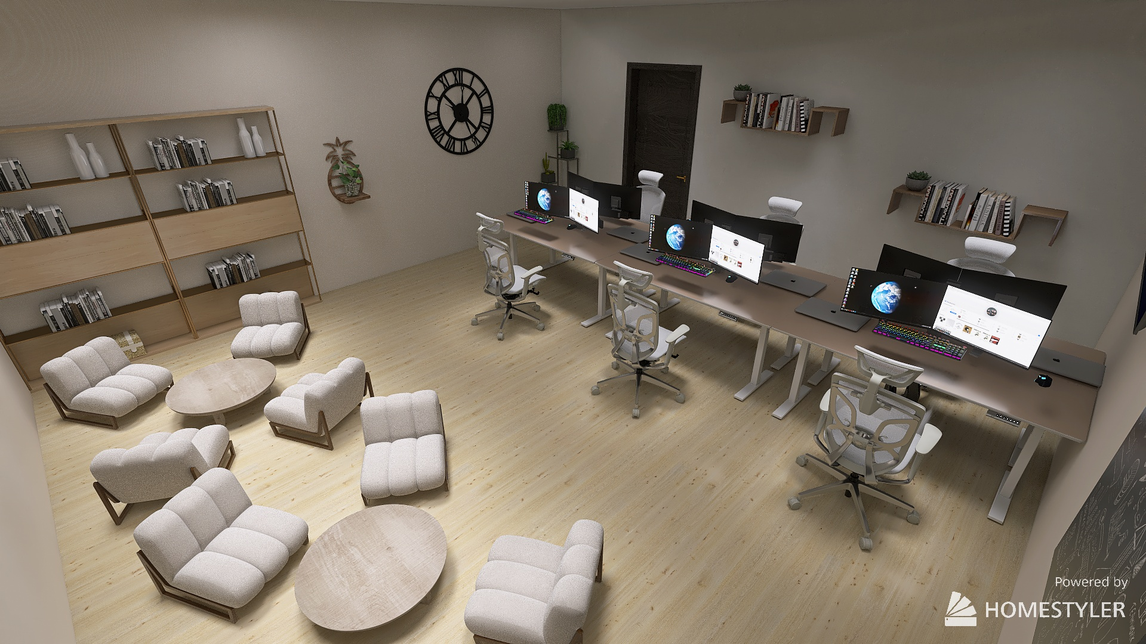
IDEATION Room

Slide 10
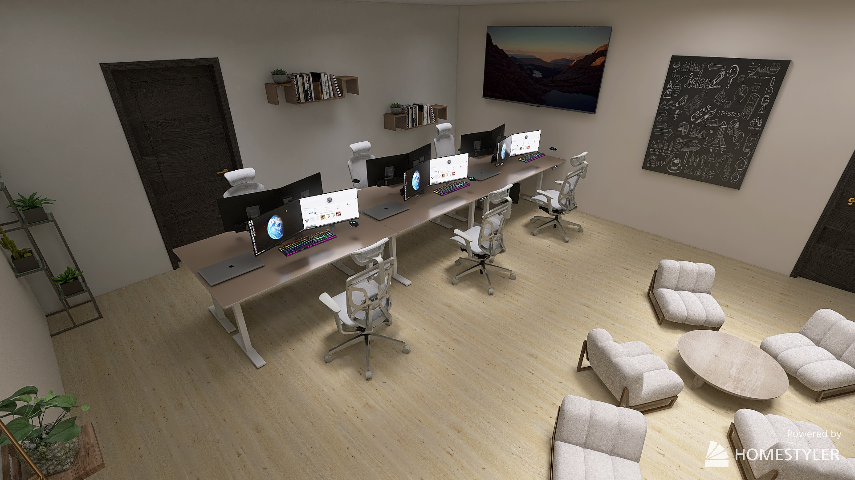
IDEATION Room

Slide 11
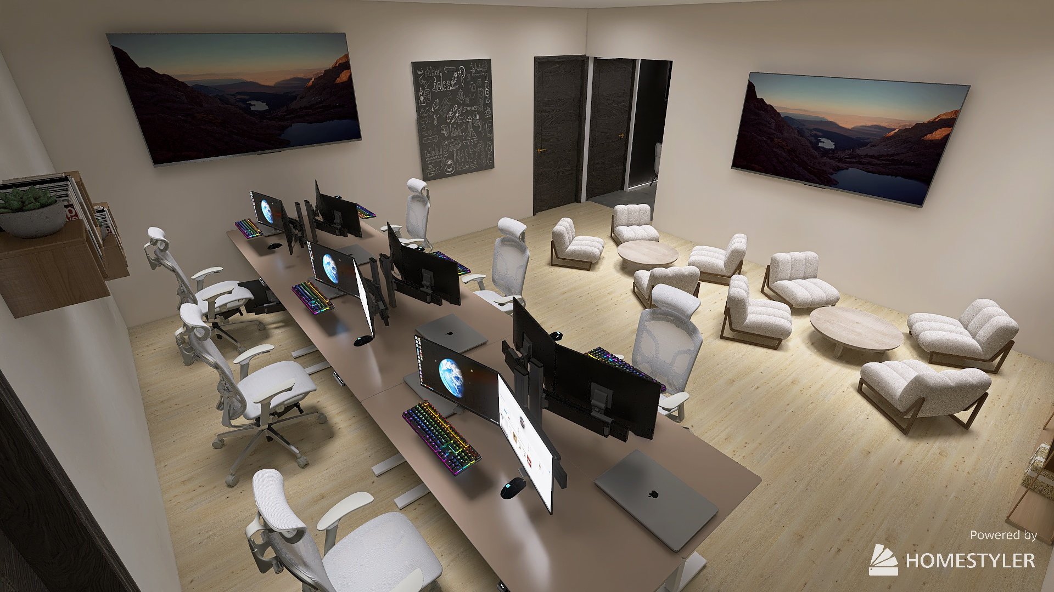
IDEATION Room

Slide 12
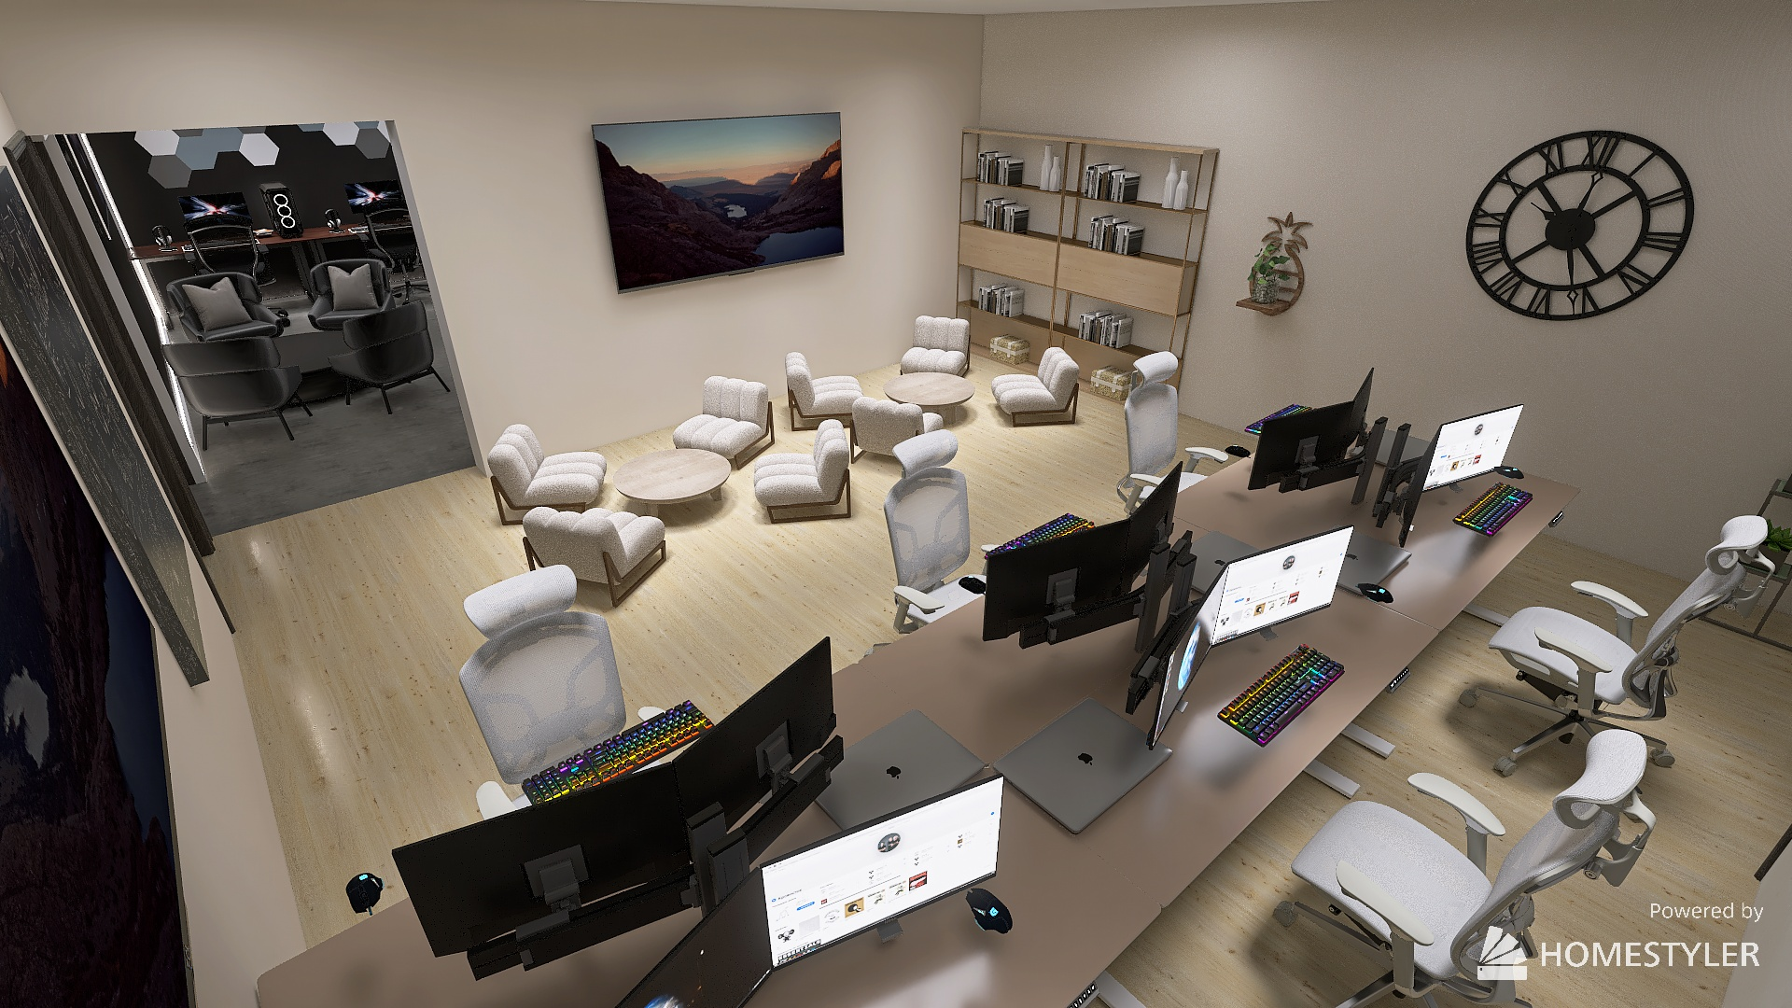
IDEATION Room

