Slide 1
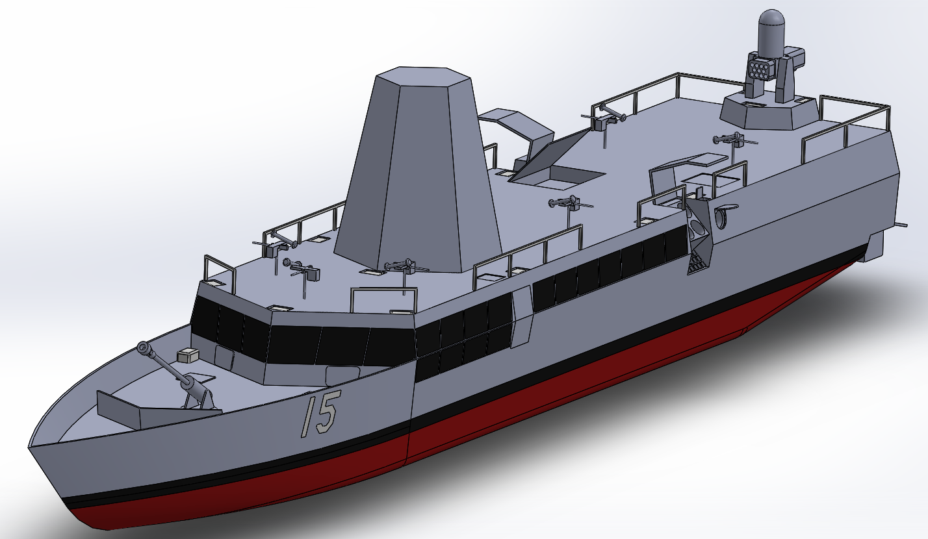
LMACC Update to CRUSER
Dr. Shelley Gallup and Ben DiDonato, August 2023

Slide 2
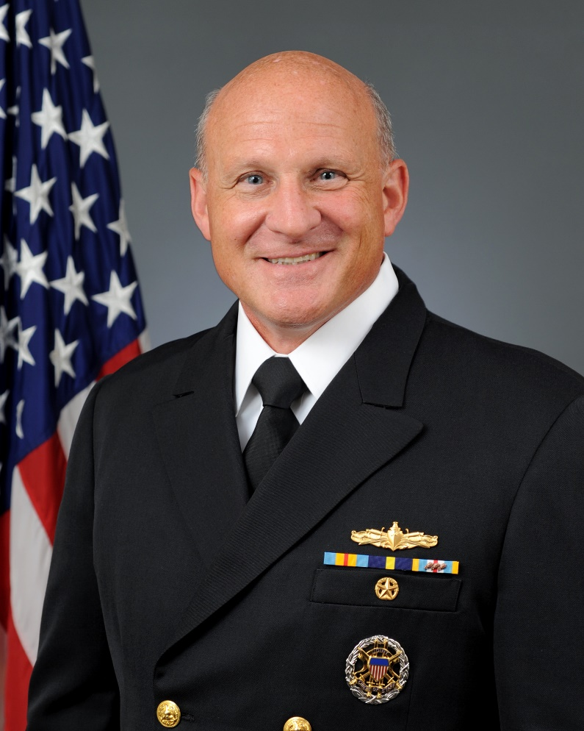
CNO Nav Plan 2022 Force Design Imperatives
LMACC satisfies force design imperatives for DMO
Expand Distance:
Long range missiles and very long cruise range
Leverage Deception:
Blends into civilian traffic, hides in littoral clutter
Oversized electronic warfare suite, optics rather than radar for emissions control
Harden Defense:
Electronic warfare with backup hard-kill defenses
Increase Distribution:
Costs less than $100 million, can be acquired in large numbers
Ensure Delivery:
Transports personnel and light equipment into high-threat areas
Generate Decision Advantage:
Local ad-hoc networking with manned and unmanned forces afloat and ashore
AI partnership accelerates crew decision making
Admiral, Chief of Naval Operations
Admiral Michael Gilday

Slide 3
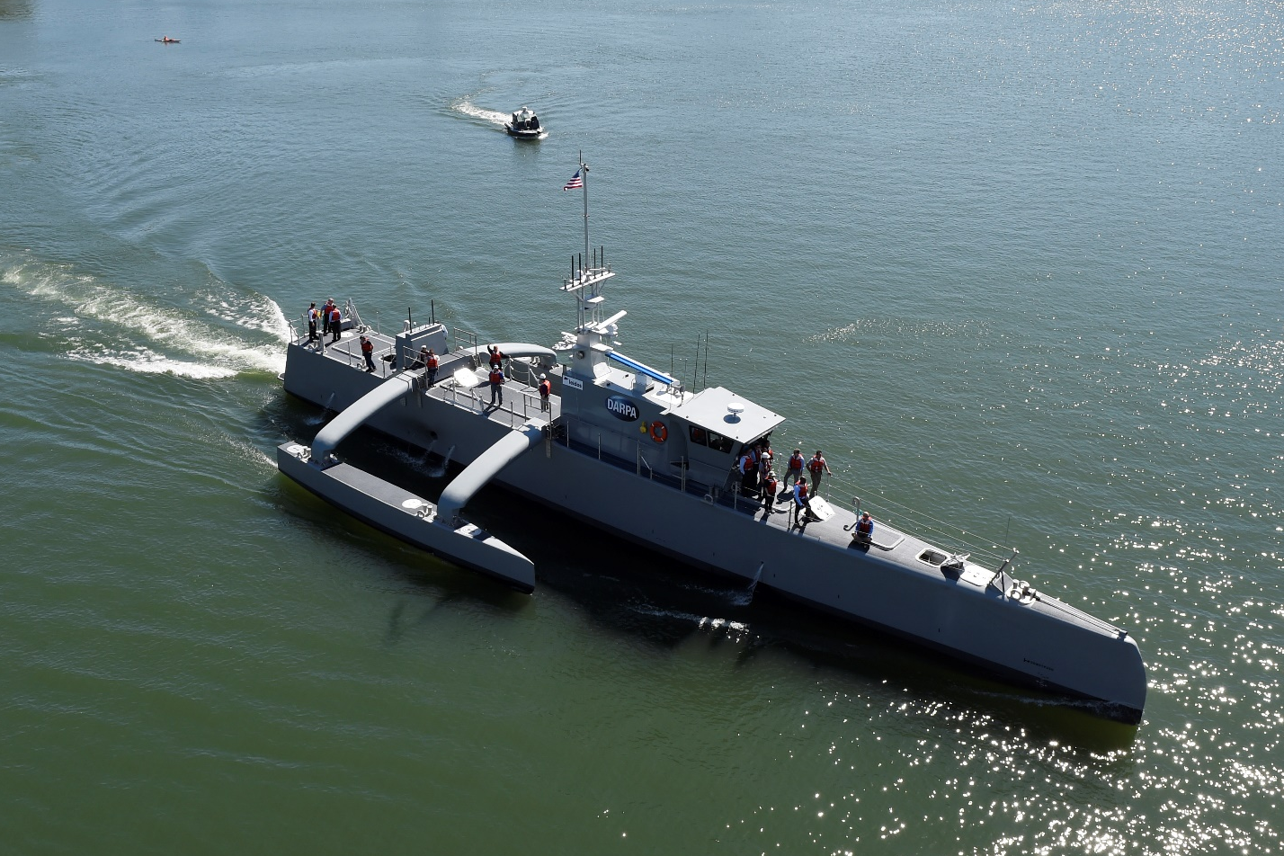
Program Origin
Study began after working with DARPA on Sea Hunter
At-sea experience revealed weaponizing autonomy will continue to create C2 problems
Workshops made it clear that the USN did not have a clear vision of autonomous missions or tactics
Determined the solution to these problems is to combine Sea Hunter’s autonomy with a small crew to handle tactics
Selected the Cyclone Class as a basis for the new design
Design refinement drew heavily from Kline and Hughes original “Streetfighter” concept
Developed new armament configuration for heavy anti-ship firepower and unprecedented flexibility for a small ship
Evolved design to enable blue water Pacific operations
Incorporated novel NLOS networking capabilities to work as a “Flotilla” including MUSVs in a sensor grid

Slide 4
Review of basic concept….
“The Network IS the Platform” Peter Denning and John Arquilla
210 feet LOA, 1000 tons, all carry long range missiles and various other weapons systems depending on variant
Flotilla concept mixes MUSV and LMACC for sensing and confusion to an adversary.
Crew size less than 30. High level of machine and weapons systems autonomy.
Innovations in HIS
100 million per ship

Slide 5
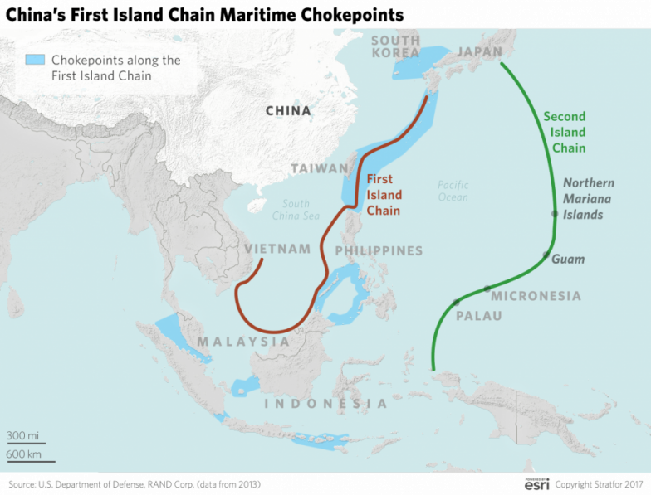
Range and Hull Characteristics Justification
Chinese strategy appears to target our logistics
Limited MSC capacity increases this risk
Can only guarantee full resupply capability at Pearl Harbor
Guam will likely retain limited functionality
Can refuel at other civilian ports in the region if needed
Ship runs on readily available diesel fuel
First island chain may be too dangerous to resupply
Ports are easy to monitor and target
MSC may not be able to operate forward
We must be able to operate forward to win
Ship must sortie from the second island chain on internal fuel
Ship must be designed for regular ocean crossings
May have deployable outriggers for heavy seas
Range and seakeeping also useful for peacetime operations
https://www.stratfor.com/sites/default/files/styles/wv_small/public/choke-points-china-asia-first-island-chain-0250217.png?itok=MdBNJ3v9

Slide 6
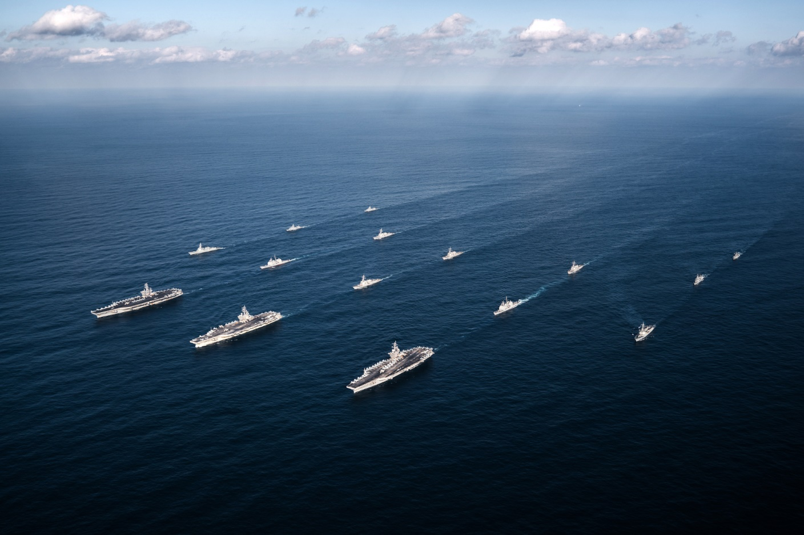
The Leviathan Navy
Current ESG, CSG, and logistics depend on very large ships and large escorts
Autonomy may have a place in these groups as a third tier of over the horizon sensors
These formations are efficient in terms of effects generated per dollar spent
High formation cost limits coverage and simplifies the enemy’s targeting problem
There is a known need for more numerous smaller ships
Distributed Lethality
Distributed Maritime Operations
LMACC provides a complementary low-cost asset
Can be mass produced to support the existing fleet
Improves coverage
Complicates the enemy’s targeting problem
Unloads low-end tasks from larger platforms
Provides early command opportunities
https://upload.wikimedia.org/wikipedia/commons/2/25/USS_Nimitz_%28CVN-68%29%2C_USS_Theodore_Roosevelt_%28CVN-71%29_and_USS_Ronald_Reagan_%28CVN-76%29_carrier_groups_underway_in_the_Western_Pacific_on_12_November_2017_%28171112-N-TQ088-1766%29.jpg

Slide 7
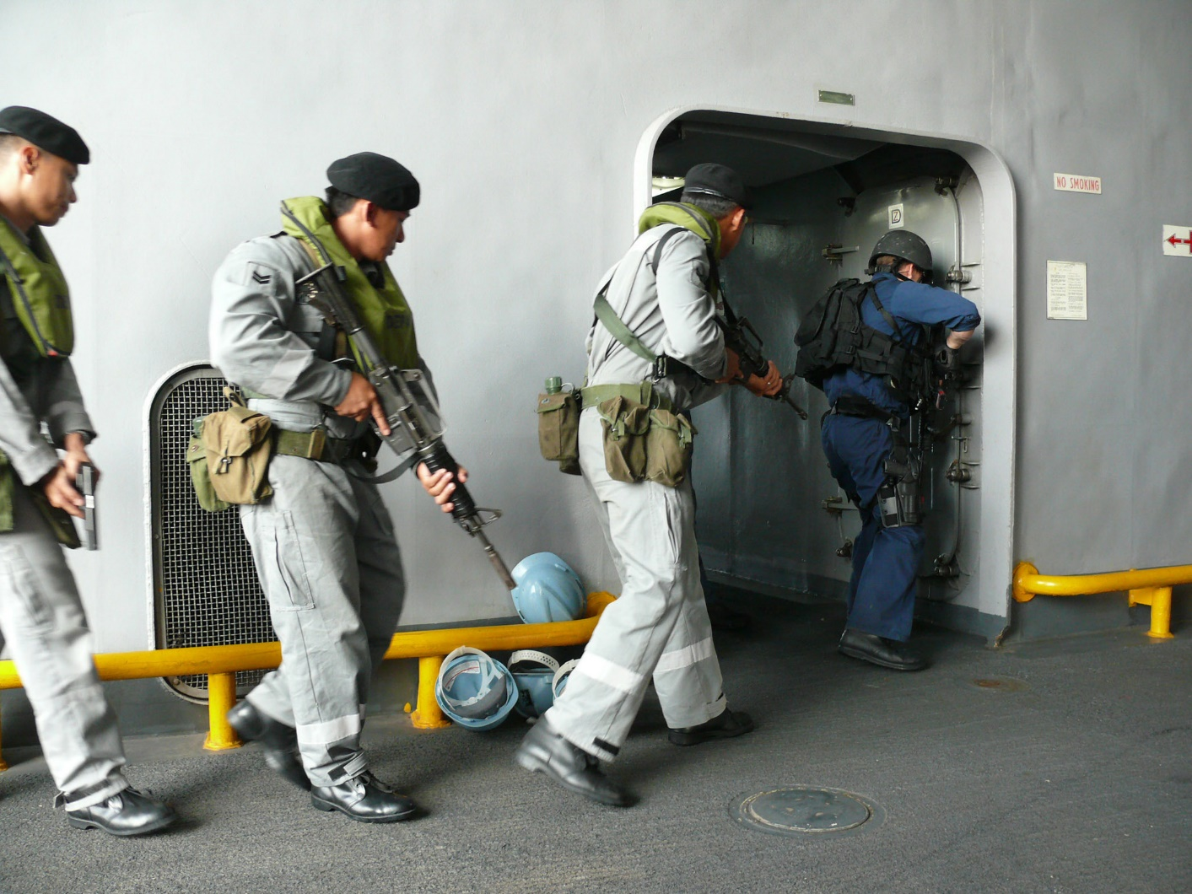
Employment Scenarios – Gray Zone Competition
Joint patrols with partner nations:
Foreign coast guard officers provide legal authority
Bad actors cannot threaten or attack a USN warship
Similarity to partner nation vessels improves joint training
Sell or transfer ships to partner nations:
Increases partner nation capabilities within their budget
Can subsidize production or donate retired ships
Low cost allows increased presence and readiness:
Can build and crew 10+ for the cost of a frigate
Increased US presence limits adversaries' options
Spreading the workload improves overall readiness
Larger ships can be held outside strike range:
These ships can be used more strategically
Contrast increases impact of large ship deployments
Prevents a Pearl Harbor-style preemptive strike
https://commons.wikimedia.org/wiki/File:US_Navy_080808-N-4431B-371_U.S._and_Brunei_navy_visit,_board,_search,_and_seizure_team_members_search_for.jpg

Slide 8
The LMACC Design
LMACC Armament
Weapon | Mission | Manning/Automation
LRASM | Long range anti-ship | Manual, automation possible
SeaRAM | Anti-missile | Man-in-the-loop and fully automatic modes
Javelin Pintle Mount | Short-range anti-boat | Manual only
105mm Howitzer | Naval gunfire support | Manual only
Spike NLOS | Medium-range anti-surface | Manual, automation possible
MHTK | Anti-UAV | Manual, automation possible
Bridge to autonomous vessels
Small permanent crew (~28)
Ship systems fully automated
Crew controls weapons
Long range (7,500+ nmi)
Operates forward in packs with MUSVs
Blends into littorals and civilian traffic
Supports EABO with sealift and fires
DDG-sized electronic warfare suite
Relies on optical sensors for EMCON
Stern ramp for 11m RHIB and USV
Topside UAV locker

Slide 9
Features
Name: USS Shrike
Type: Patrol Ship, Guided missile (PCG)
Serial production unit cost: $96.6 million (FY 2019)
Development and prototype cost: $270 million (FY 2019)
Displacement: 1000 tons fully operational load
Length: 214 feet
Beam: 32 feet (waterline)
Draft: 6.5 feet
Range: 7,500+ nautical miles
Speed: 30 knots
Two steerable, reversible pumpjets with intake screen
Integrated electric propulsion with diesel engines
Crew: ~ 28 Depending on variant
Armament:
Eight LRASMs
SeaRAM
Seven Javelin Pintle Mounts
One Javelin launch tray per mount
Ten stored missiles per mount
Either an M2 Browning or a Mk 19 AGL per mount
105mm howitzer
36 Spike NLOS missiles
64 Miniature Hit-To-Kill Missiles
COMBATSS-21 combat management system
Latest generation full-sized AN/SLQ-32 electronic warfare suite
Intelligence carry on program (ICOP) for intelligence sharing
Standard decoy launchers

Slide 10
Features
Excellent optical sensor suite:
Visible Distributed Aperture System (DAS)
IR DAS
Visible/IR camera turret
COTS navigation sonar
Maximum affordable acoustic signature reduction
Appropriate reduction of other signatures to blend into civilian traffic
Radar-transparent railings
COTS navigation radar
Thermal and acoustic damping coatings
L3Harris Falcon III® RF-7800W non-line of sight radio
Multifunction Advanced Datalink (MADL)
Basic SATCOM
Aft launch bay:
One 11m RHIB
One 11m long UUV slot (multiple UUV transportation possible)
Bay door doubles as launch ramp
Small topside UAV storage and launch accommodations
CONOPS:
All variants have the same primary mission: Get missiles into the first island chain
Long-hull variants add a secondary mission like ASW or AAW
LMACC pairs grouped into packs of 6 ships plus 6 MUSVs
Self defense by extreme maneuvering, hiding among the littorals, EW, and “hiding in plain sight” among other traffic plus self defense weapons
Support EABO with sealift, logistics, and fires
Perform a variety of other missions ranging from counterpiracy to minelaying
Variants add hull segment with additional capabilities
Allows smaller-scale deployment of specialist ships
Retains all baseline capabilities
New variants can be quickly developed and fielded

Slide 11
Armament
LRASM: long range attack against ships and heavily defended shore targets; power projection
Spike NLOS: medium range attack against fast inshore attack craft, unmanned surface vehicles, and small ships; precision land attack
Javelin/ballistic pintle mount: short range defense against swarms of small boats and USVs; limited anti-helicopter capability
105mm howitzer (bow mounted): sustained low-cost area land attack; warning shots
SeaRAM (stern mounted): short range missile and air defense; emergency anti-boat/USV
Miniature Hit To Kill (MHTK): short range anti-UAV, Counter Rocket, Artillery, and Mortar (C-RAM), missile defense, air defense
6
3
1
2

Slide 12
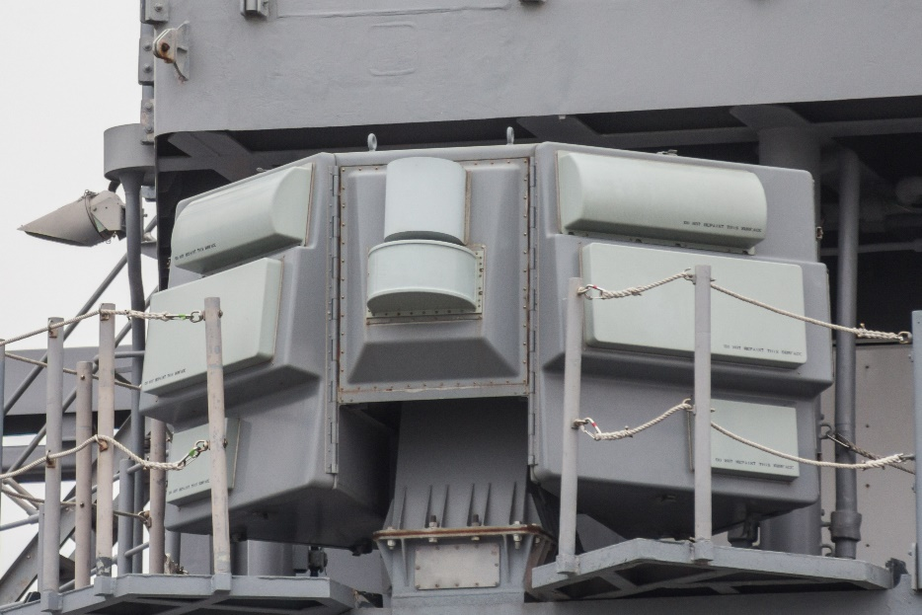
Primary Sensors
Focus on passive sensors maximizes stealth to enhance survivability
Dual-band distributed aperture system (DAS) and detail cameras:
Provides constant 360° video and thermal imaging
Allows detailed target inspection in both bands
Enables fully passive navigation, surveillance, and missile detection even in no-light conditions
Supports strict EMCON to increase survivability
AN/SLQ-32 SEWIP EW Suite:
Provides passive radar detection and localization
Enables passive triangulation of electronic emissions
Allows LRASM to engage targets while masking launch point with deceptive routing
Provides radar jamming and countermeasures employment
In service on many Navy ships
Intelligence carry on program (ICOP) for intelligence sharing
COTS radar to blend into civilian traffic
https://upload.wikimedia.org/wikipedia/commons/2/25/AN-SLQ-32_Electronic_Warfare_Suite_on_USS_CG-70_Lake_Erie_at_Osaka_%282014_April_13%29.jpg

Slide 13
Other Key Features
COTS Navigation Sonar:
Enables navigation in unmapped shallow water
Supports utilization of small, poorly mapped docks
Provides limited seabed mapping capability
Aft launch bay:
11m RHIB supports VBSS, EABO, and special operations
One oversized UUV, multiple smaller UUVs, mines, or other seabed systems
Aft door/ramp allows easy ingress/egress
Topside UAV locker supports employment of small drones
L3Harris Falcon III® RF-7800W non-line of sight radio (HF)
Multifunction Advanced Datalink (MADL)
Basic SATCOM
Innovations in engineering, work, energy, communications
Extra cabin space supports detachments, sealift, or extra crew

Slide 14
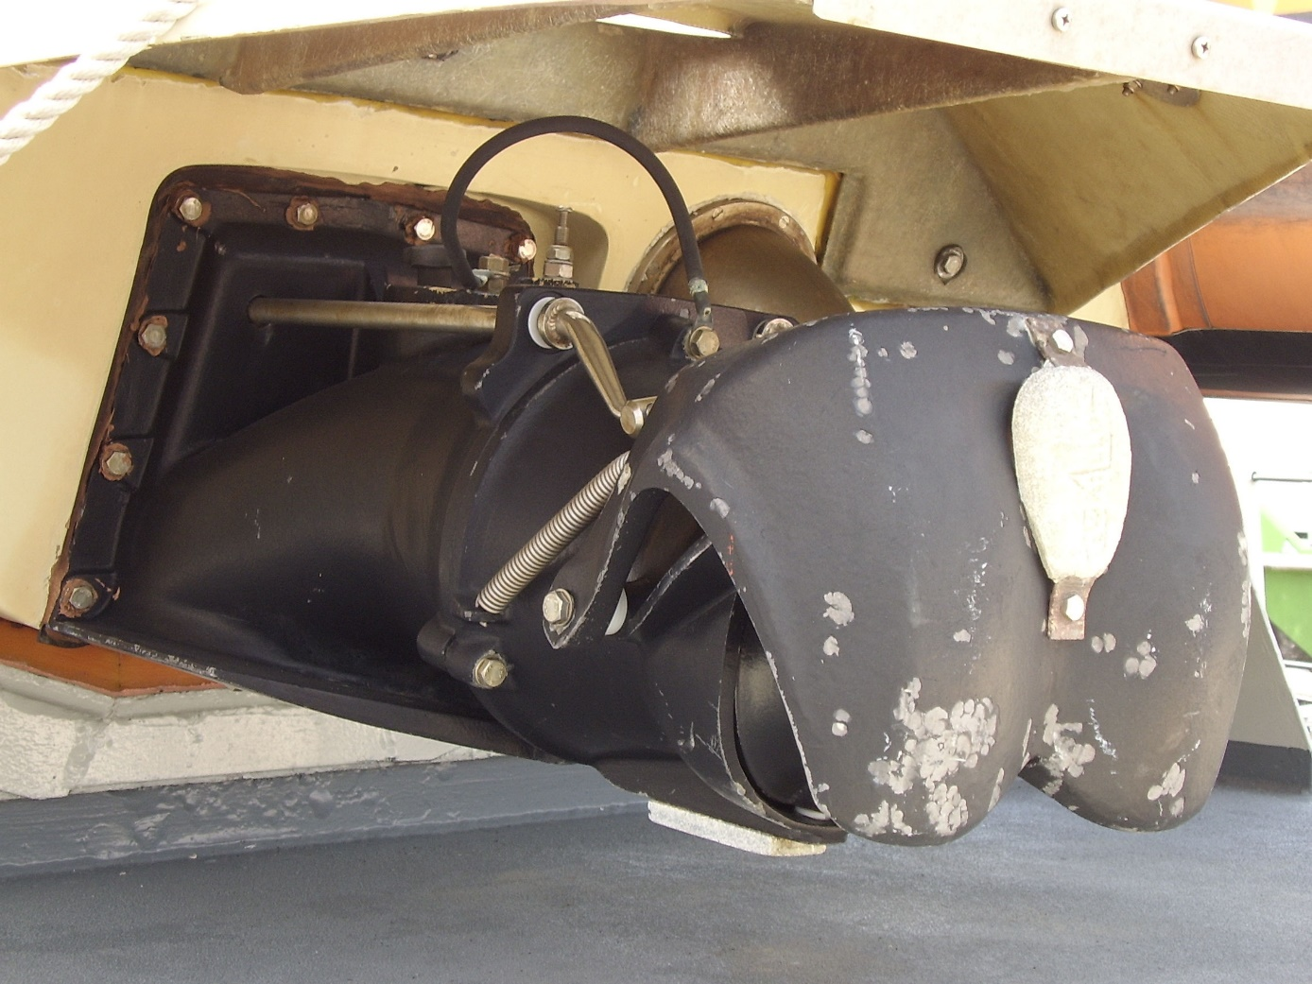
Propulsion Design Concept
Designed around littoral agility, survivability, and cost
Integrated electric propulsion system
No gearbox for lower maintenance cost and reduced acoustic signature
Provides ample power for future systems
Two main and one axillary diesel engines
Low procurement, operating, and maintenance cost
Compatible with civilian infrastructure including fuel
Two steerable, reversible pumpjets with intake screens
Maximizes agility in confined waters
Reduced risk of damage in shallow water
Reduced acoustic signature
System design greatly reduces vulnerability to submarines
Significantly reduces ship’s acoustic signature
Shallow water operations help avoid submarines
Auxiliary Power Pod allows easy, tug-free docking and emergency propulsion
https://upload.wikimedia.org/wikipedia/commons/4/4b/Waterjet.jpg

Slide 15
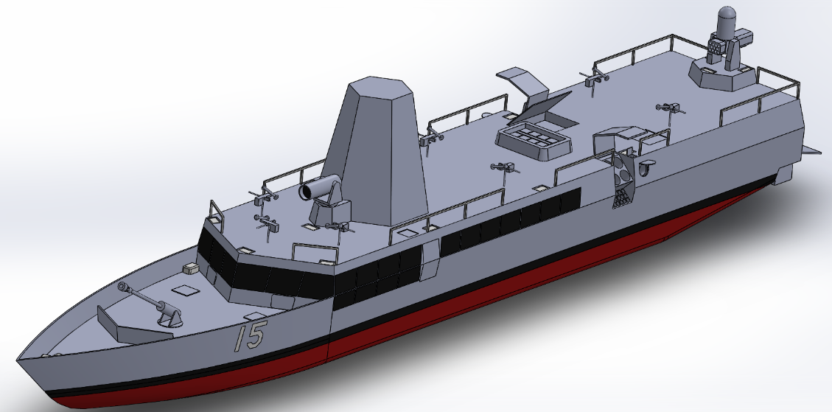
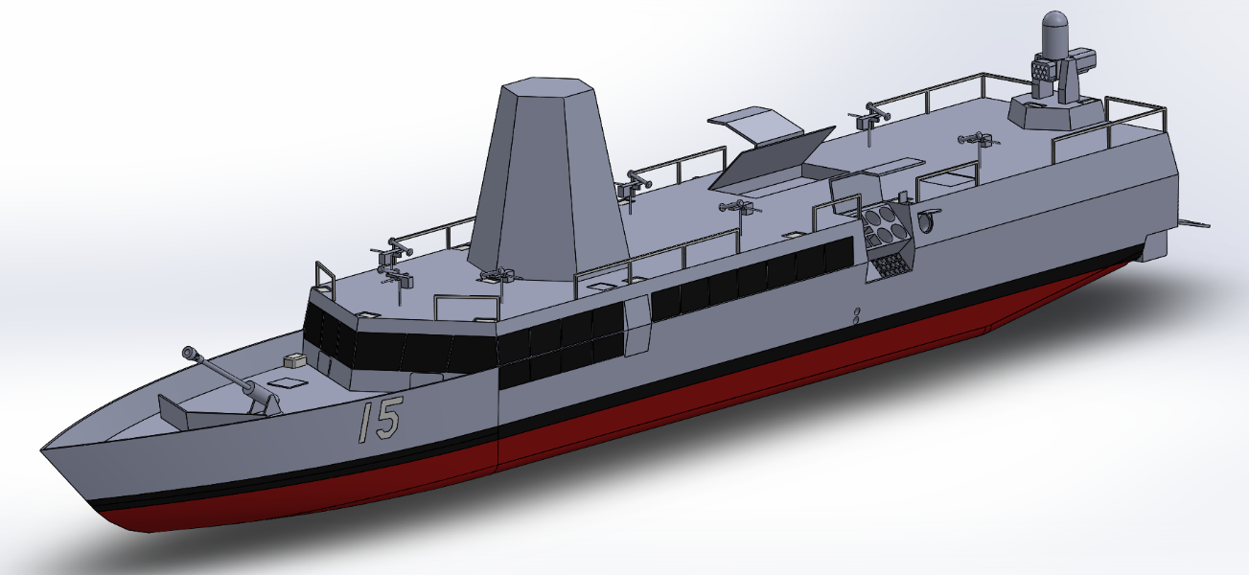
Specialized Variants (Air Defense and ASW)
VLS
Four variants currently planned; all baseline capabilities retained
Additional capabilities added with hull segments at the missile bay
10- and 20-foot hull segments currently planned
Export variants with less sensitive equipment also possible
Falcon air defense variant (top) – 10-foot segment added
Adds a tactical-length Mk 41 VLS module and powerful optic
Armed with 8 ESSM and 6 SM-2 Block IIIC Active missiles
Uses optics and triangulation to destroy hostile patrol aircraft
Added optic provides extreme-range target identification, triangulates range with its partner’s DAS, guides missile to active seeker acquisition
Fully passive targeting makes counterdetection difficult
Osprey anti-submarine variant (bottom) – 10-foot segment added
Adds 8 Tomahawks modified to carry an ASW torpedo, 4 self-defense ASW torpedoes, and a hull-mounted sonar
Attacks targets identified by offboard sensors
New optic
ASW Weapons

Slide 16
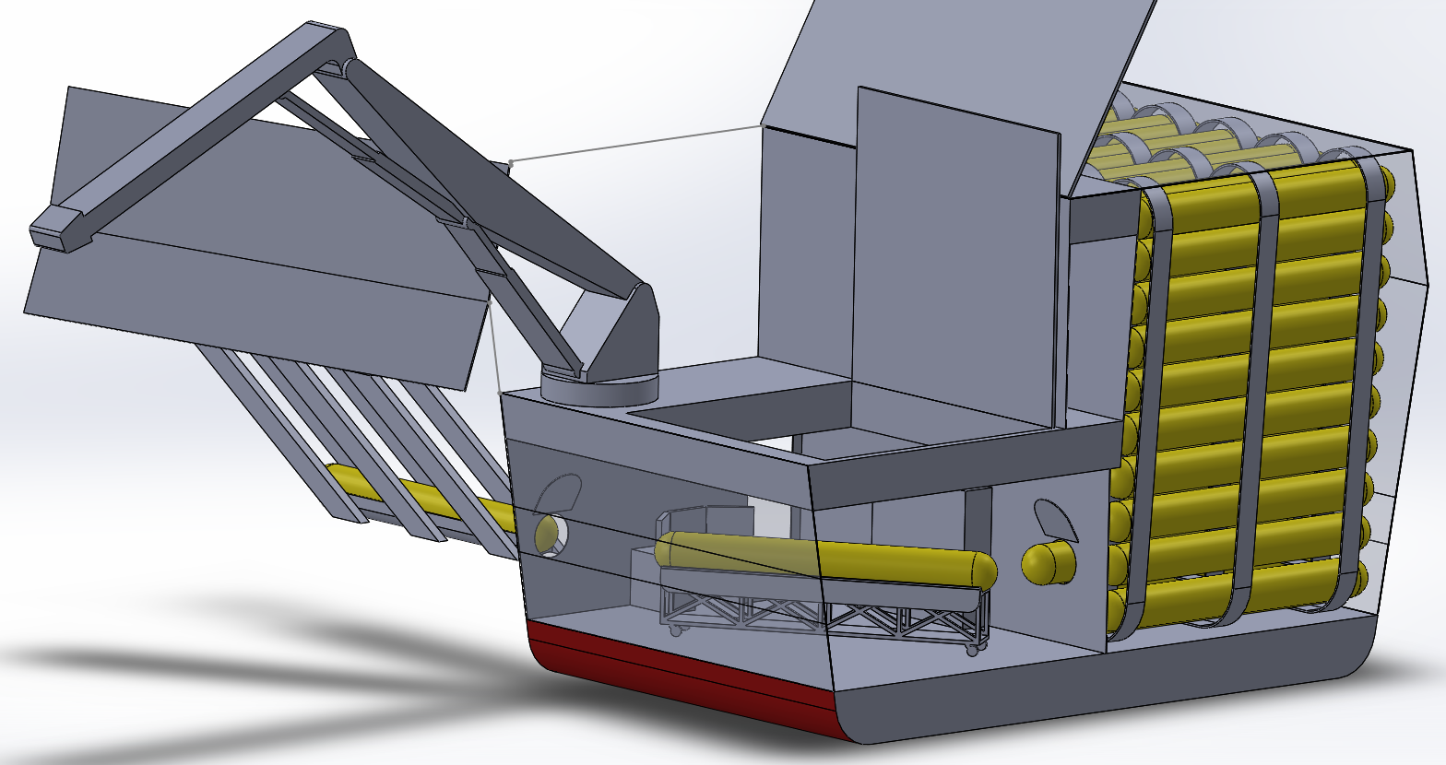
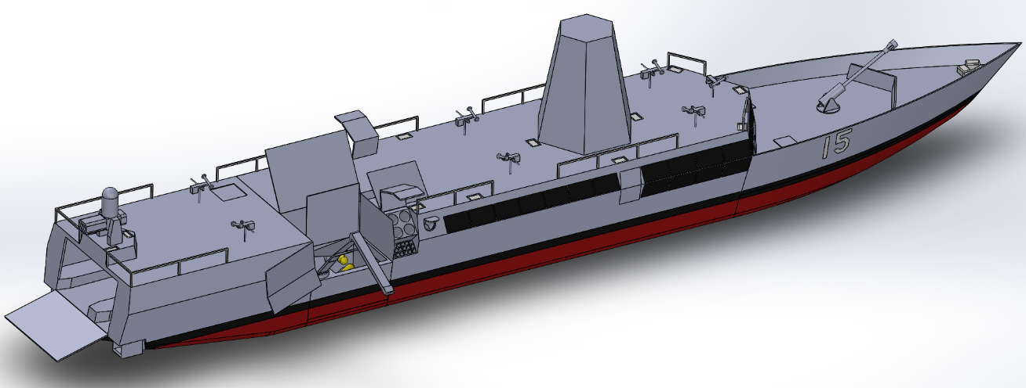
Variant (Example) - Seabed and Mine Warfare
Deploys, retrieves, and maintains seabed systems
Magazine system provides very high storage capacity
Service bay for maintenance and mission preparation
Lift raises payloads to aft launch bay
Deploys payloads and 11m RHIB via aft ramp
Crane provides logistics and alternative payload handling
Enhanced communications to export data
Improved satcom antennas
Wideband HF communications for local distribution
Intelligence Carry-On Program (ICOP)
Additional datalinks as desired
Acoustic communications system
Retains full survivability and armament
Fully enclosed configuration prevents hostile surveillance

Slide 17
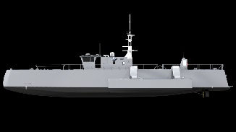
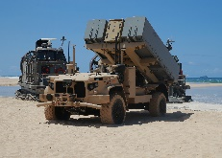
Basic Wolfpack Tactics
USMC missile battery
LMACCs, MUSVs, and Marines secure area
Combined arms team provides layered defense
MUSVs provide outer sensor screen
USMC spotters difficult to counterdetect
LMACC provides primary striking power
USMC missiles provide supporting fire
Example has 3 sensor lines and 64 ASCMs
LMACC relocates USMC spotters as needed
Air defense on LMACC and/or shore batteries
All personnel and manned ships well concealed
MUSV more exposed, doubles as bait
Difficult to dislodge without risking a carrier
Combined arms force costs less than a DDG
Real terrain offers additional depth for more defensive lines and ambiguity
LMACCs concealed behind islands
USMC spotters
MUSV screen
USMC missile battery

Slide 18
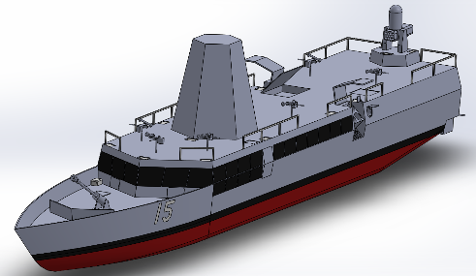
Deceptive LRASM Routing Tactics
Enemy detected
Enemy returns fire on presumed launch point
LRASM launched towards another island
Empty Island
Enemy missiles fly harmlessly into an unoccupied island
LRASM turns to engage target

Slide 19
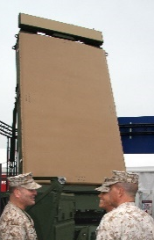
The Long-Range Forward Sensor Grid 5G Cloud Based Targeting between vessels
LMACC relays LOS signal
Secure LOS transmission
G/ATOR detects aircraft
SOPA
USV detects warship
NLOS HF transmission bounced off ionosphere
Engagement decision made
Marines detect submarine
USV relays LOS signal

Slide 20
A Bridge to Autonomy
Weaponized autonomy emerges from complex system interactions
Emergent behavior necessary to meet operational needs
Emergent behavior causes unpredictable outcomes
Strong parallels with humans taking unpredictable actions
This can be positive or negative with examples ranging from Medal of Honor actions to disasters
We need to correct mistakes and build trust in these systems before we can allow them to act independently
Strong parallels with junior officer development
Initially require close supervision, but eventually earn the trust required for independent action
Current lack of experience with autonomous systems creates the need for human oversight
LMACC allows us to gain this experience by pairing autonomous systems with a permanent crew

Slide 21
2023 NRP Effort
To develop CONOPS for:
Undersea logistics (LT Thuan Chu, OR Thesis)
EABO/MLR landing, sustainment, weapons and comms
SAG
Mine Warfare
Deterrence Operations
Technology
Cognitive HF LPI/LPD for long haul comms (Christopher Cirullo, Ph.D. student)
Local cloud data sharing via 5G to include MLR (Experimentation on Stiletto)
Variety of energy conservation technologies

Slide 22
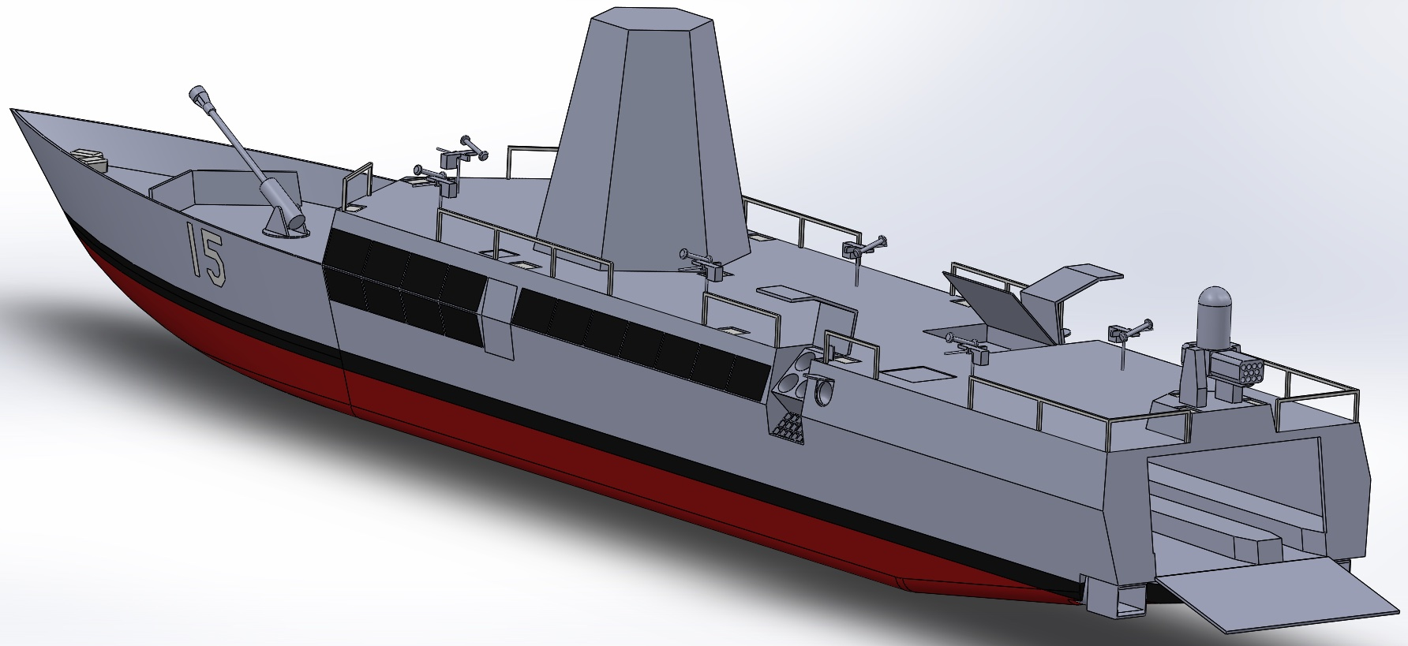
OV-1
5G Link updating GPS position.
RHIB
Stiletto

Slide 23
FY 2024
NRP funding (OPNAV N96F)
At sea experimentation for 5G data sharing cloud
DoD vessel Stilleto and SailPlan CRADAs in place
OR validation of CONOPS
Wargaming possibilities
Human-Machine Partnership (Monterey Phoenix)
3D printed hull and internal structure analysis
Advance innovation inclusion to current design—form, fit and function

Slide 24
Supporting activities
In discussion with USNA marine architecture prototype
Human-Machine Partnership via virtual assistants (Gallup, NEJ March 23)
Classified theses
Campaign Analyses
Ph.D. topic using knowledge graphs to reduce DRIP
Support from Stiletto for range of experiments (Just completed first)
Commercial involvement by innovators (SailPlan)

Slide 25
Video U/W with Stiletto in Comms Exp 1

Slide 26
Web Site
https://nps.edu/web/lmacc
UNCLAS public facing
CUI content via CAC
Constantly Under construction
Contact spgallup@nps.edu

