Slide 1
Rule-Based AI
Vinnie Monaco
vinnie.monaco@nps.edu

Slide 2
Outline
Background
Early attempts
Expert systems
Conclusions

Slide 3
Rules
If X then Y
If it is a federal holiday, then there are no classes.
All X are Y
Baseballs are round
To do X, one must first do Y
Requesting leave requires submitting a form

Slide 4
Inference
Rules and facts
If something is round, then it can roll away.
A baseball is round.
Conclusion
A baseball can roll away.
Forward
chaining
Backward
chaining

Slide 5
Components of a rule-based AI
Inference engine
Working memory
Facts+Rules
User interface
AI

Slide 6
Tools of the trade
Prolog
roll_away(X) :- shape(X, round).
shape(baseball, round).
roll_away(baseball)
Knowledgebase
Goal/query

Slide 7
Rule-based AI vs neural networks

Slide 8
Early attempts
1959: GPS
General Problem Solver
1961: SAINT
Symbolic Automatic Integrator
1962: ANALOGY
A is to B as C is to ?
1964: STUDENT
If the number of customers Tom gets is twice the square of 20% of the number of advertisements he runs, and the number of advertisements is 45, then what is the number of customers Tom gets?
Notes:
GPS:
Herbert A. Simon, J. C. Shaw, and Allen Newell
Supposed to be a universal problem solver but only solved simple problems like towers of Hanoi
SAINT
Jams Robert Slagle at MIT in 1961. Written in Lisp. Could solve all but 2 problems taken from an MIT freshman calculus exam
ANALOGY
Thomas Evan, solve IQ-test style question, shape A is to shape B as shape C is to which
STUDENT
Daniel Bobrow, word-algebra problems at the high-school level

Slide 9
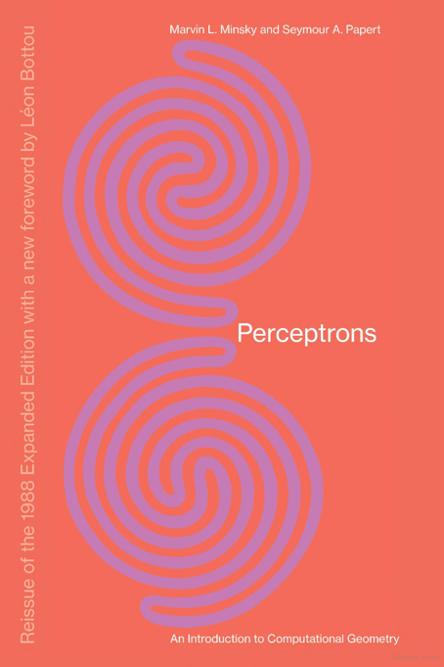
The rise of GOFAI: Good old-fashioned AI
“within a generation ... the problem of creating 'artificial intelligence' will substantially be solved.”
- Marvin Minsky, 1967
“In from three to eight years we will have a machine with the general intelligence of an average human being.”
- Marvin Minsky, 1970
Minsky-Papert 1969

Slide 10
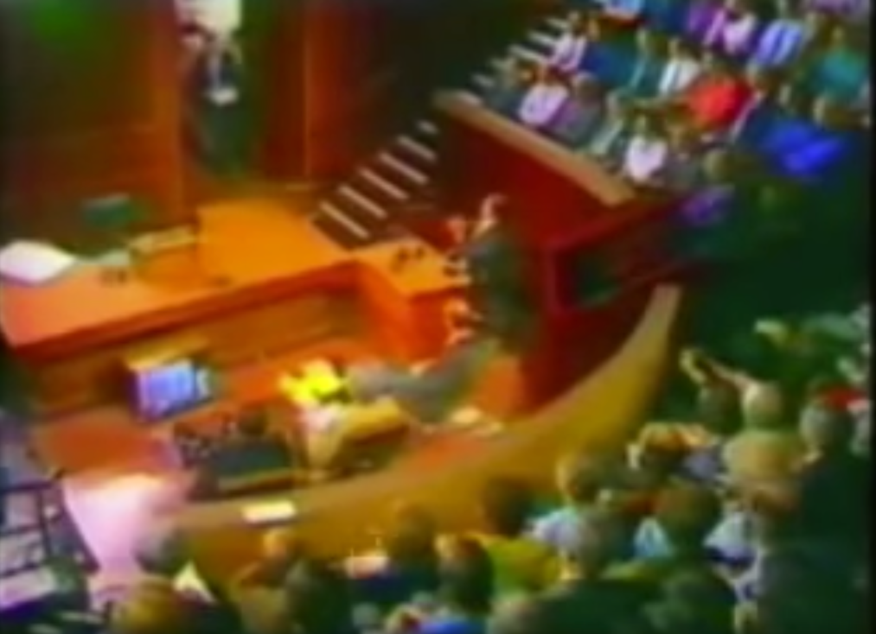
The 1st AI winter: 1974-1980
1973 “Controversy” debate following the Lighthill Report
Notes:
Contributing factors:
Combinatorial explosion of real-world problems
Hype: overpromising, underperforming
Mansfield Amendment – DARPA must fund mission-oriented direct research rather than basic undirected research
DARPA disappointment with speech understanding at CMU; the system built was very rigid

Slide 11
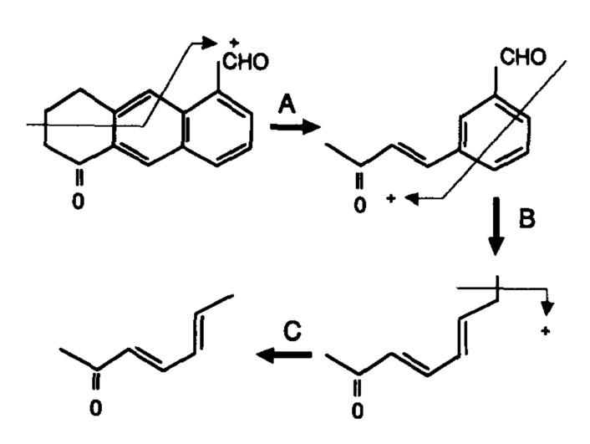
Expert systems
Dendral
MYCIN
XCON
Notes:
Dendral
Identify unknown organic molecules using knowledge of chemistry.
MYCIN
Identify bacteria causing severe infections and recommend antibiotics; backward chaining. Never used in practice.
XCON, 1978
Expert configurer
Saved $25 million per year

Slide 12
Japan’s fifth generation Computer
The next step in computing
Vacuum tubes → transistors → integrated circuits → microprocessors → parallelism
Began 1982, lasted 10 years
$400 million effort
Failure or ahead of it’s time?
Parallel Interface Machine (PIM)

Slide 13
Expert system limitations
They cannot learn
Restricted by the size of the knowledgebase
Expensive to maintain
Lack commonsense knowledge
Not possible to explicitly define some rules
Notes:
Rigid, cannot learn. Like a human born with fixed knowledge
Restricted by the size of the knowledgebase
Expensive to maintain; the knowledgebase creates a bottleneck, for example it’s difficult to add new rules without creating contradictions.
Not possible to explicitly define some rules
Expert systems lack commonsense knowledge

Slide 14
A difficult task for rule-based AI
Recognize sunglasses if:
pixel at 100,150 is pink
pixel below is pink
pixel to right is black
…

Slide 15
The 2nd AI Winter: 1987-1993
Commercialization slowed
LISP machines underperformed
Fifth Generation project ended
New York Times, March 4, 1988
Notes:
AI development tool companies suffered continued losses
Machine manufacturers changed goals
Expert system applications suffered sales

Slide 16
The commonsense problem
Winograd Schema Challenge
The city councilmen refused the demonstrators a permit because they feared violence.
The city councilmen refused the demonstrators a permit because they advocated violence.
Notes:
Identify the antecedent of an ambiguous pronoun

Slide 17
Ongoing effort: Cyc
Started by Doug Lenat in 1984
An attempt to solve the “common sense problem”
25 million common sense rules
1000 persons-years to build
Just recently started to commercialize
Notes:
Was able to detect potential insider dealing after inferring from an organizational chart that two people sat next to each other.

Slide 18
Advantages of rule-based AI
Computationally inexpensive
Moravec’s Paradox
Explainable
Well-suited for symbol manipulation and reasoning

Slide 19
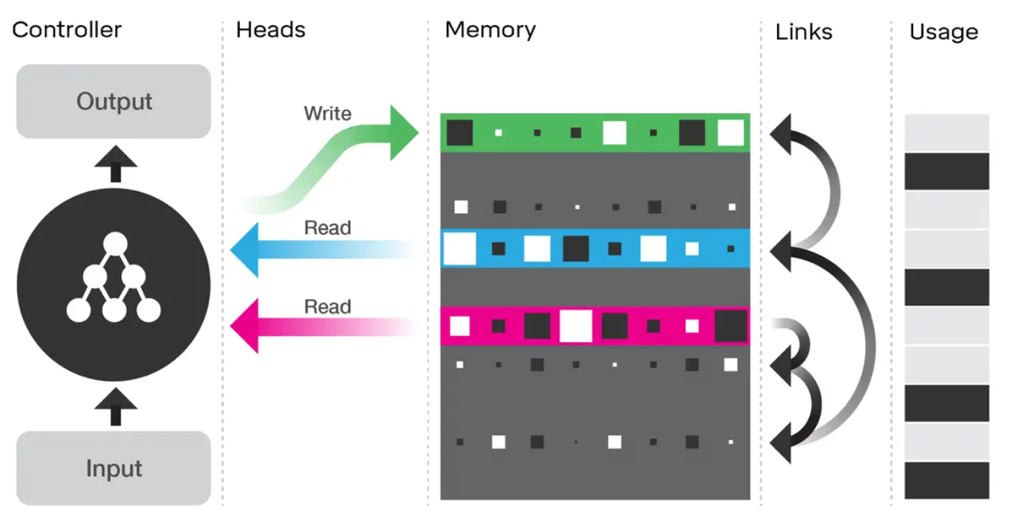
Current trends
DNC: Differentiable Neural Computer

Slide 20
Questions?
vinnie.monaco@nps.edu
https://vmonaco.com

