Slide 2
GSOIS Travel Brief
NPS Travel Office
9 January 2019

Slide 3
Briefing Summary
Invitational Travel SSN/ITIN Requirement
Navy Conference Guidance
Travel Office Website
Update on DTS REJECTs
Proposed Change to Travel Office Structure

Slide 4
Changes to Invitational Travel Processing
Invitational Traveler must have SSN or individual taxpayer identification number (ITIN)
Travel payments cannot be paid otherwise
Lead time for ITIN is 7 weeks
Allows processing via DTS
https://www.irs.gov/individuals/individual-taxpayer-identification-number

Slide 5
Navy Conference Guidance
SECNAVISNT 5050.6
Replaces OPNAV 5050.34
No significant changes
SECNAV 5050/2
Replaces OPNAV 5050-11
No changes blocks 1-22
Space for approval authority to provide guidance

Slide 6
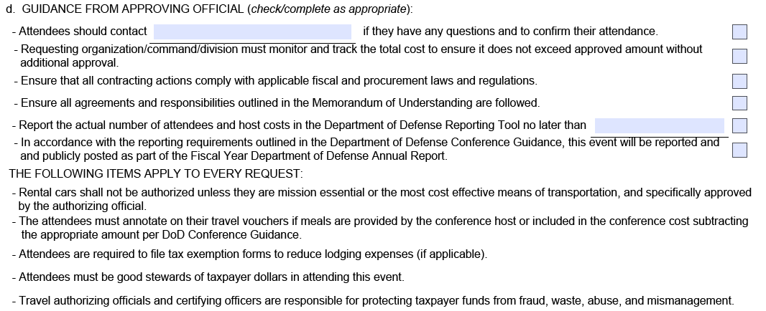
Guidance from Approval Authority

Slide 7
NPS Conference Approval Authorities
Tier One
Tier Two
OTHER
SECNAV
UNSECNAV
UN/SECNAV appointed Tier Two
-BLUE LIST
President, NPS
-WHITE LIST
-ITA Attendance
-Cost between $100k & $250k
Provost
VPAA
Deans
Military Assoc. Deans
Assoc. Deans
-Not on BLUE or WHITE Lists
-No ITA attendees
-Cost below $100k

Slide 8
Conference Process Improvement
Monthly emails (3 Dec 19)
Updated conference website (in progress)
Process Tier One and Two requests through Microsoft Forms (proposed)
Conference selected from drop-down
Prompts routing to appropriate authority
Produces SECNAV 5050-2 & SF 182
Could be adapted for <Tier Two conferences

Slide 9
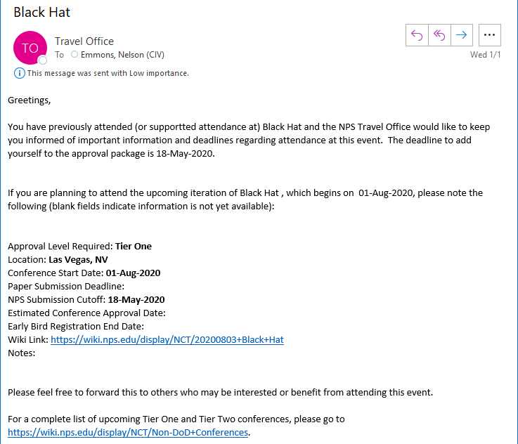

Slide 10
Travel Office Website
Wiki → LifeRay (in-process)
Some areas still under construction
New functions
Travel Request (testing)
In/Out Processing (live)
Virtual Travel Assistant (in development)
Virtual APC (live)
Country Clearance (live)

Slide 11
Travel Office Website Metrics, Reporting, & Tracking
Travel ‘Pizza Tracker’ (in development)
Customized and/or Summary Reporting
Comparative metrics & performance
What is important to GSOIS?
What is useful to GSOIS?

Slide 12
Update on REJECTs
Underlying issues persist
Workaround approved for payments (6 Jan 19)
Actions taken by NPS Travel Office
Comptroller working with FMP & BUPERS on permanent solution (TBD)
Questions, please email Travel@nps.edu

Slide 13
Proposed Travel Office Restructuring
Current
Proposed
8 Staff
Travel Officer
Lead Travel Specialist
Travel Account Specialist (APC)
Travel Specialist (CO) x2
Travel Assistant x4
Centrally located in HE-038
11 Staff
Travel Officer
Lead Travel Specialist
Travel Compliance Specialist x3
Travel Assistant x6
8 Centrally located in HE-038
One Travel Assistant detailed each to GSDM, GSEAS, GSOIS, & SIGS

Slide 14
Benefits of Proposed Restructure
Travel Office staff detailed to a school
GSOIS gains greater access to reporting & information
Workload sharing with GSOIS administrative staff
Travel Office improves surge processing capacity
GTCC APC in each school
Detailed staff able to provide tailored support
Duties reorganized with travelers in mind
Improved voucher processing capacity during peak periods
Continued commitment to customer service

Slide 15
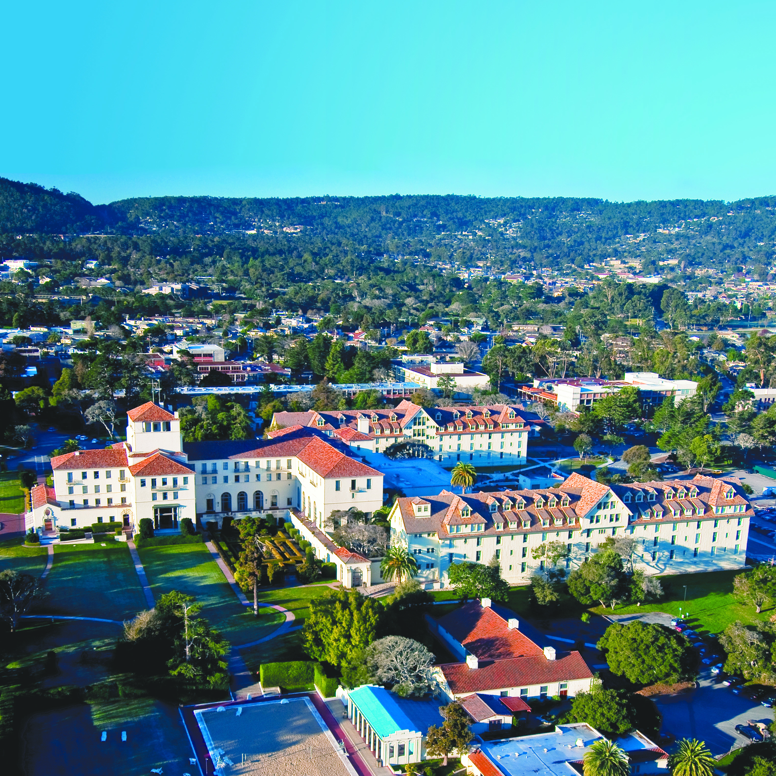
NAVAL POSTGRADUATE SCHOOL TRAVEL OFFICE
1 University Circle • Monterey, CA 93943
(831) 656-2041 • www.nps.edu/travel

